Slide 1

New Generation in WSCC
Presentation
July 24, 2000
Proprietary and Confidential 5/02

Slide 2
Contents
Section Page
Sources ………………….……………….…..………………………………………. 3
Criteria…………………….…….…….…..……………………………………………4
Region-by-Region Evaluation …….…..…………………………………………… 5

Slide 3
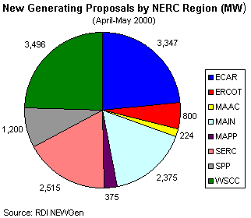
Sources
State Siting Offices
  CEC: Siting Division
  Oregon Siting Dept.
  Washington Siting Dept
  State Utility Commissions
PIRA, RDI, CEC Publications
Air Quality Districts
EPA
Zoning Districts
WSCC
Origination
Future Henwood
Notes:
The California Energy Commission has the statutory authority to site and license thermal power plants that are rated at 50 megawatts and larger and related transmission lines, fuel supply lines and other facilities.
Contact: Mignon Marks (916) 654-4732
San Diego Air Pollution Control District
Contact: Marcie (858) 694-3979
San Joaquin Valley Air Pollution Control District
Contact: Steve Roeder (559) 230-5888Everett Planning and Community Development
Contact: Paul Roberts (425) 257-8731, Jerry Irvin
Origination: Steve Thome, Ed Clark, Frank Vickers,Dave Parque, Jim Buerkl, Saji John
PIRA
Contact: Jimmy Kow (212) 686-6808
CEC Report - MARKET CLEARING PRICES UNDER ALTERNATIVE RESOURCE SCENARIOS 2000 — 2010 Appendix C

Slide 4
Criteria
Under Construction or Completed
Regulatory Approval Received
Application Under Review
Starting Application Process
Air Permit Approval
Press Release
Word-of-Mouth
Verify with Government Agencies
Verify with Origination
Speak with people on-site or with development
Check publications
Notes:
Hydrology includes consumptive and non-consumptive rights
Model Run-of-River, Storage and Pump storage
Les Nicholson, Nevada Irrigation District
PGAE typically spills mid May - June
FERC license mandates minimum pool for flood control, in stream minimum flows. Corps of Engineers sets limitations for reservoirs during certain times of the year
Folsom Dam kept low in Oct and March. 1996 unusually early flood event got up to river capacity. Modifications were made to Folsom in order to release more water
Set of scalars and prices for different water years (good, average, bad) 1-2 std
Algorithm to optimize production from top units to units downstream
PGAE indicates that power contracts arenot for sale

Slide 5
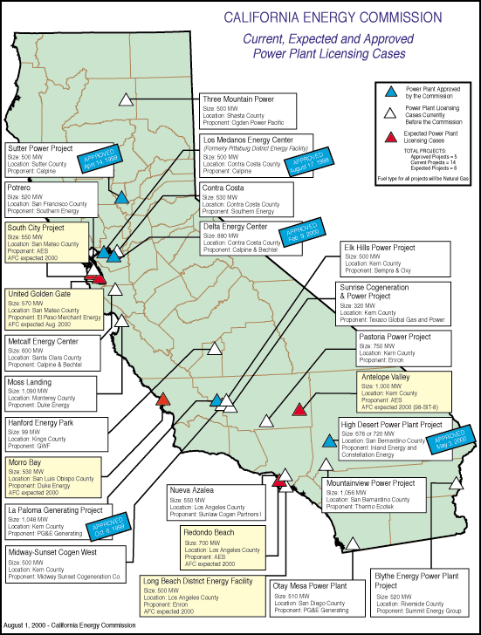
California
High Probability Plants: (UC) Under Construction (AP) Approved by CEC
  Los Medanos(Pitt), 500 MW, Jul 2001 (UC)
  Sutter, 500MW, Jun 2001(UC)
  La Paloma, 1,048 MW, Nov 2001(UC)
  Delta, 880 MW, Jul 2002 (UC)
  High Desert, 720 MW, Jan 2003 (AP)
Medium Probability Plants
  Elk Hills, 500 MW, Sep 2002
  Moss Landing, 1,090 MW, Sep 2002
  Otay Mesa, 510 MW, Nov 2002
  Pastoria, 750 MW, Jun 2003
  Blythe, 520 MW, Mar 2003
  Midway-Sunset, 500 MW, Mar 2003
  Contra Costa, 530 MW, Apr 2003
  Mountainview, 1,056 MW, Apr 2003
  Nueva Azalea, 550 MW, Jan 2004
California

Slide 6
California Electricity Updates
LA city council approved $1.7 billion power plan for LDWP over the next 10 years. The plan consists of capacity upgrades, DSM payments and increase use of green power. Capacity increases include:
  250 MW Valley
  50 MW Haynes
  50 MW Scattergood
  240 MW Harbour (Peaker)
  60 MW Castiac Pump Storage (Peaker)
La Paloma, 1,048 MW, Nov 2001, ZP26 (UC). Difficulty obtaining all easements has pushed back completion date from Aug 2001 to Nov 2001.
Moss Landing, 1,060 MW, Sep 2002, NP15. Duke has now said that it is committed to building this plant.
Otay Mesa, 510 MW, Nov 2002, SP15. Air quality issues are currently being addressed. It is unclear if this will affect the current projected start date of Nov 2002. Strong political support to get this built.
Sunrise, 320 MW, Jan 2003, ZP26. Continued labor issues are not yet resolved. Plant will probably not be built by Texaco, but may be acquired by another developer. On-line date moved from Aug 2002 to Jan 2003.
High Desert, 720 MW, June 2003, SP15. Approved by CEC. Water issues have been resolved. Waiting for an environmental assessment from Fish & Wildlife. Completion date delayed from Dec 2002 to June 2003.
California
Notes:
CISO has reset target pricing mechanism for the real time energy imbalance market. The price of the highest decremental bids is greater than the price for the lowest incremental bid. The new price is to be greater of zero or the lowest incremental bid.

Slide 7
PNW Updates
Washington
  Fredrickson, 249 MW, June 2002. Air permits have been received. The site is 60% complete with a BPA interconnection agreement expected to be signed this month. The major problem with this site is that they have been unable to obtain Frame 7 A or B turbines. Start date has been set, as per developer, to June 2002.
  Chehalis, 550 MW, June 2003. Construction set to begin Spring 2001. Changed to a higher efficiency turbine which increased capacity by 60 MW. Turnkeys bidders are being requested now.
Idaho
  Rathdrum, 270 MW, 6,900 HR CC, June 2001. Published start date is Dec 2000, developer had estimated Aug - Sept 2001. No weather delays means they now expect June 2002 startup.
Oregon
  Klamath Falls, 500 MW, July 2001
  Vestas Wind 100 MW incremental capacity, Jan 2001, Umatilla County, 35% Capacity factor.
  Coyote Springs Phase 2, 231 MW, June 2002
  Hermiston, 536 MW, June 2002. Began construction last week with the official ground break set to Friday, Aug 25, 2000.
Wyoming
  Foot Creek #4 Wind, 17 MW, June 2000
PNW
Notes:
Formerly (stalled) NWPE 220 MW project. FPL bought rights in 1/99. Construction to began 9/1/99 As of 4/25/00 Unit 1 not complete and gas line construction has been stalled.

Slide 8
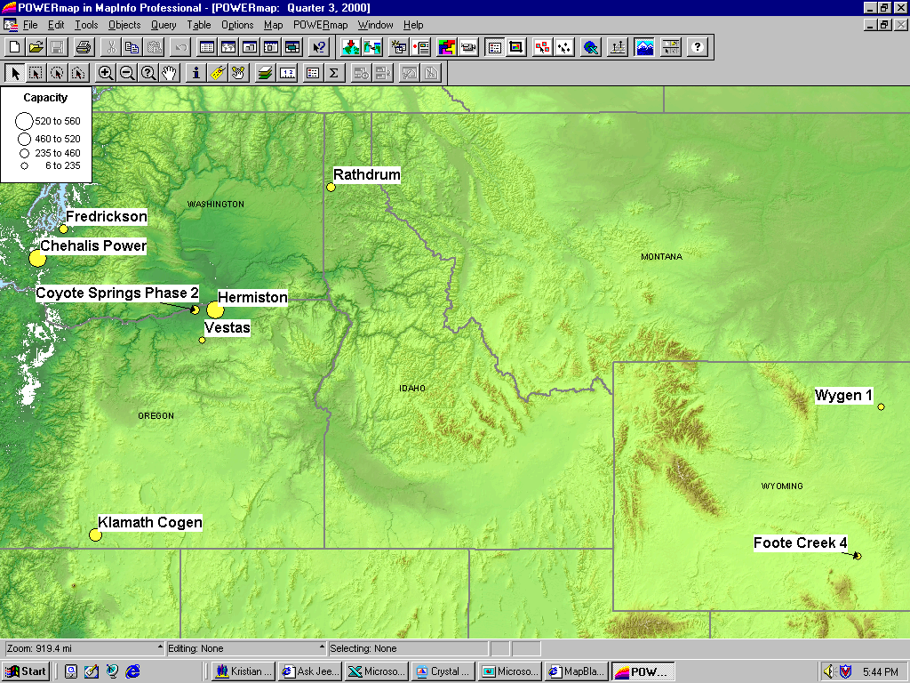
PNW New Generation Map

Slide 9
Rockies Updates
Manchief (Brush), 265 MW (UC). Original on-line date June, 2000. Encountered testing delays on-line date was July, 21th 2000.
Ft. St. Vrain, 235 MW (UC), June 2001. Construction has begun on this 3rd unit of existing 2 7FA converted nuke site.
Ray Nixon (Phase 2), 460 MW, May 2001. Not short listed, but will probably be built.
PSCo has issued its “Recommended Plan” which shows 739 MW for 2002, 334 MW for 2003 and 516 MW 2004 for a total of 1,589MW.
PSCo has a $4.5 million DSM Request for Proposal for Bid 2001.
Source: PSCO 1999 Integrated Resource Plan
Rockies

Slide 10
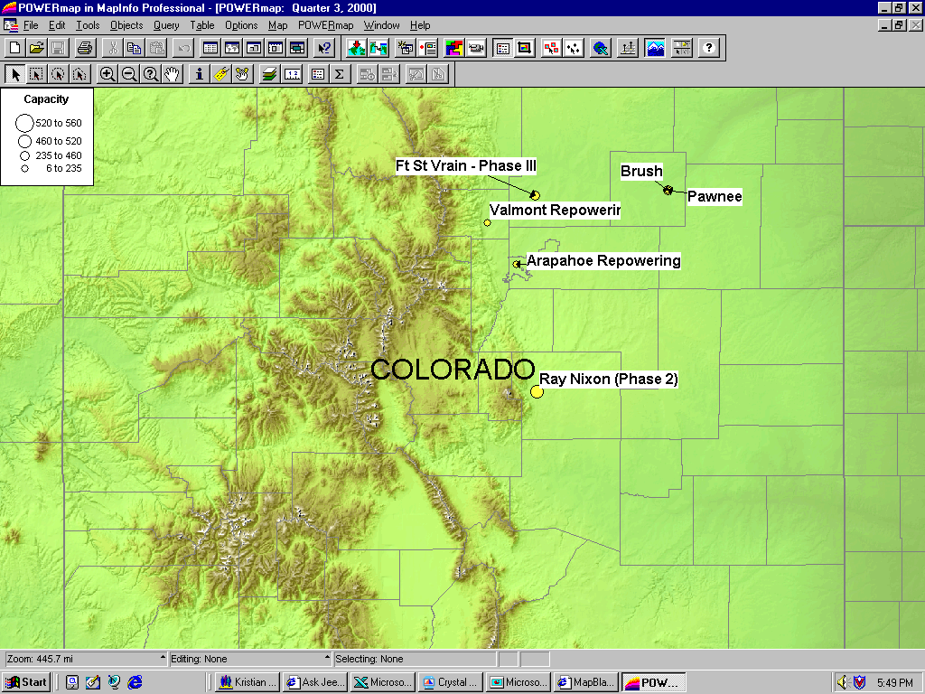
Rockies New Generation Map

Slide 11
DSW Updates
Arizona
  South Point Power Plant (UC) [Mojave], 545 MW, construction manager indicated that this project is on an accelerated schedule Mar 2001 rather than June 2001
  Griffith Energy Project (UC), 520 MW, May 2001. The “absolute drop dead date” is July 2001
  Desert Basin Generating (UC), 560 MW, June 2001, 7,000 Heat Rate
  West Phoenix 4- Repower, 70 Incremental MW, August 2001
  West Phoenix 5- New Build, 500 MW, December 2001
  Arlington Valley, 550 MW, Duke, August 2002.
  Panda Gila, 1,000 MW, Oct 2002. According to developer construction is to begin November or December 2000.
  Harquahala, 1,040 MW, March 2003. Special use permit granted on July 17, 2000. Still awaiting air, water and environmental assessment. Expected to begin construction in January 2001.
Nevada
  Las Vegas CoGen Expansion, 220 MW, June 2002.
DSW

Slide 12
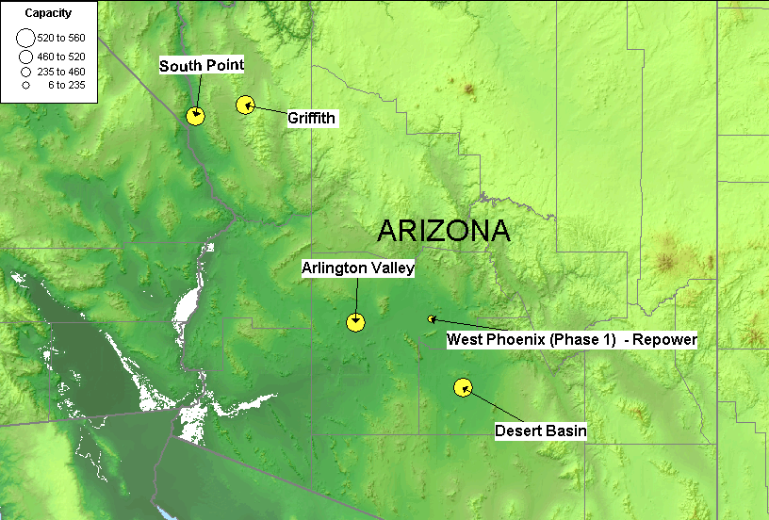
DSW New Generation Map

Slide 13
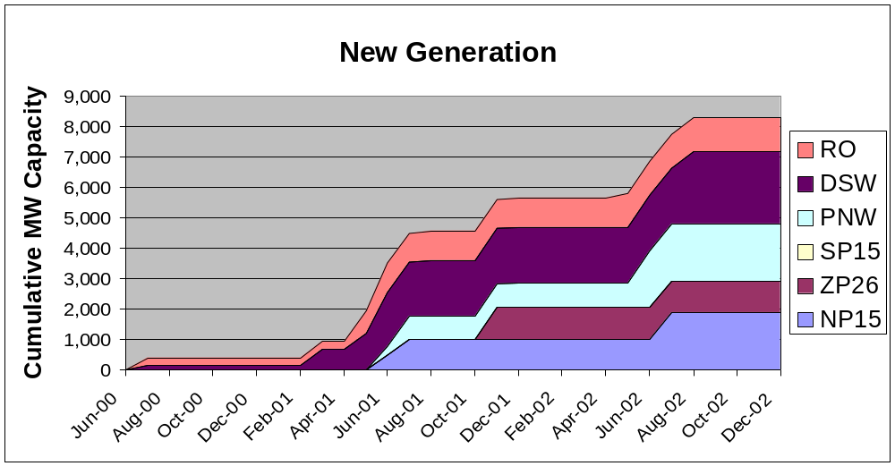
Summary
RO: Rockies DSW: Desert Southwest
PNW: Pacific Northwest
Summary

Slide 14
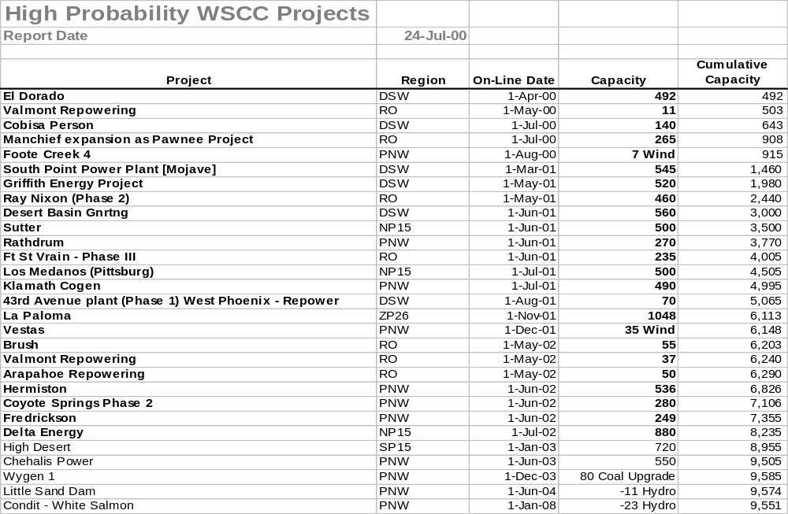
Sorted List By Date
Bold items are shown on the preceding graph

Slide 15
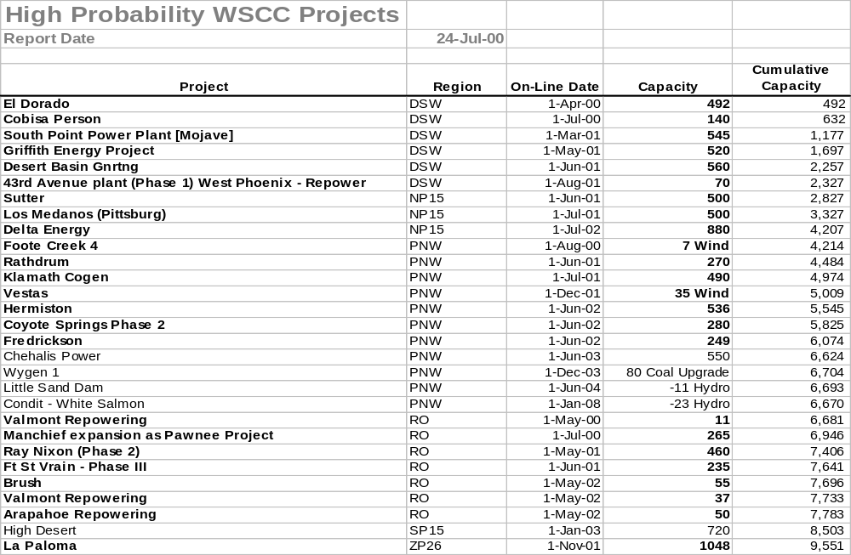
Sorted List By Region

Slide 16
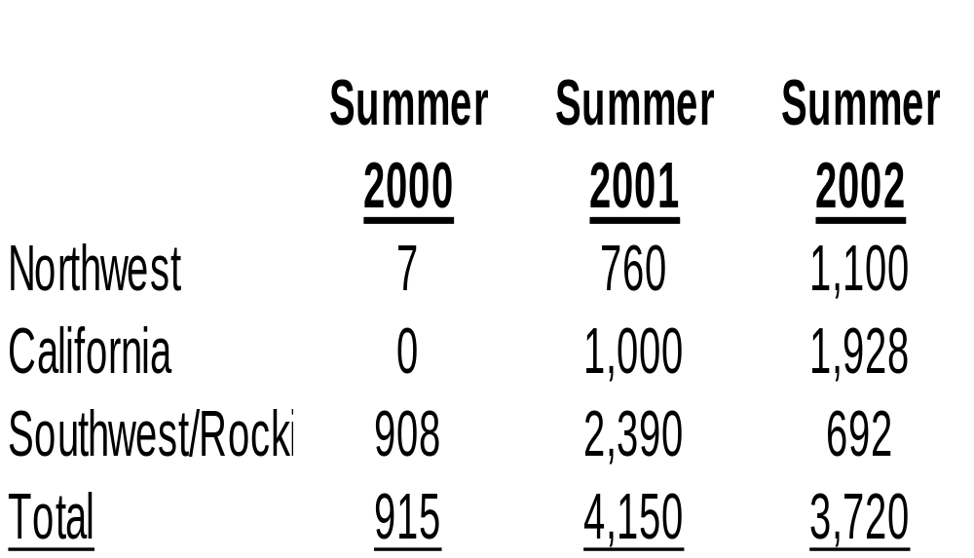
WSCC Capacity Additions
*
**
* Everett Delta plant mothballed
** High Desert delayed
Sorted List By Summer

