Slide 1
Mission Statement
To build Enron’s Texas Intrastate business through the development of a trading and origination platform.

Slide 2
Current State of the Texas Market
“Code of Conduct”
  Texas Railroad Commission “Code of Conduct”, intended to level the “playing field” for shippers, is vague and open to different interpretation.
    Enables intrastate pipelines to be lowest cost providers to large end-users (both utility and industrial)who will pay a premium for reliability of service. This condition is largely due to intrastate pipelines pricing 3rd parties out of the firm transportation market.
    Does not alleviate the competitive advantage of intrastate pipelines to gather wellhead production and bundle merchant services.
    Does not incentivize intrastates to offer competitive transport rates to 3rd parties.
Generation Driven Market
  Delivery characteristics(deliveries require higher pressure than traditional swing) of new IPPs and Cogens will dramatically affect the Texas market by reducing excess capacity.
  New plants built in non-traditional locations will serve to equalize demand on the grid and cause basis spreads to tighten.

Slide 3
Texas Intrastate Players
Houston Pipe Line Company
  Under new management.
  New strategy unclear.
Tejas/Coral - a subsidiary of Shell
  Characterized by culture clashes with Shell.
  Recently announced merger with Intergen, Shell’s power generation arm.
El Paso
  Currently strategizing to dominate Texas through consolidation.
  Recently acquired Coastal Marketing and Valero Pipe Line.
    Acquisitions provide for a formidable force in the Texas Intrastate market.
    Coastal provides successful marketing and operations organizations as well as wellhead supply and upstream assets.
    Valero provides upstream assets in South Texas, West Texas, Carthage, and Katy areas.
Midcon/KN
  Recently separated marketing operations from the pipeline.
  Traditionally focused on servicing large utility markets (Reliant Entex and HL&P). Recently signed “virtual pipeline” deal with Calpine which will limit their ability to provide swing service to these large utility markets.

Slide 4
Post HPL Action Plan
Lobby the Railroad Commission’s “Code of Conduct” with an aggressive political strategy to create open access in Texas similar to that in FERC regulated markets.
Develop a physical trading desk to facilitate the gathering of information across the state.
  Utilize HPL storage and flow data to fundamentally enhance trading decisions.
  Develop flexible, decentralized storage positions in key areas.
  Integrate EOL into all Texas intrastate pipelines.
    Trading Hubs - King Ranch, Katy, Carthage.
    Supply Zones - Agua Dulce, Thompsonville.
    Market Areas - Houston Ship Channel.
    Intrastate Transportation - HPL, Midcon/KN, Tejas, El Paso.
Cultivate relationships to maximize supply and market, asset management potential, and gather information.
  Independent Power Producers (IPPs) - Constellation, ANP, FPL.
  Pipelines - TXU/Lonestar, KN/Midcon.
  Utilities - City of San Antonio, City of Austin.
  Suppliers - Conoco, Exxon-Mobil, BP-Amoco, Duke, Anadarko, Chevron-Texaco.

Slide 5
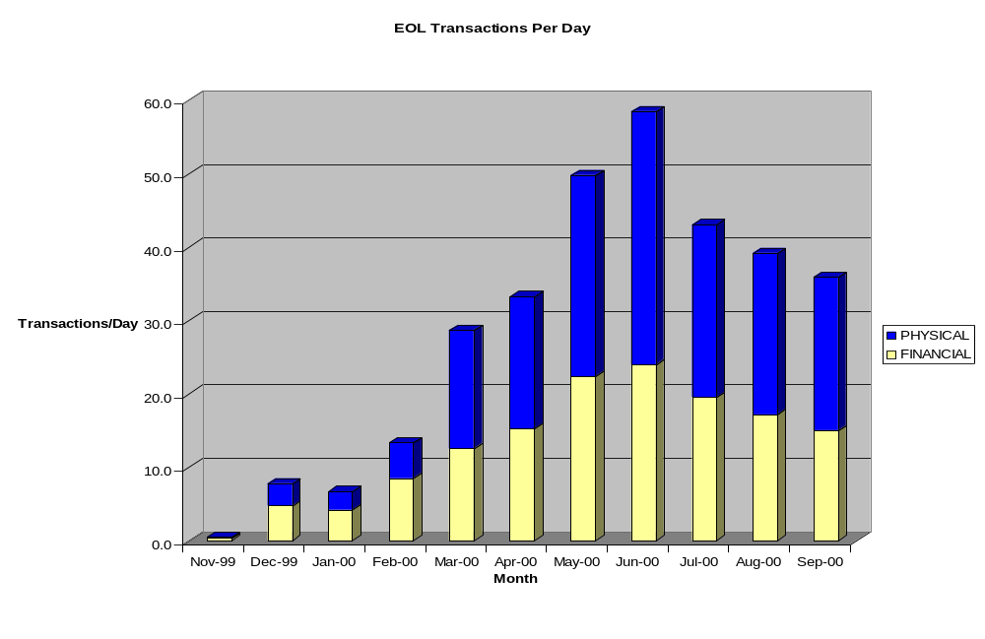
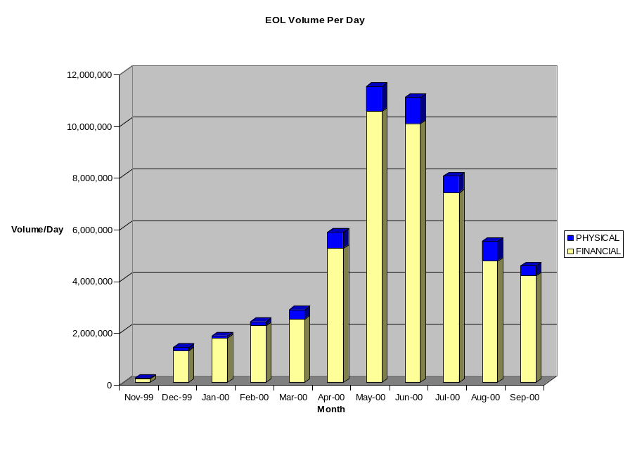
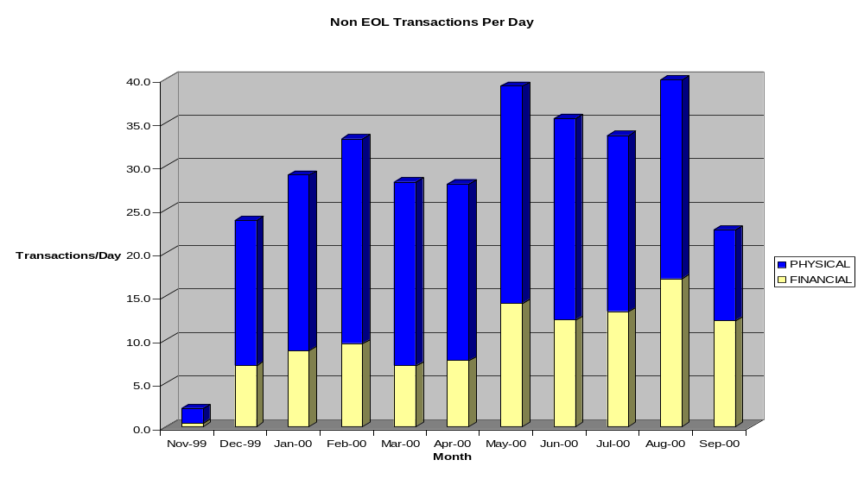
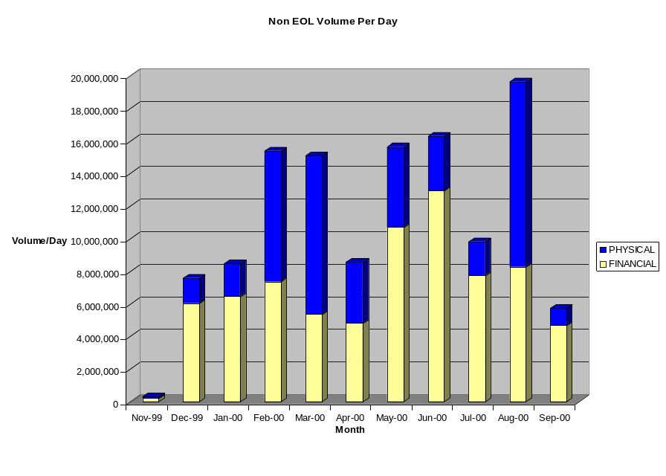
Performance Metrics for 2000

Slide 6
Goals For 2001
Physical Goals
  Position desk to be able to close one major asset and/or fuel management deal.
    Provides asset capability.
    Provides access to asset information.
  Acquire storage capacity in 2 strategic locations.
  Average 500,000 MMBtus per day in trading volumes.
  Establish a transport position that enables the desk to take advantage of expected basis tightening.
EOL Goals
  Add 25 new EOL customers to existing clientele.
  Introduce 2 New EOL products.
  Average 1500 trades (EOL and Non-EOL) per month.
  Entice one intrastate pipeline to market transport via EOL.

Slide 7
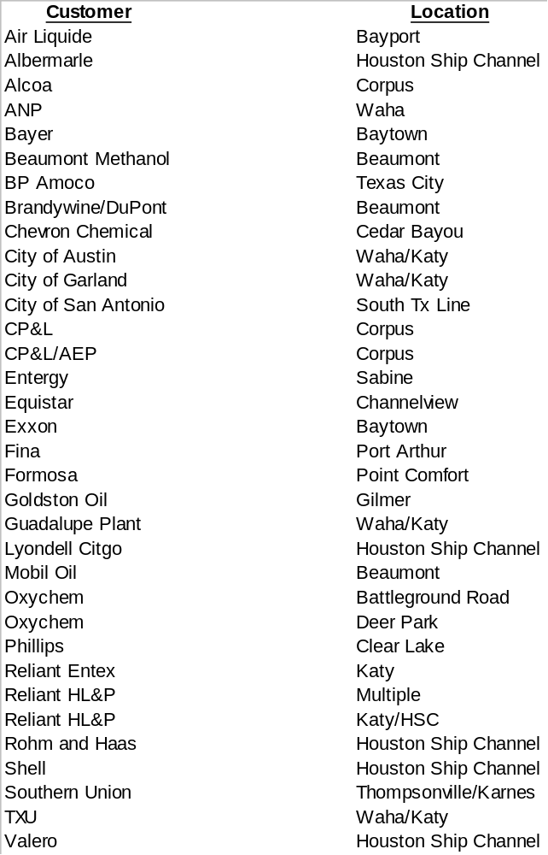
Prospective Off HPL Customers

