Slide 1
Eservices
Business Plan

Slide 2

Mission Statement
To create a group that is responsible for the physical delivery of wholesale and retail power as well as the facilitation of incremental power products and services that complement the existing trading,origination and midmarketing models. This group will be responsible to create and develop the physical aspect of our business that will allow the long term creation of a virtual services utility by leveraging our existing commodity risk management and technology experience.

Slide 3
The Eservices Team
Require a focused management team to lead the following groups
  Scheduling
  North East Physical
  South East Physical
  Midwest Physical
  Ercot Physical
  Genco
  Gas management
  Physical asset management
  Fundamentals

Slide 4
Market Summary
Market:
ISO progress will create a large group of customers who can’t keep up with logistical requirements.
Provide tagging and CA services to the smaller players.
Aggregate and serve the smaller LSE’s and Genco’s. (virtual CA’s)

Slide 5
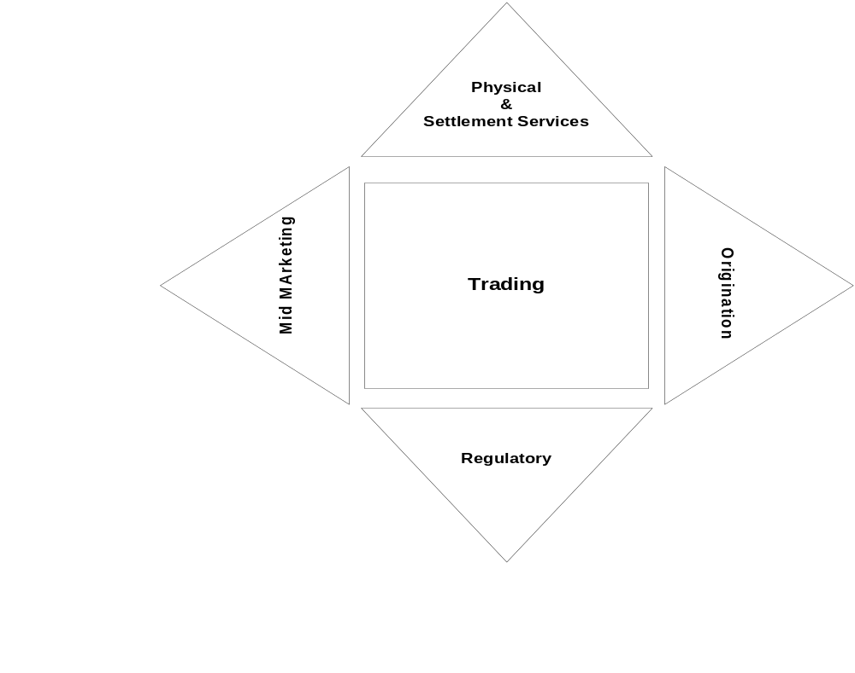
East Power Team

Slide 6
Opportunities
Problems and opportunities:
  Require a rock solid business model so substantial amount of the financial risk is born by the buyer of services.
  Regulatory differences in each area will result in multiple models.
  Lack of experience in this area.

Slide 7
Business Concept
Take advantage of the Internet to aggregate data as well as return feedback to our customer on the service being provided.
Leverage our extensive experience with setting up Control Areas and asset management of own generation resources.
Take the asset management/scheduling/settlements driven deals to this group to evaluate, install and manage.

Slide 8
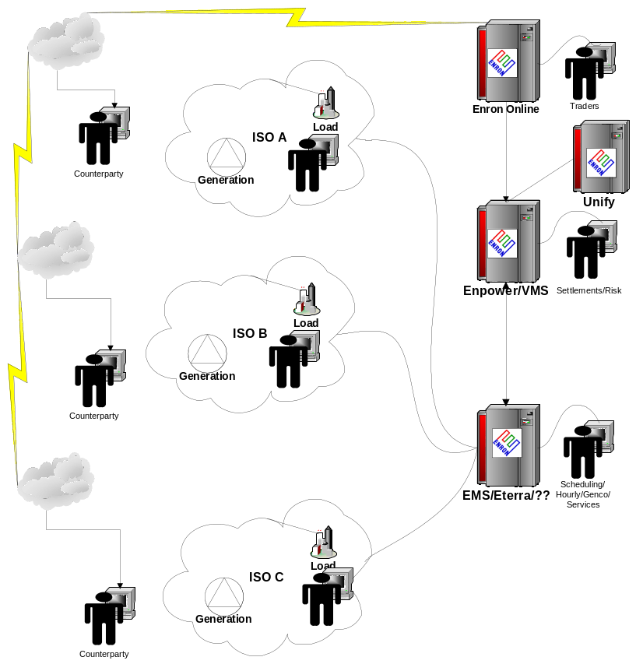
Technology Overview

Slide 9
Competition
Traditional utilities
New Gencos
ISO participants
Our advantage is our presence in all markets as well as our ability to deploy technological solutions and services quickly.

Slide 10
Goals & Objectives
Initial goals
  Our market share will initially be small but should grow as we build up products and recognition.
  Fee based business.
  Information & transaction flow strengthens commodity trading business.

Slide 11
Financial Plan
High-level financial plan that defines technology requirements, services provided, and pricing assumptions.
Use several slides to cover this material appropriately when done.

Slide 12
Resource Requirements
Technology requirements
  Enhancement of the EMS is being performed as part of the Ercot project and will need some addition support staff.
Personnel requirements
  Initially will require two EFT’s plus two analysts as well as some full time regulatory support.
Resource requirements
  Will require authority to create our own physical book to manage our real time portfolio of load/gen using the real time and balance of month products.
External requirements
  Looking into a ISP service to aggregate customer sites and metering data.

Slide 13
Risks & Rewards
Risks
  Delivery of poor service
Addressing risk
  Create a fair incentive system that is measurable that will attract and retain good staff over the long term.
Rewards
  Additional profitability and improved market knowledge.
  Increased transaction flow
  High return on capital

Slide 14
Key Issues
Near term
  Creating the businesses model and contracts.
  Reducing technology costs
  Locate additional staff
Long term
  Create correct incentives
  Create technology that can automate these services
  Create technology that can reconcile and bill for these services.
We will require some capital for technology to get started.

