Slide 1

Board Presentation
Greg Whalley
Enron Net Works
October 2000

Slide 2

Enron Net Works
Our mission:
  To provide the framework for applying Enron’s successful wholesale business model in other commodity and commodity-like markets
  To develop the electronic platforms necessary to grow market share in both our current and future markets
  To design tools for streamlining support processes which are valuable to both Enron and other potential users/customers

Slide 3
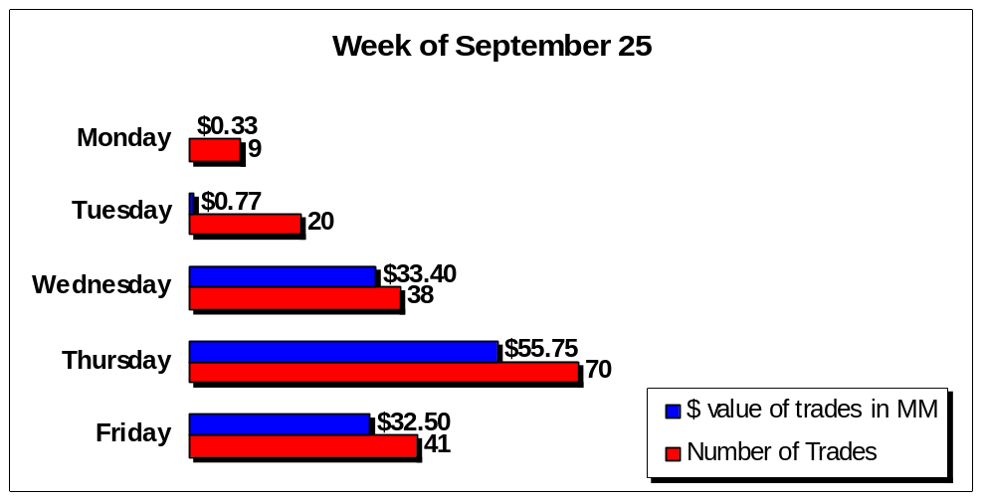
Enron Metals Update
Sept. 11 all Enron Metals employees moved into 40 Grosvenor Place
Sept. 25 LME registered contracts went live on EOL
  EOL traded metals products increased from 80 to 104
  EOL is only e-commerce site offering LME registered contracts to both LME and non-LME ring members
After 1 week with LME registered contracts, EOL did more transactions in 1 day (70), than MG’s maximum 1 day total (6 mo. period)

Slide 4
Enron Industrial Markets
“Expanding the Enron Business Model”
Approximate
Market Size
New Markets
Key Market Attributes
Pulp & Paper
Lumber
Steel
$ 300 Billion
$ 50 Billion
$ 330 Billion
$ 680 Billion
Certain base grade commodity products
Capital intensive industries that desire Risk Management products
Legacy distribution channels with no price transparency
Receptive to Enron’s eCommerce model
Industries beginning to commoditize
Define
Product
Standards
and Contracts
Obtain Access
to Physical
Product
Develop
Physical
Distribution
Innovative
Structured
Products
Market Making
Establishes
Liquidity
Risk
Management

Slide 5
Enron Industrial Markets - Organization
Wholesale Division
Developed Markets
CEO - Mark Frevert
Enron North America
CEO - Dave Delainey
COO - John Lavarato
Enron Industrial Markets
CEO - Jeff McMahon
COO - Ray Bowen
Enron Global Markets
CEO - Mike McConnell
COO - Jeff Shankman
Enron Europe
CEO - John Sherriff
COO - Michael Brown
Target Markets: Pulp & Paper / Steel / Lumber
Funding: Enron Net Works Partners
Personnel: Approximately 100 People
2001 EBIT Estimate: $100 Million

Slide 6
Project Falcon
Target: Fletcher Challenge Canada
  Three plants located in British Columbia
  1,000,000 tons/year production of pulp
  1,000,000 tons/year production of paper (majority is newsprint)
Acquisition Consistent with Enron Net Works Market Penetration Strategy
Assumed First Investment of Enron Net Works Partners LP

Slide 7
Enron Net Works Partners LP
Total outside equity investment of $1 Billion
Enron ownership percentage approx. 60-70%
Potential Partners
Leads
Secondary
Bain Capital
Blackstone Group
KKR
Hicks Muse
Bessemer
Chase Capital Partners
Francisco Partners
LJM2
CalPERS
Targeting end of October close

Slide 8
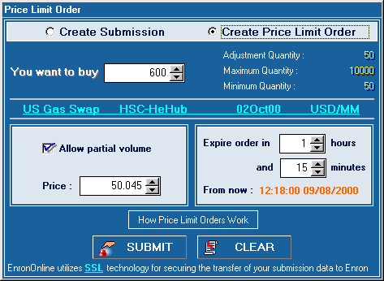
EnronOnline: Phase II
Highly successful launch of Phase II on Sept. 18
  Broad customer adoption of the new platform
  New transaction record set on the day of launch: 2,867 transactions
Phase II included:
  New trading functionality:
  price limit orders; customizable workspace, etc.
  Market specific content:
  news, weather maps and data, stock quotes, industry specific publications, etc.

Slide 9
…and going forward
Significant increase in the level of business
  New transaction record: 3,018 transactions on Sept. 26th.
  Average daily transactions have increased from 2,000 to 2,800 recently
System architecture has proven scalable & reliable
Metals group integrated rapidly into EnronOnline
Commercial agreements in place with competing platforms
Establishing a private network with 25 largest customers in conjunction with EBS

Slide 10
DealBench Status
DealBench™ is a secure, collaborative web platform that enables our
clients to conduct business on the web. We provide a collaborative
environment to conduct auctions, manage RFQ/RFPs, share documents,
host webcasts, and monitor deal progress - efficiently and effectively.
Beta version launched 24th of April
Site launched 16th of July
Transaction statistics for the first 60 days
  29 deals
  more than $ 4.8 bn total value of deals
  $ 1.6 m in earnings
  375 users, with 176 entities

Slide 11
Commodity Logic
Provides Web-based solutions for commodity mid-office and back-office operations--EOL for the back-office
Task-specific value-added modules connect to a central data hub
  Financial Management Module--allows users to change payment dates (available October 2000)
  Contract Exchange--allows schedulers to exchange logistical info online
  Invoice Exchange--invoice verification and matching
  Confirm Central--tabular presentation of key confirm data
Version 1.0 targeted at enhancing Enron capabilities, due April 2001
Version 2.0 available to all market principals, pay subscription fee

Slide 12
Clickpaper.com
Clickpaper was created as a unique site for the forest products industry.
Site is based on Enron’s business model of taking successful “market maker” skills into other industries.
Site is technically consistent with the EnronOnline model.
Three key areas to the site
  Industry specific content
  Trading floor based exactly on EOL model
  Match area providing posting services to buy/sell consistent with other B2B sites in the paper industry.
Primary goal is to fundamentally change the way pulp, paper, and wood products companies buy and sell their products.
How ?
  Accelerate the commoditization of four or five industry products.
  Establish hubs and create liquidity at those hubs.
  Move into physical market making.
  Accelerate growth of physical spot market.
  Grow financial trading business.
  Use Clickpaper as the tool to accelerate our business model in paper.

Slide 13
Enron Net Works Ventures
Strategy: Venture capital investments in e-commerce/IT technologies, ASPs/Outsource providers or exchanges which Enron would use to support its strategic business initiatives
Six investments to date with $16 million of capital committed
  ECOutlook
  Pentasafe
  Acta
  Impresse
  ChemConnect
  Intel 64 Fund
Letter of intent with Kiodex to merge in EnergyDesk.com and link to EOL for 32% of equity

Slide 14
Looking Ahead
Transportation / Logistics
Agriculture
Nymex
ECNs

