Slide 1
PROJECT DOOR STEP
LONDON
UK & Continental Gas UK Power Continental Power Global Products
Office Visit- April 10-14, 2000
Report Issued- April ___, 2000
Confidential

Slide 2
Project Doorstep - London
Review Highlights
Project Objective:
We performed an on-site review of processes, procedures and controls that support the UK and Continental Gas, UK Power, Continental Power and Global Products trading and origination business activities within the London office. Our procedures included interviews with key commercial and accounting personnel. We also performed a test of commodity transactions from deal execution through to settlement entries.
Team Members: Office Personnel Interviewed:
Brent Price Joe Gold - Managing Director Continental Gas & Power
Carrie Hollomon Richard Lewis - Managing Director UK Power & UK Gas
Tom Bauer - AA James New - Head of Gas& Power Risk Management
John Vickers - AA Gail Hill - Head of Gas & Power Documentation & Contract
Nic Swingler - AA Commitments
Rebecca Morrill - AA Mark Jones - Gas Risk Manager
Ian Sloman - Head of Gas & Power Settlements
Annette Schneider - UK Power Documentation
Tani Nath - Head of Global Product Operations
Peter Crilly - Head of Gas and Power Logistics
Rebecca Millerchip - Head of Global Product Coordination
Group
David Hardy - RAC - Credit

Slide 3
Project Doorstep - London
Observations
EFFECTIVE CONTROLS
Trading P&L and positions reported to Enron management in Houston on a daily basis
Clear segregation of duties between Commercial & Commercial Support groups as well as the individual support functions
Top Commercial and Commercial Support personnel have an appropriate assessment of operational risk and are knowledgeable about their roles within the controls process
Power traders input deals directly in the system and review confirmations for accuracy
Coordination group implemented in Global Products to act as liason between Trading / Logistics and Trading Support and ensure proper controls are maintained over operational data.
Invoices and payments are reviewed by Settlements Management before being sent to counterparties to ensure proper support is in place for invoiced terms
Documentation and Settlements functions are adequately staffed with applicable language skill sets to process confirms and invoices for each country in which transactions are occurring
Proper segregation of scheduling and operational responsibilities exists between Commercial and Commercial Support for Gas, Power and with the implementation of the Coordination Group, Global Products

Slide 4
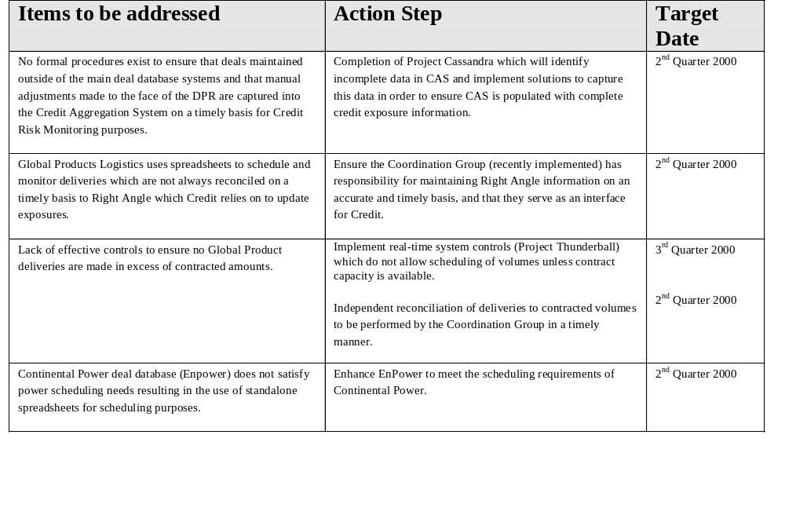
Project Doorstep - London
Observations

Slide 5
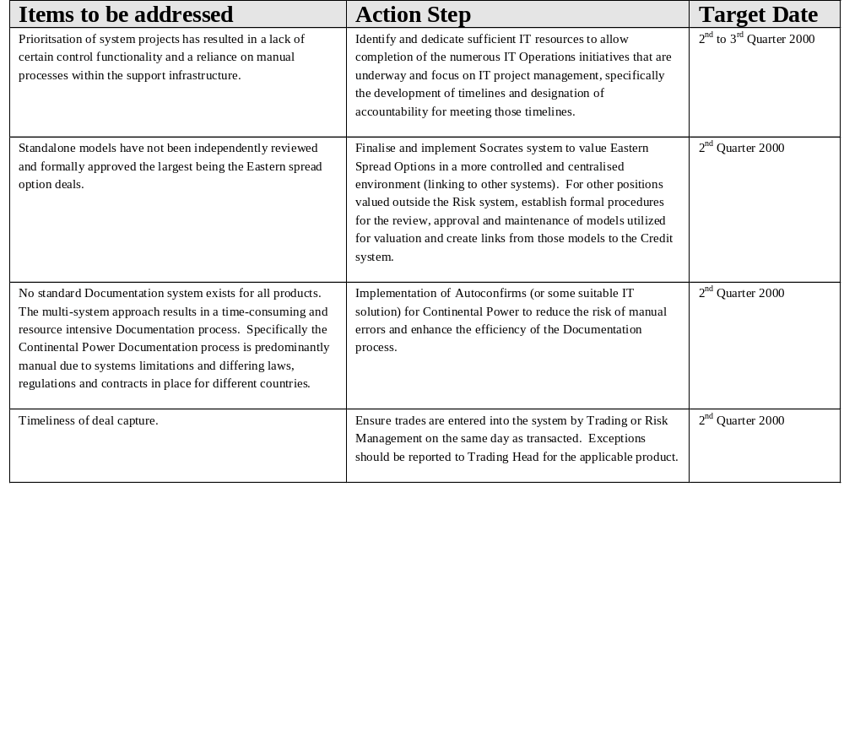
Project Doorstep - London Observations

Slide 6
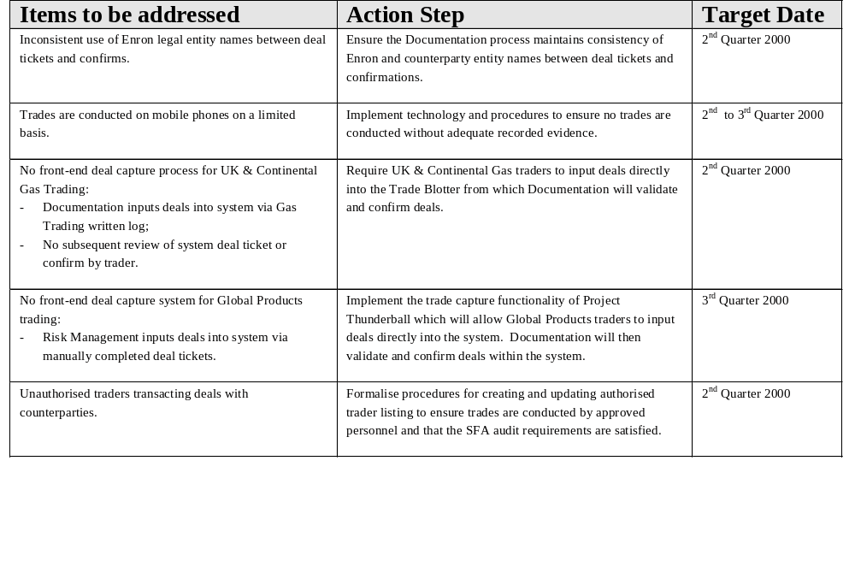
Project Doorstep - London
Observations

Slide 7
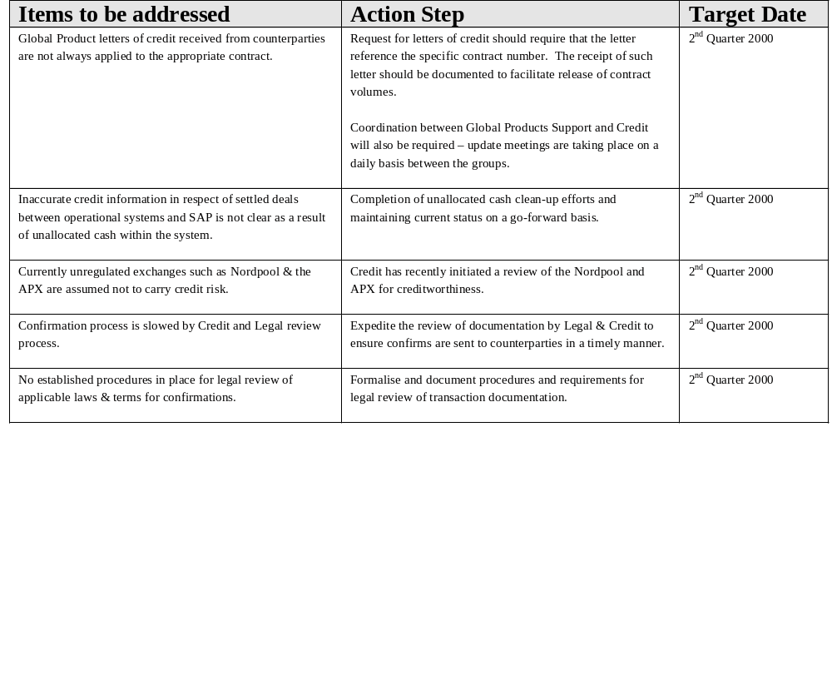
Project Doorstep - London
Observations

Slide 8
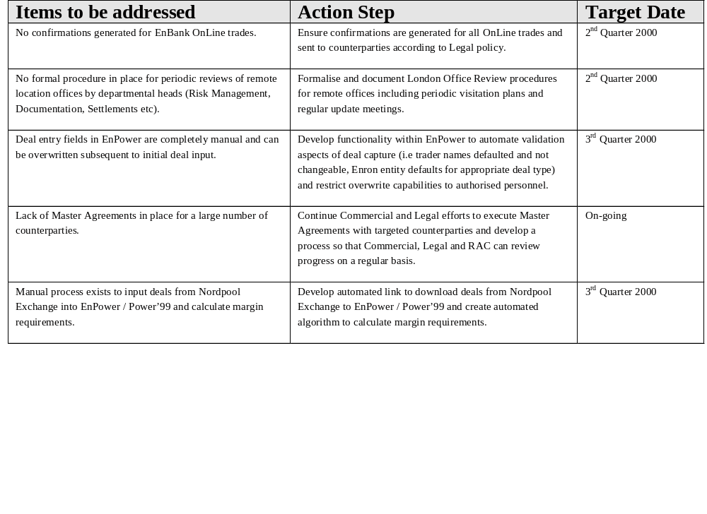
Project Doorstep - London
Observations

Slide 9
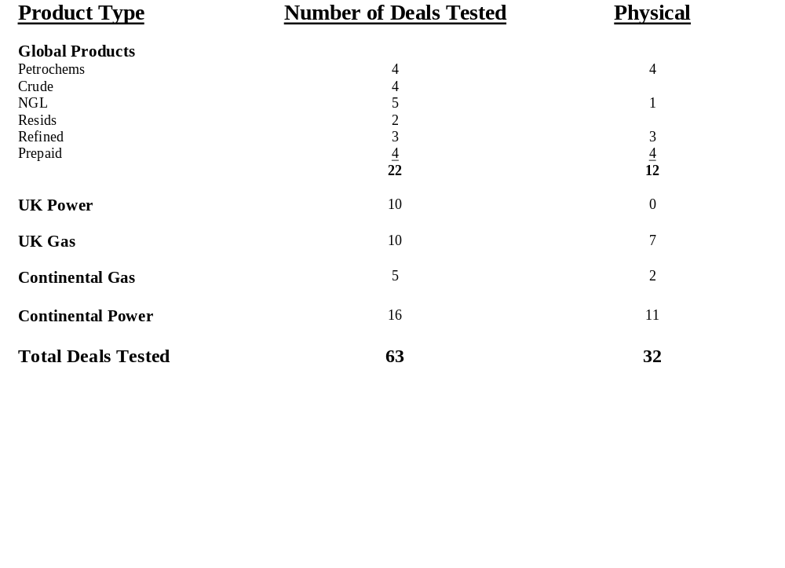
Project Doorstep - London Deal Test Overview

Slide 10
Project Doorstep - London Deal Test Attributes
Global Liquids - Key attributes tested
Deal Capture
  Authorized trader
  Deal Ticket sign off
  Deal correctly booked in TAGG/ERMS
  Deal correctly booked in Right Angle (Physical deals)
Documentation
  Confirmation creation date
  Time taken to create contract since trade date
  Authorized signatory
  Counterparty approval date
  Contract agrees to deal ticket
  Appropriate Departmental sign off for contract amendments
Logistics
  Bill of lading date
  Bill of lading agrees to Right Angle
Settlement / Accounting
  Invoice agrees to Right Angle/LOM
  Validation Sheet agrees to Invoice
  AR/AP entry
  Physical evidence of cash

Slide 11
Project Doorstep - London
Deal Test Findings
Global Liquids - Summary of test findings
No trader sign off on 2 deals tested;
Volumetric difference between broker contract confirmation & deal ticket for one deal tested;
Counterparty terms & conditions for a financial trade not passed to Legal for review even though no Master Agreement in place with that counterparty;
No counterparty confirmation or broker confirmation received for 2 petrochemical deals tested;
Download of settled trades to accounting system (SUN) only takes place twice a month. As a result a settled deal in April could not be agreed to SUN as download had not yet occurred.
(Test findings for prepaid contracts to be finalised)

Slide 12
Project Doorstep - London Deal Test Attributes
UK Power - Key Attributes tested
- 10 deals tested (all financial)
Deal Capture
  Authorized trader
  Deal ticket sign off
  Deal correctly booked in Power Desk
Documentation
  Confirmation creation date
  Time taken to create contract since trade date
  Authorized signatory
  Counterparty approval date
  Contract agrees to deal ticket
Settlement/ Accounting
  Invoice validated to LOIS /Deal Ticket
  Details agreed to LOM
  Details agreed to SAP
  AR/AP entry
  Physical evidence of cash

Slide 13
Project Doorstep - London
Deal Test Findings
UK Power -Summary of test findings
No trader sign off on 2 Asian Option deal tickets;
Backdating - Deal start date pre-dated deal trade date for one Asian option deal;
Enron entity name per broker confirmation different to Enron entity name per deal ticket and counterparty confirmation for one swap and one swaption trade;
Named trader per Enron contract confirmation different to named trader on deal ticket. Deal ticket unsigned;
No signed confirmation from counterparty for Asian Option trade (executed October 1999);

Slide 14
Project Doorstep - London Deal Test Attributes
Continental & UK Gas - Key attributes tested
- 15 deals tested (10 UK, 5 Continental, 9 Physical)
Deal Capture
  Authorized trader
  Deal ticket sign off
  Deal ticket agrees to Blue book
Documentation
  Confirmation creation date
  Time taken to create contract since trade date
  Authorized signatory
  Counterparty approval date
  Contract agrees to deal ticket
Settlement / Accounting
  Invoice validated to LOIS /Deal Ticket
  Details agreed to LOM
  Details agreed to SAP
  AR/AP entry
  Cash applied/payment entry made
  Physical evidence of cash

Slide 15
Project Doorstep - London
Deal Test Findings
UK & Continental Gas - Summary of test findings
No Enron confirmation created or counterparty confirmation received for EnBank OnLine trade;
Enron entity abbreviations on deal tickets inconsistent;
Price discrepancy between bluebook and Gas Desk deal ticket for one trade due to rounding (£0.000003/Mmbtu)
Named traders per bluebook not on authorised traders listing;
Named traders per authorised listing no longer trade UK Gas;
Incorrect price for capacity trade entered into Bluebook and Gas Desk. This was picked up by Settlements and amended accordingly 5 days later;
Volume discrepancy on option trade between bluebook & counterparty confirmation. Enron currently refuse to sign counterparty confirmation until amended (trade date 23 March 2000).

Slide 16
Project Doorstep - London Deal Test Attributes
Continental Power - Summary of attributes tested
- 16 deals tested (11 Physical)
Deal Capture
  Authorized trader
  Deal ticket sign off
Documentation
  Confirmation creation date
  Time taken to create contract since trade date
  Authorized signatory
  Counterparty approval date
  Contract agrees to deal ticket
Settlement / Accounting
  Invoice validated to LOIS /Deal Ticket
  Details agreed to LOM
  Details agreed to SAP
  Invoice agrees to Validation Sheet
  AR/AP entry
  Physical evidence of cash

Slide 17
Project Doorstep - London
Deal Test Findings
Continental Power - Summary of test findings
Contract confirmation date pre-dates deal ticket trade date for 7 deals tested;
Volume discrepancy between deal ticket and broker confirmation for one trade;
Discrepancy between Enron entity per deal ticket and Enron entity per counterparty confirmation for two deals;
Enron confirmation created and signed two months post deal trade date due to Credit review for one trade;
No counterparty confirmations received for 5 trades (4 are day ahead physical trades);
Iberian Power trades currently not captured into EnPower or Back Office Settlements System (BOSS);
Name of person capturing trade on deal ticket different from trader who executed the trade for two deals;
No counterparty confirmation of trade or payment received for one trade (due 24 Feb 2000, but currently in dispute);

Slide 18
Project Doorstep - London
Deal Test Findings
Continental Power - Summary of test findings
Enron has not signed one counterparty confirmation and counterparty refuses to sign Enron’s confirmation for one trade. No Master Agreement currently in place with this counterparty;
APX pricing link not operating correctly resulting in two incorrect invoices produced by BOSS. These were manually amended to reflect the correct balances (APX pricing link has now been corrected).

Slide 19
Project Doorstep - London Observations
AREAS FOR FURTHER REVIEW
Credit Aggregation process
Market Risk process review
New Counterparty approval procedures
Capacity / Transmission transactions
Global Products Exchange traded futures and options
NETA implementation and risk assessment plans
IT System implementation timeline
Gas and Power settlement systems
Implications of Enron Direct for wholesale business and support

