Slide 1
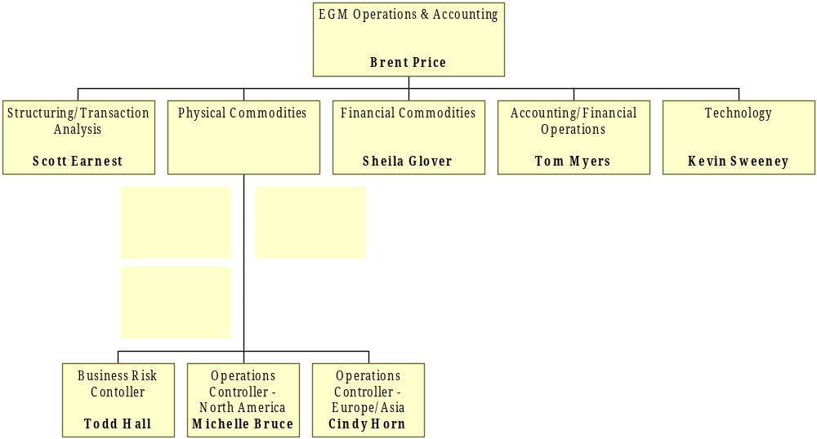
Global Markets Management Team
Financial Trading
Insurance
Pricing
Valuation
Modeling
Risk Analysis
Crude &
Products
Coal
LNG
Freight
Weather
Risk Mgmt.
Daily Commercial
interface
Confirmations
Settlements
Trade Acctg.
Mgmt. Reporting
G/L Management
Consolidations
Plan/Current Estimates
Project Thunderball
implementation
New technology
opportunities
Risk Mgmt.
Daily Commercial
interface
Confirmations
Coordination
Settlements
Trade Acctg.
Confirmations
Coordination
Settlements
Trade Acctg.

Slide 2
Global Markets Management Team
EGM Operations & Accounting
Brent Price
Physical Commodities
Crude &
Products
Coal
LNG
Freight
Weather
Business Risk
Controller
.
Todd Hall
London
Coal
LNG
Freight
Weather
Risk
Crude & Products
Controller
Dimitri Taylor
John Swinney
Frank Prejean
TBD
Shelly Stubbs
Will Kelly
Simon Thurbin
Kenny Nicoll
Operations Controller
Operations Controller
-North America
-Europe/Asia
Michelle Bruce
Cindy Horn
Coordination/
Confirmations
Settlements &
Settlements
Trade Accounting
Singapore
Crude & Products
Coal
Rebecca Millerchip
Jeff Sorenson
Mark Leskowitz
Controller
Business Lead
Business Lead
Tiong Hock Lim
Simon Thurbin
Kenny Nicoll

Slide 3
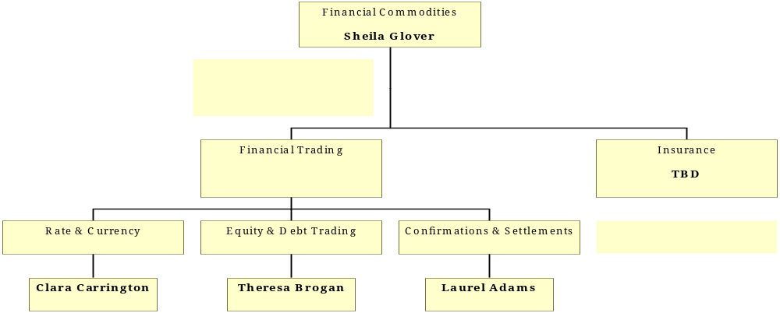
Global Markets Management Team

