Slide 1


Enron North America
MAPS
Report Date- June 2, 2000
Confidential

Slide 2
MAPS
Project Objective:
Our review was designed to identify and test key policies, procedures, and controls related to 1) the use of MAPS by appropriate parties, 2) the insurance of timely, complete and accurate data capture, 3) key calculations, interfaces, and data validation checks and their sufficiency to preserve data integrity, and 4) the protection of critical data from unauthorized modification and misuse.
AA Team Members: Enron Team Members:
Tom Bauer Andrea Reed
Michael Schultz L’Sheryl Hudson
Patricia Grutzmacher Carol Marshall
Andrew Schuleman Maria LeBeau
Cindy Davis Michael Galvan
Russ Bouwhuis Christine Dinh
Carrie Applewhite Monica Reasoner
Mark Austin Cindy Hudler
Qi Mu
David Fontana
Adarsh Vakharia

Slide 3
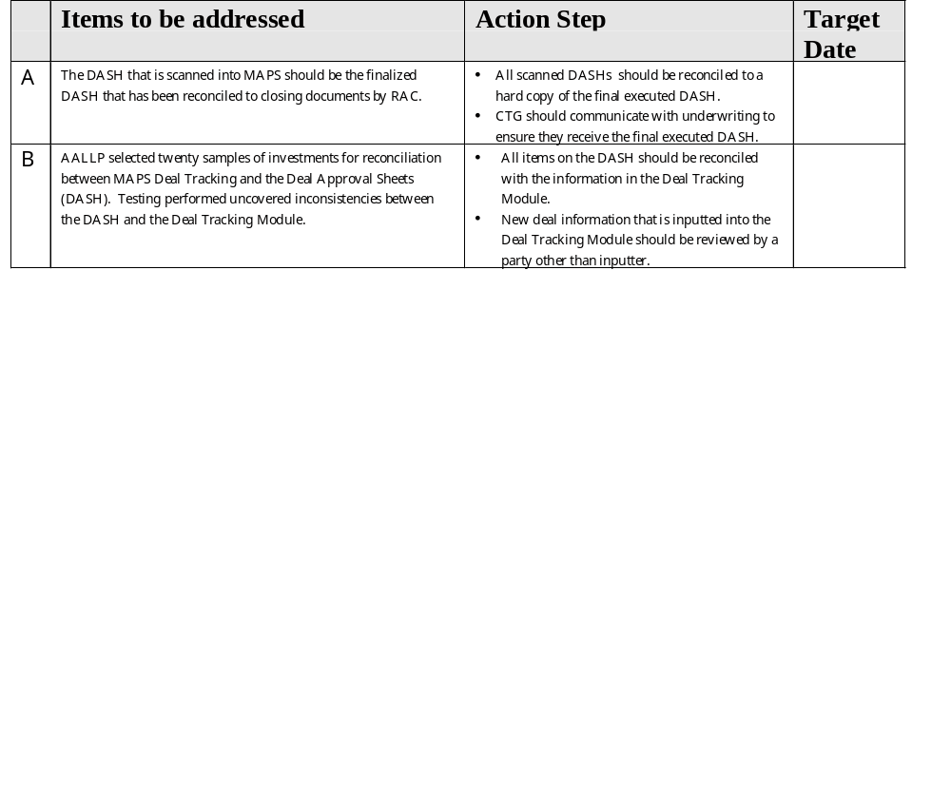
MAPS Observations

Slide 4
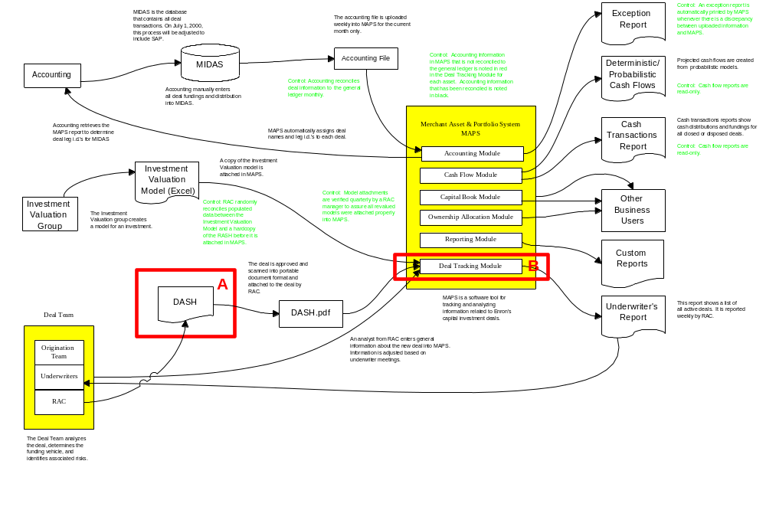
MAPS

