Slide 1

Enron Metals North America
future structure
Structure of each department

Slide 2
Index
Topic Page Number
Overview of process flow 3
Front office functions 4-7
Merchanting Middle office functions 8-10
Brokerage Middle office functions 11-12
Brokerage Compliance function 13
Back office functions 14
RAC functions 15
Global finance functions 16
Other functions 17
Process flows for each location 18- 24
Organization charts 25-31

Slide 3
Overview of Process flow
Front
Middle
Back
Support services
Trading
Coordination/ Settlements
Financial ops
Credit
Authorizing new counter-parties, calculating credit risk
Physical & financial
Logistic & trading support (all documentation with the exception of confirmations)
Financial reporting, management reporting, budgeting
Risk Control
Logistics
Confirmations & contracts
“Police” - analyzing P&L, reviewing violations
Shipping and secondary services
Cash mgmt
Executing contracts & confirms
Cash movements
RM/ Trade accounting
Legal
Calcs books, responsible for commercial accounts
Tax
Transaction support

Slide 4
Duties of Commercial Functions - the Front Office
Business Head Duties
Setting & Communicating strategic direction
Allocating overall trading limits
Ensuring that new types of business / significant transactions have all appropriate sign-offs
Designated Heads
Copper concentrates - Phil Bacon, NY
Metals - Michael Farmer, London, (Aluminum - Sam Hainsworth, London)
Scrap Copper
Achim Lindhorst - Germany
Broker - Craig Young, NY

Slide 5
Duties of Commercial Functions - the Front Office
Trading
Head trader only - Allocating limit given by business head to subordinate traders
Head trader only - Agreeing & signing daily profit reports
Managing customer relationship
Originating new business
Negotiating structured deals with counter-parties
Notifying credit of any new counter-parties before transaction is done
Managing risk positions of the firm (physical & financial)
Taking proprietary positions where appropriate
Negotiating trades with counter-parties
Writing deal tickets
Signing of amendments made to deal tickets by commercial support
Reviewing contracts as being in accordance with the deal concluded
Keeping positions within authorized limits
Looking at credit headroom before dealing
Providing explanations for limit violation reports and signing them
Setting of pricing inputs ("curves")
Negotiating concerning mismatches of actual deliveries
Settling disputes with counter -parties
Notifying Credit & Documentation of any new counter-parties not already notified by Origination
Using appropriate legal entity for each trade (as determined by legal & tax depts.)
Approving invoices and supporting evidence for payment for primary product
Designated Head Trading Personnel
Copper concentrates - Phil Bacon, NY
Metals - Michael Farmer, London (Primary aluminum - Sam Hainsworth, London)
Scrap - Joe Robertson, NY
Broker - T.J. Pimpinelli, NY
Note: The head trader can further allocate trading responsibility to other traders within their group. Therefore not all personnel trading need to be on the authorized trading list.

Slide 6
Duties of Commercial Functions - the Front Office
Agency
Managing customer relationship
Originating new business
Negotiating trades & structured deals with counter-parties
Committing the company to trades & ancillary services within the band set daily by the head trader
Hedging physical trades using COMEX or LME exchange instruments (not required)
Writing deal tickets
Signing of amendments made to deal tickets by commercial support
Negotiating concerning mismatches of actual deliveries
Settling disputes with counter-parties
Using appropriate legal entity for each trade (as determined by the head trader)
Approving invoices and supporting evidence for payment for primary product
Designated Agency Heads (where necessary)
Copper Concentrates - Not Applicable
Copper - Joe Robertson
Zinc - Bill Silverstien
Lead - Bill Silverstein
Primary aluminum - Jean Michaud
Copper scrap - Mike Casey/Joe Robertson (NY)
Aluminum scrap - David Rosenblum/Joe Robertson (NY)
Broker (proprietary positions) - Michael Hutchinson
Broker (US) - T.J. Pimpenielli

Slide 7
Duties of Commercial Functions - the Front Office
Logistics
Locating transport/transmission opportunities / booking berths
Negotiating contracts for secondary services
Recording terms of contracts for services
Recording terms of amendments of contracts for services
Negotiating with suppliers of secondary services concerning actual outruns
Reviewing and amending contracts from a logistics standpoint
Scheduling movements
Monitoring journeys
Calculating loading volumes
Directing sample taking
Monitoring quality reports / reviewing inspectors reports
Providing documentation for customs
Monitoring completeness of shipments for loading & discharge as recorded by coordination
Calculating, monitoring and negotiating demurrage
Notifying risk management of demurrage payable and receivable and any other agreements
Approving invoices with supporting evidence for payment for secondary services
Placement of Logistics
Copper cons - Dan Murphy, NY
Metals - Janet Vala-Terry, NY (all primary aluminum -Nicole Dion, Montreal)
Copper scrap - Ruth Zarren-Koch, St. Louis
Aluminum scrap - Derik Van Deusen, Chicago
Broker - NA

Slide 8
Duties of Commercial Support - Merchanting Middle Office
Co-ordination & Settlements
Primary responsibilities: Logistic & trading support, liaison with cash mgmt dept (all documentation with the exception of confirmations)
Updating logistics system for delivery information
Reconciling logistic (volume, delivery and location) systems to external statements
Reconciling delivery reports to positions from risk management systems
Preparing supporting evidence for payment of invoices for both primary product and secondary services & sending out these statements
Confirming (either in writing or verbally) incoming and outgoing payments before the statement is sent out.
Obtaining approval of payments for invoices from commercial
leasing with cash management - approving invoice for their payment
Chasing debtors for payment
Producing a weekly report of unpriced volumes (this should be done by global counter-parties - is this possible for metals)
Booking the inventory into accounts and validating monthly balance
Checking of incoming invoices to delivery documents
Reconciling statements from brokers to RM system
Reconciling OTC brokerage charges from broker to accounting system
Co-ordination & Settlements (continued)
Sending negotiable documents to purchasers
Applying cash received to accounts receivable accounts on a daily basis
Monitoring accounts receivable & accounts payable
Communication overdue Accounts Receivable to account coordinators (also within this group) daily and advising of chasing required
Monitoring accounts payable balances
Raising disputes on settlement amounts to the attention of Trading
Preparing cash forecasting for next 30 days
reconciling liquidated position to risk management information
Placement of Coordination
Copper cons - NY
Metals - London
Copper scrap - NY
Aluminum scrap - NY

Slide 9
Duties of Commercial Support - Merchanting Middle Office
Confirmations & Contracts (Documentation)
Executing contracts & confirms, liaison with “global counter-parties Enron personnel”
Reviewing deal from deal ticket prepared by trading/agency and input into the risk management system by risk management/trade accounting
Reviewing amendments to trades into the risk management system
Producing confirmations &/or contracts from the deal ticket
Monitoring approvals for prepared confirmation/ contracts from traders, agency, logistics, legal, credit and tax.
Dispatching contracts to counter-parties
Keeping a log of executed contracts and following up on contracts not returned, reporting this log to reporting group)
Reconciling broker confirmations to Risk Management Systems
Responding to counter-party contacts, taking advice from Legal, Credit and Logistics
Answering queries relating to contracts
Advising & following up with legal on general terms and conditions amendment requests from counter-parties
Documentation (continued)
Preparing New Counter-party information for distribution and system update in response to requests from Origination & Trading
Ensuring global counter-parties updates their systems for new counter-parties
Producing monthly statistics concerning contracts (with the exception of executed info as this comes from global counter-parties)
Liaising with the global counter-parties personnel re executed confirmations
Placement of Documentation
Copper cons - NY
Metals - London
Copper scrap - NY
Aluminum scrap - NY

Slide 10
Duties of Commercial Support - Merchanting Middle Office
Risk Management & Trade Accounting
Responsible for completing deal capture, book calcs, commercial accounts, and payment approval from an accounting standpoint
Capturing deal from deal ticket prepared by trading/agency into the risk management system
Capturing amendments to trades into the risk management system
Following up with the confirms/ contracts group on unclear positions
Obtaining sign-offs from traders on amendments made to deal tickets
Entering accruals and actuals for secondary services payable & receivable, including demurrage, into the risk management systems
Producing daily position reports
Producing & officializing daily profit reports
Verifying price inputs ("curves")
Ensuring actual prices in systems are accurate
Making trading & business head aware of violations
Communicating violations & their explanations to RAC & DPR group
Running reports of internal deals with group entities for traders to authorize (could be captured in trader sign off of all deals – don’t need to pull out)
Providing advice to business head on the risk aspects of new / proposed trades / products re how they will affect the daily positions
Approving each payment made from an accounting standpoint
Justification & analysis of monthly trading results
Risk Management & Trade Accounting (continued)
Reviewing all new trades to ensure that they are within the mandate of the business
Advising risk control of new types of trades and likely impact on suitability of existing limits
Implementing policies for income recognition for management & consolidation accounting purposes
Keeping commercial accounts in general ledger accurate and reconciled
Reconciling risk management and logistics systems
Preparing booking for mark to market
Ensure adequate allocation of trading prepayments & accruals
Reconciliation of volumes traded to amounts booked
Placement of Risk Management & Trade Accounting
Copper cons - NY
Metals - London
Copper scrap - NY
Aluminum scrap - NY

Slide 11
Duties of Commercial Support - Brokerage Middle Office
Co-ordination & Settlements
Primary responsibilities: Support Brokers, liaison with cash mgmt department
Reconciling third party positions to exchanges
Making margin calls to customers
Confirming (either in writing or verbally) incoming and outgoing payments
Obtaining approval of payments for invoices from brokers
liaising with cash management - approving invoice for their payment (G&A)
Reconciling statements from brokers to Rolfe & Nolan system
Reconciling brokerage charges from broker to accounting system
Applying cash received to accounts receivable accounts on a daily basis
Monitoring accounts receivable & accounts payable
Monitoring margin accounts
Rolfe & Nolan System
Third party service provider
Process future/Option trades
Prepares customer daily statements
Prepares customers monthly statements
Calculates margin requirements for each customer
Automatic regulatory reporting
Interface directly with general ledger
trade import facility - COMEX/NYMEX
Daily mark to market of all open positions
Prepares daily operational reports for reconciling to Exchanges
Captures and maintains history of all journal entries by customer
Placement of Coordination
Broker - New York
Broker Proprietary - London

Slide 12
Duties of Commercial Support - Brokerage Middle Office
Documentation
Executing account documentation and trade confirmations
Reviewing order ticket prepared by brokers and input into the risk management system by risk management/trade accounting
Reviewing amendments to trades into the risk management system
Producing confirmations from the order ticket
Monitoring approvals for prepared confirmation/ account documentation from brokers, legal, and tax.
Keeping a log of executed futures contracts Reconciling broker confirmations to carrying brokers reports
Responding to counter-party and customer inquires, taking advice from Legal, and Compliance
Advising & following up with legal on disputes with counter-parties
Risk Management & Trade Accounting
Responsible for completing deal capture, book calcs, commercial accounts, and payment approval from an accounting standpoint
Capturing trade from order ticket prepared by broker into the risk management system
Capturing amendments to order ticket into the risk management system
Review for accuracy confirms generated from the risk management system
Obtaining sign-offs from brokers on amendments made to order tickets
Producing daily position reports
Ensuring actual prices in systems are accurate
Communicating violations & their explanations to compliance officer and RAC group
Approving each payment made from an accounting standpoint
Justification & analysis of monthly results (fee income)
Keeping commercial accounts in general ledger accurate and reconciled
Prepare booking for mark to market
Placement of
Documentation/ Risk Management /Trade Accounting
Broker - NY
Broker proprietary - London

Slide 13
Duties of Commercial Support - Brokerage Compliance
Compliance
Regulatory Record Keeping
Respond to Commodity Exchange and CFTC inquiries and requests
Daily calculation of regulatory capital requirements (IFR)
Prepares daily segregation reports
Overseas and approves new account opening papers
Monitors promotional material
Registers entities and personnel with regulatory bodies
Acts as liaison between CFTC and Exchanges
Monitors and responds to customer concerns
Placement of
Documentation/ Risk Management /Trade Accounting
Broker - NY

Slide 14
Duties of Commercial Support - the Back Office
Financial Operations
Responsible to ensure proper ledgers, statutory and compliance reporting, budgeting, and reporting to the consolidation group
Non commercial AP & expenses (including batch payments)
Procurements & ordering
G&A journal entries (e.g. payroll), & non trading prepayments/accruals
Loan & interest calculation & posting
Allocations – calculation & posting
Fixed assets & depreciation
Ensure the validity of the whole TB for each ledger (ledger owners)
Tax liaison
Cost center, WBS, internal order and profit center set up & maintenance
Timesheet management
Preparation of monthly management accounts for cost center & profit center owners
Reconciling the monthly management accounts to the GL
Reconcile GL to DPR
Preparation of annual and quarterly forecasts
Preparation of cash flow forecasts
Analysis of budget/actual & comments to group & management
Financial Operations
Consolidating accounting information across different businesses
Reporting monthly management accounting information
Reporting information to Corporate Reporting to enable production of group statutory accounts
Producing and filing statutory accounts
Ensuring that all accounting complies with FAS and other relevant standards
Calculating and booking differences in management and consolidation income recognition (calculation may have to be done by RM) – EITF 98-10, FAS 133, inter-company profits, portfolio gross ups
Booking structured transactions
Issuing other local compliance reports
Coordinating with external auditors/handling external audit requests
Placement of Financial Operations
Copper cons - NY
Metals - London
Copper scrap - NY
Aluminum scrap - NY
Broker - NY
Broker proprietary - London

Slide 15
Duties of Commercial Support - RAC
Credit
Approving new counter-parties
Setting credit limits for each counter-party
Creating new counter-parties in Credit Systems
Reviewing and amending contracts from a credit standpoint
Aggregating all exposures to counter-parties
Monitoring compliance with credit limits
Reporting violations of credit limits to Chief Risk officer and to business head
Calculating potential credit exposure and including it in the credit exposure report
Monitoring compliance with potential exposure limits
Reporting violations of potential exposure limits to Chief Risk officer and to business head
Confirming that a given payment will or will not result in a breach of credit limit in response to a query from the coordination / settlements department
Approving each payment made from a credit standpoint
Alerting business head and Risk control when credit limits are exceeded Sending purchase confirmations to counter-parties banks
Risk Control
Advising board of Directors of appropriate limits to set
Communicating limits set by Board of Directors
Indicating understanding of reasons for breaching of any limits by signing limit violation reports
Monitoring of positions and losses against limits
Obtaining signature on limit violation reports from trading
Consolidating position reports across different business – London/ Houston
Producing limit violation reports - Houston
Placement of RAC - Credit
Copper cons - NY
Metals - London
Copper scrap - NY
Aluminum scrap - NY
Broker - London
Placement of RAC - Risk Control
Copper cons - NY?/London?
Metals - London
Copper scrap - NY?/London?
Aluminum scrap - NY?/London?
Broker - NY?/London?

Slide 16
Duties of Commercial Support - Global Finance
Funding
Manage Enron Credit rating
Provide funding for all business requirements
Cash Management
Effecting manual payments to counter-parties
Authorizing batches of automatic payments
Liaising with banks & providing appropriate documentation (LC’s etc)
Placement of Funding
All - Houston
Placement of Cash Management
Copper cons - Houston
Metals - Houston & London
Copper scrap - Houston
Aluminum scrap - Houston
Broker - Houston & London

Slide 17
Duties of Commercial Support - Other
Tax
Authorizing VAT amounts payable
Advising on optimum legal entity for booking of each type of trade
Reviewing tax clauses in contracts
Calculation of deferred tax
Preparation of tax returns
Tax advisory on structured transactions
Global counter-parties
Responsible for updating and warehousing master data
Responsible for warehousing executed confirmations & updating statistics concerning executed contracts
Accounting advisory on structured transactions
Updating Risk Management systems for new counter-parties
Transaction Support
Setting policies on income recognition
Accounting advisory on structured transactions
Legal
Writing standard contracts
Advising on transactions
Dealing with litigation
Placement of Tax
All - London with support from Houston
Placement of Global Counter-parties
Copper cons - London
Metals - London
Copper scrap -London
Aluminum scrap - London
Broker - London
Placement of Transaction Support
All - Houston/London
Placement of Legal
All - New York

Slide 18
Process flow - Copper Concentrates - NY
Breakdown positions, input into RM system, calculate MTM
Write deal ticket
RM/trade accounting
Trader
Perform secondary services
Capture secondary service movements in system, invoicing
Cash Management
Coordination/ Settlements
Logistics
Prepare confirm/contract, execute
Credit
Documentation
Legal
Legend
Houston
New York Trading
New York Middle office

Slide 19
Process flow - Metals - NY
Breakdown positions, input into RM system,
Write deal ticket
RM/trade accounting
Trader
Calculate MTM
Perform secondary services
RM/trade accounting
Logistics
Capture secondary service movements in system, invoicing
Cash Management
Coordination/ Settlements
Prepare
confirm &
execute
Prepare contract & execute
Legal
Credit
Legal
Documentation
Documentation
Legend
Houston
New York Trading
New York middle support office
London middle office

Slide 20
Process flow - Broker (FCM)- NY
Input into Rolf & Nolan system, calculate MTM
Write deal ticket
RM/trade accounting
Trader
Margin calls
Cash Management
Coordination/ Settlements
Prepare confirm /statements
Documentation
Legal
Legend
Houston
New York Trading
NY middle office (Rolf & Nolan) and support

Slide 21
Process flow - Introducing Broker - NY
Input into RM system
Write deal ticket
RM/trade accounting
Trader
Calculate MTM
RM/trade accounting
Margin calls, invoicing
Cash Management
Coordination/ Settlements
Prepare confirm/contract, execute
Credit
Documentation
Legal
Legend
New York Trading
London middle office

Slide 22
Process flow - Copper Scrap - St. Louis
Breakdown positions, input into RM system, calculate MTM
Price set within a band by Desk Head in Germany via NY
Write deal ticket
RM/trade accounting
Marketers
Trader
Capture secondary service movements in system, invoicing
Perform secondary services
Coordination/ Settlements
Logistics
Prepare confirm/contract, execute
Cash Management
Credit
Documentation
Legal
Legend
Houston
New York
St. Louis

Slide 23
Process flow - Aluminum Scrap - Chicago
Breakdown positions, input into RM system, calculate MTM
Price set within a band by Desk Head in London via NY
Write deal ticket
RM/trade accounting
Marketers
Trader
Capture secondary service movements in system, invoicing
Perform secondary services
Coordination/ Settlements
Logistics
Prepare confirm/contract, execute
Cash Management
Credit
Documentation
Legal
Legend
Houston
New York
Chicago

Slide 24
Process flow - Primary Aluminum - Chicago, Montreal
Breakdown positions, input into RM system, calculate MTM
Price set within a band via NY
Write deal ticket
RM/trade accounting
Trader
Marketers
Capture secondary service movements in system, invoicing
Perform secondary services
Coordination/ Settlements
Logistics
Prepare confirm/contract, execute
Cash Management
Credit
Documentation
Legal
Legend
Houston
London
Chicago & Montreal
New York

Slide 25
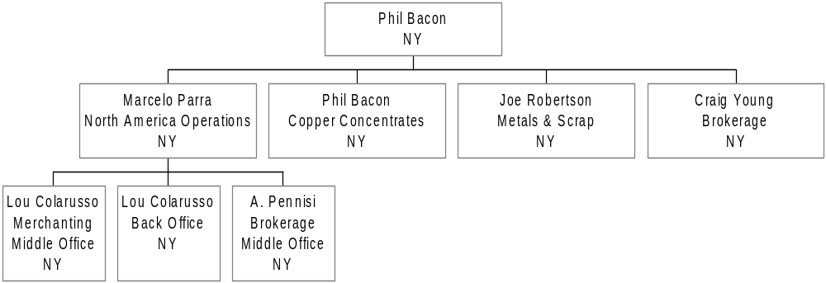
Overview of New York Office
Tom McKeever

Slide 26
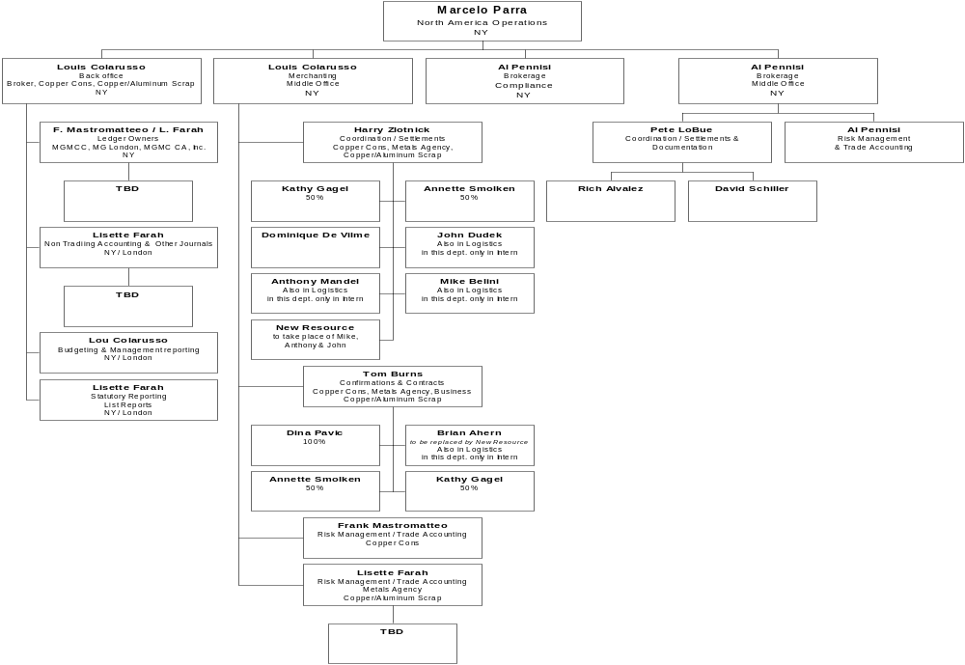
Reporting Lines for Support
Legal Dept..
TBD
New York
Kevin Rhodes
Brokerage
London
Note: All middle and
back office functions will
also report into their
respective Department
leads in London

Slide 27
Reporting Lines for Copper Concentrates
Mike Farmer
Phil Bacon
Copper Concentrates
NY
Spiro Spirakus
Trader
NY
Claus Pramer
Trader
NY
P. Benington
LME execution/logistics
NY
Dan Murphy
Shipping & Logistics
NY
Brian Ahern*
Logistics
NY
1 Person
Logistics
NY
Michael Bellini*
Logistics
NY
Anthony Mandel*
Logistics
NY
John Dudek*
Logistics
NY
* These people may, on occasion, perform certain trading functions

Slide 28
Reporting Lines for Scrap Business
Sam Hainsworth
Aluminum Scrap
Business Head
London
Joe Robertson
Scrap Trading
New York
Achim Lindhorst
Copper Scrap
Business Head
Germany
David Rosenblum
Alu Scrap Trader
Chicago
Mike Casey
Copper Scrap Trader
St. Louis
Bob Uxa
Alu Scrap Trader
Chicago
Randy Logan
Copper Scrap
St. Louis
Derik Van-Deusen
Alu Scrap Logistics*
Chicago
Ruth Zarren-Koch
Logistics Assistant
St. Louis
Stephanie Tucker
Assistant
Chicago
Rita Maria Burkett
Logistics
Chicago
Jennifer Cornfield
Logistics
Chicago
* This person may, on occasion, perform certain trading functions

Slide 29
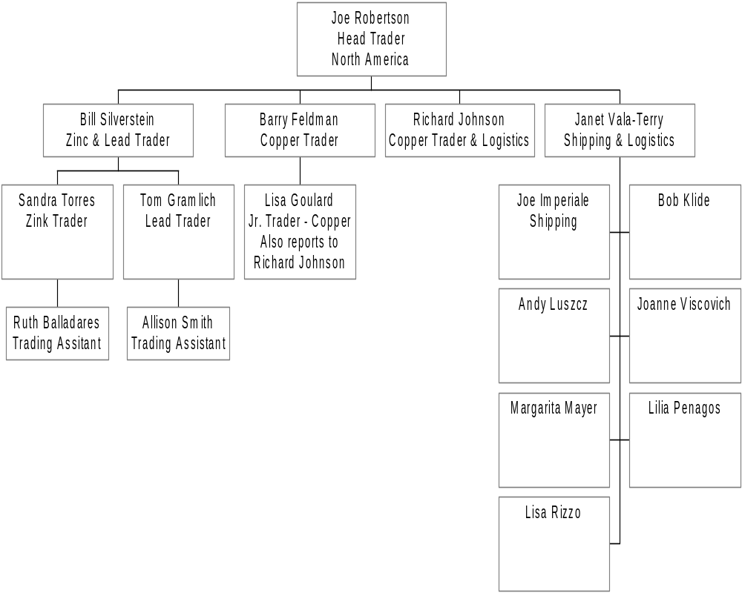
Reporting Lines for Metals Business
Mike Farmer

Slide 30
Reporting Lines for the Broker Business
Mike Hutchinson
Craig Young
Brokerage Business
Business Head
T.J. Pimpinelli
Precious
Metals
Dealers &
Brokers
Marketing
Funds
Bernie Penner
Ed Bracco
Brian Flaherty
Sid Strutt
Keith Gworzdz
Steve Kanner
Colin Crowley
Burak Hurbas
TBN
Cai Parmer

Slide 31
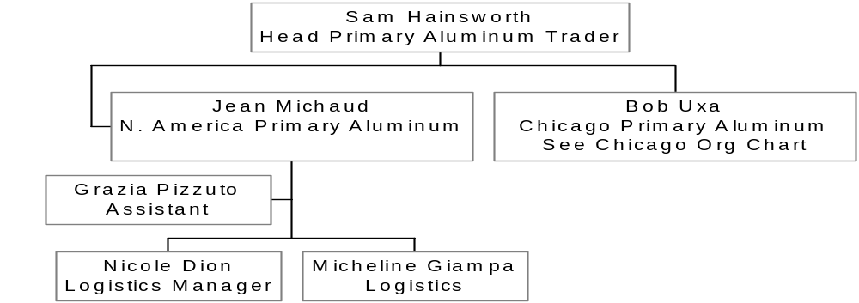
Reporting Lines for Montreal
Michael Farmer

