Slide 1


Report to the Audit and Compliance Committee Of the Board of Directors
December 11, 2000

Slide 2
2000 Overall Assessment
Observations
Magnitude of business growth and change continue to increase control environment challenge.
Overall trend continues to be toward closing identified gaps with significant improvements in 2000.
Certain areas are necessarily requiring longer-term development (i.e., systems and emerging businesses). In those areas, focus has been to ensure interim processes are performing adequately to prevent or detect material items at current activity levels.
Control Gap
Business
Activity
Ultimately Desired Process and Control Environment
Existing Process and Control Environment
Time
1

Slide 3
Assessment by
Major Business Unit
Trading and Portfolio Management
(Commodity and Related)
Wholesale
Americas Europe EES EBS Overall
Significance
Deal Execution
and Capture
Trading Operations
Valuation Activities
Portfolio Monitoring,
Analysis & Management
Overall
Comments
Trading volume increases adding significant stress to infrastructure.
Efforts to more comprehensively consolidate credit reporting and monitoring continue.
Consistency and control procedures surrounding valuation models continue to need refinement.
Portfolio risk measurement and monitoring strategies continue to evolve for newer products.
Formal position management processes related to complex positions and certain EES exposures continue to be under development.
EES efforts related to contract administration and compliance in early stages. Billing processes continue to be refined.
EBS risk books and trading processes in early stages of development. Also continued focus needed on deal capture, real time capacity information, scheduling and systems as business activity increases. A long-term systems architecture plan has been developed.
L M H
Relative significance of current business unit activity to Corporation as a whole
L M H
Degree of progress toward ultimately desired state of control environment
2

Slide 4
Assessment by
Major Business Unit
Trading and Portfolio Management
(Merchant and Other Investments)
Wholesale
Americas Europe EBS Overall
Significance
Deal Origination
Valuation Activities
Portfolio Monitoring,
Analysis & Management
Overall
Comments
Efforts underway to more consistently manage merchant investments on a portfolio vs. asset-by-asset basis.
Increased commercial group ownership of periodic asset valuation and performance reviews (now predominately performed by RAC Group) in process.
Consistent application of origination processes to all merchant and strategic asset acquisitions continues to improve.
L M H
Relative significance of current business unit activity to Corporation as a whole
L M H
Degree of progress toward ultimately desired state of control environment
3

Slide 5
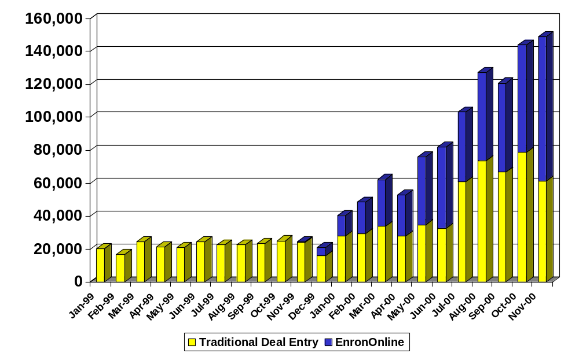
New Deal
Transactions Counts
Systems
4

Slide 6
Assessment by
Major Business Unit
Systems
Wholesale
Net Works*
Europe
EES
ETS
EBS
EIN Overall
Dependence
Access
Integrity
Availability
Overall
* Includes Web Initiatives, Corp., North America, International, and Infrastructure
Comments
Overall dependence on information technology increased significantly in 2000 due to EnronOnline and the resulting increase in transactions, and due to the imminent strategic importance of the Enron Intelligent Network.
Access
Security administration processes require formalization and consistency
Integrity
Change management processes are improving yet are inconsistent
Reliance on end user systems should be reduced
Availability
Comprehensive business continuity plans do not exist for Net Works, Europe, EES, and EBS
L M H
Business unit dependence on Information Technology
L M H
Degree of progress toward ultimate desired state of control environment
5

Slide 7




IT Controls
Control Target
Assessment
Initiatives
Security Administration
Account Management & Review
Policies
Exit Procedures
IT Control Standards
Security Administration Reorganization
Employees
Contractors
Applications & Networks
Passwords
Encryption
Authentication
Parameter Settings
Environment Controls
Change Management
Documentation
Penetration Studies
Continuity Planning
Monitoring
Dev’t Methodology
Virus Detection
Logging
Enterprise Command Center
Continuous Penetration Studies
Incident Response Team
Standardizing Development Methodology
Evaluating Continuity Planning Vendors
IT Control Standards
Applications
Databases
Infrastructure
Network OS
PCs
Demilitarized Zone
Firewalls
Monitoring
Penetration Studies
Parameter Settings
Encryption
Policies
Change Management
Testing of all DMZ changes
IT Control Standards
Host Servers
Communications
Policies
Encryption
Parameter Settings
Penetration Studies
Remote access evaluation team
Dial Up Connections
Data Communications
Voice Communications
Removable Media
Significant Current Focus
Significant 2000 Progress
Operating Effectively
6

Slide 8
Assessment by
Major Business Unit
Other Basic Controls
Wholesale
Corporate
Americas Europe EES EBS ETS & Other Overall
Significance
Comments
Management oversight and control attitude remain strong.
SAP implementation has added structure to many processes.
Significant improvements made related to consistency of cash access and disbursement controls across all business units.
Emerging businesses continue to work on developing and systemizing many core processes and controls. Significant initiatives include:
  EES account reconciliation activities and adoption of drafted operational policies
  EBS asset-tracking systems and operational policies
L M H
Relative significance of current business unit activity to Corporation as a whole
L M H
Degree of progress toward ultimately desired state of control environment
7

Slide 9
Final SEC Rules
Auditor Independence
  Substantially codifies previously existing rules except for:
  Restricts internal audit services to no more than 40% of a client’s “internal audit activities” related to internal accounting controls, financial systems or financial statements. Does not restrict “operational internal audits” unrelated to those areas.
    Currently unclear whether services pursuant to an external opinion would be affected.
    A transition period of 18 months (from anticipated January 2001 effective date) is provided to allow sufficient time to work through any issues.
  Requires annual proxy disclosure of fees paid to principal accountants for...
    Audit
    Financial information systems design and implementation
    All other services
  and comment that audit committee has considered fees in assessing independence.
8

Slide 10
Enron Assurance Services Network
Causey
Audit Committee
IT Compliance
EAS Leader
Parsons
Lindholm / Kilchrist
4-5 EAS Team Members
Wholesale - Americas, RAC
EAS Leader
Atwood
Europe
EAS Leader
Bromley
EES
EAS Leader
Barrett
EBS
EAS Leader
Gregorcyk
Corporate
EAS Leader
Wheeler
GPG
EAS Leader
Sutton
International EAS Leader
Berggren
Key Points
An independent and objective network of internal control experts positioned within the business units facilitating control improvement, working with management to align control work efforts and supervising execution of internal control programs.
Each business unit is forming a control committee which is responsible for the control environment. This group consists, at a minimum, of the COO, CAO, EAS leader and Shawn Kilchrist.
The business unit EAS Leader is 100% dedicated to improving controls and responsible to the EAS business unit control committee.
9
Notes:
1. The organization structure shown has 2 key requirements:
-The EAS leader will be 100% dedicated to control work. Job= help people sleep better at night
-A group/committee is formed, similar to a audit committee. Will direct the internal control focus and be responsible for the control environment.
2. I will sit on each committee to ensure consistency and risks are captured and addressed and inform Rick and the AC.
3. This structure:
-Adds focus
-Adds independence and objectivity
-Is in the business unit with a matrixed flavor
NOTE: Emphasis not on insource but move to a co-source to better manage it and better serve the business units.

Slide 11
Appendix

Slide 12
Assessment By Key Business Risk Area
Assessment
Comments
Strategy/
Business Portfolio
Business Integration Strategy
Strategic Portfolio Management
Competitive Analysis
New Business/Product Assessment
Political Risk Assessment and Management
Operating effectively with continuous and high degree of top management input.
See separate assessment and comments at Trading “By Business Unit” summary.
Progress being made with much improved resource commitment. See separate comments at various “By Business Unit’ summaries.
See separate assessment and comments at Trading “By Business Unit” summary.
All operating effectively with recent good progress to implement various corporate-wide control standards over treasury and cash disbursement processes.
Financial Markets
Deal Pricing and Execution
Portfolio Deal Capture
Valuation Activities
Portfolio Monitoring, Analysis & Management
Financial and Operational
Completeness and Accuracy
Core Infrastructure Development for Emerging Businesses (EES, EBS)
Trading Operations
Cash Disbursement Activities
Revenue Recording Activities
Consolidations and Intercompany Activities
Complex Accounting and Tax Transactions
Unique Foreign/Statutory Reporting Activities
Tax Compliance
(Emerging Bus.)
(Trading Ops.)
(all other)
1

Slide 13
Assessment By Key Business Risk Area
Assessment
Comments
Authority/Limit
Transaction Commitments
Physical and Financial Settlements
Bank and Brokerage Account Maintenance
All operating effectively with recent good progress to implement various control standards across business units.
See separate assessment and comments at Systems “By Business Unit” Summary.
Effective separate business unit processes. Continued efforts to more comprehensively consolidate credit reporting and monitoring and ultimately to move to real-time capabilities.
Operating effectively, current efforts primarily relate to enhancing accuracy and efficiency of current processes.
Operating effectively.
Systems
Systems Availability
Access and Security
Infrastructure
Critical Applications
eBusiness
Credit/Counterparty
Material Counterparty Assessment and Approval
Overall Position Assessment and Management
Capital Availability/ Liquidity
Needs Assessment and Monitoring
Stress Testing and Sensitivity Analysis
Legal/ Regulatory
Material Contract Review and Approval
Litigation Identification and Monitoring
Monitoring of and Compliance with Laws and Regulations
2

Slide 14
Assessment By Key Business Risk Area
Assessment
Comments
Illegal Acts/Fraud
FCPA Violation Prevention
Trading Operations
Cash Disbursement Activities
Operating effectively; current year improvements include company-wide standards over treasury and cash disbursement processes and institutionalized remote office reviews.
Operating effectively; see separate assessment and comments regarding Business Resumption at Systems “By Business Unit” summary.
Catastrophic Event
Insurance Assessment
Environmental Management System
Business Resumption
Resource and Asset Security
Critical Physical Ops
3

