Slide 1
Market Risk/Operational Risk Report
Examples of Oversight and Error
as of June 1 - August 28, 2000
Book Not Officialized
Curves Not Benchmarked
Deal(s) Not Booked
Incorrect Position
No Price/Volumetric Curve
Spreadsheet Not Loaded
VAR Not Run/Run Late
VAR Added Twice

Slide 2
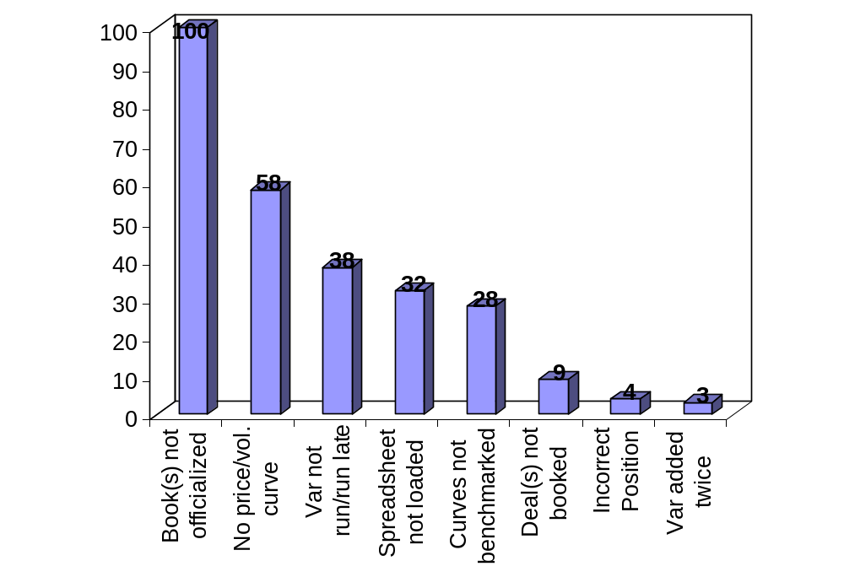
By Oversight and Error
Number of Times per Example
as of June 1 - August 28, 2000

Slide 3
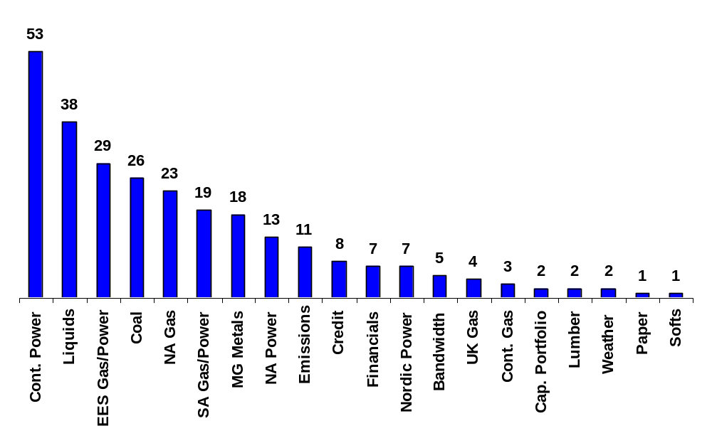
By Commodity Group
as of June 1 - August 28, 2000

