Slide 1

Wholesale/Retail Power Integration Assessment Summary
November 5, 2001

Slide 2
Table of Contents
Background
  Project Objectives
  Personnel Involved
Summary Information Flow
Functional Architecture
  Jan’ 02 Functional Architecture
  Jun’ 02 Functional Architecture
  Jun’ 03 Functional Architecture
Open Issues
Recommendations and Proposed Management Structure
Appendices
  Retail/Wholesale Similarities and Differences
  Retail/Wholesale Overall Flow
  Capability/Interface Descriptions
  Retail/Wholesale Power Interfaces
  Book Settlement Analysis
  Business Area Retail/Wholesale Flows

Slide 3
Background & Objectives
Background
  East Desk completed an initial systems gap analysis with Accenture July, 2001
  East Desk initiated project Spark Gap August, 2001 to project manage new systems development efforts
  Spark Gap and EES systems development team designed an integrated systems vision October, 2001.
  IT and business sponsored 3 week analysis project during IT offsite on October 12, 2001 to further develop the integrated Wholesale and Retail business vision.
Objectives
  Document high level Power Wholesale and Retail processes
  Develop business vision for functional systems architecture for January 2002, June 2002 and June 2003
  Identify opportunities to leverage common systems solutions across Wholesale and Retail Power in order to improve trading operations

Slide 4
Personnel Involved
The project team gathered information through discussions with Enron management from different business and IT groups.
Sponsors | Tim Belden Kevin Presto Lloyd Will | Anthony Dayao Beth Perlman
Project Leads | Todd Busby Debra Bailey
 | Retail Power |  | Wholesale Power
Origination and Structuring | Paige Grumulaitis Greg Nikkel |  | Todd Busby
Trading and Scheduling | Rogers Herndon Jeff Richter | Narsimha Misra | Corry Bentley Smith Day
Volume Risk Management | Fred Kelly Greg Woulfe Malik Avs | Vladimir Gorny Mike Frazier Beth Jenkins
Risk | Kristin Albrecht Todd Busby |  | Stacey White Todd Busby
Volume Management, Settlements and Invoicing | Murray O’Neil |  | Thresa Allen
Asset Management | Fred Kelly |  | Lloyd Will
IT | Anthony Dayao Neal Symms Mike Fink | Kenny Ha Pablo Pissanetzky | David Poston John Warner Duong Luu | Norman Lee Steve Nat Mike Marryott

Slide 5
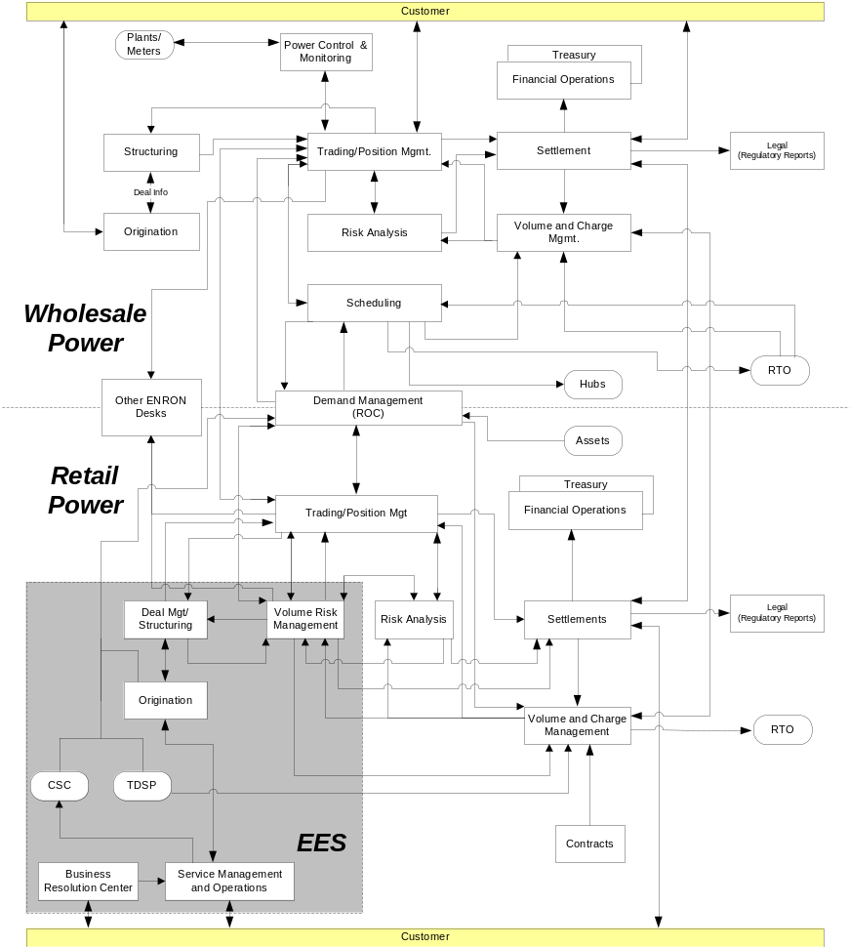
Summarized Findings & Information Flow
Commonality Across Retail & Wholesale Power Functions
  Enter and manage shaped and block positions
  Valuate, liquidate and flash shaped and blocked positions
  Allocate RTO volumes and charges to counterparties and books
  Establish positions and generate invoices with counterparties and customers
  Monitor and control physical assets to support demand management and generation products
Multiple Architectures Performing Similar Functions Across Retail & Wholesale Power
  Calculation engines used for structuring, valuation, liquidation and settlements
  Deal entry infrastructures, e.g., EnPower, Everest, spreadsheets
  Volume management infrastructures, e.g., spreadsheets, ESCA, VMS
  Scheduling infrastructures, e.g., FSP, ESCA, spreadsheets
  Reporting infrastructures
  Billing/settlement systems (CSC, Avista, Genesys, UNIFY, Edge - Calgary)

Slide 6
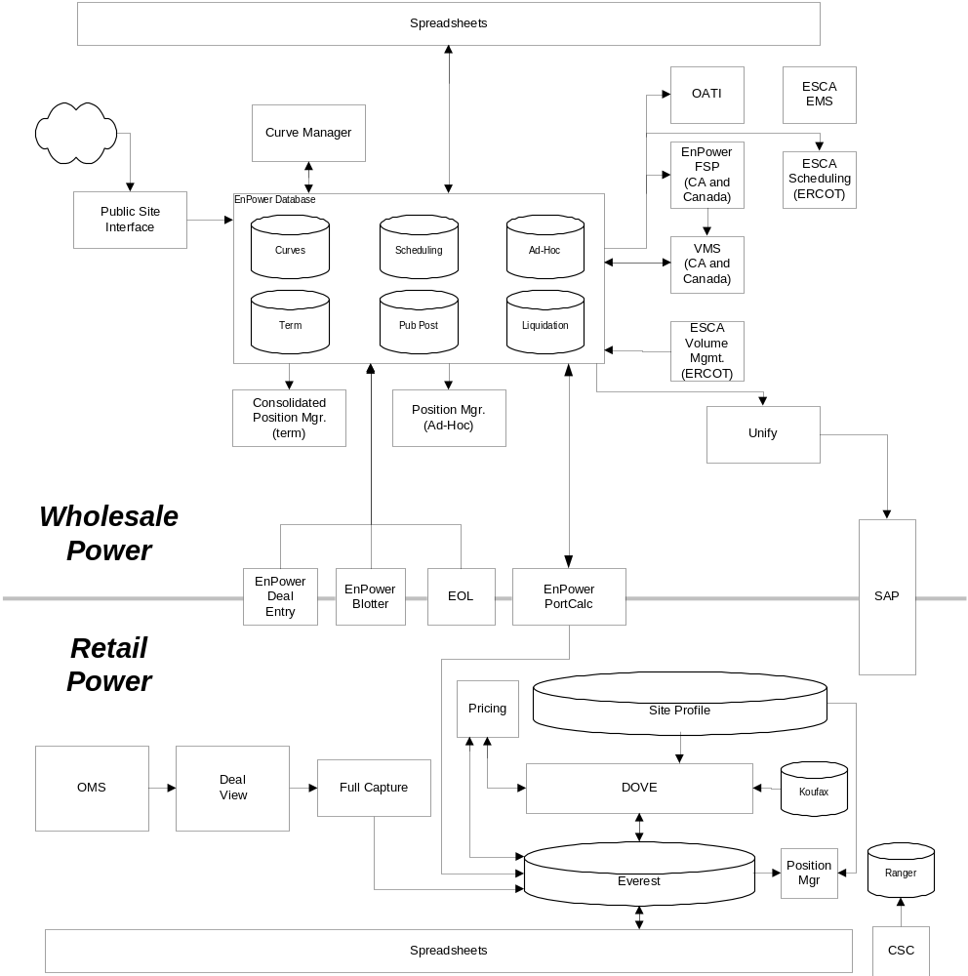
January 2002 Functional Architecture - Assumptions
Wholesale
Existing EnPower Infrastructure
FSP for scheduling to California/Canada markets, ESCA MOS for ERCOT scheduling, and websites/spreadsheets for other markets
VMS for California/Canada volume management, ESCA for ERCOT volume management, and spreadsheets for other markets
Unify for billing/settlements
Retail
Deal View/Dove used for deal structuring, pricing, and valuation
Everest database / Deal View architecture to manage positions
KOUFAX for curve management
Ranger to store billing history
EnPower for blocked deal entry (PortCalc results pushed Everest database)
CSC, Avista and spreadsheets for billing/settlements

Slide 7
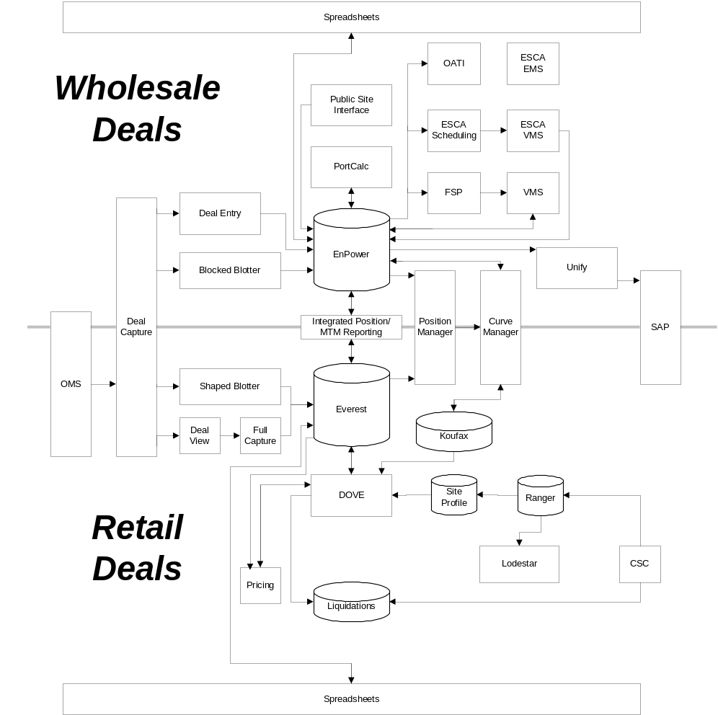
June 2002 Functional Architecture
Business Requirements
Provide an integrated view of wholesale and retail positions
Provide Wholesale an Retail efficient data models for both shaped deals and blocked deals
Architecture Recommendations
Common interface for deal capture linked to Everest database and EnPower database
Shaped deals stored in Everest and blocked deals stored in EnPower
Shaped deals valued in Dove, block deals valued in PortCalc
Retail, Wholesale and other commodity positions provided by consolidated postion manager
Curve management provided by integrated curve manager
Integrated reporting provided by shared reporting mechanism
Illustrative

Slide 8
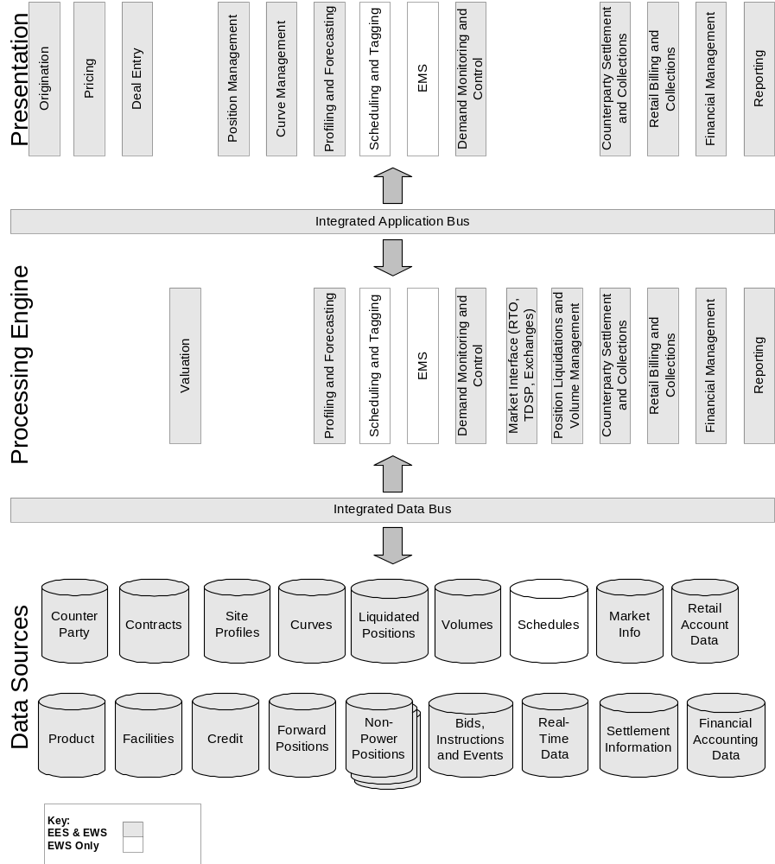
June 2003 Functional Architecture
Business Requirements
Eliminate unnecessary reconciliation between systems
Support single integrated process for volume management
Support rapid flash to actual analysis
Support integrated view of profits & losses
Different types of deals entered efficiently
Architecture Recommendations
Single position management application
Single curve management application
Flexible deal entry
Common volume management engine
Single settlements engine for gas and power
Flexible and integrated reporting engine, e.g., positions, P&L
Common repositories for all shared data

Slide 9
Open Issues
Power IT and operations remain organizationally divided between Wholesale and Retail
  Wholesale and Retail trading under one management structure and have developed one systems architecture business vision
  WHS and retail IT developing separate solutions to support wholesale and retail requirements (blocked versus shaped deals)
  Wholesale FSP, VMS and Curve Manager applications require EnPower architecture and will not run on Everest
  Divided teams will prohibit achieving integrated June ’02 and June ’03 visions
Settlements development efforts are not global
  Retail, wholesale and Canada developing separate solutions
  No movement towards single settlements system
Coordinated effort required to manage the design, development, test and transition of the business to the June ’02 and June ’03 visions

Slide 10
Recommendations
Create one power IT & one operations organization for retail and wholesale
Create power program management team to coordinate business requirements for trading/deal capture, risk, settlements & volume mngt across wholesale and retail desks:
  East, West, and Canada power requirements included
  requirements globally coordinated and prioritized
  design coordinated and approved by business owners
  vision achieved in phased release of tactical and strategic solutions
Coordinate Gas and Power systems requirements to develop integrated systems solution where appropriate (such as billing/settlements)

Slide 11
IT & Operations versus Trading
Organizations
EES IT
(WHS & Retail)
Wholesale IT
(WHS & Retail)
EES Operations
(Retail)
Wholesale
Operations
(WHS)
Today
Power Trading
(WHS & Retail)
Gas Trading
(WHS & Retail)
Recommended
Power IT & Operations
(WHS & Retail)
Power Trading
(WHS & Retail)
Integrate systems
where appropriate
Gas IT & Operations
(WHS & Retail)
Gas Trading
(WHS & Retail)

Slide 12
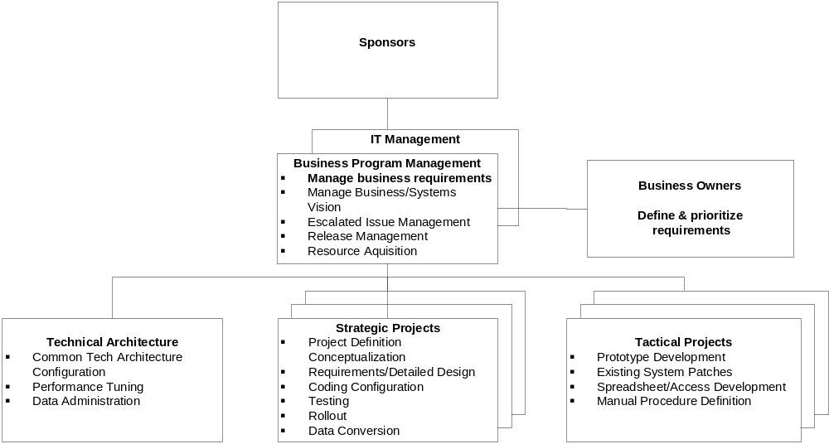
Proposed Management Structure
Recommend business requirements managed by business sponsored
program management teams (expand Spark Gap project)
Recommended Program Management Team:
Trading/Deal Capture – WHS/Retail
Risk – WHS/Retail
Volume Management – WHS/ Retail
Settlements – WHS/Retail (Gas & Power)

Slide 13
Appendices
Appendices
  Retail/Wholesale Similarities and Differences
  Retail/Wholesale Overall Flow
  Capability/Interface Descriptions
  Retail/Wholesale Power Interfaces
  Book Settlement Analysis
  Business Area Retail/Wholesale Flows

Slide 14
Retail/Wholesale
Similarities and Differences
In many cases Retail and Wholesale execute conceptually similar business processes. However for Retail, the transaction volumes and the level of their granularity are greater.
 | Retail / Wholesale Similarities | Retail / Wholesale Differences
Origination and Structuring | Both Wholesale and Retail perform enrollment processes. Both Wholesale and Retail perform custom structured and non-structured deals for large customers. Both Wholesale and Retail structure deals with variable load shape and block components. Both Wholesale and Retail execute many deal types – e.g. full requirements, asset management, multi-commodity, ICAP, transmission services). Both Wholesale and Retail utilize matrix pricing/on-the-spot mechanisms for deal closure. Wholesale uses EOL and Retail uses Enron-Direct. Both Wholesale and Retail need to consider operations capabilities and costs in their structuring process. | Retail customer enrollment processes are much higher volume than Wholesale. Retail utilizes some channels not used by wholesale e.g., agents Retail requires data gathering and validation activities to support load profiling. Retail able to apply standard product components to support custom structured deals. Retail predominantly originates variable load shape deals and Wholesale predominantly executes block forward deals.

Slide 15
Retail/Wholesale
Similarities and Differences
 | Retail / Wholesale Similarities | Retail / Wholesale Differences
Trading and Scheduling | Conceptually both Retail and Wholesale perform similar trading processes. Both wholesale and retail look for trading opportunities with counter-parties (either external or book-book) to manage volume and/or price risk. Both wholesale and retail through their origination processes (EOL, Enron-Direct) develop open positions which need to be covered. Both Wholesale and Retail need to enter deals which can be of a shaped or block forward nature. Both wholesale and Retail need to use (and update as needed) price curves which reflect the value of forward positions in the market. Both wholesale and retail need to understand the P&L for all the positions managed by them at a trader and desk level. Both Wholesale and Retail need to be able to view and update positions in their book to manage their exposure and risk. Both wholesale and Retail need to confirm the terms of each of their positions with counter-parties. Both Wholesale and Retail need to manage the physical flows with their respective operating organizations Scheduling with RTOs Retail trading with ROC (demand management instructions) | Wholesale schedules RTO and HUB flows where Retail only manages demand side power flow Significant volumes of Wholesale deals are booked out (with other Wholesale books or with counter-parties) where most Retail deals flow to physical delivery. Retail publishes daily prices to support pre-structured matrix deals for Retail sales force. Wholesale publishes offers and bids positions on EOL for a counter-party. Retail generates load profiles and baseline forecasts for customers to support volume risk management needs (in general not required by Wholesale). Retail maintains greater numbers of curves and position than wholesale although the average volume associated with retail deals is smaller than wholesale. Retail requires accurate switching date information to support forecasting and volume risk management processes.

Slide 16
Retail/Wholesale
Similarities and Differences
 | Retail / Wholesale Similarities | Retail / Wholesale Differences
Risk Analysis | Both Wholesale and Retail value both blocked and shaped deal components Conceptually Retail and Wholesale risk analysis complete similar business functions Both Wholesale and Retail perform MTM valuation and P&L report generation at book level. Both Wholesale and Retail perform Liquidation and “flash” generation Both Wholesale and Retail provide corporate analysis information (e.g., VAR calculation input data) Both Wholesale and Retail perform disputed volume/charge allocation to books Both Wholesale and Retail perform curve auditing Both Wholesale and Retail perform control processes | Wholesale predominantly values blocked deal components and Retail predominantly values shaped deals components Retail needs to audit volume profiles used to generate account level volume forecasts (not required in Wholesale)

Slide 17
Retail/Wholesale
Similarities and Differences
 | Retail / Wholesale Similarities | Retail / Wholesale Differences
Volume Management | Conceptually lots of common business functions however retail transaction volume and granularity differs from wholesale. e.g., Both wholesale and retail gather actual information such as schedules, bids, consumption/production, indexes to support adjustments and allocations Both wholesale and retail aggregate actuals to verify counterparty/RTO settlements Both wholesale and retail disaggregate actuals to positions and books for volume and charge allocation Both wholesale and retail perform RTO and TDSP charge estimation/calculation to reconcile counterparty/RTO/TDSP information Both wholesale and retail need to identify discrepancies and manage disputes with counterparties including RTOs Both wholesale and retail require regulatory reporting support | Both require similar input data but may gather it from different sources at different granularities Wholesale aggregates forecast/actual information to the RTO schedule level while Retail aggregates forecast/actual meter level usage to the wholesale position level Retail completes backcasted meter level consumption estimation to reconcile wholesale allocations Retail calculates proof of performance on demand control products (e.g., load curtailment, distributed generation) Wholesale performs charge estimation for RTOs while Retail calculates their allocation of the wholesale charges Wholesale allocates RTO volumes and charges to wholesale positions while Retail allocates Wholesale volumes and charges to retail account level positions

Slide 18
Retail/Wholesale
Similarities and Differences
 | Retail / Wholesale Similarities | Retail / Wholesale Differences
Settlement | Conceptually lots of common business functions for Retail and Wholesale however transaction volumes and granularity are higher within Retail. e.g., Both wholesale and retail process physical deals Both wholesale and retail perform counterparty/intercompany bill calculation and invoicing Both wholesale and retail perform aggregation and netting of actual information to the counterparty level Both wholesale and retail perform counter-party checkout Both wholesale and retail perform billing adjustments Both wholesale and retail perform cash management (A/R and A/P) with differences between granularity of accounting entries Both wholesale and retail reconcile risk to G/L (flash to actuals) Both wholesale and retail require multiple potentially common interfaces to support settlement Both wholesale and retail book financial transactions to G/L following Enron policy (“seller rules”) | Retail processes deals that result in physical delivery Retail typically performs checkouts with counter-parties by exception Retail leverages CSC for A/R Retail and Wholesale both complete “flash to actuals” but the number of transactions associated with Retail is greater Retail currently has more complex interfaces to support settlement (e.g., switching and usage from CSC, collections from service management, capacity from TDSPs, checkouts with large customers, market specific rules associated with 1 or 2 retail bills)

Slide 19
Retail/Wholesale
Similarities and Differences
 | Retail / Wholesale Similarities | Retail / Wholesale Differences
Asset Management | Both Retail and Wholesale perform monitoring and control of physical assets. | ROC is responsible for retail asset management and Gen. Desk is responsible for wholesale asset management Retail provides scheduling data and Wholesale executes scheduling instructions.

Slide 20
Retail/Wholesale Summary Information Flow
See Visio Drawing

Slide 21
Wholesale Capability/Interface Descriptions
Capability | Description | Inputs | Outputs
Origination | Work with customer to confirm needs Gather customer data Work with Structuring to translate customer needs into product offering Develop a notional and executable price to meet customer needs Sign contract with customer | Customer info Pricing signals and deal structure information from Structuring Global counter-party, credit and contracts information | Deal information to Structuring Contract with customer Updated counter-party, credit and contract information to global
Structuring | Analyze customer financial information Translate customer origination requirements into deal components Perform price modeling for an originated deal. Develop a notional and executable price to meet customer needs Structure all terms of the deal (Legal, Credit, financial, volumes) Work with Trading to confirm deal parameters and pricing Approve Deal price Reconcile Deal valuation with Risk | Price signals from Trading Customer requirements from origination | Deal structure to origination Executed Deal to trading Deal valuation to risk

Slide 22
Wholesale Capability/Interface Descriptions (cont’d)
Capability | Description | Inputs | Outputs
Trading and Position Management | Determine trading opportunities – Create bids and offers. Enter deals Manage positions in the real-time (on the day), cash (on the month), and term (beyond one month) time frames. Forecast market trends, develop and maintain forward price curves. Negotiate pricing with Structuring Trade with Counter-parties Develop and execute hedging strategies with counter-parties Take wholesale positions against Retail positions. Generate market instructions (demand and generation) for assets under control. Manage services positions through the use of Power Control and Monitoring. | Non-structured Bids/offers from counter-parties (and EOL) and originated deals from structuring Net open positions by book from Scheduling Positions from Retail Information for Real-time trading from ROC Adjustments and Allocations from Volume and Charge Management Daily position and P&L information from Price Risk Analysis Market Information from Fundamentals group Value at risk from Global Risk | Closed Deals Net positions to Scheduling Deals for valuation Liquidated positions to settlements Confirmed positions to reflect Retail/Wholesale, Counter-Party trades Forward price curves Instructions to ROC and Power Control and Monitoring Prices to Structuring
Risk Analysis | Valuate forward positions. Generate liquidated position values Maintain desk P&L Reconcile valuations with Structuring Reconcile Flash/Actual with Settlements Audit price curves Provide risk data to corporation | Deals, forward (mid) price curves from Trading Adjustments and allocations from Volume and Charge Management Public market information – indexes Currency and interest rates from global Pre-valued non-power commodity valuations | Position and valuation reporting to the trading desk Information to support Global Credit, Risk and cash flows analysis Liquidated valuation (Flash) to settlements

Slide 23
Wholesale Capability/Interface Descriptions (cont’d)
Capability | Description | Inputs | Outputs
Scheduling | Flattens trader positions Analyze and execute trader positions book-out activity Performs routing and pathing to ensure electricity can get from source to sink Schedules net positions at hubs and RTOs/ISOs Obtains transmission reservations from various OASIS sites Create and maintains eTags Sends Bids (includes demand schedules from ROC) into RTO/ISO markets Manages schedule and bid information | Net positions from Trading and Positions Management Demand schedules (by zone for demand, and by unit for generation) from ROC Schedule/bid confirmations from RTO/ISOs eTag and OASIS confirmations from OASIS and eTag sites | Bids/schedules to RTOs/ISOs Tags, transmission reservations to transmission owners Schedules to volume and charge management Demand scheduling information actuals to ROC Scheduling information to Trading and Position Management to support Book-out and Flattening
Power Control and Monitoring | Manage services deals for trading by providing monitoring and control services to IPPs | Services positions from trading Data from Power Plants | Sending controls to the power plants Actuals (after-the-fact) for the services deals to Trading and Position Management Actuals to Volume and Charge Management.

Slide 24
Wholesale Capability/Interface Descriptions (cont’d)
Capability | Description | Inputs | Outputs
Volume and Charge Management | Gather and validate actuals information Aggregate actuals to schedule level. Estimates volumes and charges Reconciles estimated values with the settlement charges from ISOs/RTOs Allocates volumes and charges to all wholesale positions Adjusts deals as appropriate based on after-the-fact analysis of actuals Provide Risk with information on adjustments to re-valuate deals Manage dispute processing | Actual RTO Schedules sent Confirmed bids, wholesale actuals and ISO/RTO settlement charges from RTOs/ISOs. Disputes from settlements Disputes and dispute information from Retail Actual TDSP information from Retail | Allocated charges to wholesale positions Adjustments and allocations to price risk analysis and trading and position management Disputes with RTOs/ISOs Inter-company dispute information to Risk
Settlements | Performing financial settlement of a deal Handling Flash to Actuals analysis Generate disputes Counter-Party netting and aggregation of Buys and Sells Cash forecasting, A/R, A/P entries, generate invoice statement Provide summary financials to Financial Operations Customer check-out | Liquidated positions from trading Liquidated valuation (flash) from Risk Analysis Settlement information from Retail and other counter-parties Global counter-party contract, credit, facilities and other information to support settlements | Disputes to volume and charge management Summary financials to financial operations Inter-book transfers (journal entries) to Retail settlements Regulatory reports through Legal Invoices/statements to counter-parties and Retail

Slide 25
Retail Capability/Interface Descriptions
Capability | Description | Inputs | Outputs
Origination | Work with customer to confirm needs Gather customer data Work with Structuring to translate customer needs into product offering Develop a notional and executable price to meet customer needs Sign contract with customer Work with agents and third-parties for matrix deals (to initiate and close deals on a single call) | Customer info (includes bills – one bill for matrix and one-year of bills for structured) Pricing signals and deal structure information from Structuring Pricing matrix from Trading and Position Management. Global counter-party, credit and contracts information | Deal information to Structuring Contract with customer Pre-structured deals to trading directly Deal information to service management Updated counter-party, credit and contract information to global
Deal Management/ Structuring | Analyze customer financial information Translate customer origination requirements into deal components Perform price modeling for an originated deal. Develop a notional and executable price to meet customer needs Structure all terms of the deal (Legal, Credit, financial, volumes) Work with Trading to confirm deal parameters and pricing Approve Deal price | Price signals from Trading Profiles and prices from Site-profile desk Preliminary deal terms from origination Operational cost information | Deal structure to origination Executed Deal to Volume Risk Management and Trading and Position Management

Slide 26
Retail Capability/Interface Descriptions (cont’d)
Capability | Description | Inputs | Outputs
Volume Risk Management | Includes the Site Profile Desk which takes positions by developing baseline forecasts Includes the Volume Desk which takes positions on DG, DSM, Load curtailment Develop and execute hedging strategies Provides profiles and prices to structuring and other desks Performs load forecasting (short and long term) Provides (Demand and generation) instructions to ROC Manage Desk and position P&L Plan and execute DSM, LC and DG projects Deal terms and contract information from Structuring | Adjustments and allocations from Volume and charge management Metered data from all sources to develop baseline Economic and company information to support site profile development Weather forecasts and other historical data for short-term forecasting ROC actions and actual data regarding actions on positions executed Valuations from Risk Bids and offers from other counter-parties (including wholesale and Retail trading) | Volume positions to trading Instructions to ROC Load profiles and prices to Structuring Actual consumption to Volume and charge management Bids and offers to other counter-parties (including wholesale and Retail trading) Liquidated positions to Settlements Hedges with other counter-parties

Slide 27
Retail Capability/Interface Descriptions (cont’d)
Capability | Description | Inputs | Outputs
Trading and Position Management | Manage retail positions for all retail demand needs. Determine trading opportunities – Create bids and offers. Enter deals Forecast market trends, develop and maintain forward price curves. Negotiate pricing with Structuring Develop pre-structured pricing for Enron-Direct Trade with Counter-parties Develop and execute hedging strategies with counter-parties Work with Wholesale and help them take positions to cover retail obligation. Generate instructions and notifications to ROC to implement DSM controls, Load Curtailment, or to operate a DG. | Non-structured Bids/offers from counter-parties (and EOL) and originated deals from structuring Fulfilled positions from Wholesale Adjustments and Allocations from retail Volume and Charge Management Daily position and P&L reports from retail Risk Analysis Information for Real-time trading from ROC Value at risk from Global Risk | Closed Deals Instructions, notifications and retail load positions from ROC Deals to valuation Liquidated positions to settlements Deal information to CSC for mass retail. Confirmed positions to reflect Retail/Wholesale, Counter-Party trades Forward price curves Instructions to ROC and Power Control and Monitoring Prices to Structuring

Slide 28
Retail Capability/Interface Descriptions (cont’d)
Capability | Description | Inputs | Outputs
Risk Analysis | Valuate forward positions. Generate liquidated position values Maintain desk P&L Reconcile Flash/Actual with Settlements Audit price and volume curves Provide risk data to corporation for V@R calculation | Deals, forward (mid) price curves from Trading and Position Management Adjustments and allocations from Volume and Charge Management Public market information – indices Currency and interest rates from global Inter-company disputes information from Financial Operations | Position and valuation reporting to the Trading and Position Management Position and Valuation reporting to Volume Risk Management Information to support Global Credit, Risk and cash flows analysis Liquidated valuation (Flash) to settlements
Demand Management (ROC) | Maintaining baseline measurement (consumption and generation) data to support site profiling and other data requests Implementing load curtailment (LC), demand side management (DSM), and distributed generation (DG) operations Provides DSM support and analysis (Performance Verification – PV) Works with Scheduling to bid and manage LC/DG activities in the RTO/ISO space. Works with desks to provide demand information and implement their LC/DG/DSM instructions (obtains customer agreement and to executes control) Provides actual demand management information to Volume Management for allocation | Measurement information from various sources (e.g., assets) Trading instructions from Wholesale Trading and Retail Trading Actual bid information from Scheduling Customer acceptance of LC instructions | Demand schedules (by zone for load and by unit for generation) to Wholesale Scheduling Real-time information to support Trading and Position Management Asset management notification decisions (by account for load and by unit for generation) to Volume and Charge Management Instructions and notifications to demand and generation assets

Slide 29
Retail Capability/Interface Descriptions (cont’d)
Capability | Description | Inputs | Outputs
Volume and Charge Management | Gather and validate actuals information Aggregate actuals to wholesale position level. Estimates volumes and charges Reconciles estimated values with the settlement charges from wholesale counter-Parties (including Wholesale Volume and Charge Management) Allocates volumes and charges to all Retail positions Adjusts deals as appropriate based on after-the-fact analysis of actuals Provide Risk with information on adjustments to re-valuate deals Manage dispute processing Develop baseline justification reports to RTOs/ISOs for demand and generation performance verification | Notifications (by account for load, by unit for generation) from ROC Actual consumption from volume risk management Contract terms contracting Allocated charges from Wholesale volume and charge management Disputes from Retail Settlements Actual measurement data from ROC Actual TDSP information | Allocated charges to retail positions Adjustments and allocations to Risk, Volume Risk Management and trading and position management Disputes and supporting information to Wholesale. Inter-company dispute information to Risk Baseline justification reports to RTOs and ISOs for demand and generations performance verification
Settlements | Performing financial settlement of a deal Handling Flash to Actuals analysis Generate disputes Counter-Party netting and aggregation of Buys and Sells Cash forecasting, A/R, A/P entries, generate invoice statement Provide summary financials to Financial Operations Customer check-out by exception | Liquidated positions from trading and Volume Risk Management Liquidated valuation (flash) from Risk Analysis Settlement information from Wholesale and other counter-parties Global counter-party contract, credit, facilities and other information to support settlements | Disputes to volume and charge management Summary financials to financial operations Inter-book transfers (journal entries) to Retail settlements Regulatory reports through Legal Invoices/statements to counter-parties and customers

Slide 30
Retail/Wholesale Power Interfaces
Interfaces required to extract maximum value from the business.
1. Wholesale Volume Management / Retail Volume Management
  Actual wholesale charges and allocations at schedule/bid (for LC, DG, etc.) level provided to retail volume management to allocate to customers and books.
  Detailed retail data (e.g., consumption, rate, price) from Retail to Wholesale to support RTO dispute resolution (actual or backcasted).
  Aggregated TDSP data not provided to Wholesale by the RTO directly.
2. Wholesale Settlement / Retail Settlement
  Estimated or actual settlement information and supporting docs to facilitate internal checkout between Retail and Wholesale. The wholesale deal checkout is standardized while RTO timing and approach for checkout may vary by RTO.
  Financial transfer payments reflecting settlement between Retail / Wholesale positions (seller initiates payment per Enron policy)
3. Wholesale Trading / Retail Trading
  Retail sends net positions to wholesale over EOL or through direct communication with desks
    Physical positions to cover open retail net positions.
    Hedge positions used to manage retail risk.
4. Wholesale Scheduling / Retail ROC
  ROC sends demand instructions (load by zone, generation by unit) to scheduling for bidding into RTOs.
  ROC receives status on all bids from scheduling. This includes bids which were sent to Scheduling but were not bid into the RTO.
  ROC send short term forecast information to Scheduling to support near term scheduling requirements.
5. Wholesale Trading / Retail ROC
  Wholesale Trading (real-time desk) provides demand management instructions to ROC (on volume positions taken) and receives confirmation around execution of those instructions.
  Wholesale Trading (real-time desk) receives near term forecast information from ROC to assist in trading decision making.

Slide 31
Book Volume Management Settlement Analysis
See Visio Drawing

Slide 32
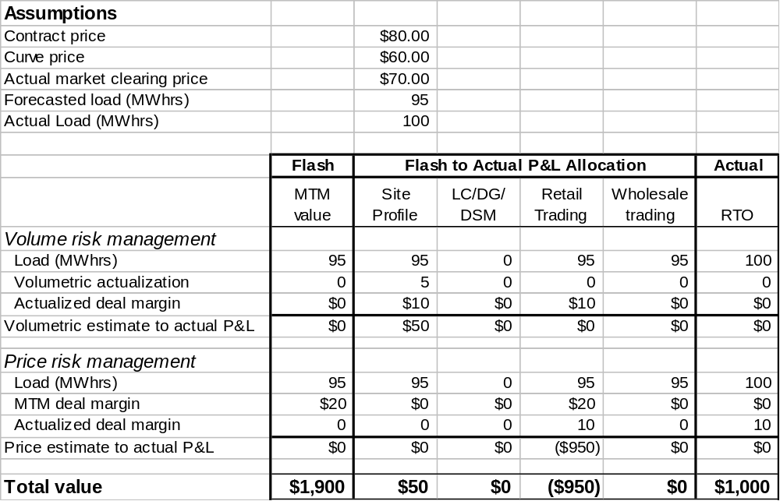
Flash to Actual
P&L Allocation Example

Slide 33
Book Volume Management Example (no demand management)
The following example illustrates the commonality of processes for retail and wholesale volume management for a retail deal in an open access RTO market.
 | Customer Contract | Site Profile | LC/DG/DSM | Retail Trading | Wholesale Trading | Generator/ Counterparty | RTO
Contract Info Flow | 10 | 10 | 0 | 10 | 10 | 10 | 10/10
Imbalance Settlement Info Flow | 9 | 9 | 0 | 9 | 9 | 10 | 9/10
10MW @ $15
10MW @ $12
10MW @ $10
1
2
10MW @ $13
3
4
balanced schedule
5
9
7
1MW @ $15
1MW @ MCP
8
1MW @ MCP
6
1MW @ MCP
Site Profile makes 5$ on volume variance @MCP=$20
Site Profile loses 5$ on volume variance @MCP=$10
Actual consumption is less than scheduled
Assumptions | Steps
All contract prices fixed (Customer price fixed for variable volume) All Enron imbalance settlements at MCP All prices are bundled at full requirements price LC, DG, and DSM have no volume position Actual retail consumption is 9MW Actual generator production is 10MW The extra production of 1MW was sold in RTO imbalance market at MCP | Site Profile has volume obligation of 10 MW at $15/MW with customer Retail Trading picks up volume obligation of 10 MW at $13/MW with Site Profile Wholesale Trading picks up volume obligation of 10 MW at $12/MW with Retail Trading Wholesale Trading covers volume obligation by purchasing 10 MW at $10/MW Wholesale Trading submits balanced schedule to RTO (10 obligation, 10 production) RTO reimburses Wholesale Trading for extra production at MCP Wholesale Trading reimburses Retail Trading for lower consumption at MCP Retail Trading reimburses Site Profile for lower consumption at MCP Site Profile settles with Customer Contract for actual consumption at $15

Slide 34
Book Volume Management Example (with demand management)
This example adds a load curtailment position to the prior example. During the volume management process, it is determined that expected load curtailment did not occur.
 | Customer Contract | Site Profile | LC/DG/DSM | Retail Trading | Wholesale Trading | Generator/ Counterparty | RTO
Contract Info Flow | 10 | 10 | 2 | 8 | 8 | 8 | 8/8
Imbalance Settlement Info Flow | 9 | 9 | 1 | 8 | 8 | 8 | 8/8
10MW @ $15
3
8MW @ $12
8MW @ $10
1
2MW @ $9
4
5
balanced schedule
2
10MW @ $13
6
9
7
1MW @ $15
1MW @ MCP
1MW @ MCP
8
Site Profile & LC are each responsible for offsetting 1MW imbalances
Actual consumption & production are balanced
Assumptions | Steps
All contract prices fixed (Customer price fixed for variable volume) All Enron imbalance settlements at MCP All prices are bundled at full requirements price A 2MW load curtailment position is taken Actual retail consumption is 9MW Actual generation is 8MW Actual load curtailment is 1MW (non-performance indicated by ROC) There is no RTO imbalance | Site Profile has volume obligation of 10 MW at $15/MW with customer Retail Trading picks up volume obligation of 10 MW at $13/MW with Site Profile Retail Trading exercises 2MW LC option at $9/MW with LC/DG/DSM Wholesale Trading picks up volume obligation of 8 MW at $12/MW with Retail Trading Wholesale Trading covers volume obligation by purchasing 8 MW at $10/MW Wholesale Trading submits balanced schedule to RTO (8 obligation, 8 production) Retail Trading reimburses Site Profile for lower consumption at MCP LC/DG/DSM reimburses Retail Trading for non-performance at MCP Site Profile settles with Customer Contract for actual consumption at $15

Slide 35
Retail/Wholesale Business Area Flows
Retail Origination & Structuring
Wholesale Origination & Structuring
Retail Risk Analysis
Wholesale Risk Analysis
Retail Trading and Scheduling
Wholesale Trading and Scheduling
Retail Volume Management and Settlements
Wholesale Volume Management and Settlements
Retail Asset Management
See Visio Drawings

