Slide 1
Selective Test-Time Adaptation for Streaming APT Stage Detection
Under Source-File Shift
Praxis 06 defense result: narrow, locked, cloud-audited
Core claim: safety-gated no-label TTA recovers shifted Reconnaissance without a broad TTA generality claim.
Notes:
Open by saying this is the lead positive result after portfolio triage. The claim is deliberately narrow and evidence-bounded.

Slide 2
The Problem
APT stage detection under deployment-style shift
Source-file, day, host, and traffic shift are deployment realities.
Rare stages can collapse even when the overall detector appears usable.
Reconnaissance is operationally important but fragile under shift.
Security ML needs improvement without damaging high-consequence stages.
Notes:
Frame this as deployment realism, not benchmark polishing.

Slide 3
Why Previous Paths Were Not Enough
Praxis 04 stage routing failed under shift.
Treatment-Stage Macro-F1 0.5981 vs Baseline-TSE 0.6313.
Stage-conditioned imbalance did not rescue rare classes cleanly.
OpTC provenance labels are ready; detector generalization remains blocked.
Notes:
This sets up why we moved from more routing or weighting to deployment-time adaptation.

Slide 4
Research Questions And Decision Gates
Question | Gate
Improve Macro-F1? | delta >= +0.05
Recover Recon? | delta >= +0.25
Preserve DE? | mean delta >= 0; per-seed >= -0.05
Stay selective? | override <= 0.05 in locked replay
More than filtering? | confidence-reject Recon remains collapsed
Notes:
Emphasize that gates prevent a broad post-hoc tuning story.

Slide 5
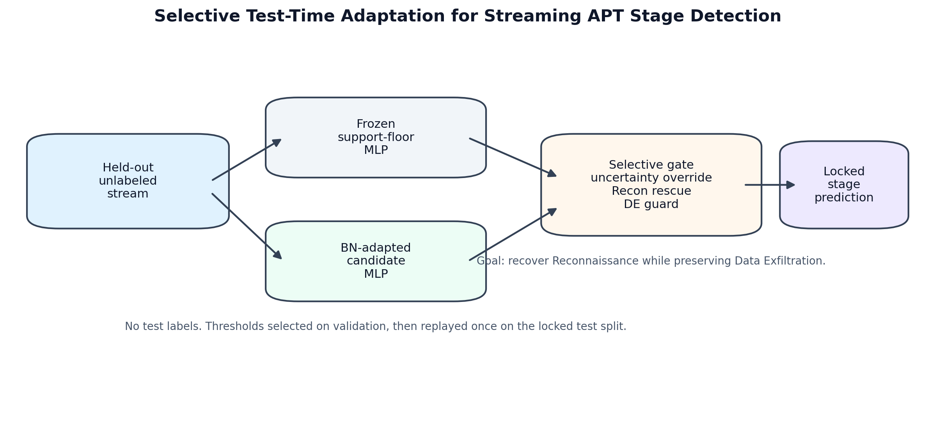
Method: Selective TTA
Frozen support-floor MLP produces baseline probabilities.
BatchNorm adaptation updates unlabeled stream statistics.
recon_guarded gate accepts only selected adapted decisions.
Confident Data Exfiltration predictions are protected.
Notes:
The method is not unconstrained TTA. The safety gate is the contribution.

Slide 6
Data And Leakage Controls
Split | Rows | Sources | Recon | DE
Train | 307,733 | 142 | 5,151 | 3,077
Validation | 61,886 | 6 | 23,791 | 2,253
Test | 65,869 | 25 | 5,852 | 2,192
Held-out source-file split.
Zero source/group overlap across splits.
Temporal deltas use reset_each_split.
Validation is Recon-heavy; sensitivity check is reported.
Notes:
Name the validation/test Recon gap before the committee does.

Slide 7
Main Locked Result
Method | Macro-F1 | Recon F1 | DE F1 | PR-AUC | Rate
Frozen MLP | 0.7685 | 0.0250 | 0.9157 | 0.8732 | 0.0000
Locked selective TTA | 0.8658 | 0.5050 | 0.9202 | 0.8738 | 0.0470
Macro-F1 delta: +0.0974.
Recon F1 delta: +0.4800.
PR-AUC delta: only +0.0006.
Interpretation: operating-point decision-policy improvement.
Notes:
Say clearly: this is not a broad ranking-quality gain.

Slide 8
Alternative Explanation Check
Critique: maybe TTA only filters uncertain rows.
Control: reject the same fraction of frozen predictions.
Matched reject rate: 4.7%.
Result: frozen confidence rejection leaves Recon F1 at 0.0000.
Baseline | Reject | Macro | Recon | DE
Frozen confidence reject | 0.0470 | 0.7730 | 0.0000 | 0.9374
Notes:
This is the strongest defense against the simplest critique.

Slide 9
Defense Hardening
Seven-seed robustness: Recon F1 0.5147 +/- 0.0589.
Validation-distribution sensitivity mostly preserves the effect.
Stronger frozen baselines still collapse on Recon.
BN stream-order ablation checked.
Override-to-Recon fraction: 0.8075; override-from-DE count: 0.
Notes:
Hardening supports the locked story but does not replace the locked primary result.

Slide 10
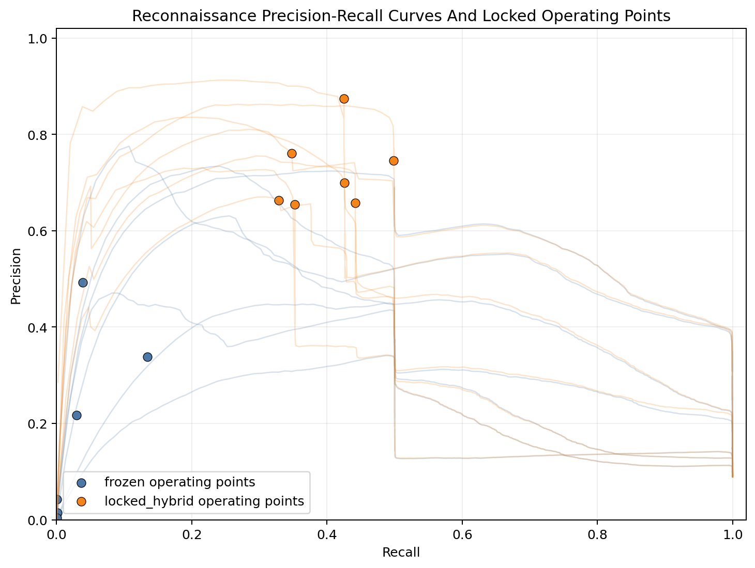
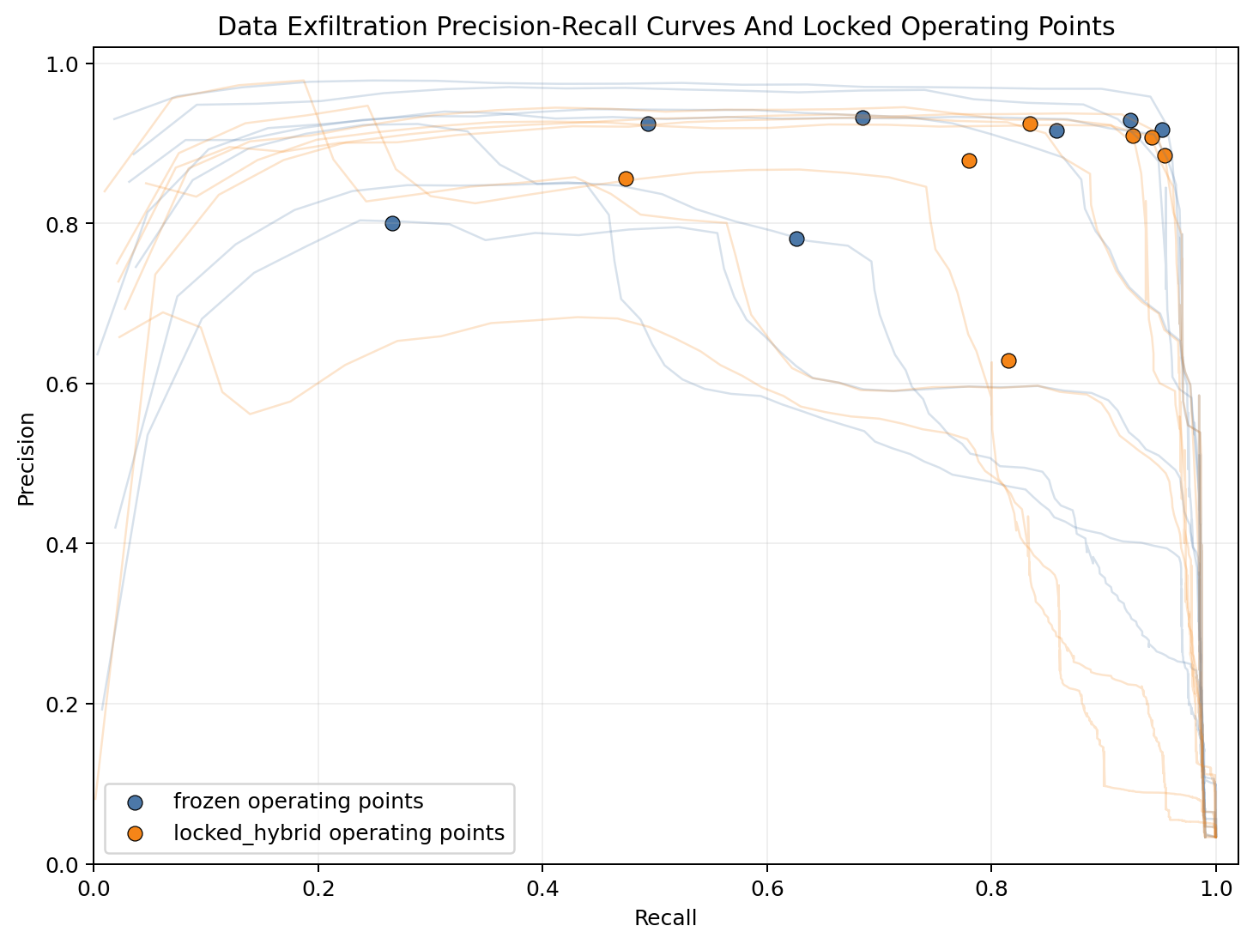
Operating-Point View
Notes:
Use these figures to reinforce the decision-policy framing and DE safety discussion.

Slide 11
Boundary Conditions
DAPT item | Result
MLP Macro F1 | 0.6353 +/- 0.0043
MLP Recon F1 | 0.8932 +/- 0.0089
TTA Macro delta | -0.2874
TTA Recon delta | -0.6589
DAPT supports detector-recipe transfer only.
DAPT does not support TTA generality.
DAPT DE support is too small for a DE safety claim.
The boundary is visible by design.
Notes:
This slide helps the committee trust the result because the boundary is visible.

Slide 12
Final Defense Claim
Selective no-label TTA can recover rare-stage Reconnaissance under held-out source-file shift when constrained by a validation-selected safety gate.
Proves: locked rare-stage recovery and a safety-gated adaptation pattern.
Does not prove: universal TTA, cross-dataset TTA, or adversarial-stream robustness.
Next portfolio result: ATT&CK TTP-set profile retrieval.
Notes:
End with discipline: narrow result, strong evidence, honest boundary.

