Slide 1
Project Progress Forum II
Team LORT
March 23 2015

Slide 2
Schedule for remaining tasks
Deadlines:
Tuesday March 24 -> ½ scenes animated
Saturday March 28 -> all scenes animated
Sunday March 29 -> final video compilation

Slide 3
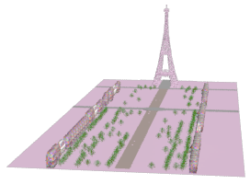
Gary

Slide 4
Gary
Completed Tasks:
Created Eiffel tower model
Set up max files for each scene
Created prop models
Outstanding tasks:
Animate scenes 6, 13, 20-23

Slide 5
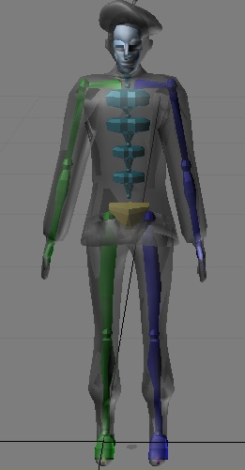
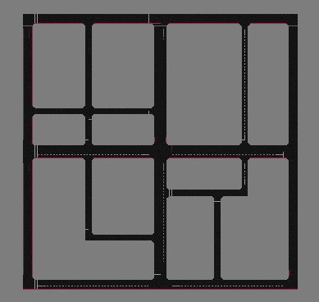
Justin

Slide 6
Justin
Completed Tasks:
Create Arc de triomphe and road models
Creating soundtrack
Rigging character models
Outstanding tasks:
Animate scenes at the Arc and the river (scenes 8-12)

Slide 7
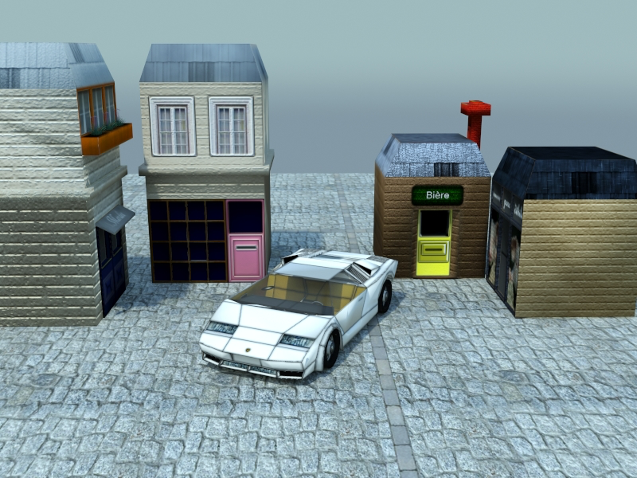
Sam

Slide 8
Sam
Completed Tasks:
Creating car, building, and the Louvre models
Texturing cars, buildings
Adding hair to models
Creating template for character bodies
Outstanding tasks:
Animate bakery scenes (scenes 2-5)

Slide 9
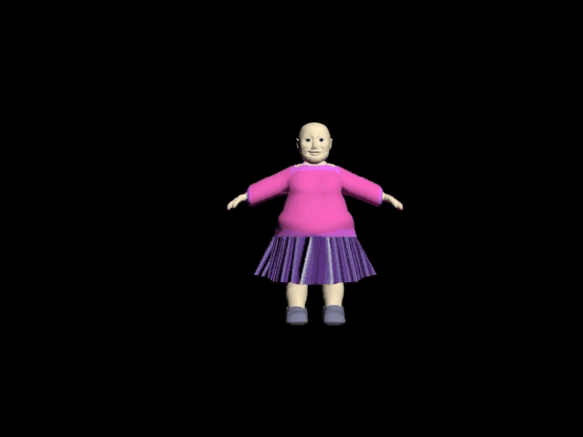
Sasha

Slide 10
Sasha
Completed Tasks:
Creating character models
Texturing character models
Texturing some buildings
Outstanding tasks:
Animate scenes on the highway and at the intersection (scenes 7 and 14-21)

