Slide 1
Data Science For Fun and Profit
By Gary Short
@garyshort

Slide 2

Introduction
Gary Short
Freelance Data Scientist
Freelance Data Engineer
MVP C#
Predictive Analytics
Computational Linguistics
Machine Vision
gary@duncodin.it
www.duncodin.it
@garyshort

Slide 3

What Are we Doing Here?
Predict Which Horse Will Win The Race

Slide 4

What’s The Difference Between a Prediction And a Guess?

Slide 5

Naïve Probability

Slide 6

Conditional Probability

Slide 7
What’s The Difference Between a Prediction And a Guess?
Guess
Picking what side of chance an event will fall.
Prediction
Predicting an outcome accounting for the known conditions.

Slide 8
Step 1
All things being equal, who will win?

Slide 9
Demo

Slide 10

Step 2 – Let’s Build a Model

Slide 11

Wait, What? Why do we Build a Model?

Slide 12
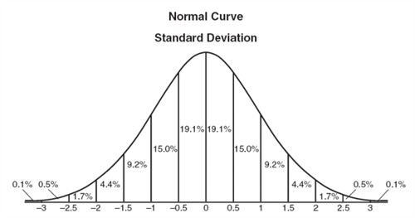
So What Does a Predictive Model Look Like?

Slide 13

Average – The Simplest Model
Let’s assume a horse finishes:
1, 5, 3, 7, 7,2,4,5,1,8
In its last 10 races
Then it’s average finishing positon is given by:
$∑$(1, 5, 3, 7, 7,2,4,5,1,8) / 10
Right?

Slide 14

Wrong!

Slide 15


Slide 16
Okay, Look, There are Two Types of Data
Quantitative
Numbers
You can do arithmetic with them
Qualitative
Categorical
Rule of thumb:
All qualitative data is rubbish. ☺

Slide 17
Some Qualitative Data is Sneaky
On a scale of 1 – 10 how happy are you with this talk
Where 1 is “very happy” and 10 is “do you have a cigarette?”
The average response was 9.9.

Slide 18


Slide 19
It Was Just Pretending to be Numbers!
1, 2, 3 are actually categories
They just happened to be called 1, 2, 3
That fooled you into thinking you could do arithmetic (like average)
What if they’d be called Tom, Dick and Hilary?
Hilary cos I’m not a brogrammer
Also cos @rachelreese scares him a little –Ed.
So now, what’s the average of Dick and Hilary?
You could have phrased that better –Ed.

Slide 20

Okay, so How do we Deal With Position?

Slide 21
So, For Average, Let’s Stick to Numbers
Demo

Slide 22
Let’s Get Back to Position

Slide 23
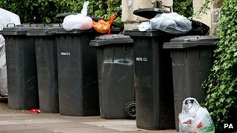
Demo - Bin the Categorical Information

Slide 24

Can we Unify This Into One Probability?

Slide 25
Sure we Can!
Demo

Slide 26

More Art Than Science

Slide 27
Demo
Is a variable significant? Can maths help us decide?

Slide 28

Demo - Watch Out For “Confounding Variables”

Slide 29
Demo
We’re not all data scientists, just give me a formula for predicting winners!

Slide 30

But Wait, we Can’t Use That!

Slide 31
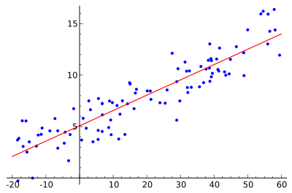
Why Not?!

Slide 32
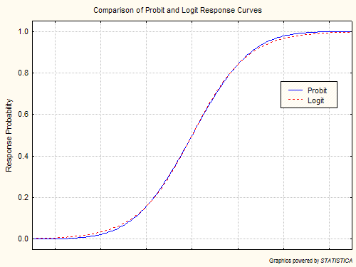
So What Can we Use?

Slide 33
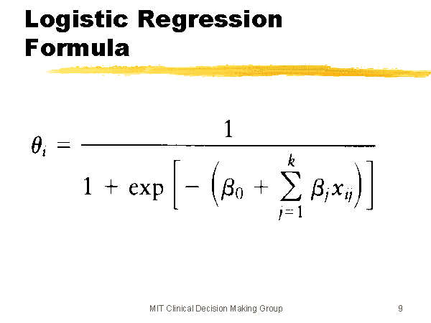
Logistic Regression Formula

Slide 34
Demo
Oh dude, you sooo need to show me a concrete example for that!

Slide 35

What if The Relationship Isn’t Linear?

Slide 36
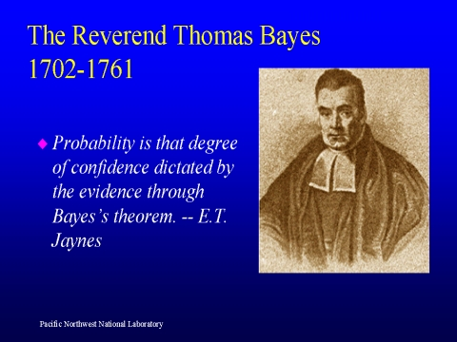
Enter Bayes

Slide 37
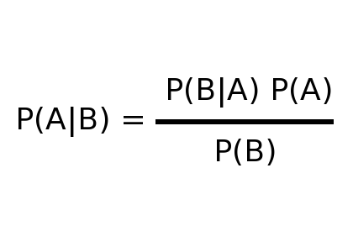
Bayes Theorem

Slide 38
Demo

Slide 39
What we Learned
The difference between a prediction and a guess
Naïve and conditional probability
Why it’s important to build a model
Average is the simplest model
Standard deviation tells you how well a fit average is
Qualitative and quantitative data
How to bin qualitative data
Weightings and normalisation
Linear regression
Logistic regression (for binary predictions)
Bayesian statistics (for non linear relationships).

Slide 40
Questions?
Gary Short
Contract Data Scientist
Contract Data Engineer
MVP C#
gary@duncodin.it
www.duncodin.it
@garyshort

