Slide 1
Deep Dive Into Deep Learning
@GaryShort

Slide 2

Introduction
Gary Short
Data Solution Architect Microsoft
gashort@microsoft.com
gary@duncodin.it
@garyshort
Image © @Blackmarble

Slide 3
Agenda
Define what a neural network is
We’ll see why that was a terrible idea
I’ll show you how we fixed it
Then explain why it was *still* a terrible idea
Final I’ll show you how we fixed it properly.

Slide 4
A Quick Word About Maths
Yes it is Maths and not Math
I’ll be using pictures and “jazz hands”.

Slide 5
What is a Neural Network?

Slide 6
In machine learning and cognitive science, artificial neural networks (ANNs) are a family of statistical learning models inspired by biological neural networks and are used to estimate, or approximate, functions that can depend on a large number of inputs and are generally unknown.

Slide 7
In machine learning and cognitive science, artificial neural networks (ANNs) are a family of statistical learning models inspired by biological neural networks and are used to estimate, or approximate, functions that can depend on a large number of inputs and are generally unknown.

Slide 8
In machine learning and cognitive science, artificial neural networks (ANNs) are a family of statistical learning models inspired by biological neural networks and are used to estimate, or approximate, functions that can depend on a large number of inputs and are generally unknown.

Slide 9
In machine learning and cognitive science, artificial neural networks (ANNs) are a family of statistical learning models inspired by biological neural networks and are used to estimate, or approximate, functions that can depend on a large number of inputs and are generally unknown.

Slide 10
In machine learning and cognitive science, artificial neural networks (ANNs) are a family of statistical learning models inspired by biological neural networks and are used to estimate, or approximate, functions that can depend on a large number of inputs and are generally unknown.

Slide 11
Further…

Slide 12
Artificial neural networks are generally presented as systems of interconnected "neurons" which exchange messages between each other. The connections have numeric weights that can be tuned based on experience, making neural nets adaptive to inputs and capable of learning.

Slide 13
Artificial neural networks are generally presented as systems of interconnected "neurons" which exchange messages between each other. The connections have numeric weights that can be tuned based on experience, making neural nets adaptive to inputs and capable of learning.

Slide 14
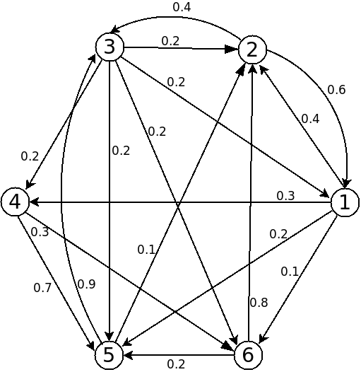

Slide 15
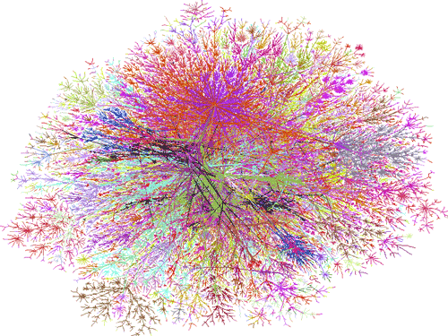

Slide 16
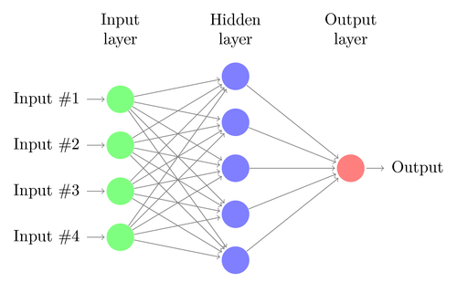

Slide 17
This Idea is Old…

Slide 18
1943 - Warren McCulloch and Walter Pitts created a computational model for neural networks based on mathematics and algorithms called threshold logic
Late 1940s - Psychologist Donald Hebb created a hypothesis of learning based on the mechanism of neural plasticity that is now known as Hebbian learning
1954 - Farley and Wesley A. Clark first used computational machines, then called "calculators," to simulate a Hebbian network at MIT
1958 - Frank Rosenblatt created the perceptron, an algorithm for pattern recognition based on a two-layer computer learning network using simple addition and subtraction.

Slide 20
Demo – Trivial Neural Network

Slide 21
Then it All Goes a Bit Wrong…

Slide 22
1969 - Neural network research stagnated after the publication of machine learning research which discovered two key issues:
The first was that single-layer neural networks were incapable of processing the exclusive-or circuit
The second significant issue was that computers sucked.

Slide 23
Things Get Better in The 70’s & 80’s
Not the fashion or the music… obviously

Slide 24
1975 – Werbos discovers ‘backpropagation’ solving the XOR issue
1986 – Distributed and parallel computing solves the ‘computers suck’ issue.

Slide 25
WTF is ‘Backpropagation’?!

Slide 26
Backpropagation, an abbreviation for "backward propagation of errors“
It’s a common method of training artificial neural networks
Used in conjunction with an optimization method such as gradient descent
The method calculates the gradient of a loss function with respect to all the weights in the network
The gradient is fed to the optimization method which in turn uses it to update the weights, in an attempt to minimize the loss function.

Slide 27


Slide 28
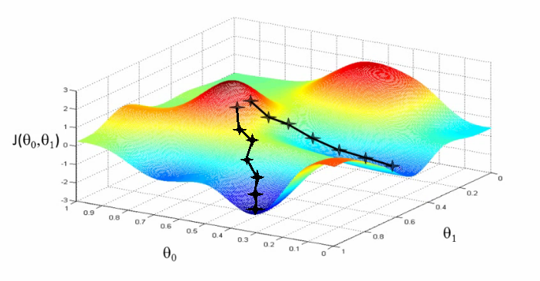

Slide 29
Despite these improvements support vector machines and other, much simpler methods such as linear classifiers gradually overtook neural networks in machine learning popularity
But the advent of deep learning in the late 2000s sparked renewed interest in neural nets.

Slide 30
What Improvements Did Deep Learning Bringing to Neural Nets?

Slide 31
The biggest issue with neural nets was that it took forever to train the model.
A US implementation to recognise hand written Zip codes was successful…
But it took THREE DAYS to train the model!!

Slide 32
~2006 - The term "deep learning" gained traction after Geoffrey Hinton and Ruslan Salakhutdinov showed how a many-layered feedforward neural network could be effectively pre-trained one layer at a time
Treating each layer in turn as an unsupervised restricted Boltzmann machine
Then using supervised backpropagation for fine-tuning.

Slide 33
A restricted Boltzmann machine (RBM) is a generative stochastic artificial neural network that can learn a probability distribution over its set of inputs.

Slide 34
A generative model is a model for randomly generating observable-data values

Slide 35
Stochastic neural networks are a type of artificial neural networks built by introducing random variations into the network

Slide 36
Stochastic just means unpredictable due to random events

Slide 37
So deep learning is just a way to train a neural network, one layer at a time, by randomly generating distributions that “look like” the solution space

Slide 38
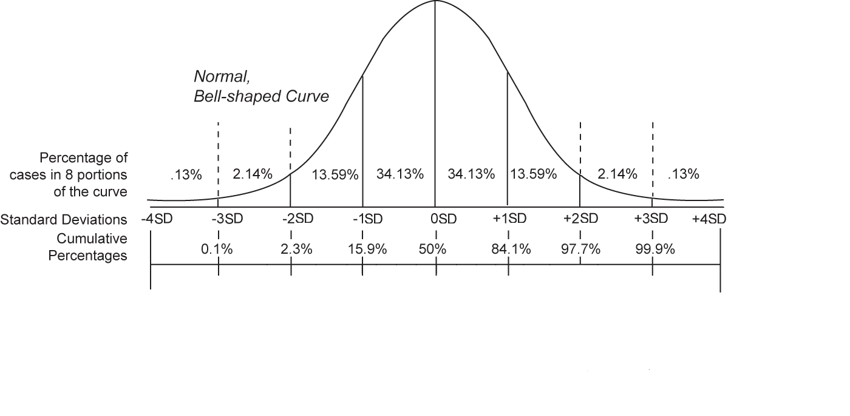

Slide 39
2010 - The real impact of deep learning in industry started in large-scale speech recognition.
Geoff Hinton was invited by Li Deng to work with him and colleagues at Microsoft Research in Redmond to apply deep learning to speech recognition
Then… Cortana.

Slide 40
None of This Really Matters ☺

Slide 41
Neural Net Demo Using Libraries

Slide 42
What we Learned…
An artificial neuron takes evidence and weight and outputs a decision
Artificial neurons are composed into layers
Layers are composed into a network
A ANN is trained by adjusting the weights
The weights are adjusted using a loss function and back propagation
Deep learning improves ANN by training one layer at a time.

Slide 43
Questions?
Gary Short
@garyshort
Image © @Blackmarble

