Slide 1

Welcome
Virtual Festival of Technology 2020
The Art of AI & Digital Innovation
@atlanTecFest | #atlantec | #technology

Slide 2

‘The Only Tool You Need For Data Science’
Welcome to this Session
Monday 18 May 11:00am
Gary Short
Principal Data Scientist - AMEY Consultancy Ltd
guest speaker
For full calendar of events, visit www.atlantec.ie

Slide 3
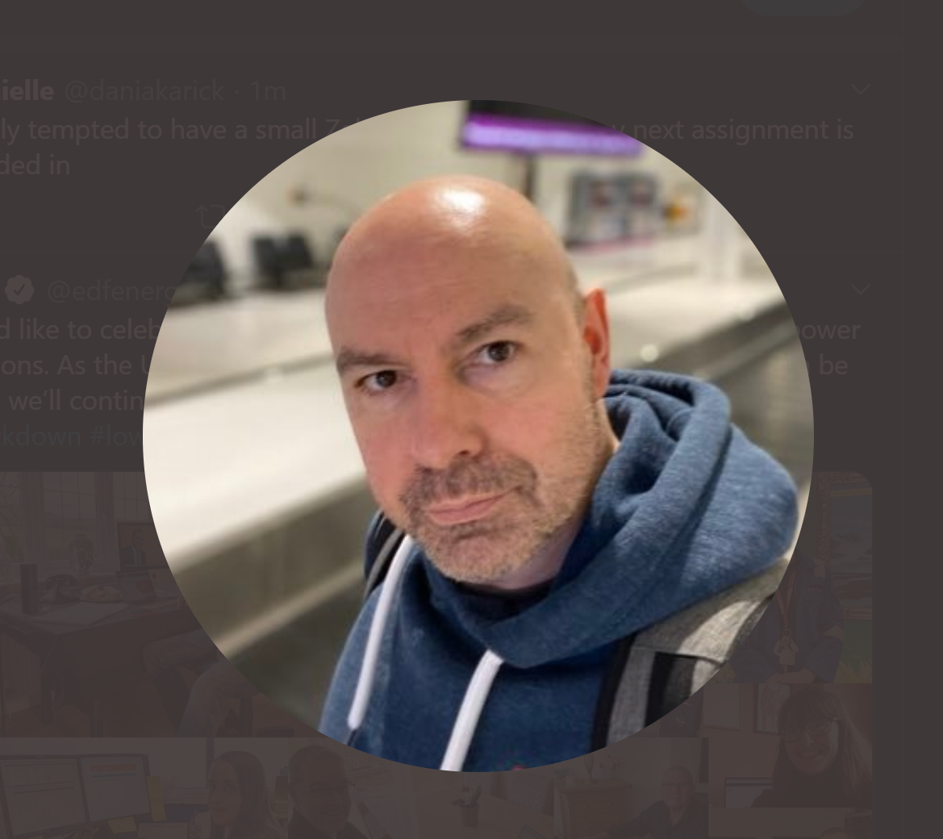
Who is This Guy?
Freelance data scientist and instructor
Currently working on object detection, from dash cam video, on the Strategic Road Network, for Highways England
@garyshort
gary@duncodin.it

Slide 4
Agenda
Introduction to the only data science tool you need
Why tool is important
The theory of the tool
A practical demonstration of the tool
Questions

Slide 5
Introduction to The Tool

Slide 6
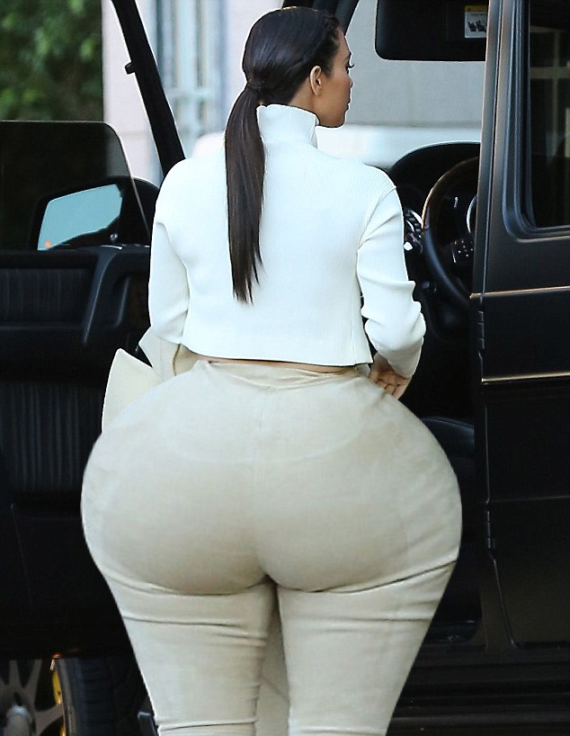
Butt Weight

Slide 7
Why is This Tool so Important?

Slide 8
To Answer That… A Little Story…

Slide 9
“We have socialised business analytics”

Slide 10
“We have socialised trauma medicine so today you’ll be looked after by Dave, the porter, from Ward 12”

Slide 11
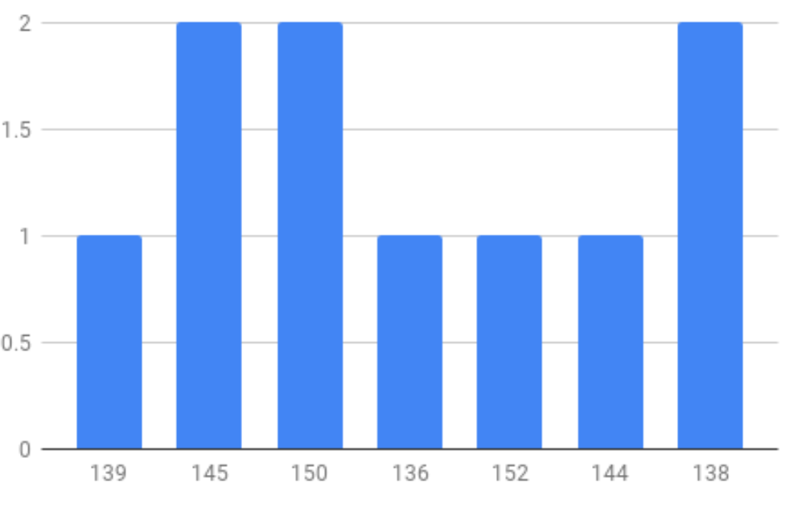
Result
Intervention

Slide 12
Theory of The Tool

Slide 13
P(A|B) = P(B|A) * P(A) / P(B)
Prior probability
Marginal probability

Slide 14
Practical Demonstration

Slide 15

Thanks for attending this session
For more Sessions visit:
www.atlantec.ie

