Slide 1
Best Practices For Heterogeneous Data Stores
@garyshort

Slide 2

Introduction
Gary Short
Microsoft MVP C#
Freelance data scientist
Big Data / architect / engineer
HDInsight / Hadoop / Pig / Hive
Predictive Analytics
Computational Linguistics
gary@duncodin.it
@garyshort
Image © @Blackmarble

Slide 3

Best Practices For What Now?

Slide 4
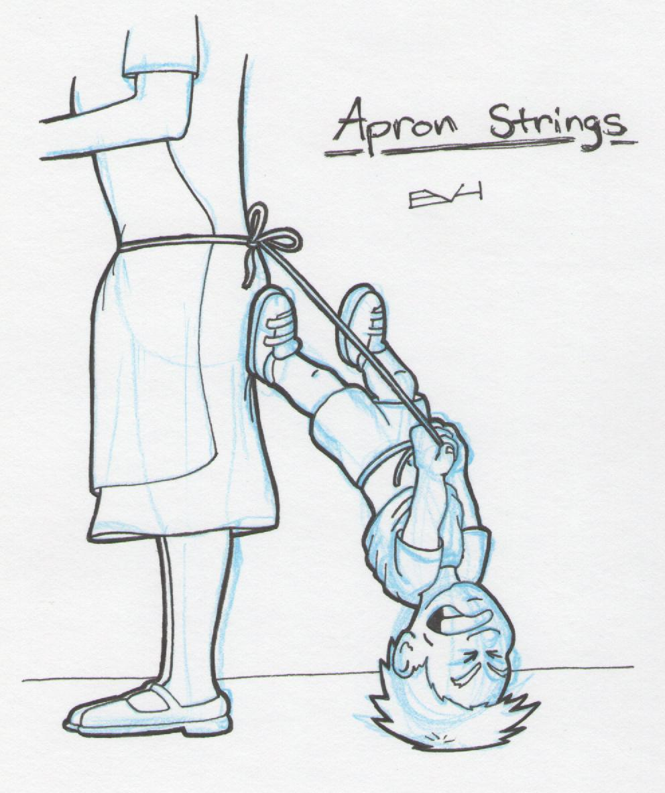
On/Off Prem… Don’t be Afraid to Mix

Slide 5

If Data is Off Prem, Security Becomes a Worry

Slide 6
Think About…
Weak credential reset mechanisms: Clear text passwords anyone?
Weak or faulty authorizations techniques: Url guessing
Authorization at too course a granularity: Admin for everything
Security of the facility: Do you know who’s in your house?
Hardware virtualisation: Would you know if it’d been tempered with?
Disaster recover: How long until you’re back up and running?
Data transmission security: Who’s listening in?

Slide 7

Data Stores – Horses For Courses

Slide 8
Relational Database
Use if the following is important to you:
Data and how it’s related
Reduced storage
Faster transmission
Integrity.

Slide 9
RDBMS – Best Practices
Use a consistent naming convention
Meaningful names
Singular not plural
Avoid prefix / suffix
I know it’s a table TblCustomer doesn’t help me!
Favour Id over GUID for primary keys
*ducks*
Provide a DB access role
Partition big/rarely used tables to different physical storage
Implement untrustworthy client (use constraints: foreign key, check, not null).

Slide 10
Key-Value Store
Key value pair
No index
No foreign keys
Used mostly for session data:
Web users
Mobile apps
Gamer session
Also for:
Aggregate lookup
Blindingly fast

Slide 11
Key-Value Store: Best Practice
Cloud servers tend to have low i/o capability
This is important as you’ll tend to be doing a lot of read/write
Spend time modelling your business as a set of K/V pairs
This is hard for architects used to the relational world
Model your access patterns too.

Slide 12
Column-Family Data Store
Next step “up” from key/value store
Consists of a tuple of key and value where:
The key… is the key
And the value is a “column-family” of data
So, that’s a table to you and me.
Each column is a triplet of:
Name
Value
Timestamp
Good for:
Fast read/write
Like Key/Value, but with more data
Highly distributed, sparse data.

Slide 13
Column Family: Best Practices
Don’t think of a relational model
Think sorted map
Column name size is usually restricted, so don’t store descriptions
Column value is usually much larger (~2GB)
Careful how much you store though, as there’s rarely streaming so fast fetches will disappear if you store close to the limit
Pick a row key that can be sharded
So ddmmyyyy|CustomerId not ddmmyyyy
Model column families around query patterns.

Slide 14
Document Store
Next step up from column family data store
Stores aggregates
For example customer, order, orderItems
Similar to de-normalised RDBMD
Repeated data
Good for semi structured data.

Slide 15
Document Store: Best Practices
Durability is, generally, through replication
Don’t run a stand alone document store server
Use replica sets for high availability via automatic failover
Storage engines often use memory mapped files for performance
So, prefer 32 bit systems over 64 bit
If your store supports write ahead journaling, turn in on!
This will greatly help crash recovery and node durability
Keep your working set (plus indexes) to a size that fits in RAM
Increasing number of page faults will indicate when it’s getting too big
Don’t shard without a good understanding of your data access patterns
Choosing a good sharding key is… well, key ☺

Slide 16
Blob Storage
Use for storing… blobs
Binary Large OBjectS
Basic Large OBjectS
Stored as either:
Page blob
Optimised for random read/writes
So good for storing things like VM harddrives
Block blob
Uploaded and stored as a series of blocks and then committed as one file
Good for upload times and throughput
Maximum size of 200Gb.
Can have meta data attached, which allows us to add context

Slide 17
Blog Storage: Best Practice
Always define the content type of your blobs
This allows the client to handle the content being sent
Define the cache control header
Allows cache to be placed at client side, reduces reads
Always upload on parallel
Choose the right blob
Block if you want to stream
Page if you want to write extensively
If you just need the meta data, then just read that!
Turn on CDN for better availability.

Slide 18
Queue Storage
Storing “messages” for consumption by other clients
Often have a message size limit
Often have a TTL limit
Durable and persistent.

Slide 19
Queue Storage: Best Practice
Elastically grow / shrink to keep queue throughput even
Don’t hold on to a message longer than you have to
If the message is too large:
Overflow to “larger” storage, e.g. blog storage
Create a meta message to point to the actual data
Test persistence and durability.

Slide 20

Lock That Stuff up And Hide it Away!

Slide 21
Architecture For Heterogeneous Data Stores
RDBMS
Document Store
Key/Value Store
Queue
Blob
Data Access API
Service Bus
Mobile Client
Web Client
REST API
Desktop Client
Tablet Client

Slide 22
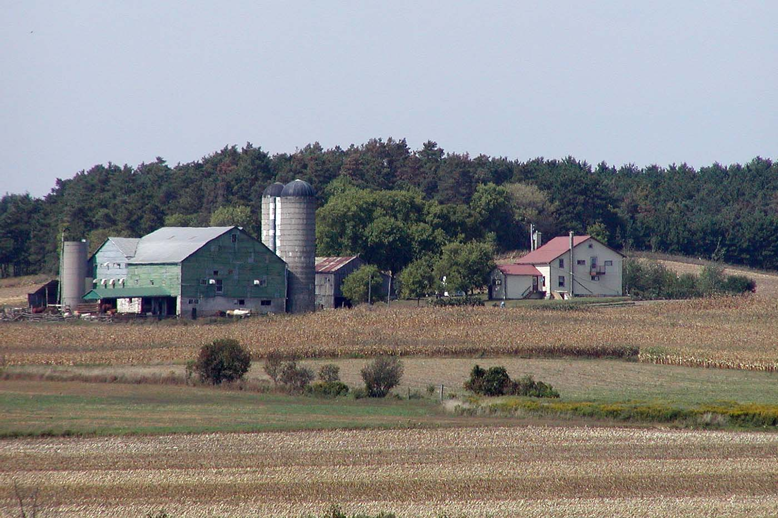
Case Study

Slide 23
Application Maps

Slide 24
Data and Storage Used
Shape files
Delimit field boundaries
Binary
Stored in Blob storage
Soil Samples
CSV
X, Y, Z1 … Zn
Stored in Column-Family store

Slide 25
Normalized Difference Vegetation Index

Slide 26
Which Is..?
Geo graphical indicator
Used to sense remotely gathered information
Normally from a space platform
Indicates the presence of health, green vegetation.

Slide 27
Data And Storage used
Satellite images
Binary data
Stored in blob storage
Reflected light index
CSV
Stored in column-family store

Slide 28
We Use it For?

Slide 29
Potato Blight Prediction

Slide 30
Potato Blight
Fungal infection of potato tubers
Highly correlated with temperature and humidity
Renders crop, or part thereof, useless.

Slide 31
Data and Storage Used
Temperature data
CSV
Stored in Column-family store
Prediction model
X, Y, Z
Key/Value Store

Slide 32
What we Use it For

Slide 33
Questions?
Gary Short
Duncodin Limited
Freelance data scientist
Big Data architect / engineer
www.duncodin.it
gary@duncodin.it
@garyshort
Image © @Blackmarble

