Slide 1
Data Science For Fun And Profit.
Gary Short
www.Duncodin.it

Slide 2

Introduction
Gary Short
Contract Data Scientist
Contract Data Engineer
MVP C#
gary@duncodin.it
www.duncodin.it
@garyshort

Slide 3

What Are we Doing Here?
Learn Data Science through the medium of horse racing

Slide 4
What Will That Look Like?
We’ll look at
Basic statistics
Some more advanced statistics
Conditional probability
Bayesian statistics
Machine learning
Finish off with a little “you” time
Work on extending what we’ve done here
Or work using these techniques on your own domain problems.

Slide 5

What’s The Difference Between a Prediction And a Guess?

Slide 6

Naïve Probability

Slide 7
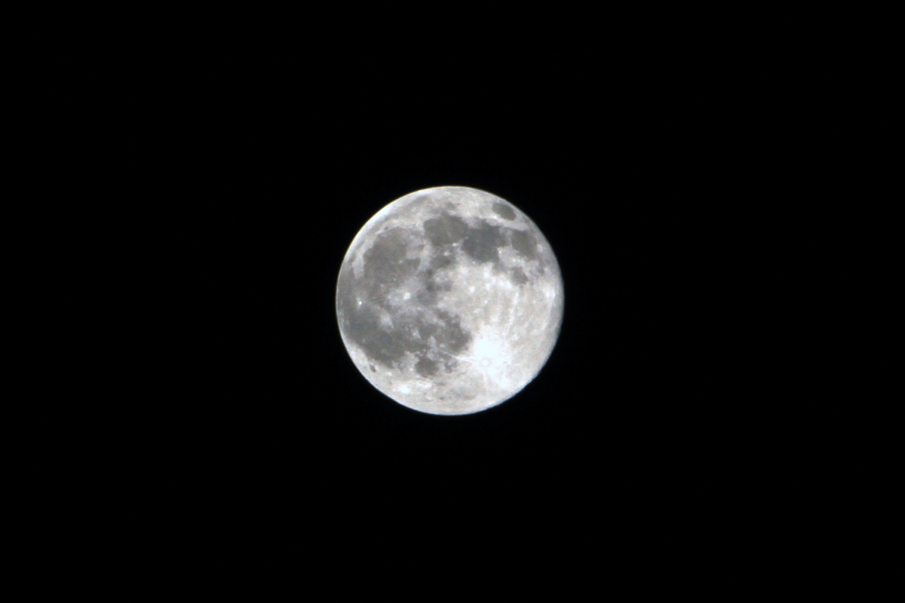
Conditional Probability

Slide 8
What’s The Difference Between a Prediction And a Guess?
Guess
Picking what side of chance an event will fall.
Prediction
Predicting an outcome accounting for the known conditions.

Slide 9
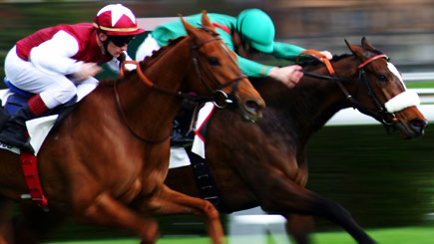
Naïve Probability – It’s Never a Two Horse Race (Unless it Actually is of Course)
Your horse will either win or not
But the probability isn’t ½
It’s 1/n
Where n = the number of runners.

Slide 10
We Must Account For the Known Conditions

Slide 11
Part 1 – Traditional Statistics

Slide 12

We Have to Build a Model

Slide 13

Some Models Fit Well

Slide 14
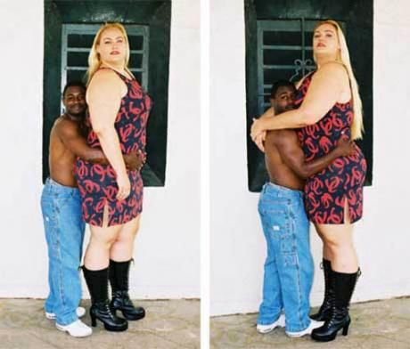
Others, Not so Much…

Slide 15

So Our Prediction Will be Model + Error

Slide 16
So What’s The Simplest Model we Can Build?
Summary Statistics
Mean
Mode
Median

Slide 17
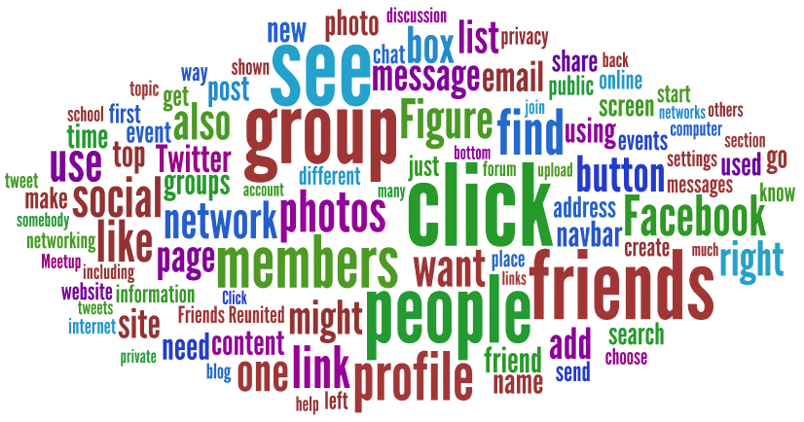
Mode

Slide 18

Median

Slide 19
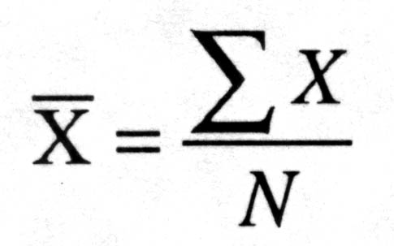
Mean

Slide 20
So How do we Know How Well Mean Fits?

Slide 21
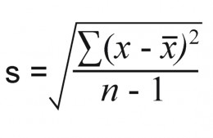

Slide 22
Demo – Simplest Predictive Model

Slide 23
Lab 1
Create various sample data
Calculate, min, max, mean, mode, median and SD
“Manually” create left and right skewed samples
Repeat the calculations from above
Random samples always seem to “work out”, anyone know why?

Slide 24
A Quick Aside About Data

Slide 25
Let’s Model Winners
So if a horse finishes:
1, 4, 6, 2, 7, 1, 5, 1, 7, 2, 4, 3, 1
We can just take an average, and if the SD is small (relative to the mean), we know that’s a good fit for prediction…
Right?
Right?!

Slide 26
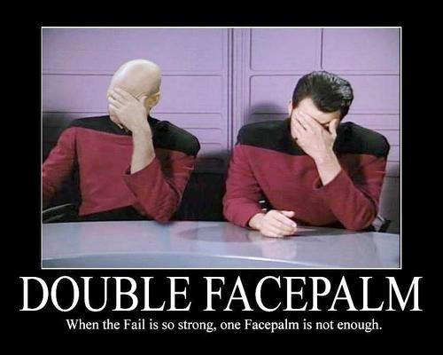
Wrong!

Slide 27


Slide 28
Okay, Look, There are Two Types of Data
Quantitative
Numbers
You can do arithmetic with them
Qualitative
Categorical
Rule of thumb:
All qualitative data is rubbish. ☺

Slide 29
Some Qualitative Data is Sneaky
On a scale of 1 – 10 how happy are you with this talk
Where 1 is “very happy” and 10 is “do you have a cigarette?”
The average response was 9.9.

Slide 30


Slide 31
It Was Just Pretending to be Numbers!
1, 2, 3 are actually categories
They just happened to be called 1, 2, 3
That fooled you into thinking you could do arithmetic (like average)
What if they’d be called Tom, Dick and Hilary?
Hilary cos I’m not a brogrammer
Also cos @Irisclasson scares him a little –Ed.
So now, what’s the average of Dick and Hilary, Dickary?!
You could have phrased that better –Ed.

Slide 32
Repeat After me:
You can only do arithmetic on quantitative data!

Slide 33
So Race Placing’s Can’t be Modelled? Lame!

Slide 34
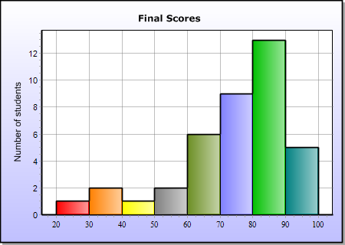

Slide 35
Now We’ve Straightened Out Data
Let’s make some predictions!

Slide 36
Cool Your Jets!
Before we do, we’ve got to learn a couple of rules.

Slide 37
Parametric Tests
Have 4 assumptions

Slide 38

1. Normally Distributed
This is context sensitive and a bit tricky
Soooo…

Slide 39
2. Homogeneity of Variance
Condition in which all the variables in a sequence have the same finite, or limited, variance.
I don’t know about you, but that’s as clear as mud to me!
For example, if we take a sample of horses, their mile times all vary between a similar min and max.

Slide 40
3. Data Should be Measured at The Interval Level
Measured data has the same interval
So in the case of our horses
Top speed in MPH
Weight in KGs
Etc.

Slide 41
4. Independence
Variable of one participant has no effect on the variable of another
In the case of our horse
The top speed of one horse does not effect the top speed of another.

Slide 42
How do I know Which Variables to Model?

Slide 43
Covariance and Correlation
Variance is when a measure deviates from the mean
Covariance is when two measures deviate in the same way
Correlation is covariance in a standard unit of measure, e.g. KGs

Slide 44
Demo – Pearson’s R

Slide 45
Lab 2
Create sample data
Add a transform
Calculate R between that and the dependent variable
Add another transform
Calculate R between that and the dependent variable
Calculate R between the two independent variables
Experiment with the size of the transforms
See the effect it has on R.

Slide 46
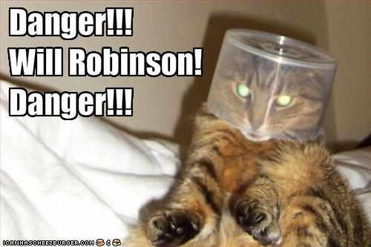
Watch Out For “Confounding Variables” Though

Slide 47
Now we Know What to Model
Let’s make some predictions!

Slide 48
Demo – Linear Regression

Slide 49
Lab 3
Create a dependent sample
Create an independent variable
Calculate the dependent value for an independent measure in your sample.
Add more independent variables
Repeat the calculation

Slide 50
That’s Cool, But we Can’t Use It!

Slide 52
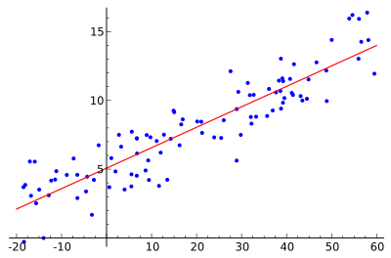
Why Not?!

Slide 53
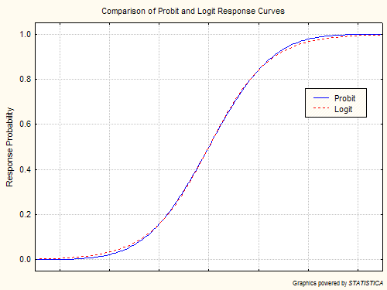
So What Can we Use?

Slide 54
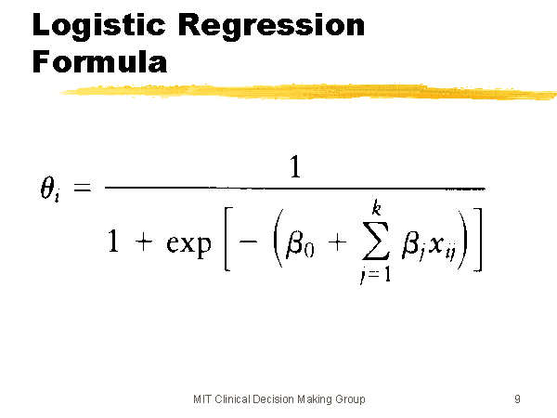
Logistic Regression Formula

Slide 55
Demo
Oh dude, you sooo need to show me a concrete example for that!

Slide 56
Lab 4
Create some sample data
Do the calculation ☺

Slide 57
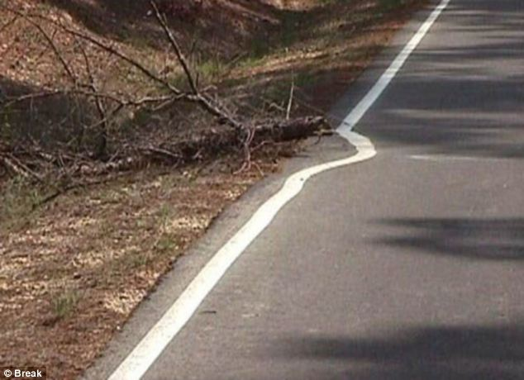
What if The Relationship Isn’t Linear?

Slide 58
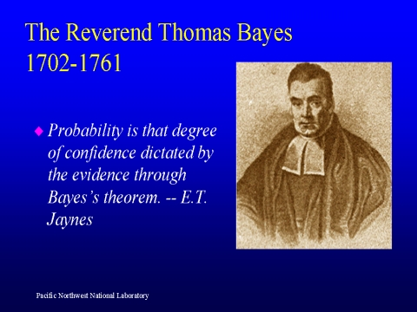
Enter Bayes

Slide 59
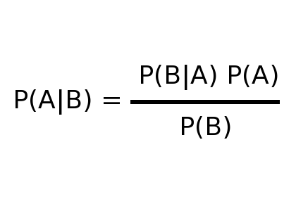
Bayes Theorem

Slide 60
Demo – Bayes Theory

Slide 61
Example
Dread disease in the country
Incidence in the population 1/10,000
Test for this disease
Test is 90% accurate
You test positive for the disease
Should you be worried?

Slide 62
But we Want to Condition on More Than 1 Variable!

Slide 63
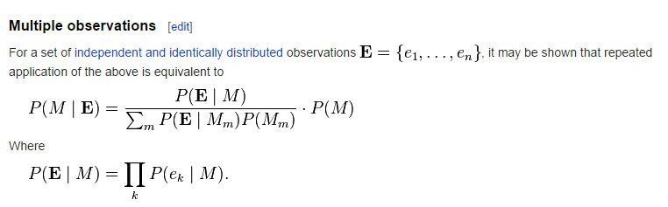

Slide 64
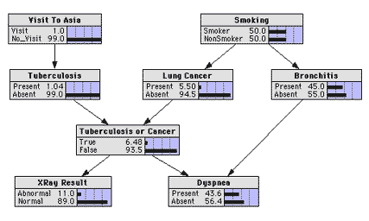

Slide 65
Demo - Machine Learning

Slide 66
Demo - Multi Model

