Slide 1
From Zero to Hadoop (on The MS Dev Stack)
By Gary Short
Duncodin Limited
www.duncodin.it

Slide 2

Introduction
Gary Short
Microsoft MVP C#
Freelance data scientist
Big Data / architect / engineer
HDInsight / Hadoop / Pig / Hive
Predictive Analytics
Machine Vision
Computational Linguistics
gary@duncodin.it
@garyshort
Image © @Blackmarble

Slide 3
Agenda
What problem does Hadoop solve?
How do I install it?
How do I get my C# code running on it?
How do I visualize my results?
Questions?

Slide 4
Demo – What Problem Does Hadoop Solve?

Slide 5

You Just Swapped One Set of Problems For Another!

Slide 6
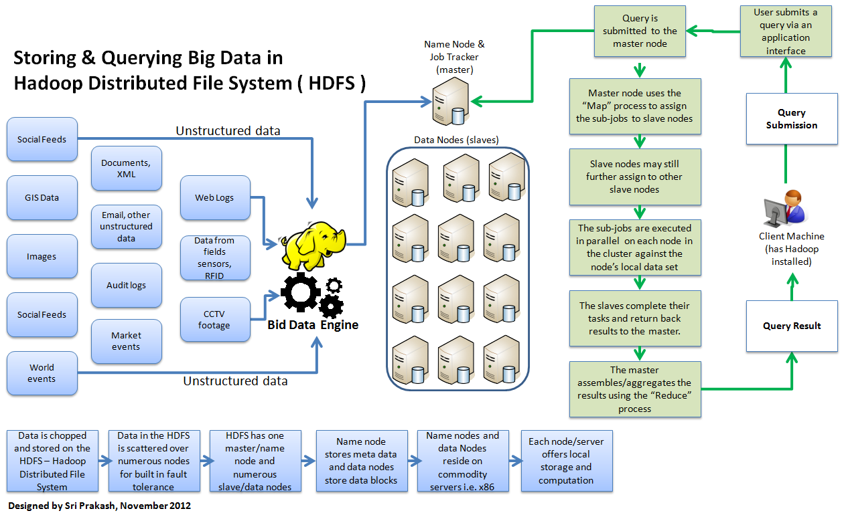
Hadoop Architecture – Data Storage

Slide 7
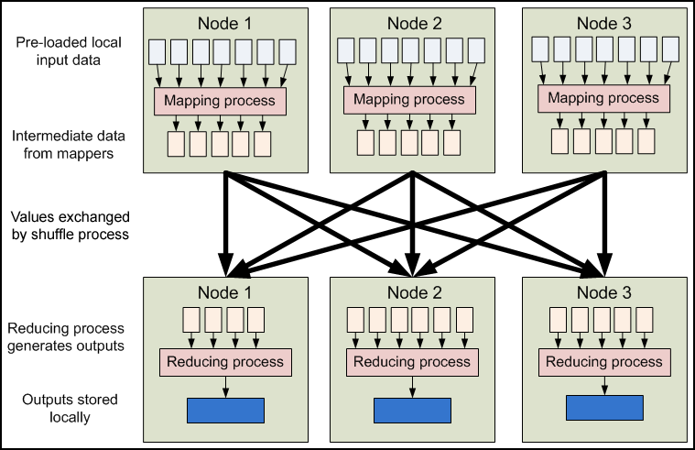
Hadoop Architecture – Map Reduce

Slide 8
How do I Install It?

Slide 9
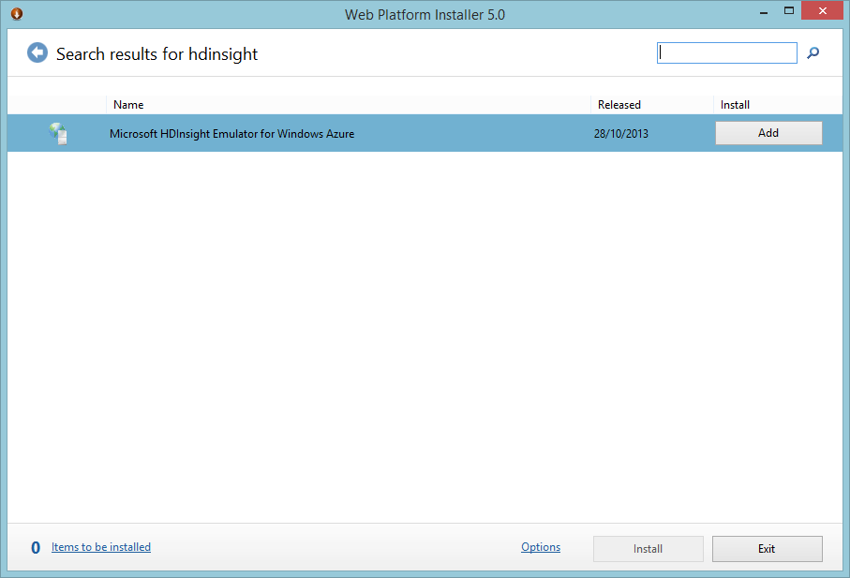

Slide 10
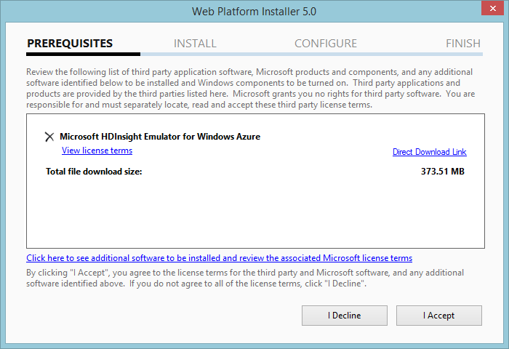

Slide 11
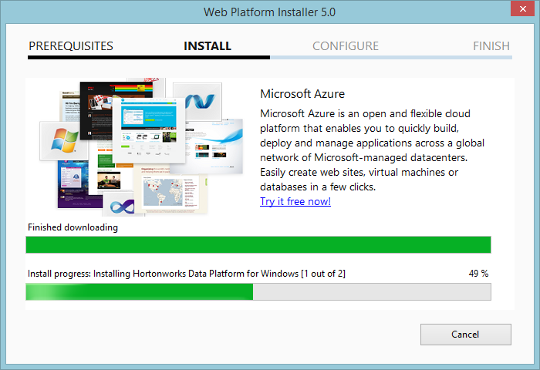

Slide 12
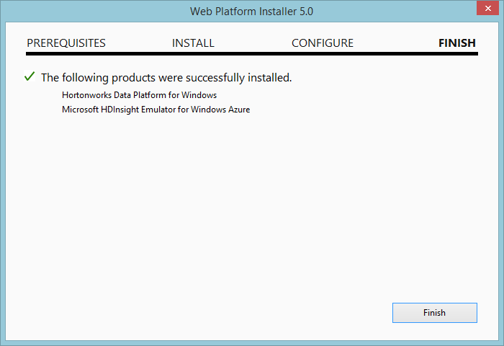

Slide 13


Slide 14
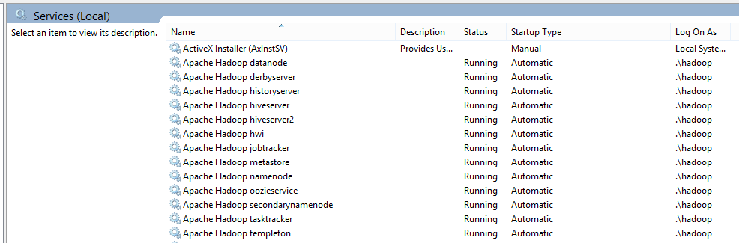

Slide 15
How do I get my C# Code Running?

Slide 16

Say “word count” one more time!

Slide 17

Which one will win?

Slide 18
Demo - Streaming

Slide 19
I’m Not Gonna Lie, That Was a Ballache.
Is there an easier way?

Slide 20
Demo - SDK

Slide 21
Demo - How do I Visualize my Results?

Slide 22
Questions?
Gary Short
Duncodin Limited
Freelance data scientist
Big Data architect / engineer
www.duncodin.it
gary@duncodin.it
@garyshort
Image © @Blackmarble

