Slide 1
Using AI to Beat The Bookies
By Gary Short
@garyshort

Slide 2

Introduction
Gary Short
Data Scientist for Microsoft
MVP C#
Predictive Analytics
Computational Linguistics
Machine Vision
www.duncodin.it
@garyshort

Slide 3
I have a favour to ask…

Slide 4
Team Data Science Process / CRISP-DM

Slide 5
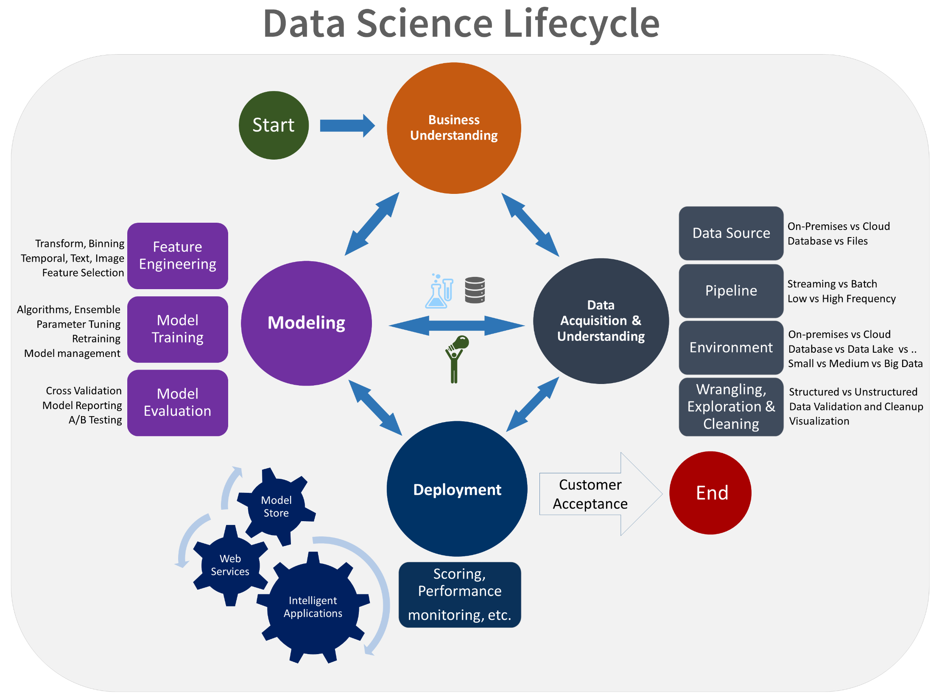

Slide 6

What Are we Doing Here?
Predict Which Horse Will Win The Race

Slide 7

What’s The Difference Between a Prediction And a Guess?

Slide 8

Naïve Probability

Slide 9

Conditional Probability

Slide 10
What’s The Difference Between a Prediction And a Guess?
Guess
Picking what side of chance an event will fall.
Prediction
Predicting an outcome accounting for the known conditions.

Slide 11
Step 1
All things being equal, who will win?

Slide 12
Demo

Slide 13

Step 2 – Let’s Build a Model

Slide 14

Wait, What? Why do we Build a Model?

Slide 15

Average – The Simplest Model
Let’s assume a horse finishes:
1, 5, 3, 7, 7,2,4,5,1,8
In its last 10 races
Then it’s average finishing positon is given by:
$∑$(1, 5, 3, 7, 7,2,4,5,1,8) / 10
Right?

Slide 16

Wrong!

Slide 17


Slide 18
Okay, Look, There are Two Types of Data
Quantitative
Numbers
You can do arithmetic with them
Qualitative
Everything that can’t be measured
Rule of thumb:
All qualitative data is rubbish. ☺

Slide 19
Some Qualitative Data is Sneaky
On a scale of 1 – 10 how happy are you with this talk
Where 1 is “very happy” and 10 is “do you have a cigarette?”
The average response was 9.9.

Slide 20
It Was Just Pretending to be Numbers!
1, 2, 3 are actually categories
They just happened to be called 1, 2, 3
That fooled you into thinking you could do arithmetic (like average)
What if they’d be called Tom, Dick and Hilary?
So now, what’s the average of Dick and Hilary?
Dickary?!
You could have phrased that better –Ed.

Slide 21

Okay, so How do we Deal With Position?

Slide 22
So, For Average, Let’s Stick to Numbers
Demo

Slide 23
Let’s Get Back to Position

Slide 24
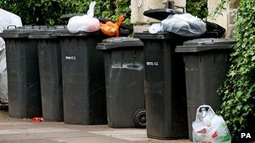
Demo - Bin the Categorical Information

Slide 25

Can we Unify This Into One Probability?

Slide 26
Sure we Can!
Demo

Slide 27

More Art Than Science

Slide 28
Demo
Is a variable significant? Can maths help us decide?

Slide 29

Watch Out For “Confounding Variables” Though

Slide 30
Demo
We’re not all data scientists, just give me a formula for predicting winners!

Slide 31
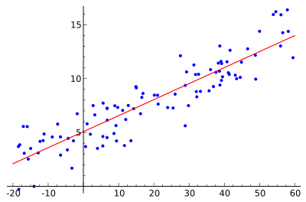
Yeah, but we can’t use that! ☺

Slide 32
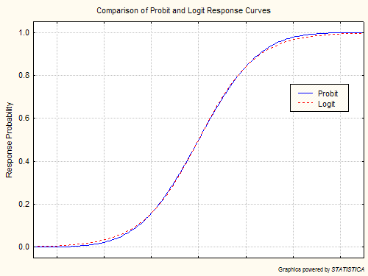
So What Can we Use?

Slide 33
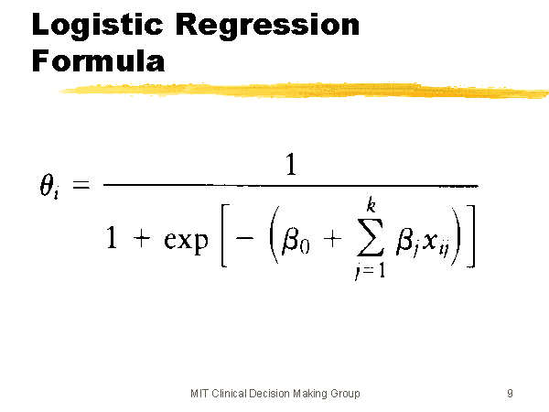
Logistic Regression Formula

Slide 34
Demo
Oh dude, you sooo need to show me a concrete example for that!

Slide 35

What if The Relationship Isn’t Linear?

Slide 36
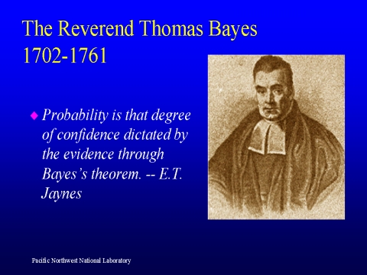
Enter Bayes

Slide 37
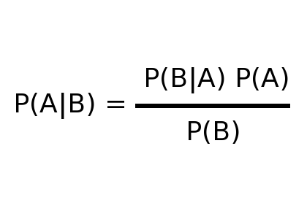
Bayes Theorem

Slide 38
Demo

Slide 39
What we Learned
The difference between a prediction and a guess
Naïve and conditional probability
Why it’s important to build a model
Average is the simplest model
Standard deviation tells you how well a fit average is
Qualitative and quantitative data
How to bin qualitative data
Weightings and unity
Linear regression
Logistic regression (for binary predictions)
Bayesian statistics.

Slide 40
Questions?
@garyshort
gary.short@microsoft.com

