Slide 1


Critical Paths in R: Turning Data Scientists into Effective Project Managers
Gary Sutton

Slide 2
Project Management Isn’t Just Coordination—It’s Quantitative
Why Projects Fail
Projects typically do not fail because of poor execution; they fail because of poor planning and management
Poor estimates, unclear dependencies, and unmanaged risk are common causes of schedule overruns and missed objectives
Yet projects are often planned as though task durations, resource availability, and outcomes are known with certainty
Uncertainty is unavoidable and must therefore be managed
Why This Matters
Project management is often viewed primarily as a coordination and communication function, requiring soft skills only; however, effective project management requires the use of quantitative techniques to reduce uncertainty, such as:
Estimating task durations
Understanding task dependencies
Finding the critical path
Evaluating trade-offs
These are fundamentally analytical problems
The Opportunity
The same methods used by data scientists to model uncertainty, analyze networks, quantify risk, and optimize decisions can be applied to project planning
Projects are not just plans—they are systems that can be modeled, analyzed, and optimized
The good news: All of this can be done using the R ecosystem

Slide 3
Projects as Data: A Pipeline in R
Projects can be represented, modeled, and optimized using the same workflow commonly applied to data science problems
Project Planning Task | R-Based Approach
Represent project activities and attributes | Structured data (dplyr, tibble)
Define dependencies between tasks | Network modeling (igraph)
Incorporate uncertainty in task durations | Statistical modeling (PERT)
Identify schedule constraints | Critical path analysis (criticalpath)
Quantify risk and completion probabilities | Probabilistic modeling
Evaluate trade-offs and alternative schedules | Optimization techniques
Communicate results | Visualization (ggplot2)
Projects are data sets composed of tasks, durations, dependencies, constraints, uncertainty, and decisions
Project management is not separate from data science; it is another modeling problem that fits naturally within the R ecosystem

Slide 4
A Simple Project Example: Work Breakdown Structure (WBS)
WBS for Automated Reporting Tool Project
A WBS decomposes a project onto discrete activities and defines the relationships between them—transforming the beginnings of a plan into a structured data set
Column Definitions
Activity: Unique identifier for each project task
Description: Concise label describing the task
Dependencies: Predecessor tasks that must be 100% complete before the tasks can start
Implementation in R
Defined as a table using the tibble()function
Alternatively, can be imported from a CSV using the read_csv()function
Activity | Description | Dependencies
A | Define Project Objectives and Scope | NA
B | Assemble Project Team | A
C | Gather Requirements from Stakeholders | A,B
D | Data Collection and Integration | C
E | Data Cleansing and Preprocessing | D
F | Design Report Templates | C
G | Develop Data Processing Pipelines | E
H | Implement Report Generation Logic | F
I | Develop User Interface for Report Access | F
J | Integrate Data Pipelines with Report Generation | G,H
K | Conduct User Testing and Feedback | I,J
L | Finalize and Deploy Automated Reporting Tool | K

Slide 5
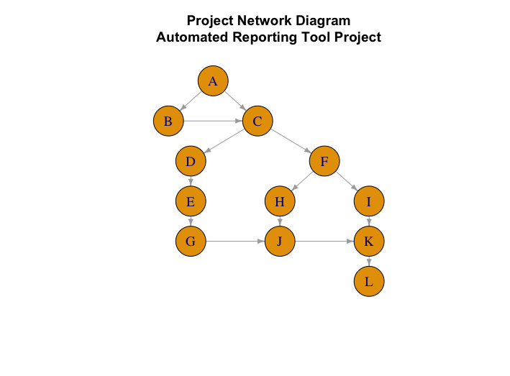
Modeling Dependencies as a Network
How it was created
Built from the igraph package and the WBS activities and dependencies
Each activity becomes a node; dependencies define directed edges
Why we create it
Makes task dependencies explicit
Transforms the project from a list of activities into a network that can be analyzed
Provides the foundation for:
Scheduling
Critical path analysis
Risk modeling
How to interpret it
Nodes = activities
Arrows = dependency relationships
Direction = flow of work
Paths = sequences of dependent tasks
Longest path = critical path (introduced next)
No durations are included-–this is structure only
At this stage, the project structure has been defined and visualized—but the project duration remains outstanding

Slide 6
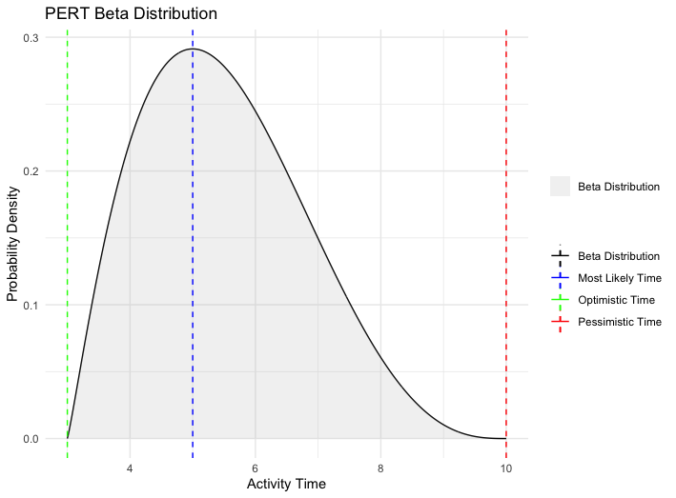
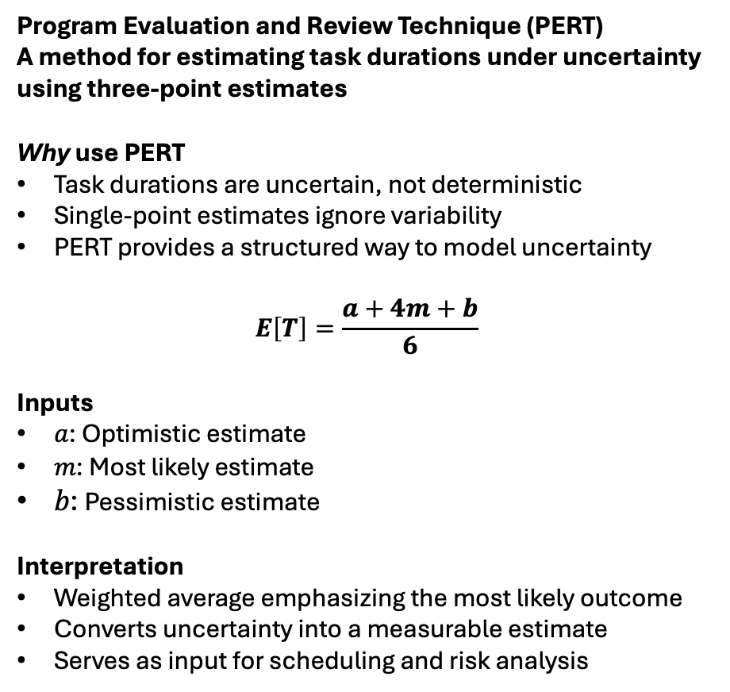
Modeling Task Durations with Uncertainty (PERT)
Program Evaluation and Review Technique (PERT)
A method for estimating task durations under uncertainty using three-point estimates
Why use PERT
Task durations are uncertain, not deterministic
Single-point estimates ignore variability
PERT provides a structured way to model uncertainty
$$E\left[T\right]=\frac{a+4m+b}{6}$$
Inputs
𝑎: Optimistic estimate
𝑚: Most likely estimate
𝑏: Pessimistic estimate
Interpretation
Weighted average emphasizing the most likely outcome
Converts uncertainty into a measurable estimate
Serves as input for scheduling and risk analysis
Task duration is modeled with a Beta distribution bounded by optimistic and pessimistic estimates. Unlike a normal distribution, it is not forced to be symmetric—allowing the most likely value to shape the distribution and reflect expected skew in task outcomes. Created using ggplot2.

Slide 7
From Three-Point Estimates to Expected Durations
Estimated Task Durations for Automated Reporting Tool Project
Interpreting the Estimates
Estimates are expressed in weeks and rounded to practical planning values
Each value represents an expected task duration, not a fixed estimate
Derived from three-point estimates using PERT
Because tasks can run in parallel, the project timeline cannot be derived by summing the PERT estimates
Important Distinction
These are durations, not levels of effort
Effort reflects work required, which may not map directly to calendar time
Why This Matters
Scheduling depends on time, not effort
Critical path analysis (next) requires durations along dependency chains
Activity | 𝑎 (Optimistic) | 𝑚 (Most Likely) | 𝑏 (Pessimistic) | PERT Estimate
A | 2 | 3 | 5 | 3
B | 1 | 2 | 3 | 2
C | 2 | 3 | 5 | 3
D | 4 | 5 | 8 | 5
E | 2 | 3 | 5 | 3
F | 3 | 4 | 6 | 4
G | 3 | 4 | 6 | 4
H | 2 | 3 | 5 | 3
I | 2 | 3 | 5 | 3
J | 3 | 4 | 7 | 4
K | 2 | 3 | 5 | 3
L | 1 | 2 | 3 | 2

Slide 8
Determining the Project Timeline: Critical Path Analysis
Critical Path Analysis for Automated Reporting Tool Project
Forward Pass
Computes earliest start (ES) and earliest finish (EF)
Moves through the network from start → finish
Assumes no delays
Backward Pass
Computes latest start (LS) and latest finish (LF)
Works from finish → start
Preserves overall project duration
Slack (or float)
Slack = LS – ES or LF – EF
Indicates scheduling flexibility
Critical vs. Non-Critical Tasks
Critical tasks: Slack = 0
Non-Critical Tasks: Slack > 0
From criticalpath package
Activity | Duration | ES | EF | LS | LF | Slack | Critical
A | 3 | 0 | 3 | 0 | 3 | 0 | TRUE
B | 2 | 3 | 5 | 3 | 5 | 0 | TRUE
C | 3 | 5 | 8 | 5 | 8 | 0 | TRUE
D | 5 | 8 | 13 | 8 | 13 | 0 | TRUE
E | 3 | 13 | 16 | 13 | 16 | 0 | TRUE
F | 4 | 8 | 12 | 13 | 17 | 5 | FALSE
G | 4 | 16 | 20 | 16 | 20 | 0 | TRUE
H | 3 | 12 | 15 | 17 | 20 | 5 | FALSE
I | 3 | 12 | 15 | 21 | 24 | 9 | FALSE
J | 4 | 20 | 24 | 20 | 24 | 0 | TRUE
K | 3 | 24 | 27 | 24 | 27 | 0 | TRUE
L | 2 | 27 | 29 | 27 | 29 | 0 | TRUE
Project timeline can be derived by summing the durations of the critical path tasks (in red; 29 weeks); delays to critical path tasks will delay entire project.

Slide 9
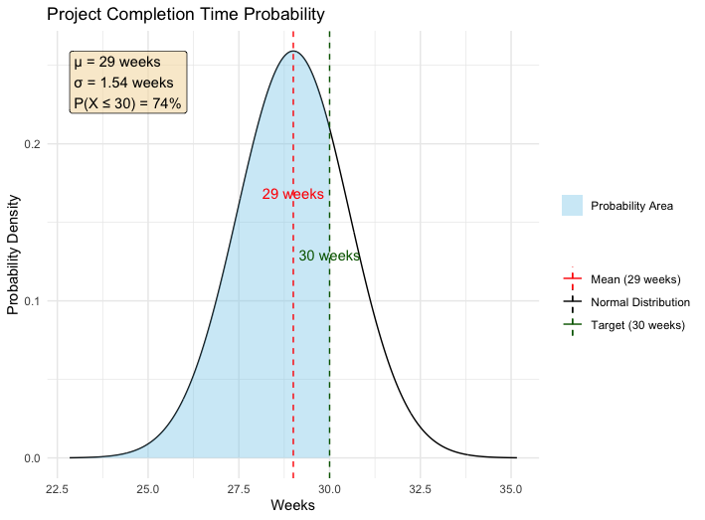
Probability of On-Time Project Completion
Project duration is treated as a random variable, with its expected value defined by the critical path and its variability driven by uncertainty in task durations.
Steps to Compute Probability of Completion Within 30 Weeks
Compute task-level variance using PERT → measures uncertainty in individual task durations
Sum the variances along the critical path → aggregates uncertainty across dependent tasks
Compute the project standard deviation → measures overall variability in project duration (1.54)
Define a due date and the project mean → due date = 30 weeks in this instance; project mean = critical path duration (29 weeks)
Standardize using a z-score → expresses target relative to the project’s variability (0.65)
Evaluate the cumulative probability → returns the probability of completion within the due date (74%)
Project duration is approximated as a distribution; the shaded area represents the probability of completing within the 30-week target. Created using ggplot2.

Slide 10
Optimizing the Project Schedule: Project Crashing
≤ 25 weeks
≤
Project crashing shortens the timeline by allocating resources to selected critical path tasks—trading increased cost for reduced duration
What is project crashing?
Reduces task durations, typically by adding resources and therefore adding cost
Only applies to where it impacts the overall project timeline → critical path tasks
Key Principle
Only tasks on the critical path affect the project duration
Crashing Procedure
Define crash time and costs for each activity
Compute cost per unit time reduction → (Crash Cost – Normal Cost) / (Normal Time – Crash Time)
Identify critical path (it may have changed)
Rank critical tasks by lowest cost per week saved
Select activities to crash based on cost efficiency
Selected Activities Crashed
A, B, C, E, G, L (lowest-cost critical path tasks)
Impact
Original duration: 29 weeks
Crashed duration: 22 weeks
Updated Risk
Probability of completion within 25 weeks → 97%

Slide 11
Projects as Data: From Planning to Decision-Making in R
≤ 25 weeks
≤
What We Did
Represented the project as structured data
Modeled dependencies as a network
Incorporated uncertainty using PERT
Computed the project schedule via critical path analysis
Quantified risk using probability
Optimized outcomes through project crashing
What This Means
Projects are not deterministic plans
They are stochastic systems with dependencies and constraints
They can be:
Modeled
Analyzed
Optimized
Why R
Unified environment for:
Data modeling
Graph analysis
Statistical inference
Optimization
Project management is not just coordination—it is a modeling problem involving structure, uncertainty, risk, and optimization
The same methods and tools used to analyze data can be used to plan projects and improve decisions

Slide 12

About the Presenter
Gary Sutton is the author of two books, both published by Manning Publications: Statistics Slam Dunk: Statistical analysis with R on real NBA data and Statistics Every Programmer Needs. His third book, Timeless Algorithms, will be published later in 2026.
Mr. Sutton earned his undergraduate degree from the University of Southern California and master’s degrees from George Washington University and Northwestern University.
LinkedIn
Amazon
This presentation as well as the supporting R script are available here: GitHub

