Slide 1
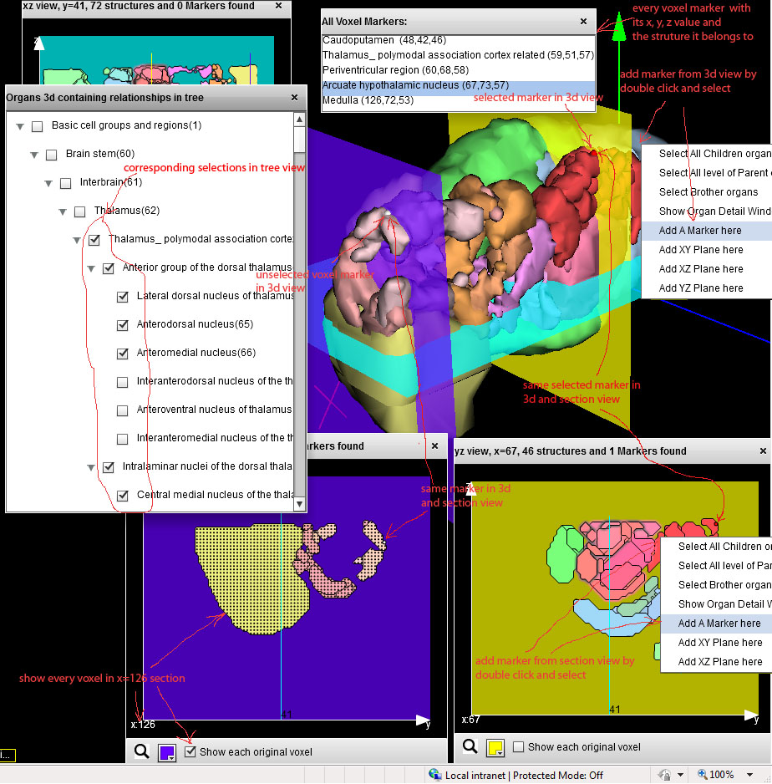
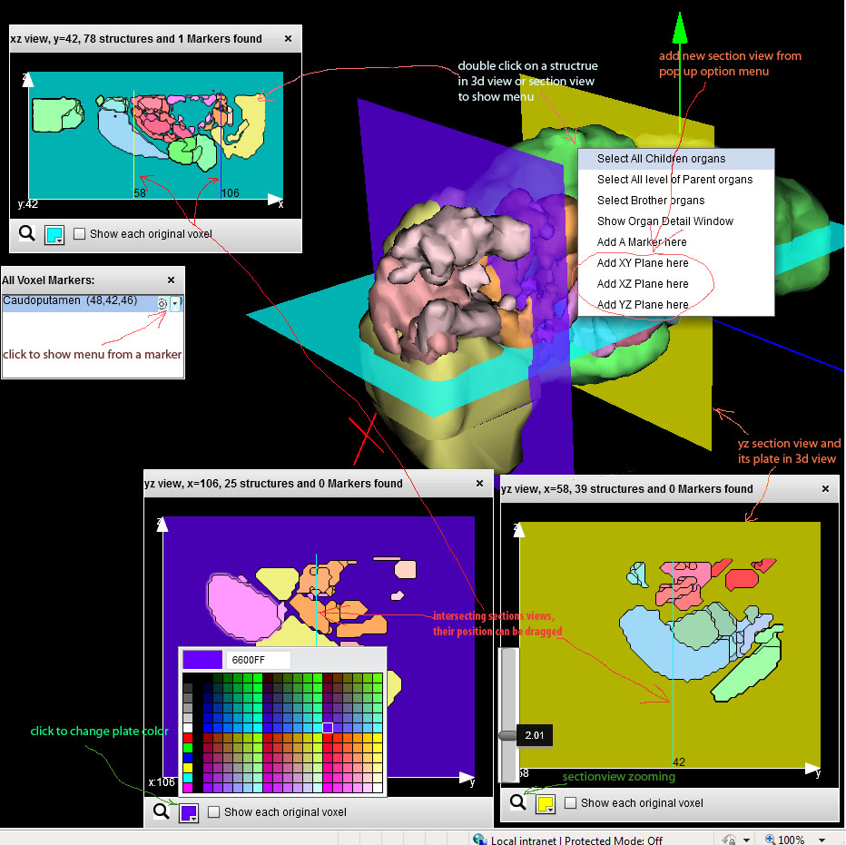
Web-Based 3D-Display of Brain Structures for Data Exploration
Gang Yang¹ and Fan Meng^{1,2}
¹ Molecular & Behavioral Neuroscience Institute and Psychiatry Department
² Center for Computational Medicine and Bioinformatics, University of Michigan
Background
The complexity of the structure and function of brain makes text- or even 2D-graphics based exploration of high throughput data sets and literature related to brain ineffective. We hope to build a web-based system to facilitate the understanding of brain structures, circuits, gene expression levels and disease by taking advantage of large data sets in a centralized database. We choose to use the Adobe Flash Platform for 3D development due to its cross browser support. The newly released Adobe released Flash Player 11 and AIR 3 now support the Stage3D API, which is a set of low-level GPU-accelerated APIs enabling advanced 2D and 3D capabilities. In comparison, while HTML5 is gaining popularity, its features are not fully supported by all browsers and it still does not provide any framework for rapid development.
We build brain 3D structure models using voxel-level data provided by the Allen Brain Institute. The 3D models are converted into the format that Flash Stage3d API can use and they are saved on a BlazeDS server. When requested by users, 3D models will be loaded from server to the Flash player in users’ browser. User can select 3D structures to display together with the corresponding 2D view in x, y, or z directions. We believe this is the first implementation of interactive 3D biological structure display in Flash and we plan to integrate this implementation with gene expression, function annotation and literature data to help the understanding of high throughput neurobiology data in the context of brain structure and functions.
Application Highlights
Our implementation support standard 3D manipulation functions such as zooming, rotating, and panning. We also incorporate the following functions to facilitate data exploration:
1) Customizable 2D section views:
Rather than restricted to three 2D views on the xy-, xz- and yz-planes, Our 3D browser allows users to define multiple 2D section views, such as two views at different x locations on the yz-plane by using option menus from anywhere there’s an axis value.
The location of the 2D sections are labeled in the 3d view. In each section view, the location of other intersecting 2D views is displayed as lines with the same color as the corresponding intersecting view’s background color. Users can control other section views’ position by scrolling or moving other planes’ line. Each section view’s zoom level, background color (also the color of corresponding plane in 3d ), can also be adjusted by users.
2) Overlay of voxel level gene expression data
Since every structure’s 3d model was generated from structurally annotated voxel data provided by the Allen Brain Atlas data, each structure can be linked to voxel level expression data set for over 18,000 genes. A user can access every structure and its underlying voxel data from tree/section/3d view, User can also mark voxels from both section and 3D views. The markers will be displayed in all views. User may also let section views to display gene expression data at the 200 micron voxel level.
3) Multiple structures selection
Every Structure has 3 different status: 1) off stage: structure will not display in any view 2) 2D onlly: structure will display in section view (when intersected by plane) 3) both 2D and 3D: structure will display both in 2D section and 3D views
Since displaying all brain structures at the same time in the 3D view will often make the exploration more difficult, We use a menu system based on brain structure hierarchy for flexible display structure selection. Each structure can be display in 3d/section/tree views, and user can select multiple structures and operate in a batch.
Summary
Our 3D brain structure browser incorporates unique functions to facilitate the comparative exploration of brain structures and associated data. We are in the process of integrating additional data sets, such as Medline, gene expression, protein-protein interaction data into a 3D PubAnatomy application to help the understanding of high throughput neurobiology related data. Our approach can be extended for the exploration of other biological data sets in their anatomical content as well as other type of 3D structures associated with complex data sets.
Acknowledgements: This work is supported by National Library of Medicine grant 1R01 LM009812 to F.M. and B.M..

