Slide 1
Software Engineer & what is take to become one

Slide 2
Software Engineer career path
Build your own CV
Interview

Slide 3
Software Engineer career path
A software engineer is a person who applies the principles of software engineering to the design, development, maintenance, testing, and evaluation of the software that make computers or other devices containing software work.

Slide 4
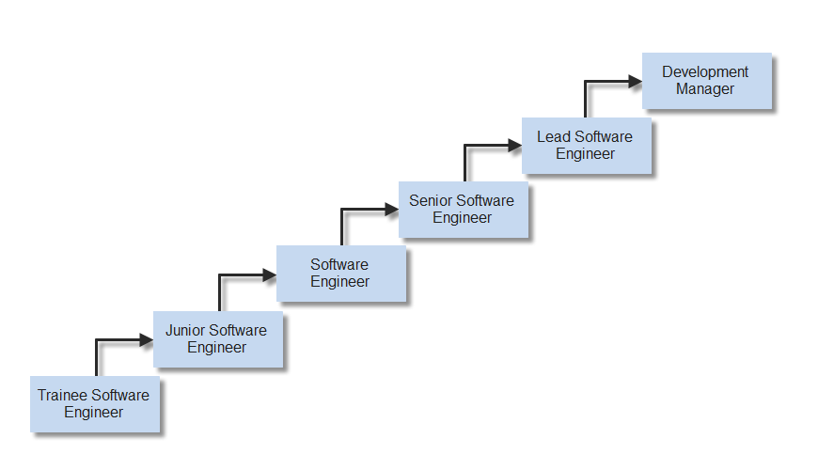
Developer Career

Slide 5
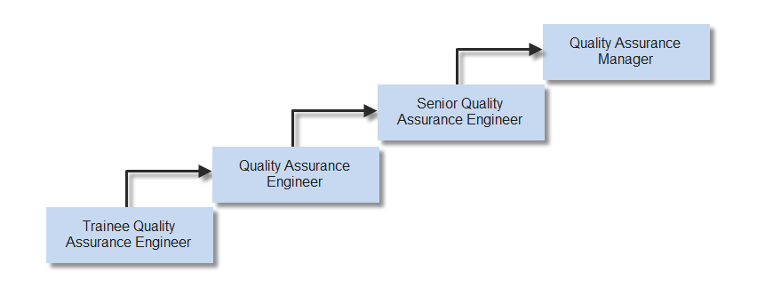
Tester Career

Slide 6
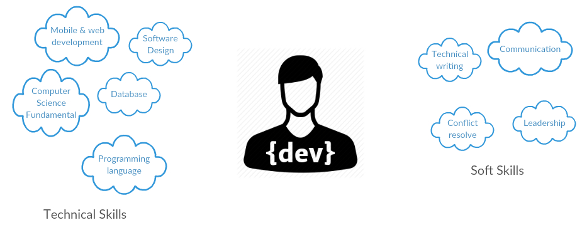
Software Engineer Skillset

