Slide 1
Progressive web app

Slide 2
Agenda
What are Progressive Web App, Benefit of PWA.
Application Shell Architecture
Service Worker, Scope, Service Worker Lifecycle
Events(Caching strategy)
Fetch API
Web App Manifest
Offline Browsing
Push Notification
IndexDB, BackgroundSync
Demo

Slide 3
What are Progressive Web App Benefit of PWA
Progressive web app are a new way to offer incredible mobile app experiences that are highly optimized, reliable, and accessible completely on the web.
Main benefit of PWA:
Offline Mode
App-like
Improved performance
Zero install
Use specific mobile feature (push notification)

Slide 4
Tool to build pwa
Ionic
React Native
AMP (Accelerated Mobile Pages)
Polymer
Meteor
Lighthouse

Slide 5
Application Shell Architecture
The app shell mean minimal HTML,CSS,JS powering the user interface. Since shell doesn’t usually change we can cache and once loaded, dynamic content can populate the view.
Benefit:
Load fast
Use as little data as possible
Use static assets from a local cache
Separate content from navigation
Retrieve and display page-specific content (HTML, JSON, etc.)
Optionally, cache dynamic content
Reliable performance that is consistently fast. Repeat visits are extremely quick. Static assets and the UI (e.g. HTML, JavaScript, images and CSS) are cached on the first visit so that they load instantly on repeat visits
Demo: https://github.com/GoogleChromeLabs/application-shell

Slide 6
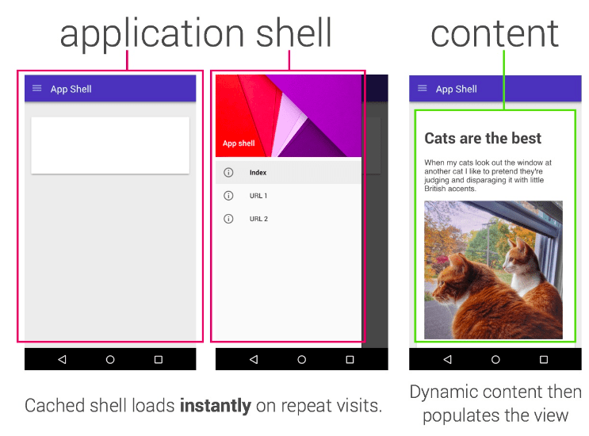

Slide 7
Service worker
Service worker is a script that browser runs in the background, completely separate from web page and don’t need user interaction
Service worker characteristic:
Can't access the DOM directly.
Service worker allowing you to control how network requests from your page are handled.
It's terminated when not in use, and restarted when it's next needed. If there is information that you need to persist and reuse across restarts, service workers do have access to the IndexedDB API.
Service workers make extensive use of promises

Slide 8
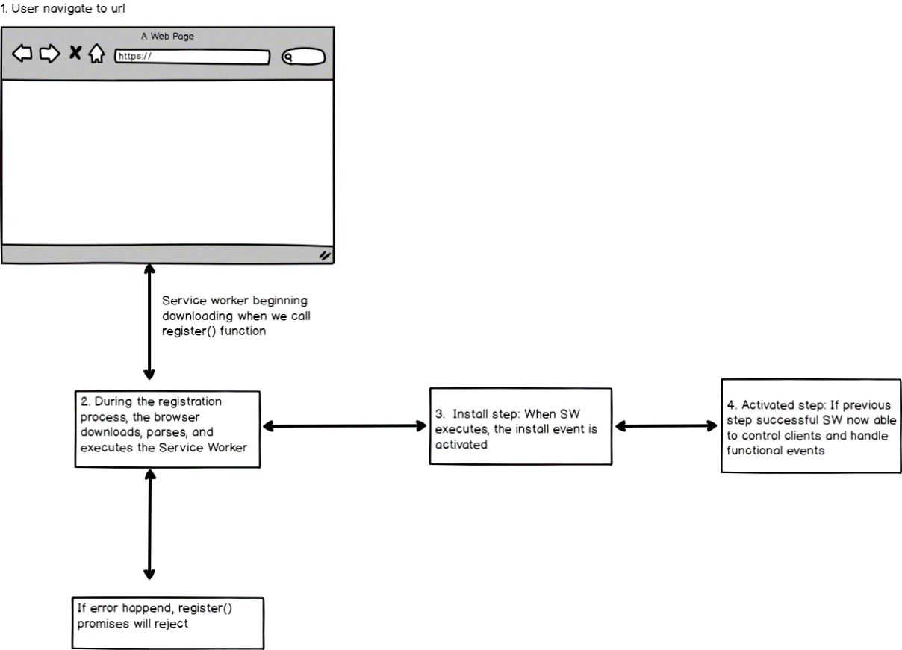
Service worker lifecycle

Slide 9
Events
On Install: After registered and downloaded, sw get installed in the background. Suitable for static assets like js,css,img
On activate: After install stage is finished. SW now in control of things within its scope. Suitable for clean up old cache and update new version.
On network response (Fetch): When browser download data. Suitable for caching web request, response
Demo:
Precaching during Service Worker installation
Cache First

Slide 10
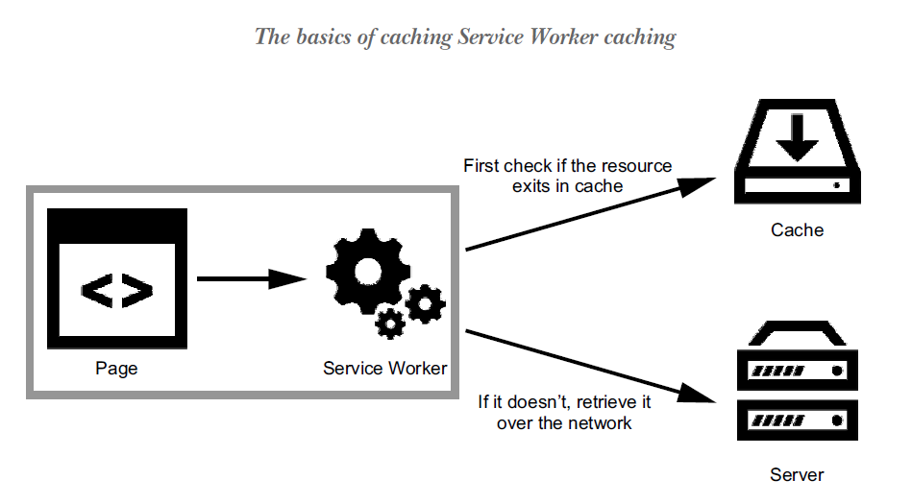

Slide 11
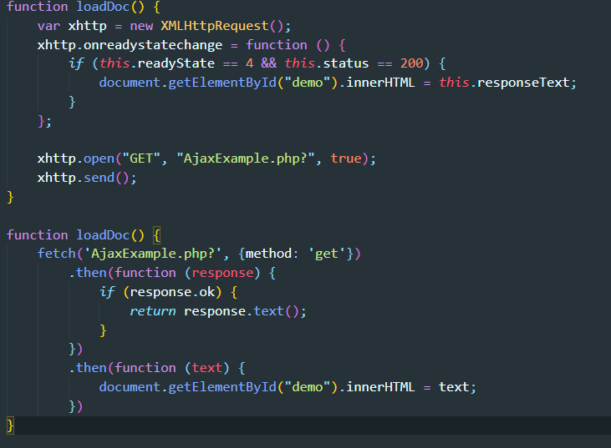
Fetch API

Slide 12
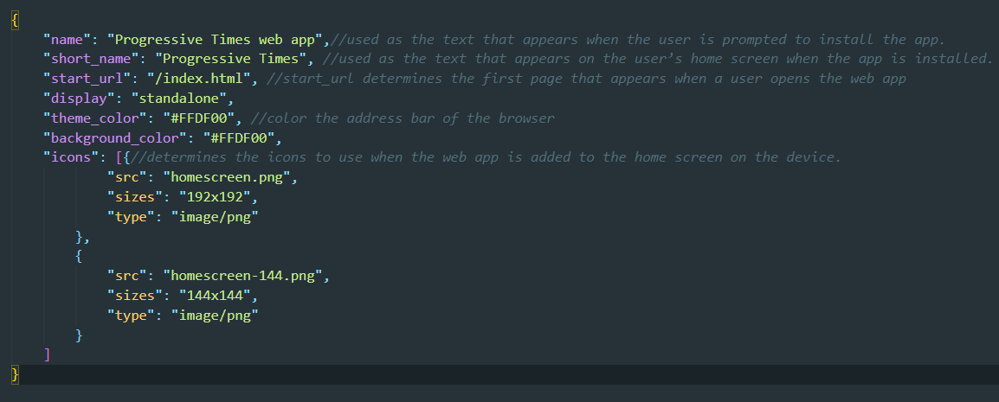
Web App Manifest
A web app manifest file is a simple JSON file that provides useful information about the application (such as its name, author, icon, and description) in a text file.

Slide 13
Offline Browsing DEMo

Slide 14
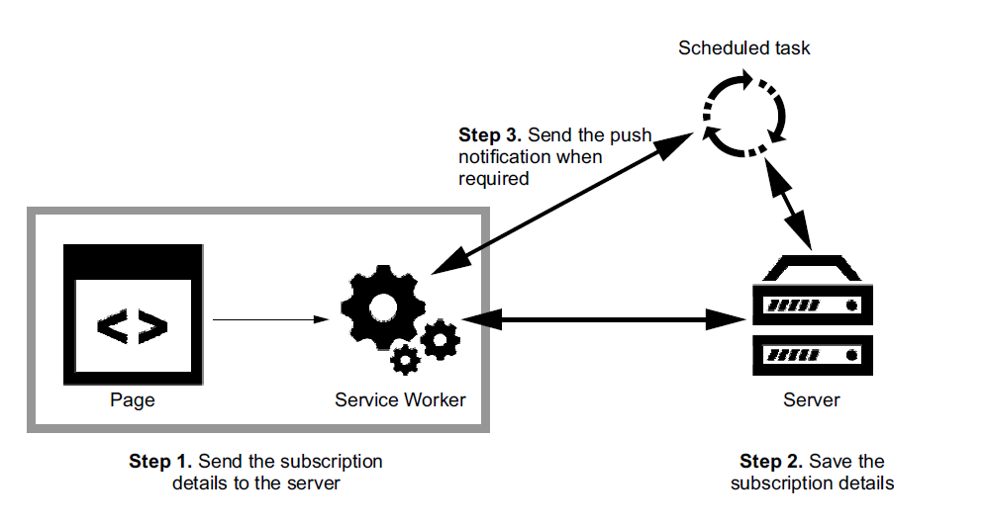
PUSH NOTIFICATION

Slide 15
Push notification
VAPID protocol: is short for Voluntary Application Server Identification. It’s a specification that defines a handshake between your app server and the push service and allows the push service to confirm which site is sending messages.
Push Notification Implementation step:
Adding the client side logic to subscribe a user to push (i.e. the JavaScript and UI in your web app that registers a user to push messages).
The API call from your back-end / application that triggers a push message to a user's device.
The service worker JavaScript file that will receive a "push event" when the push arrives on the device. It's in this JavaScript that you'll be able to show a notification.
* Demo

Slide 16
Background sync & Index DB
BackgroundSync is a new web API that lets you defer actions until the user has stable connectivity, which makes it great for ensuring that whatever the user wants to send is sent when they regain connectivity
IndexedDB is a low-level API for client-side storage of significant amounts of structured data, including files or blobs. This API uses indexes to enable high-performance searches of this data. IndexedDB it’s a better solution when it comes to large amounts of data.

Slide 17
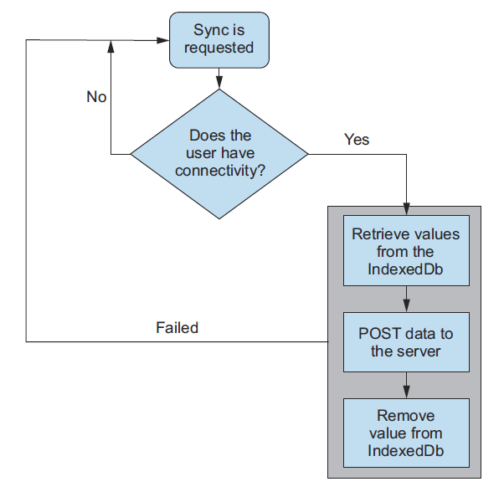
The retry logic for BackgroundSync

