Slide 1
State Management in Angular with NgRX

Slide 2
Agenda
What is NgRX ?
Benefit of NgRX
Core concept
Pure function definition
Redux architecture
Overview of NgRX architecture
Store, Feature Store, Store devtool
Actions, Action Types, Dispatch action
Reducer
Effects
Demo

Slide 3
WHAT IS nGRX
A state management library for Angular applications inspired by Redux. By using this library we are able to keep the current state of the app in one place — the store. This enables us to use the store as a single source of truth meaning we can reliably access the state of the app from this one place rather than components of the app holding their own state and having to communicate and pass data between them. This reduces the communication between components which is particularly helpful to scale our app without adding more complexity.

Slide 4
Benefit of NgRX
Single source of truth (1 store only)
Local cache of data
Render item instantly
Avoid round trip to API
Scalable for large app

Slide 5
Core concept
We can’t mutate the application state. State is immutable.
Actions describe state changes.
State mutation can only be done by dispatching Actions.
Changes are made with pure functions.
Only pure Reducer functions are capable of changing Application State.
Pure functions called reducers take the previous state and the next action to compute the new state.

Slide 6
Pure function definition
Pure function is a function which:
Given the same input, will return same output
Produces no side effects

Slide 7
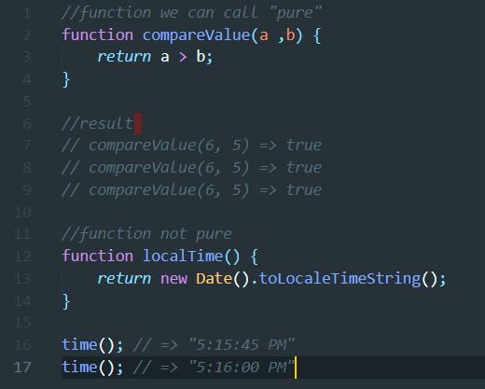

Slide 8
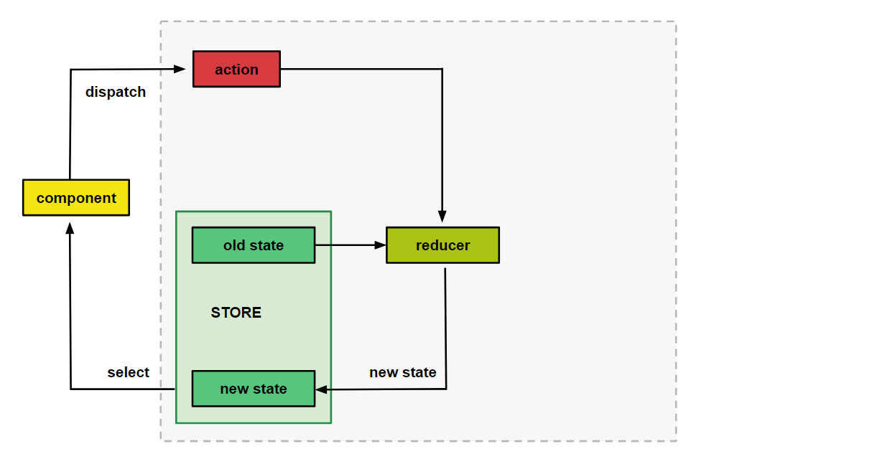
Redux architecture

Slide 9
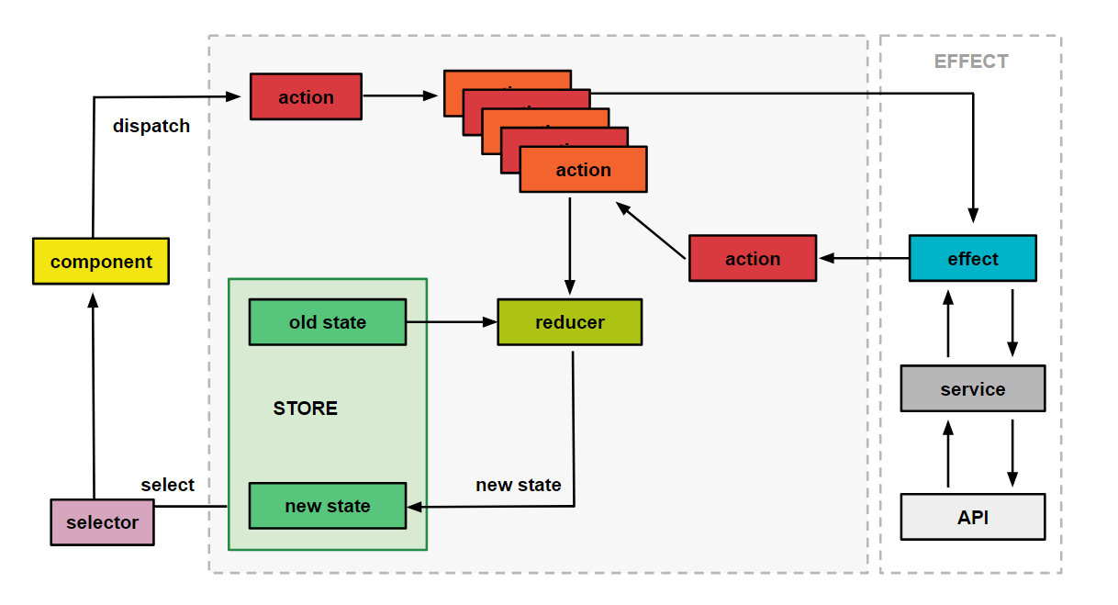
Overview of NGRX architecture

Slide 10
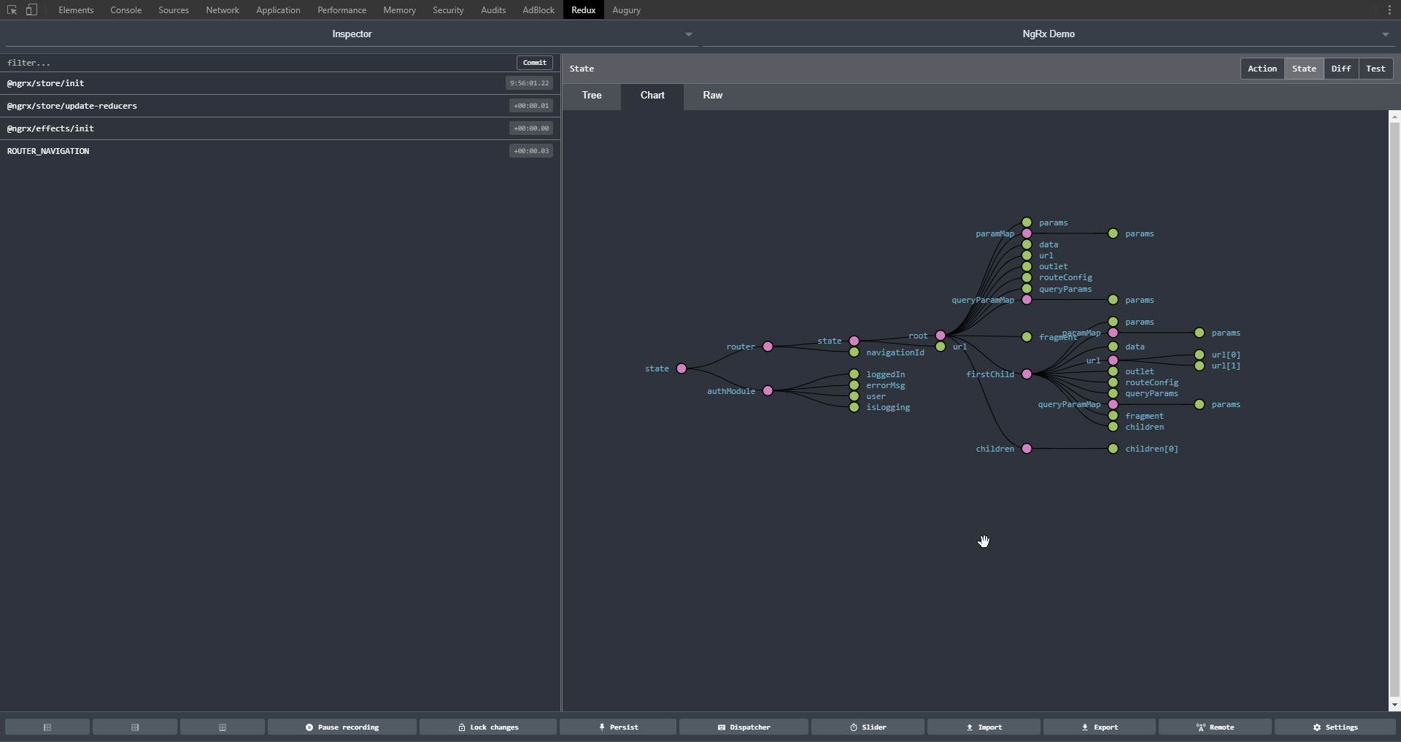
Store devtool

Slide 11
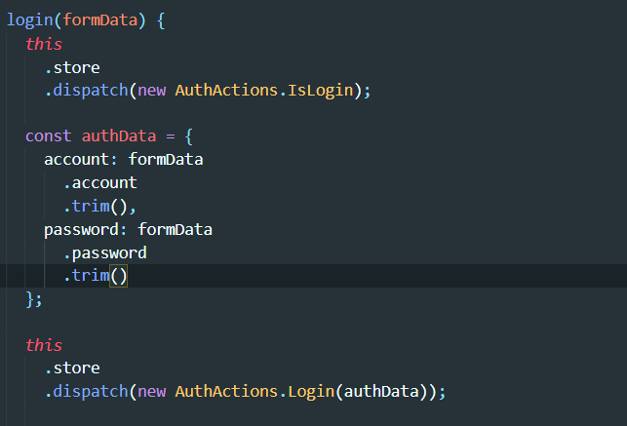
Action, Action types
The action describes the change in state that is to be made.
Dispatch action use to send action types and payload to reducer to calculate new state

Slide 12
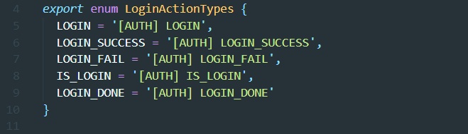
Action types
Action types

Slide 13
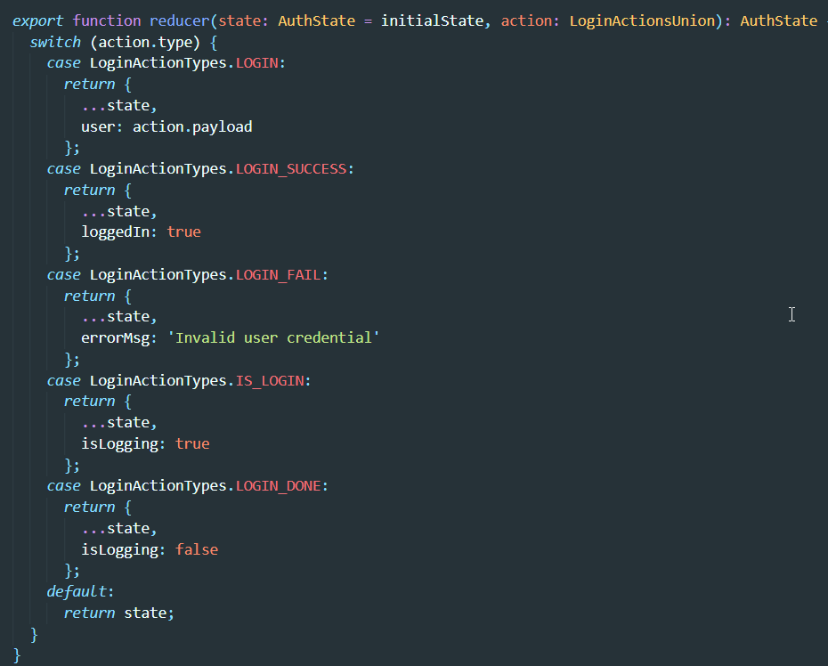
Reducer
Reducers specify how the application's state changes in response to actions sent to the store

Slide 14
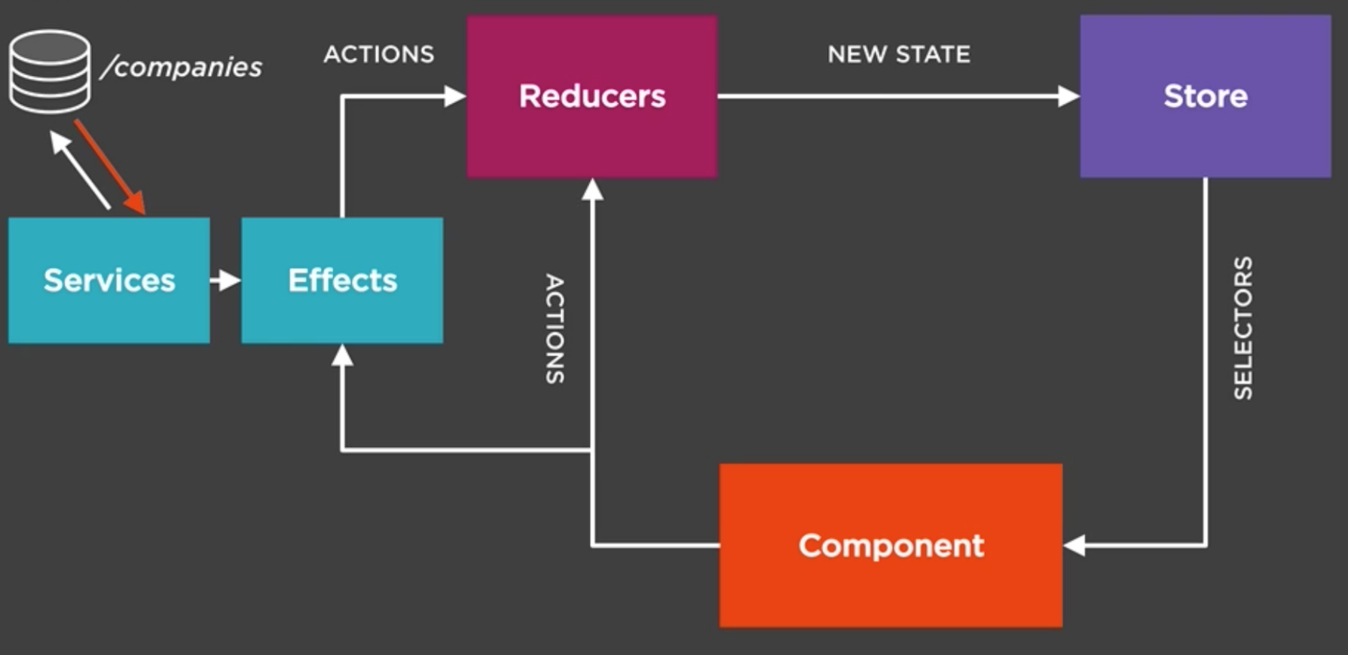
Effect
- Listen for actions dispatched from @ngrx/store.
- Isolate side effects from components, allowing for more pure components that select state and dispatch actions.

Slide 15
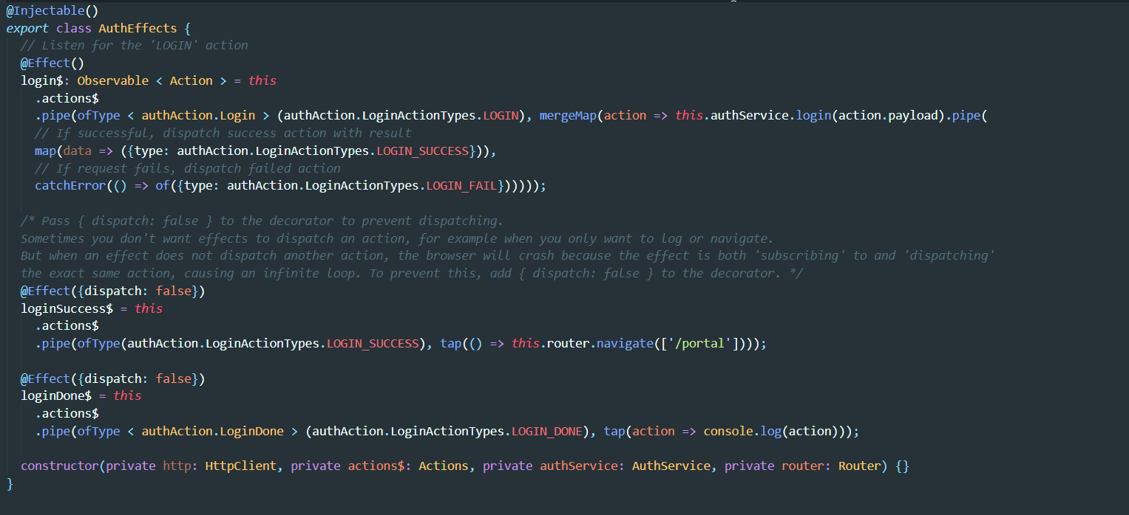

Slide 16
Thank you for listening

