Slide 1

ALPHA · 0.1.0 · LOCAL TUI
COMPANY HARNESS / WORK TALK
polycode
A coding agent we host.
One loop. Many models.
Graphs sit on the loop. They are not a second agent framework, not LangChain, and not Grok Build cloud.
GASAN
3 · SEP · 2026
Notes:
Open with the TUI already running on the other screen. One sentence: this is a terminal coding agent we host, not a website and not a LangChain demo. Then go live.

Slide 2
POLYCODE // HARNESS
§ WHAT IT IS 02 / 12
IN ONE BREATH
A Claude-Code-shaped TUI on a provider-blind engine.
IS
IS NOT
ISOLATION
Terminal coding agent, local first
Not LangChain / LangGraph
Bring your own key
Same loop for Grok, Gemini, OpenAI, Muse, NIM, Qwen, Anthropic (native SDK)
Not Grok Build cloud or Rhai workflows
Docker --network none + path jail
Depth-1 children, worktrees, dashboard
Not a multi-tenant hosted product
No training-tier models by default
JSON graphs with file checkpoints
Not nested agent swarms
Hosted HTTP is a scaffold only
Notes:
Three boxes, then stop. Isolation is BYOK + docker + no training-tier defaults — say that if someone asks 'how is this company-hosted.'

Slide 3
POLYCODE // HARNESS
§ CONSTRAINTS 03 / 12
WHAT WE REFUSED
The harness is the product. Wrappers are not.
01
Own the tool loop
The SDK streams. We run tools. Permissions, redaction, and the dashboard only exist if we own that loop.
02
Canonical types, vendor at the edge
core never imports a provider SDK. Add a model by writing an adapter — not by forking the agent.
03
One depth of children
Explore / researcher / general / review. Children cannot spawn. Parent-only: task, graph.
04
Deny before convenience
Protected paths beat a “safe” short-circuit. Env files are not process env. Safe is not skip-the-gate.
Notes:
These four are the talk if the demo dies. Especially: we own the loop; we did not import LangGraph.

Slide 4
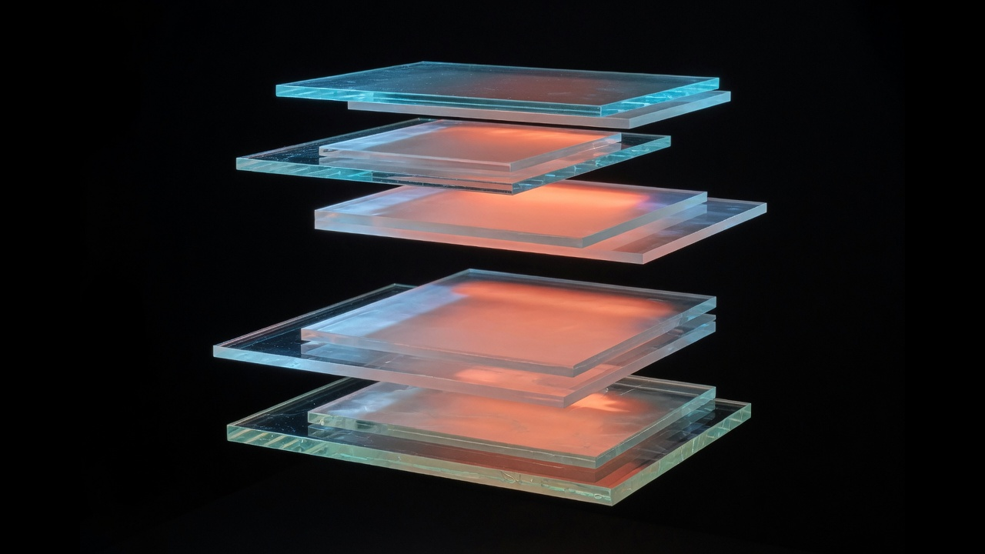
POLYCODE // HARNESS
§ ARCHITECTURE 04 / 12
ONE LOOP, MANY SKINS
You never talk to a vendor shape.
TUI / CLI
Ink composer, /slash, y/a/n, dashboard
Agent.run()
stream → tools → permission → sandbox
Canonical events
text_delta · tool_call · stop · error
Provider adapter
the only AI-SDK-aware code
Sandbox
local jail or docker --network none
Graph / team
children + checkpoints on that loop
Notes:
Point at the glass: each pane is a package. The law: core never imports a provider. TUI and HTTP both construct an Agent.

Slide 5
POLYCODE // HARNESS
§ MONOREPO 05 / 12
PNPM WORKSPACE · NODE 20/22
Packages depend inward. core has no provider SDK.
@polycode/core
@polycode/tools
@polycode/sandbox
loop, permissions, spawn, compaction
read, glob, task, graph, …
path jail, docker, worktrees
@polycode/providers
@polycode/tui
@polycode/graph
AI SDK adapters only
Ink, dashboard, statusline
state, edges, file checkpointer
@polycode/workflows
@polycode/secrets
@polycode/cli / server
TS sequential / parallel budget
keychain, allowlisted .env
pnpm dev · POST /chat SSE
Notes:
Don't tour every package. Hit core, providers, graph. Mention Anthropic is native SDK, not AI SDK.

Slide 6
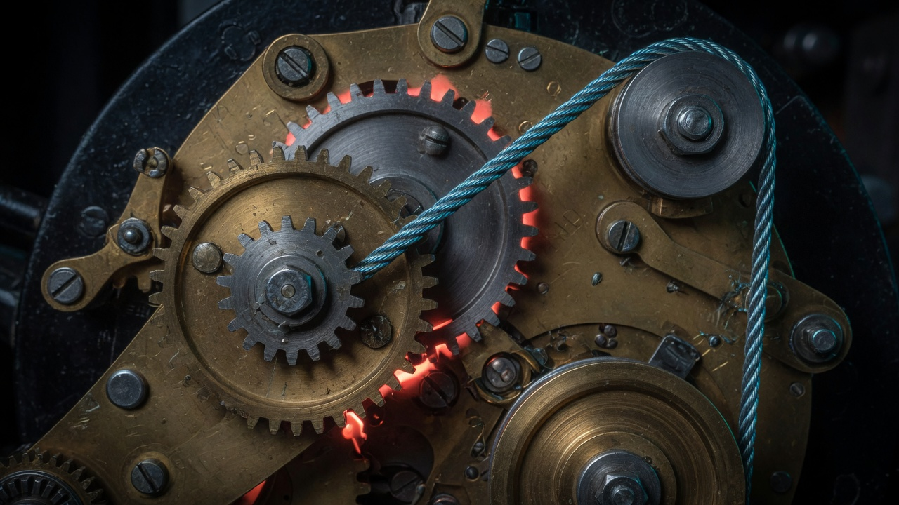
POLYCODE // HARNESS
§ THE LOOP 06 / 12
REACT, NOT A HIDDEN SDK TOOL RUNNER
One stream. We execute the tools.
01
You submit. Hooks can block.
02
Router may pick cheap / strong / long.
03
provider.stream() → canonical events.
04
Safe tools parallel; writers sequential.
05
Deny + protect, then mode, then y/a/n.
06
sandbox.exec only. Output redacted.
07
At 85% context: elide, then summarize.
Permission order is a security feature.
Notes:
Modes: plan / ask / acceptEdits / yolo. Demo stays in ask, with a brief plan refuse. Repeat prompts lead with a = session always.

Slide 7
POLYCODE // HARNESS
§ AGENTS 07 / 12
DEPTH ONE IS A FEATURE
Fan-out is not a graph. A graph is a graph.
Parent
Explore / researcher
General / review
Full tools. Can call task and graph. Statusline c:N while kids run.
Read-only (plus web for researcher). Safe for a live stage.
Writers. Two in one turn get git worktrees. Isolated permission engine.
/team
/dashboard
Caps
Workflow: parallel explore + worktree implement + review. Budgeted. Not a DAG.
Peek, attach, kill. Last graph thread as a dim line. Ctrl+\.
8 live children, 32 finished GC, loops 15s–24h, max 4. No depth-2.
Notes:
If someone says 'LangGraph agents': /team is a workflow. /graph is the state machine. Same children, different runtime.

Slide 8
POLYCODE // HARNESS
§ GRAPHS 08 / 12
LANGGRAPH-SHAPED · ZERO LANGCHAIN
State, edges, super-step, checkpointer — on our loop.
State
JSON object, replace or append
Node
spawnChild; prompt fills from state
Edge
fixed, or if.field includes / equals
Super-step
all ready nodes, Promise.all, then save
Checkpoint
.polycode/graph-runs/<thread>.json
Interrupt
/graph resume <id> continues the machine
STAGE GRAPH
demo START → explore → __end__ explore-only, no worktree, 8 bullets
Parent graph tool · /graphs prints DAGs · onStep progress · dashboard last thread
Notes:
Live: /graphs then /graph show demo then /graph demo …. research-implement is the two-node writer graph — do not run it on stage.

Slide 9
POLYCODE // HARNESS
§ SCARS 09 / 12
CRANKY UNTIL APPROVE · THEN A BUDDY IN THE CHAIR
Green tests are not UX. These were.
.env as RCE
Safe skipped the jail
Copied every KEY=VALUE. NODE_OPTIONS could load attacker code. Fix: allowlist provider keys only.
read of .env auto-allowed. Fix: deny and protect run first. Order of checks is the feature.
Jared, permissions 2/5
“We are LangGraph”
bash + wc on Windows, then retries. /hepl looked like a crash. Fix: glob counts; a for session; system copy, not red unknown.
Fan-out looked like a graph. It wasn’t. Fix: @polycode/graph — named honestly, implemented on the loop.
Notes:
Jared would use it again (4/5). The fail was chrome and bash-for-inventory. Teach a for session-always if a prompt pops.

Slide 10
POLYCODE // HARNESS
§ LIVE 10 / 12
ASK MODE · NO YOLO · NO --SERVE
Type this. Don’t narrate over it.
1
what is this repo?
glob / grep / read — not bash + wc
2
/hepl
system: not sent to the model. Did you mean /help?
3
/mode plan, then try an edit
write refused. Permissions are visible.
4
/graphs
ASCII DAGs, including demo
5
/graph demo how the loop works…
progress lines, child, checkpoint
6
/dashboard
kids + last graph thread. Statusline c:N
BACKUP /explore what is this repo? · if bash prompts, press a (session)
Notes:
Backup: /explore what is this repo? Cite packages/core and packages/graph. Full cheat sheet: docs/demo-script.md. If bash prompts, press a.

Slide 11
POLYCODE // HARNESS
§ SHIPPED 11 / 12
SQUASH TO MAIN · PRIVATE REPO
Built in the open of our own git history.
#5–#10
314
3
4/5
kernel through FORME
unit tests next to the bug
cranky rounds to APPROVE
Jared: would use again
#5 company harness kernel
#6 TUI / Grok / multi-agent
#7 harden + beta logger
#8 permission spam + /hepl
#9 @polycode/graph
#10 FORgasan narrative
Notes:
This PR (demo graph, parent graph tool, DAG, deck) may still be unmerged at talk time — say what's on the branch if so. Numbers are unit tests, not a live TTY count.

Slide 12
POLYCODE // HARNESS
§ NEXT 12 / 12
HONEST BACKLOG
Ship the loop we own. Don’t fake a cloud.
01
Live TTY is the real test
Windows Terminal, a buddy, the survey. Vitest does not replace that.
02
Hosted mode stays dark
POST /chat exists. Tenant isolation does not. Do not bind it public.
03
Graph v1 has no cross-thread store
Long-term facts stay in memory.md. Decide if that is enough.
04
Smoke the other providers
Multi-model is an architecture claim. Prove it on Gemini and Muse, not only Grok.
Notes:
Close: the ask is to keep building this harness in-house — graphs on our loop, keys on our box. Questions.

