Slide 1
Request: Provide a summary table of species’ sample sizes in each market category by time block.
Rationale: The requested information will assist in understanding where there are gaps in the available data that the model is filling in by means of its pooling structure.
Response: The following slides show tables of total sample sizes and the frequency of occurrence by species within each sample (across all years, gears, ports and quarters within a time period) for the three rockfish market categories that we focus on in the presentation, as well as elasmobranchs and flatfish. Supplementary excel files include data summaries and pivot tables that can be used to review the same information for all other market categories, as well as these and other market categories at higher levels of stratification (year, port complex, gear, quarter) to address specific questions or concerns.

Slide 2
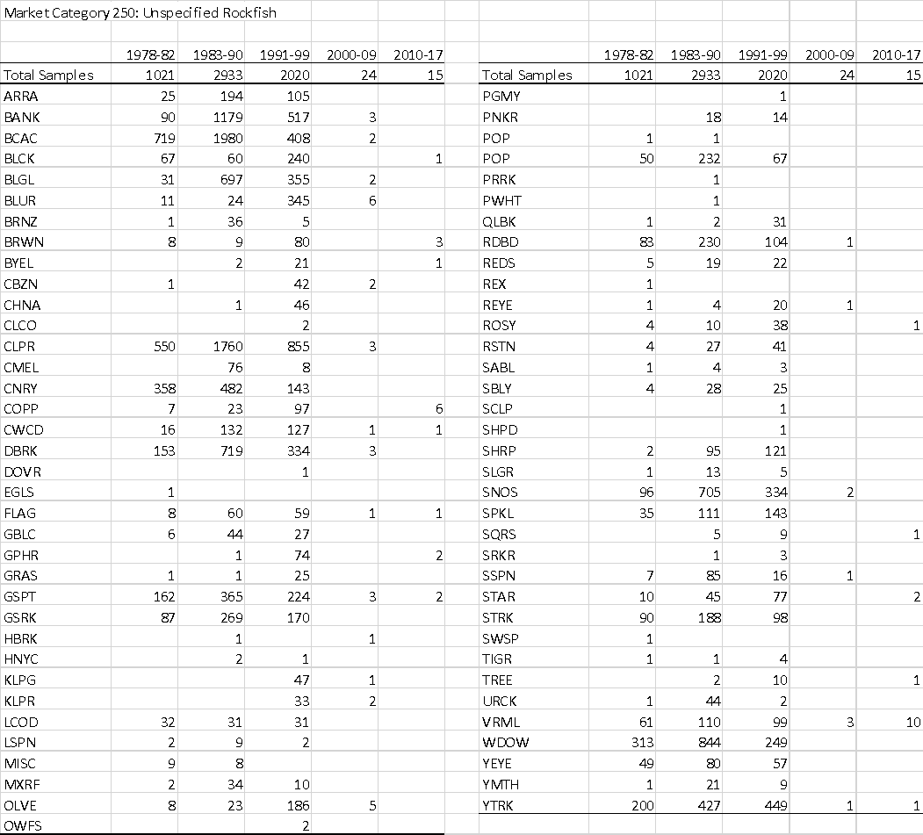
This table shows the total number of samples for Market Category 250 (Unspecified rockfish) in five major time periods (noting that this market category was among the most heavily used early, but lightly used in later time periods; see Figure 2 of Grunloh et al. report from first review- I’d like to add total catches for this MC and time period to upper row of table!). The sparseness of some species in the sample data (e.g., bronzespotted rockfish in the 1978-1982 period, when just one was encountered) directly relates to the challenges and poor diagnostics in the fits for such rare species.

Slide 3
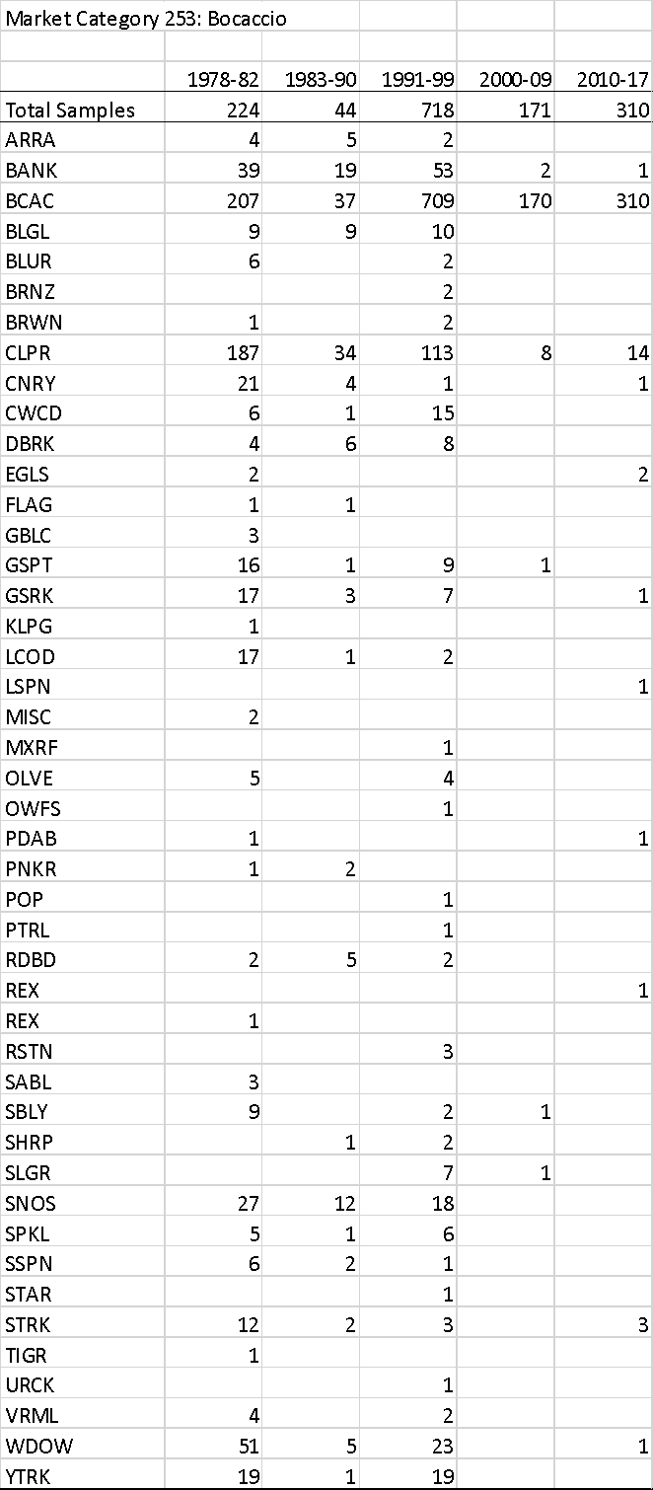
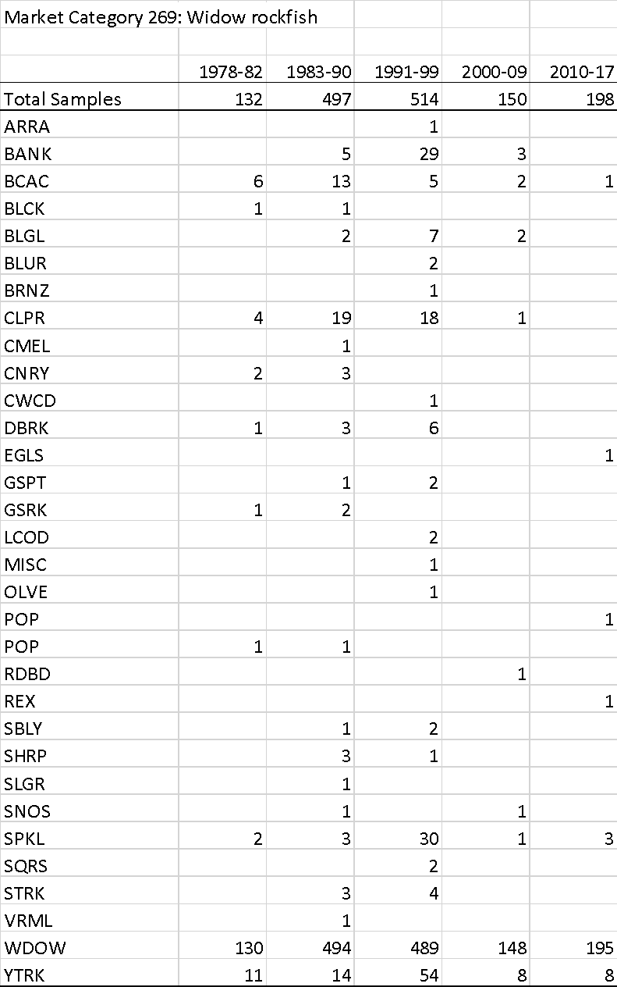
These tables shows the total number of samples for Market Category 253 (Bocaccio) and 269 (Widow rockfish), with the frequency of occurrence of all other rockfish species in each sample, in five major time periods.

