Slide 1
Second order graph convolutional networks
Elnur Gasanov

Slide 2

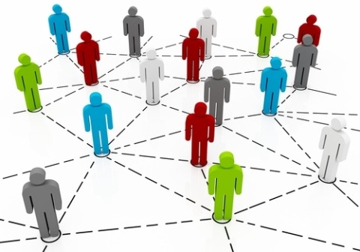
Introduction
http://www.4icrsie.com/en/?id=108&p=94
https://www.socialmediaexaminer.com/what-your-business-needs-to-know-about-social-graphs/

Slide 3
Related work
Deferrard et al. Convolutional neural networks on graphs with fast localized filtering
Henaff et al. Deep convolutional networks on graph-structured data
Kipf & Welling. Semi-supervised classification with graph convolutional networks

Slide 4

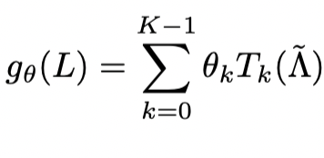


SECOND ORDER GCN
GENERAL FORM OF FILTERING:
CHEBYSHEV PARAMETRIZATION:
SECOND ORDER MODEL:

Slide 5
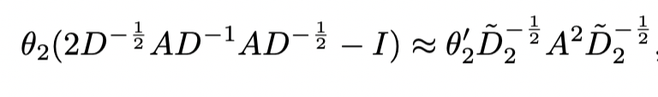
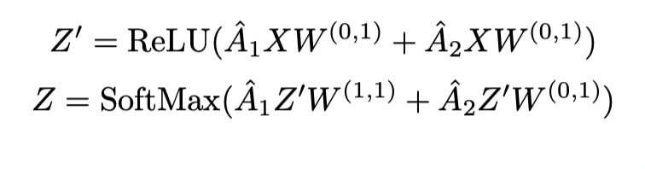
SECOND ORDER GCN
AS IN VANILLA GCN

Slide 6
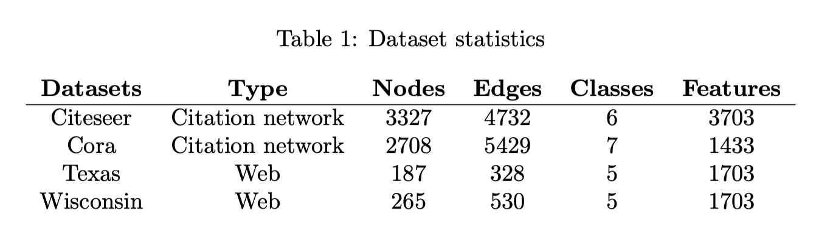
Datasets

Slide 7
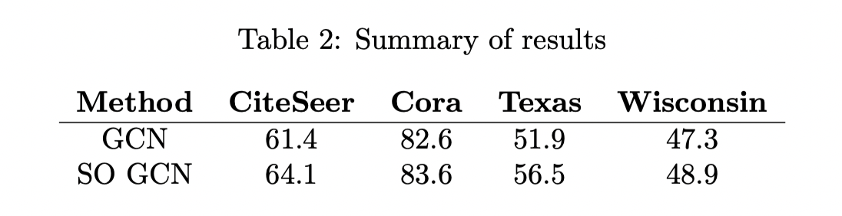
Results

