Slide 1
Exploratory Analysis Report

Slide 2
Univariate Analysis

Slide 3
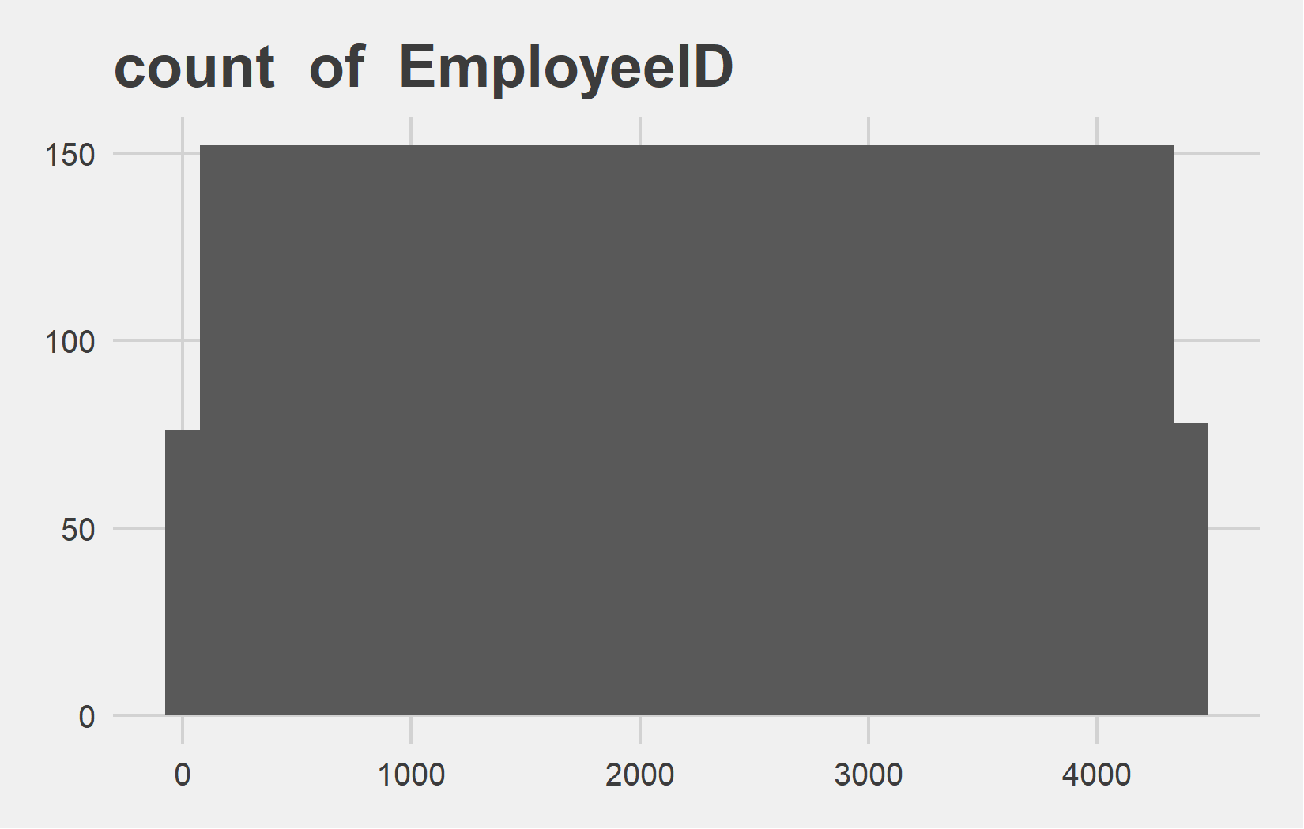
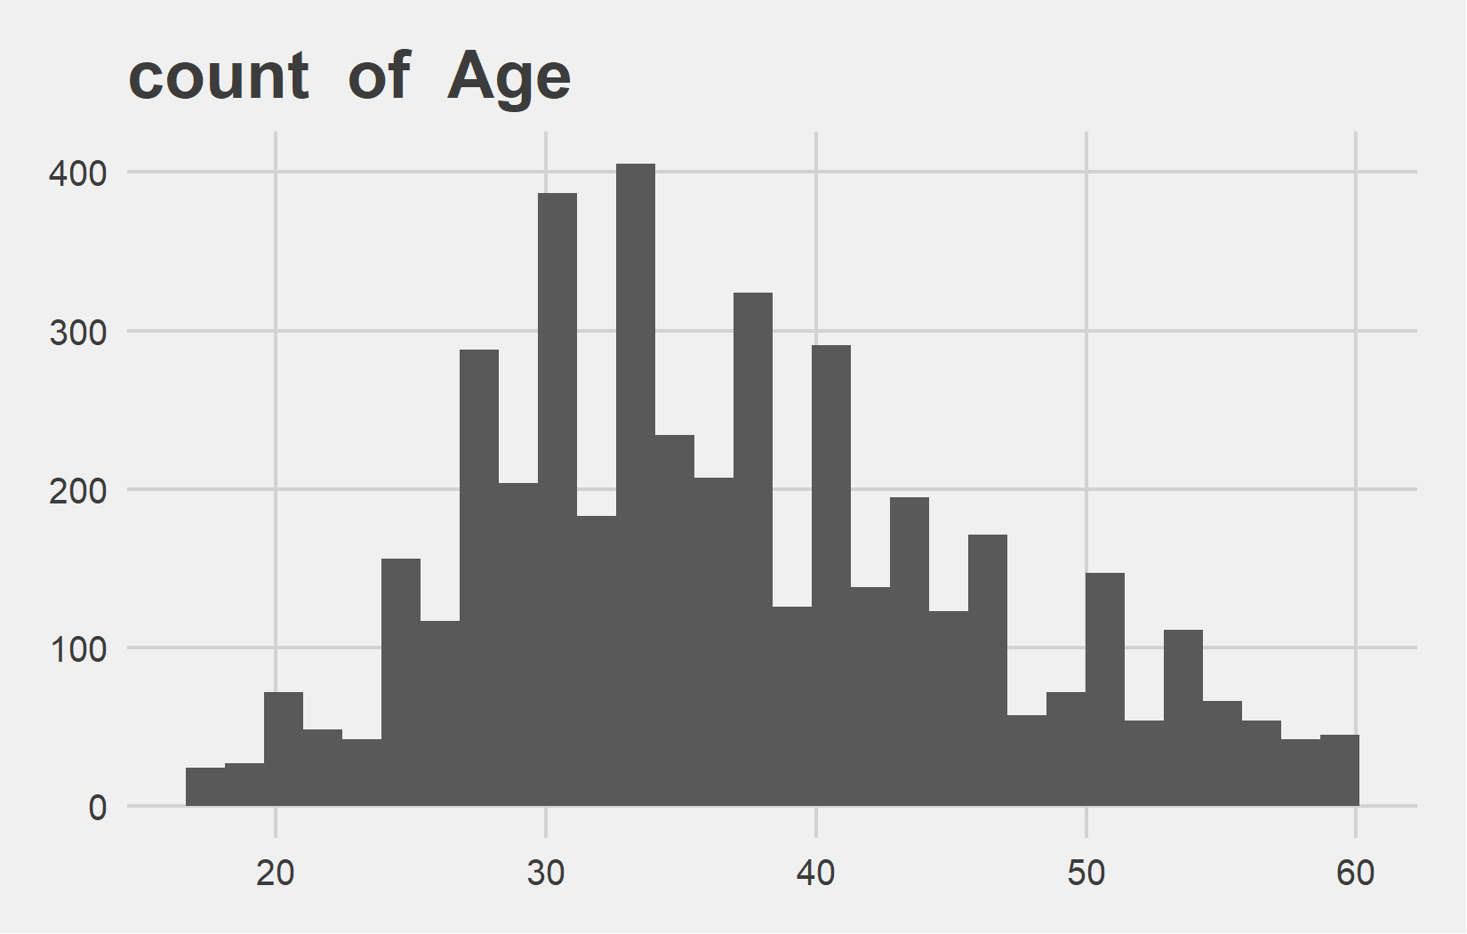
Univariate Analysis Slide 1 of 13
min | 25th | 50th | 75th | max
1 | 1103 | 2205.5 | 3308 | 4410
min | 25th | 50th | 75th | max
18 | 30 | 36 | 43 | 60

Slide 4
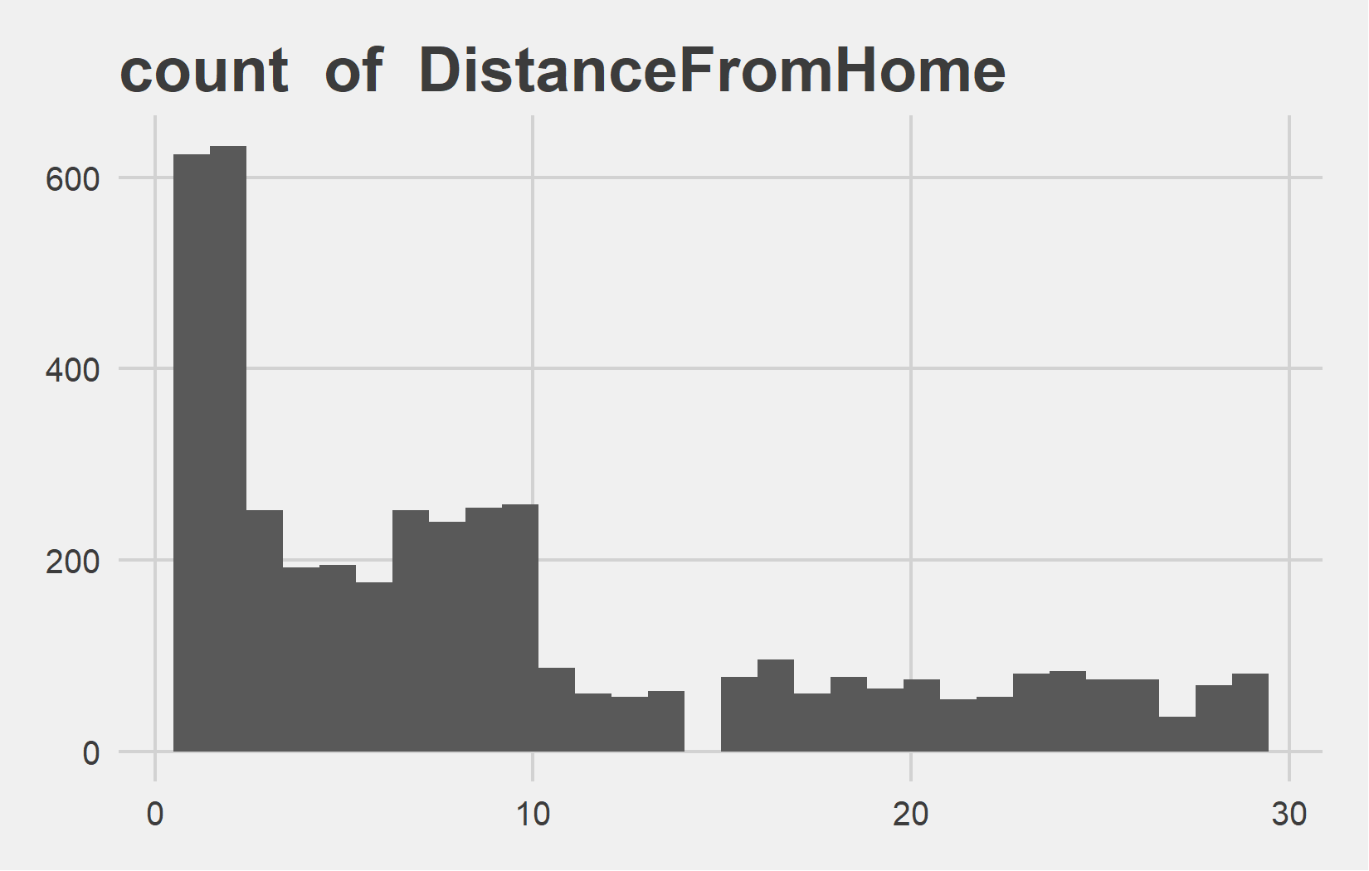
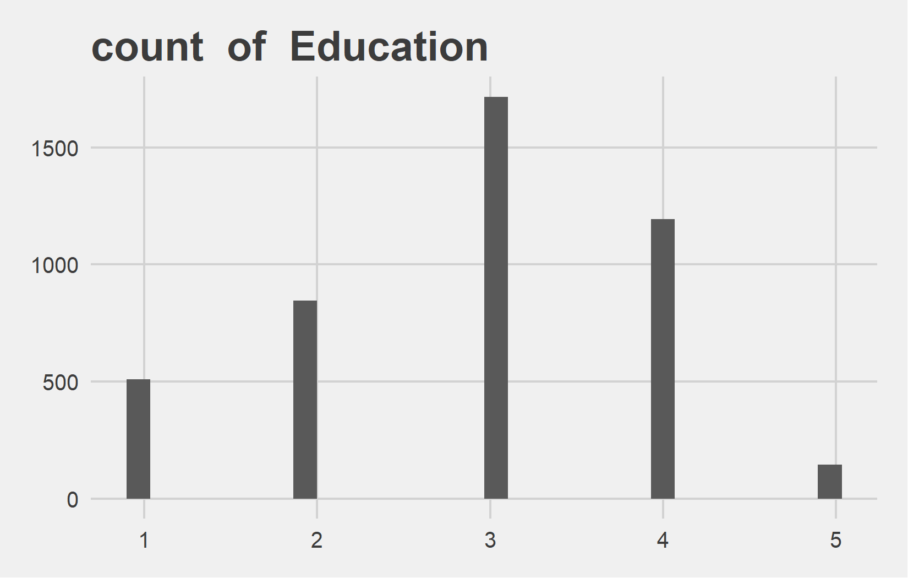
Univariate Analysis Slide 2 of 13
min | 25th | 50th | 75th | max
1 | 2 | 7 | 14 | 29
min | 25th | 50th | 75th | max
1 | 2 | 3 | 4 | 5

Slide 5
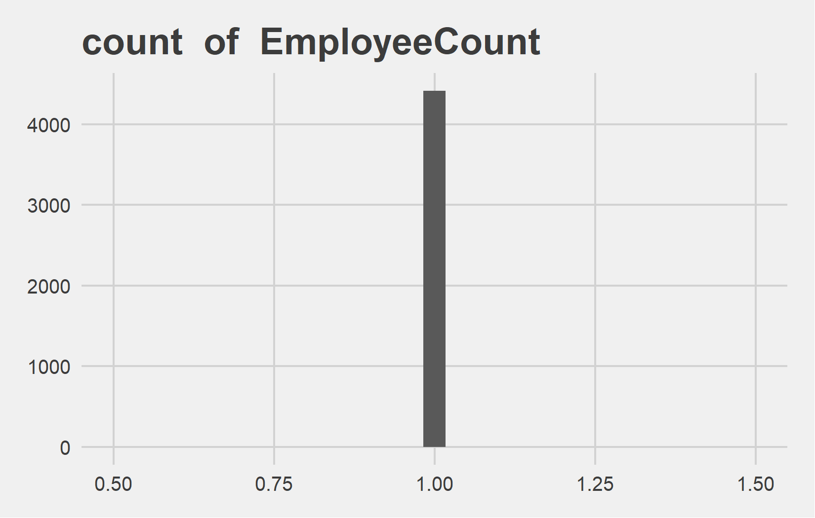
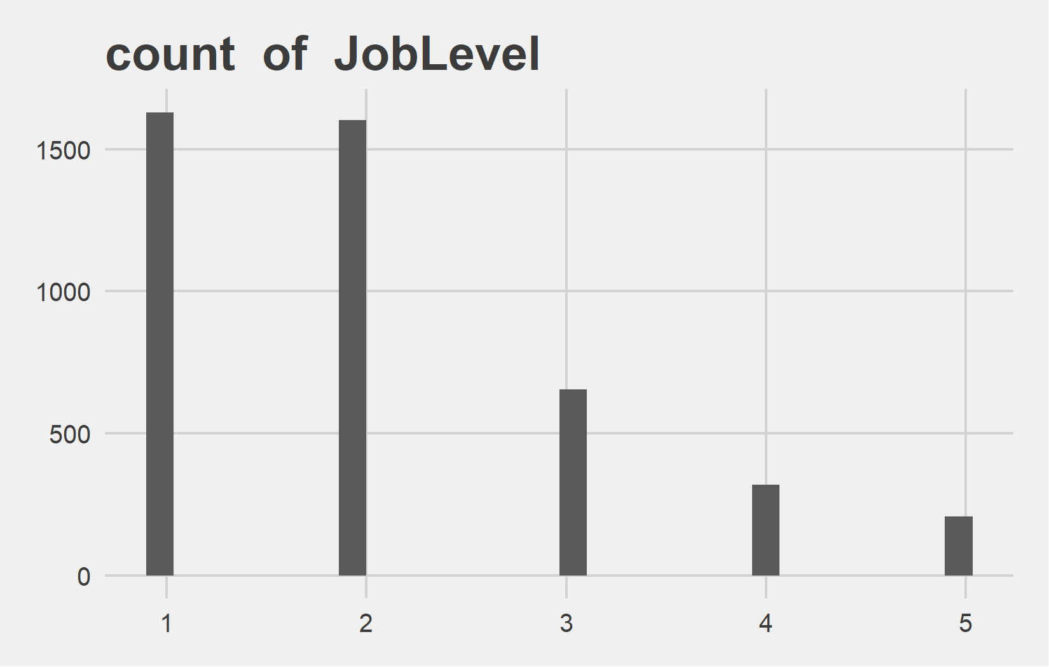
Univariate Analysis Slide 3 of 13
min | 25th | 50th | 75th | max
1 | 1 | 1 | 1 | 1
min | 25th | 50th | 75th | max
1 | 1 | 2 | 3 | 5

Slide 6
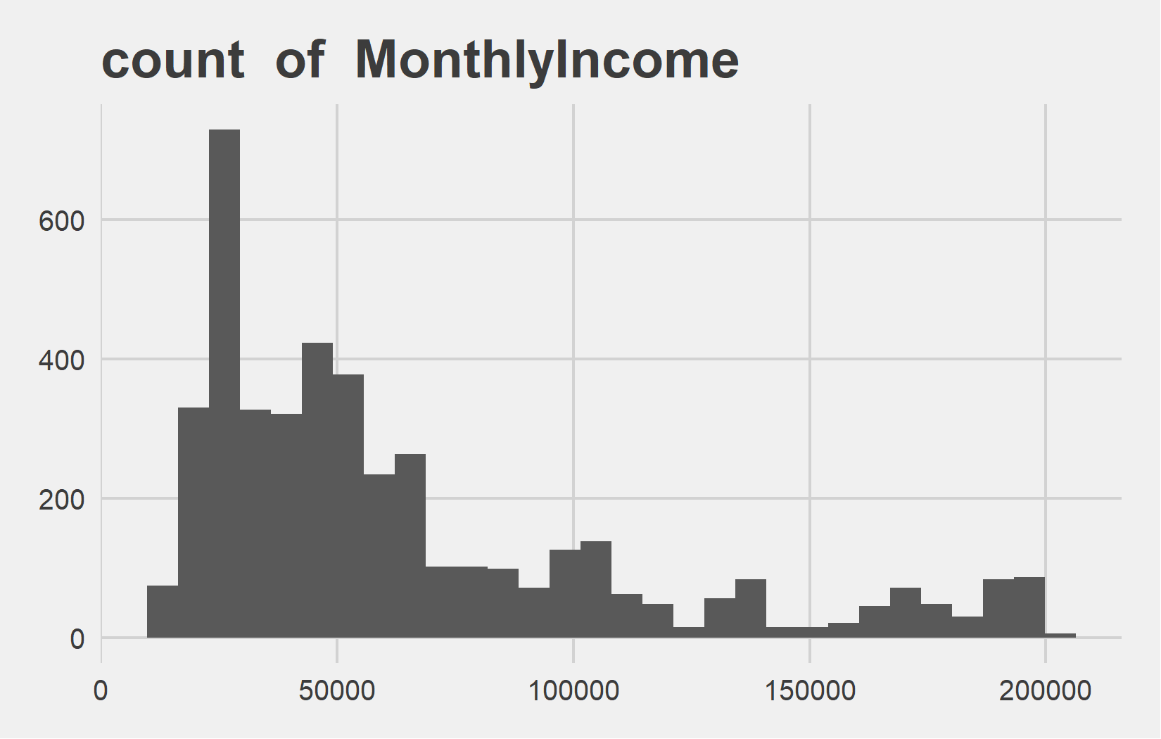
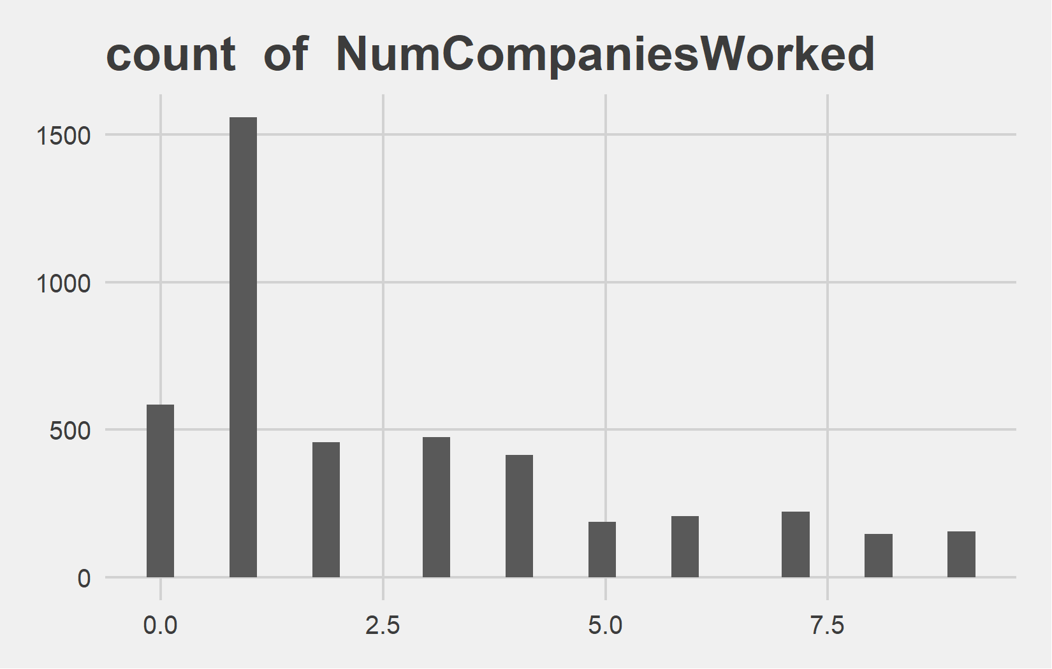
Univariate Analysis Slide 4 of 13
min | 25th | 50th | 75th | max
10090 | 29110 | 49190 | 83800 | 199990
min | 25th | 50th | 75th | max
0 | 1 | 2 | 4 | 9

Slide 7
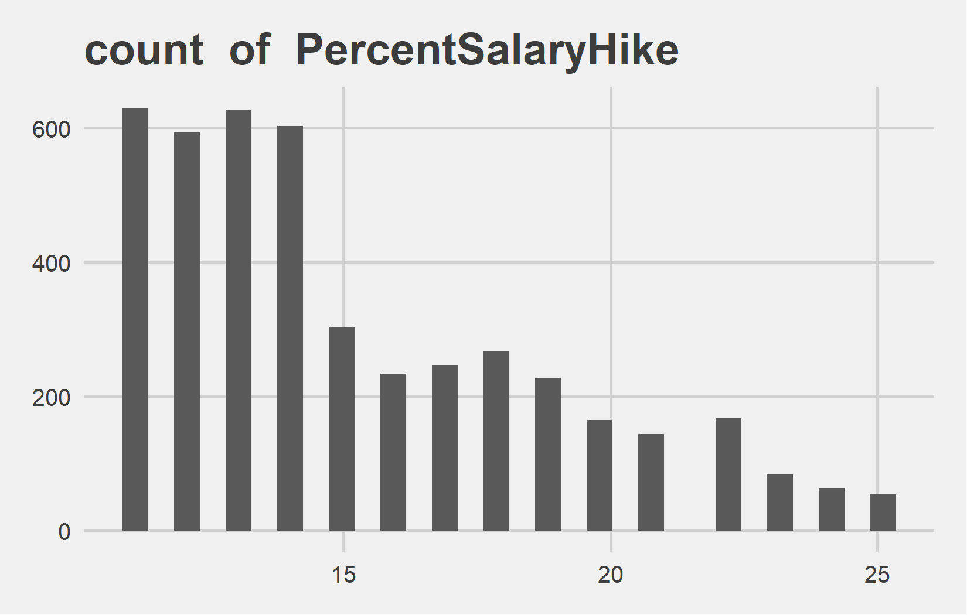

Univariate Analysis Slide 5 of 13
min | 25th | 50th | 75th | max
11 | 12 | 14 | 18 | 25
min | 25th | 50th | 75th | max
8 | 8 | 8 | 8 | 8

Slide 8
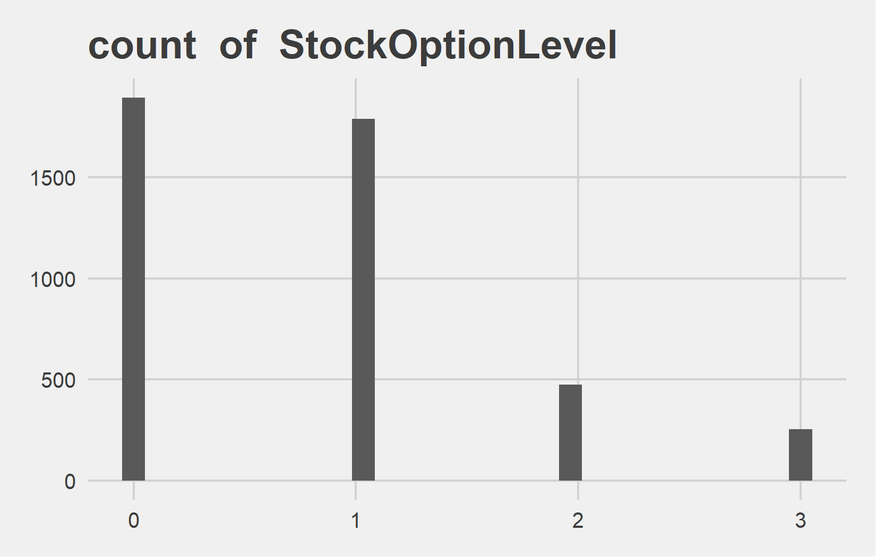
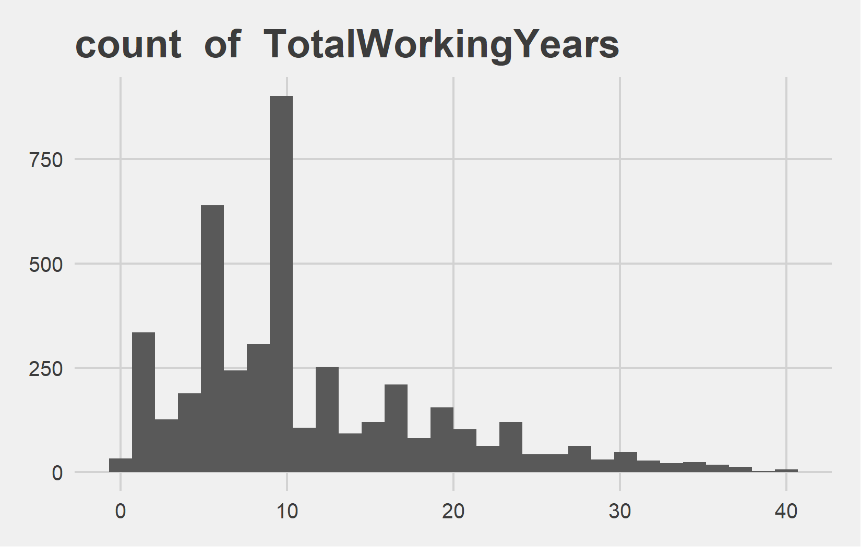
Univariate Analysis Slide 6 of 13
min | 25th | 50th | 75th | max
0 | 0 | 1 | 1 | 3
min | 25th | 50th | 75th | max
0 | 6 | 10 | 15 | 40

Slide 9
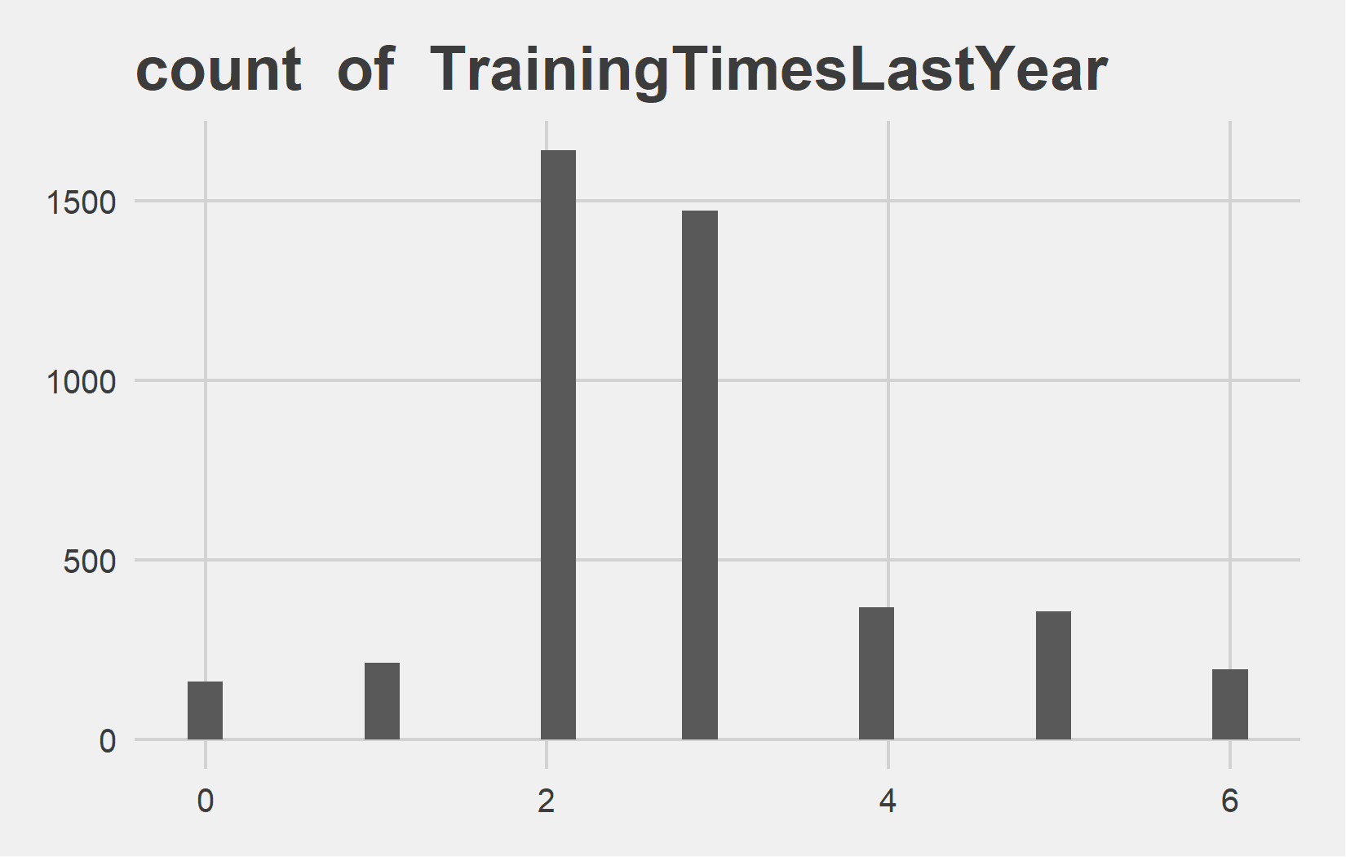
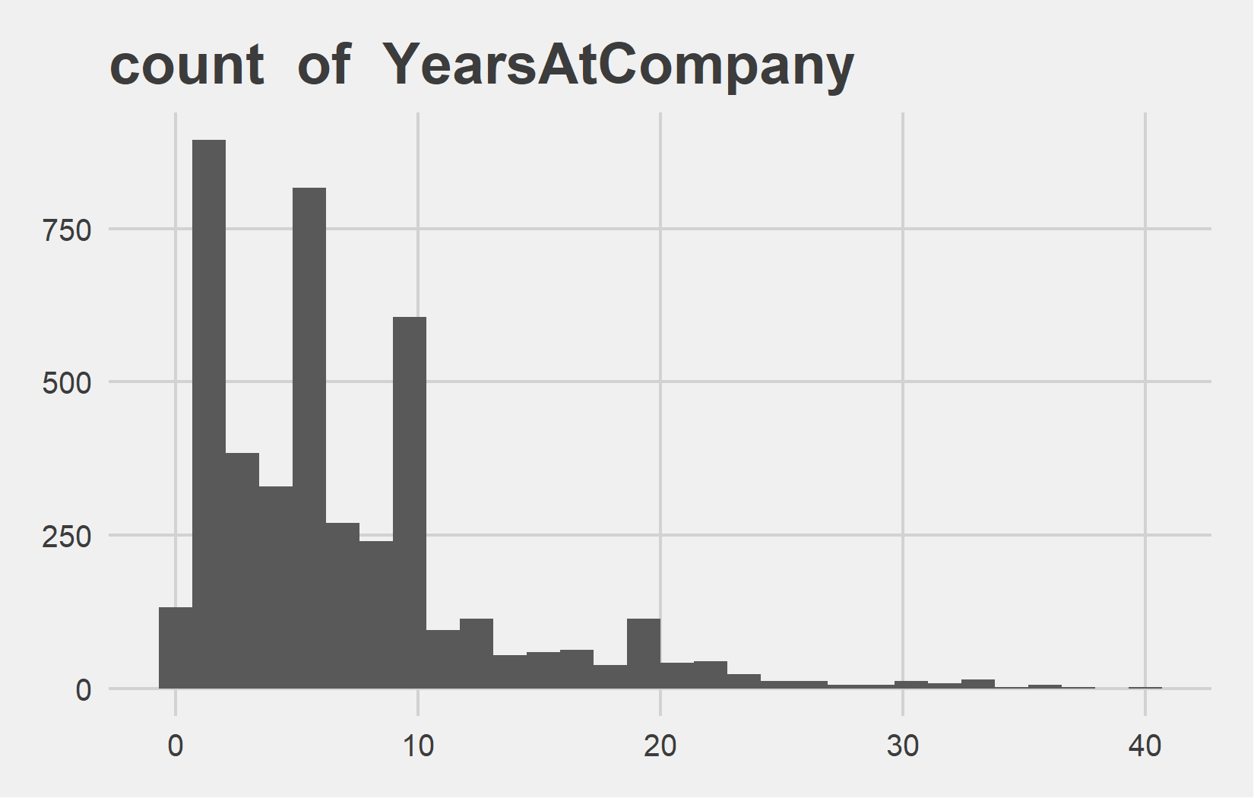
Univariate Analysis Slide 7 of 13
min | 25th | 50th | 75th | max
0 | 2 | 3 | 3 | 6
min | 25th | 50th | 75th | max
0 | 3 | 5 | 9 | 40

Slide 10
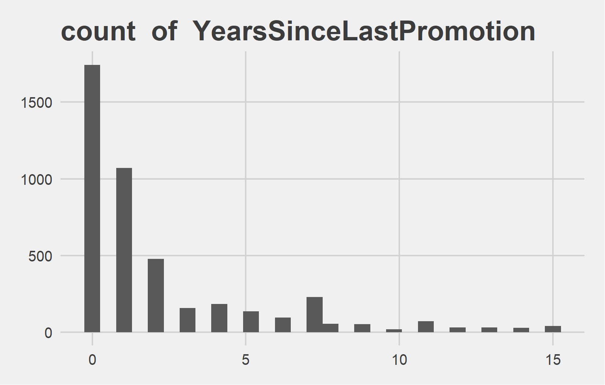
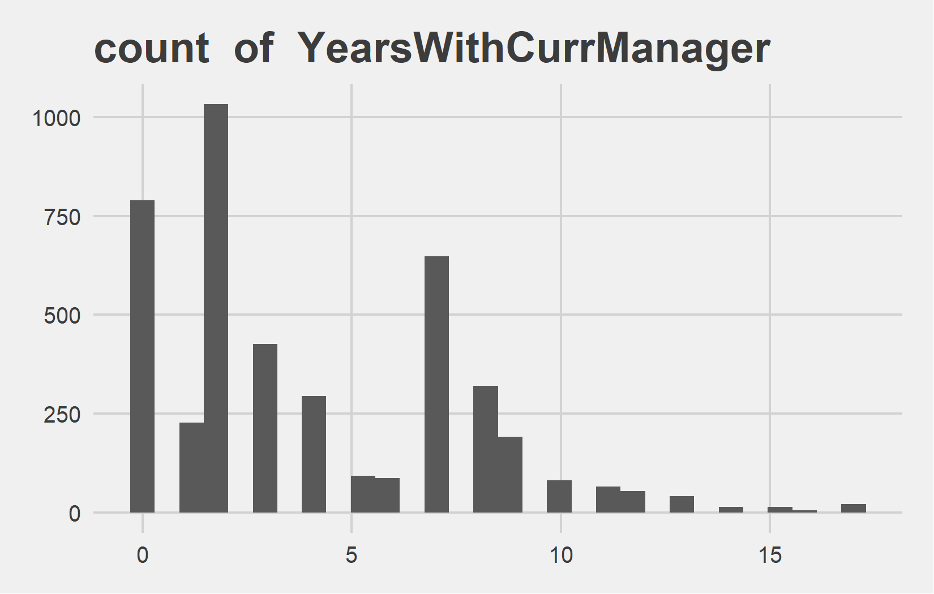
Univariate Analysis Slide 8 of 13
min | 25th | 50th | 75th | max
0 | 0 | 1 | 3 | 15
min | 25th | 50th | 75th | max
0 | 2 | 3 | 7 | 17

Slide 11
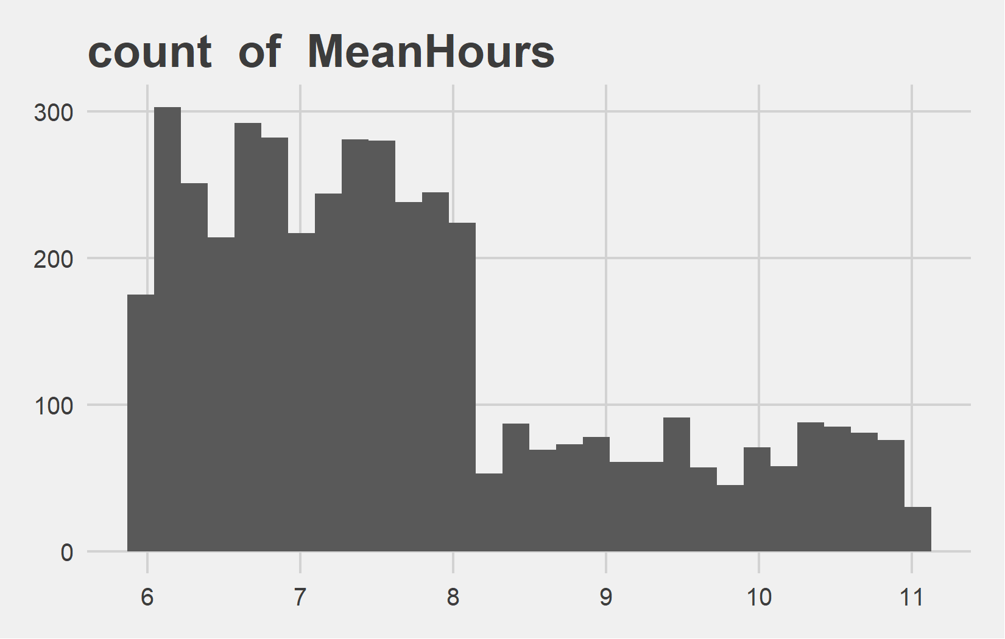
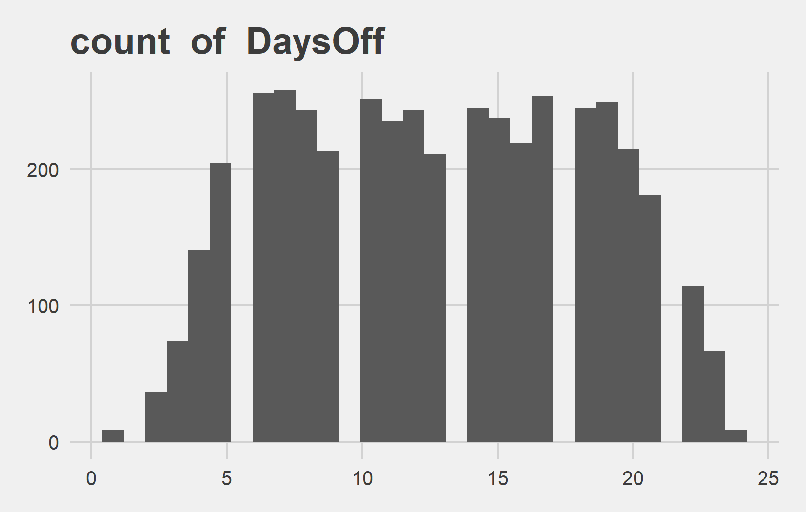
Univariate Analysis Slide 9 of 13
min | 25th | 50th | 75th | max
5.95 | 6.67 | 7.41 | 8.37 | 11.03
min | 25th | 50th | 75th | max
1 | 8 | 13 | 17 | 24

Slide 12
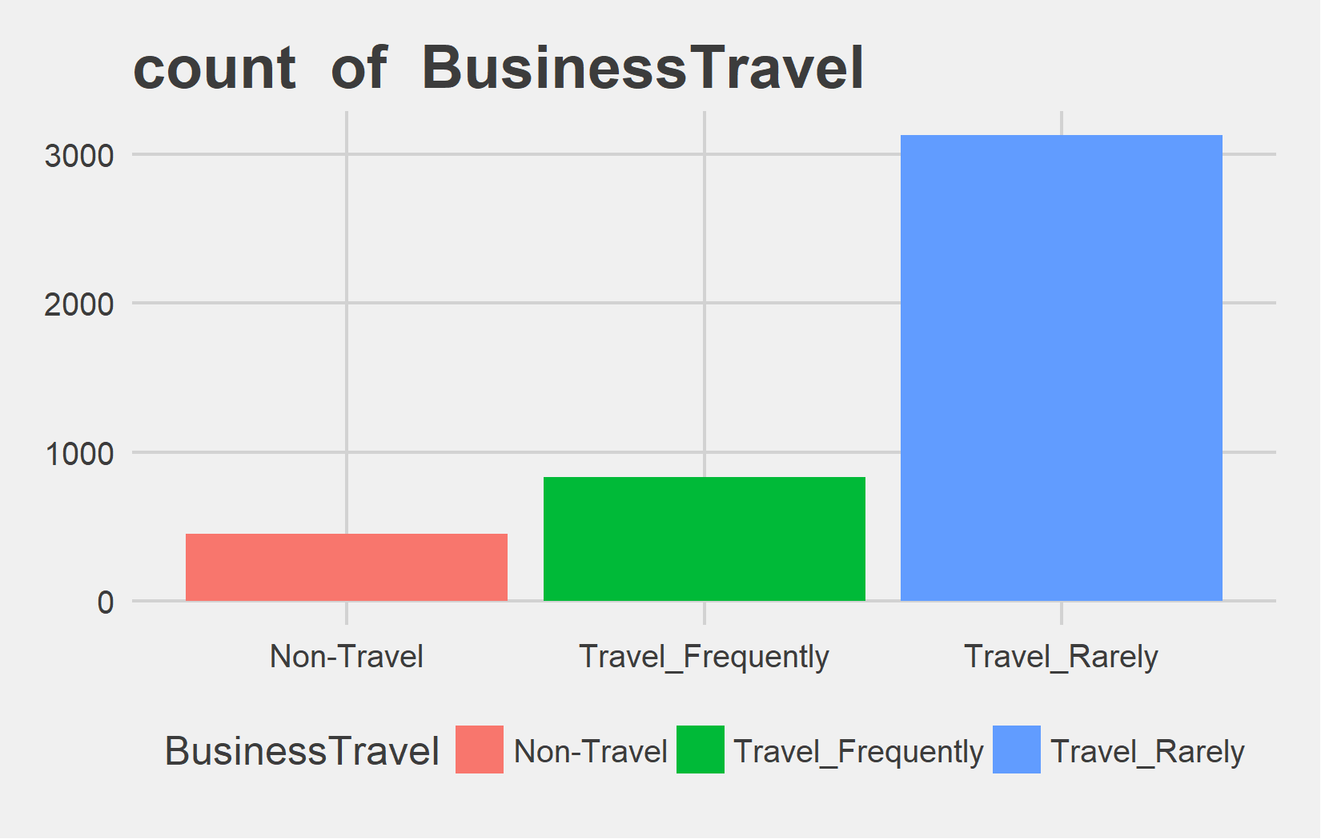
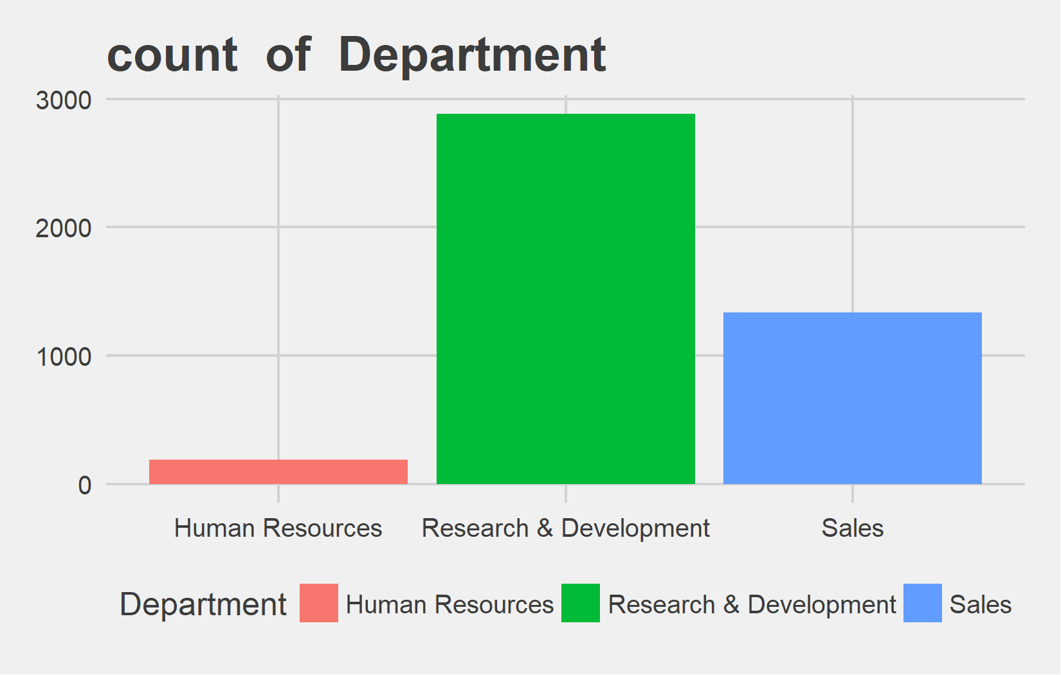
Univariate Analysis Slide 10 of 13
Metric | Non-Travel | Travel_Frequently | Travel_Rarely
Count | 450 | 831 | 3129
Perct. | 10.2% | 18.84% | 70.95%
Metric | Human Resources | Research & Development | Sales
Count | 189 | 2883 | 1338
Perct. | 4.29% | 65.37% | 30.34%

Slide 13
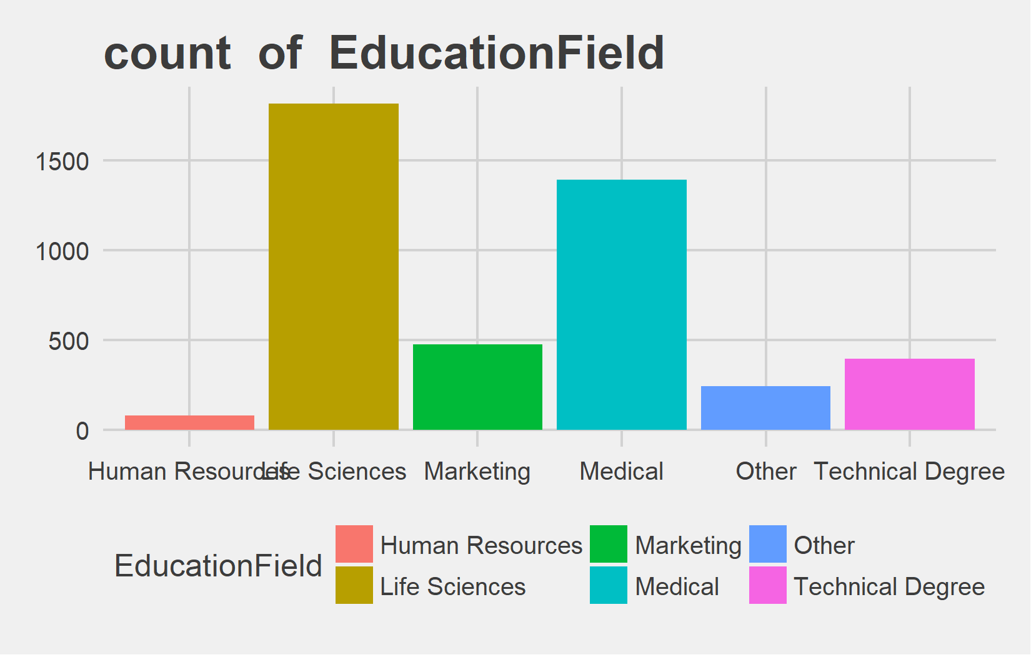
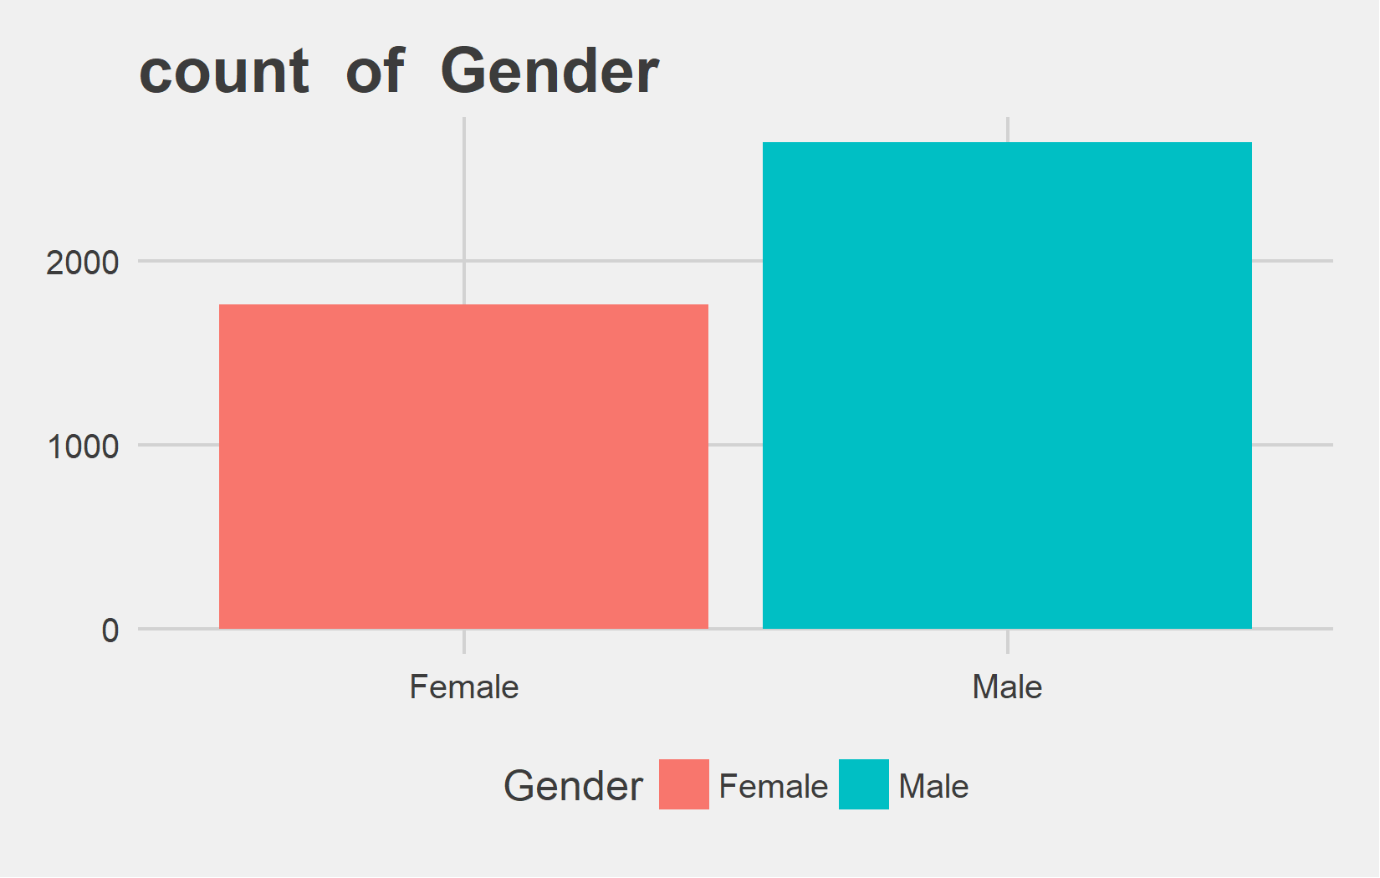
Univariate Analysis Slide 11 of 13
Metric | Human Resources | Life Sciences | Marketing | Medical | Other | Technical Degree
Count | 81 | 1818 | 477 | 1392 | 246 | 396
Perct. | 1.84% | 41.22% | 10.82% | 31.56% | 5.58% | 8.98%
Metric | Female | Male
Count | 1764 | 2646
Perct. | 40% | 60%

Slide 14
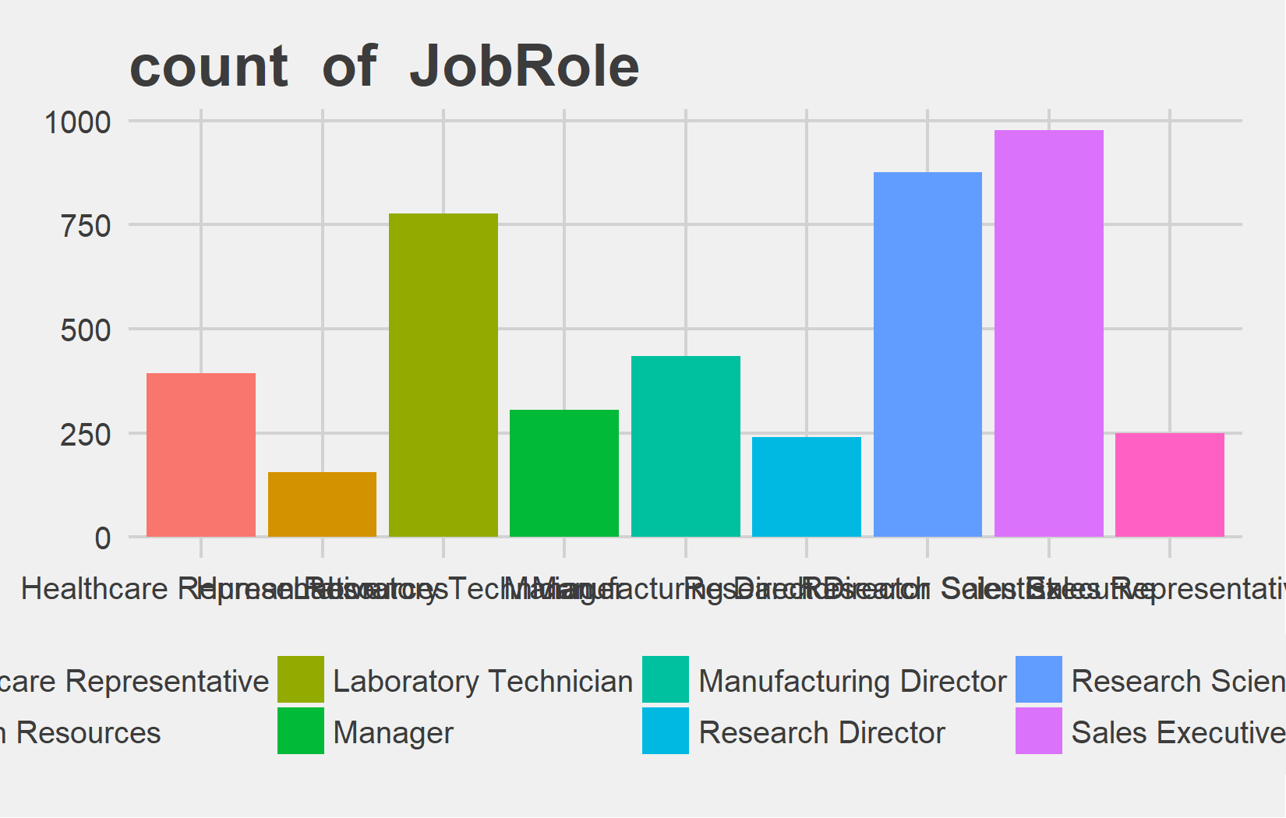
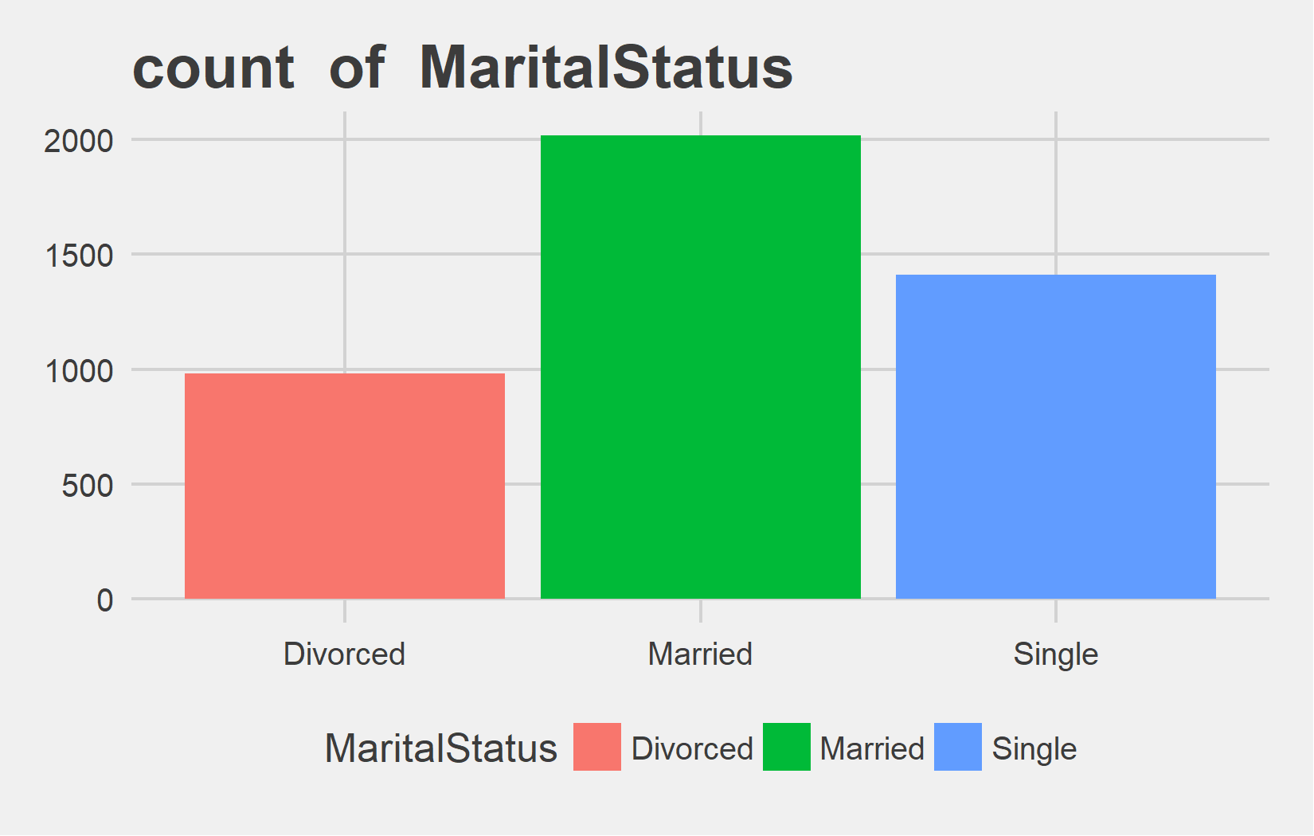
Univariate Analysis Slide 12 of 13
Metric | Healthcare Representative | Human Resources | Laboratory Technician | Manager | Manufacturing Director | Research Director | Research Scientist | Sales Executive | Sales Representative
Count | 393 | 156 | 777 | 306 | 435 | 240 | 876 | 978 | 249
Perct. | 8.91% | 3.54% | 17.62% | 6.94% | 9.86% | 5.44% | 19.86% | 22.18% | 5.65%
Metric | Divorced | Married | Single
Count | 981 | 2019 | 1410
Perct. | 22.24% | 45.78% | 31.97%

Slide 15
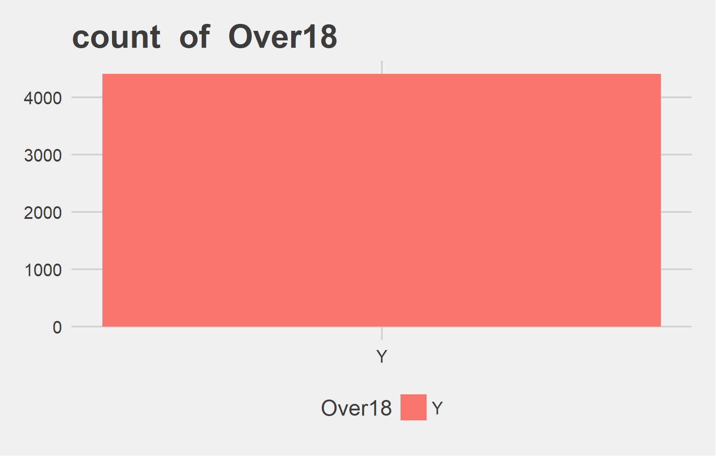
Univariate Analysis Slide 13 of 13
Metric | Y
Count | 4410
Perct. | 100%

Slide 16
Bi-variate analysis

Slide 17
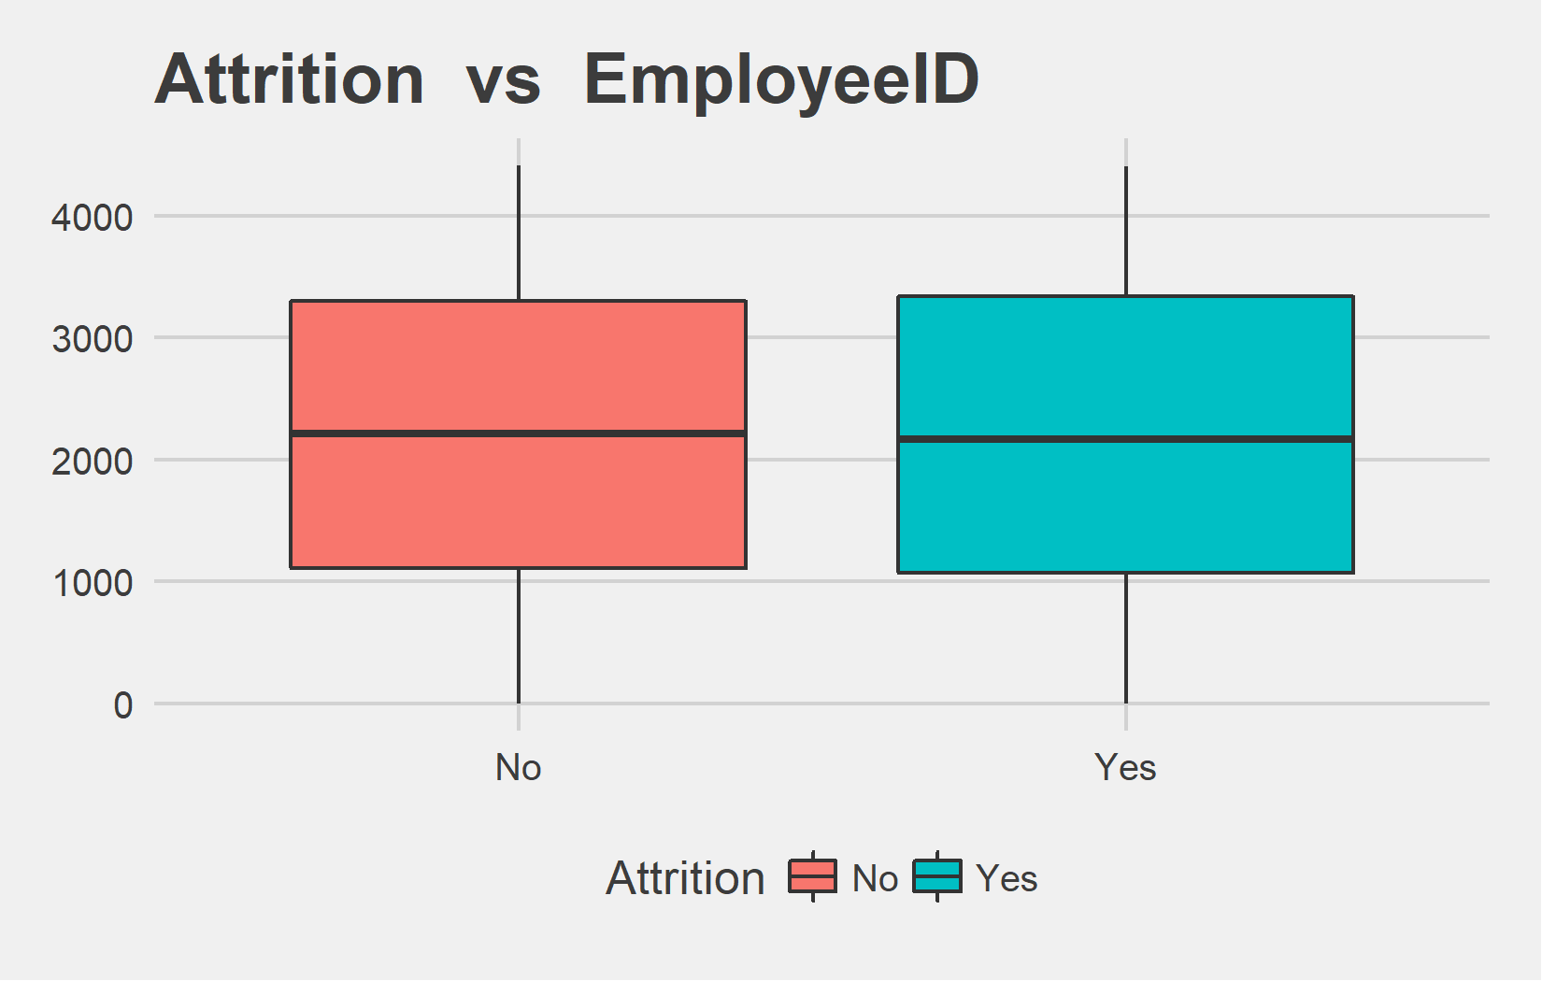
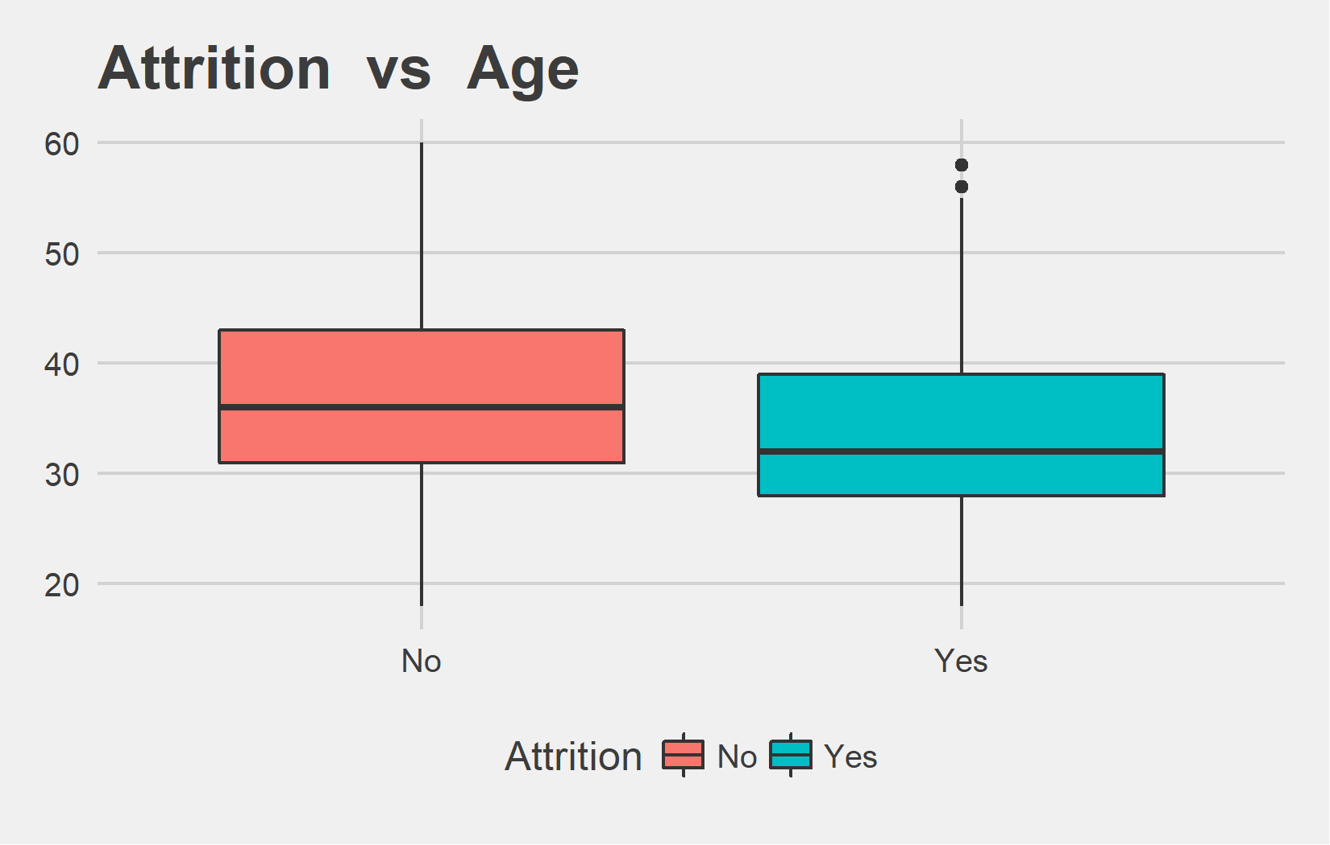
Bi-variate analysis Slide 1 of 13
Attrition | mean - EmployeeID | median - EmployeeID
No | 2208.14 | 2213
Yes | 2191.77 | 2165
Attrition | mean - Age | median - Age
No | 37.56 | 36
Yes | 33.61 | 32

Slide 18
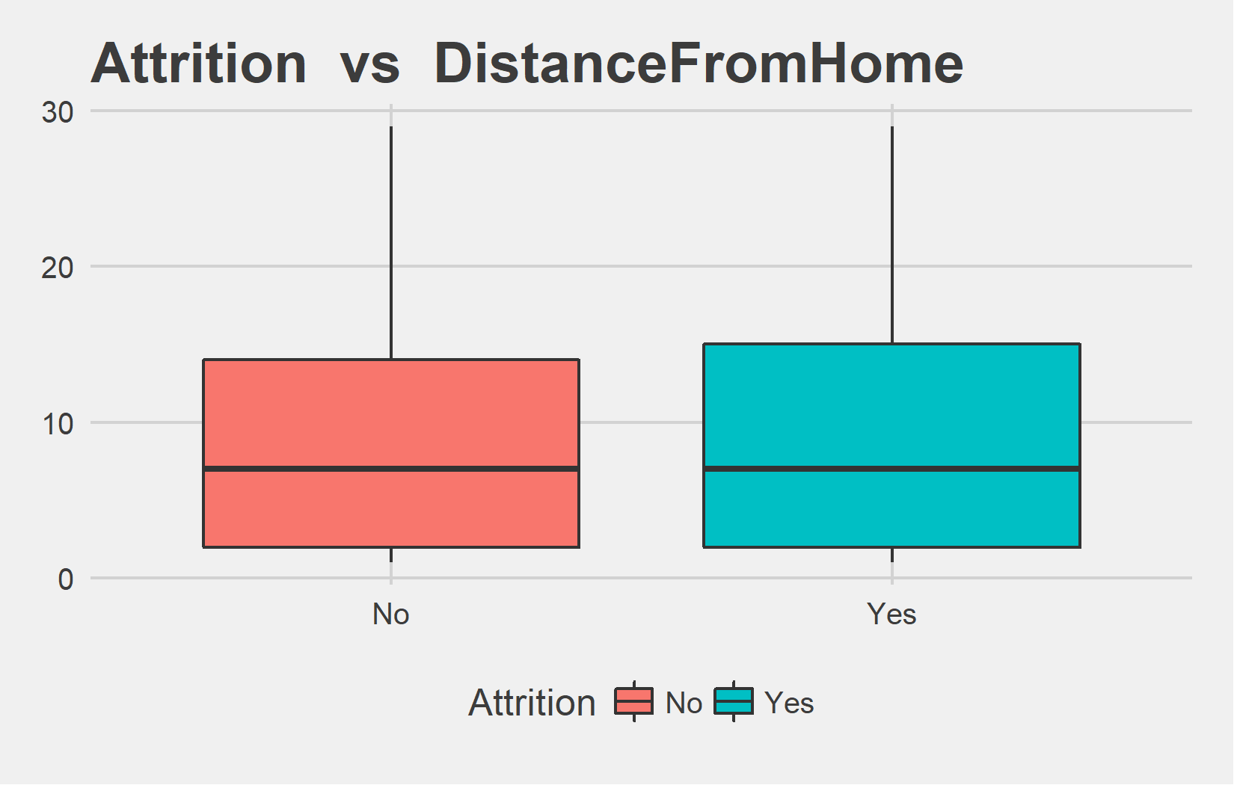
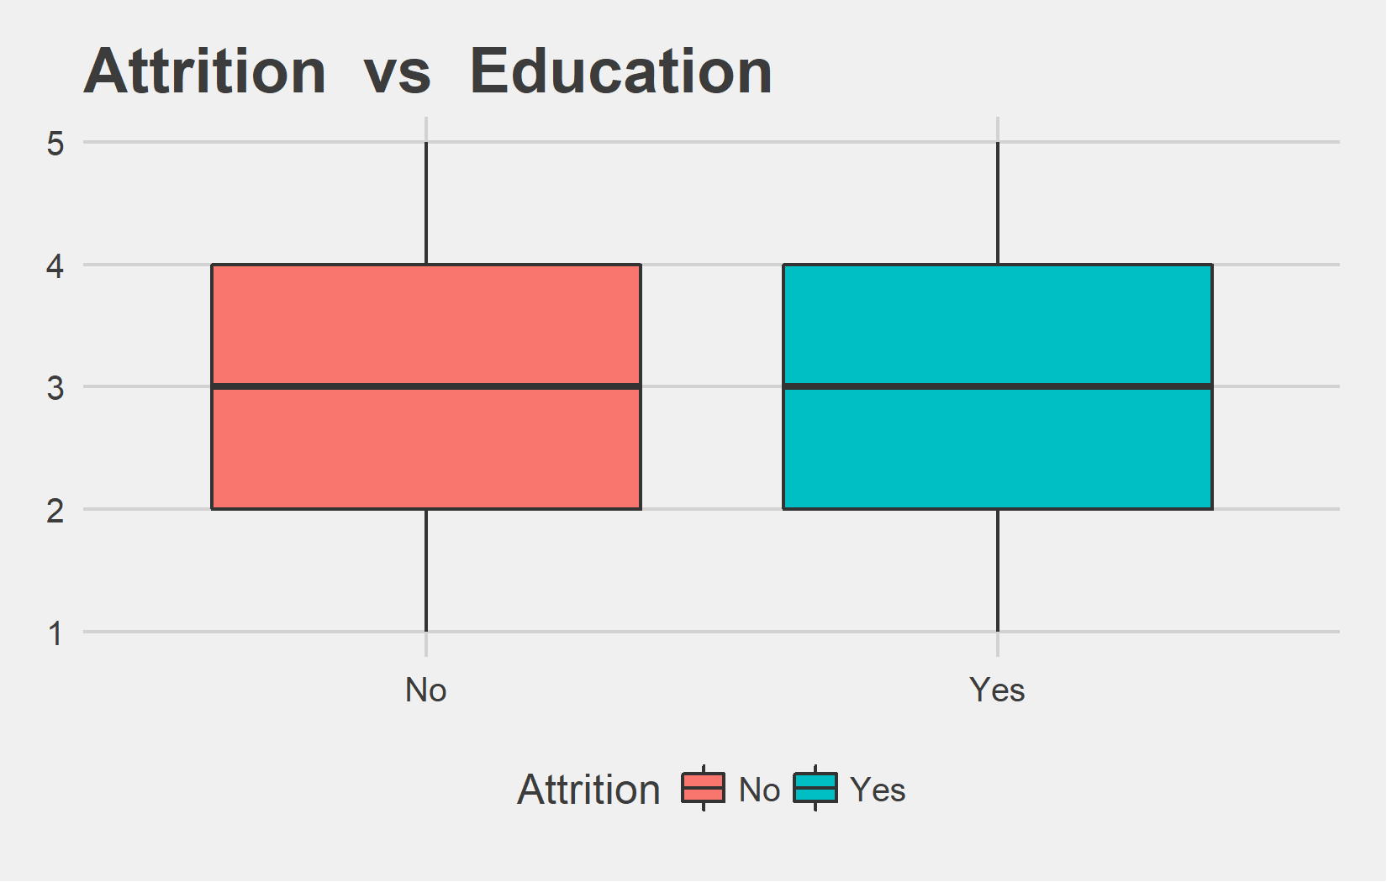
Bi-variate analysis Slide 2 of 13
Attrition | mean - DistanceFromHome | median - DistanceFromHome
No | 9.23 | 7
Yes | 9.01 | 7
Attrition | mean - Education | median - Education
No | 2.92 | 3
Yes | 2.88 | 3

Slide 19
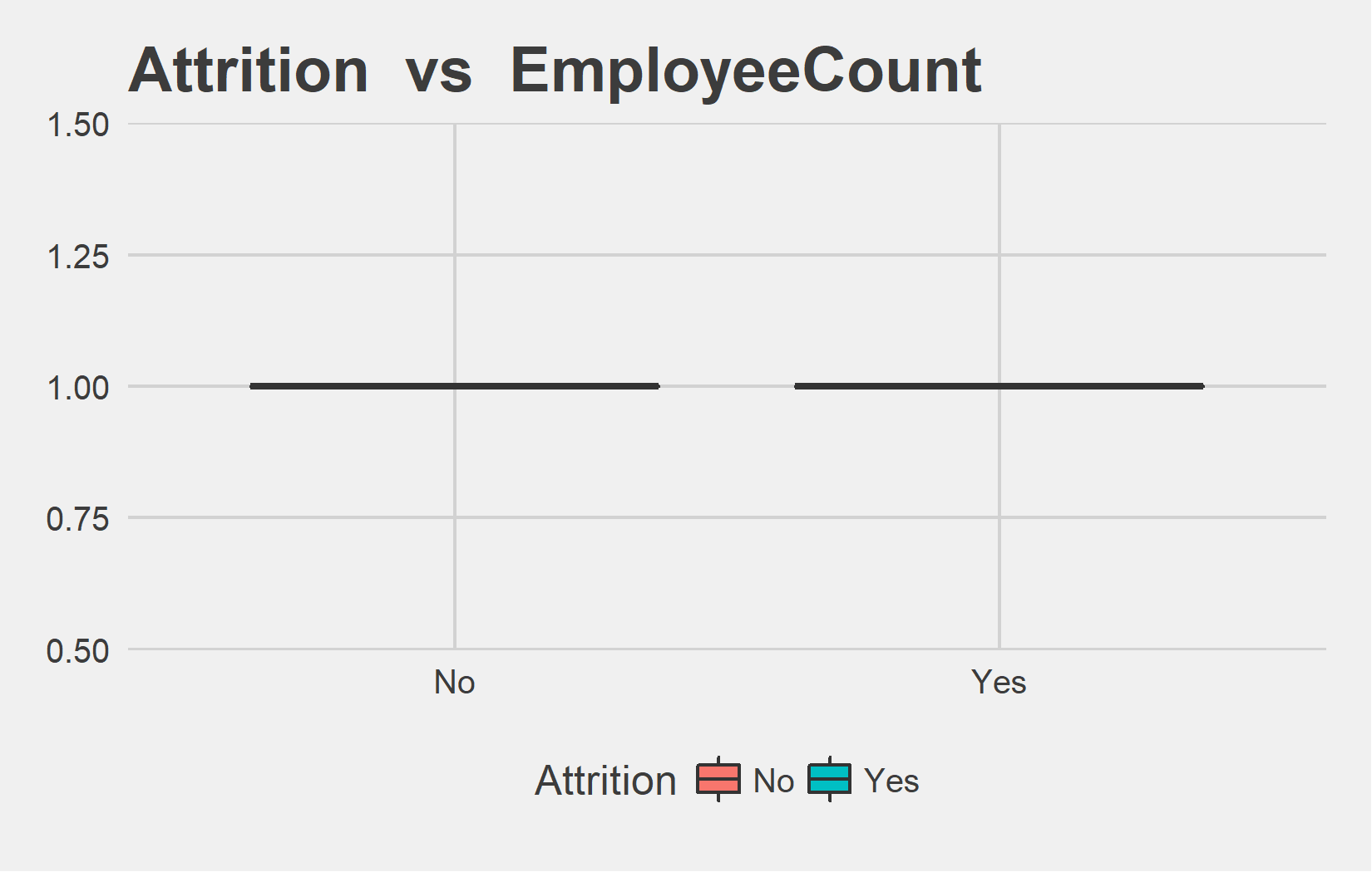
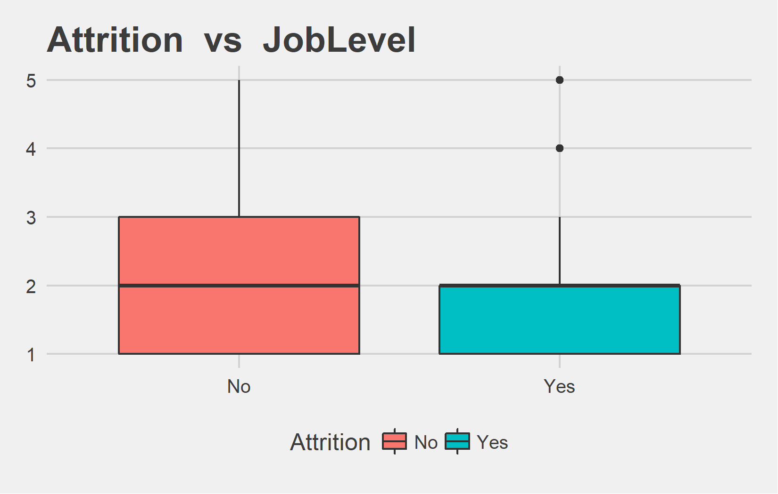
Bi-variate analysis Slide 3 of 13
Attrition | mean - EmployeeCount | median - EmployeeCount
No | 1 | 1
Yes | 1 | 1
Attrition | mean - JobLevel | median - JobLevel
No | 2.07 | 2
Yes | 2.04 | 2

Slide 20
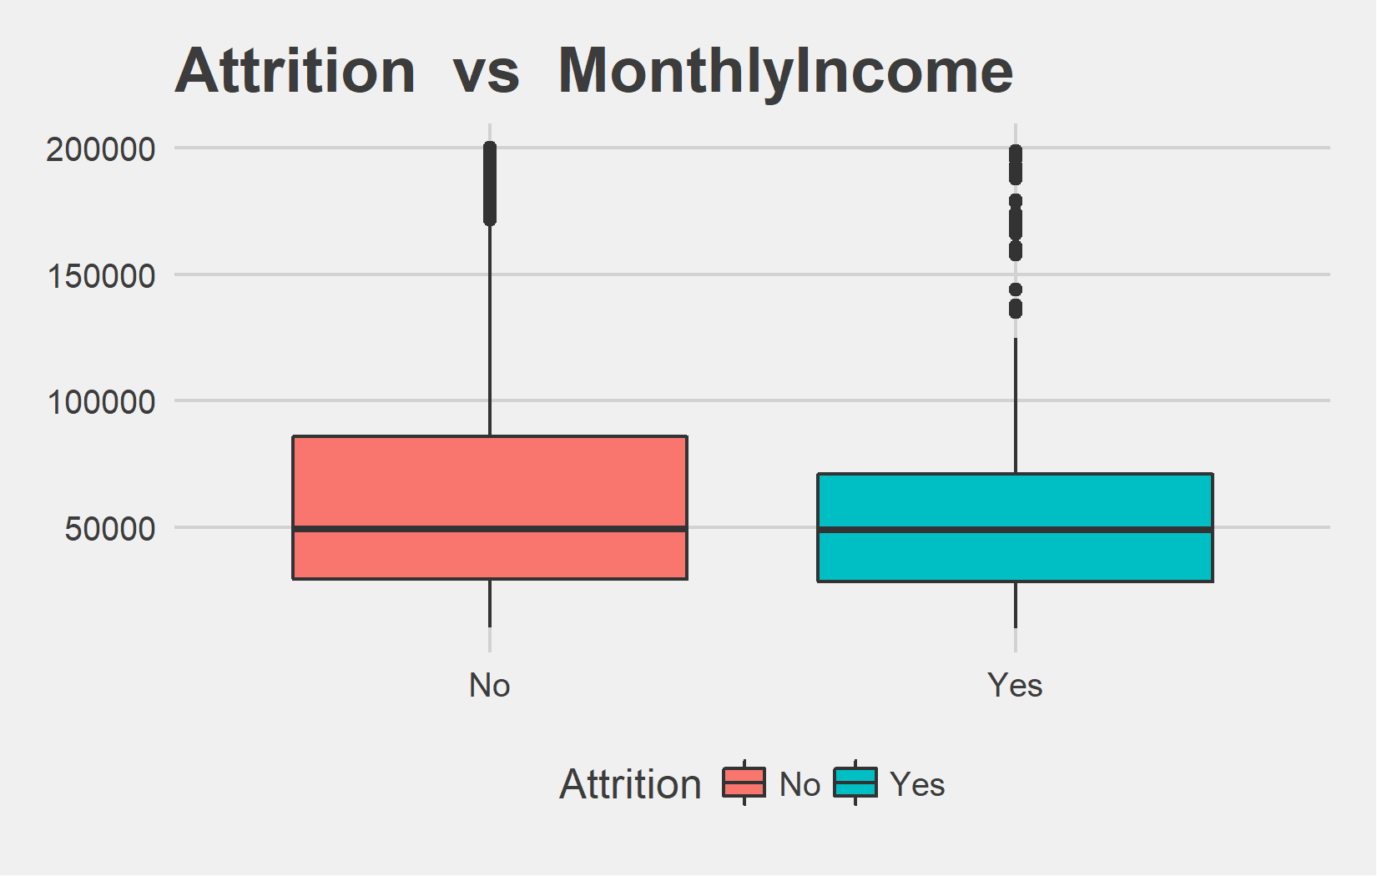
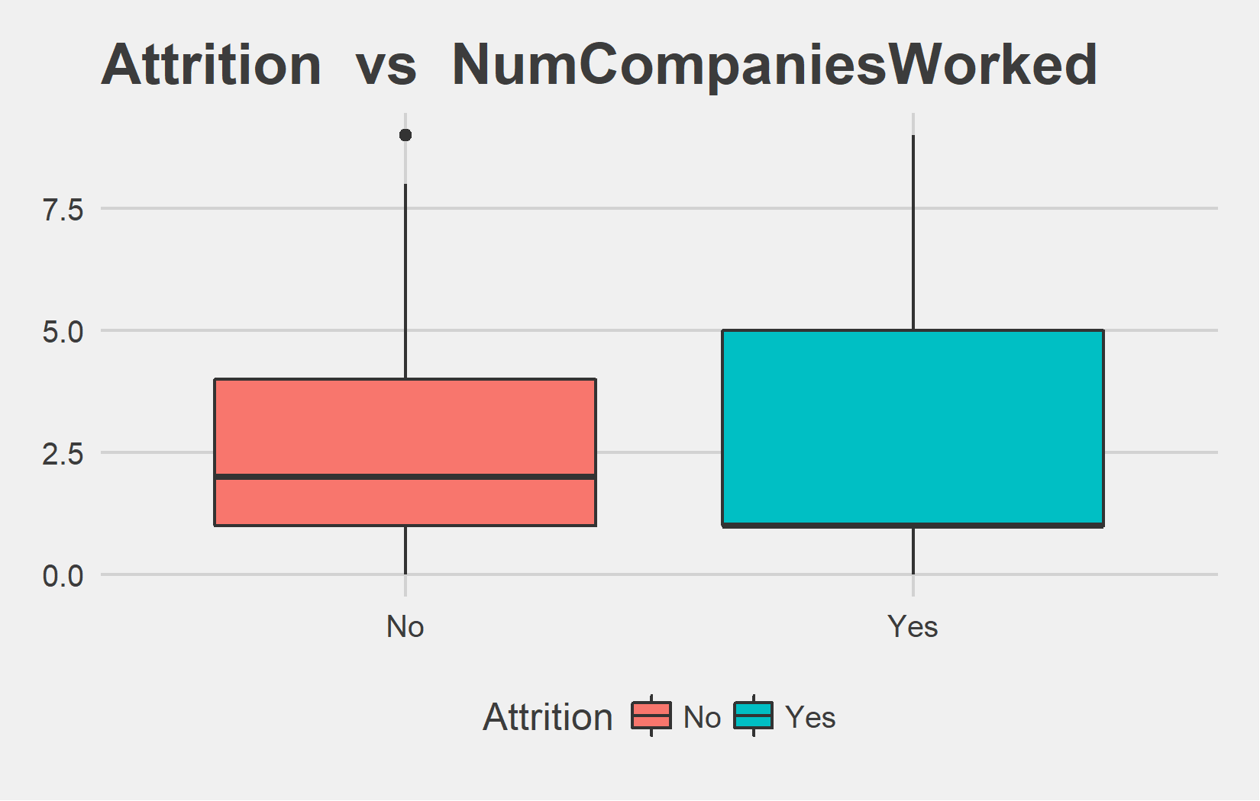
Bi-variate analysis Slide 4 of 13
Attrition | mean - MonthlyIncome | median - MonthlyIncome
No | 65672.60 | 49300
Yes | 61682.62 | 49080
Attrition | mean - NumCompaniesWorked | median - NumCompaniesWorked
No | 2.65 | 2
Yes | 2.93 | 1

Slide 21
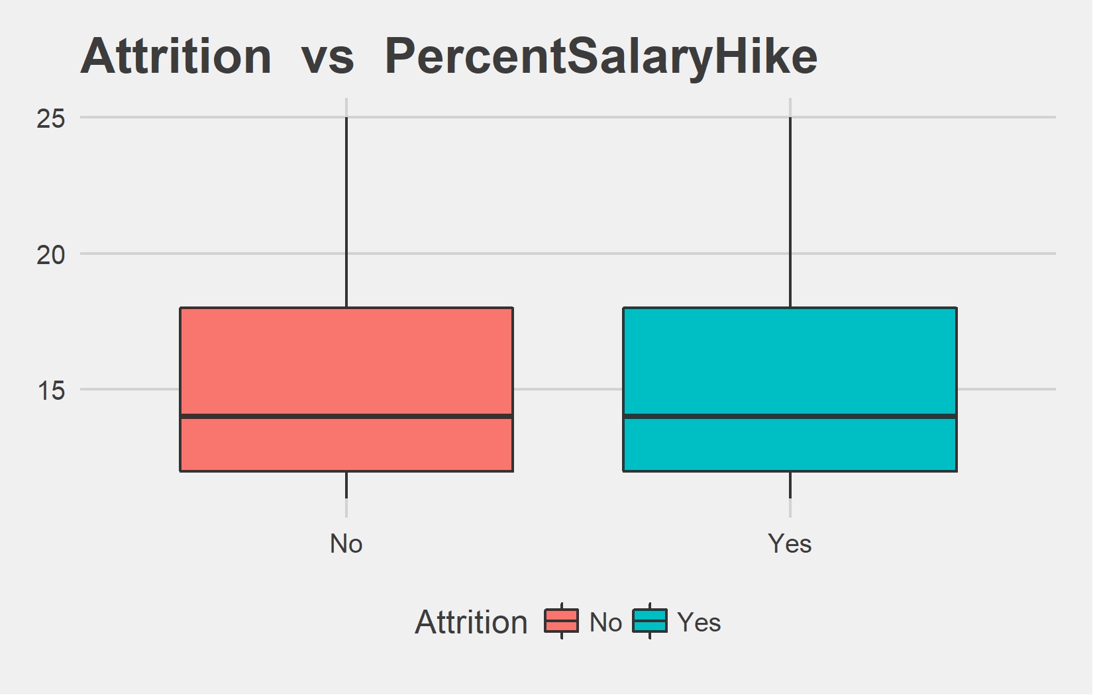
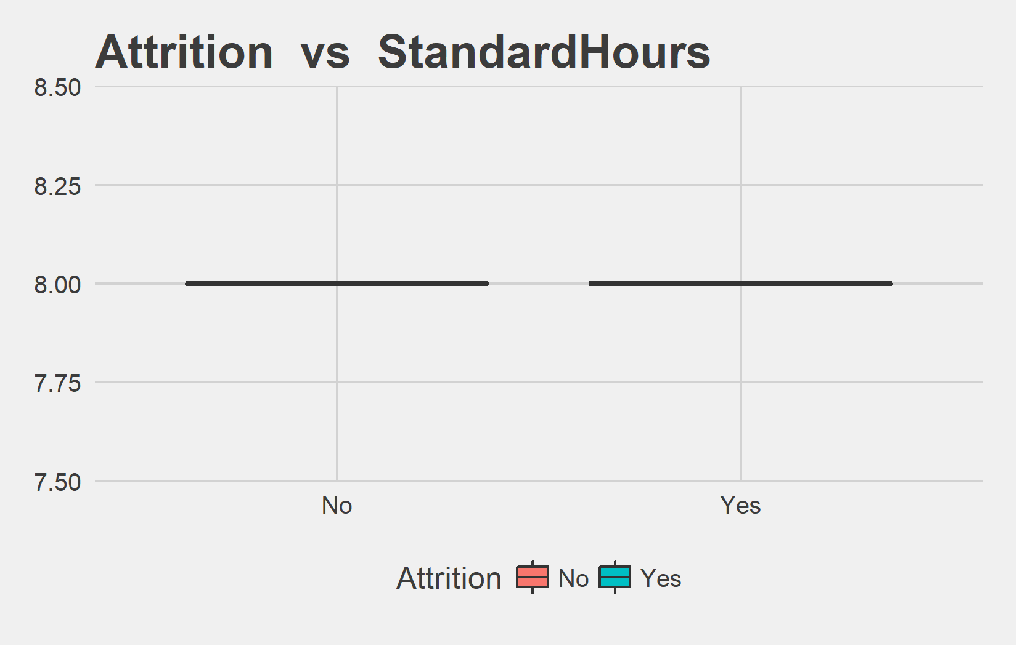
Bi-variate analysis Slide 5 of 13
Attrition | mean - PercentSalaryHike | median - PercentSalaryHike
No | 15.16 | 14
Yes | 15.48 | 14
Attrition | mean - StandardHours | median - StandardHours
No | 8 | 8
Yes | 8 | 8

Slide 22
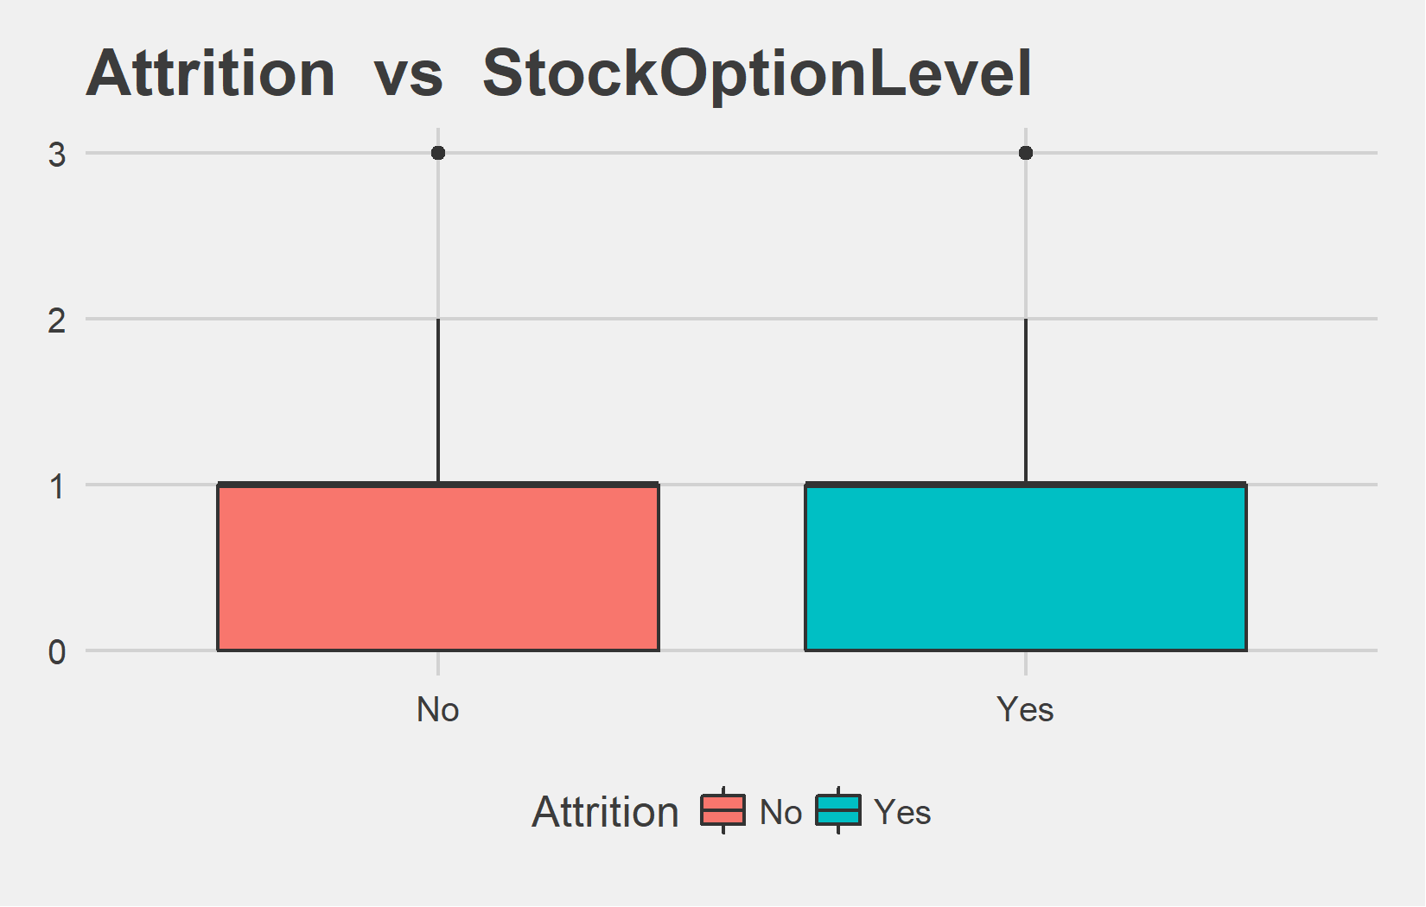
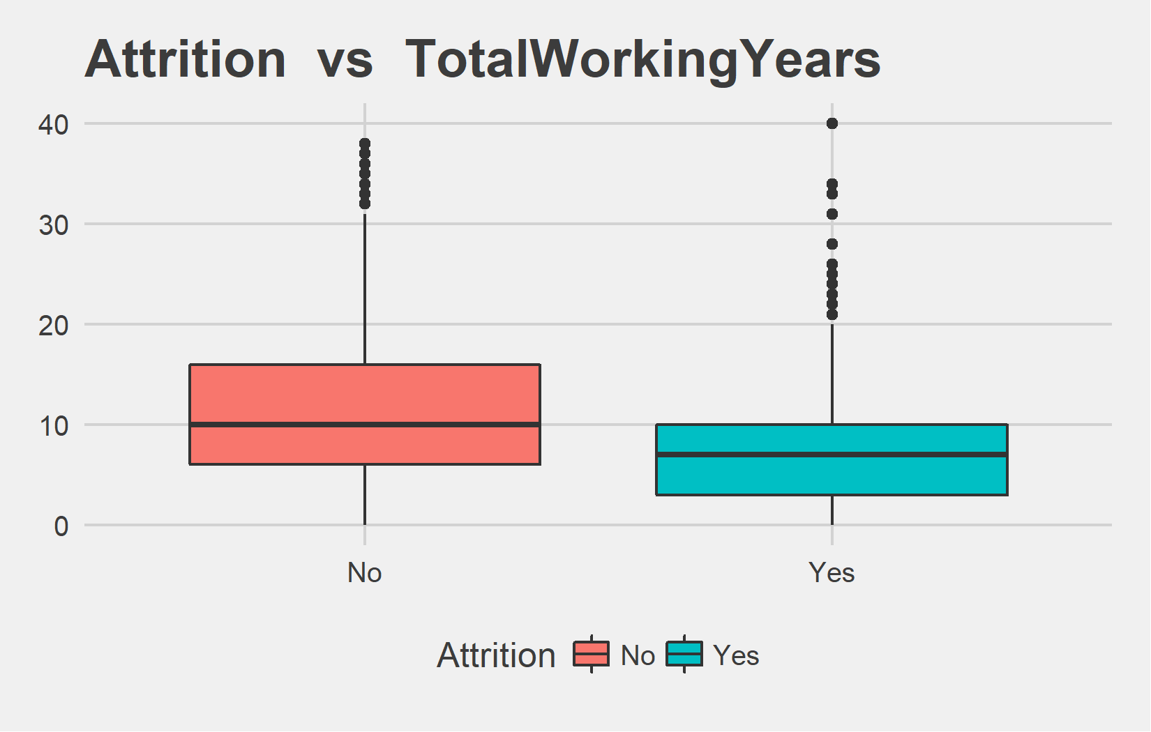
Bi-variate analysis Slide 6 of 13
Attrition | mean - StockOptionLevel | median - StockOptionLevel
No | 0.80 | 1
Yes | 0.78 | 1
Attrition | mean - TotalWorkingYears | median - TotalWorkingYears
No | 11.86 | 10
Yes | 8.26 | 7

Slide 23
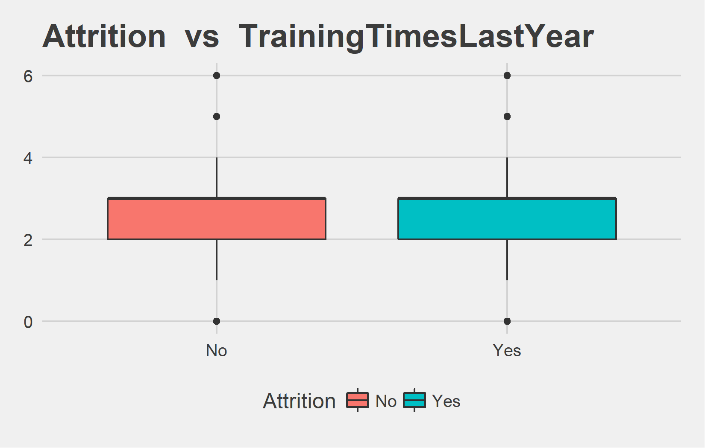
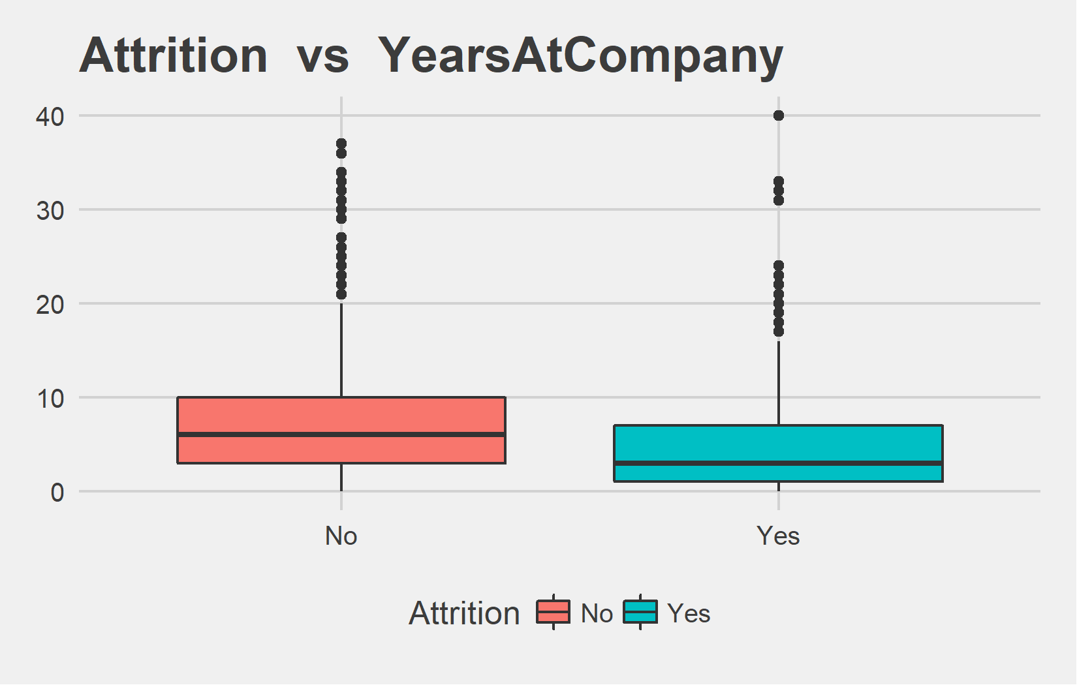
Bi-variate analysis Slide 7 of 13
Attrition | mean - TrainingTimesLastYear | median - TrainingTimesLastYear
No | 2.83 | 3
Yes | 2.65 | 3
Attrition | mean - YearsAtCompany | median - YearsAtCompany
No | 7.37 | 6
Yes | 5.13 | 3

Slide 24
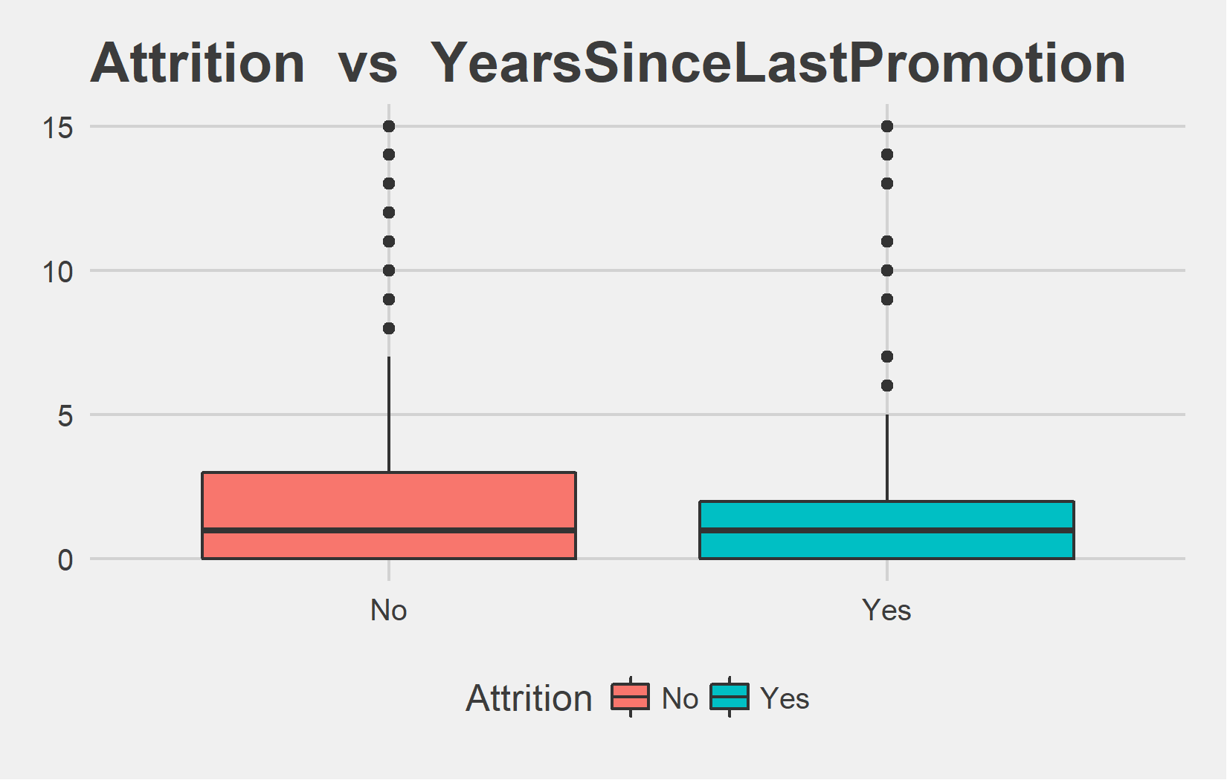
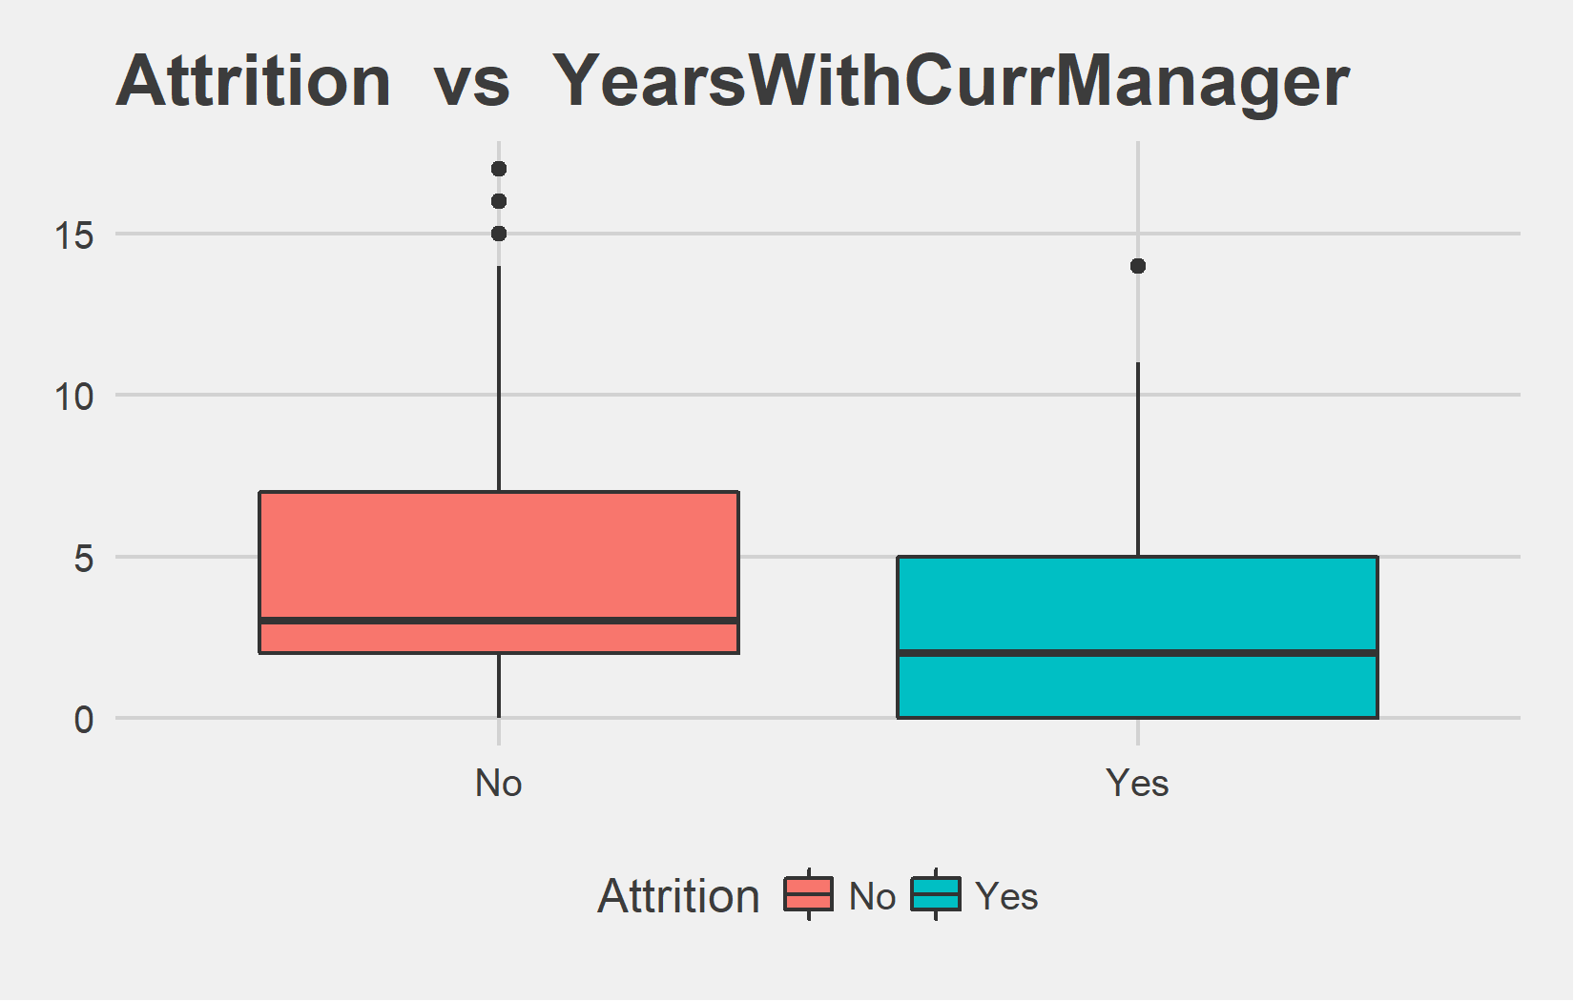
Bi-variate analysis Slide 8 of 13
Attrition | mean - YearsSinceLastPromotion | median - YearsSinceLastPromotion
No | 2.23 | 1
Yes | 1.95 | 1
Attrition | mean - YearsWithCurrManager | median - YearsWithCurrManager
No | 4.37 | 3
Yes | 2.85 | 2

Slide 25
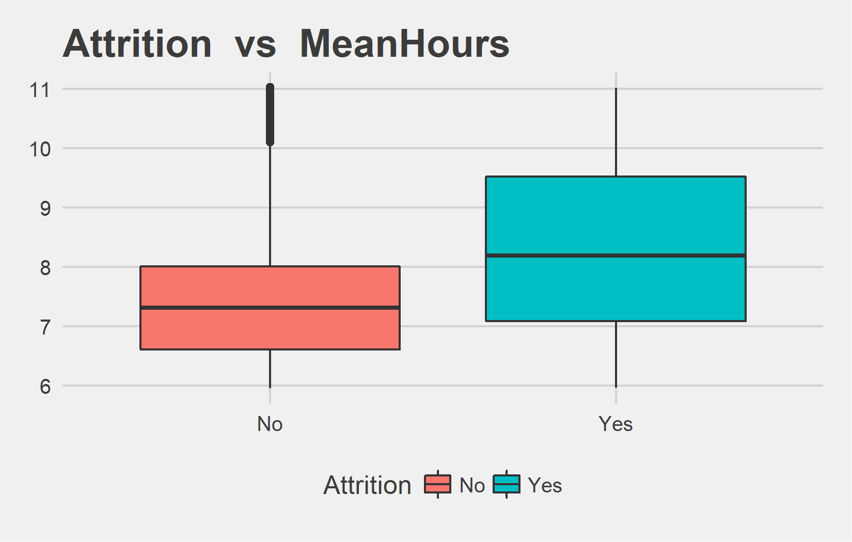
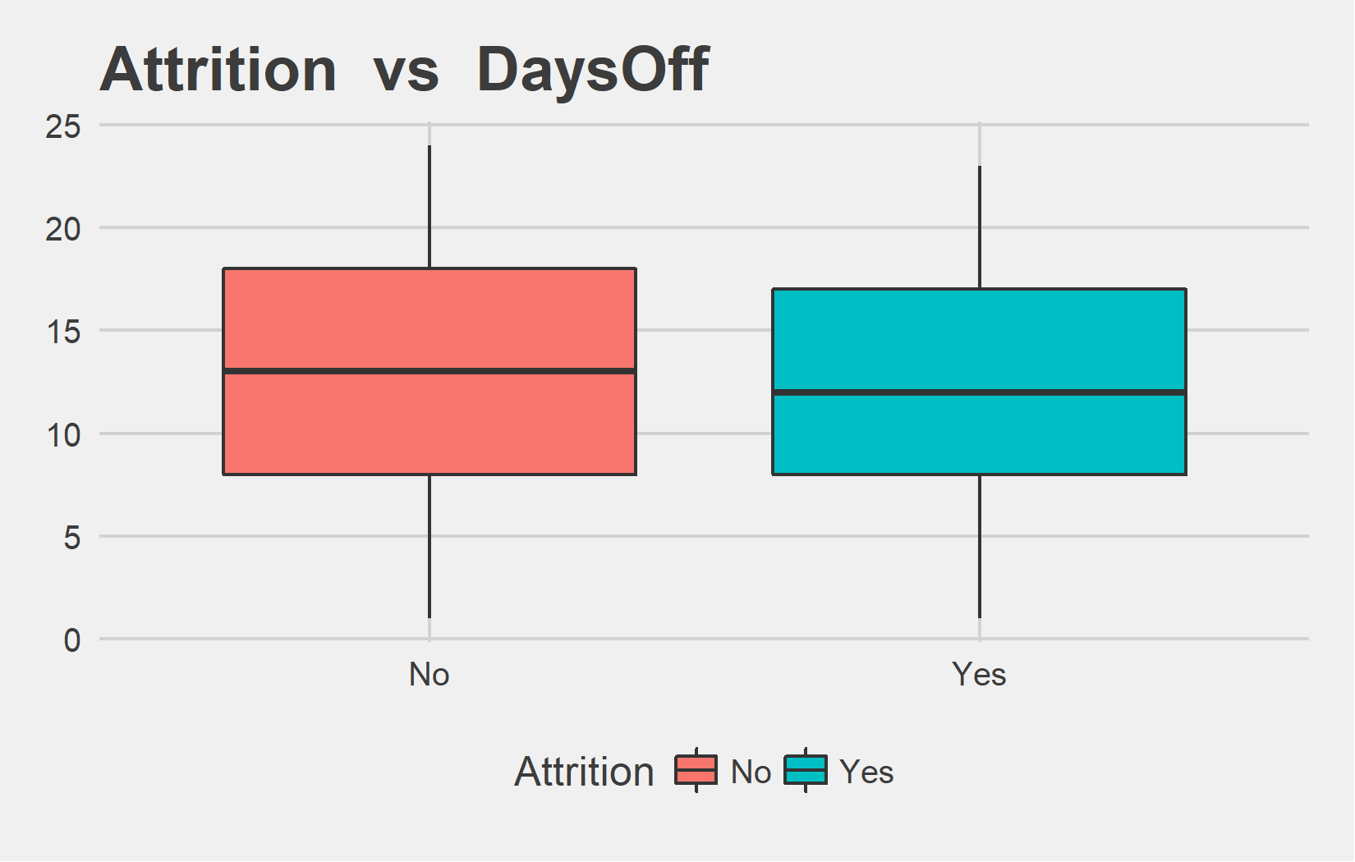
Bi-variate analysis Slide 9 of 13
Attrition | mean - MeanHours | median - MeanHours
No | 7.58 | 7.31
Yes | 8.32 | 8.19
Attrition | mean - DaysOff | median - DaysOff
No | 12.84 | 13
Yes | 12.19 | 12

Slide 26
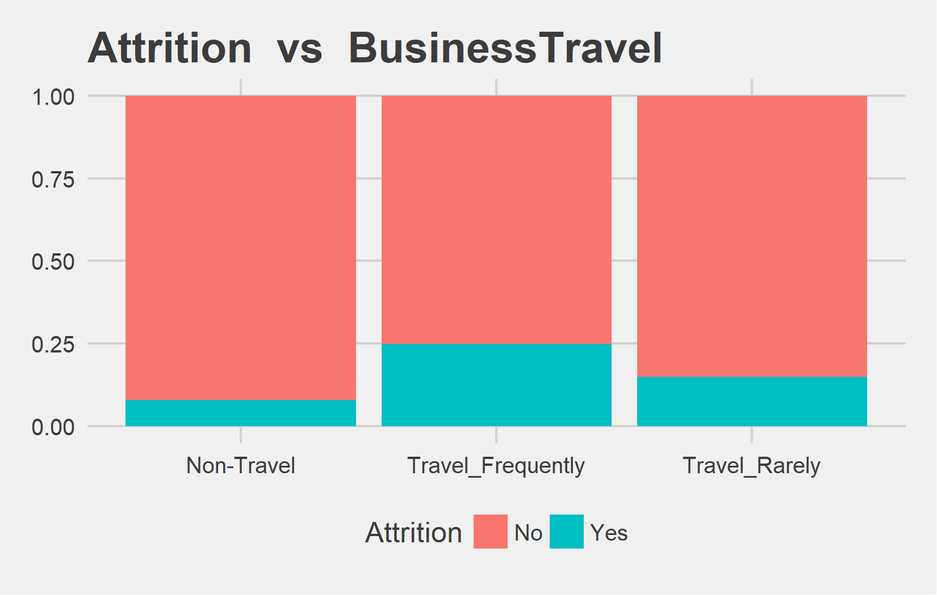
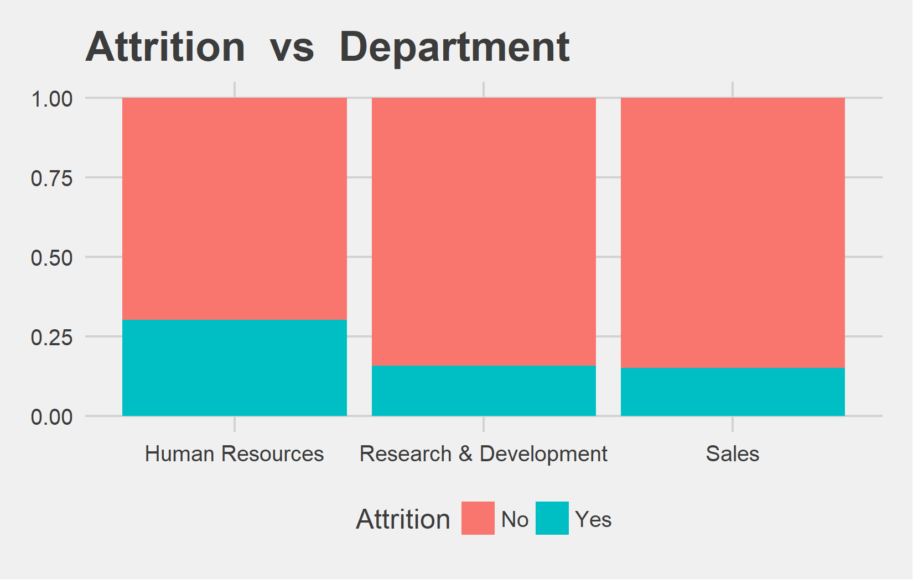
Bi-variate analysis Slide 10 of 13
Attrition | Non-Travel | Travel_Frequently | Travel_Rarely | Non-Travel | Travel_Frequently | Travel_Rarely
No | 414 | 624 | 2661 | 92% | 75.09% | 85.04%
Yes | 36 | 207 | 468 | 8% | 24.91% | 14.96%
Attrition | Human Resources | Research & Development | Sales | Human Resources | Research & Development | Sales
No | 132 | 2430 | 1137 | 69.84% | 84.29% | 84.98%
Yes | 57 | 453 | 201 | 30.16% | 15.71% | 15.02%

Slide 27
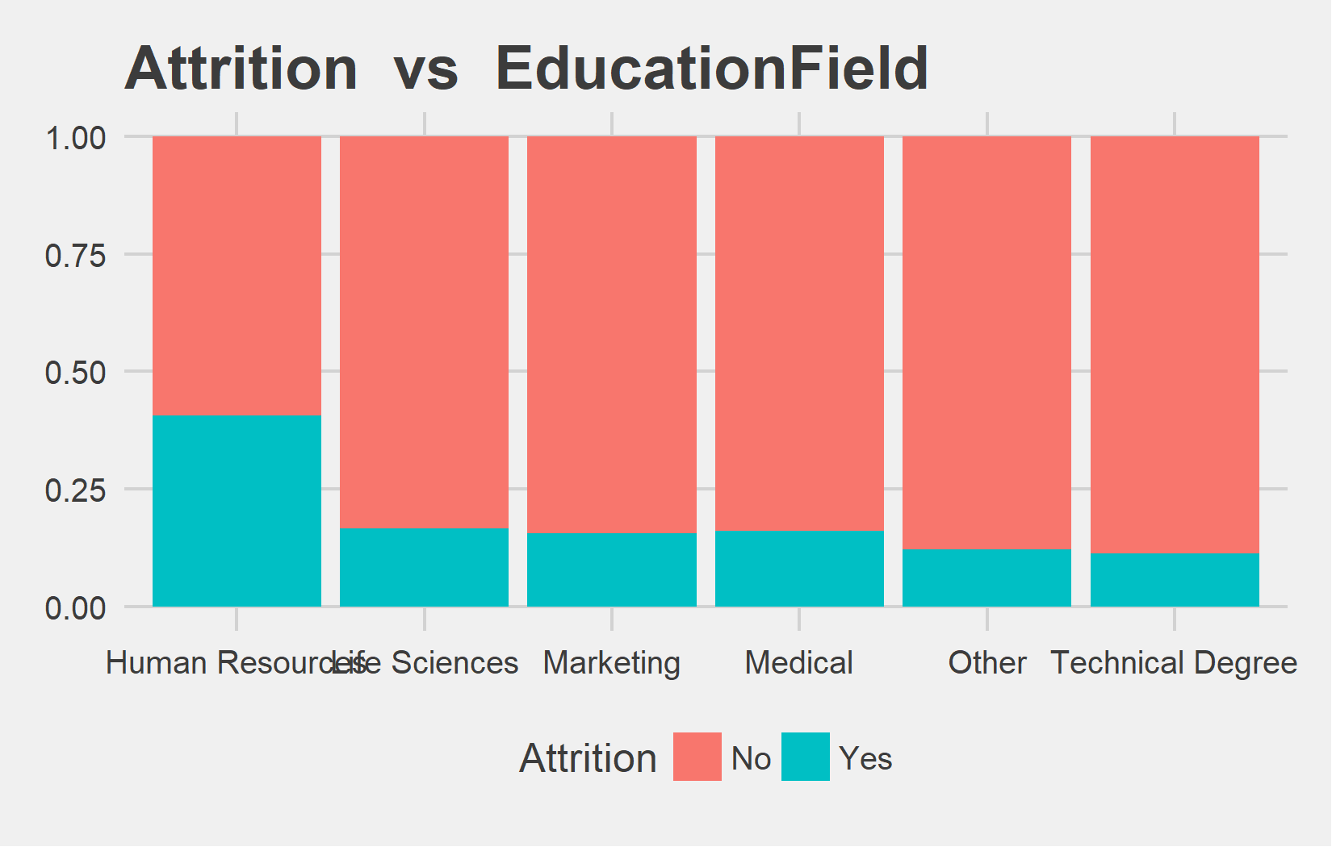
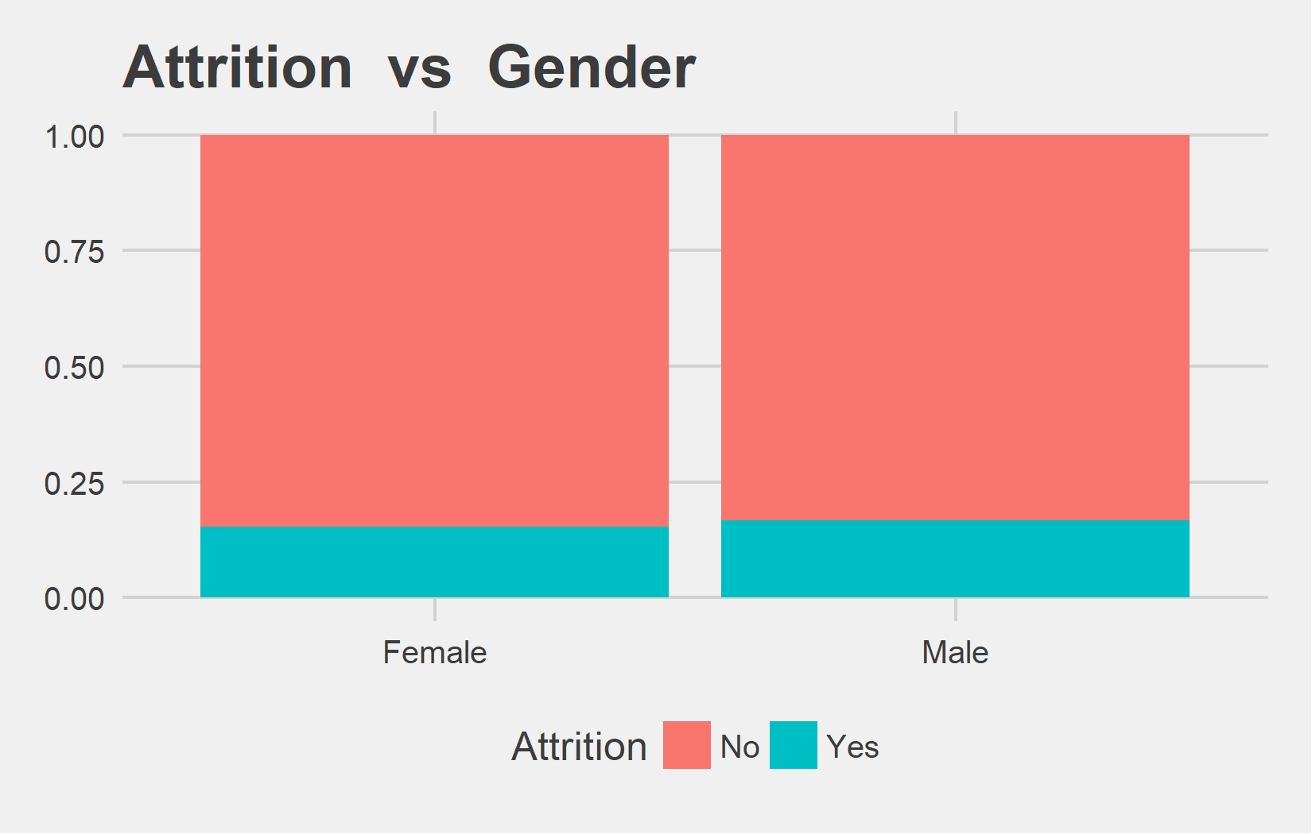
Bi-variate analysis Slide 11 of 13
Attrition | Human Resources | Life Sciences | Marketing | Medical | Other | Technical Degree | Human Resources | Life Sciences | Marketing | Medical | Other | Technical Degree
No | 48 | 1515 | 402 | 1167 | 216 | 351 | 59.26% | 83.33% | 84.28% | 83.84% | 87.8% | 88.64%
Yes | 33 | 303 | 75 | 225 | 30 | 45 | 40.74% | 16.67% | 15.72% | 16.16% | 12.2% | 11.36%
Attrition | Female | Male | Female | Male
No | 1494 | 2205 | 84.69% | 83.33%
Yes | 270 | 441 | 15.31% | 16.67%

Slide 28
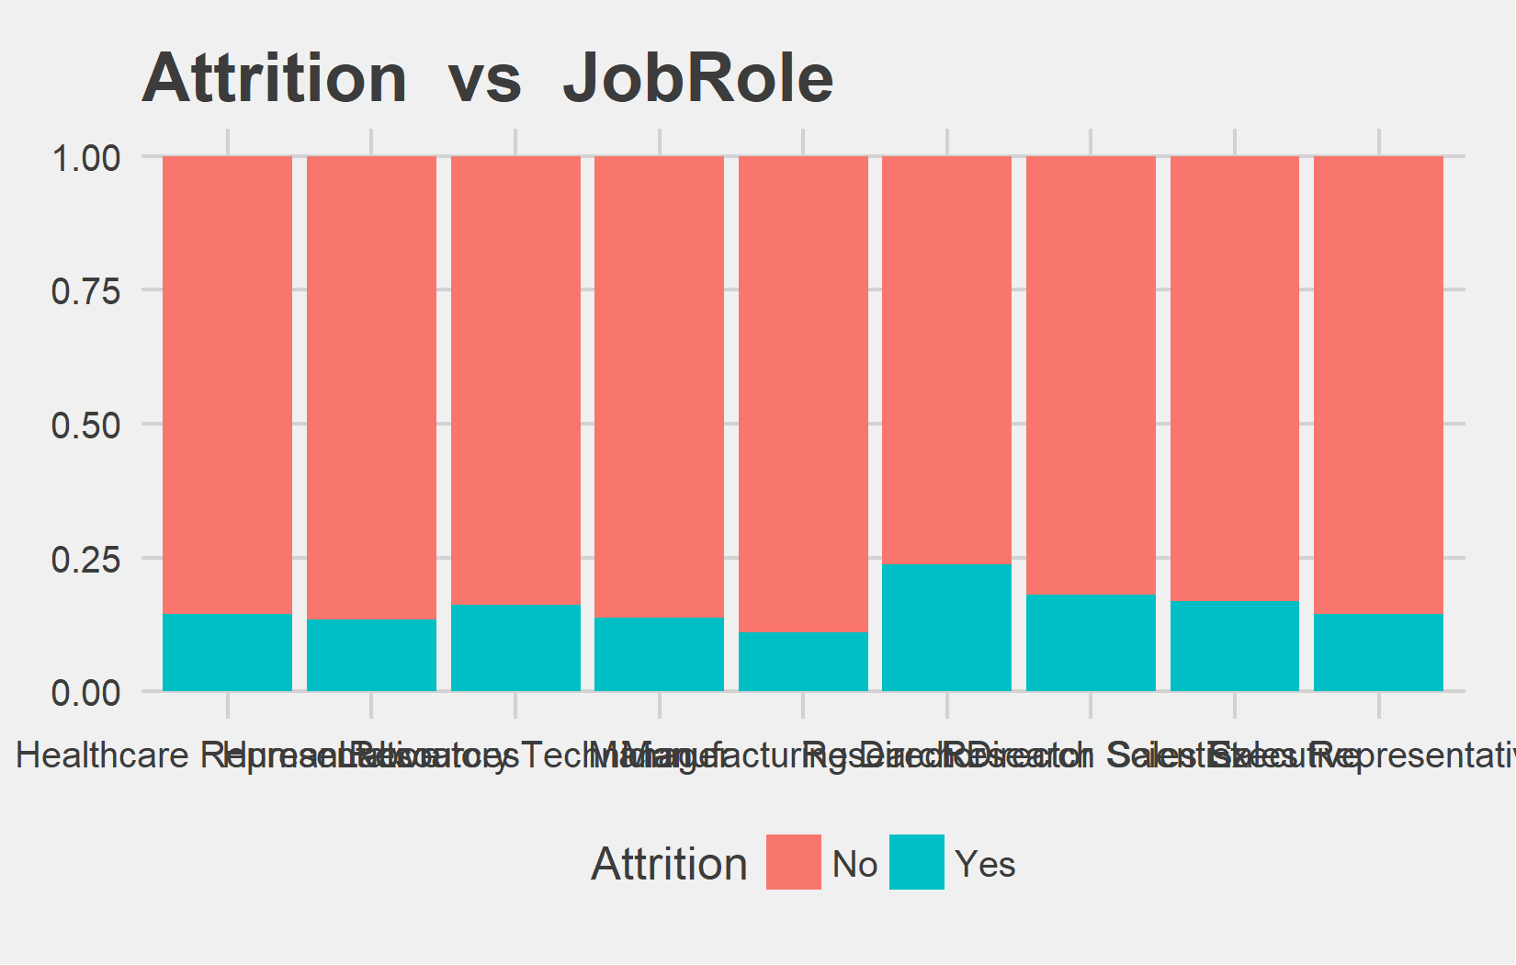
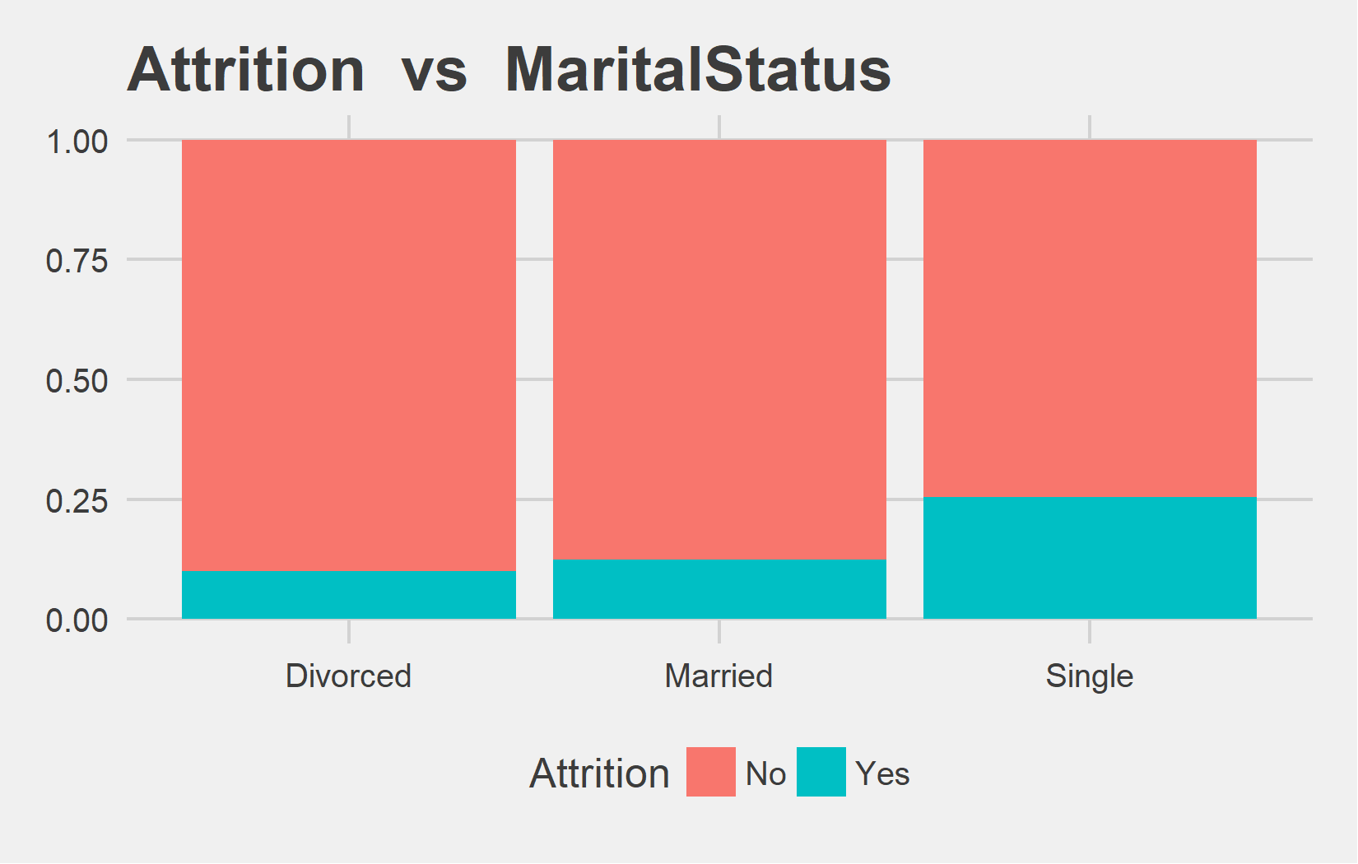
Bi-variate analysis Slide 12 of 13
Attrition | Healthcare Representative | Human Resources | Laboratory Technician | Manager | Manufacturing Director | Research Director | Research Scientist | Sales Executive | Sales Representative | Healthcare Representative | Human Resources | Laboratory Technician | Manager | Manufacturing Director | Research Director | Research Scientist | Sales Executive | Sales Representative
No | 336 | 135 | 651 | 264 | 387 | 183 | 717 | 813 | 213 | 85.5% | 86.54% | 83.78% | 86.27% | 88.97% | 76.25% | 81.85% | 83.13% | 85.54%
Yes | 57 | 21 | 126 | 42 | 48 | 57 | 159 | 165 | 36 | 14.5% | 13.46% | 16.22% | 13.73% | 11.03% | 23.75% | 18.15% | 16.87% | 14.46%
Attrition | Divorced | Married | Single | Divorced | Married | Single
No | 882 | 1767 | 1050 | 89.91% | 87.52% | 74.47%
Yes | 99 | 252 | 360 | 10.09% | 12.48% | 25.53%

Slide 29
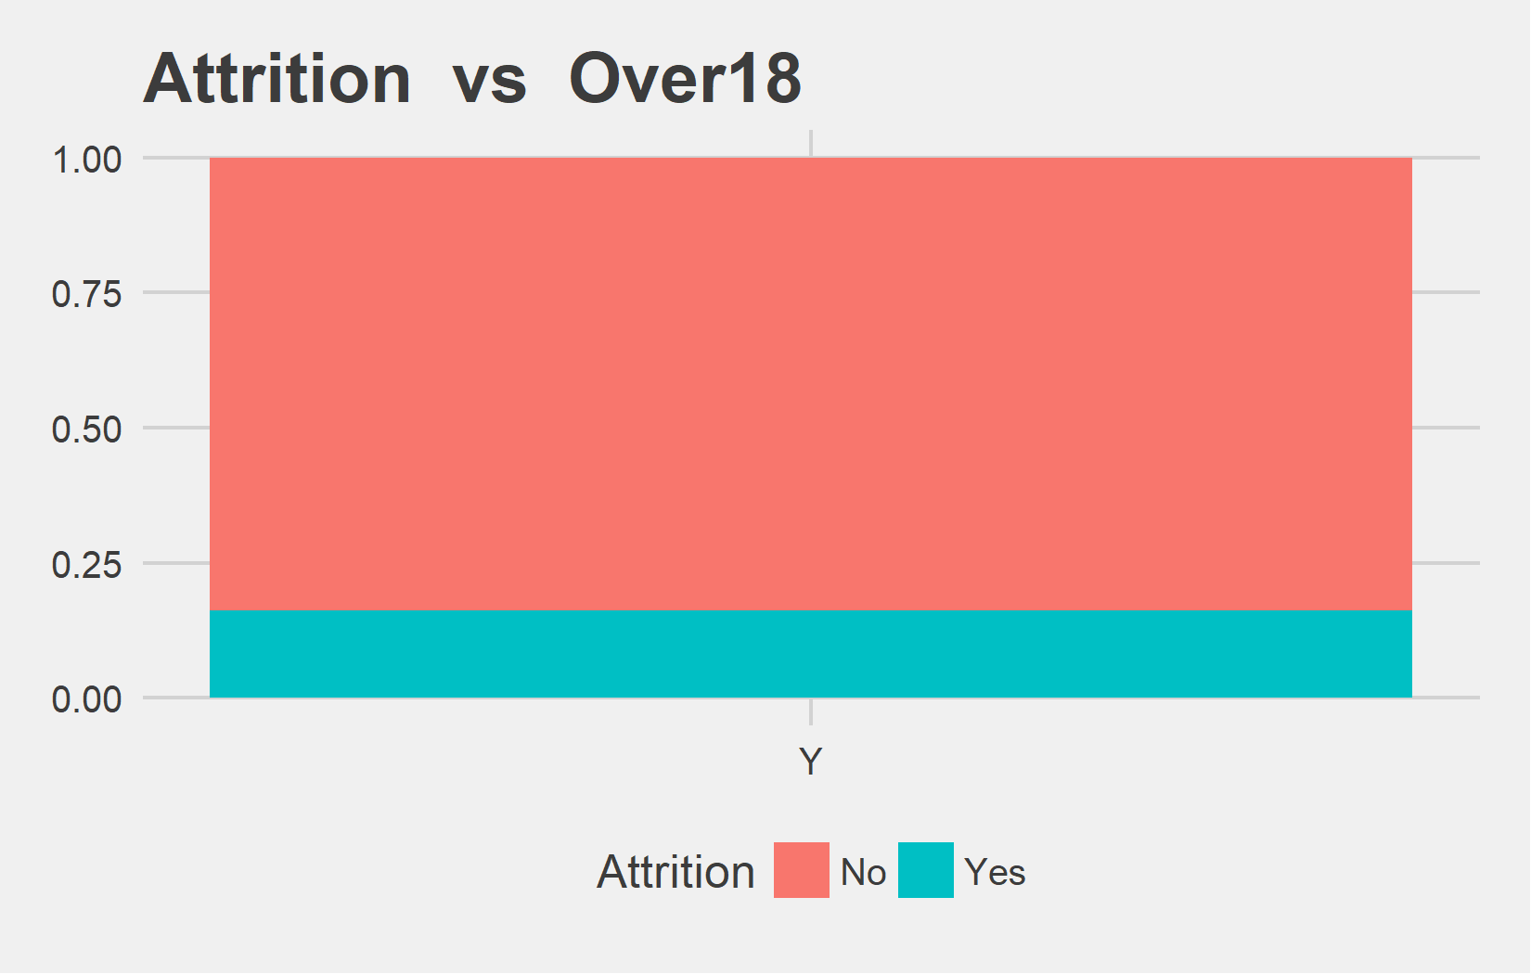
Bi-variate analysis Slide 13 of 13
Attrition | Y | Y
No | 3699 | 83.88%
Yes | 711 | 16.12%

