Slide 1
Short tutorial on ANACONDA, v2
- Installation
- Step-to-step through routines
- future merging with HDF5/MAX IV

Slide 2
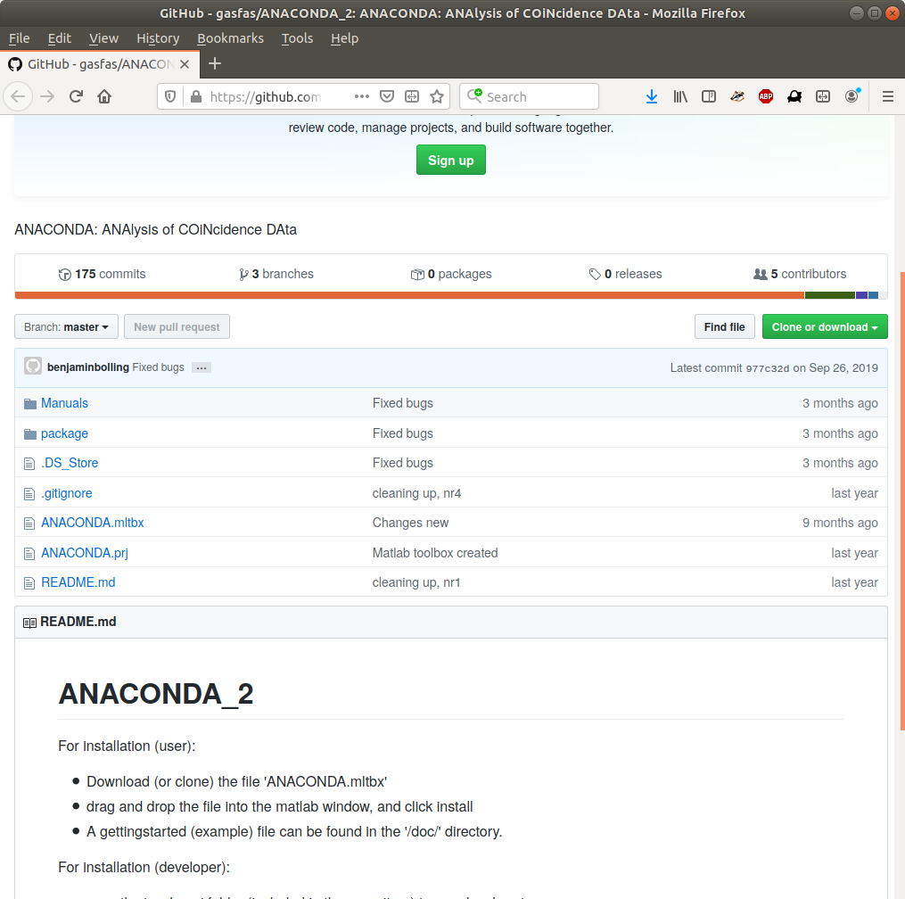
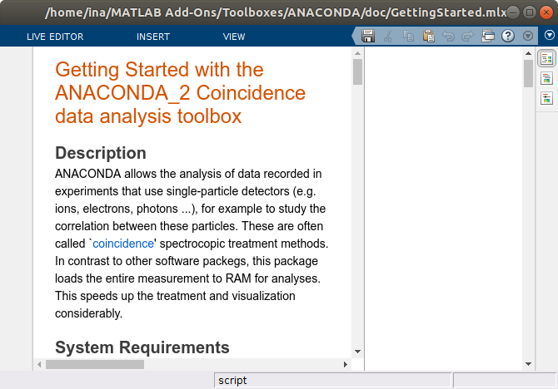
Installation (as user)
- Download (clone) from GitHub:
https://github.com/gasfas/ANACONDA_2
- D&D in MATLAB cmd window
- Open ‘GettingStarted.mlx’,
or ‘GettingStarted_plain.m’
- Run it, enjoy the errors...

Slide 3
Installation (as dev)
- Install github desktop
- Clone from repository
- Request developer permissions

Slide 4
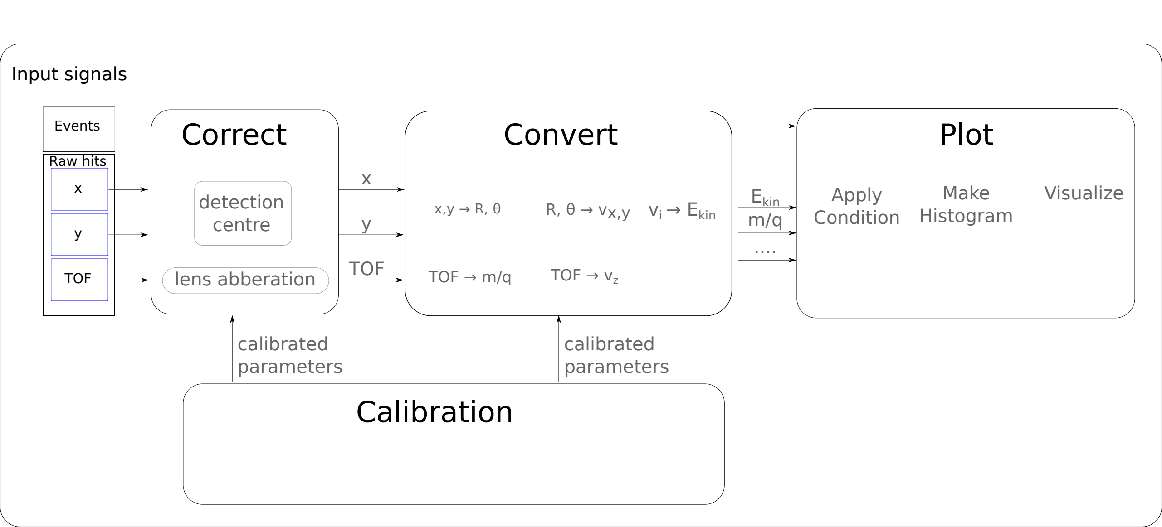
Data analysis structure
Macro: function that executes subroutines.
One macro for each step: Correct, convert, plot, etc.

Slide 5
Importing (meta) data
Load data:
  data = IO.import_raw(‘full data filename’)
And metadata:
  mdata = IO.import_metadata(‘full metadata filename’)
If you have no data at hand, use an example:
  data = IO.COBOLD.import_example();
If metadata is not yet defined: default metadata is defined in the toolbox for each setup. e.g.:
  mdata = metadata.defaults.exp.CIEL.md_all_defaults

Slide 6
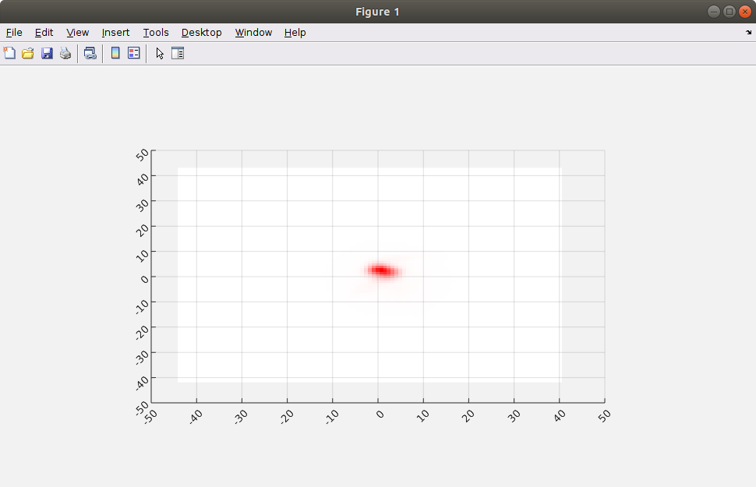
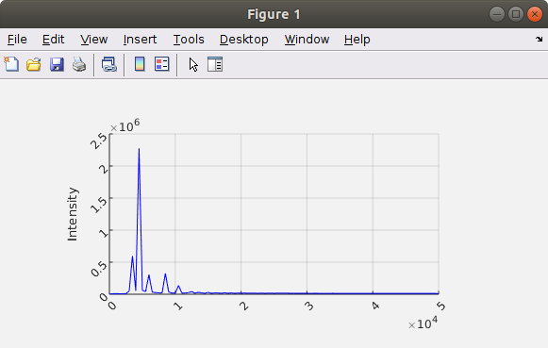
Quick visualization of imported data
Make histogram of X,Y:
plot.quickhist(data.h.det1.raw(:,1:2))
Make histogram of TOF:
plot.quickhist(data.h.det1.raw(:,3))
Inspect any function:
edit macro.calibrate.TOF_2_m2q

Slide 7
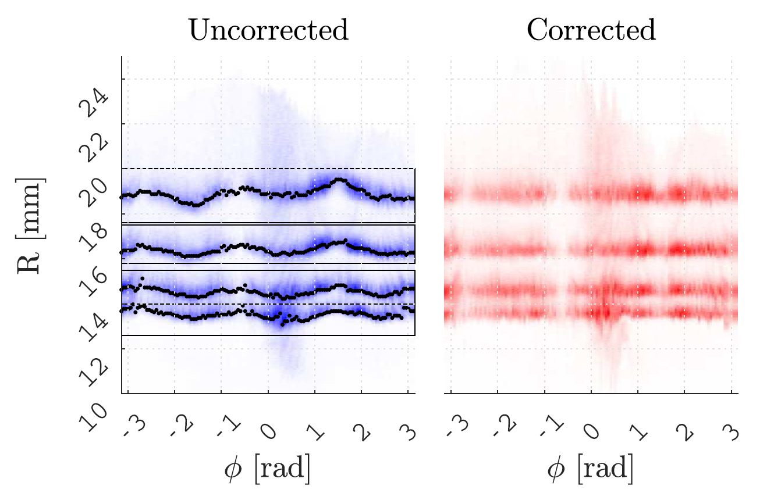
Correct data (t₀, abberations, etc.)
To handle alignment or artefacts issues

Slide 8
Correct data (t₀, abberations, etc.)
To handle alignment or artefacts issues
Calibration needed to determine the correction values (as defined in metadata)
For example to centre detector:
  data_correct = macro.correct.dXdY(data, mdata, ‘det1’);
Or to deal with a spectrometer abberation:
  data_correct = macro.correct.lensadd(data, mdata, ‘det1’)

Slide 9
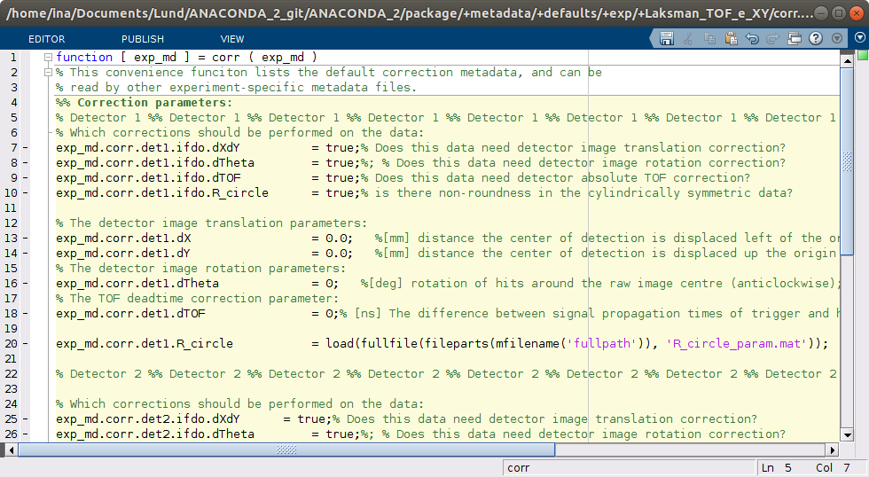
On/off ‘flags’
Corrections can be turned on or off in metadata:

Slide 10
On/off ‘ifdo’ flags
These flags exist for the macros:
  - Correct
  - Convert
  - Plot
  - Filter

Slide 11
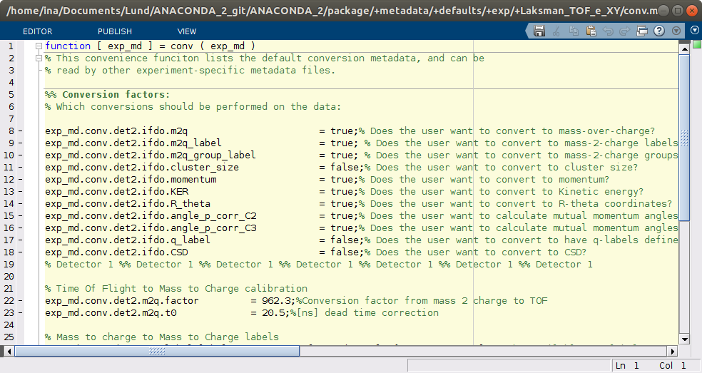
Convert (X, Y, TOF, etc.) to (m, p_{x}, etc.)

Slide 12
Filter on hits:
Filters are formed from conditions. e.g.:
  cond.oil.data_pointer = 'h.det1.m2q_l';

Slide 13
Filter on hits:
Filters are formed from conditions. e.g.:
  cond.oil.data_pointer = 'h.det1.m2q_l';
  cond.oil.type = 'discrete';

Slide 14
Filter on hits:
Filters are formed from conditions. e.g.:
  cond.oil.data_pointer = 'h.det1.m2q_l';
  cond.oil.type = 'discrete';
  cond.oil.value = [72; 73];

Slide 15
Filter on hits:
Filters are formed from conditions. e.g.:
  cond.oil.data_pointer = 'h.det1.m2q_l';
  cond.oil.type = 'discrete';
  cond.oil.value = [72; 73];
  cond.oil.translate_condition = 'AND';

Slide 16
Filter on hits:
Filters are formed from conditions. e.g.:
  cond.oil.data_pointer = 'h.det1.m2q_l';
  cond.oil.type = 'discrete';
  cond.oil.value = [72; 73];
  cond.oil.translate_condition = 'AND';
  cond.oil.invert_filter = true;

Slide 17
Filter on hits:
Data pointer could be any MATLAB expression:
  cond.m2q.data_pointer = 'h.det1.m2q_l.*h.det1.TOF+1';
  cond.m2q.type = 'discrete';
  cond.m2q.value = [72; 73];
  cond.m2q.translate_condition = 'AND';
  cond.m2q.invert_filter = true;

Slide 18
Filter on hits:
The 1st and/or 2nd and/or 3rd hit can be selected:
  cond.m2q.data_pointer = 'h.det1.m2q_l.*h.det1.TOF+1';
  cond.m2q.type = 'discrete';
  cond.m2q.value = [72; 73];
  cond.m2q.translate_condition = 'AND';
  cond.m2q.invert_filter = true;
  cond.m2q.hitselect = [1, 3];

Slide 19
Filter on events:
Total Kinetic energy:
  KER_sum.type = 'continuous';
  KER_sum.data_pointer = 'e.det1.KER_sum';
  KER_sum.value = [0; 80]; % [eV]

Slide 20
Merging of conditions:
When merging filters, operators can be defined:
  cond.combined.m2q = m2q
  cond.combined.oil = oil;
  cond.combined.KER_sum = KER_sum;
  cond.combined.operators = {‘AND’, ‘OR’};

Slide 21
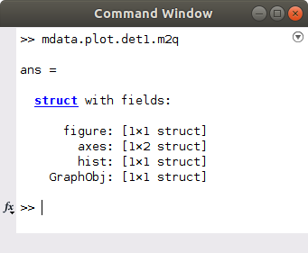
Making Plots
Metadata separated in categories:
  figure: Figure handle properties
  axes: Axes handle properties
  hist: Histogram metadata
  GraphObj:Graphical Object handle
  Cond: (optional) plot condition
What are handles?

Slide 22
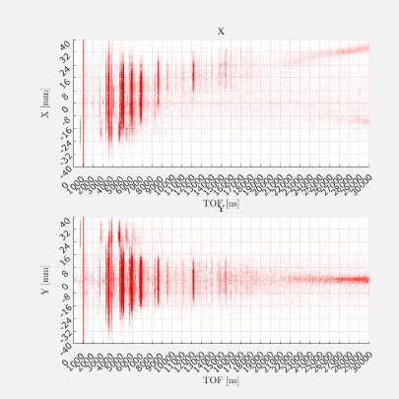
Calibration
All correction and conversion parameters need calibration.

Slide 23
Calibration
Metadata calibration:
macro.calibrate.momentum(data, 1, mdata)

Slide 24
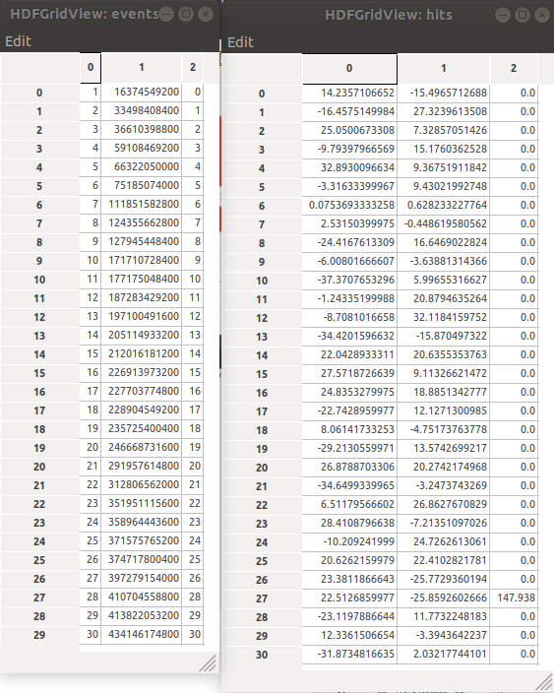
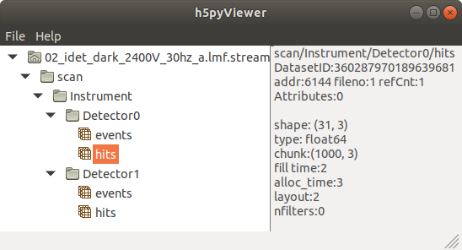
HDF5 dummy file

