Slide 1
Automatic Time Table Generating System
Team-6

Slide 2
Team Members
Khyati Desai (201812006)
Niraj Lahori (201812041)
Jinal Virani (201812049)
Parita Dudhani (201812051)
Khushboo Tolat (201812065)
Siddharth Mishra (201812081)
Yashvi Dave (201812095)
Yash Badiyani (201812096)
Krupa Koshti (201812100)
Disha Mehta (201812120)

Slide 3
Introduction
An Automatic time table generator is a Web-based application software that will help to generate time table for our institute automatically.
It is a PHP based application which will help user to manage data like adding, updating, deleting and viewing details of faculty, programs and courses.
It provides an easy and efficient way for automating the process of developing timetable.

Slide 4
Current System
Currently the time table is prepared by Dean of Academic Programs, PG convenor, UG convenor, Professor Puneet Bhateja and Professor Asim Banerjee manually.
They have to keep track of slots, faculties and courses also. This makes it more time consuming and increases the workload on the committee members.

Slide 5
Proposed System
So we are going to make an Automatic time table generator which is a Web-based Application Software that will help to generate time table for our institute automatically.
It takes data like Faculty Names, Courses and Student enrollment details for generating the feasible time table.
Timetabling is a task of satisfying some constraints. These constraints are hard constraints and soft constraints. In this project hard constraints have been taken care of strictly.

Slide 6
Product Features
In Automatic Time Table Generating System, all the processes are handled by the admin. In the first step, we have the student registration details and course and faculty details in a particular excel format so that when the system requires it, we provide it.
Now the process is followed by a sequence of steps:
Admin logs into the system with the username and password.
If successful login, he/she can manage faculties, courses, and programs.
If admin wants to generate the lecture timetable, he/she has to provide data for lecture. (Here, data means Student Registration details and Course-Faculty details)
Now, Admin has to click on Generate Time Table (for lecture) to generate time table and then he/she can view the timetable.

Slide 7
Functional Requirements
Login : The admin can log into the system using login page which is the first page provided in the Web App System.
Manage Faculty: Admin can manage faculties. He/she can add faculty, update faculty, delete faculty and view them.
Manage Programs: Admin can manage programs. He/she can add programs, update programs, delete programs and view them.
Manage Courses: Admin can manage Courses. He/she can add courses, update courses, delete courses and view them.
Generate Time Table: For generating the time table, Admin has to upload the excel sheet containing student details and course-faculty details and this system will generate a feasible timetable accordingly.

Slide 8
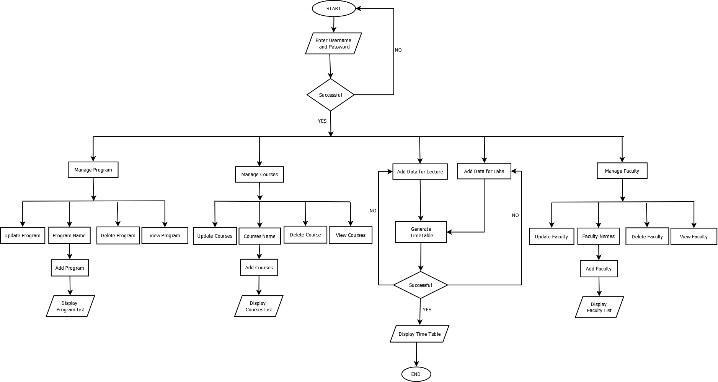
System Flow Chart
diagrams\imgs\FlowChart.png

Slide 9
Future Scope
Various features in the Automatic Time Table Generating System can be worked upon to achieve greater efficiency and rigidness in use and functioning of the system.
Few of the features that could be worked upon in future to improve Automatic Time Table Generating System are:
Algorithm can be improved to generate time table in lesser amount of time with greater efficiency.
Functionality of generating time table for lab could also be added later.

Slide 10
Thank You

