Slide 1
Architecting
Rich Internet Applications
Maturitätsarbeit
Maturitätsarbeit
Architecting
Rich Internet Applications
May 24, 2005
May 24, 2005
Daniel Gąsienica
Daniel Gąsienica

Slide 2
What I will talk about
Why did I choose this topic?
What is an RIA? Examples…
Introducing Phyre: Physics Rämibühl Experiments
Quick Tour of Phyre
Discussion: Advantages/Drawbacks of Phyre
Theory: Three–Tiered Application Architectures
Insight: Implementing the Catalog’s Categories
Questions?

Slide 3
Why did I choose this topic?
Background:
6 years experience in web development
2000: First steps with Macromedia Flash
Fascinated by modern web technologies…
Challenge:
Applying my skills to build a real world web application …
  … using mostly free technologies
  … applying modern day development concepts
Rich Internet Applications (RIA)

Slide 4
What is a Rich Internet Application?
Compared to a Desktop Application, an RIA …
… does not require to be installed.
… can be updated/deployed instantly.
… can be accessed from any computer with an internet connection.

Slide 5
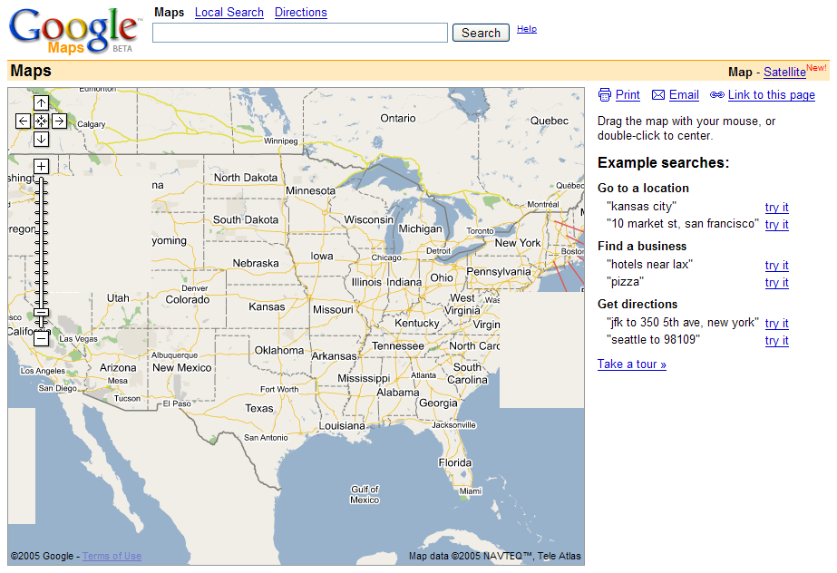
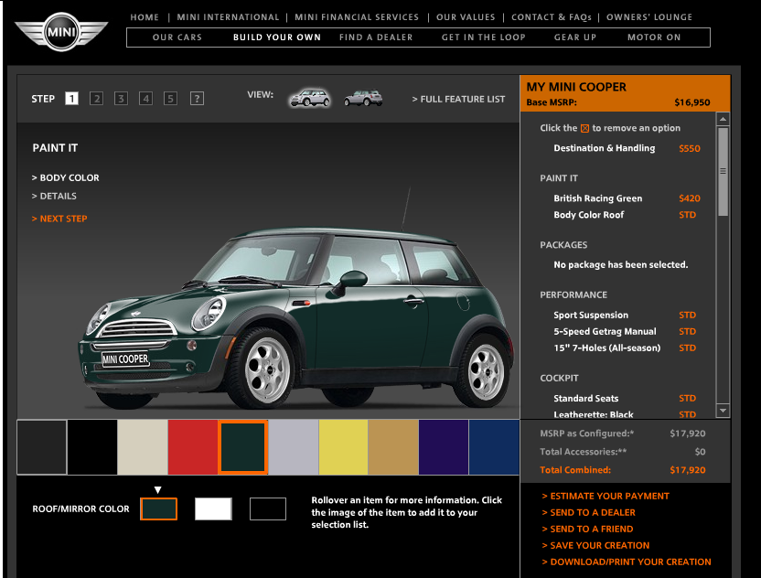
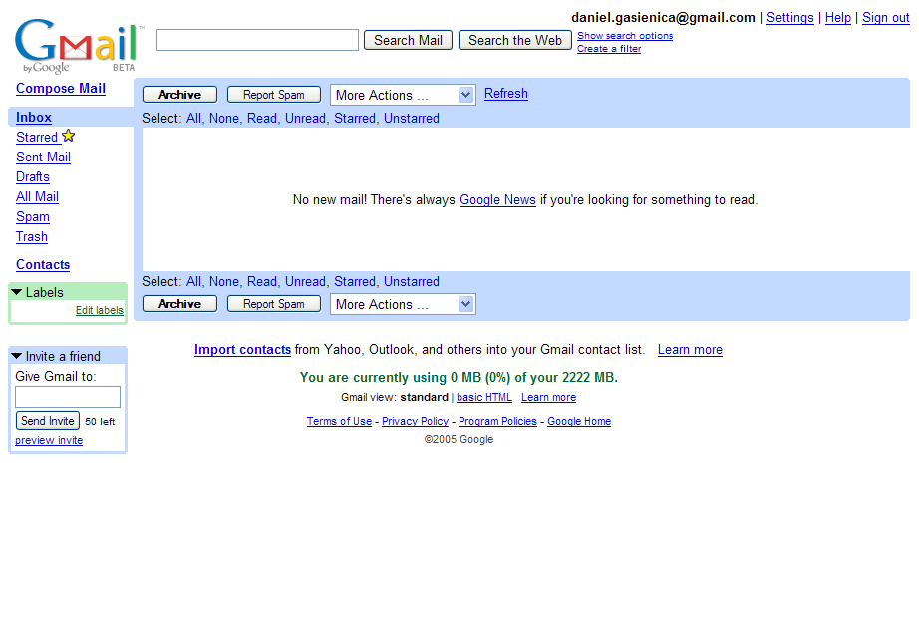
Three Examples of RIA
Google Maps
MINI Car Configurator
GMail

Slide 6
Phyre: Physics Rämibühl Experiments
Phyre is an RIA that manages the catalog of
experiments at the MNG Rämibühl.
It manages:
Experiments
Parts
Images/Illustrations
Users

Slide 7
Quick Tour of Phyre

Slide 8
Advantages of Phyre
Centralized database
Fully searchable
No page refreshes
User authentication
Intuitive, rich user interface
Drawbacks of Phyre
Non-standard technology: Macromedia Flash Player
Performance: Due to inefficiency of Flash Player

Slide 9
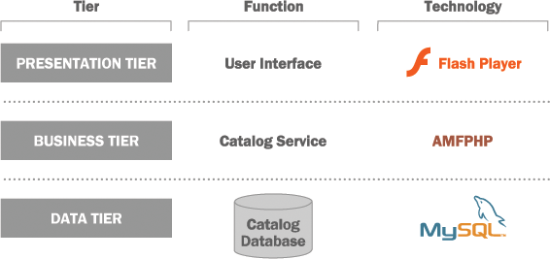
Three–Tiered Application Architectures
What you see as a user
Link
Storage of Information

Slide 10
Insight:
Implementing the Catalog’s Categories

Slide 11
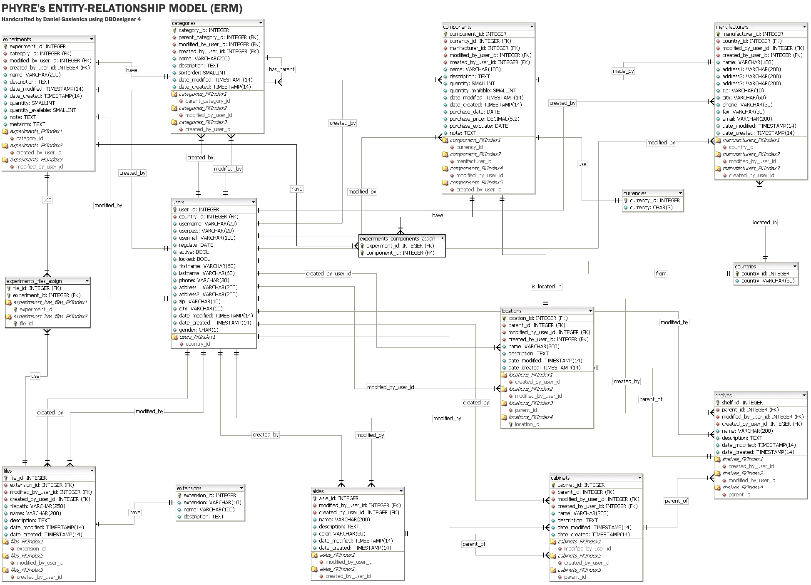
Phyre‘s Database
We‘ll look only at this one…

Slide 12
Storing Hierarchical Data
Mechanik
Reality:
Würfe
Arbeit
Mechanik
Würfe
Arbeit
Database:
id: 1
id: 2
id: 3
parent_id: NULL
parent_id: 1
parent_id: 1
Notes:
Dfgdfgdfg

Slide 13
Creating a Hierarchical Tree
function buildTree() {
FIND ALL CATEGORIES IN THE DATABASE;
while( THERE ARE CATEGORIES ) {
CREATE CATEGORY ITEM;
if (CATEGORY HAS SUBCATEGORIES) {
buildTree();
}
}
}
Recursion
<categories>
<item label="Mechanik" id="1">
<item label="Würfe" id="2" />
<item label="Würfe" id="3" />
</item>
</categories>
Mechanik
Würfe
Arbeit

Slide 14
What Happens Behind the Scenes?
Desktop Computer
PocketPC
Cell Phone
Presentation Tier
Request:
get categories
Return:
categories
Business Tier
build
categories
tree
find categories
Database

Slide 15
Thank you.

Slide 16
Questions?

Slide 17
Architecting
Rich Internet Applications
Architecting
Rich Internet Applications
May 24, 2005
May 24, 2005
Daniel Gąsienica
Daniel Gąsienica

