Slide 1

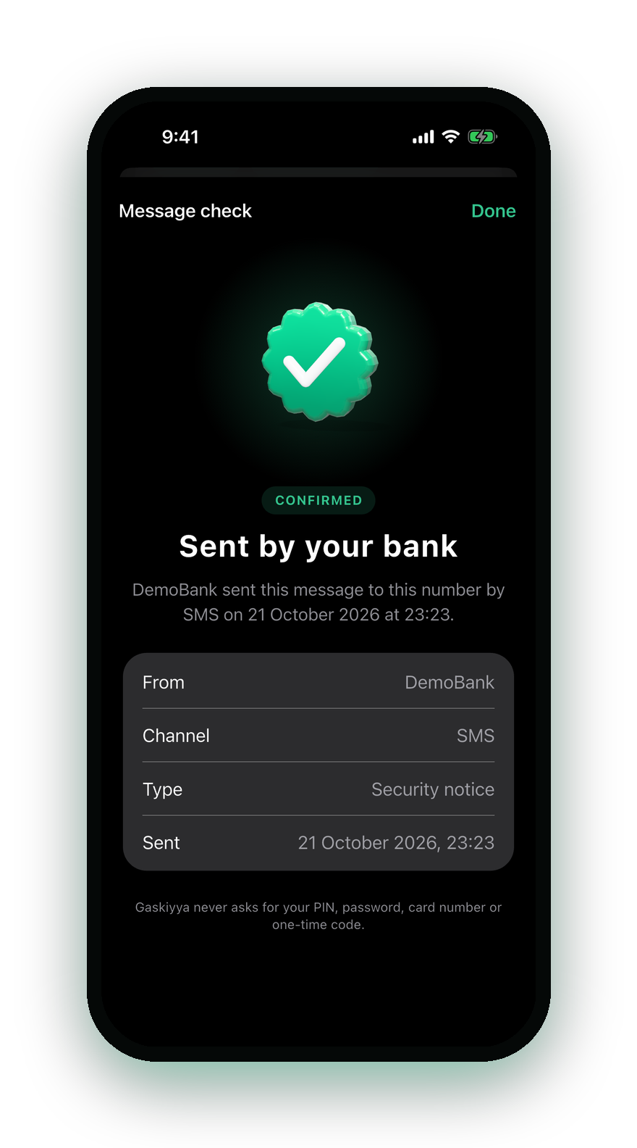
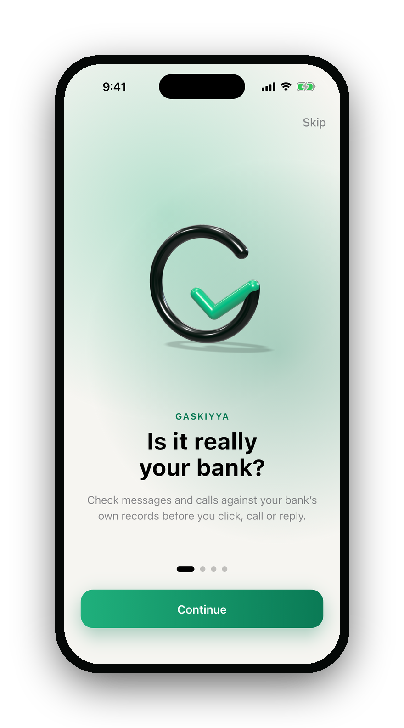

Gaskiyya
Know it is really your bank.
“GASKIYA” MEANS TRUTH IN HAUSA
Jhmeel Mikail · Mojeed Fathia — Zecathon 6.0
Notes:
(15 sec) Good morning. I’m [name], with Mojeed Fathia. This is Gaskiyya — “truth” in Hausa. It lets anyone know, in seconds, if a message or call is really from their bank. Let me tell you about Amina.

Slide 2
Amina gets two texts from her bank
9:14 PM · SURULERE, LAGOS
Real
DemoBank · SMS · 9:14 PM
A new device signed in to your account. Review it at demobank.ng/security
Spot the fake.
Fake
DemoBank · SMS · 9:16 PM
A new device signed in to your account. Review it at demo-bank.ng/security
One hyphen. That’s all a fraudster needs.
Notes:
(20 sec) Meet Amina. She runs a provisions shop in Surulere. At 9:14 her bank texts her. Two minutes later — another text. Same name, same words. Which one is fake? [pause] It’s one hyphen. Amina can’t see it. Honestly, neither can we. And the sender name can be spoofed.

Slide 3



AMINA IS NOT ALONE. EVERY DAY IN NIGERIA:
₦70.8 million
is lost to fraud.
One case every 7.8 minutes
#1 trick: pretending to be your bank
NIBSS 2025: ₦25.85bn lost, 67,518 incidents; social engineering “the most prevalent technique” · daily and per-minute figures derived
Notes:
(15 sec) And Amina isn’t alone. Every day in Nigeria, ₦70.8 million is lost to fraud — one case every 7.8 minutes. NIBSS says the number-one technique is social engineering: pretending to be your bank.

Slide 4
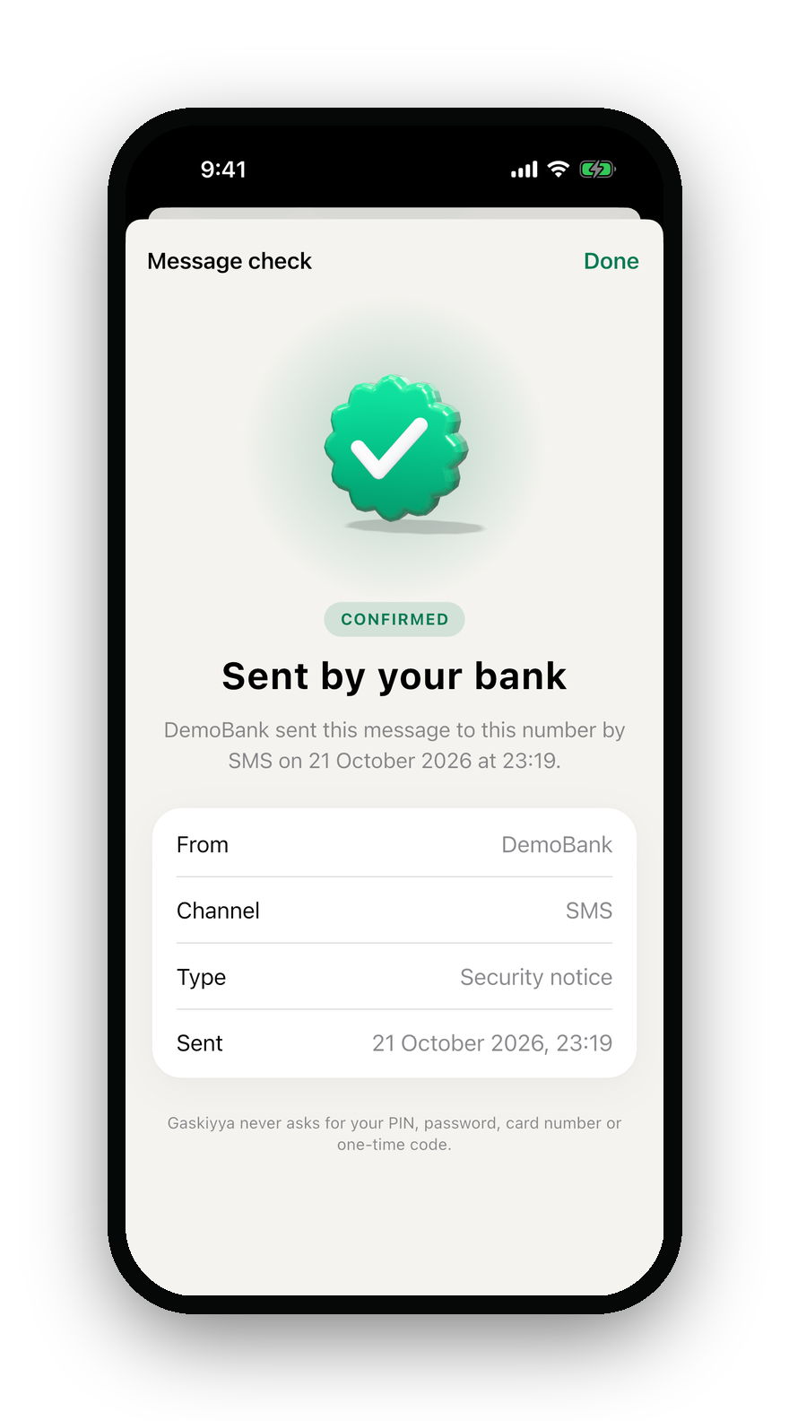
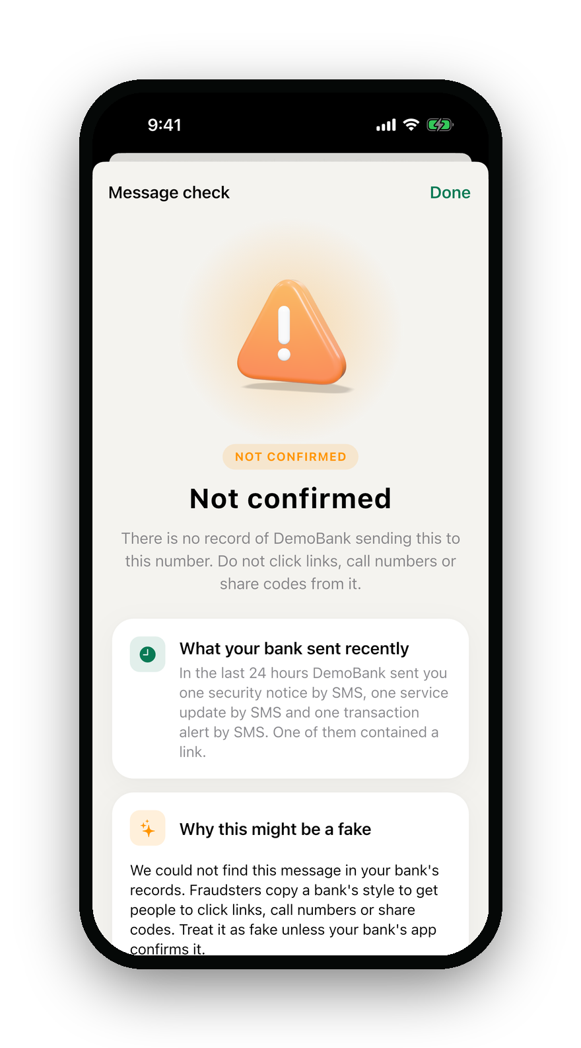
One tap. The truth.
9:17 PM · AMINA OPENS GASKIYYA
Not her eyes. Not AI. Her bank’s own records decide.
01
Bank logs every message it sends
02
Amina shares it with Gaskiyya
03
Only an exact match confirms
Notes:
(25 sec) So Amina opens Gaskiyya and shares the message. One tap. The first: “Sent by your bank.” The second: “Not confirmed — don’t click.” How? When the bank sends any message, it makes one API call that stores a fingerprint — never the text. Gaskiyya only says “confirmed” on an exact match, for her number. Forward a real message to someone else? Not confirmed. Change one character? Not confirmed. AI explains — it never decides.

Slide 5
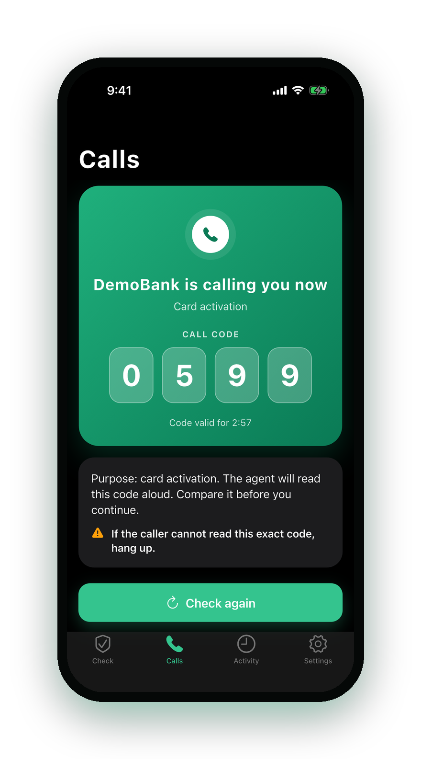
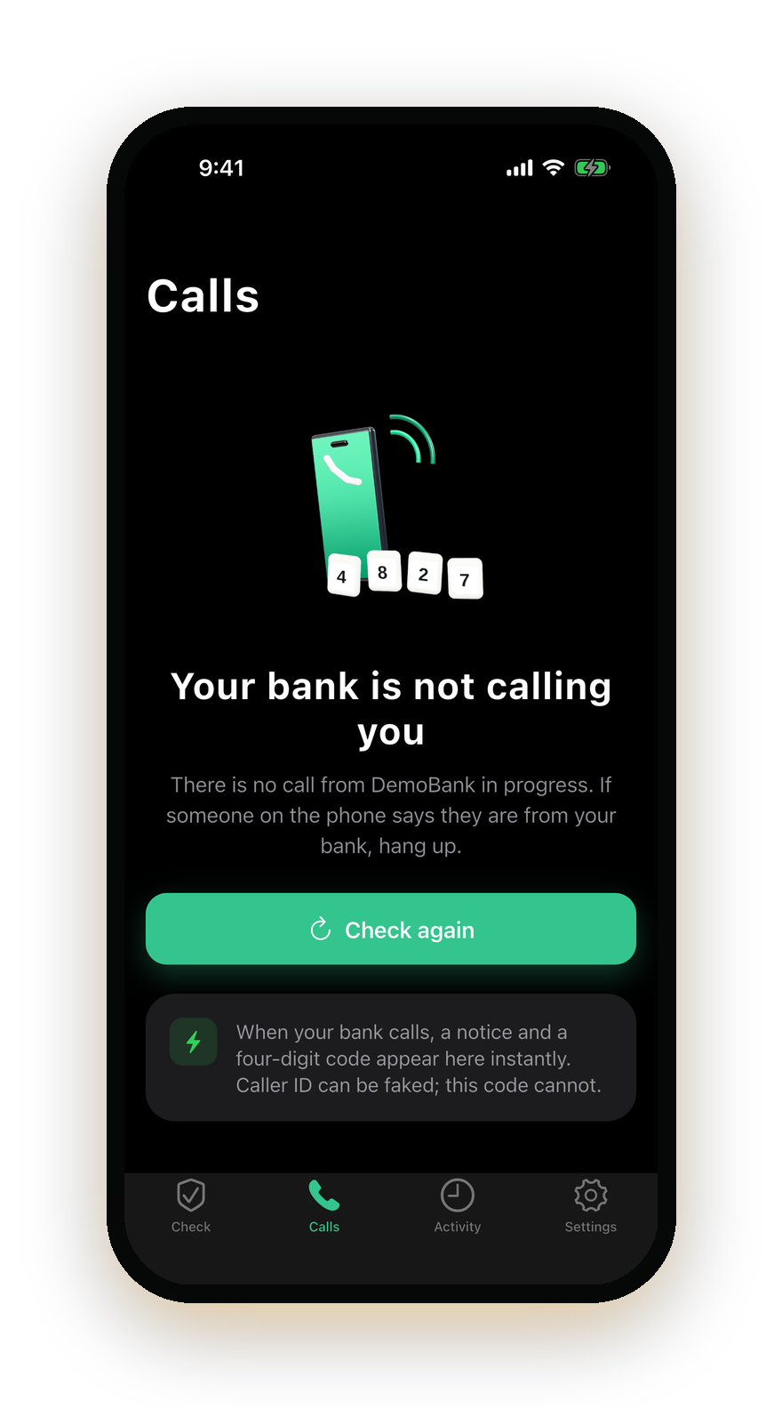
“Hello madam, this is your bank.”
NEXT MORNING · HER PHONE RINGS
Is it? The agent reads a 4-digit code. Her app shows the same code.
No call announced? The app says it plainly: hang up.
Real bank call
Fraudster calling
Notes:
(20 sec) Next morning, the phone rings: “Hello madam, this is your bank.” Caller ID can be faked — so before the bank dials, it announces the call to Gaskiyya. The agent reads a 4-digit code; Amina’s app shows the same code. If a fraudster calls, the app simply says: your bank is not calling you. Hang up.

Slide 6
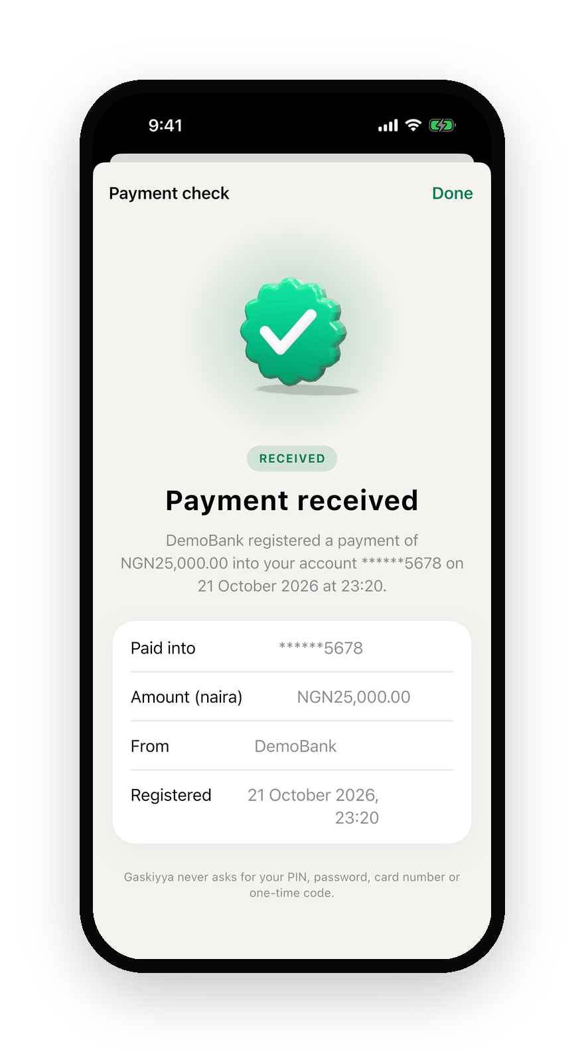
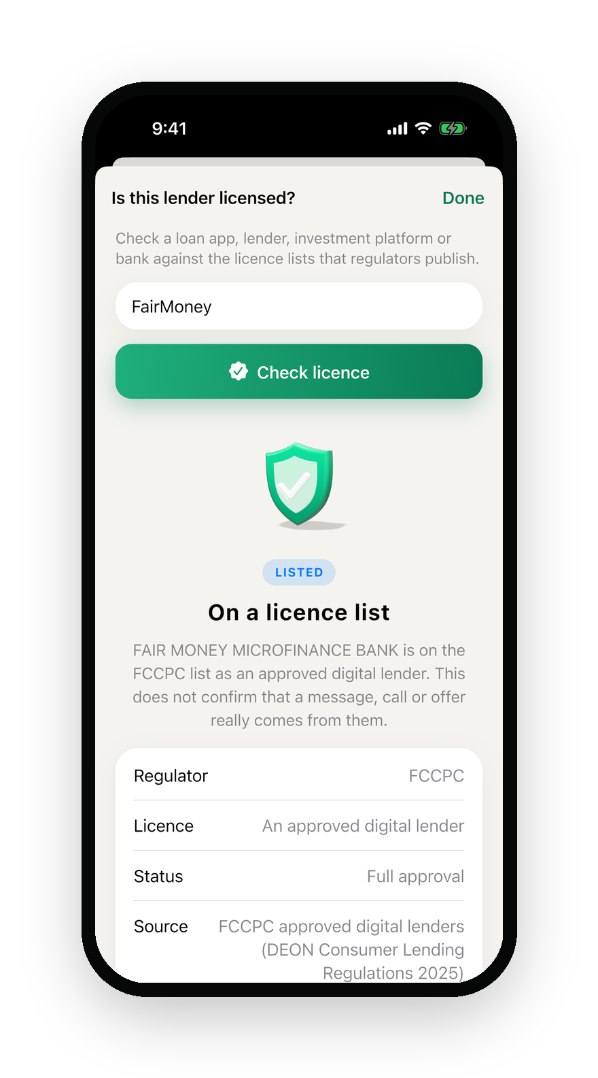
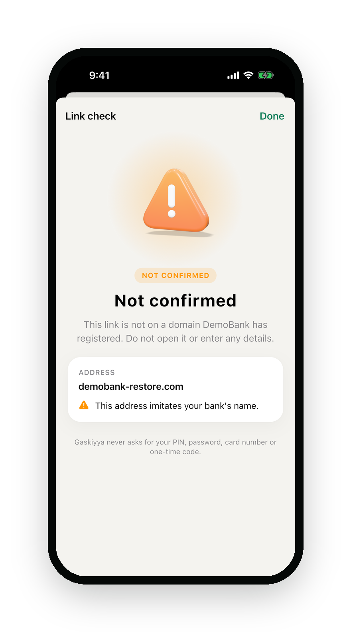
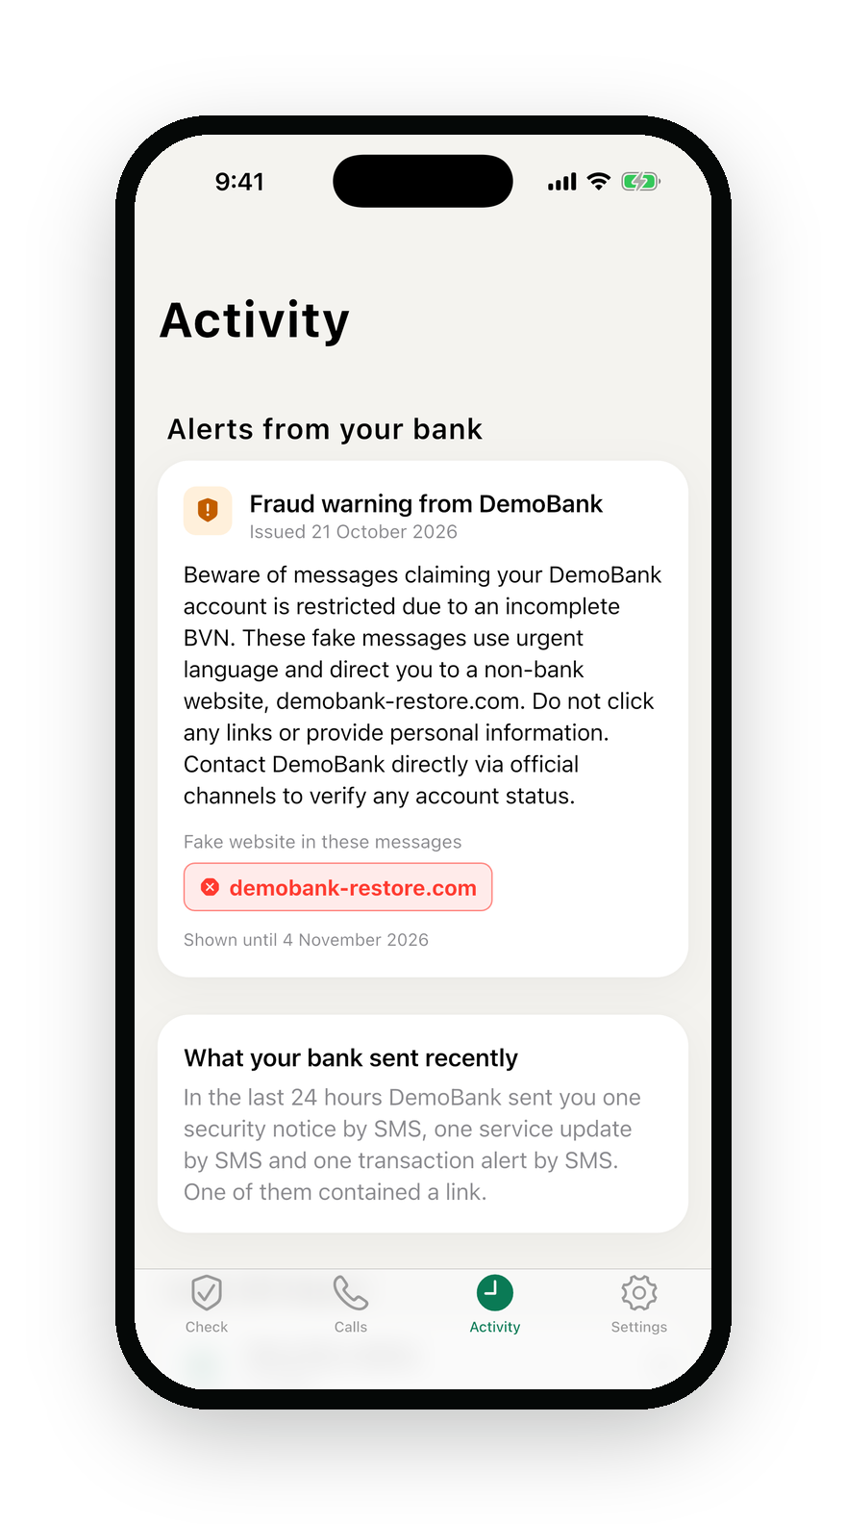
One app. Every trick in the book.
THE REST OF HER DAY
“I’ve paid you” — true?
Is this loan app legal?
Is this link my bank?
Scam wave? Warned first.
Notes:
(20 sec) And it protects the rest of her day. A customer says “I’ve paid you” — Amina checks the receipt before releasing goods. A loan app offers quick cash — Gaskiyya checks it against FCCPC and CBN licence lists. A link — it catches lookalikes. And when scammers launch a wave, our AI fraud desk spots it, a human approves, and every customer is warned. Plus SIM-swap alerts that stop stolen OTPs.

Slide 7



Every phone. Every language.
AND HER MOTHER IN KANO?
Bank app & Gaskiyya app
*347*123#
iPhone and Android, with zero-click Shield
1 Is my bank calling me?
2 What did my bank send today?
WhatsApp
Forward the message. Get the truth.
Reply: 2
Today your bank sent 2 alerts and 1 OTP. None had a link.
USSD on any phone
No data needed — 1 in 3 lines is still 2G
Hello
How far?
Sannu
Ẹ n lẹ
Ndewo
English · Pidgin · Hausa · Yoruba · Igbo
Notes:
(20 sec) And Amina’s mother in Kano, with a basic phone and no data? She dials a USSD code: is my bank calling me, what did my bank send today. On WhatsApp, just forward the message. In the app, Shield even warns automatically on Android. In English, Pidgin, Hausa, Yoruba and Igbo. That’s financial inclusion: protection on the phone people already own.

Slide 8
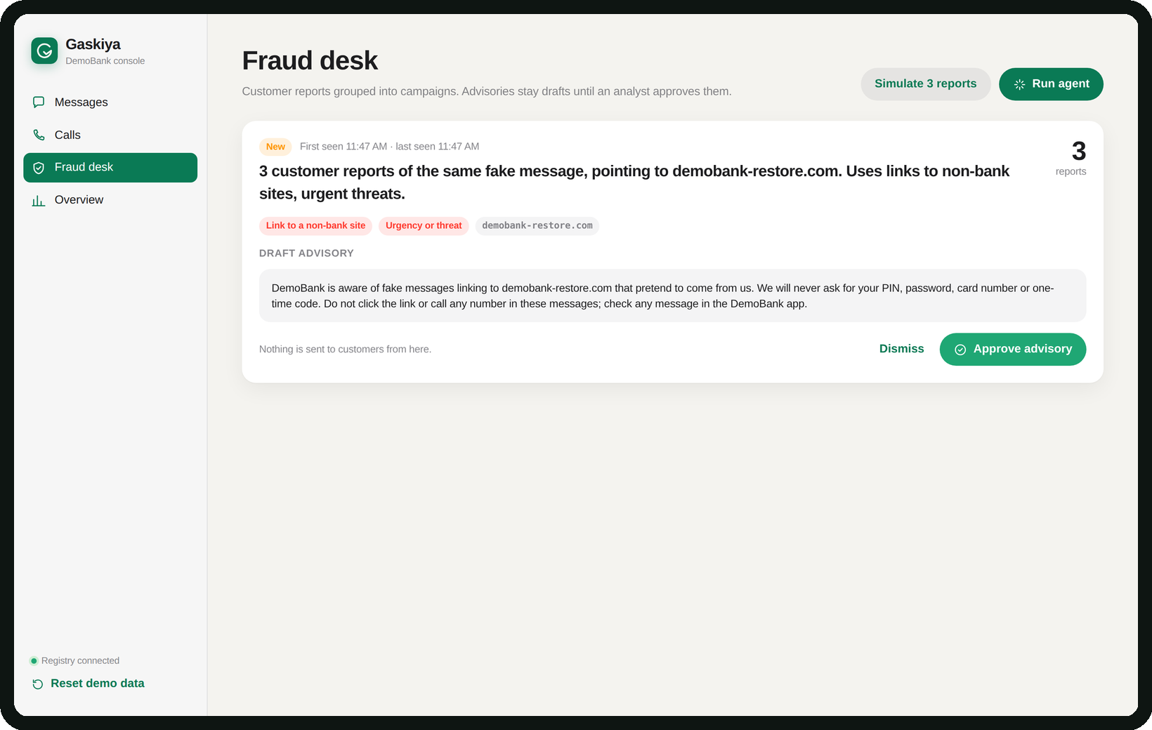
One API call. Nothing to leak.
FOR THE BANK
6,000+
checks per second
0
message texts stored
400+
automated tests
Live
on AWS today
Fraud desk: AI groups reports into a scam campaign. A human approves the warning.
Banks pay a licence + per message · Customers check free
Notes:
(20 sec) For the bank: no change to its messages, no core-banking access — one API call when it sends. We store only fingerprints, so there’s nothing to leak — NDPA by design. The fraud desk turns customer reports into scam campaigns; AI drafts the warning, a human approves it. Over 6,000 checks a second in our load test (laptop, in-memory store — production numbers come with the pilot), 400+ automated tests, live on AWS. Banks pay a licence plus a per-message fee; customers check free. Built on Flutter, Node.js, Firestore, Gemini and the GSMA SIM-swap API.

Slide 9

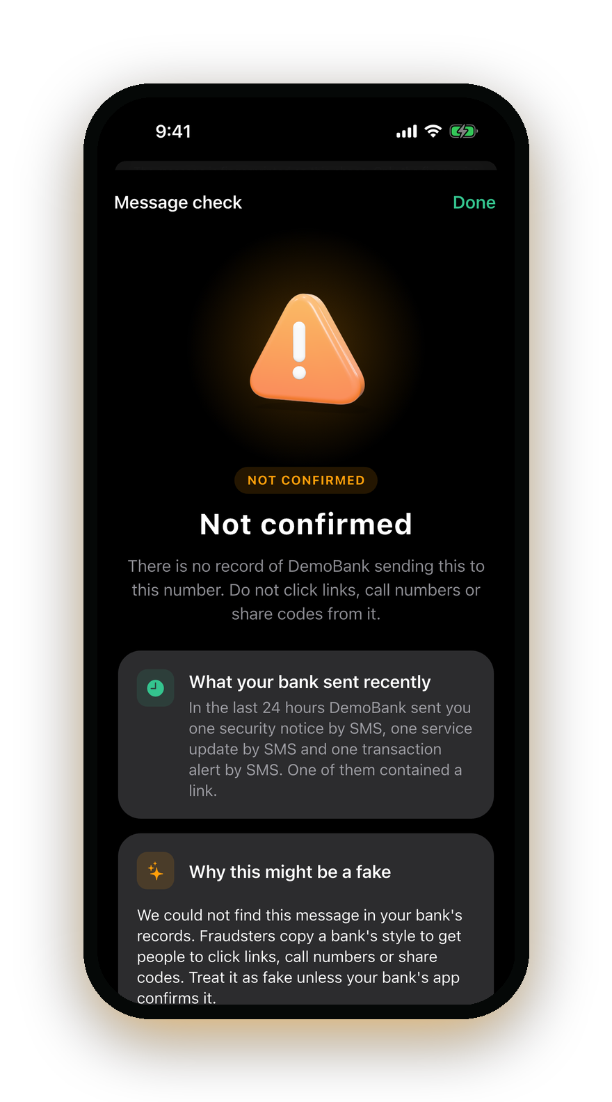
LIVE DEMO
Let’s try to scam Amina.
Right now. On a real phone.
Notes:
DEMO — 4 MINUTES (bank console on the screen, Amina’s phone mirrored).
1) Real alert (30s): Console → Messages → send a transaction alert → share it to Gaskiyya: “Sent by your bank”.
2) The fake (30s): paste the demo-bank copy → “Not confirmed” + what the bank really sent today. WOW: paste Amina’s REAL message as Tunde → also “Not confirmed” (tied to her number).
3) Bank calls (45s): Announce & call → same 4-digit code on agent screen and phone. Hang up → “Your bank is not calling you”.
4) Basic phone (30s): USSD emulator → *347*123# → 1 call code, 2 today’s messages.
5) SIM swap (30s): swap SIM → send OTP → bank told to hold it; red warning on phone.
6) Fraud desk (45s): simulate 3 reports → Run agent → campaign + draft warning → approve → alert lands on the phone; the warning SMS itself verifies.
Backup if Wi-Fi fails: in-browser sandbox at gaskiyya-io.web.app/console, then the 60-second film.

Slide 10


WHAT’S NEXT
Pilot with Zenith Bank. Then every bank.
Month 1–3
Next
Then
Pilot
Full rollout
One registry
One message type + bank calls
All messages, USSD with telcos
Every bank, fintech, agency
Jhmeel Mikail
Mojeed Fathia
Software engineer
Business analyst
Know it is really your bank.
Notes:
(25 sec) What’s next: a pilot with Zenith Bank — one message type plus outbound calls, inside the bank’s own environment. Then every message type and USSD with the telcos. Then one registry for every bank, fintech and agency in Nigeria. We’re Jhmeel and Fathia. Gaskiyya: know it is really your bank. Thank you.

