Slide 1

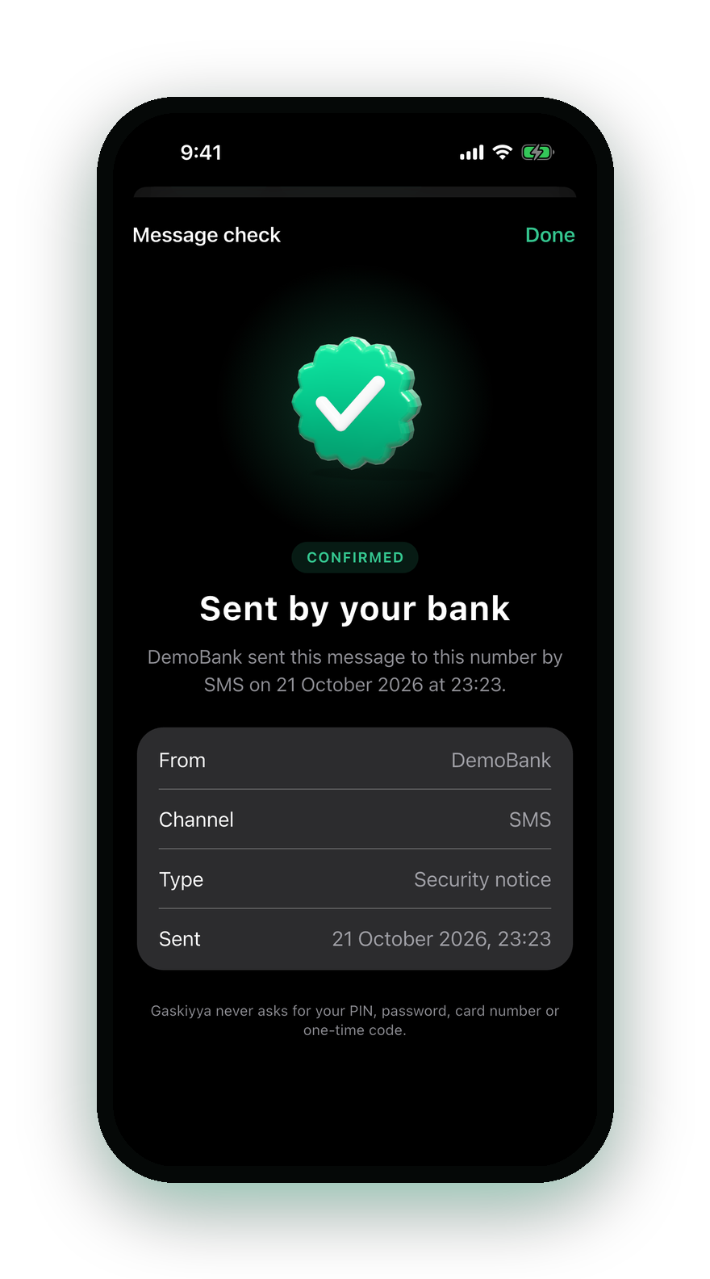
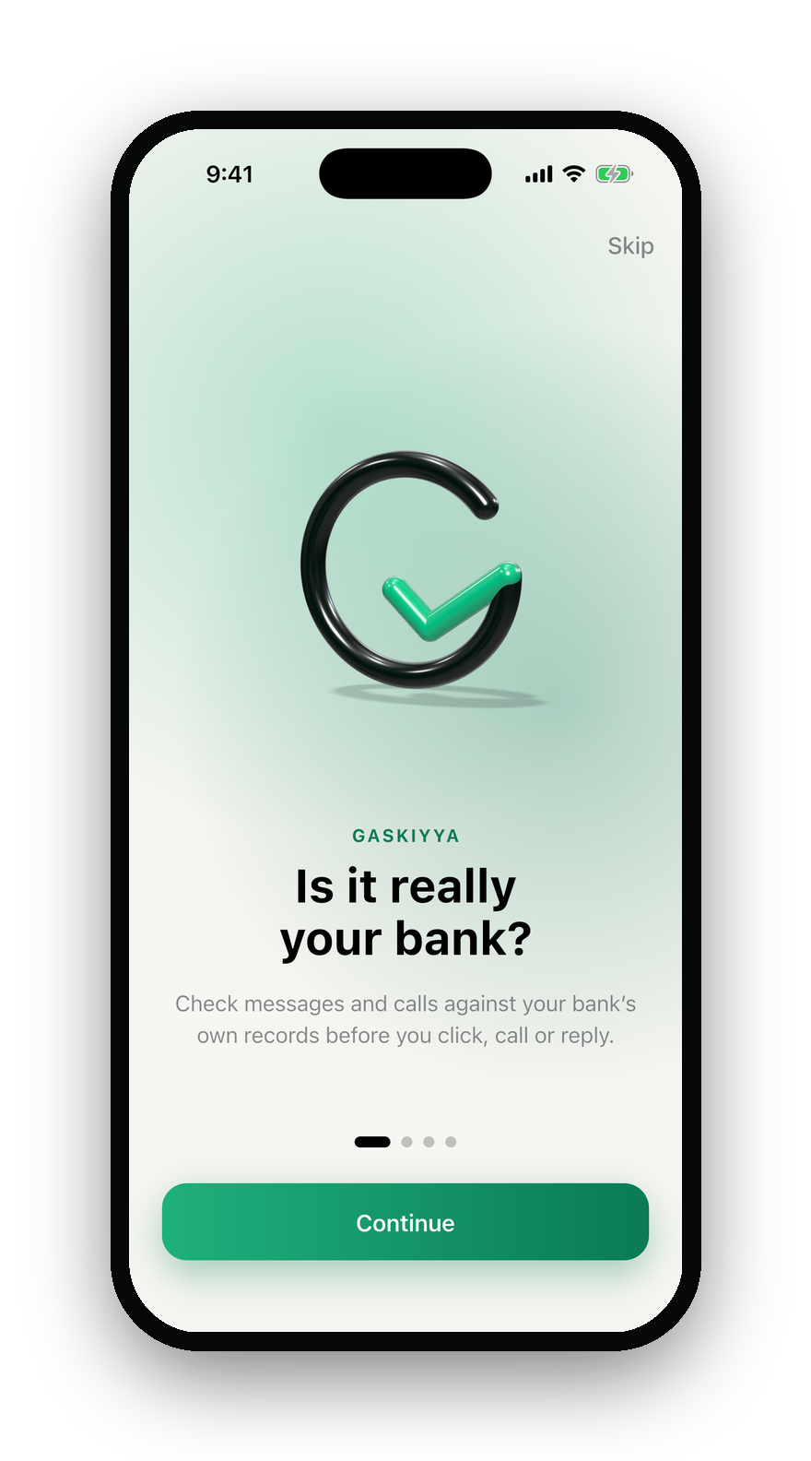



Strengthening Trust in Digital Banking
Gaskiyya
The Truth Layer Between
Banks and Customers
“GASKIYA” MEANS TRUTH IN HAUSA
10X Team · Jhmeel · Oluwatobi
Notes:
OLUWATOBI · 20 seconds
Good morning. We are 10X Team. I’m Oluwatobi, and this is Jhmeel. Our project is Gaskiyya. “Gaskiya” is the Hausa word for truth.
We’re working on Strengthening Trust in Digital Banking, and on one simple question: when a message or a call says it’s from your bank, how do you know it really is?
Let’s start somewhere unexpected.

Slide 2

She doesn’t look back. She knows he will catch her.
That is trust.
Now imagine someone pretending to be him.
Notes:
JHMEEL · 45 seconds. The three lines appear one after another on their own. Let each one land.
[Line 1] Look at this little girl. She doesn’t look back. She knows her father will catch her.
[Line 2] That is trust. Not a contract, not a password. Just confidence that the person on the other side is who you think they are.
You have the same kind of trust with your bank. You trust it with your money, your information and your biggest decisions.
[Line 3, slow] Now imagine someone pretending to be him. Someone who looks like him, sounds like him, and knows your name.
[pause] That is exactly what happens every day when fraudsters pretend to be your bank.

Slide 3



What if it isn’t your bank?
The problem
You can’t reliably tell a real bank call or message from a fake.
Gaskiyya
Check it against your bank’s own records, before you act.
Source: NIBSS, 22 January 2026: social engineering was the most prevalent fraud technique in Nigeria in 2025.
Notes:
OLUWATOBI · 40 seconds
Imagine your phone rings. “Hello, this is your bank.” They know your name. They say there’s an urgent problem with your account and you need to act now.
Would you know if it was really your bank? What if the voice sounded convincing, or the SMS looked exactly right?
That’s what impersonation exploits. NIBSS reported social engineering as the most prevalent fraud technique in Nigeria in 2025, with ₦25.85 billion lost to fraud that year.
[point to the phone] Gaskiyya gives you a way to check before you act. Your bank registers what it really sends and every call it really makes. So when this “Bank Support” calls, the app says it plainly: your bank is not calling you.
For Q&A: today we check SMS and WhatsApp text, links, contacts, and calls the bank announces through Gaskiyya. Not every channel.

Slide 4
What 33 people told us
Source: Gaskiyya user survey, October 2026, 33 respondents. “Useful” means a rating of 4 or 5 out of 5.
Notes:
JHMEEL · 30 seconds
We didn’t want to guess, so we asked. 33 people answered our survey this week.
58% have hung up on a real call from their bank because they couldn’t tell if it was real. 42% ignored or deleted a real bank message because they thought it was fake. A third lost money to a fake message or call, or someone close to them did.
So fakes don’t just steal money. They make people distrust the real bank too.
And 73% rated a check like this useful, 4 or 5 out of 5.
For Q&A: also, 64% want the check inside their own bank’s app, and 45% say they would trust digital banking more. It is a small, young sample (79% aged 18 to 25, mostly Lagos and the South-West), so we treat it as a signal, not proof.

Slide 5




How Gaskiyya works
2 Checks a message or call
1 Registers what it sends
3 Gets a clear answer
The bank
Gaskiyya registry
The customer
Sends SMS, calls and OTPs
Fingerprints only. No message text.
Checks before acting
Confirmed
Not confirmed
Cannot check
Notes:
JHMEEL · 45 seconds
Three parties, three steps.
One: when the bank sends a message or places a call, its system makes one API call to the Gaskiyya registry. We store a keyed fingerprint, an HMAC-SHA-256 hash. Think of it as a seal that can’t be reversed. No message text, no phone numbers, so there’s nothing useful to steal.
Two: the customer checks. They share the message to the app, or look at the Calls screen when someone rings.
Three: the registry looks for an exact match for that customer’s number, and the customer gets one of three answers: confirmed, not confirmed, or cannot check. Change one character, or forward it to someone else, and it fails. If we can’t check, we say so. We never say “safe” by default.
Under the hood: a Flutter app for iOS and Android, a TypeScript and Fastify API on Firestore, deployed with Docker on AWS through CI/CD. GenAI only explains a failed check in plain language. It never decides.
Honest limitation: the bank side is simulated today. Connecting a real bank’s messaging system is the next step.

Slide 6






Who it helps
Customers
Traders and SMEs
Banks
Check before acting
Confirm every payment
Spot scam waves early
Works on any phone
Bank app
WhatsApp
USSD, no data
5 languages
Notes:
OLUWATOBI · 35 seconds
Who benefits?
Customers: a way to pause and check before clicking a link, calling back, or sharing a code.
Traders and small businesses: check that a transfer is real before handing over goods. No more fake “I’ve paid you” receipts.
Banks: customer reports of a fake message are grouped into a scam campaign, and a human approves every warning before it goes out. It complements the bank’s security. It doesn’t replace it.
And it works on any phone: in the bank’s app or ours, on WhatsApp, and by USSD for basic phones without data, in English, Pidgin, Hausa, Yoruba and Igbo. The translations still need native-speaker review.
Why it matters for inclusion: people only use digital banking if they feel confident in it. These are potential outcomes, and we want to measure them in a pilot.

Slide 7

Built to scale
Bank A
Bank or Gaskiyya app
Bank B
WhatsApp
Bank C
USSD on any phone
Same API for every bank
Each bank keeps its own keys
Customers check every bank in one place
Notes:
JHMEEL · 20 seconds
It scales by design. Every bank joins through the same API. Each bank keeps its own keys and its own records, isolated from the others. And customers get one place to check messages from every bank they use: in their bank’s app or ours, on WhatsApp, or by USSD on any phone.
To get there we still need real bank integrations, a USSD short code with the telcos, security and privacy reviews, and operational support. Production scale isn’t proven yet. That’s what the pilot is for.

Slide 8
The next three months
Built in 3 days
Month 1
Month 2
Month 3
1
2
3
Done
Validate
Strengthen
Pilot
Registry live on AWS
iOS and Android app
WhatsApp, USSD, CI/CD
Test with real users
Make every result clear
Security and privacy review
Bank integration requirements
Controlled pilot with a partner bank
Measure, then decide on rollout
Notes:
JHMEEL · 25 seconds
We built this in three days. The registry is live on AWS, with the iOS and Android app, the bank console, WhatsApp and USSD, all deployed through CI/CD with automated tests.
Next three months. Month one: put it in front of real users and make sure every result is clear. Month two: a security and privacy review, better error handling, and the real requirements for connecting to a bank. Month three: a controlled pilot, if a partner bank agrees, measured properly.
The goal isn’t more features. It’s proving Gaskiyya is useful and reliable for real customers.

Slide 9
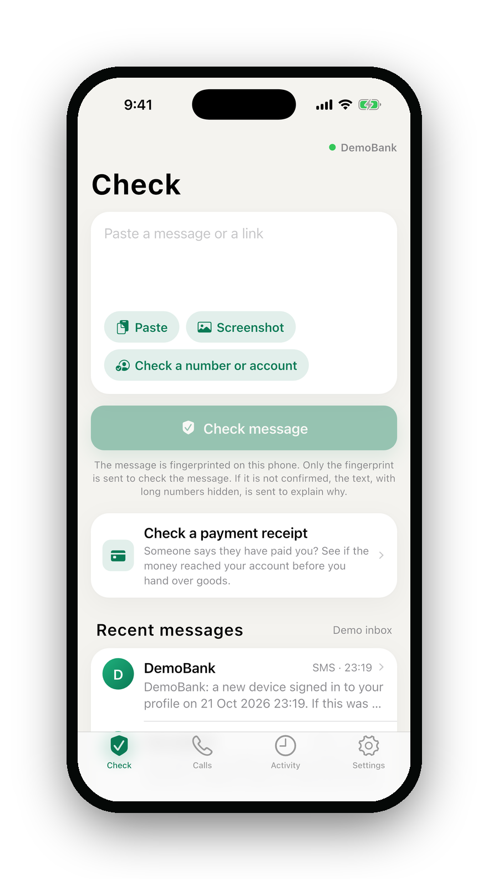
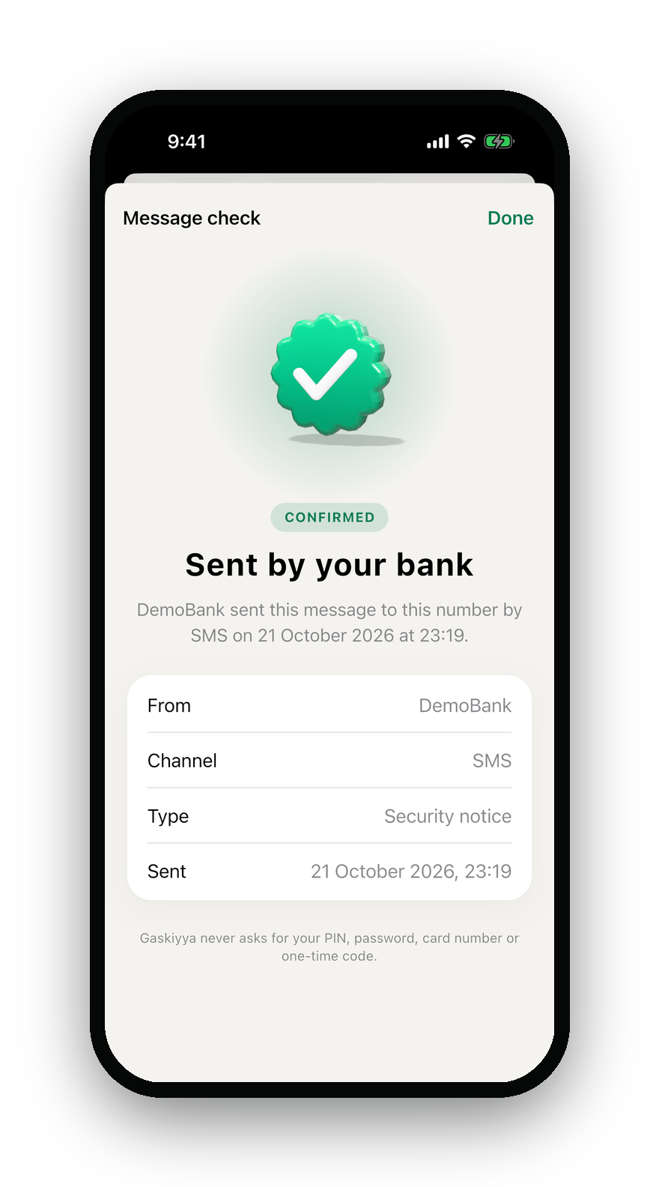
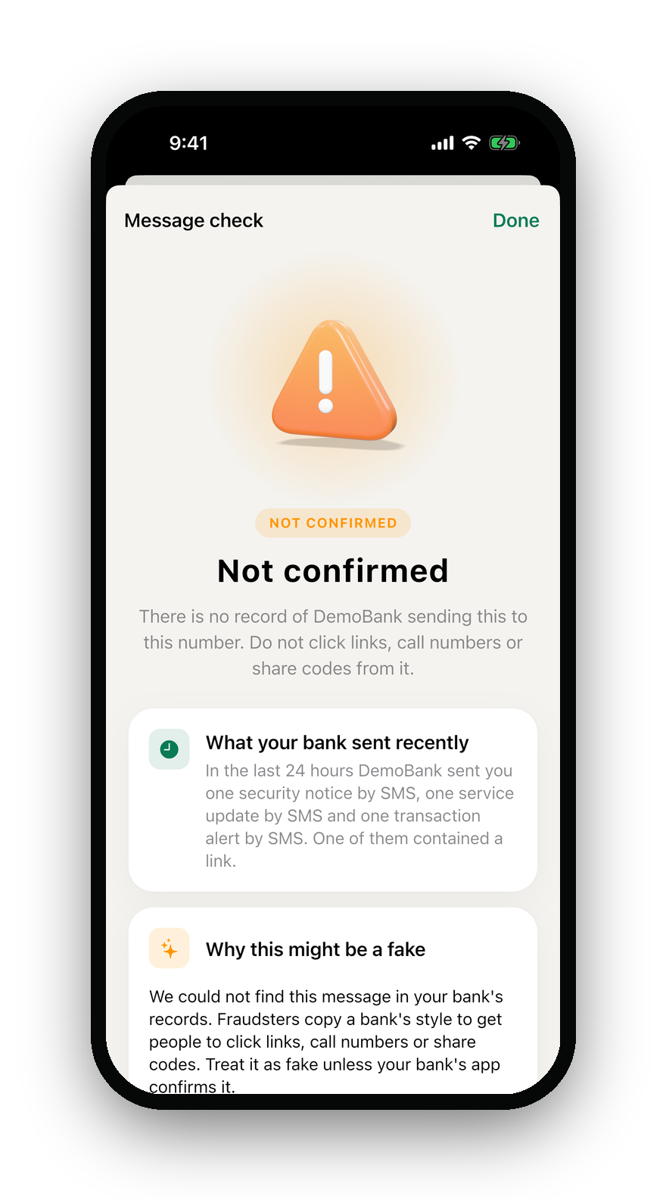
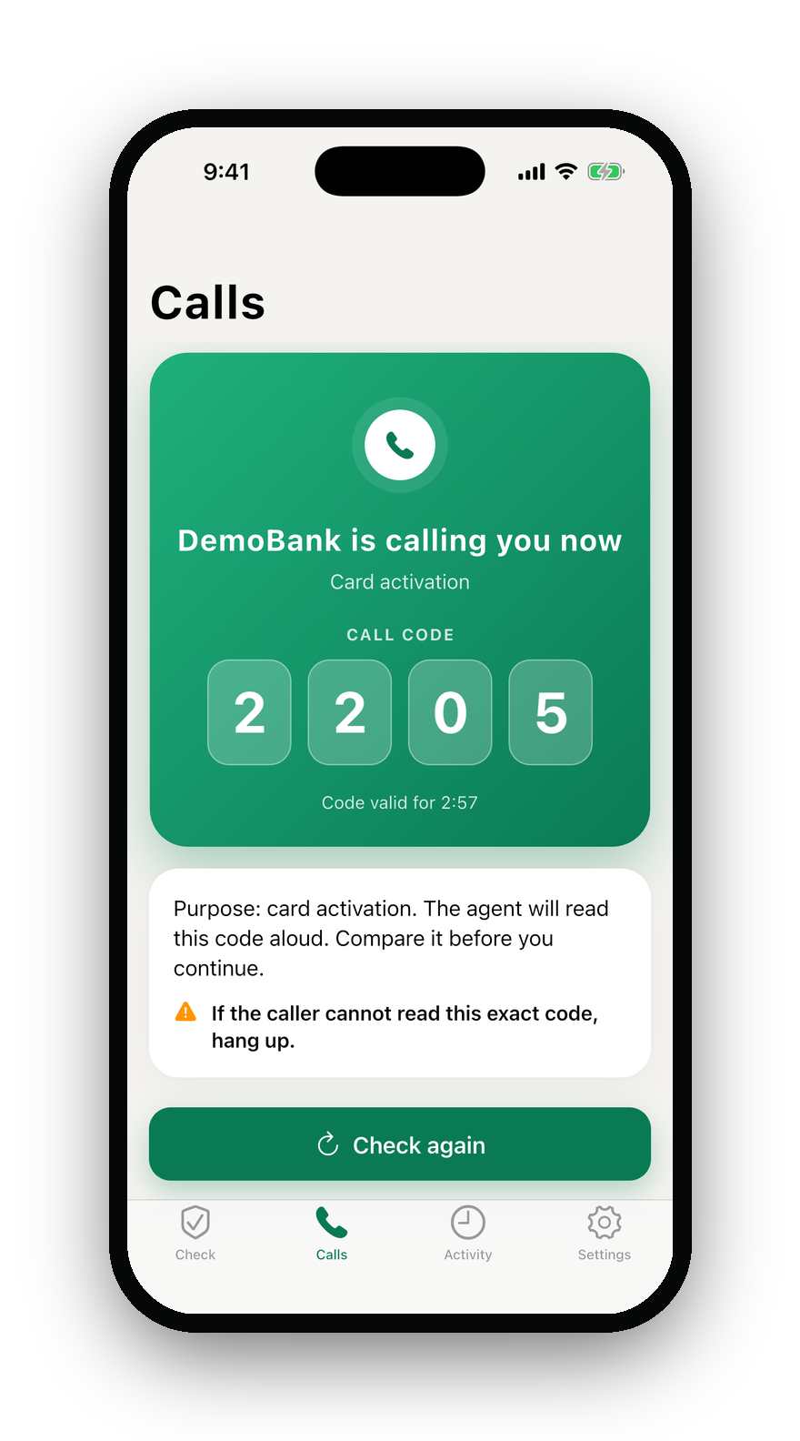
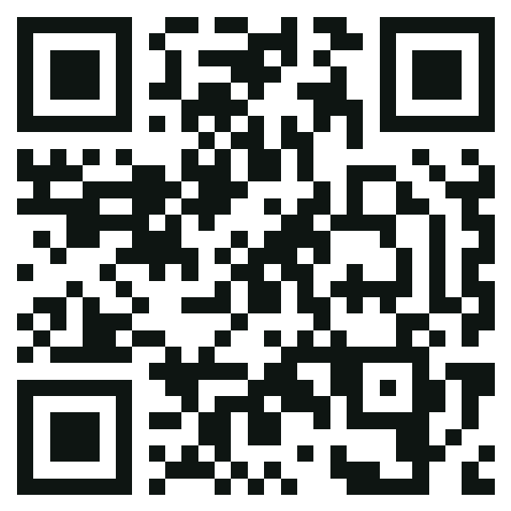
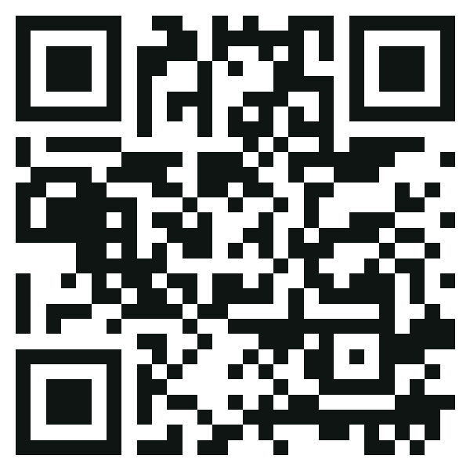
Live demo
Scan to try it
Website
gaskiyya-io.web.app
1
2
3
4
5
The bank sends a real alert
Customer shares it
Sent by your bank
Tampered copy: not confirmed
Bank calls: same code on both screens
Bank sandbox
gaskiyya-io.web.app/console
Notes:
BOTH · 3 minutes. One drives the app and console, the other narrates (agree who does which before the pitch). Test data only. No real customer data, keys or tokens on screen.
1. THE BANK SENDS (20s): “On the left is the bank’s side, our bank console. On the right, a customer’s phone with Gaskiyya.” Console, Messages, send a security alert.
2. CUSTOMER SHARES IT (20s): On the phone, share the message to Gaskiyya.
3. SENT BY YOUR BANK (30s): The app shows “Sent by your bank.” “That message is genuine. The bank registered it a moment ago.”
4. TAMPERED COPY (40s): Paste the copy with the lookalike link (one hyphen added). Result: “Not confirmed”, plus what the bank actually sent in the last 24 hours and why this looks like a scam. Optional: paste the genuine message as a different customer. Also “Not confirmed”, because checks are bound to the recipient.
5. BANK CALLS (40s): Console, Calls, announce and call. The same 4-digit code appears on the agent screen and the phone. Hang up: the app now says your bank is not calling you.
Close (10s): point at the QR codes: “Scan these to try the website and the bank sandbox yourself.” Then: “Each time, the customer got a clear answer before clicking a link, sharing a code, or trusting a caller.”
If the live demo fails: switch to the backup screen recording and say clearly, “This is a recording of the same app.”

Slide 10

Every
OTP
proven.
Every
message
proven.
Every
link
proven.
Every
call
proven.
Gaskiyya: The Truth Layer Between Banks and Customers
Strengthening Trust in Digital Banking · 10X Team: Jhmeel and Oluwatobi
Notes:
OLUWATOBI · 30 seconds (calm, slow). The four words appear one after another on their own: OTP, message, link, call.
At the heart of digital banking is a relationship between a bank and its customers. That relationship becomes fragile when customers can’t tell a genuine message from an impersonation.
Gaskiyya is our answer: making verification a normal part of deciding what to do.
We’ve built the prototype, you’ve seen it work, and we know the next steps.
Every OTP, proven. Every message, proven. Every link, proven. Every call, proven.
Because when the truth is easier to verify, trust has a stronger foundation.
Thank you.
[Stop. Let the judges respond.]

