Slide 1
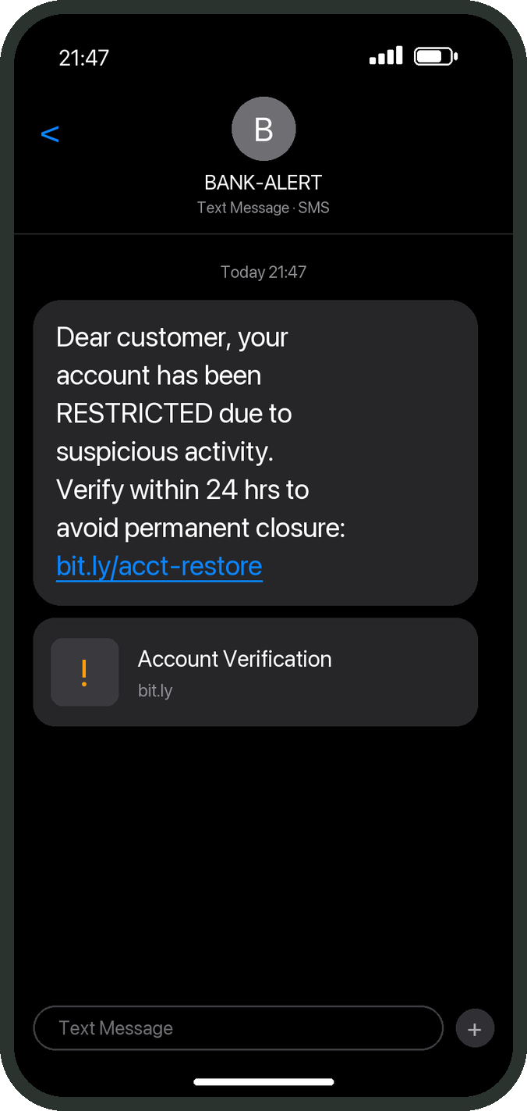
Real or fake?
You have three seconds.
The sender name can be faked. The number can be faked. The wording can be copied word for word.
Today, nothing on that screen can tell you the truth.
Illustrative message
Notes:
Open in silence. Let the room read the message. Then: "Real or fake? You have three seconds. That is all most people give it." The message is illustrative and names no real bank. Nothing a customer can see on that screen proves who sent it: SMS sender names can be set by whoever sends, caller ID can be spoofed, and a fraudster can copy the bank's wording exactly (docs/DESIGN.md, "The check never relies on caller ID"). Move on after about 15 seconds.

Slide 2
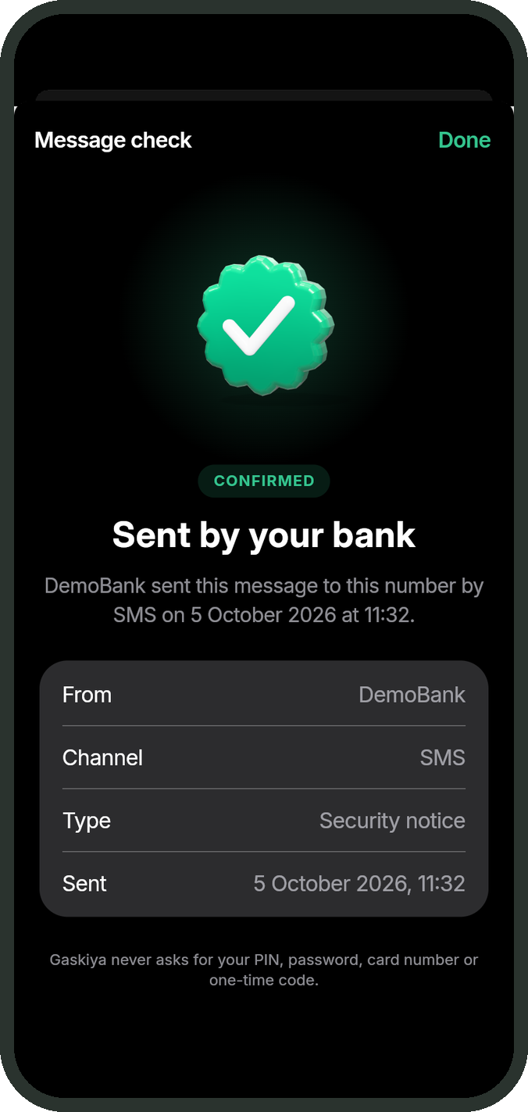
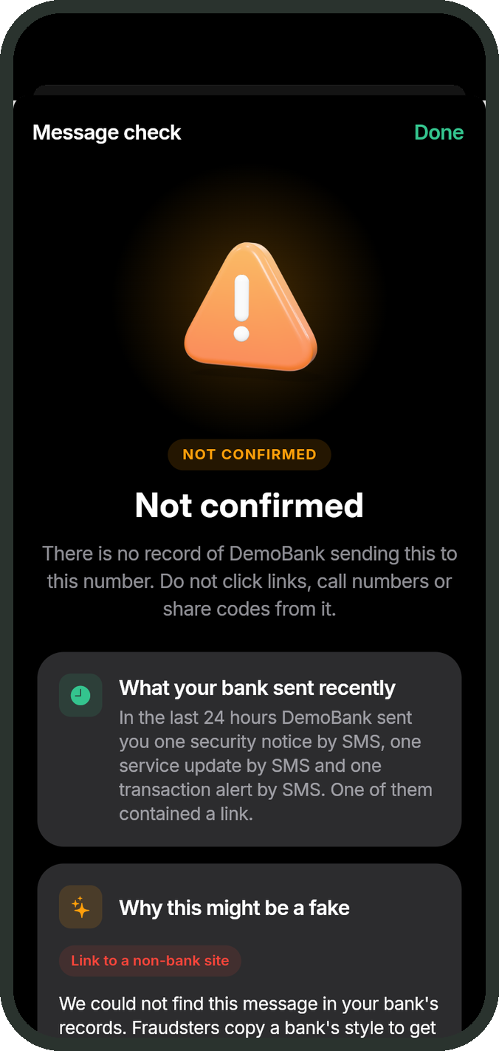
Gaskiyya
Is it really your bank? Now the bank itself answers.
Sent by your bank
"Gaskiyya" is Hausa for truth (gas-KEE-ya)
Not confirmed
Cannot check right now
Track: Strengthening Trust in Digital Banking
[TEAM NAME] | Simulated bank systems only: no live banking or production APIs
Notes:
Gaskiyya is a registry where banks record what they really sent, so a customer can check any message or call against the bank's own records, not a guess. On screen are the real app screens: the same app shows "Sent by your bank" for the genuine message and "Not confirmed" for a copy. Three answers, fixed text: "Sent by your bank", "Not confirmed", "Cannot check right now" (packages/schemas/copy.json, CH-4). Name the track: Strengthening Trust in Digital Banking. Say plainly: everything in the demo runs against a simulated bank (the bank sandbox console); no live banking system or production API is involved.

Slide 3
In Nigeria, a digital payment fraud is reported
every 7.8 minutes.
N70.8m
N25.85bn
#1
lost every single day in 2025
lost to digital payment fraud in 2025
technique: social engineering, "the most prevalent"
NIBSS, 22 Jan 2026 [S2]: 67,518 incidents and N25.85bn lost in 2025. "Every 7.8 minutes" (525,600 min / 67,518) and "N70.8m a day" (N25.85bn / 365) are derived by us. Reported cases only.
Notes:
These are the industry's own 2025 numbers, published by NIBSS on 22 January 2026 [S2]: 67,518 reported digital payment fraud incidents and N25.85bn lost, and NIBSS names social engineering "the most prevalent fraud technique". The per-minute and per-day figures are our arithmetic on those totals: 525,600 minutes in a year divided by 67,518 is one every 7.8 minutes; N25.85bn divided by 365 is about N70.8m a day. Say "reported": these are cases banks reported to NIBSS, so the real number is higher, not lower. If asked about 2024: the press-reported N52.26bn [S3] was, in NIBSS's words, "largely driven by a single fraud incident of N31.1 billion involving one entity" [S2]. For 2023, NIBSS counts show 65.8% of reported cases were social engineering (derived) [S1].

Slide 4
2026: they impersonate anyone
21 APR
MAY
16 SEP
SEP
Even the Central Bank
Your phone rings
A N5 "traffic fine"
Still on 2G
The CBN warns the public about fake messages claiming to be the CBN, built to hack personal accounts [S16]
51% of unknown calls to Nigerians in 2025 were flagged as spam or fraud: the highest in Africa [S5]
A fake FRSC text asked for N5. One victim paid it and woke up to find millions of naira gone [S17]
More than a third of mobile subscribers were still on 2G in May 2026: no app can reach them [S6]
[S16] CBN press statement, 21 Apr 2026 (press report). [S5] Truecaller via Vanguard, 6 May 2026 (press report). [S17] FRSC alert, 16 Sep 2026 (press report). [S6] KPMG/Orange, Sep 2026.
Notes:
Four moments from this year. 21 April: the Central Bank of Nigeria itself warned the public about fake messages and emails claiming to come from the CBN, designed to "hack personal accounts" (statement signed by Hakama Sidi-Ali, Acting Director of Corporate Communications; press reports, BusinessDay and AllAfrica) [S16]. May: Truecaller's report, covered by Vanguard on 6 May, found 51% of unknown calls to Nigerians flagged as spam or fraud, the highest in Africa (press report) [S5]. 16 September: the FRSC warned about texts saying a traffic offence had been recorded; one victim paid a N5 "fine" through the link and later found millions of naira had allegedly been taken from her account (press report; no exact figure was published) [S17]. That was the road-safety corps, not a bank, but the trap is identical. And the KPMG/Orange study (Sep 2026) quotes NCC data: more than a third of subscribers were still on 2G in May 2026 [S6]. The point: if fraudsters can be the Central Bank, they can be your bank.

Slide 5




Everything you can see can be faked
Caller ID
Sender name
The wording
AI detectors
Spoofed. "It showed the bank's number" proves nothing.
Set by whoever sends the SMS.
Copied from a real alert, word for word.
Guess from wording. A perfect copy scores as genuine.
Only one party knows what the bank really sent: the bank.
Notes:
Every check a customer can do today looks at something the fraudster controls. Caller ID can be spoofed; SMS sender names are set by whoever sends; wording is copied. AI scam detectors output a probability: a perfect copy of the bank's template scores as genuine. Gaskiyya never relies on any of these (docs/DESIGN.md). Our test suite sends ten prompt-injection messages telling the model to call a message genuine; none changes a verdict, because the verdict is fixed before the model runs (AI-2, tests/ai.test.ts). The CBN has told customers for years that banks never ask for PINs or passwords [S10]; that advice only helps once the fraudster asks. The answer has to come from the one party that knows the truth.

Slide 6




Ask the bank itself
Bank sends
Bank registers
Customer checks
Exact match
Message unchanged
One API call: a keyed fingerprint, bound to that phone number
App, WhatsApp or USSD
Or it is not confirmed
One character changed
Sent to another phone
Registry down
Registry breached
Not confirmed
Not confirmed
Cannot check, never "genuine"
No texts, no phone numbers inside
Calls too: before the bank dials, the app and the agent show the same 4-digit code.
Notes:
As the bank's notification service sends an SMS, it makes one extra call, POST /v1/messages, with a digest of the text and the recipient's number. The registry turns both into keyed hashes (HMAC-SHA-256, a key per bank) and throws the plain number away. When the customer checks, the phone computes the digest itself, so the text never leaves it, and the registry looks for an exact match among that bank's records for that customer's own number. Change one character: no match (REG-1, CAN tests). Forward a genuine message to someone else: no match (REG-2). Registry slow or down: "Cannot check right now", never genuine (REG-6). Breach the registry: keyed hashes and a few labels, no message text and no phone numbers (SEC-1). The verdict is one pure function with no network or model calls (apps/api/src/domain/verdict.ts). For calls, the contact centre registers the call first and the customer sees the same four-digit code the agent reads out (CALL-1 to CALL-4).

Slide 7
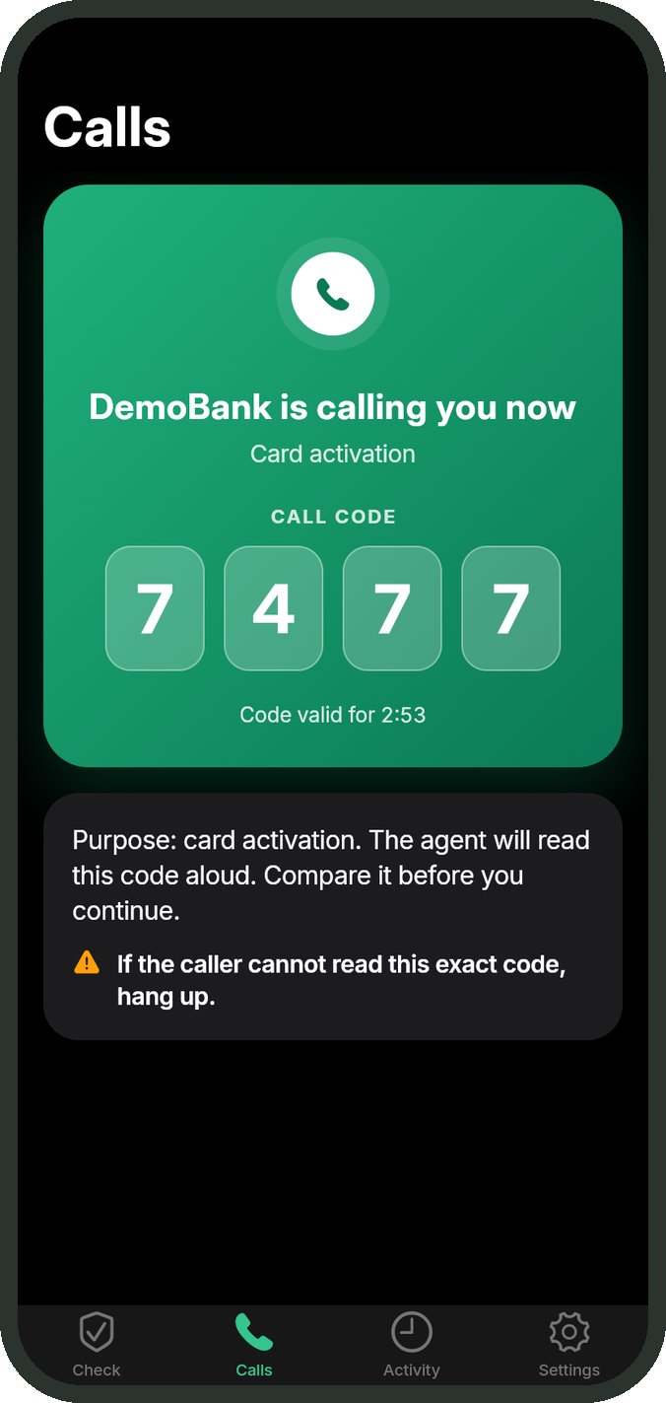
What the customer sees
The real message
One character changed
The bank is calling
Sent by your bank
Not confirmed
Same code the agent reads
Notes:
These are real screens from the Gaskiyya app (apps/mobile, captured in docs/screens/app-dark). Left: a genuine bank message, confirmed with when and how the bank sent it. Middle: the same message with one character changed: not confirmed, with what the bank really did send recently and why this one looks fake. Right: the bank opens a call before dialling; the app shows a four-digit code that the agent reads aloud; if the caller cannot read it, hang up. The message text is fingerprinted on the phone; only the fingerprint is sent to check it (CH-1). If it is not confirmed, the text, with long numbers hidden, is sent once to explain why (decision 0012).

Slide 8











12 fraud tricks, one registry
Fake bank SMS, WhatsApp, email
Phishing and lookalike links
Fake "bank staff" calls
"Read me your OTP" scripts
Not ours to stop
Insider abuse
Account takeover
Card and POS fraud
Fake identities (KYC)
Edited or forwarded messages
Spoofed sender names
Fake customer-care numbers
Fake "I have paid you" receipts
Fake banking apps (APKs)
SIM swap before an OTP
Fake government messages
Unlicensed loan apps
Only an exact match against what the organisation registered can say "genuine". Every new check follows the same rule, and SIM-swap or lookalike signals only ever add a warning.
Notes:
This is the coverage map, from our own research into how Nigerian bank customers are defrauded (NIBSS 2025: social engineering is the most prevalent technique; SIM swap, account compromise and phishing are rising). Gaskiyya now catches twelve tricks, each with tests on main: fake bank messages and calls, phishing and lookalike links, OTP scripts, edited or forwarded messages, spoofed sender names (REG, LINK, CALL tests); fake customer-care numbers and handles (OFF tests, decision 0014); fake transfer receipts shown to merchants (RCPT tests, decision 0015); fake banking apps and APK downloads (OFF tests); SIM swap before an OTP, using the GSMA CAMARA SIM Swap standard with a simulated network in the demo (SIM tests, decision 0017; no Nigerian network offers the API publicly yet); fake government and agency messages, because agencies can register too (OFF tests); unlicensed loan apps, checked against 1,770 entries from the FCCPC and CBN lists retrieved on 20 Oct 2026 (LIC tests, decision 0016). On the right, be honest: insider abuse (which NIBSS calls the greatest threat), account takeover, card and POS fraud and KYC fraud are other systems' jobs. Gaskiyya stops impersonation; it is not a whole fraud platform.

Slide 9
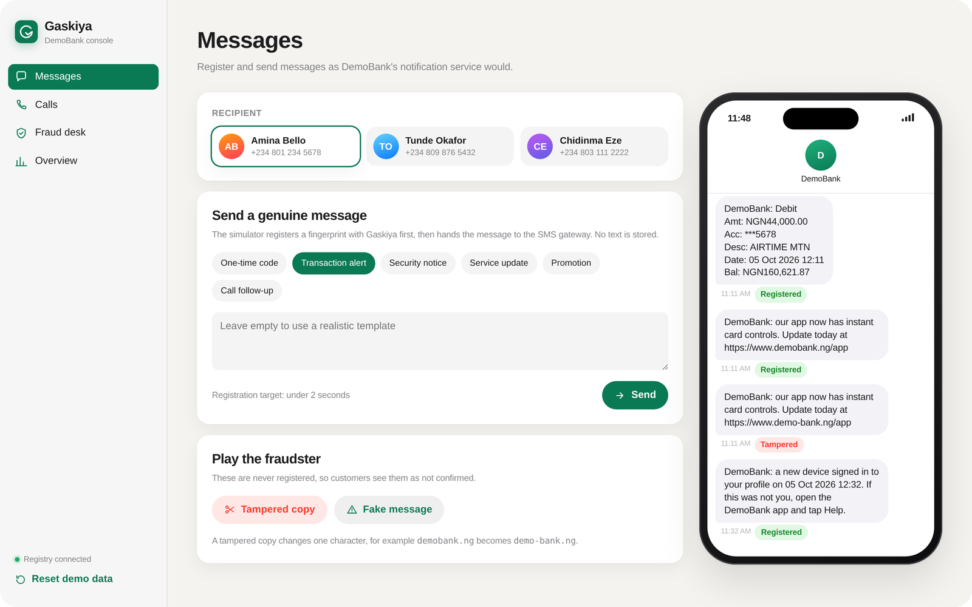
Live: 90 seconds
Simulated bank systems only: no live banking or production APIs
A
The real SMS
B
One character changed
Sent by your bank
Not confirmed
C
Same SMS, another phone
D
The bank calls
Not confirmed
Same 4-digit code
E
F
The bank sandbox console plays the bank: it sends messages, places calls and runs the fraud desk.
A basic feature phone
Three scam reports
USSD: bank calling?
Campaign + approved warning
Notes:
Say first: "Everything you are about to see runs against a simulated bank." Run the click path in docs/pitch/script.md. Narrate outcomes, not clicks. A: the bank sent it, so it is confirmed. B: one hyphen added to the link, not confirmed. C: the same genuine message, checked by another customer, not confirmed, because it was never sent to them. D: the bank opens a call; the phone shows the same four digits as the agent's screen. E: the console's feature phone dials the USSD code and sees the call. F: three scam reports become one campaign with a model-written briefing; the warning goes out only after an analyst approves it. If anything fails, use the recovery line for that step (docs/DEMO.md section 7). Evidence: CH-3 and DEMO-3 (tests/console.test.ts), USSD-8, AI-5, AI-9.

Slide 10




AI explains. It never decides.
The verdict comes first.
Your screenshot stays on your phone
Read on the device; only fingerprints are sent
It cannot say "genuine"
AI explains underneath. Nothing it says can change the answer.
Any model text claiming a message is safe or verified is replaced
It flags the wrong sender
A sender the bank never uses gets a warning
Gemini, OpenAI, open-weights models inside the bank, or no AI at all.
It briefs the fraud desk
Reports become campaigns; a human approves every warning
Notes:
AI does four jobs; deciding authenticity is not one of them. 1. Screenshots: Google ML Kit reads the screenshot on the phone, and up to three likely message texts are fingerprinted and checked on the device; only digests are sent. The image goes to a server only if on-device reading fails (apps/mobile/lib/src/core/ocr_mlkit.dart, screenshot.dart; screenshot_test.dart "the OCR path sends digests only"). 2. Explanations for "Not confirmed": long numbers are masked first (AI-4); any model output saying a message is genuine, safe, verified or from the bank is replaced by fixed text (AI-7); a hardened filter blocks any output asking for a PIN, OTP or password, including disguised spellings (F5, tests/secrets.test.ts). 3. Sender warning: a sender that is not one of the bank's sender IDs is flagged; a matching sender never upgrades a verdict, because sender IDs can be faked (AI-8). 4. Fraud desk: reports are grouped deterministically, the model writes a briefing, and the advisory stays a draft until a named analyst approves it; the agent has no tool that sends (AI-5, AI-9). Be honest: for a not-confirmed result, the masked text is sent once to explain it. Ollama runs open-weights models locally (decision 0011); tested against a stand-in, not yet end to end.

Slide 11




No smartphone. No data. Still protected.
93%
1 in 3+
~40m
of Nigerian adults use a mobile phone [S7]
subscribers still on 2G in May 2026 [S6]
adults financially excluded [S7]
USSD
WhatsApp
App
5 languages
Accessible
Any phone, no data
Nothing to install
Messages, links, screenshots, calls
English, Pidgin, Hausa, Yoruba, Igbo*
Screen reader, large text
[S7] EFInA A2F 2023. [S6] KPMG/Orange Nigeria Smartphone Study, Sep 2026, citing NCC. *Translations pending native-speaker review.
Notes:
Fraud lands hardest on people with the least room to check. EFInA: 93% of adults (103m) use a mobile phone, 26% (about 40m) are financially excluded, and at least one in two in priority excluded groups have only a basic phone [S7]. The KPMG/Orange study (Sep 2026) quotes NCC data: more than a third of subscribers were still on 2G in May 2026 [S6]. So Gaskiyya works where people are. USSD on any phone with no data: "Is my bank calling me?" shows the live call code; "Messages my bank sent me today" lists category, channel and time only (USSD-1 to USSD-8). WhatsApp with nothing to install (CH-2), with a LANG command. Five languages across the app, WhatsApp and USSD (LANG-1 to LANG-7); the four non-English ones were drafted without a native speaker and go live for real customers only after review. Accessibility: one screen-reader label for the call code, 2x text, reduced motion (A11Y-1 to A11Y-4). Several banks in one app (BANK-1 to BANK-5).

Slide 12
Fraud is becoming the bank's bill
What the bank changes
CBN draft rules on push-payment fraud
Neither bank at fault? They split the refund. Weak controls? The bank pays it all.
One API call at send time
Messages, sender ID and length unchanged
No core banking, balances or transactions touched
Keys rotate with no downtime; data stays in-house
Exposure draft, Nov 2025 [S18]
1 Jan 2027
6,000+
checks per second on one laptop; 160 ms from registration to confirmed (target 2 s)
Payment data generated in Nigeria must stay in Nigeria (CBN circular, press report) [S11]. Gaskiyya deploys inside the bank.
[S18] CBN exposure draft, Guidelines for Handling Authorised Push Payment Fraud, Nov 2025 (summarised by BusinessDay, 2 Dec 2025). Load test: docs/PERFORMANCE.md, memory store; Firestore not measured.
Notes:
Why a bank such as Zenith moves now. The CBN's exposure draft on authorised push payment fraud (November 2025) covers fraud induced through deception, social engineering or impersonation. As summarised by BusinessDay on 2 December 2025: when neither institution is negligent and the customer is eligible, both banks share the reimbursement equally; banks with weak KYC or inadequate fraud detection bear the full value; customers report within 72 hours; investigations close within 14 working days; refunds are paid within 48 hours [S18]. It is a draft: do not call it final. Every impersonation stopped before the customer pays is a refund the bank never has to make. Data: the CBN payments data-localisation circular (PSS/DIR/PUB/CIR/001/004) requires payment data generated in Nigeria to be stored in Nigeria by 1 January 2027 (press report) [S11]; Gaskiyya deploys as one Docker image inside the bank, and stores keyed hashes only, in line with NDPA 2023 s.24(1)(c) data minimisation and s.39(2)(a) pseudonymisation [S12]. Integration is one call, POST /v1/messages, at send time. Load test (pnpm load, docs/PERFORMANCE.md): Apple M1 laptop, memory store: 6,056 to 7,696 checks/s and 5,728 to 8,476 registrations/s across three runs; slowest registration-to-confirmed 160 ms against the 2 s REG-7 target. Firestore and production are not measured. Scale mechanics: one document read per check, sharded counters, shared rate limiter, key rotation (KEY-1 to KEY-3), agent as a scheduled job.

Slide 13





Built on open source
Every paid service is optional. The whole demo runs offline: pnpm demo:offline
Mobile
Registry
AI
Agent
Flutter, Dart, ML Kit on-device OCR
Node.js, TypeScript, Fastify, zod
Ollama open-weights, or Gemini / OpenAI, or none
Our TypeScript loop, no send tool
Bank sandbox
Crypto
Storage
Delivery
React + Vite: simulates the bank
HMAC-SHA-256, keys per bank
In-memory or Cloud Firestore
Docker, SSE, FCM, WhatsApp, USSD
Licences checked from installed packages: docs/TECH_STACK.md. Llama and Gemma are open weights under custom licences (not OSI). Remotion (video only) is source-available.
Notes:
Everything that decides whether a message is genuine runs on open-source code: a Fastify registry in TypeScript on Node, the same canonicaliser in Dart on the phone (both pinned to Unicode 15.1, decision 0013), and HMAC-SHA-256 from Node's own crypto. No model and no hosted service sits in that path. The demo runs offline with pnpm demo:offline: memory store, local Ollama or no AI, the bank sandbox console as the bank. Hosted services (Gemini, OpenAI, Firestore, FCM, Resend, WhatsApp, Africa's Talking) are each behind an interface with an offline alternative. Full list with every licence checked: docs/TECH_STACK.md.

Slide 14
Free for customers. Paid by the bank.
Pilot KPI (to measure) | What it shows
Registration coverage | Registered / sent for the enrolled type
Checks per week | Adoption by channel: app, WhatsApp, USSD
Not-confirmed rate | Fakes caught, and coverage gaps
Report to warning time | Speed of the fraud desk
Losses in pilot group | Impersonation losses vs a comparable group
Proposal
Annual licence per bank + a fee per 1,000 registered messages [PRICE: to set]
Customer checks free on every channel
No extra SMS: the bank's SMS bill does not change
Pilot: one message type + calls, bank-hosted
Targets to agree before the pilot, not results. [CONFIRM: pilot targets]
Notes:
This is a proposal, not a signed price [PRICE: to set]; we have no customers. The bank pays because the bank gets the value: fewer impersonation losses and refunds, fewer complaints, and a fraud desk that sees campaigns early. Gaskiyya sends no SMS, so messaging cost is unchanged; retail SMS is about N6 per message after the January 2025 tariff approval (press report) [S13]. Our cost per message is one API call, a small record that expires after 30 days, and one document read per check; infrastructure cost is not yet measured beyond the laptop load test. KPIs are to be measured during the pilot; /v1/metrics already reports registered vs verified counts, the not-confirmed rate and checks by channel (tests/coverage.test.ts).

Slide 15

Truth should not be a guess.
Our ask
One bank. One message type. Outbound calls. Bank-hosted, with a limited group of customers.
Let us prove it on your customers.
[NAME]
[NAME]
[NAME]
[ROLE]
[ROLE]
[ROLE]
317 tests
passing on memory and Firestore, plus 177 Flutter and 116 Dart [CONFIRM: test count]
[TEAM NAME] | [CONTACT]
Notes:
Close on the ask. We want one bank's notification team, contact centre and fraud desk for a pilot: one message type plus outbound calls, in the bank's own environment, with its data protection officer reviewing the design. Everything a pilot needs from us exists today as code with tests; what we need from a bank is the integration point, its security review, and our assumptions (docs/DESIGN.md, Assumptions to confirm) checked against its real systems. None has been checked with a bank yet. End where you began: "Real or fake? With Gaskiyya, you never have to guess." Replace the test count with a fresh run on the day [CONFIRM: test count].

Slide 16
Sources
S1 NIBSS, 2023 Annual Fraud Landscape, Apr 2024 (primary; % derived)
S2 NIBSS, "Digital payment fraud drops 51% to N25.85b", 22 Jan 2026 (primary)
S3 Nairametrics / Blueprint, Feb 2025, on NIBSS 2024 data (press report)
S5 Vanguard, 6 May 2026, on the Truecaller Spam and Fraud Report (press report)
S6 KPMG and Orange, Nigeria Smartphone Study, Sep 2026 (primary; 12 cities)
S7 EFInA, Access to Financial Services in Nigeria 2023 (primary)
S10 CBN press release on fraudulent SMS, 2016 (near-primary)
S11 CBN circular PSS/DIR/PUB/CIR/001/004, Jun 2026, data localisation by 1 Jan 2027 (press report)
S12 Nigeria Data Protection Act 2023, official gazette (primary)
S13 Techeconomy / ThisDay, Jan 2025, on SMS tariffs (press report)
S16 CBN press statement, 21 Apr 2026, on fake messages (BusinessDay, AllAfrica: press report)
S17 FRSC public alert, 16 Sep 2026, fake traffic-fine SMS (Arbiterz, 17 Sep 2026: press report)
S18 CBN exposure draft, Guidelines for Handling APP Fraud, Nov 2025 (BusinessDay, 2 Dec 2025)
Notes:
Full citations with URLs: docs/pitch/deck.md (Sources). Derived figures are our arithmetic on primary totals: 65.8% (62,901 / 95,620, 2023), one fraud every 7.8 minutes (525,600 / 67,518, 2025), N70.8m a day (N25.85bn / 365, 2025). Not found, and never claimed: an official share of fraud that is specifically SMS, WhatsApp or call impersonation of a bank.

