Slide 1
Survey Report
A look at CS-165
July 5th 2018, 9:17 am MDT
***Survey has been updated since looking at statistics. The Report and proposal may have slightly varied results***

Slide 2
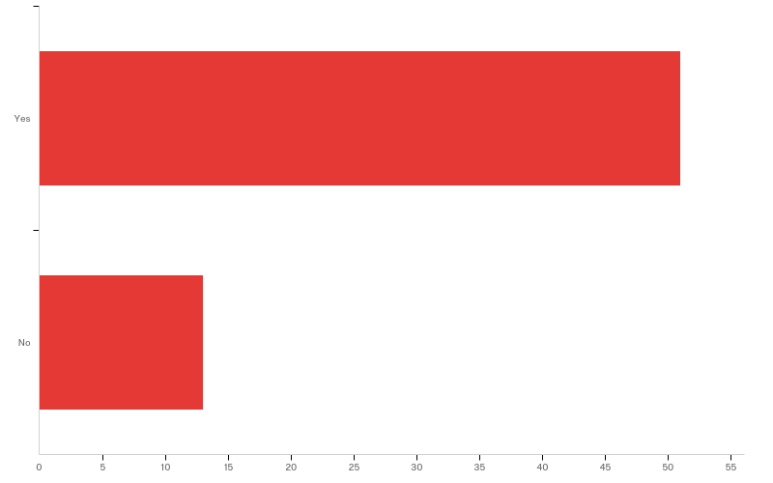
Q1 - Did you find learning object oriented programming principles with OpenGL games useful?

Slide 3
Q1 - Did you find learning object oriented programming principles with OpenGL games useful?
# | Answer | % | Count
1 | Yes | 79.69% | 51
2 | No | 20.31% | 13
 | Total | 100% | 64

Slide 4
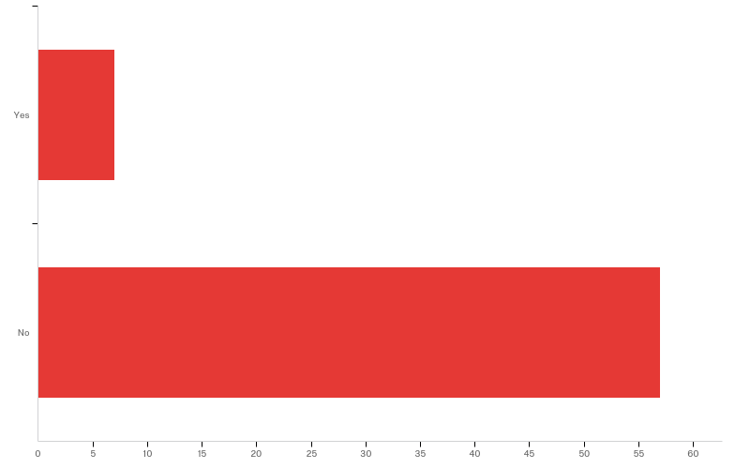
Q2 - Did you have problems working with OpenGL in your projects? If so, please explain where.

Slide 5
Q2 - Did you have problems working with OpenGL in your projects? If so, please explain where.
# | Answer | % | Count
1 | Yes | 10.94% | 7
2 | No | 89.06% | 57
 | Total | 100% | 64

Slide 6
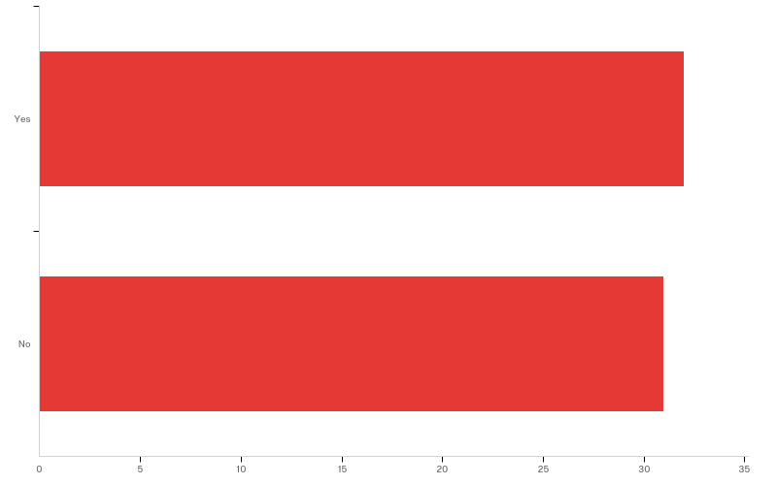
Q3 - Were you given sufficient resources to help you understand what OpenGL is and how to use it in the projects?

Slide 7
Q3 - Were you given sufficient resources to help you understand what OpenGL is and how to use it in the projects?
# | Answer | % | Count
1 | Yes | 50.79% | 32
2 | No | 49.21% | 31
 | Total | 100% | 63

Slide 8
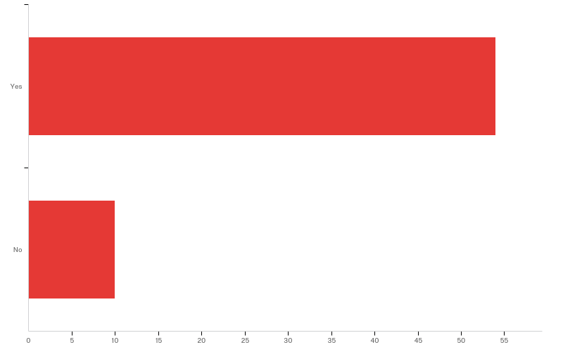
Q4 - Was it enjoyable to learn with OpenGL?

Slide 9
Q4 - Was it enjoyable to learn with OpenGL?
# | Answer | % | Count
1 | Yes | 84.38% | 54
2 | No | 15.63% | 10
 | Total | 100% | 64

Slide 10
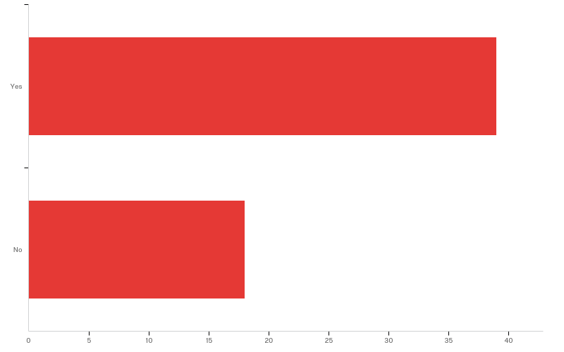
Q5 - Did you understand what dynamic allocation was before cs235?

Slide 11
Q5 - Did you understand what dynamic allocation was before cs235?
# | Answer | % | Count
1 | Yes | 68.42% | 39
2 | No | 31.58% | 18
 | Total | 100% | 57

Slide 12
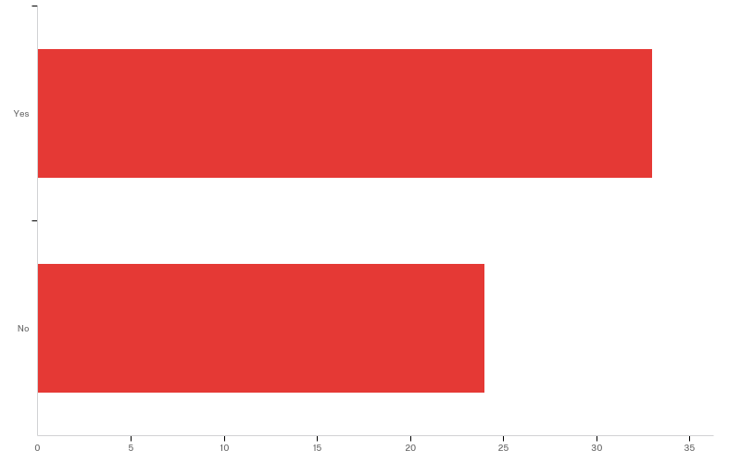
Q6 - Do you feel comfortable with debugging seg-faults?

Slide 13
Q6 - Do you feel comfortable with debugging seg-faults?
# | Answer | % | Count
1 | Yes | 57.89% | 33
2 | No | 42.11% | 24
 | Total | 100% | 57

Slide 14
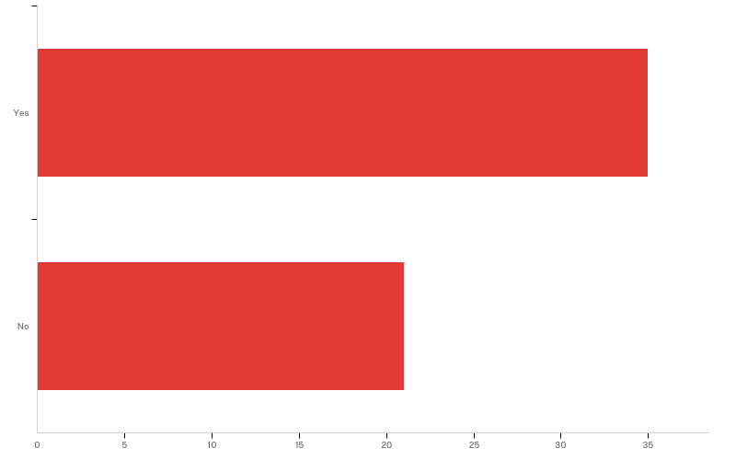
Q7 - Do you feel you were prepared enough in cs-165 to use pointers in cs-235

Slide 15
Q7 - Do you feel you were prepared enough in cs-165 to use pointers in cs-235
# | Answer | % | Count
1 | Yes | 62.50% | 35
2 | No | 37.50% | 21
 | Total | 100% | 56

Slide 16
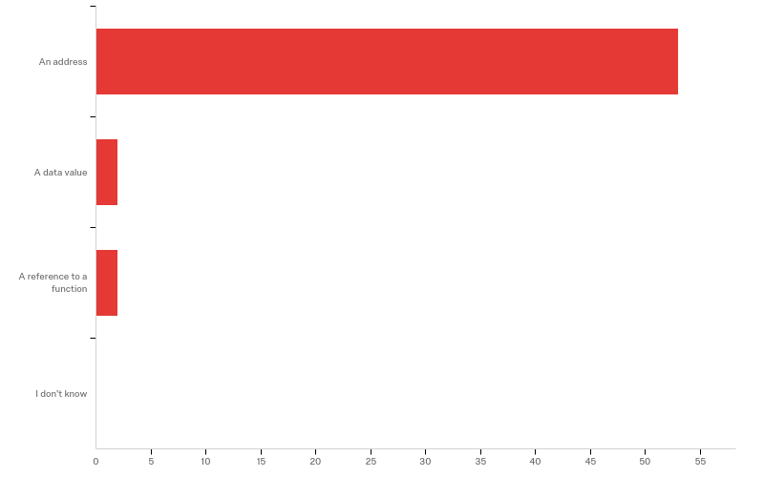
Q8 - What does a pointer hold?

Slide 17
Q8 - What does a pointer hold?
# | Answer | % | Count
1 | An address | 92.98% | 53
2 | A data value | 3.51% | 2
3 | A reference to a function | 3.51% | 2
4 | I don't know | 0.00% | 0
 | Total | 100% | 57

Slide 18
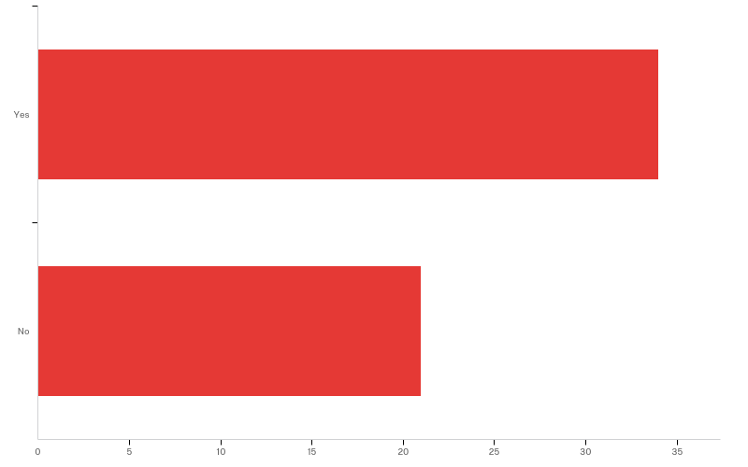
Q9 - Are you comfortable overloading an operator?

Slide 19
Q9 - Are you comfortable overloading an operator?
# | Answer | % | Count
1 | Yes | 61.82% | 34
2 | No | 38.18% | 21
 | Total | 100% | 55

Slide 20
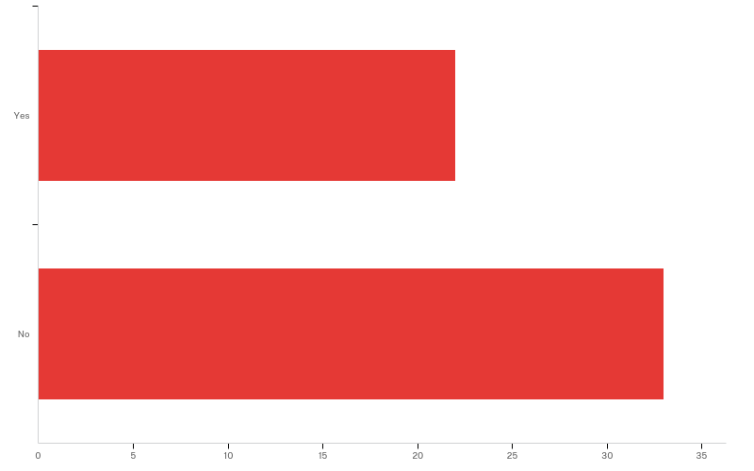
Q10 - Did you feel enough time was devoted to learning operator overloading?

Slide 21
Q10 - Did you feel enough time was devoted to learning operator overloading?
# | Answer | % | Count
1 | Yes | 40.00% | 22
2 | No | 60.00% | 33
 | Total | 100% | 55

Slide 22
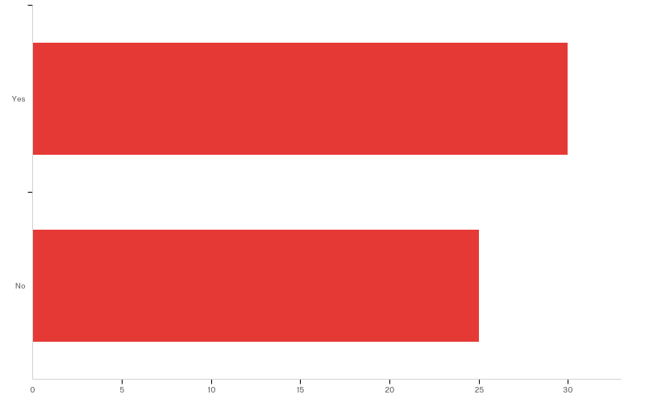
Q11 - Do you understand the difference between member and non-member operator overloading?

Slide 23
Q11 - Do you understand the difference between member and non-member operator overloading?
# | Answer | % | Count
1 | Yes | 54.55% | 30
2 | No | 45.45% | 25
 | Total | 100% | 55

Slide 24
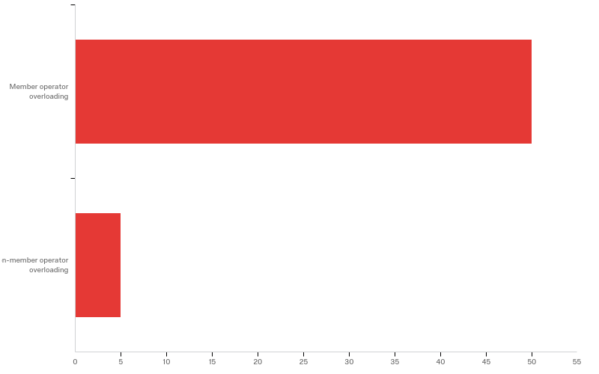
Q12 - When would you use the “this” keyword

Slide 25
Q12 - When would you use the “this” keyword
# | Answer | % | Count
1 | Member operator overloading | 90.91% | 50
2 | Non-member operator overloading | 9.09% | 5
 | Total | 100% | 55

Slide 26
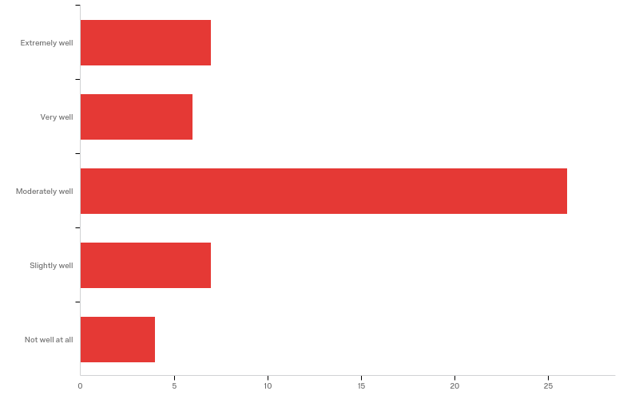
Q13 - Based off of what you learned in cs-165 how well do you understand templates?

Slide 27
Q13 - Based off of what you learned in cs-165 how well do you understand templates?
# | Answer | % | Count
1 | Extremely well | 14.00% | 7
2 | Very well | 12.00% | 6
3 | Moderately well | 52.00% | 26
4 | Slightly well | 14.00% | 7
5 | Not well at all | 8.00% | 4
 | Total | 100% | 50

Slide 28
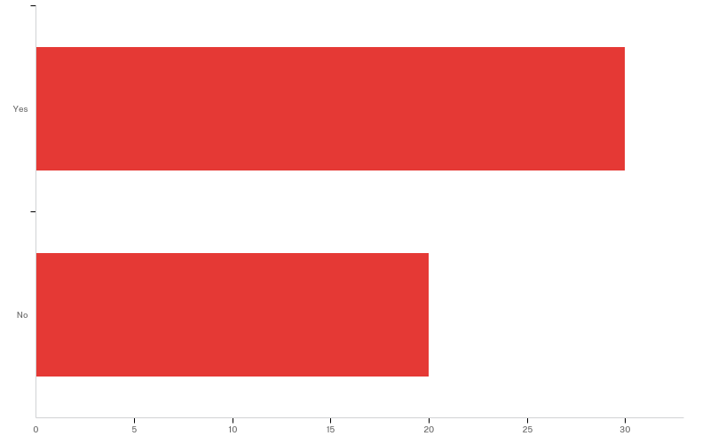
Q14 - Do you feel enough time was devoted to learning about templates in cs-165?

Slide 29
Q14 - Do you feel enough time was devoted to learning about templates in cs-165?
# | Answer | % | Count
1 | Yes | 60.00% | 30
2 | No | 40.00% | 20
 | Total | 100% | 50

Slide 30
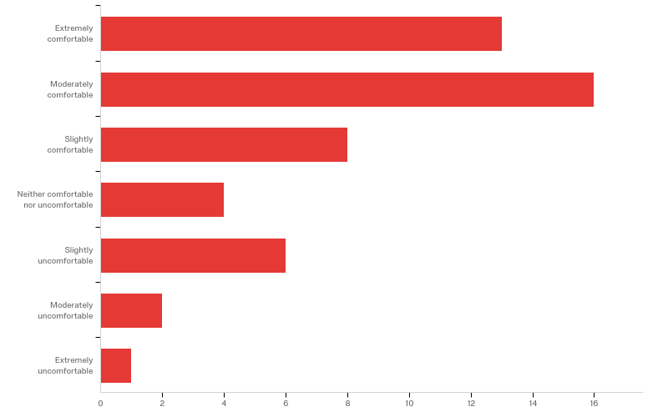
Q15 - Do you feel comfortable writing a template class?

Slide 31
Q15 - Do you feel comfortable writing a template class?
# | Answer | % | Count
1 | Extremely comfortable | 26.00% | 13
2 | Moderately comfortable | 32.00% | 16
3 | Slightly comfortable | 16.00% | 8
4 | Neither comfortable nor uncomfortable | 8.00% | 4
5 | Slightly uncomfortable | 12.00% | 6
6 | Moderately uncomfortable | 4.00% | 2
7 | Extremely uncomfortable | 2.00% | 1

Slide 32
Q15 - Do you feel comfortable writing a template class?
# | Answer | % | Count
 | Total | 100% | 50

Slide 33
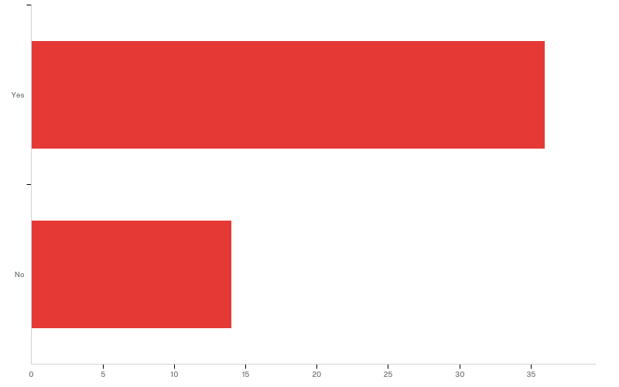
Q16 - Were you able to complete the template assignment in cs-165 without too much complication?

Slide 34
Q16 - Were you able to complete the template assignment in cs-165 without too much complication?
# | Answer | % | Count
1 | Yes | 72.00% | 36
2 | No | 28.00% | 14
 | Total | 100% | 50

Slide 35
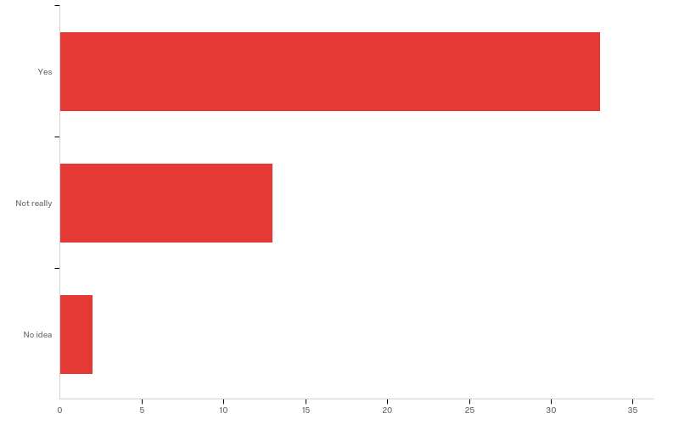
Q20 - Do you understand what polymorphism is?

Slide 36
Q20 - Do you understand what polymorphism is?
# | Answer | % | Count
1 | Yes | 68.75% | 33
2 | Not really | 27.08% | 13
3 | No idea | 4.17% | 2
 | Total | 100% | 48

Slide 37
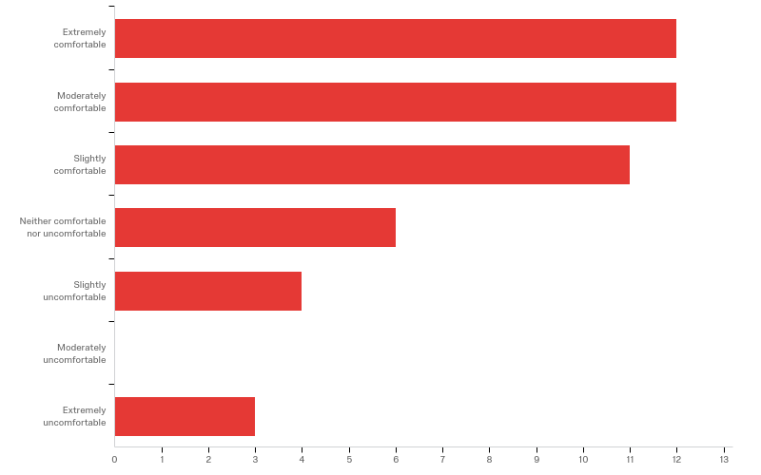
Q21 - Would you feel comfortable writing a basic program that involves polymorphic behavior?

Slide 38
Q21 - Would you feel comfortable writing a basic program that involves polymorphic behavior?
# | Answer | % | Count
1 | Extremely comfortable | 25.00% | 12
2 | Moderately comfortable | 25.00% | 12
3 | Slightly comfortable | 22.92% | 11
4 | Neither comfortable nor uncomfortable | 12.50% | 6
5 | Slightly uncomfortable | 8.33% | 4
6 | Moderately uncomfortable | 0.00% | 0
7 | Extremely uncomfortable | 6.25% | 3

Slide 39
Q21 - Would you feel comfortable writing a basic program that involves polymorphic behavior?
# | Answer | % | Count
 | Total | 100% | 48

Slide 40
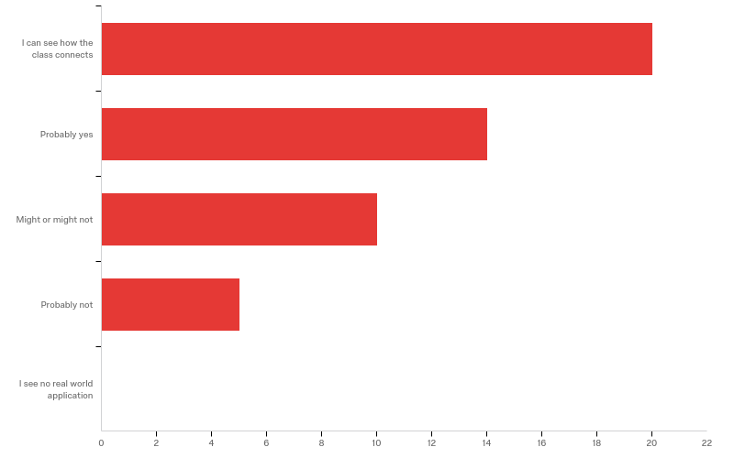
Q17 - Do you feel like the course created a bridge between the classroom and the real world?

Slide 41
Q17 - Do you feel like the course created a bridge between the classroom and the real world?
# | Answer | % | Count
1 | I can see how the class connects | 40.82% | 20
2 | Probably yes | 28.57% | 14
3 | Might or might not | 20.41% | 10
4 | Probably not | 10.20% | 5
5 | I see no real world application | 0.00% | 0
 | Total | 100% | 49

Slide 42
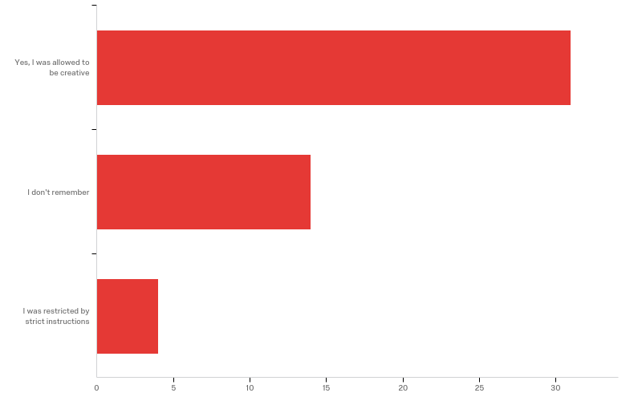
Q18 - Were you allowed to find a creative solution to a problem, or were you restricted in the way that you could solve the assignment?

Slide 43
Q18 - Were you allowed to find a creative solution to a problem, or were you restricted in the way that you could solve the assignment?
# | Answer | % | Count
1 | Yes, I was allowed to be creative | 63.27% | 31
2 | I don't remember | 28.57% | 14
3 | I was restricted by strict instructions | 8.16% | 4
 | Total | 100% | 49

Slide 44
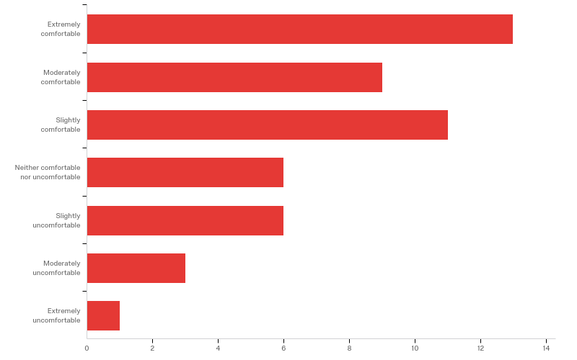
Q19 - Would you feel comfortable answering questions in a technical interview?

Slide 45
Q19 - Would you feel comfortable answering questions in a technical interview?
# | Answer | % | Count
1 | Extremely comfortable | 26.53% | 13
2 | Moderately comfortable | 18.37% | 9
3 | Slightly comfortable | 22.45% | 11
4 | Neither comfortable nor uncomfortable | 12.24% | 6
5 | Slightly uncomfortable | 12.24% | 6
6 | Moderately uncomfortable | 6.12% | 3
7 | Extremely uncomfortable | 2.04% | 1

Slide 46
Q19 - Would you feel comfortable answering questions in a technical interview?
# | Answer | % | Count
 | Total | 100% | 49

