Slide 1
Customer segmentation of Olist e-commerce

Slide 2
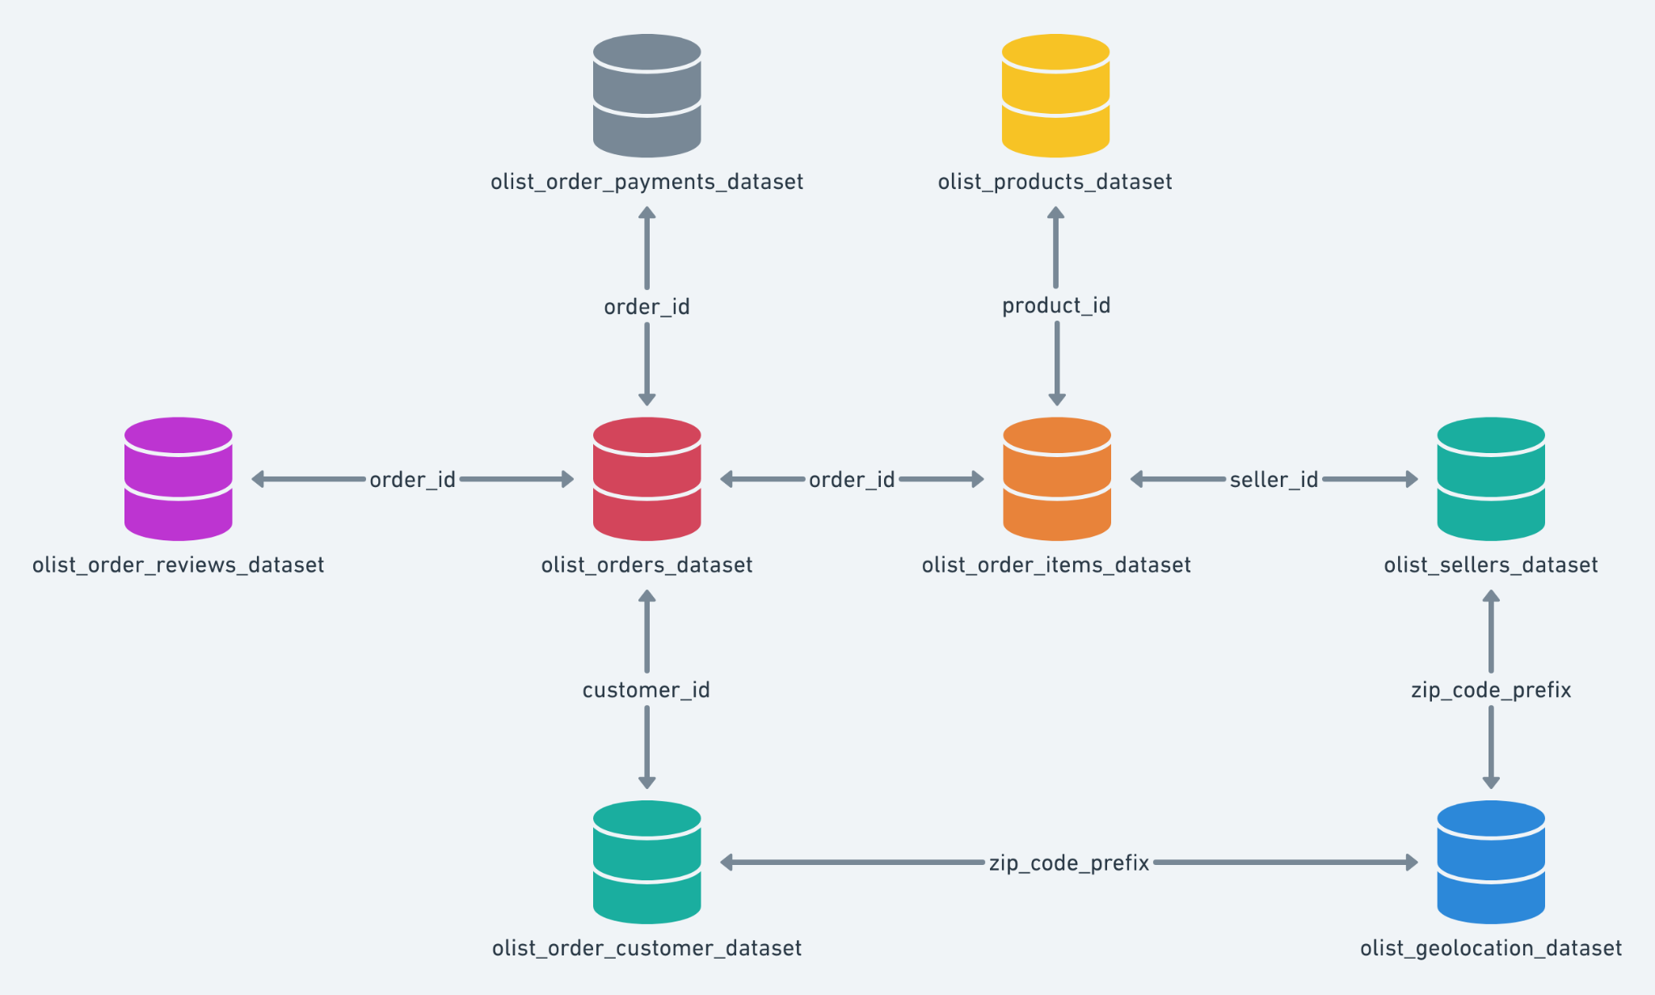
Olist data set

Slide 3
Data used for segmentation
We did a customer segmentation using the following data:
customer city and state
freight value
value (of the buy)
product category
payment type
instalment number
payment sequential (number of payment methods)

Slide 4
Segmentation results
Two groups of costumes were found
We called them group 0 and group 1

Slide 5
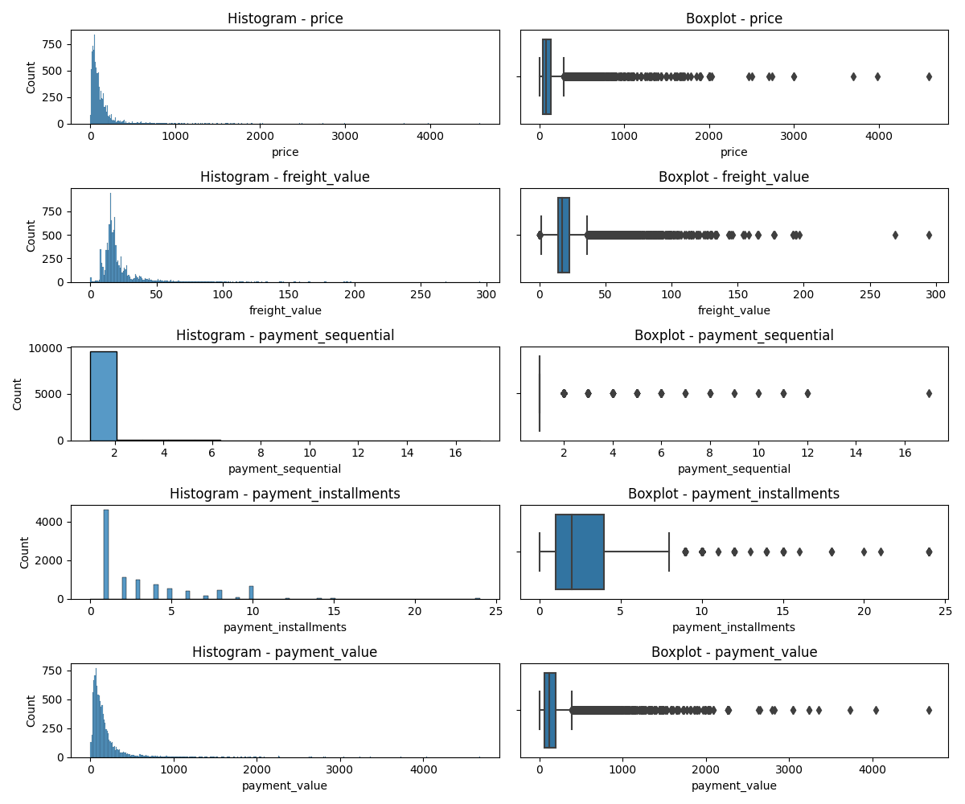
Analysis of group 0

Slide 6
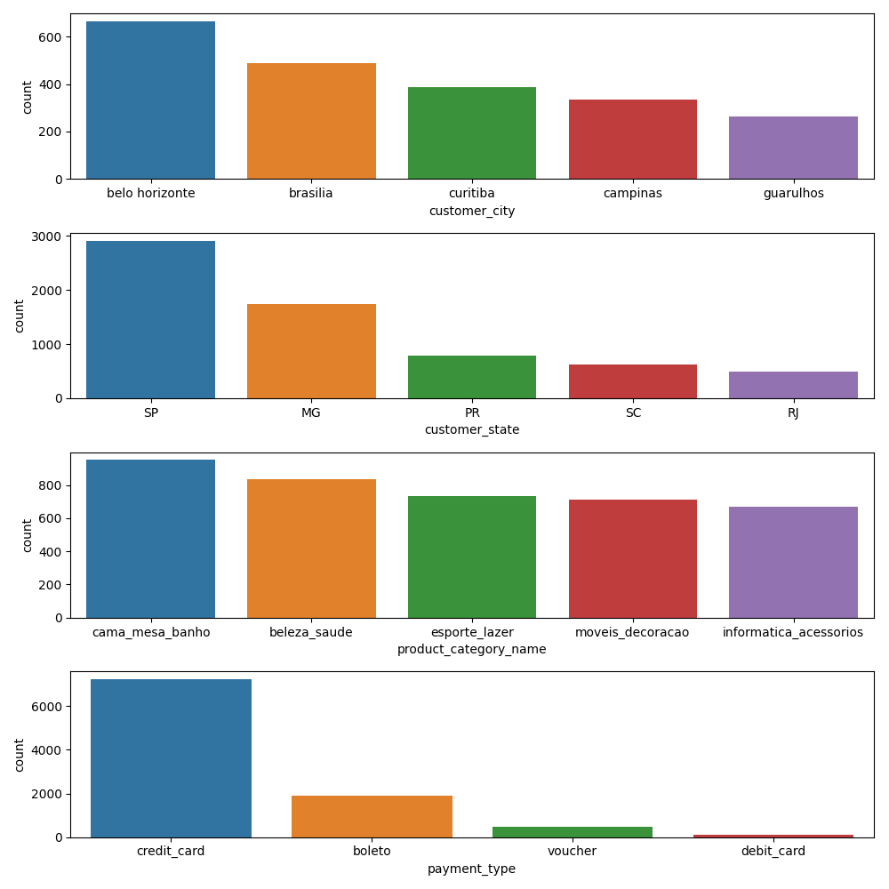
Analysis of group 0

Slide 7
Analysis of group 0
price and freight values show that most of the buys have low values
most of customers use only one method of payment
found records for payment installments raging from 2 to 6 (possibly due to tax free)
credit card is the preferred way of payment
preferred product categories (in decreasing order) are bed & bath & table, health & beauty, sport, furniture & decor and informatics.

Slide 8
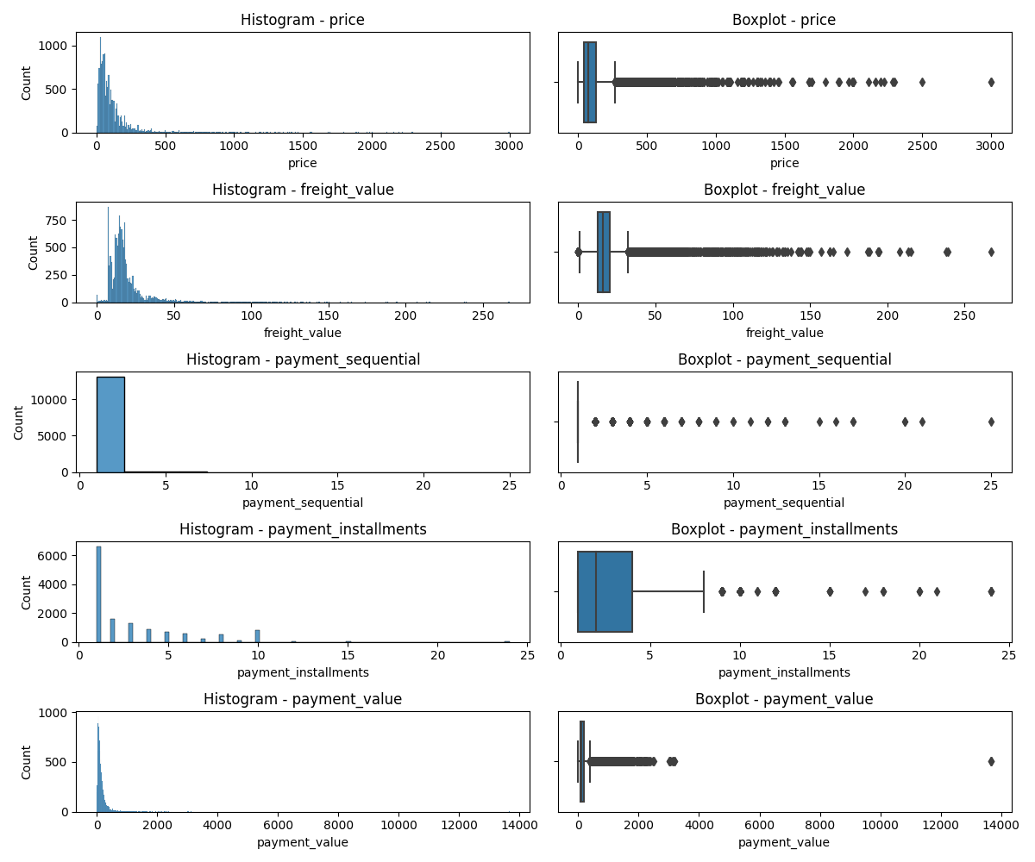
Analysis of group 1

Slide 9
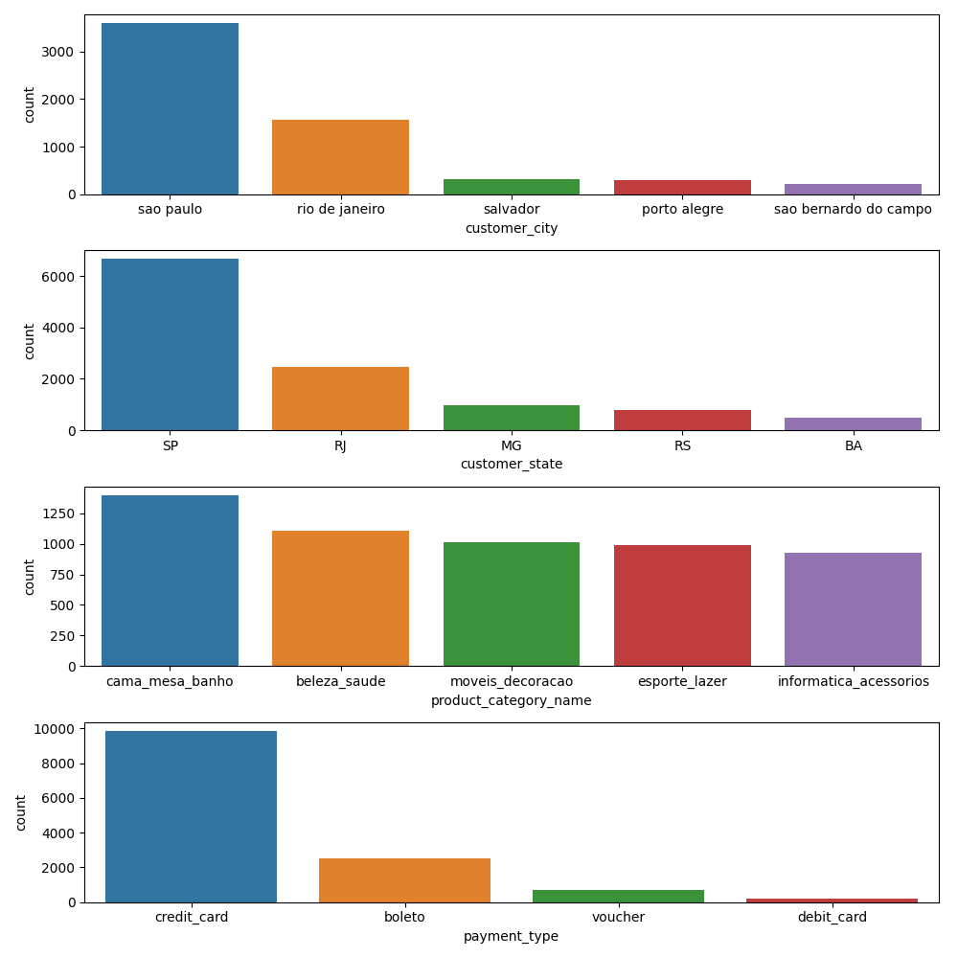
Analysis of group 1

Slide 10
Analysis of group 1
price and freight values show a similar behavior of group 0 (small buys), however the values are smaller
customers usually buy using two method of payment (different from group 0)
installment payment, product category and payment type show are quite similar to group 0
most of customers in group 1 are located at the cities São Paulo, Rio de Janeiro and Porto Alegre, whereas in group 0, they are at Belo Horizonte, Brasília and Campinas

Slide 11
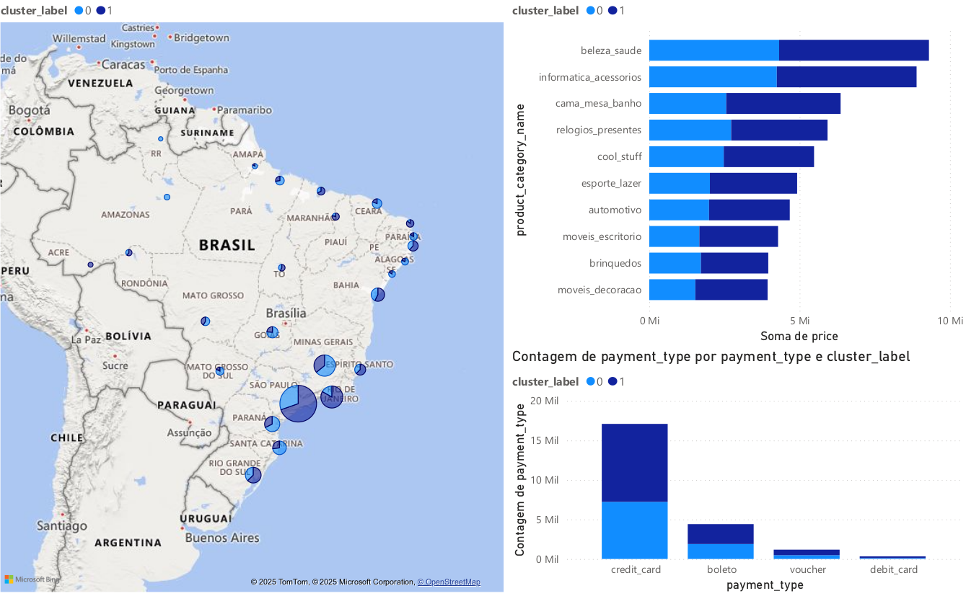
Comparison of group 0 and 1

Slide 12
Conclusion
customers could be split (not necessarily even) into two groups.
they are alike in payment type, product category, price, freight value and payment installments.
most of customers use credit card and buy items with small value
preferred categories are: bed & bath & table, health & beauty, sport, furniture & decor and informatics
the groups of customers differ location and payment sequential

