Slide 1
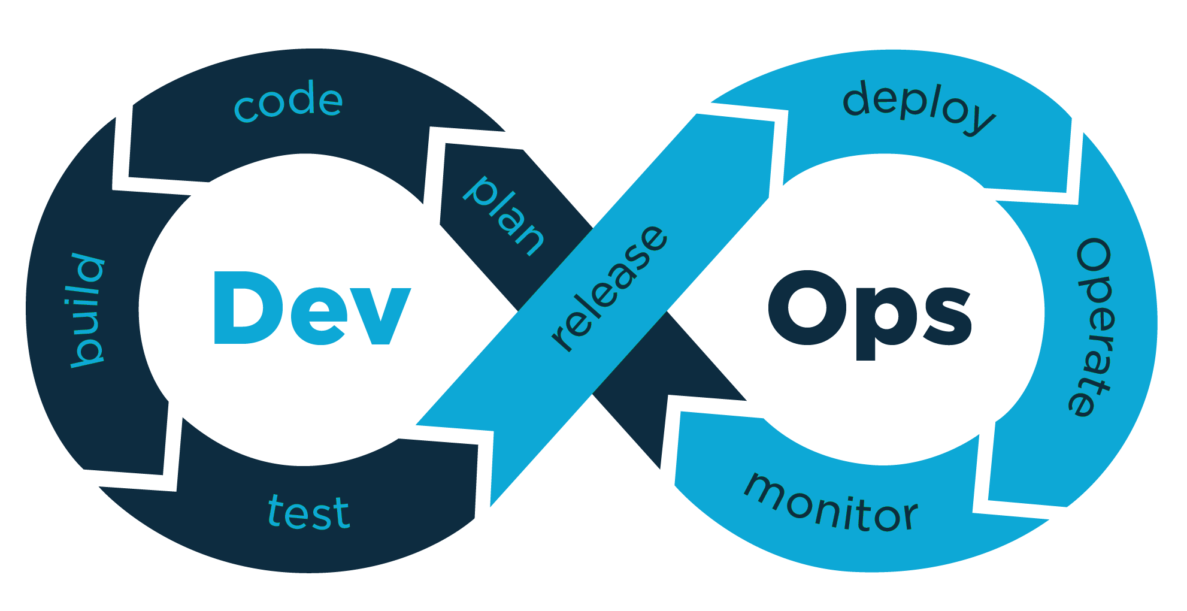

DevOps in GRM&GLO
Technical pills
Sharing experience from MyCredit onboarding journey
Webinar
Unicredit Services
Milan, Iasi - October 2nd 2020

Slide 2
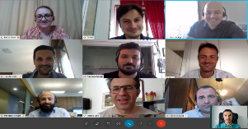
Introducing the team
Today’s speakers
Team
Guido Riva
Credit Origination ICT – E2E Initiatives
Roberto Venturetti
GRM&GLO Technologies
Raluca State
Credit Origination ICT - UW Italy SME&Corporate
Nistor Buliga
Credit Origination ICT - UW Austria

Slide 3

Agenda
1
Introduction to DevOps and On boarding Project
2
GIT, pipeline and build automation
3
Test Automation principles and Unit Testing
4
OWASP and vulnerabilities resolution
5
Deploy, database automation and Service virtualisation
6
Integration and E2E Testing
7
Next steps
8
Q&A

Slide 4
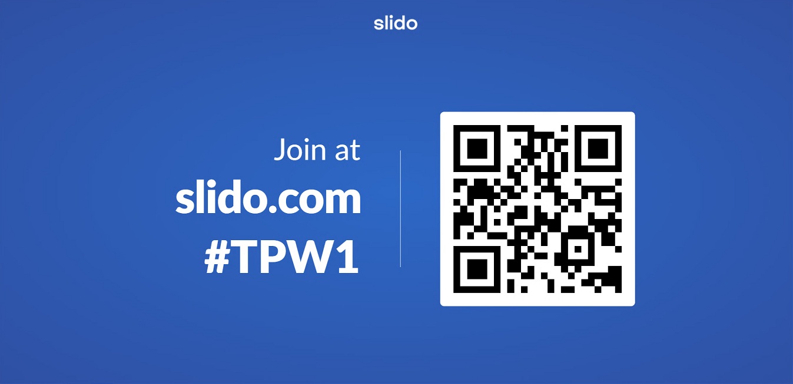
Q&A Session on slido.com

Slide 5


Introduction to DevOps concepts and philosophy
What is DevOps
DevOps is a combination of cultural philosophies, practices and tools to increase an organization’s productivity and increase software quality, robustness and security. DevOps is an extension of agile and its values
DevOps in UCS
In UCS DevOps has started taking the current operating model at the end on 2019 as an additional piece of a global view that see convergence with Agile permanent rooms, the focus shifting from project to products, and OpenShift container infrastructure for which Automation is mandatory.
The Agile onboarding project started in April 2020 by Global ICT Architecture has three main pillars:
Enhance quality, starting for example from the resolution of high and critical Sonar issues
Enhance security, by upgrading known vulnerable libraries highlighted during OWASP checks
Introduction of automation and CI/CD pipelines with a particular focus on test automation that requires the development of:
Unit testing for the new code
Integration testing of services exposed by the application
E2E Selenium tests that simulate user interaction with the FE of the application

Slide 6
DevOps – Onboarding options and constraints
Already running application
Paid by DevOps BC, savings to be guaranteed by application
Starting from Q1 2020, according to the onboarding plan
Java, Maven, API enabled Deploy target
New application using current UCS standards tech stack
Paid by the application
Starting from 2020, tools will be rolled-out month by month
Git, Java, Maven, Gandalf Deploy
New application using to be UCS standards
Paid by the application
TBD, direct agreement with DevOps team
OK from Architecture on the tech stack
Brown Field
Self Onboarded
TOBE DevOps
Definition
Budget
Timeline
Tech Constraints

Slide 7

MyCredit 2020 road map for brown field DevOps onboardings
DevOps Onboarding
DevOps adoption on Credit Origination ICT assets
At the beginning of May 2020 UB5 “Easy Loan” onboarding started alongside the setup of the environments for automation testing and the design of the pipelines and framewoks
We’re currently in the 3rd sprint of the onboarding of the second application UB4 MyCredit Small Business
Next we’ll onboard UB1, the common part of MyCredit, from beginning of November
May ‘20
DevOps env. Setup
UB5 onboarding start
July ‘20
UB4 onboarding start
Today
November ‘20
UB1 onboarding start

Slide 8





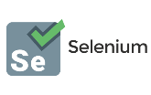











We’ll use our pipeline to guide the presentation
Continuous Integration
Continuous Delivery
Plan
Code
Build
Unit Tests
Artifact publish
Deploy
Integration Tests
Code Coverage and Vulerabilities
E2E Tests
Deploy and Release
DEPLOY
DEPLOY

Slide 9
Agile methodology: 4 sprints for the on boarding
PHASE &
TIMING
APPLICATION ON BOARDING
Goal Definition
Sprint 1
Sprint 2
Sprint 3
Sprint 4
1 Week
3 Weeks
3 Weeks
3 MONTHS
3 Weeks
3 Weeks
DEVOPS
TEAM
Appoint devops onboarding leader in devops_team
Sizing of the application
Branching strategy configuration
Pipeline design
DevOps tools provisioning & configurations
Pipeline implementation CI part
DevOps framework and services integration CI part
Pipeline implementation CD part
Framework integrations CD part
Integration and e2e tests coverage targets verification
Define timeline and goals for each sprint
Definition of integration and e2e tests coverage targets
SVN to GIT Migration and branching strategy def.
Testbook design
Testing frameworks and service virtualization* setup
Environments setup *
Feature Flag approach *
Resolution of blockers, critical bugs and vulnerabilities
Unit Test quality gate activation for new code
Integration test cov. 20%
Selenium coverage 20%
CD pipeline setup
Integration test cov. 40%
Selenium coverage 40%
DB script automation *
Integration test cov. 60%
Selenium test cov. 60%
APPLICAYION
TEAM
SYNCHRONIZE WITH CIO CUSTOMER PROJECT MILESTONES
INVOLVE CUSTOMER FOR E2E TEST
* MyCredit specific additional goals

Slide 10

Plan the development within the Team
Continuous Integration
Continuous Delivery
Plan
Code
Build
Unit Tests
Artifact publish
Deploy
Integration Tests
Code Coverage and Vulerabilities
E2E Tests
Deploy and Release
DEPLOY
DEPLOY

Slide 11
Team working and Collaboration
Mattermost is an open-source, on premise chat service alternative to Slack and Microsoft Teams that offers IRC-style features like persistent chat rooms organized by topic, private groups, direct messaging, file sharing, search, and integrations (e.g. to receive notifications on pipeline status from our Jenkins)
Jira is an already well established work management tool in UniCredit especially in agile software development projects.
DevOps initiative introduced an useful integration between Jira and BitBucket that allows:
Create a branch from a Jira issue or link a commit, branch or pull request.
Edit Jira issues from BitBucket to contextualize our work and update the team without switching applications
https://onboarding.devops.internal.unicreditgroup.eu/jira-integration/

Slide 12
Version our developments with GIT
Continuous Integration
Continuous Delivery
Plan
Code
Build
Unit Tests
Artifact publish
Deploy
Integration Tests
Code Coverage and Vulerabilities
E2E Tests
Deploy and Release
DEPLOY
DEPLOY

Slide 13
BitBucket – GIT version control and migration from SVN
Distributed version control system features:
Every working copy contains the whole history and set of branches/tags got from central server at last update
Developer can branch/tag and go forward/backward in history directly on the local copy
Every working copy is a de-facto backup of the central server
Good for remote working, no need to be always connected to server
GIT
SVN
git clone <repo_url>
git add filename.txt
git commit –m "added file"
…editing file..
git commit –m "file modified"
git push origin/master
svn co <repo_url>
svn add filename.txt
svn commit –m "added file"
…editing file…
svn commit –m "file modified"
On DEV
local copy
RED commands actually put the version on central server.
Migration approach from SVN to BitBucket
If you are not interested in historical data: checkout, git init, git set-remote, git add, git commit, git push.
Otherwise to maintain history for a branch is required some extra work described in our internal documentation
https://onboarding.devops.internal.unicreditgroup.eu/svn-to-git/

Slide 14
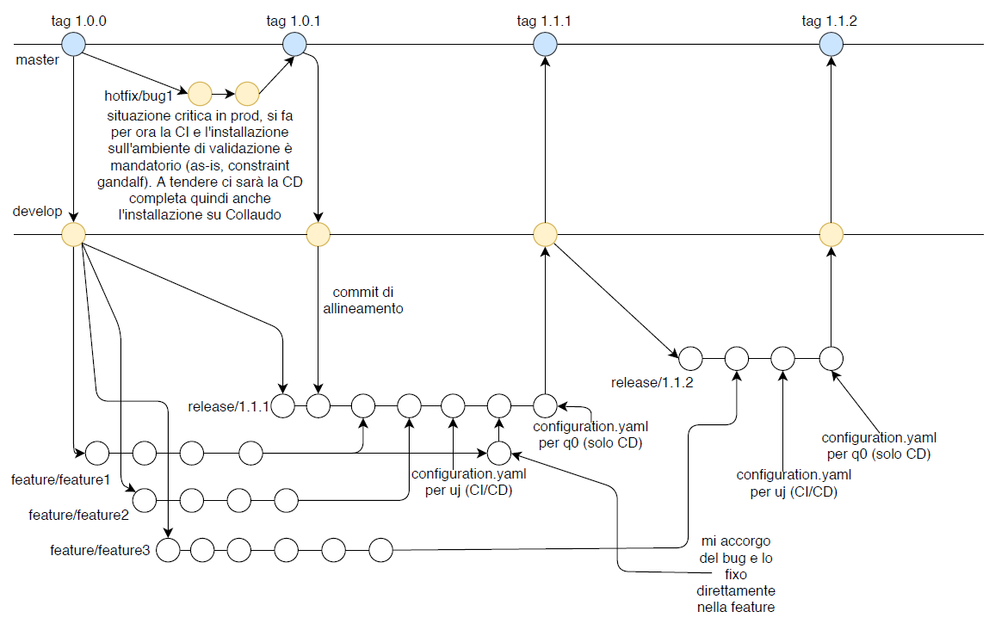


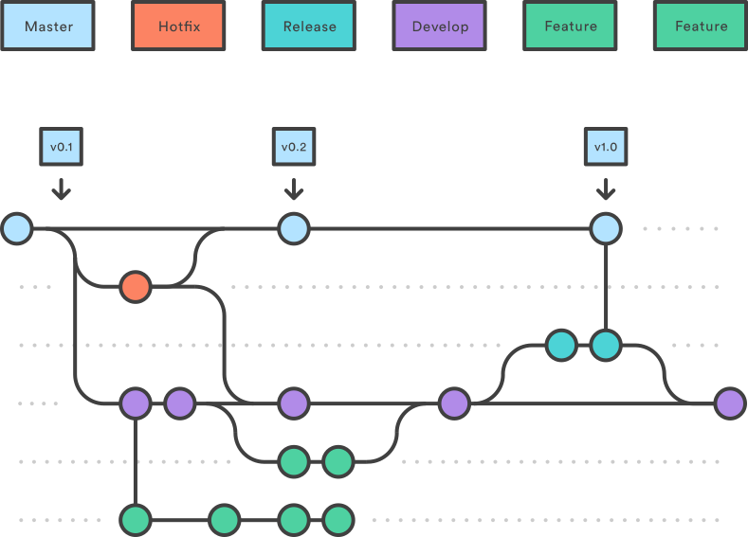
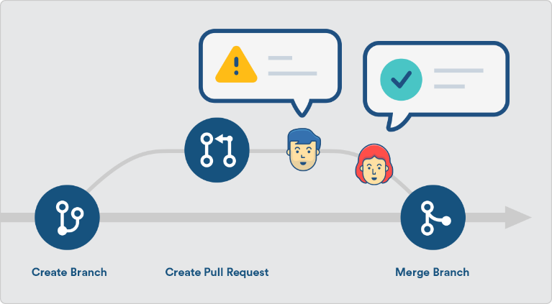
BitBucket – Branching strategies
GIT-Flow Workflow
Pull Request
The Gitflow Workflow defines a strict branching model designed around the project release. This provides a robust framework for managing larger projects
Pull Request adds an additional security layer to the flow
The developer works on his local copy, then emits a "pull request"
Another developer, tipically senior or expert, validates and approves the changes on bitbucket
Role based: only allowed developers can push or merge on the official branches
GIT-FLOW Sample
https://www.atlassian.com/git/tutorials/comparing-workflows
https://www.atlassian.com/git/tutorials/making-a-pull-request

Slide 15
Start the automated CI/CD pipeline with Jenkins
Continuous Integration
Continuous Delivery
Plan
Code
Build
Unit Tests
Artifact publish
Deploy
Integration Tests
Code Coverage and Vulerabilities
E2E Tests
Deploy and Release
DEPLOY
DEPLOY

Slide 16


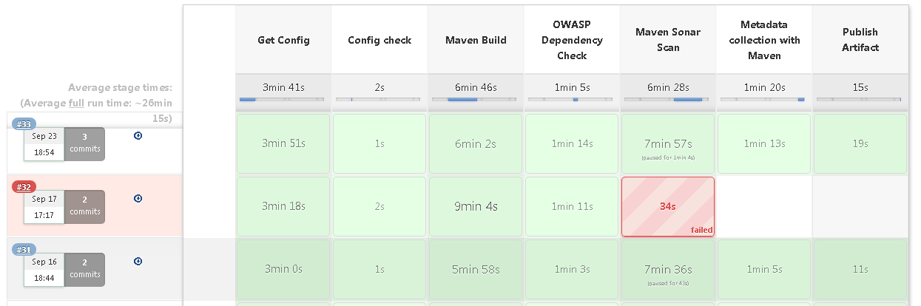
Automation pipelines with Jenkins
The automation pipeline main goal is to reduce the time to get feedback on changes. At every commit you get in a matter of minutes the entire set of build, test, scan and deploy. Introduced 4 pipeline families triggered basing on the GIT branch and repo:
CI only, or CI/CD
for Java BackEnd or for Angular FrontEnd
Fail fast
Fail Often
Push Atomic Things

Slide 17
Build our code for both backend and frontend
Continuous Integration
Continuous Delivery
Plan
Code
Build
Unit Tests
Artifact publish
Deploy
Integration Tests
Code Coverage and Vulerabilities
E2E Tests
Deploy and Release
DEPLOY
DEPLOY

Slide 18

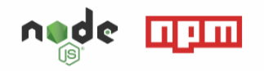
A first step in the CI pipelines: the Build phase
Back-end Java
The well known build tool for Java, extended in our pipelines with some plug-ins like OWASP, SoapUI, SeleniumBox
Front-end Angular
During the onboarding we introduced a centralized build for AngularJS and Agular which previously was performed locally on the DWPs

Slide 19
First automated test level: Unit tests
Continuous Integration
Continuous Delivery
Plan
Code
Build
Unit Tests
Artifact publish
Deploy
Integration Tests
Code Coverage and Vulerabilities
E2E Tests
Deploy and Release
DEPLOY
DEPLOY

Slide 20
Test automation principles
Test automation is the practice of running tests automatically, managing test data, and utilizing results to improve software quality. It’s primarily a quality assurance measure, but its activities involve the commitment of the entire software production team
Benefits
Fast
Reliable
Reusable
Improves Accuracy
Saves time and money
Reduces Human generated error
Support the execution of repeated test cased

Slide 21
Test Automation Pyramid
Manual Session Based Tested
Cost
Confidence
E2E
TEST
INTEGRATION
TEST
UNIT TEST
Speed

Slide 22

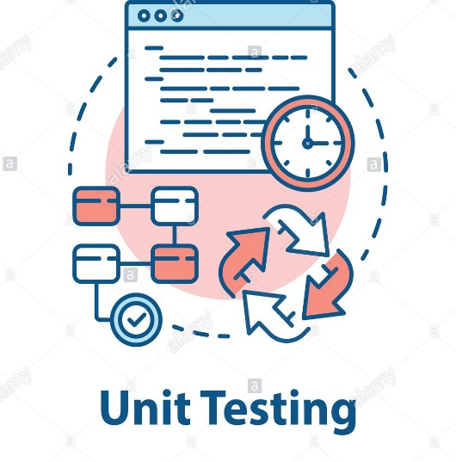


Unit testing
Tools
Unit Testing
Type of software testing where individual units or components of a software are tested
The purpose is to validate that each unit of the software code performs as expected
Unit Testing is done during the development (coding phase) of an application by the developers
Back End
JUnit5,
Powermock,
Mockito
Front End
Karma

Slide 23
Sonar Quality Gate for code coverage and vulnerabilities scan
Continuous Integration
Continuous Delivery
Plan
Code
Build
Unit Tests
Artifact publish
Deploy
Integration Tests
Code Coverage and Vulerabilities
E2E Tests
Deploy and Release
DEPLOY
DEPLOY

Slide 24

Libraries vulnerability assessment with OWASP
The Open Web Application Security Project is an online community that produces freely-available articles, methodologies, documentation, tools, and technologies in the field of web application security
Using Components with Known Vulnerabilities.
Components, such as libraries, frameworks, and other software modules, run with the same privileges as the application. If a vulnerable component is exploited, such an attack can facilitate serious data loss or server takeover. Applications and APIs using components with known vulnerabilities may undermine application defenses and enable various attacks and impacts.
From OWASP Top 10 - 2017
OWASP Maven Plugin:
Checks libraries in dependency tree against known vulnerabilities repositories and generate a report with the security level or the package
Already integrated in UniCredit DevOps pipeline
Can be also launched manually by the developer to check/fix before the commit
https://owasp.org/www-project-top-ten/

Slide 25
Getting rid of OWASP vulnerabilities – XFrame example
The first iteration with XFRAME 2.1.2 revealed a lot of vulnerable libraries (including a 2013 version of spring-context)
The "migration path" was:
Switch to XFRAME 2.1.4 (most update one at the moment of migration)
Some libraries were still too insecure; in particular:
Spring -> moved to 4.3.27.RELEASE
Jackson
forced version to 2.11.1
excluded the original XFrame version in pom.xml
Some libraries: the whole apache-cxf tree inherited from XFrame, were "whitelisted" because it was not possible to jump to a new release without an effort too huge for our time constraints, including a JDK version jump
Main approaches (from best to worst):
If the library/module is not used at all (it happened), remove it by manually excluding in the pom.xml
Search for a more recent/less bugged version of the library still compatible with your source code (or with a trivial migration path) and force it's use through pom.xml
Fallback (not so good idea):
"Take the risk": whitelist the library in a "depencency-check-suppressions.xml" file in your codebase; the libraries listed there will be ignored in dependency check

Slide 26
Deploy of the code, Database versioning and Service Virtualization
Continuous Integration
Continuous Delivery
Plan
Code
Build
Unit Tests
Artifact publish
Deploy
Integration Tests
Code Coverage and Vulerabilities
E2E Tests
Deploy and Release
DEPLOY
DEPLOY

Slide 27




Database Automation - Versions and Migrations in CI/CD
What
Automatic migrations from pipeline
Recreate DB from scratch
Clear database state -> Versions
Deterministic migration from A to B
Why
What is the state of the DB?
Has this script been applied?
How do we setup a new DB schema?
How – Mandatory Features
Transaction behaviour per Script
SQL based migrations (integrate exiting processes), Java based migrations
Versioning – history table, Script Ordering
Parametrization(cleanup=off)
Dry runs, Batching
Oracle 11.1 support, Undo/Rollback*
Pipeline support, Command line support
How – Nice to have Features
Maven Plugin
Placeholders (${field})
Convention over Configuration(Flyway)
Repeatable Migration(PLSQL packages)
Call backs and hooks

Slide 28
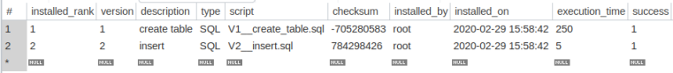
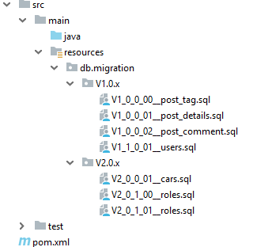
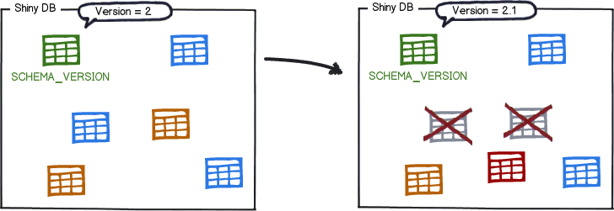
Database Automation – technical details

Slide 29



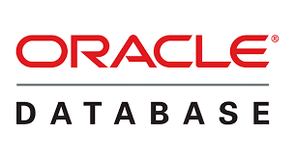
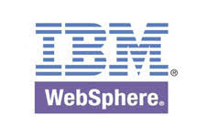
MyCredits Architecture – Complexity
AFA
ANW
MyCredit – Italian Credit Underwriting Platform
External partner networks
2x WebSphere 8.5 Clusters
SOA architecture tightly coupled with an high number of legacies
Several UB* Verticals web app applications with functional specialization (Loans, Credit Cards, Morgages, etc. ):
UB4 SME multi-product
UB5 Easy Loan – pre sales tool
UMF and UB1 are common Java components
Front-end: Angular JS and Angular 4+
Back-end: XFrame 2.1 and 2.2 , Java 6,7 and 8
Modern Batch
UB1-Ser Layer
2x
UB4-FE
UB5-FE
Afrodite
MyCredit Context
CRD
FM1 (FIN)
…
…
GMO
GWC
3x
UB1-BE
2x
UB4-BE
UB5-BE
CTC farm
PGE
PRE
XPI
XPW
7x UMF-BE
Experlan
PGA
FM0
XP0
BIN
CERVED Blos
UWM
UWC
TIBCO Middleware
TIBCO ESB
TIBCO BPM
TIBCO RE
TIBCO EMS
Clienti Condiv
GECA
 | DAO | REST | WS CLIENT | WS SERVER
UB5 | 232 | 103 | 39 | 15
UB4 | 1139 | 646 | 558 | 81
UB1 | 1022 | 275 | 429 | 255
Total | 2393 | 1024 | 1026 | 351
FSD
CTB
Channels
CS0
TMP
GP
~15 Oracle Schemas
SBA
UBZ
Oracle
Oracle
Oracle
Oracle
Oracle
Oracle
Oracle
BOE
OS0
GIMB
ATD WEB
CERI
Buddy Bank
CEBI
CLC
Glanos
4BE

Slide 30



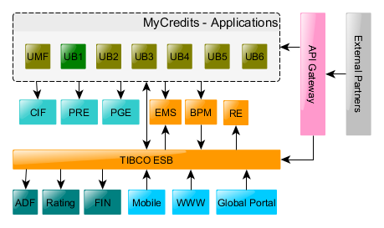
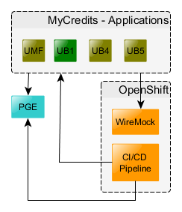
New DevOps Environments – from Complexity to Isolation and Test Suite Portability
DevOps Environments
Isolation Solutions
Actual Test/UAT/Prod
DevOps Test/UAT
DevOps Environments [UJ/Q0] – 4 WAS clusters, 2 Oracle DBS, 15 schemas per instance, and Pipeline
Activities: New Clusters, OPAT IDs, CyberArk, Data Sources, Deploy target, Publish Apps, Technical Users, Test Apps.
Oracle: New Oracle instances
Isolation solutions
New application parametrization;
Service Virtualization for IT/E2E
Simulate external calls in pipeline via HTTP Clients in Tests;
Configuration Parametrization of UT/IT/E2E Test Suites, according to environment;

Slide 31
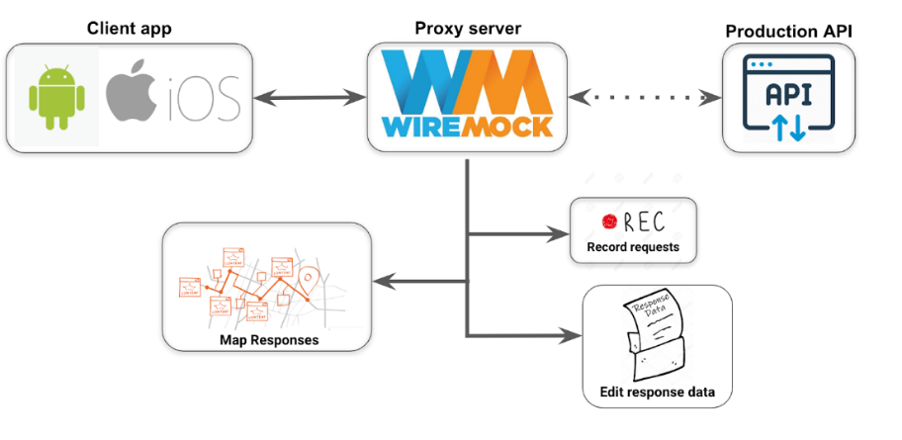


Service Virtualization with Wiremock
Features
Test Stability and portability
Standalone and Programmatic Server and stubs
SOAP/REST/Junit, Verify utils
Stateful behaviour - Scenarios
Stubs in Tests
Admin REST API (tracks near-misses)
Extensibility – extend server functionality
HTTPS, Maven Plugin, Etc.
Legacy
MyCredit
Limitations
Recording - one server per Host
10 hosts -> 10 recording WireMock JVMs
Recorded Reponses are static
Use Templates and publish stubs programmatically.
http://wiremock.org/docs/record-playback/
https://youtu.be/x3MvZ8DFrpE

Slide 32
Service Virtualization - recording with WireMock
Record:
java -jar wiremock-standalone-2.26.3.jar
--proxy-all="https://ufr-qq.validazione.usinet.it" --record-mappings
Playback:
java -jar wiremock-standalone-2.26.3.jar
Service endpoint
http://localhost:8080/XA-PRE-WS/services/PreTelAndMail
Output structure
| wiremock-standalone-2.26.3.jar
+---mappings
| mapping-XA-PRE-WS-services-PreTelAndMail-AujaZ.json
\---__files
body-XA-PRE-WS-services-PreTelAndMail-AujaZ.xml
Matchers
Must become environment agnostic and business oriented.
(For SOAP according to operation, service name, payload business context)

Slide 33
Service Virtualization – for Developers
//Recorded mappings and matchers
//mappings/mapping-XA-PRE-WS-services-PreTelAndMail-AujaZ.json
{ "id" : “",
"request" : {
"url" : "/XA-PRE-WS/services/PreTelAndMail",
"method" : "POST“,
"bodyPatterns" :
[ {
"equalToXml" : "<soapenv:Envelope xmlns:soapenv=\“..” xmlns:bean=\“... </soapenv:Envelope>"
}] }, ]
},
”response" : {
"status" : 200,
"bodyFileName" :
"body-XA-PRE-WS-services-PreTelAndMail-AujaZ.xml",
"headers" : {“”} },
“uuid”: “…” }
//Configure stub on remote server:
WireMock wm =
new WireMock("https", “wiremock.intranet.it", 8001);
//Configure Matchers programmatically:
stubFor(
// request matcher
post(urlEqualTo(“countries”))
.withRequestBody(
matchingXPath("//request/country/text()", containing(“Italy”))) .withRequestBody(
matchingXPath("//request/country/text()", containing(“Spain”)))
//response
.willReturn( aResponse()
.withStatus(200)
.withHeader("content-type","text/xml") . .withBodyFile("CountrySuccessResponse.xml")
));

Slide 34

Service Virtualization - Our Approach
Isolation and Portability
We are designing an Environment agnostic test suite
Tests must run on UJ, Q0 and in DWP.
For all endpoints. Single script for each environments
Easy to redirect to the Virtualization Service.
With Recorded Stubs for existing application with large number of integrations. WM Server address must be fixed: is not possible with programmatic WM Server started in pipeline.
Mappings are published for on playback server just before tests execution. The same approach for database state Scripts.
Simulated with HTTP Clients, triggered from the test pipeline on the right moment in the flow. Eg: BPM orchestration calls to application services.
Centralized parameters
Standalone WM Server
State management for test env
External service calls

Slide 35
Automated tests: Integration and End-2-End
Continuous Integration
Continuous Delivery
Plan
Code
Build
Unit Tests
Artifact publish
Deploy
Integration Tests
Code Coverage and Vulerabilities
E2E Tests
Deploy and Release
DEPLOY
DEPLOY

Slide 36
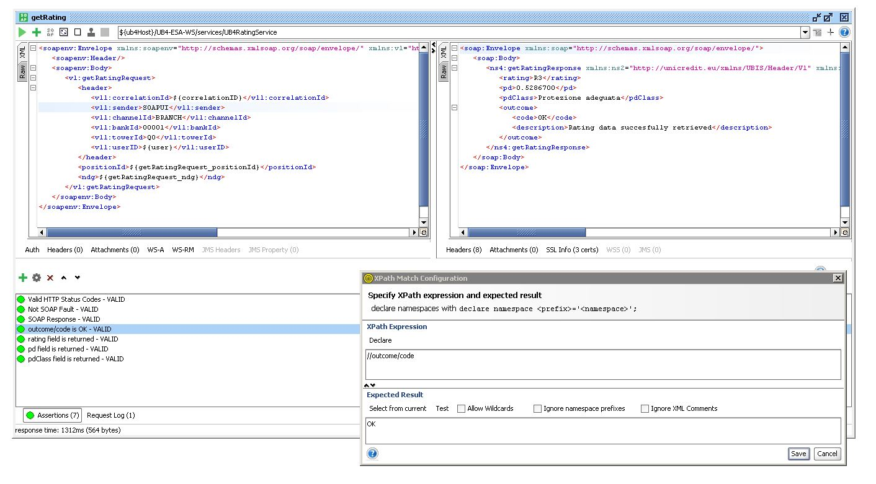
Integration testing
Purpose
K8s
WAS DevOps env.
Test the backend-to-backend SOAP Services exposed by our application
Services with state-changing actions, as opposed to inquiry services, to be repeatable requires data preparation (e.g. SQL script to run from the pipeline, or usage in combination with Withdraw services that rollback the status)
Service virtualization is also required to test services that in turn rely on other systems
MyCredit Backend
SOAP
Challenges
https://onboarding.devops.internal.unicreditgroup.eu/soapui-framework/

Slide 37



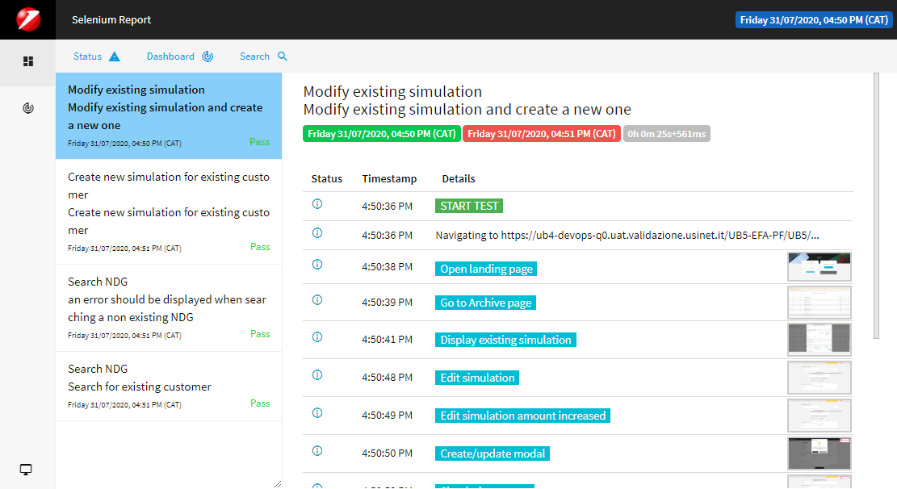
E2E Selenium Tests
Selection criteria for an automated suite
Selenium Box
WAS DevOps env.
Repetitive Test Runs
High-Risk Test Cases (critical parts of the application)
Three Golden Tests (smoke, sanity, regression)
Complex Cases
Nabu based on Selenium
MyCredit Backend
REST
Nabu
MyCredit
Angular Frontend
Tools used
https://onboarding.devops.internal.unicreditgroup.eu/selenium/e2e-test-selenium/

Slide 38
Final step: software ready for UAT
Continuous Integration
Continuous Delivery
Plan
Code
Build
Unit Tests
Artifact publish
Deploy
Integration Tests
Code Coverage and Vulerabilities
E2E Tests
Deploy and Release
DEPLOY
DEPLOY

Slide 39
What’s next…
Next goals
DevOps adoption on Credit Origination ICT assets
Extend DevOps to all the assets in Credit Origination area
Apply DevOps pipelines for the new assets that will be developed on OpenShift containers
Industrialize DB automation until production
Extend Feature Flag adoption to modify system behavior without changing code
Q2-2020
DevOps env. Setup
UB5 onboarding
Q3-2020
UB4 onboarding
Q4-2020
H1-2021
UB1 onboarding
UR4-UR3-UM1 onboarding
2021
New Applications DevOps Native
2022
H2-2021
UM3-UR1-URK onboarding
UB2-UB3-UB6 onboarding
Legend
Brown field - 2020
Self onboarding - 2021

Slide 40
Q&A Session on slido.com

Slide 41
Feature Flag development
Feature Flags (or Feature Toggles) are a powerful technique, allowing teams to modify system behavior without changing code. They fall into various usage categories:
Release Toggles: deploy software as latent code allows separating feature release/activation from code deployment (e.g. coordination with marketing campaign)
Ops toggle: useful for example when rolling out a new feature which has unclear performance implications so that system operators can disable that feature quickly in production if needed
Permission Toggles user or group based: e.g. to enable "beta" features which are only available to a small number of users. This allows also:
Canary Release enables new feature on for a small percentage of the total userbase.
https://martinfowler.com/articles/feature-toggles.html
https://github.com/ff4j/ff4j

