Slide 1


Chapter 9:
COMPUTATION OF THE DISCRETE FOURIER TRANSFORM
Department of Computer Eng.
Sharif University of Technology
Discrete-time signal processing
Content and Figures are from Discrete-Time Signal Processing, 2e by Oppenheim, Shafer and Buck, ©1999-2000 Prentice Hall Inc.

Slide 2
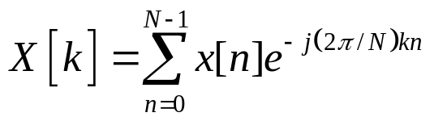
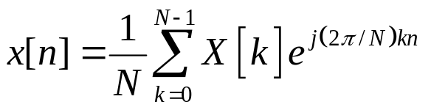
Discrete Fourier Transform
DSP
The DFT pair was given as
Baseline for computational complexity:
  Each DFT coefficient requires
    N complex multiplications
    N-1 complex additions
  All N DFT coefficients require
    N² complex multiplications
    N(N-1) complex additions
Complexity in terms of real operations
    4N² real multiplications
    2N(N-1) real additions
Chapter 9: Computation of The Discrete Fourier Transform
_{<number>}

Slide 3
Discrete Fourier Transform
DSP
Most fast methods are based on symmetry properties
  Conjugate symmetry
  Periodicity in n and k
Chapter 9: Computation of The Discrete Fourier Transform
_{<number>}

Slide 4

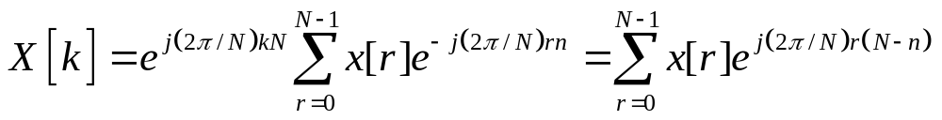
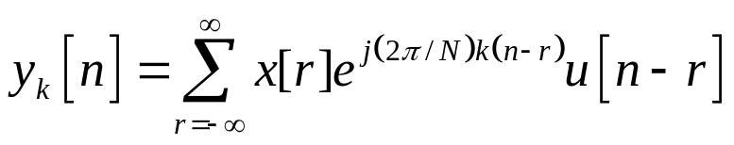
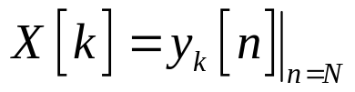

The Goertzel Algorithm
DSP
Makes use of the periodicity
Multiply DFT equation with this factor
Define
With this definition and using x[n]=0 for n<0 and n>N-1
X[k] can be viewed as the output of a filter to the input x[n]
  Impulse response of filter:
  X[k] is the output of the filter at time n=N
Chapter 9: Computation of The Discrete Fourier Transform
_{<number>}

Slide 5
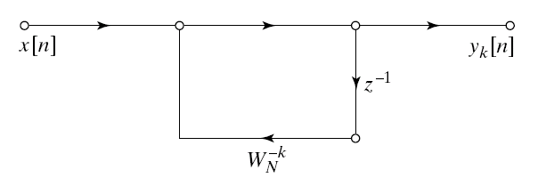
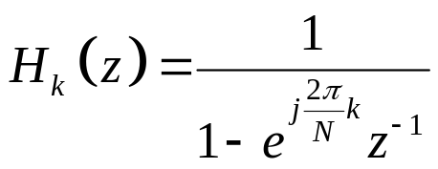
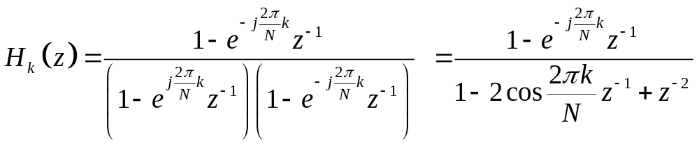
The Goertzel Filter
DSP
Goertzel Filter
Computational complexity
  4N real multiplications
  2N real additions
  Slightly less efficient than the direct method
Multiply both numerator and denominator
Chapter 9: Computation of The Discrete Fourier Transform
_{<number>}

Slide 6
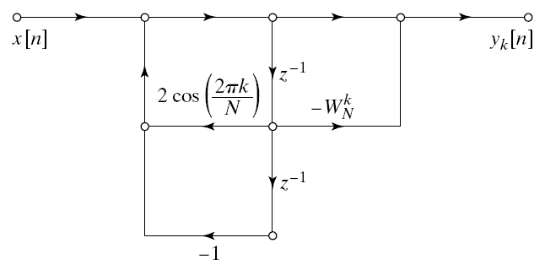
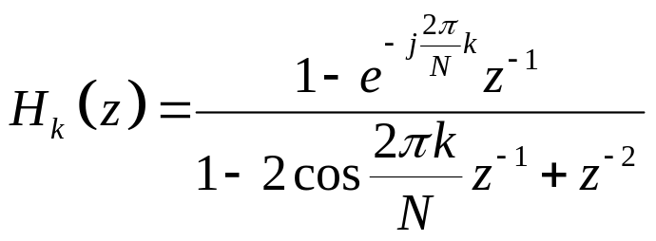
Second Order Goertzel Filter
DSP
Second order Goertzel Filter
Complexity for one DFT coefficient
  Poles: 2N real multiplications and 4N real additions
  Zeros: Need to be implement only once
    4 real multiplications and 4 real additions
Complexity for all DFT coefficients
  Each pole is used for two DFT coefficients
    Approximately N² real multiplications and 2N² real additions
Do not need to evaluate all N DFT coefficients
  Goertzel Algorithm is more efficient than FFT if
    less than M DFT coefficients are needed
    M < log₂N
Chapter 9: Computation of The Discrete Fourier Transform
_{<number>}

Slide 7
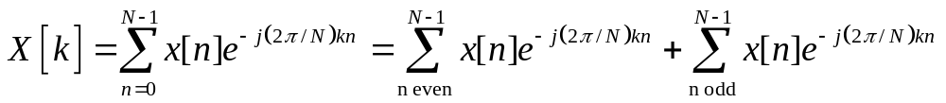
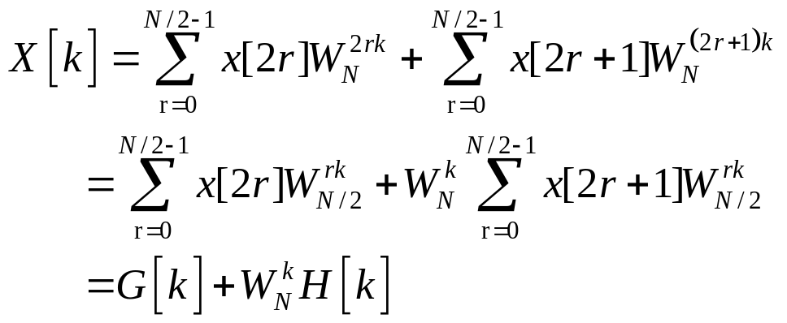
Decimation-In-Time FFT Algorithms
DSP
Makes use of both symmetry and periodicity
Consider special case of N an integer power of 2
Separate x[n] into two sequence of length N/2
  Even indexed samples in the first sequence
  Odd indexed samples in the other sequence
Substitute variables n=2r for n even and n=2r+1 for odd
G[k] and H[k] are the N/2-point DFT’s of each subsequence
Chapter 9: Computation of The Discrete Fourier Transform
_{<number>}

Slide 8
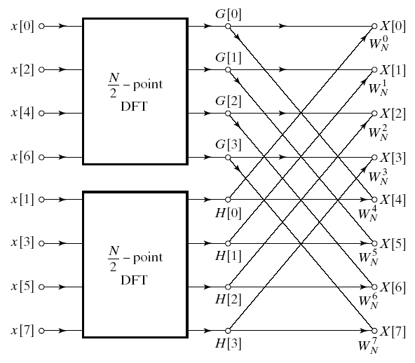
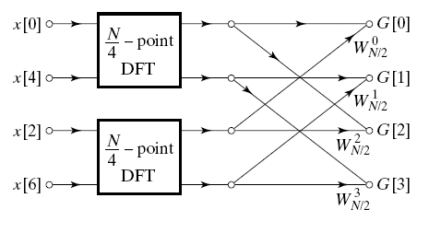
Decimation In Time
DSP
8-point DFT example using decimation-in-time
Two N/2-point DFTs
  2(N/2)² complex multiplications
  2(N/2)² complex additions
Combining the DFT outputs
  N complex multiplications
  N complex additions
Total complexity
  N²/2+N complex multiplications
  N²/2+N complex additions
  More efficient than direct DFT
Repeat same process
  Divide N/2-point DFTs into
  Two N/4-point DFTs
  Combine outputs
Chapter 9: Computation of The Discrete Fourier Transform
_{<number>}

Slide 9
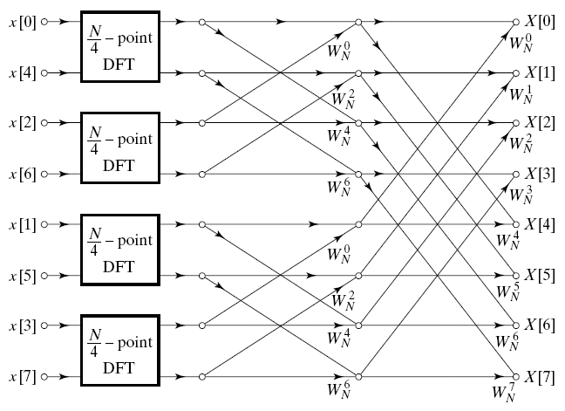
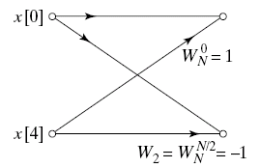
Decimation In Time Cont’d
DSP
After two steps of decimation in time
Repeat until we’re left with two-point DFT’s
Chapter 9: Computation of The Discrete Fourier Transform
_{<number>}

Slide 10
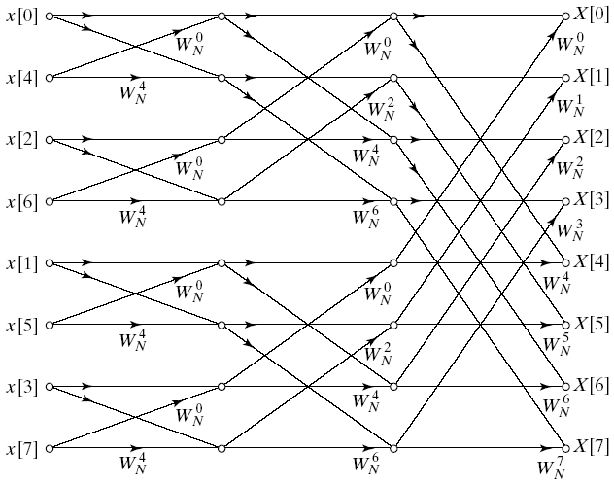
Decimation-In-Time FFT Algorithm
DSP
Final flow graph for 8-point decimation in time
Complexity:
  Nlog₂N complex multiplications and additions
Chapter 9: Computation of The Discrete Fourier Transform
_{<number>}

Slide 11
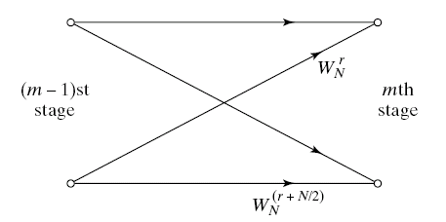
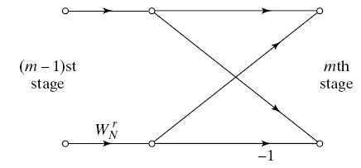
Butterfly Computation
DSP
Flow graph constitutes of butterflies
We can implement each butterfly with one multiplication
Final complexity for decimation-in-time FFT
  (N/2)log₂N complex multiplications and additions
Chapter 9: Computation of The Discrete Fourier Transform
_{<number>}

Slide 12
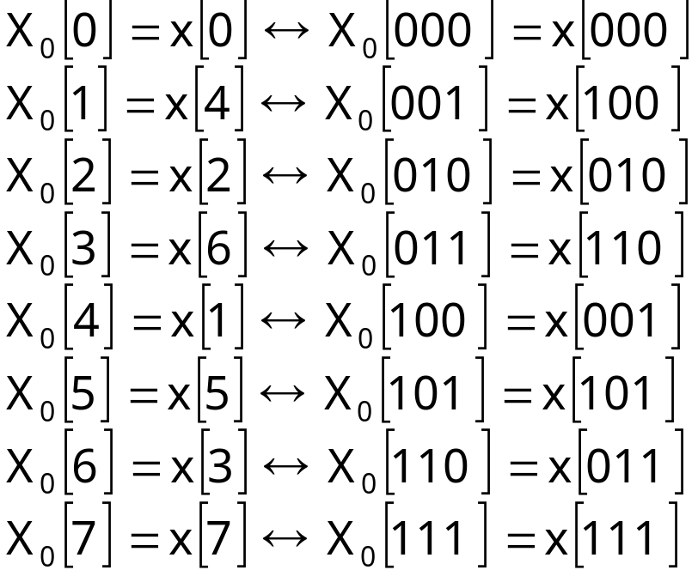
In-Place Computation
DSP
Decimation-in-time flow graphs require two sets of registers
  Input and output for each stage
Note the arrangement of the input indices
  Bit reversed indexing
Chapter 9: Computation of The Discrete Fourier Transform
_{<number>}

Slide 13
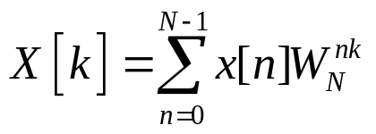
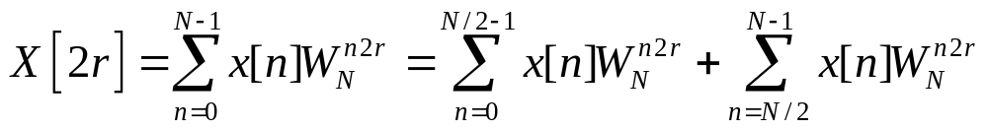
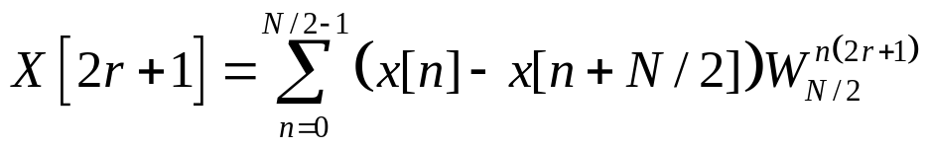
Decimation-In-Frequency FFT Algorithm
DSP
The DFT equation
Split the DFT equation into even and odd frequency indexes
Substitute variables to get
Similarly for odd-numbered frequencies
Chapter 9: Computation of The Discrete Fourier Transform
_{<number>}

Slide 14
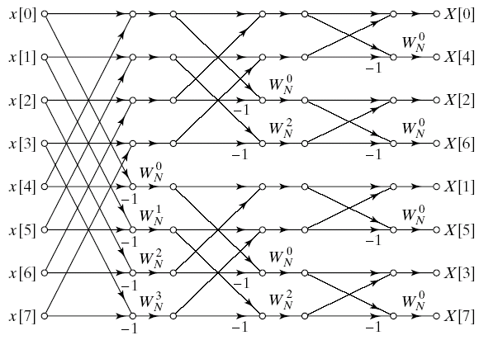
Decimation-In-Frequency FFT Algorithm
DSP
Final flow graph for 8-point decimation in frequency
Chapter 9: Computation of The Discrete Fourier Transform
_{<number>}

Slide 15
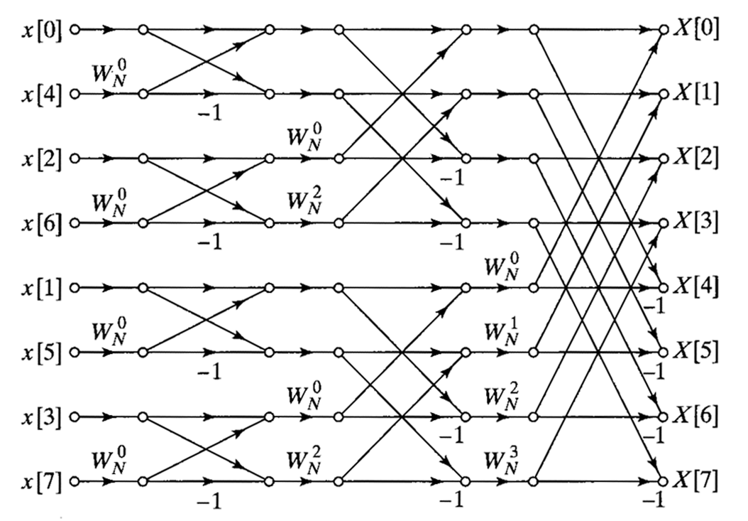
Decimation-In-Frequency FFT Algorithm
DIT structure with input bit-reversed, output natural

Slide 16
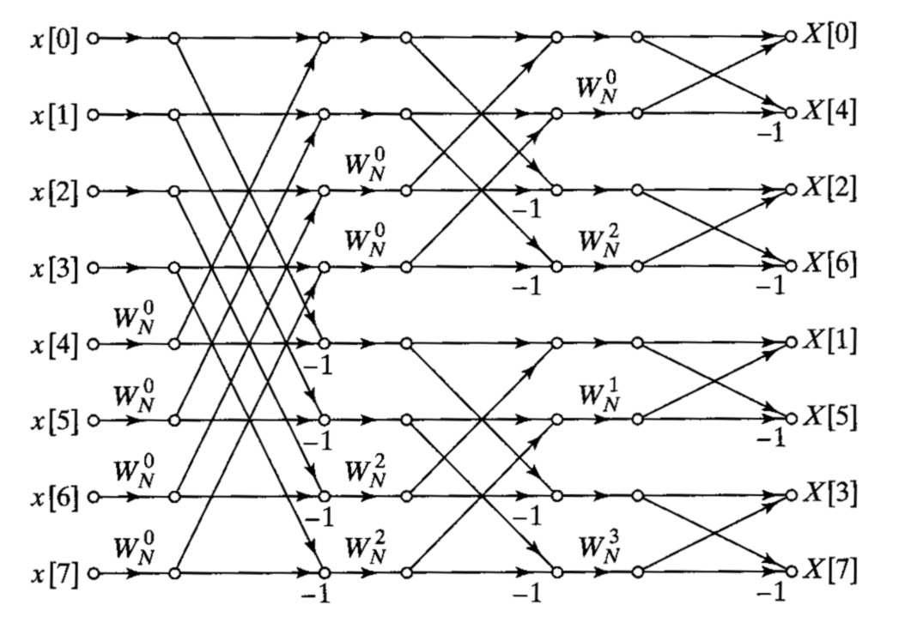
Decimation-In-Frequency FFT Algorithm
DIT structure with input natural, output bit-reversed

Slide 17
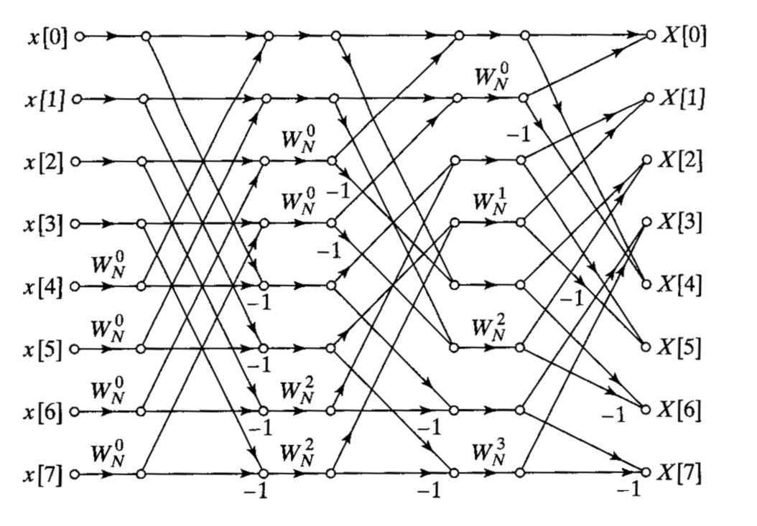
Decimation-In-Frequency FFT Algorithm
DIT structure with both input and output natural

Slide 18
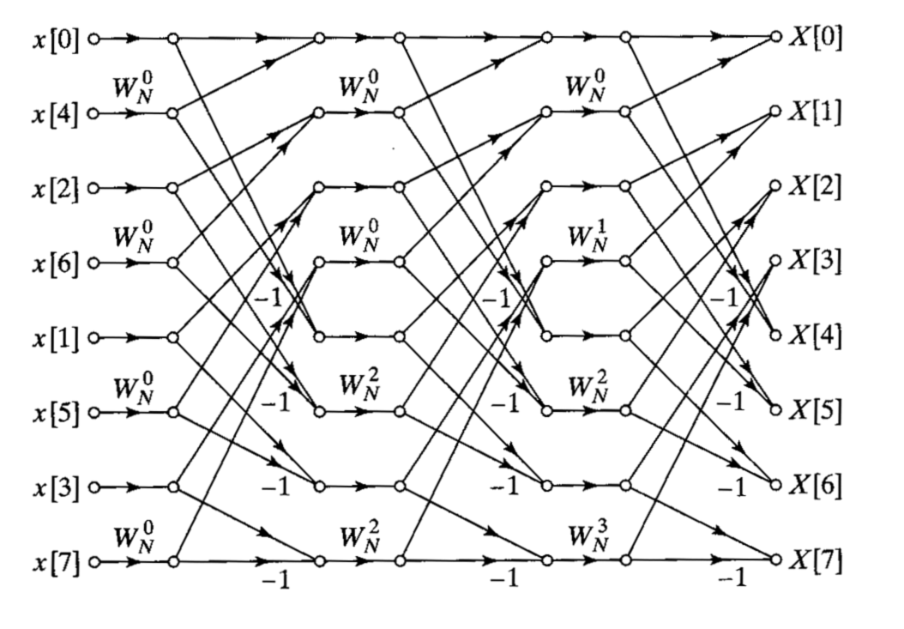
Decimation-In-Frequency FFT Algorithm
DIT structure with same structure for each stage

Slide 19
Decimation-In-Frequency FFT Algorithm
A method to avoid bit-reversal in filtering operations is:
  Compute forward transform using natural input, bit-reversed output (as in OSB 9.10)
  Multiply DFT coefficients of input and filter response (both in bit-reversed order)
  Compute inverse transform of product using bit-reversed input and natural output (as in OSB 9/14)
Latter two topologies (as in OSB 9.15 and 9.16) are now rarely used

Slide 20
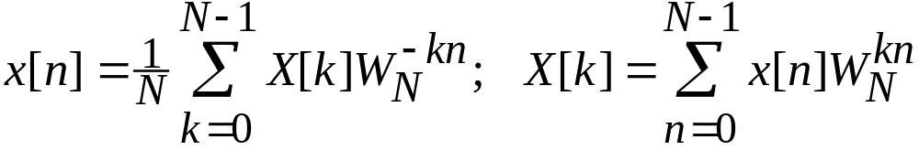



Using FFTs for inverse DFTs
We’ve always been talking about forward DFTs in our discussion about FFTs …. what about the inverse FFT?
One way to modify FFT algorithm for the inverse DFT computation is:
  Replace by wherever it appears
  Multiply final output by
This method has the disadvantage that it requires modifying the internal code in the FFT subroutine

Slide 21
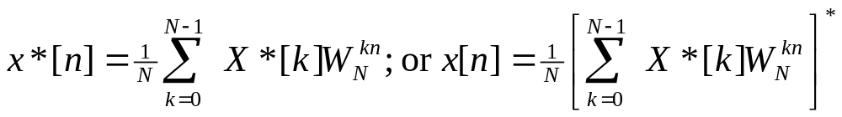
A better way to modify FFT code for IDFT
Taking the complex conjugate of both sides of the IDFT equation:
This suggests that we can modify the FFT algorithm for the inverse DFT computation by the following:
  Complex conjugate the input DFT coefficients
  Compute the forward FFT
  Complex conjugate the output of the FFT and multiply by
This method has the advantage that the internal FFT code is undisturbed; it is widely used.

Slide 22
Decimation-In-Frequency FFT Algorithm
Introduction: Decimation in frequency is an alternate way of developing the FFT algorithm
It is different from decimation in time in its development, although it leads to a very similar structure

Slide 23
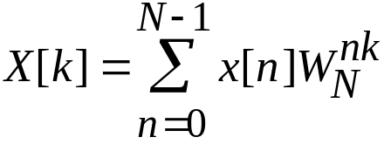
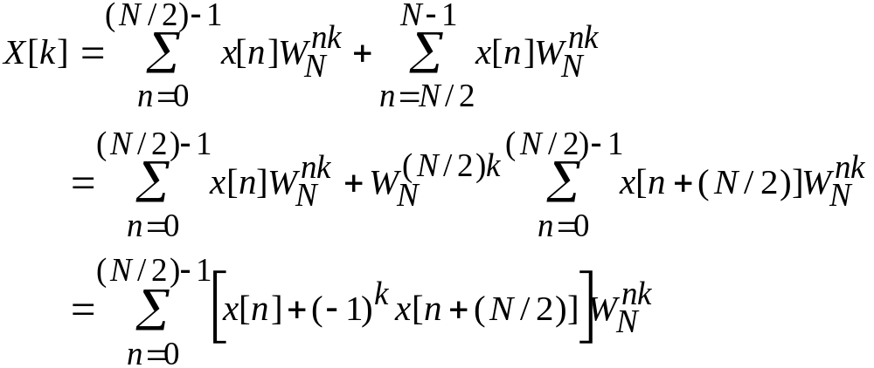
Decimation-In-Frequency FFT Algorithm
Consider the original
DFT equation ….
Separate the first half and the second half of time samples:
Note that these are not N/2-point DFTs

Slide 24
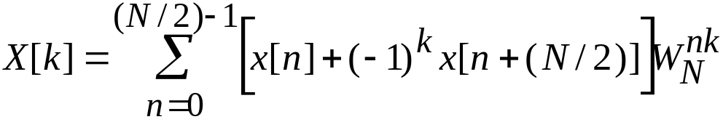


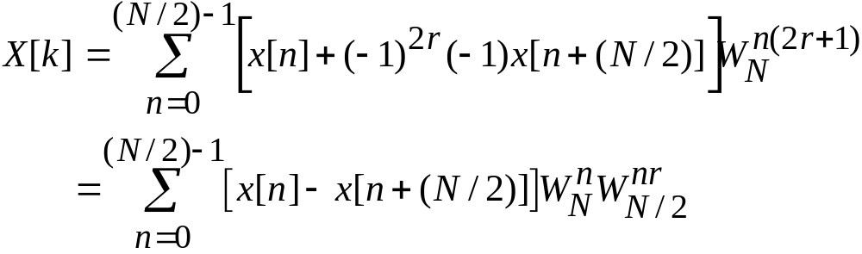
Decimation-In-Frequency FFT Algorithm
For k even, let
For k odd, let
These expressions are the N/2-point DFTs of

Slide 25
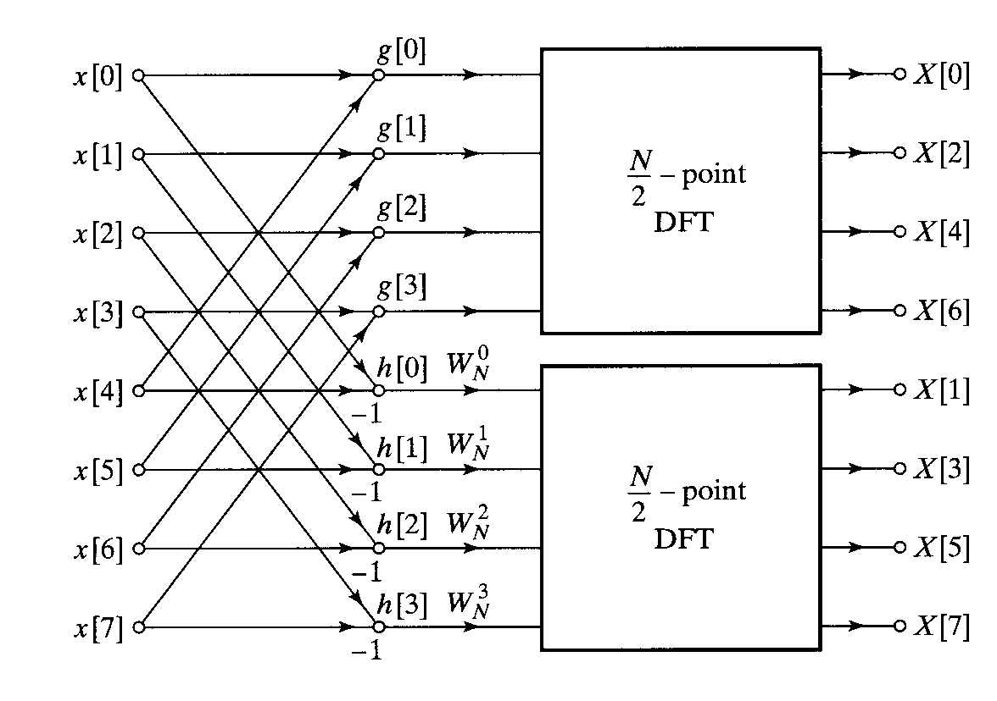
Decimation-In-Frequency FFT Algorithm

Slide 26
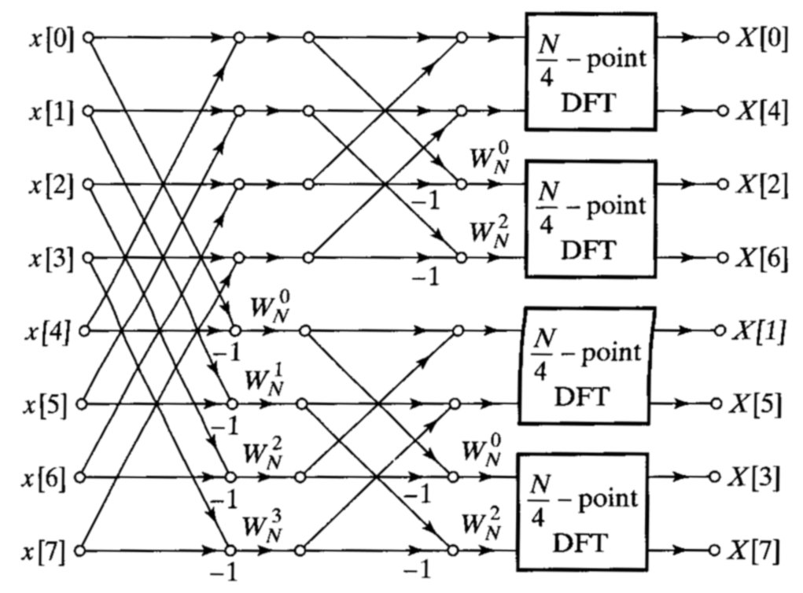
Continuing by decomposing the odd and even output points we obtain
Decimation-In-Frequency FFT Algorithm

Slide 27
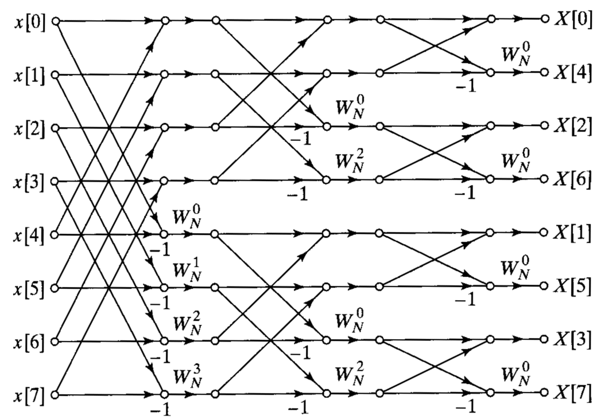
… and replacing the N/4-point DFTs by butterflys we obtain
Decimation-In-Frequency FFT Algorithm

Slide 28
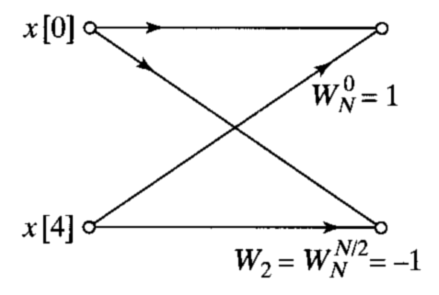
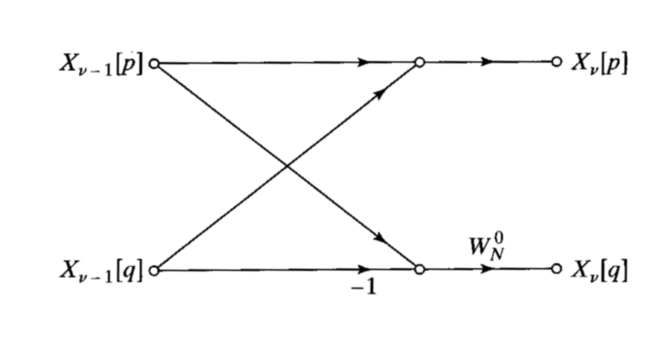
The DIF FFT is the transpose of the DIT FFT
To obtain flowgraph transposes:
  Reverse direction of flowgraph arrows
  Interchange input(s) and output(s)
DIT butterfly: DIF butterfly:
Comment:
  We will revisit transposed forms again in our discussion of filter implementation

Slide 29
The DIF FFT is the transpose of the DIT FFT
Comparing DIT and DIF structures:
  DIT FFT structure: DIF FFT structure:
Alternate forms for DIF FFTs are similar to those of DIT FFTs

Slide 30
Alternate DIF FFT structures
DIF structure with input natural, output bit-reversed

Slide 31
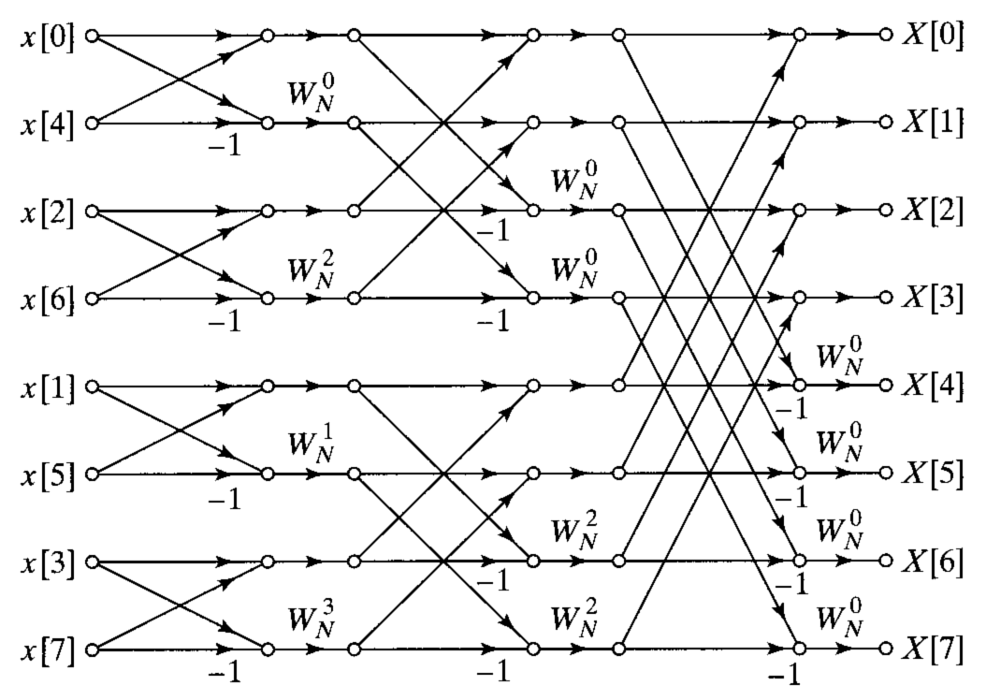
Alternate DIF FFT structures
DIF structure with input bit-reversed, output natural

Slide 32
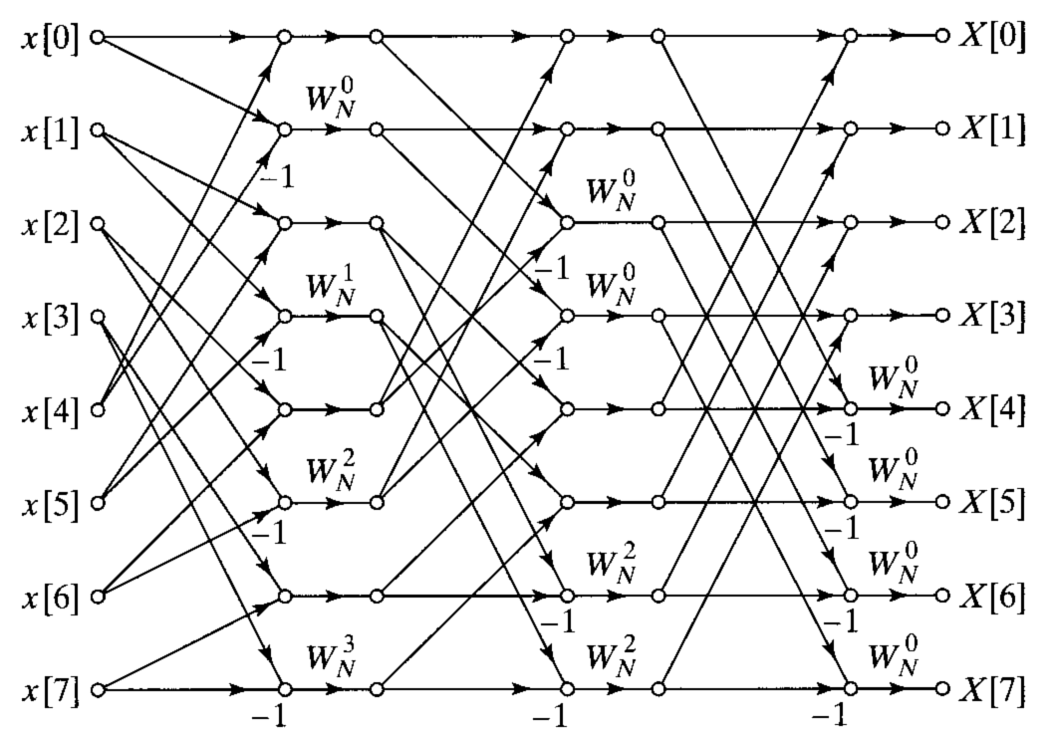
Alternate DIF FFT structures
DIF structure with both input and output natural

Slide 33
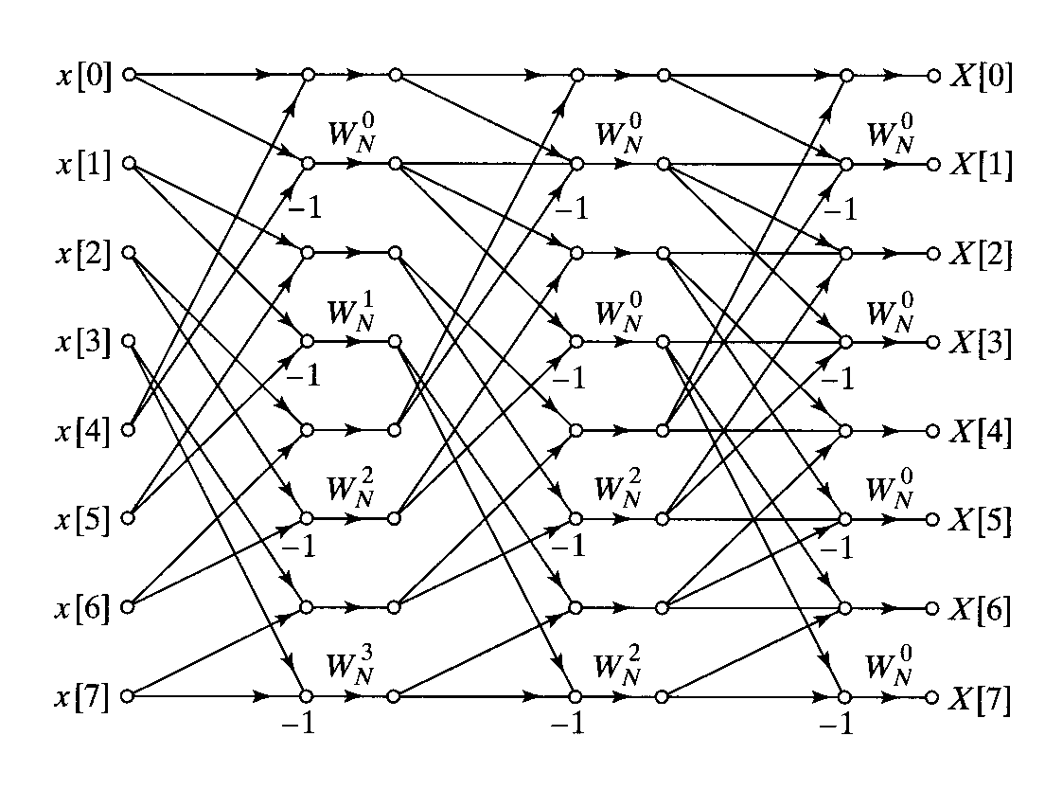
Alternate DIF FFT structures
DIF structure with same structure for each stage

Slide 34
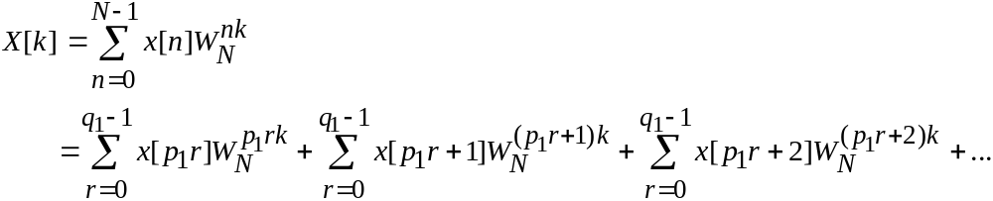
FFT structures for other DFT sizes
Can we do anything when the DFT size N is not an integer power of 2 (the non-radix 2 case)?
Yes! Consider a value of N that is not a power of 2, but that still is highly factorable …
Then let

Slide 35
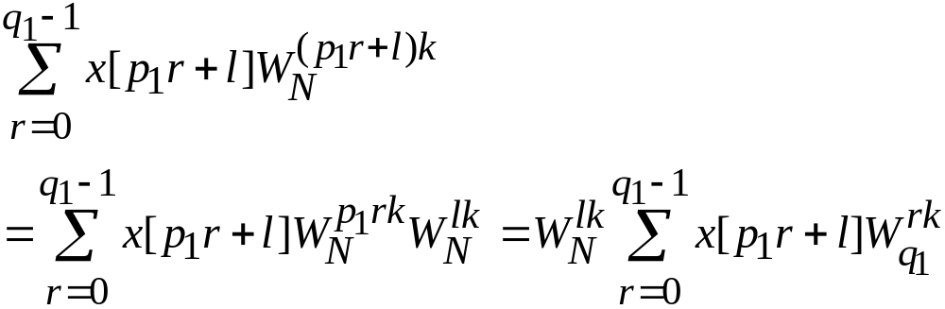


Alternate DIF FFT structures
An arbitrary term of the sum on the previous panel is
This is, of course, a DFT of size of points spaced by

Slide 36
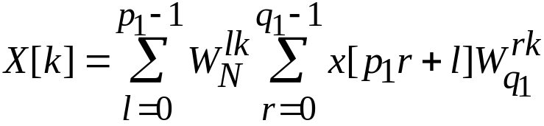
Alternate DIF FFT structures
In general, for the first decomposition we use
Comments:
  This procedure can be repeated for subsequent factors of N
  The amount of computational savings depends on the extent to which N is “composite”, able to be factored into small integers
  Generally the smallest factors possible used, with the exception of some use of radix-4 and radix-8 FFTs

Slide 37
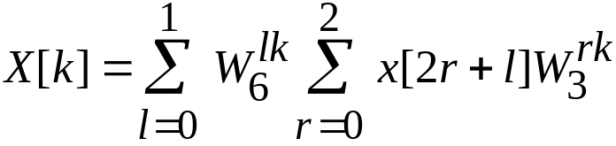
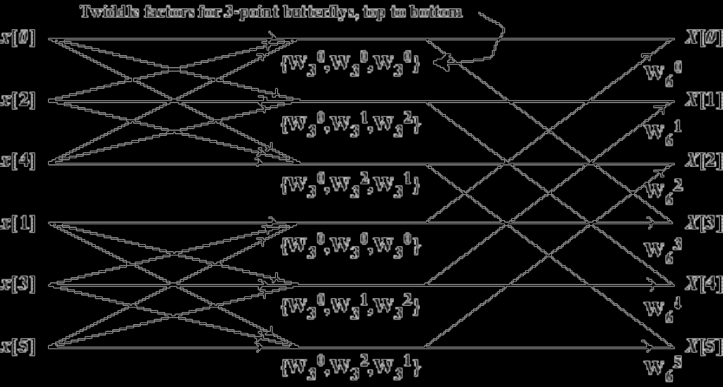
Example: the 6-point DIT FFT
P₁ = 2; P₂ = 3;

