Slide 1

Pyha - Object-Oriented Hardware
Description Language based on Python
Gaspar Karm
Master’s Thesis
Thomas Johann Seebeck Department of Electronics
06.06.2017

Slide 2
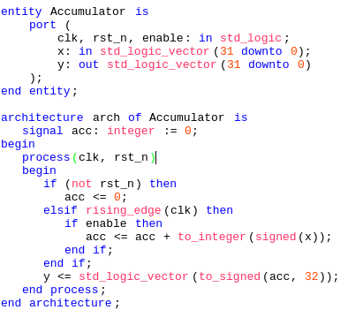
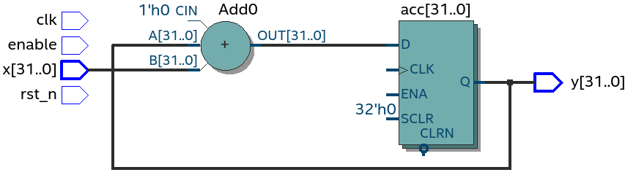
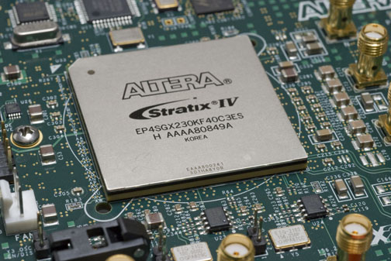
Background
VHDL - Hardware description language
Synthesised logic (Quartus RTL viewer)
Source: https://en.wikipedia.org/wiki/Field-programmable_gate_array
Notes:
Test

Slide 3
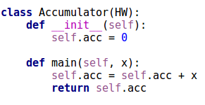
Background
VHDL - Hardware description language
Synthesised logic (Quartus RTL viewer)
Source: https://en.wikipedia.org/wiki/Field-programmable_gate_array
Notes:
Test

Slide 4
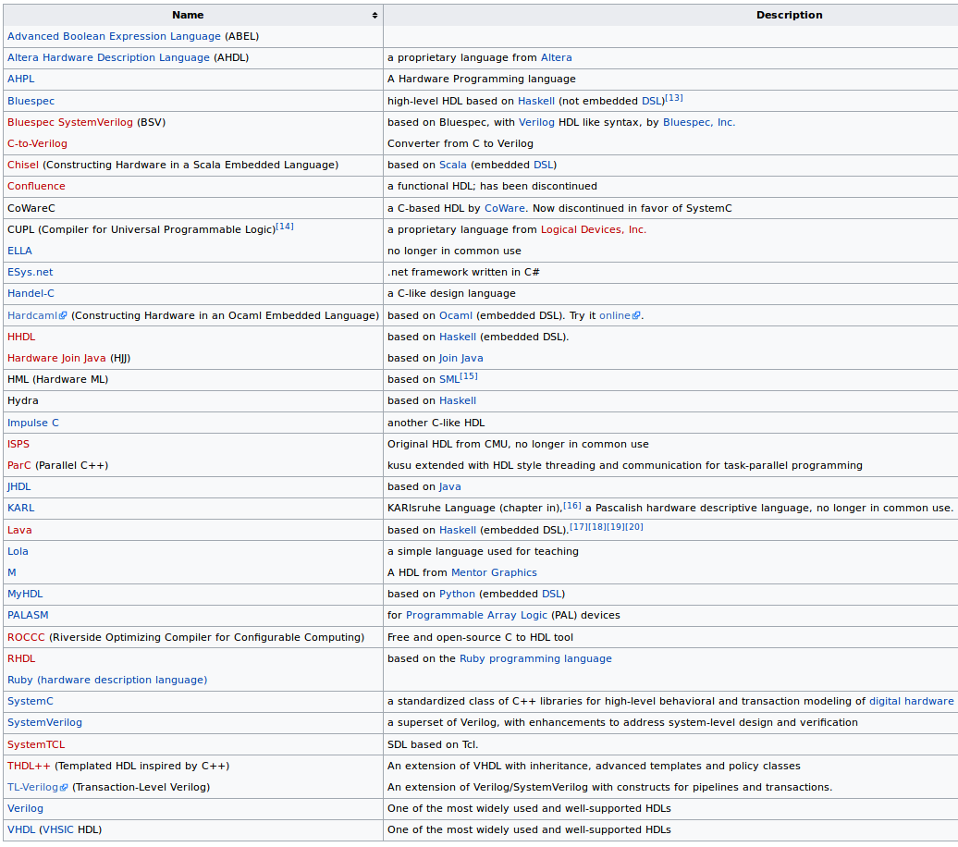
Related work – Hardware Description Languages (HDL)
Source: https://en.wikipedia.org/wiki/Hardware_description_language

Slide 5
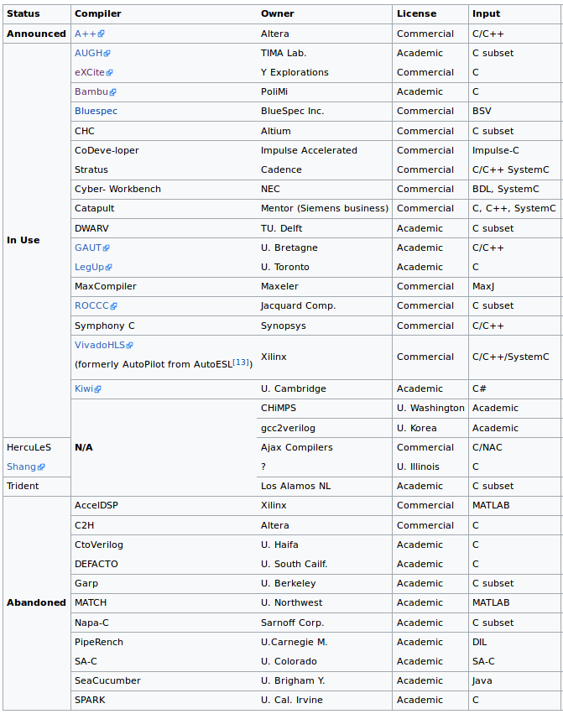
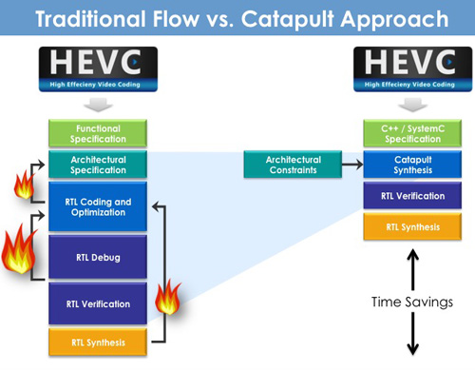
Related work – High Level Synthesis (HLS)
Source:https://www.semiwiki.com/forum/content/2652-when-good-time-start-using-high-level-synthesis.html
Source:
https://en.wikipedia.org/wiki/High-level_synthesis

Slide 6
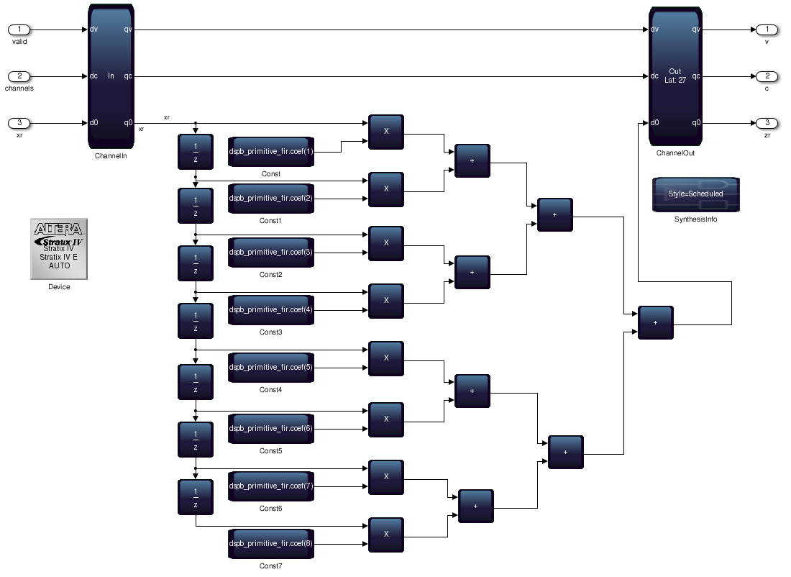
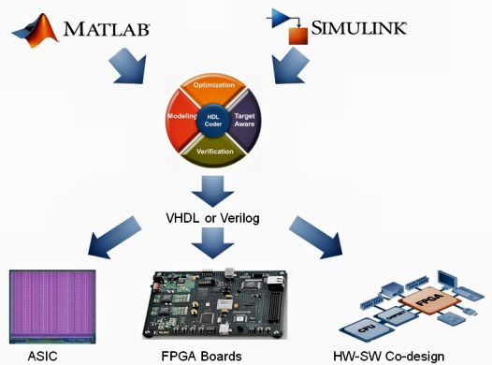
MATLAB based DSP flows
Source: https://forums.xilinx.com/t5/Xcell-Daily-Blog/MathWorks-HDL-Coder-wins-Embedded-World-AWARD-in-Nuremberg-last/ba-p/756199
Source: https://se.mathworks.com/help/hdlcoder/examples/using-altera-dsp-builder-advanced-blockset-with-hdl-coder.html

Slide 7
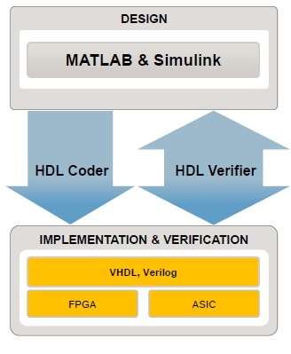
MATLAB based DSP flows - problem
MATLAB | 2000 EUR
SIMULINK | 3000 EUR
HDLCoder | 10000 EUR
HDLVerifier | 3500 EUR
Fixed-point toolbox | 10000 EUR
DSP System Toolbox | 1000 EUR
Signal Processing Toolbox | 1000 EUR
DSPBuilder | 2000 EUR (annually)
ModelSim | 2000 EUR
Quartus | 4000 EUR (annually)
Total = ~40 000 EUR
Source:
http://www.eetimes.com/document.asp?doc_id=1317035
https://www.altera.com/buy/design-software.html
https://se.mathworks.com/pricing-licensing.htm
Source:
http://www.eetimes.com/document.asp?doc_id=1317035

Slide 8
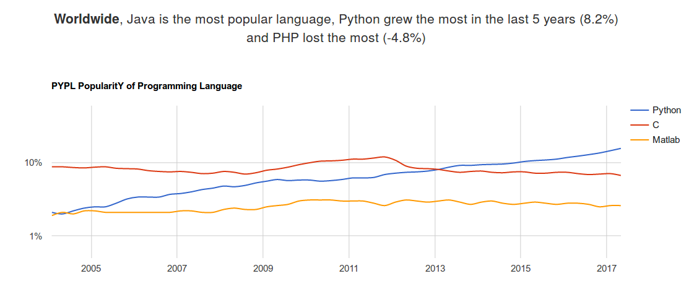
What do I propose?
Source: http://pypl.github.io/PYPL.html

Slide 9
Features
Sequential execution
Debugabble in software and hardware mode
Object oriented – still sequential!
Free and open source
https://github.com/Xilinx/HLx_Examples/blob/master/DSP/digital_up_conv/fir.h
Vivado can debug only in Software mode...

Slide 10
Features - Debugging
Sequential execution
Debugabble in software and hardware mode
Object oriented – still sequential!
Free and open source
https://github.com/Xilinx/HLx_Examples/blob/master/DSP/digital_up_conv/fir.h
Vivado can debug only in Software mode...

Slide 11
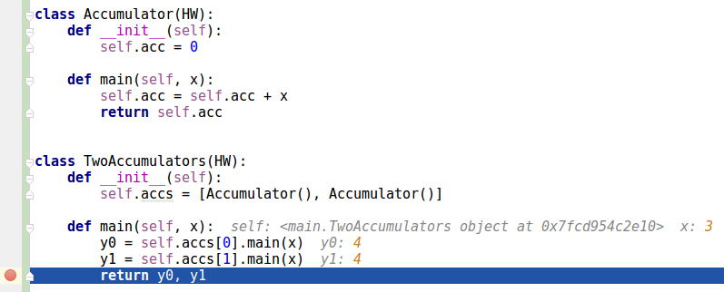
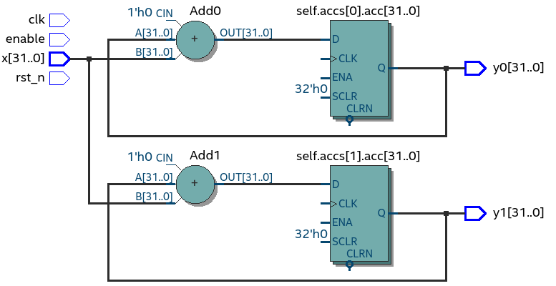
Main Features
Object orientation
No tricks
Fully sequential execution
Debuggable

Slide 12
Main contributions
• Hardware description, simulation and debugging in Python
• Sequential object-oriented VHDL model
• Simple method for converting Python to X
• Fixed-point arithmetic library for Python
• Simplified verification functions
IP cores, like CORDIC and FIR

Slide 13
Thank you for listening!

Slide 14
The meaning of PYHA? Is it an acronym?
PYthon HArdware

Slide 15
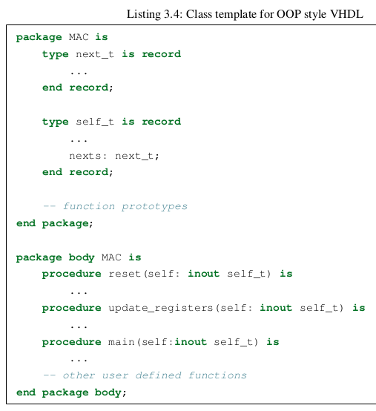
What exactly is OOP VHDL model? Is the OOP-style VHDL thesis author’s contribution?
The attempts to enhance OO features of VHDL has been done already 20 years ago.
Previous works
„OO-VHDL. Object-oriented extensions to VHDL” by S. Swamy and A. Molin and B. Covnot, 1995
„Object Oriented Extensions to VHDL” by
Benzakki, Judith and Djafri, Bachir, 1997

Slide 16
There are verification through simulation and different formal verification methods.
Where is positioned Pyha in respect of those verification methods?
What is ‘boilerplate code’? (Pg. 7)
In Figure 2.4. (Pg. 9), Figure 2.9 (Pg. 15) are four elements in Legend,
but only two values are visible.
In Figure 2.4. (Pg. 9), Figure 2.9 (Pg. 15) are four elements in Legend,
but only two values are visible.
Simulation and model based verification
Make video

Slide 17
How is Pyha related to MyHDL (which is Python based HDL)?
MyHDL is a simulation-oriented language (conversion is very limited)
Follows the event-driven approach
No fixed point type, thus not DSP oriented
Source: http://www.jandecaluwe.com/blog/its-a-simulation-language.html

Slide 18
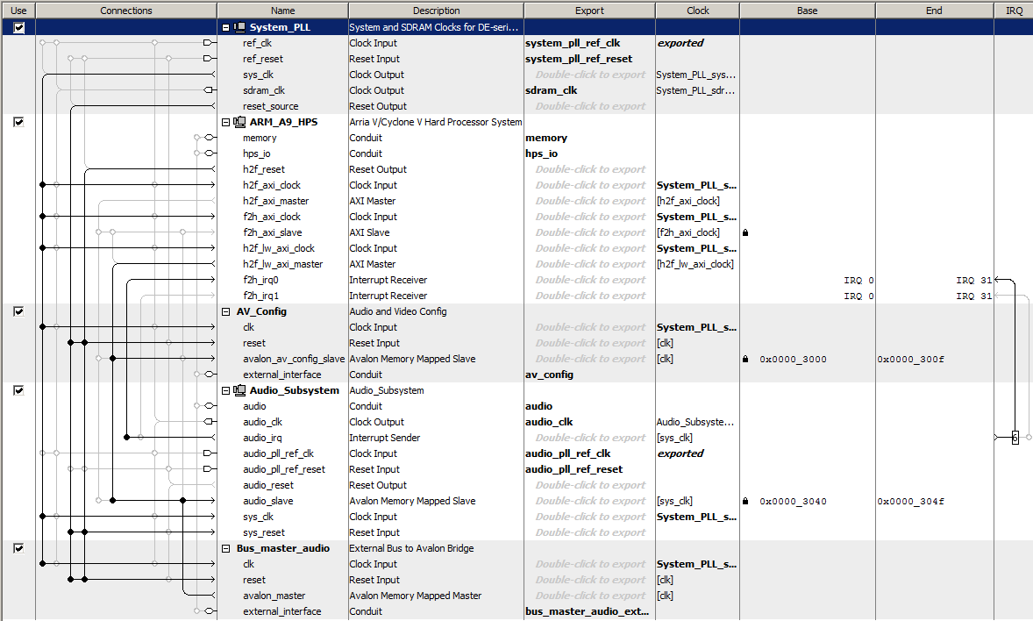
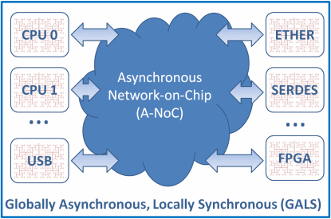
How to make Pyha applicable designing GALS
(Globally Asynchronous, Locally Synchronous) systems?
Source: http://www.eetimes.com/author.asp?doc_id=1320994&page_number=2
Source: https://hackaday.io/project/19636-audio-dsp-on-de1-soc

Slide 19
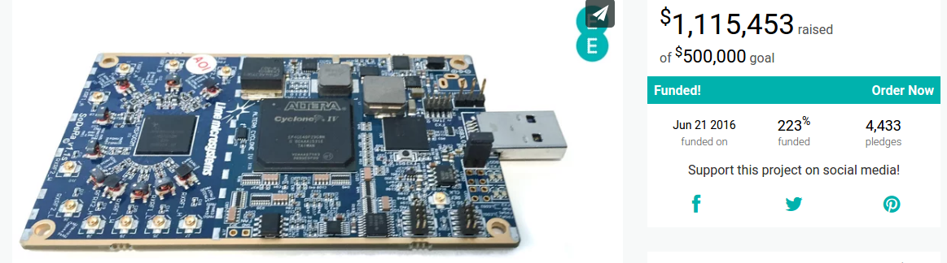
The Pyha is aimed for public domain – where can it be found?
Is there user guide of Pyha?
What plans has author disseminating the Pyha in HW designers community?
Free software: Apache Software License 2.0
Code repository: https://github.com/gasparka/pyha
Documentation: https://pyha.readthedocs.io
Source: https://www.crowdsupply.com/lime-micro/limesdr

Slide 20
TALLINN UNIVERSITY OF TECHNOLOGY
Ehitajate street 5, 19086 Tallinn, Estonia
Phone +372 620 2002 (Mon-Fri 8.30 AM – 5.00 PM)
ttu@ttu.ee
ttu.ee

