Slide 1
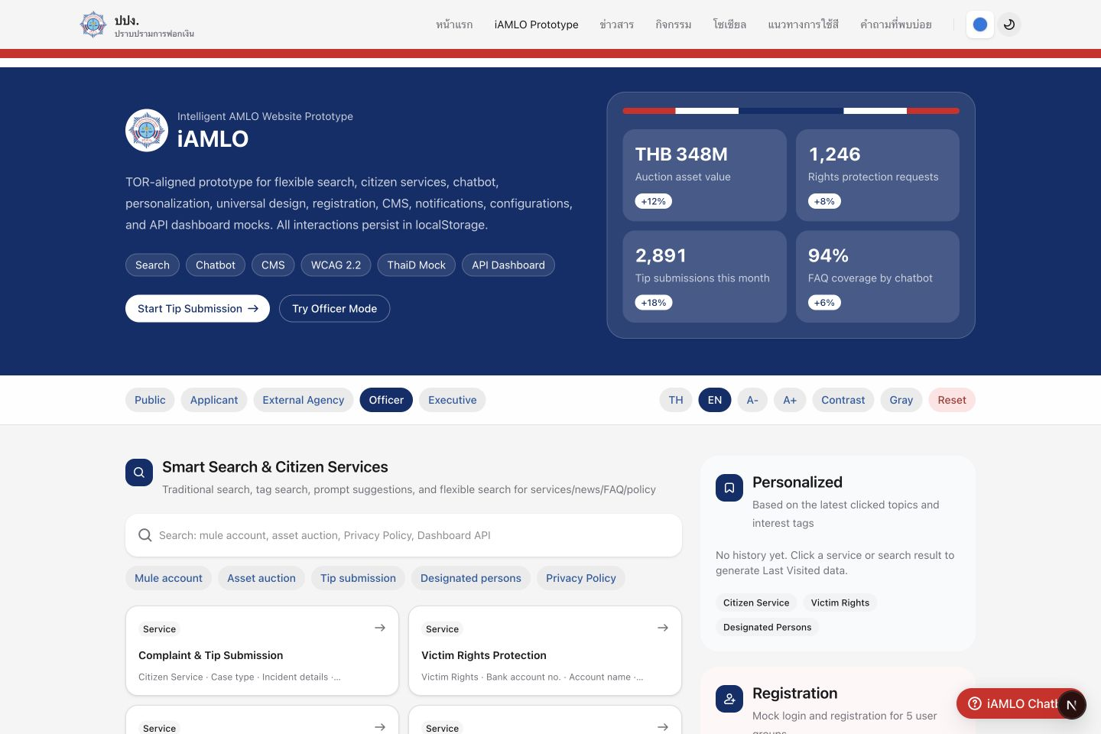
iAMLO Prototype
Clickable front-end prototype screenshots
Light / Dark / Gray accessibility views with English mock content
Prototype only
Live prototype capture
Screens captured from the local Next.js prototype route /prototype.

Slide 2
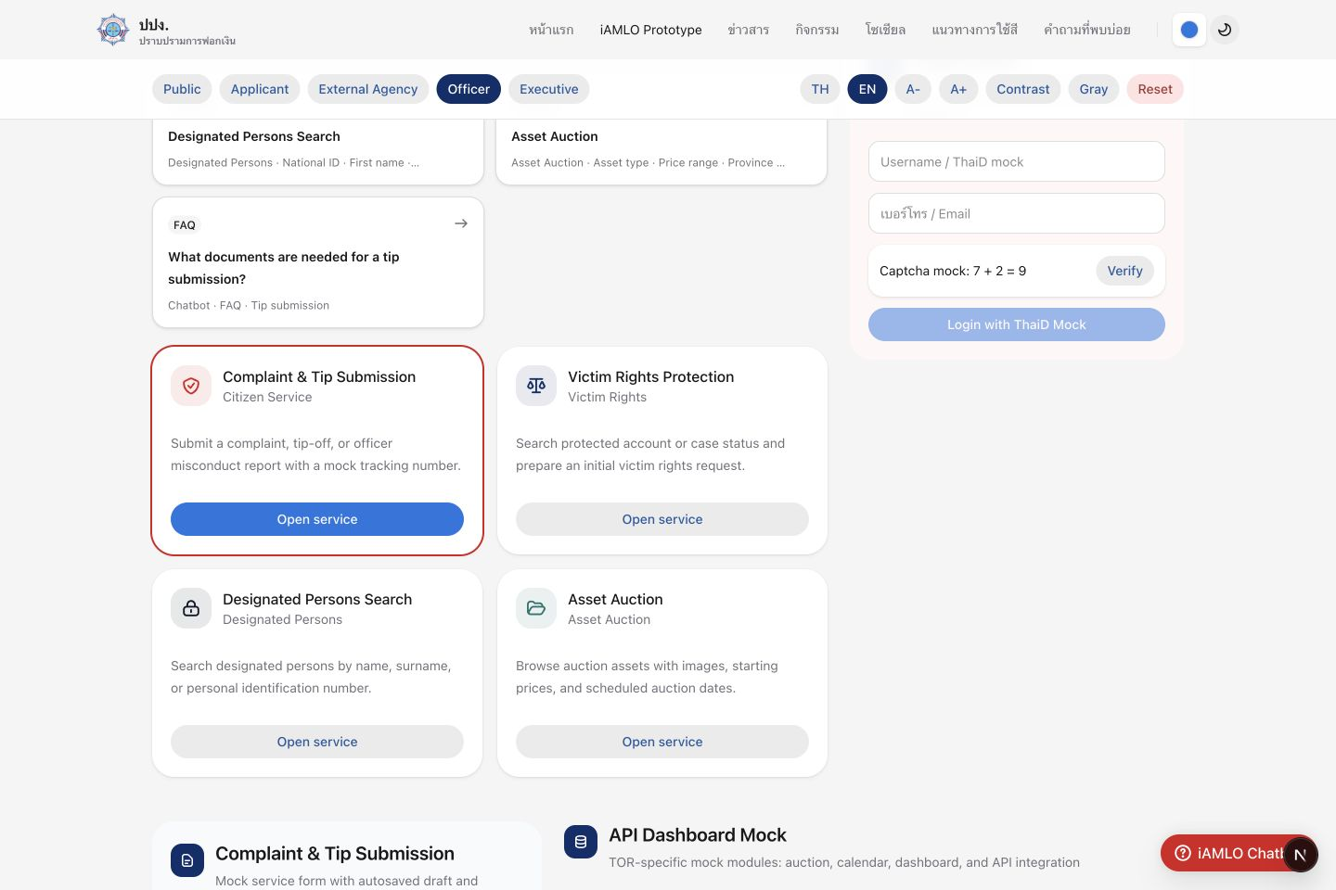
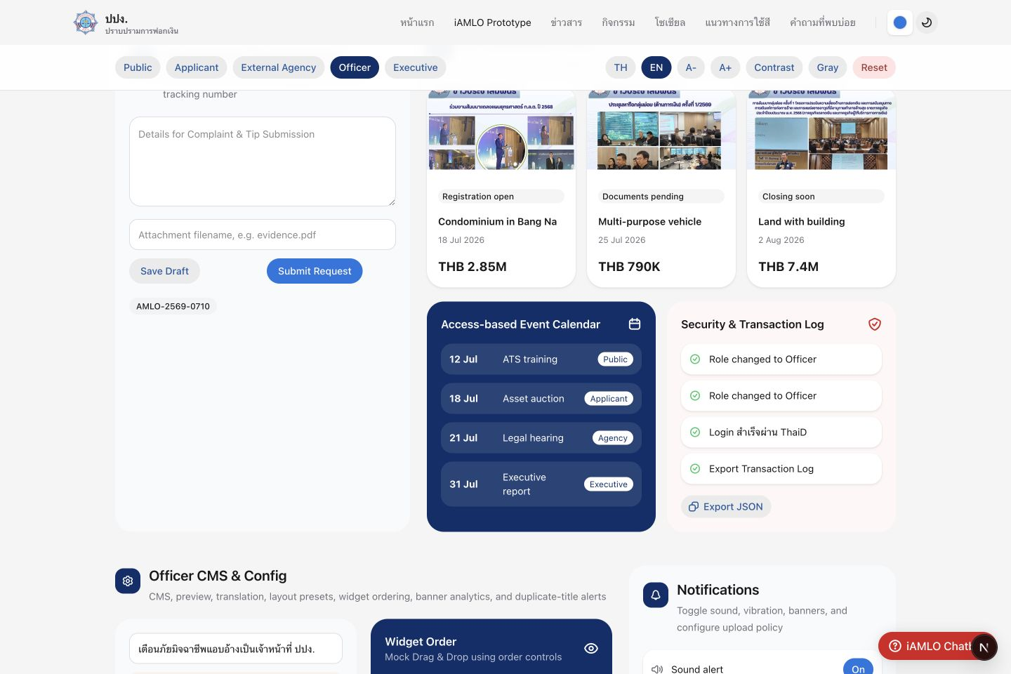
Prototype Screens - Light Mode
LIGHT
Default presentation view for public services, search, API dashboard, and officer CMS.
Services + API Dashboard
Hero + Smart Search
Mode: Light · EN mock content enabled · Officer workbench unlocked
CMS + Notifications

Slide 3
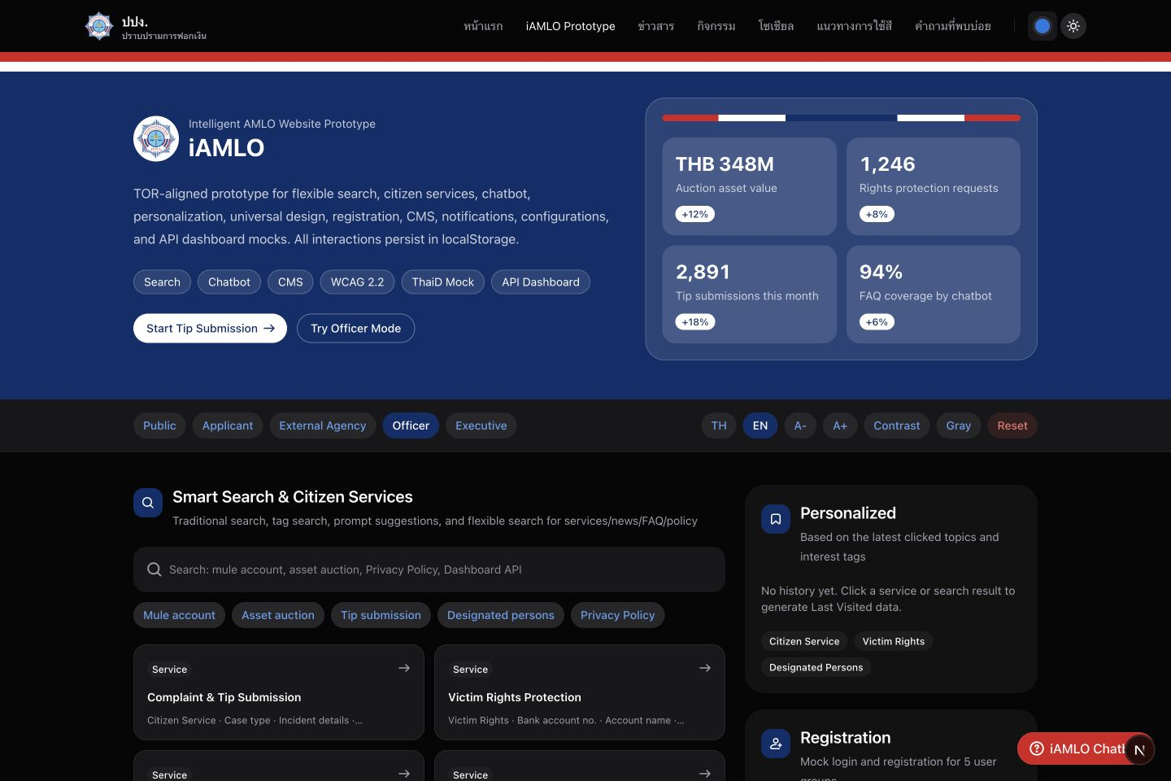
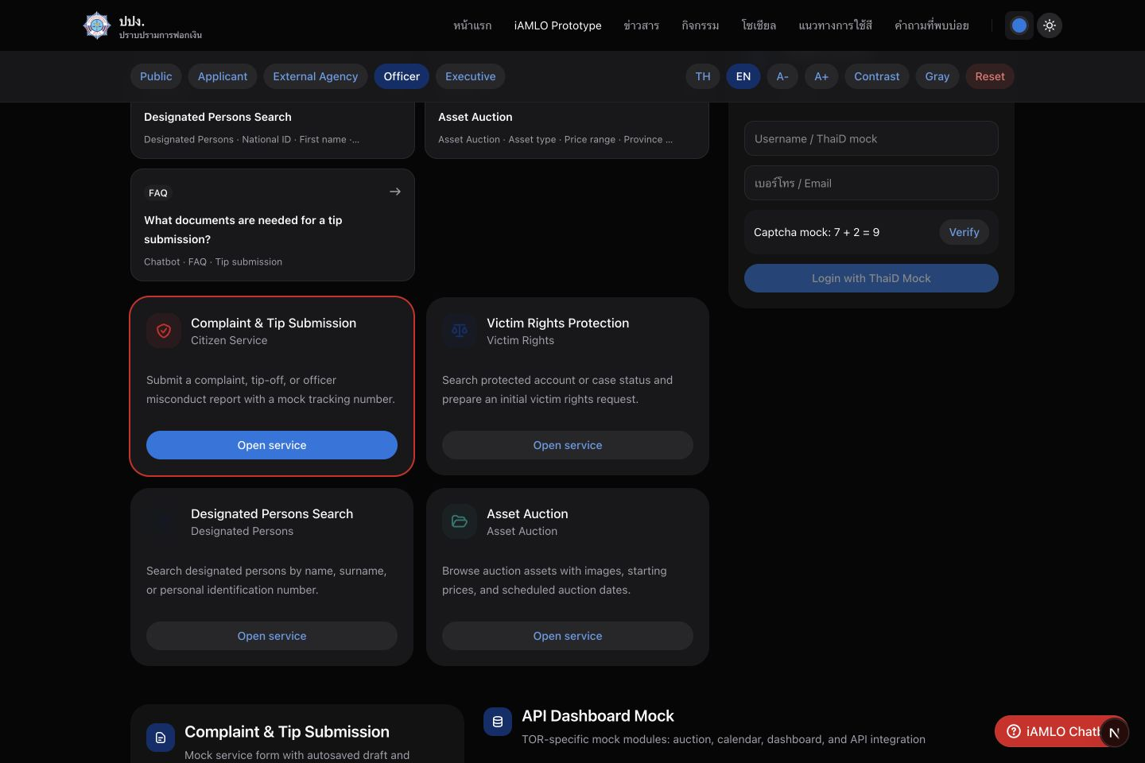
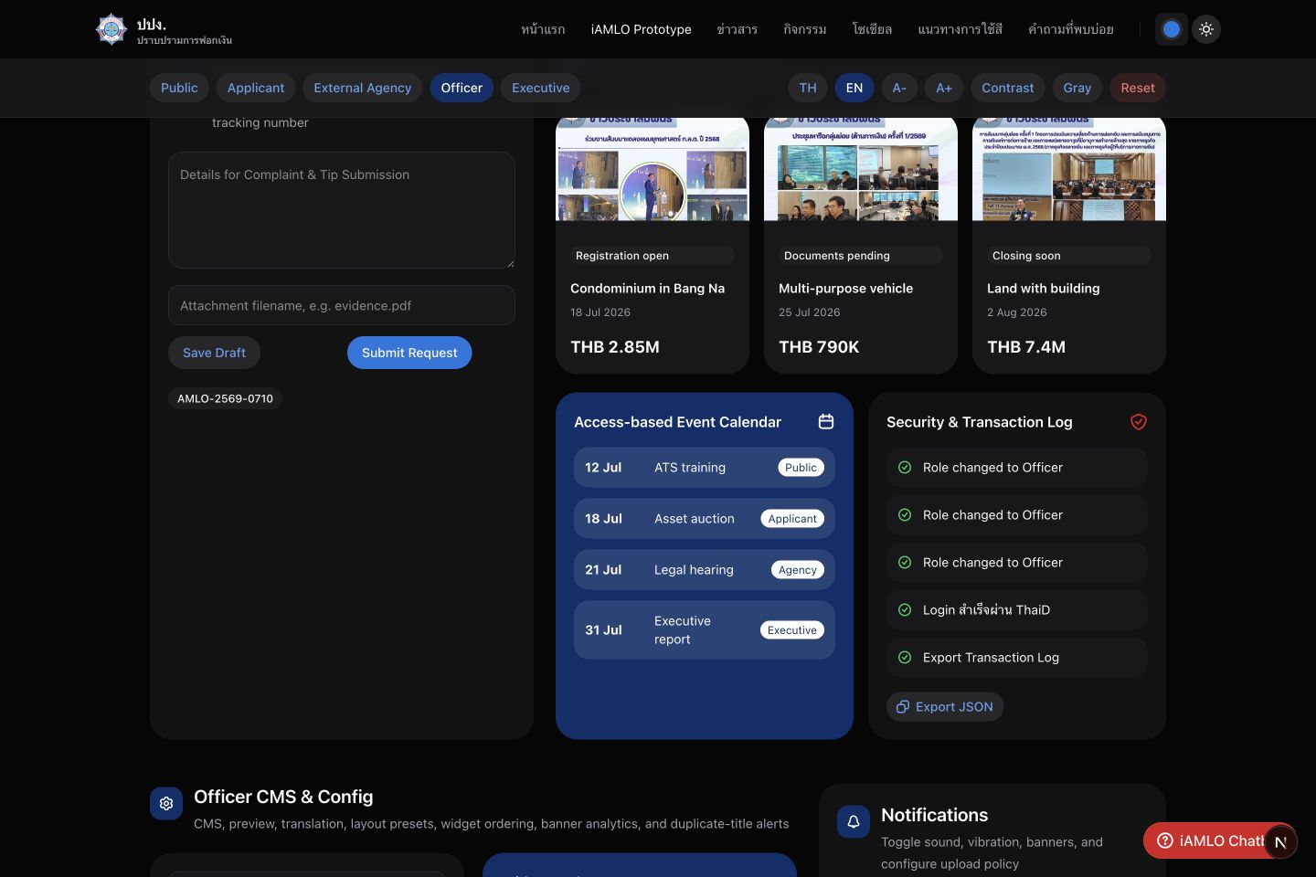
Prototype Screens - Dark Mode
DARK
Dark theme view for the same clickable prototype screens and localStorage-backed state.
Services + API Dashboard
Hero + Smart Search
Mode: Dark · EN mock content enabled · Officer workbench unlocked
CMS + Notifications

Slide 4
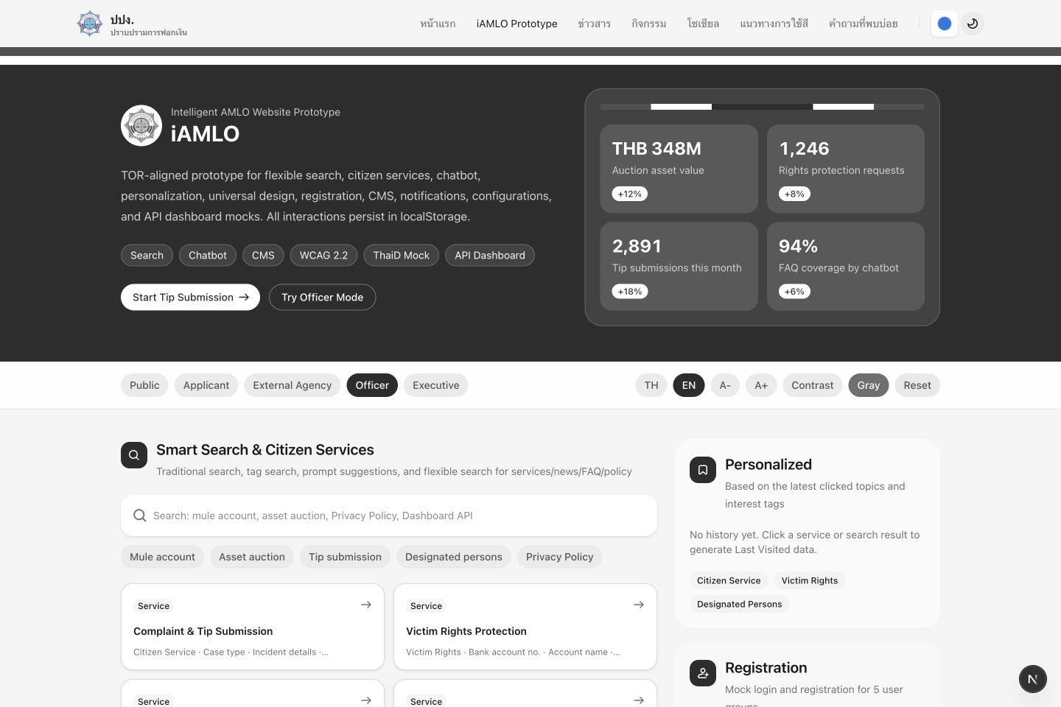
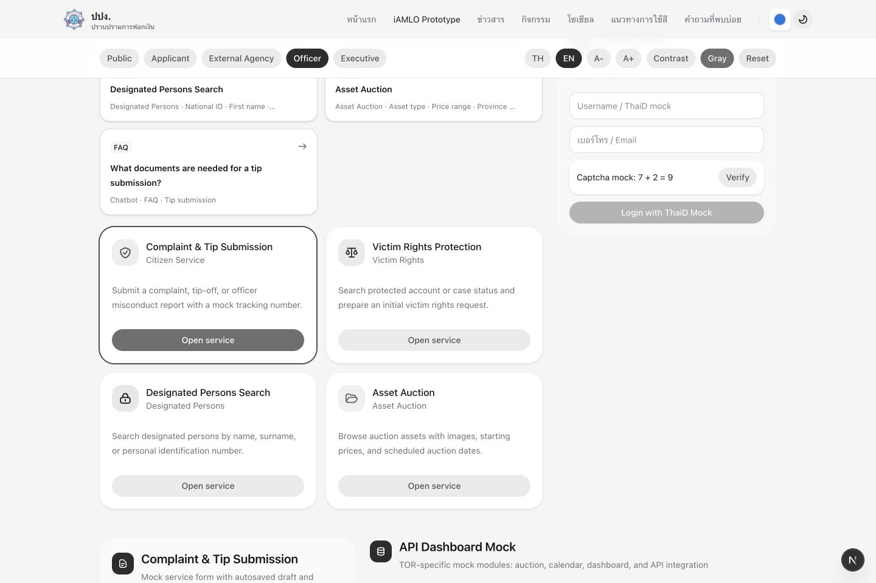
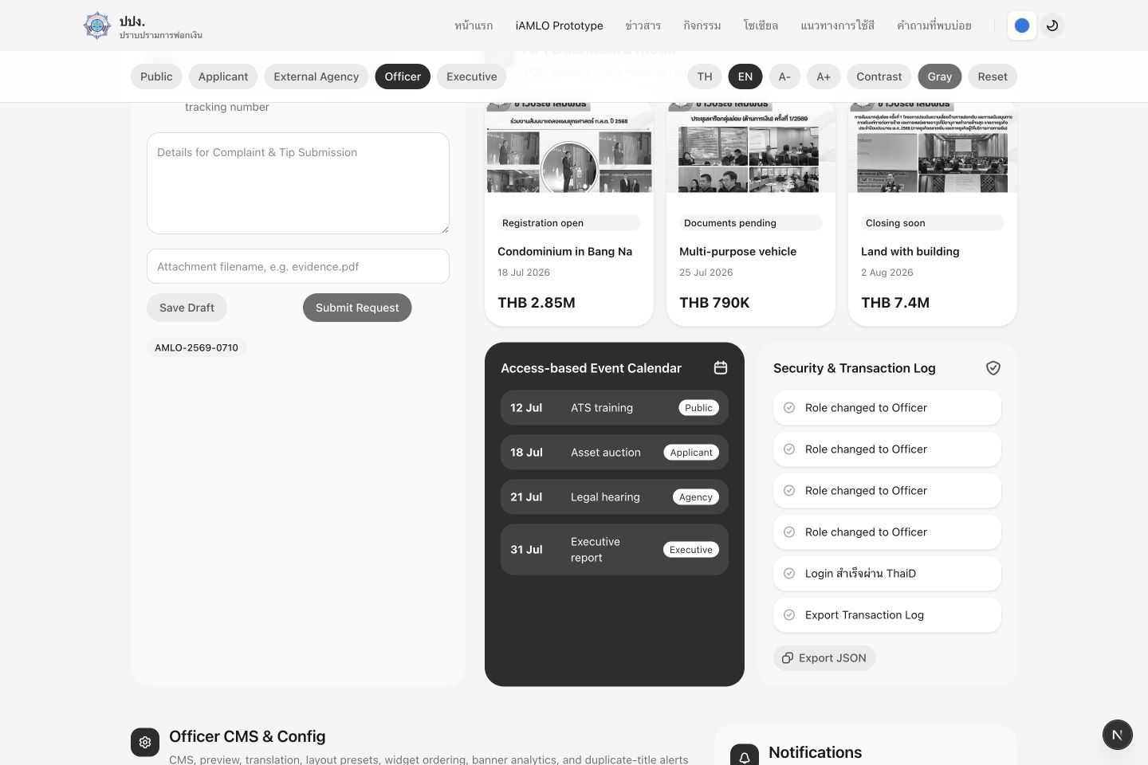
Prototype Screens - Gray Mode
GRAY
Grayscale accessibility view showing the prototype with reduced color dependency.
Services + API Dashboard
Hero + Smart Search
Mode: Gray · EN mock content enabled · Officer workbench unlocked
CMS + Notifications

Slide 5
Light Mode - Hero + Smart Search
LIGHT
Single-screen capture: hero, controls, smart search, personalization, and registration.

Slide 6
Light Mode - Services + API Dashboard
LIGHT
Single-screen capture: service cards, request form, auction cards, calendar, and logs.

Slide 7
Light Mode - CMS + Notifications
LIGHT
Single-screen capture: officer CMS, widget order, banner analytics, and notifications.

Slide 8
Dark Mode - Hero + Smart Search
DARK
Single-screen capture: hero, controls, smart search, personalization, and registration.

Slide 9
Dark Mode - Services + API Dashboard
DARK
Single-screen capture: service cards, request form, auction cards, calendar, and logs.

Slide 10
Dark Mode - CMS + Notifications
DARK
Single-screen capture: officer CMS, widget order, banner analytics, and notifications.

Slide 11
Gray Mode - Hero + Smart Search
GRAY
Single-screen capture: hero, controls, smart search, personalization, and registration.

Slide 12
Gray Mode - Services + API Dashboard
GRAY
Single-screen capture: service cards, request form, auction cards, calendar, and logs.

Slide 13
Gray Mode - CMS + Notifications
GRAY
Single-screen capture: officer CMS, widget order, banner analytics, and notifications.

