Slide 1
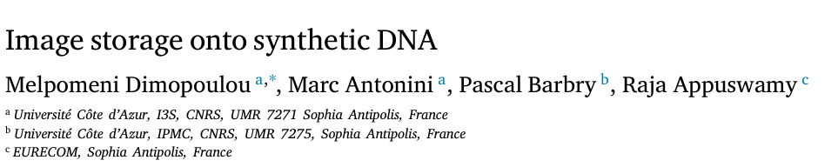


https://doi.org/10.1016/j.image.2021.116331

Slide 2
MOTIVATION & INTRODUCTION
By 2025, it’s predicted there will be over 160 zettabytes (2 raised to the 70th power) of data. Around 80% of this data is "cold data" that is infrequently accessed but stored long-term.
Traditional storage (hard disks, tapes) has limited capacity and lifespan (5-20 years), requiring frequent data migration to prevent loss.
DNA offers an extremely high data density (up to 455 exabytes per gram) and remains stable for centuries, making it an ideal candidate for archival storage.
SO WHAT? The ultimate goal is to present a practical method for encoding digital images onto DNA, paving the way for scalable, cost-effective, and durable storage solutions for the future.

Slide 3
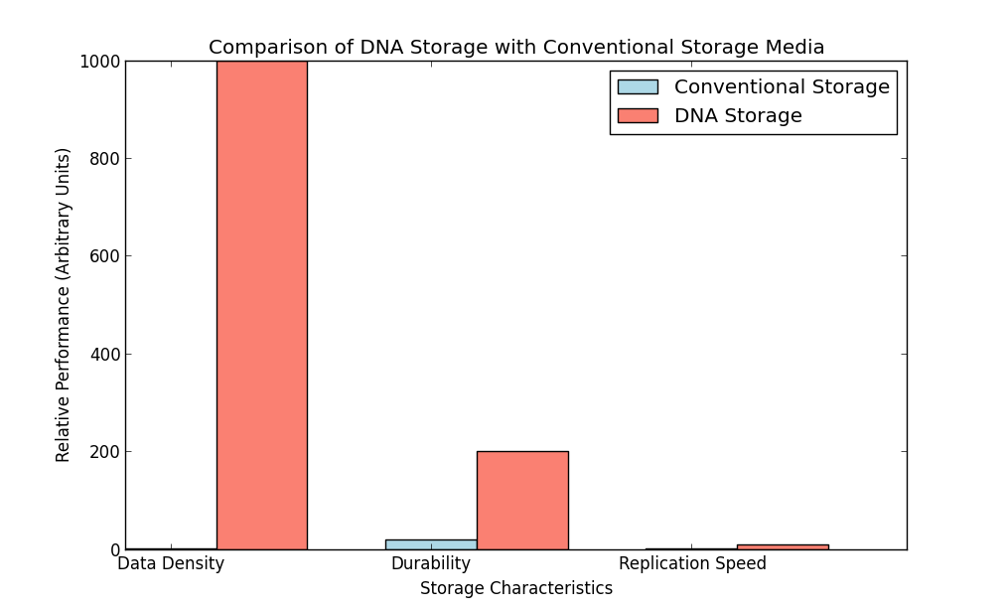
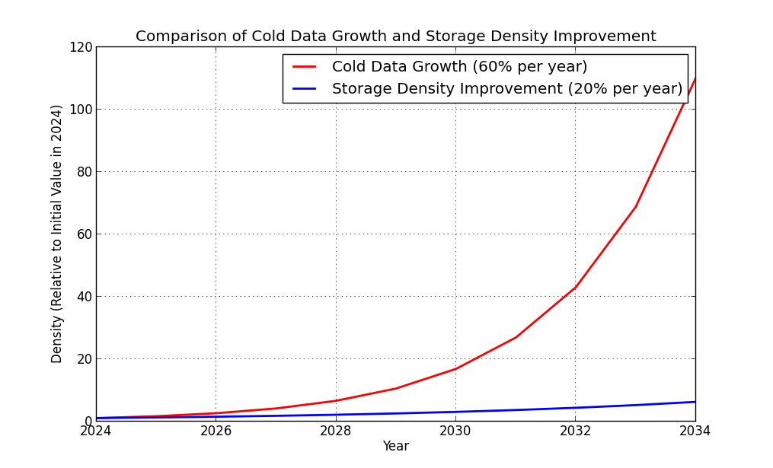
DNA STORAGE AND DATA GROWTH

Slide 4
Why DNA?
DNA can store vast amounts of information in a tiny volume. For instance, 1 gram of DNA can hold the equivalent of millions of hard drives.
DNA is stable under ambient conditions, unlike hard disks or tape, which degrade after a few decades.
DNA can be copied quickly and efficiently through in-vitro techniques, allowing rapid data backup and recovery without loss in quality.

Slide 5
Challenges of dna data storage
There a two main challenges.
DNA Synthesis and Sequencing: Current methods are costly and prone to errors.
Biological Constraints:
Homopolymers: Homopolymers are long stretches of identical bases in a DNA sequence (e.g., AAAAA or GGGGG).
GC Content Balance: GC content refers to the proportion of guanine (G) and cytosine (C) bases in a DNA sequence relative to adenine (A) and thymine (T).
Pattern Repetition: Repetitive patterns are sequences with repeating motifs (e.g., ATATAT or GCGCGC).

Slide 6
HOW DO THEY CONSTRAIN?
Homopolymers: Long stretches of identical bases (e.g., AAAA or GGGG) are challenging for sequencing technologies to interpret accurately. Homopolymers can cause errors, such as misreading the length of the repeated base. Therefore, avoiding homopolymer sequences helps to maintain accuracy in both synthesis and sequencing.
GC Content Balance: The stability of DNA strands is influenced by the proportion of guanine (G) and cytosine (C) bases relative to adenine (A) and thymine (T) bases. G and C bases bind more strongly due to their three hydrogen bonds (compared to A-T's two), so strands with too high or too low GC content may form secondary structures or become more susceptible to breaking. A balanced GC content, ideally around 40-60%, helps maintain strand stability and improves sequencing reliability.
Pattern Repetition: Repeated base patterns (like ATATAT) increase the risk of sequencing errors due to potential misalignment of reads or failure to distinguish similar patterns. Such repetitions can lead to higher error rates during sequencing, especially with long DNA strands, so the encoding must minimize these repetitive patterns to reduce sequencing inaccuracies.

Slide 7
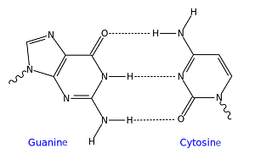
Biological constraints

Slide 8
Proposed Solution
The paper proposes a DNA encoding solution for images that is optimized to reduce synthesis costs and error rates.
The algorithm applies strict error-prevention measures, adhering to the biological constraints mentioned.
By compressing images before encoding, the solution minimizes the number of nucleotides needed, lowering costs.

Slide 9
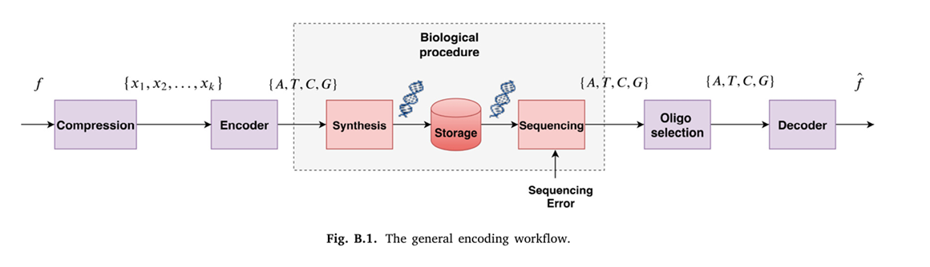
ENCODING WORKFLOW
Image Compression: The image is compressed with Discrete Wavelet Transform (DWT), breaking it into subbands.
Encoding: Quantized values from compression are encoded into DNA sequences that adhere to error-prevention rules.
DNA Synthesis: The encoded DNA is synthesized in oligos (short DNA segments) to minimize errors, with lengths of 150-200 nucleotides.
Decoding and Reconstruction: DNA sequences are decoded post-sequencing, allowing for image reconstruction.

Slide 10
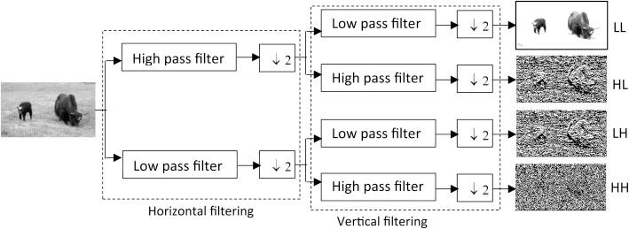
What Is dwt?
The Discrete Wavelet Transform (DWT) is a mathematical method used to analyze and break down data, like an image, into smaller parts called subbands. It separates the data into different levels of details and frequencies.
DWT transforms the image into four subbands:
LL (Low-Low): Contains the overall structure or the "blurry" version of the image.
LH (Low-High): Captures horizontal edges and details.
HL (High-Low): Captures vertical edges and details.
HH (High-High): Captures fine diagonal details.

Slide 11
ENCODING WORKFLOW
The input data consists of symbols (Σ = {s₁, s₂, ..., sₖ}) to be encoded into quaternary DNA sequences (C* = {c₁, c₂, ..., cₗ}), composed of the DNA alphabet {A, T, C, G}. The goal is to map each symbol sᵢ ∈ Σ to a codeword cᵢ ∈ C* using the function Γ(sᵢ) = cᵢ.
Dictionary used: {AT, AC, AG, TA, TC, TG, CA, CT, GA, GT}

Slide 12
COMPRESSION & NUCLEOTIDE ALLOCATION
Wavelet Compression (DWT): Compresses the image by separating it into frequency subbands, which are then quantized. This step ensures optimal data density.
Nucleotide Allocation: Similar to bit allocation in digital coding, this algorithm distributes nucleotides across the image subbands to maximize storage efficiency.
Balancing Quality and Cost: By controlling the nucleotide allocation, the process maintains image quality while minimizing the number of nucleotides needed.

Slide 13
BIOLOGICAL CONSTRAINTS IN ENCODING
Avoiding Homopolymers: Prevents consecutive identical bases by choosing diverse base pairs.
Balancing GC Content: Ensures G-C pairs are proportionally balanced with A-T pairs for stability.
Pattern Randomization: Introduces randomness to reduce pattern repetitions and further decrease error likelihood.

Slide 14
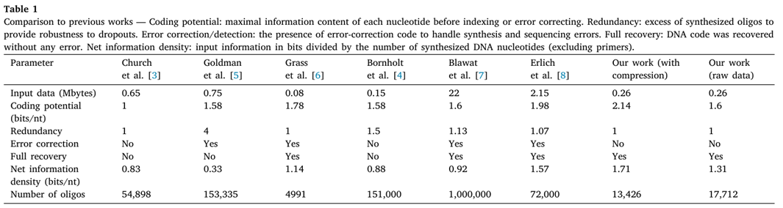
COMPARISON WITH PREVIOUS WORK
Traditional Methods: Past methods convert binary data to DNA but often fail under sequencing errors, or they involve redundancy that increases cost.
Coding Efficiency: This method reaches a coding efficiency of 2.14 bits per nucleotide, allowing both higher density and error robustness.
Avoiding Patterns and Errors: Unlike previous methods, this encoding specifically avoids patterns and meets biological constraints, reducing sequencing errors significantly.

Slide 15
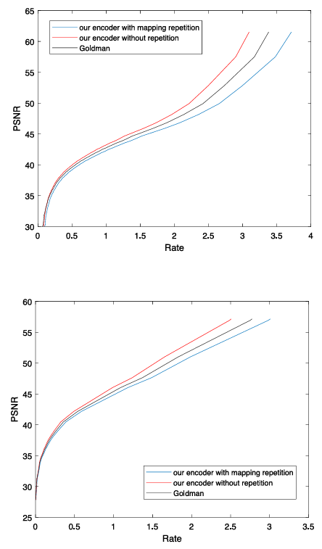
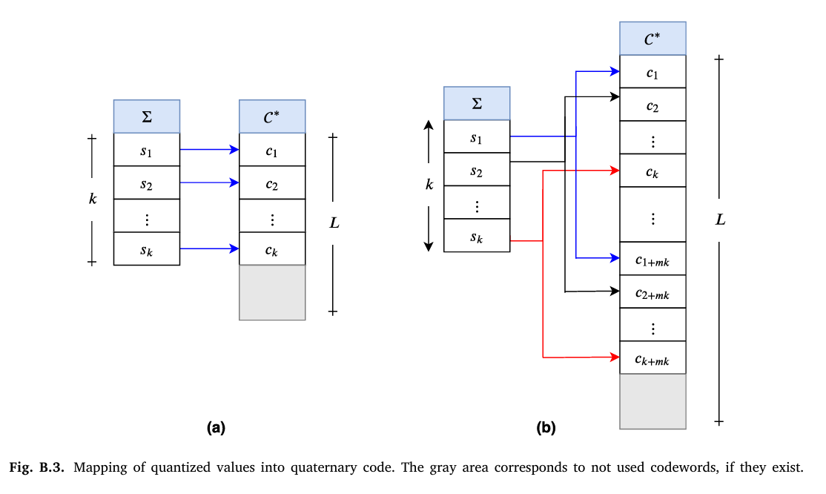

Comparison with goldman et al.

Slide 16
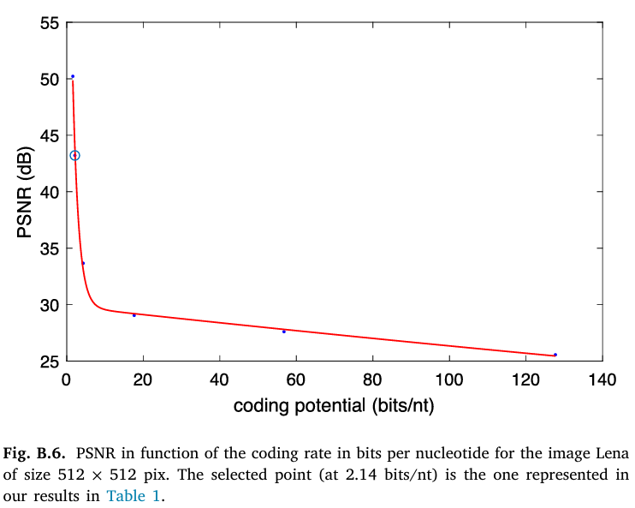
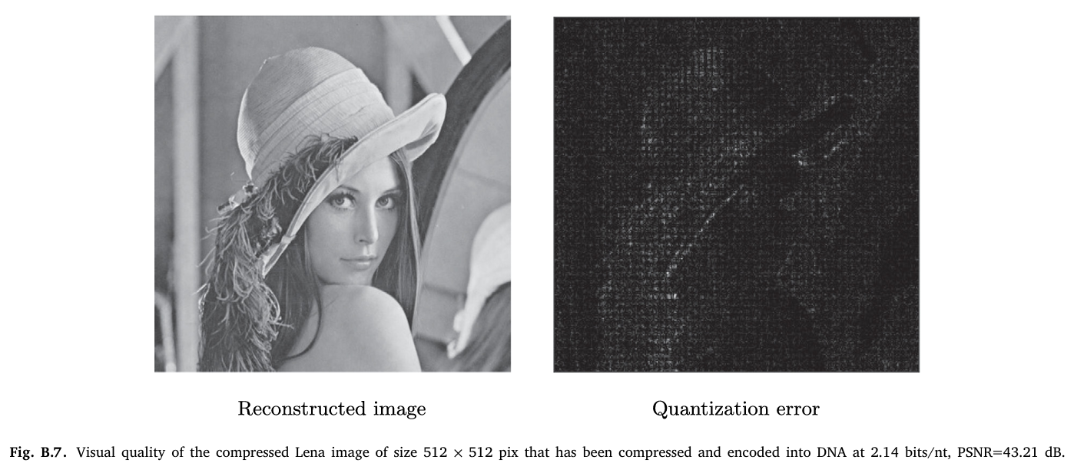
RESULTS & PERFORMANCE
The proposed encoding approach achieves high image quality at a near-lossless level, with a PSNR of 43.21 dB, and coding efficiency reaching 2.14 bits per nucleotide.
By compressing data before encoding and carefully managing nucleotide allocation, the method effectively reduces synthesis costs while maintaining image quality.

Slide 17
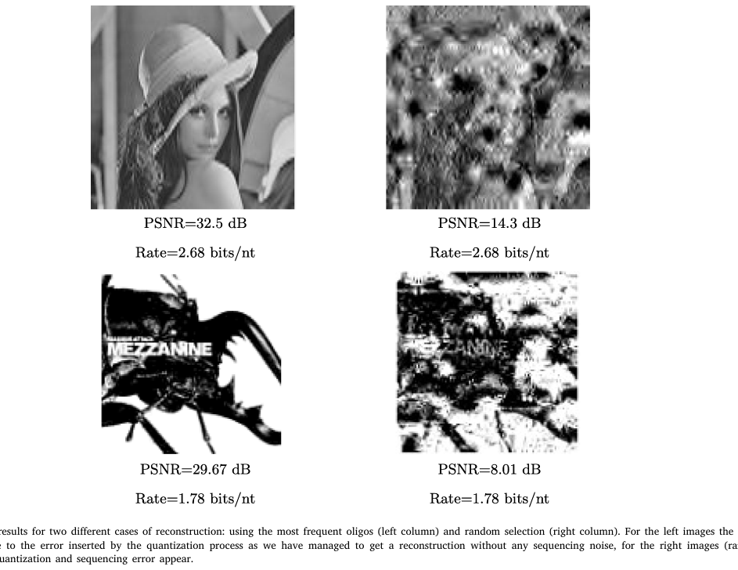
PRACTICAL EXPERIMENT & FINDINGS
Two small images, including a 128x128 version of "Lena," were successfully encoded and decoded from synthetic DNA.
Used frequent oligos to reconstruct the image accurately, with random selection showing error without affecting the main data.
This practical test showed that carefully selected oligos reduce errors and allow for faithful image retrieval.

Slide 18


MY LEARNINGS
I have tried to implement what the paper tried to accomplish, to some extent. I took a 1000 x 1000 pixel album cover, encoded it into a DNA sequence stored in FASTA format. I then used a decoder to retrieve the information and reconstructed the image.
Python code for this is as follows:

Slide 19
CONCLUSION & FUTURE DIRECTION
DNA-based storage provides unmatched data density, longevity, and replication ease. This encoding approach meets the stringent requirements of biological synthesis and sequencing.
The method could be expanded for larger datasets, different data types, and more sophisticated quantization algorithms to further improve efficiency and reduce costs.
THANK YOU

