Slide 1


JBoss Forge / Arquillian
Two Missing Links in Enterprise Java Development
Koen Aers
Sr. Software Engineer
JBoss by Red Hat

Slide 2


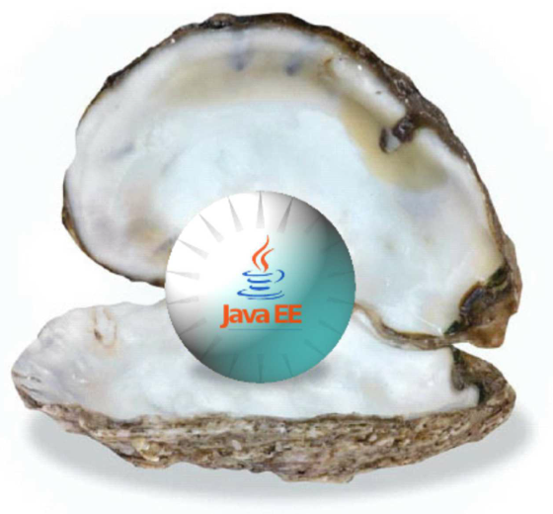
Java EE 6 Is Your Oyster
Less (boilerplate) code
Higher signal to noise ratio
Powerful mechanisms
Portable apps and knowledge
POJOs
Annotations
EJB Lite
Simplified packaging
Profiles
AS 7 startup < 3 sec

Slide 3
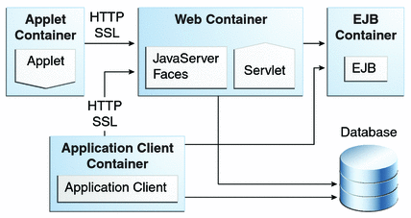
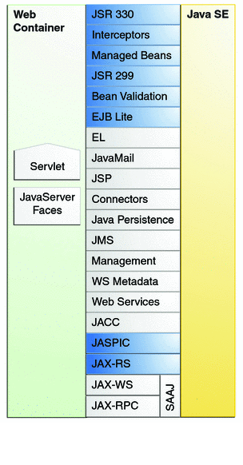

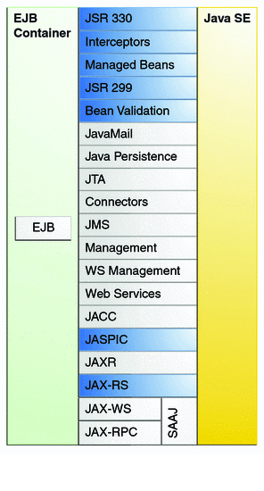
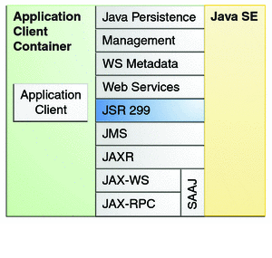

Daunting? What Do You Mean?
Startup Cost
Gotchas
Integration
Details

Slide 4


http://jboss.org/forge
Carve out a project, work it into shape

Slide 5


Slide 6
Daunting? What Do You Mean?
Startup Cost
Gotchas
Testing
Integration
Details

Slide 7

http://arquillian.org
A Container-oriented Testing Framework

Slide 8

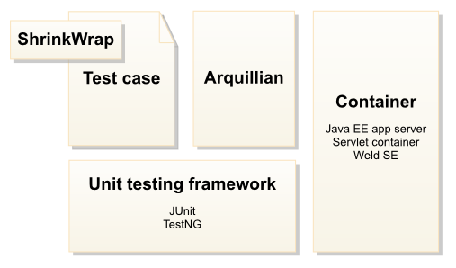

Slide 9

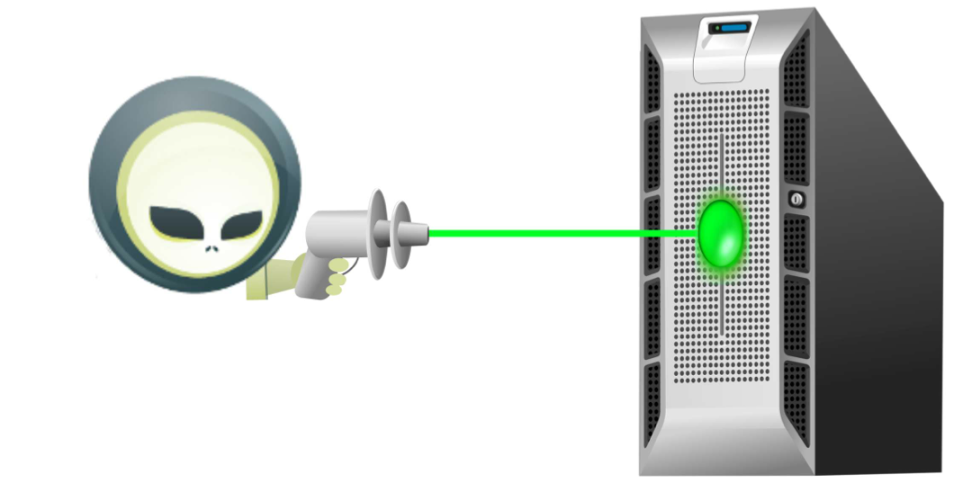
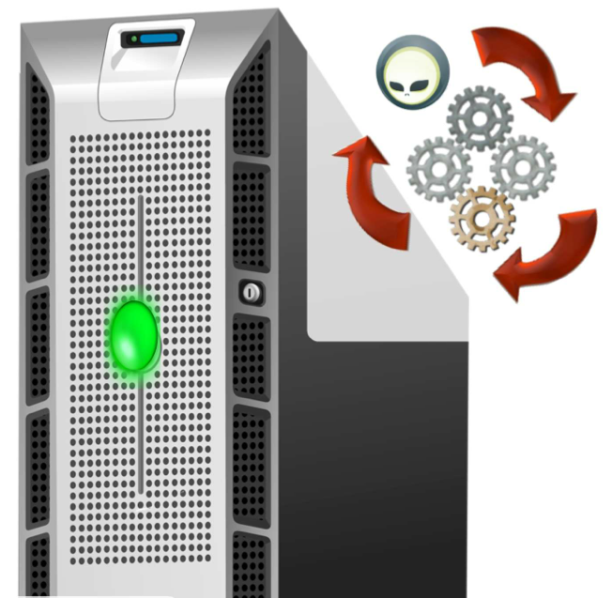
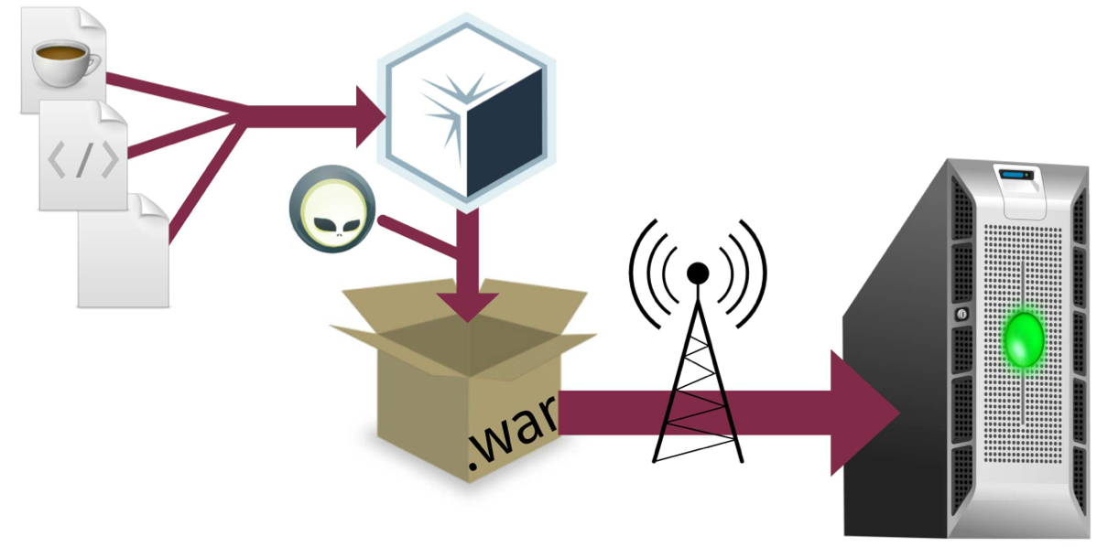
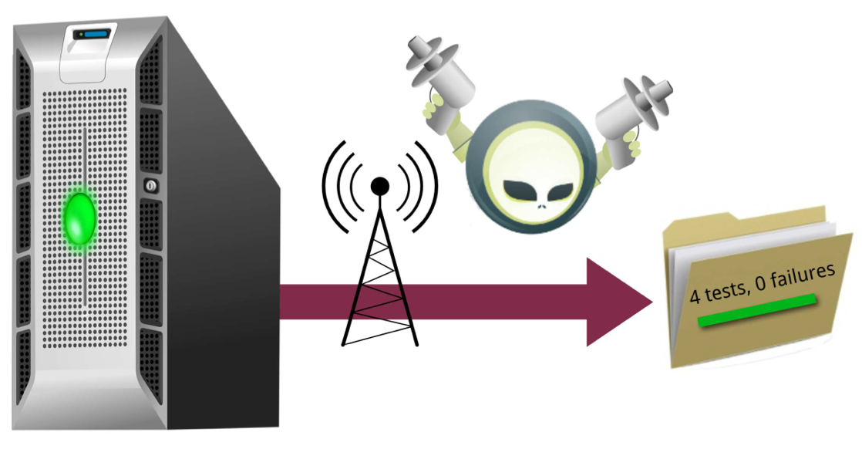
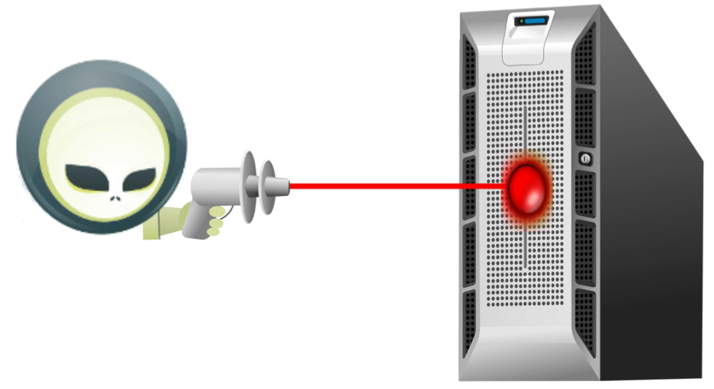
1. Select container
2. Start or connect to container
4. Run test in-container
3. Package and deploy
5. Capture results
6. Undeploy and disconnect

Slide 10

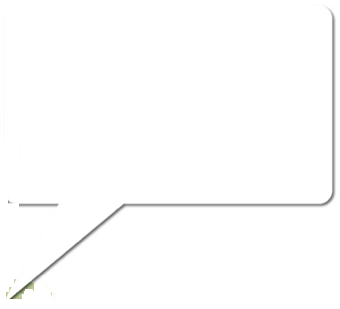
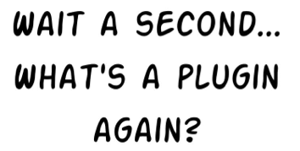

Slide 11
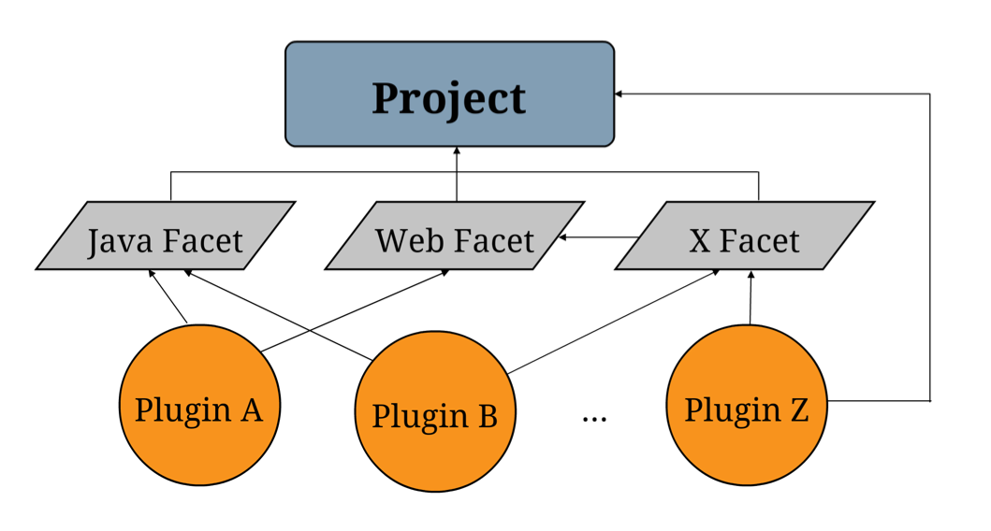

Slide 12
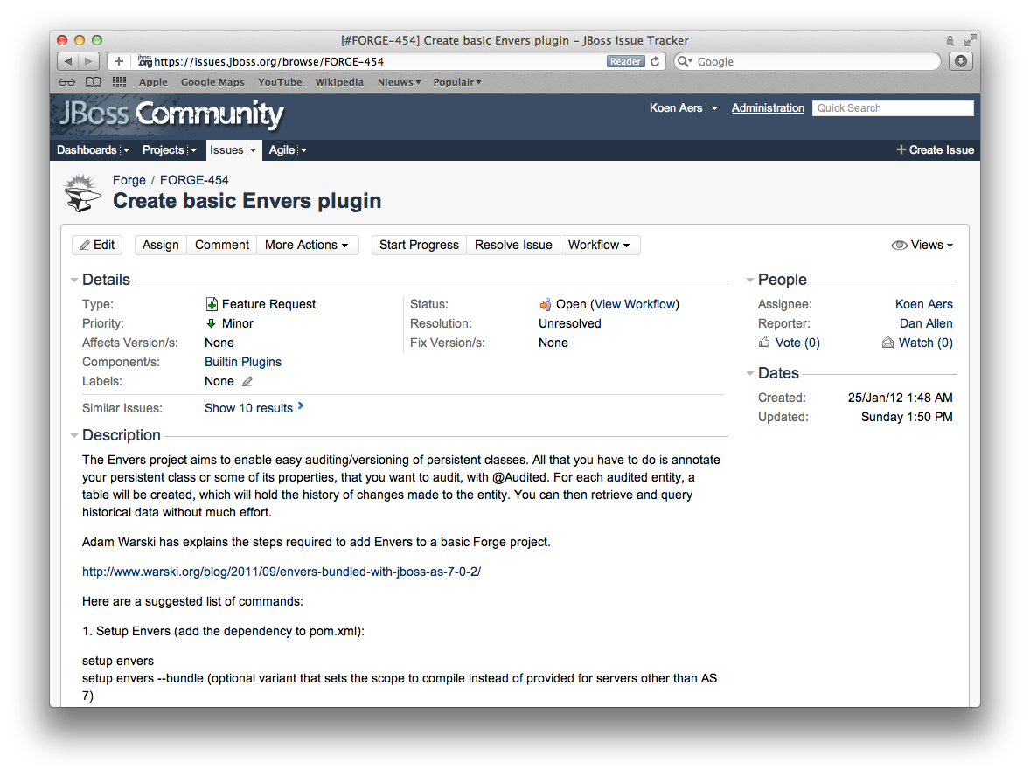

Slide 13
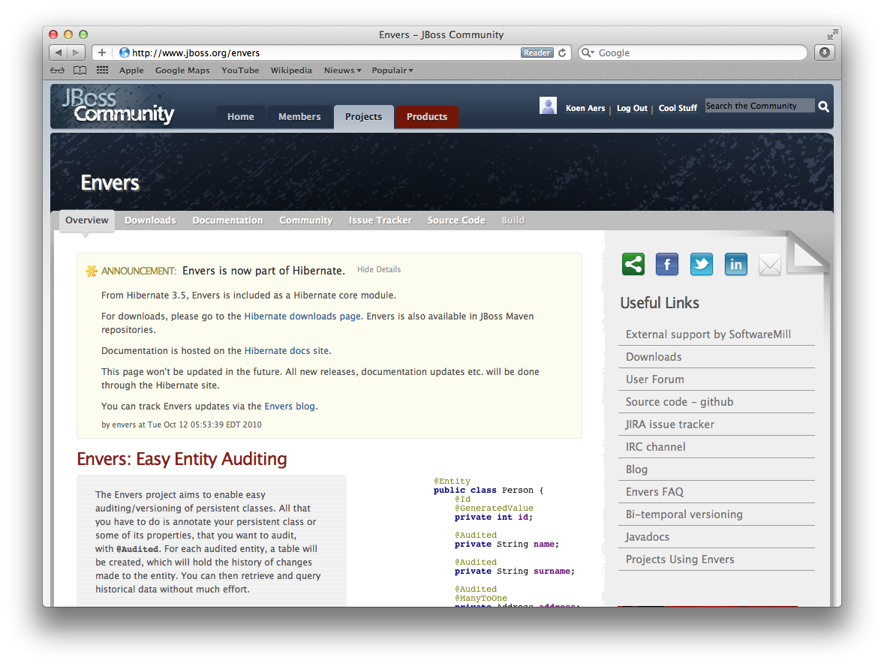

Slide 14
Gets you started quickly
Takes care of the gotchas
Adds/activates technologies via plugins
Handles details, gives you perspective
Less (boilerplate) test code
Micro-deployments
Looks like unit tests, executes in real environment
Same tests for multiple target environments

Slide 15
Questions?
http://jboss.org/forge
http://arquillian.org
koen.aers@jboss.com

