Slide 1
BOF2695 - Fast-Developing CRUD-like Applications with Java EE 7
George Gastaldi
Lincoln Baxter, III
Software Engineer, Red Hat
Software Engineer, Red Hat

Slide 2


Who are we?
George Gastaldi
  Works for Red Hat
  JBoss Forge core developer
  First Time in JavaOne
Lincoln Baxter, III
  Works for Red Hat
  JBoss Forge Project Lead

Slide 3
Agenda
CRUD
JBoss Forge
  What is JBoss Forge?
  What does it do for me?
DEMO
Q&A and discussion

Slide 4
CRUD
Create, Read, Update, Delete
  In wikipedia: the four basic functions of a persistent storage
Also known as BREAD
  Browse, Read, Edit, Add, Delete

Slide 5
We think that creating CRUD apps sucks
And it is boring
Even worse when attending a session after 8pm

Slide 6
We want it to be fast and fun

Slide 7
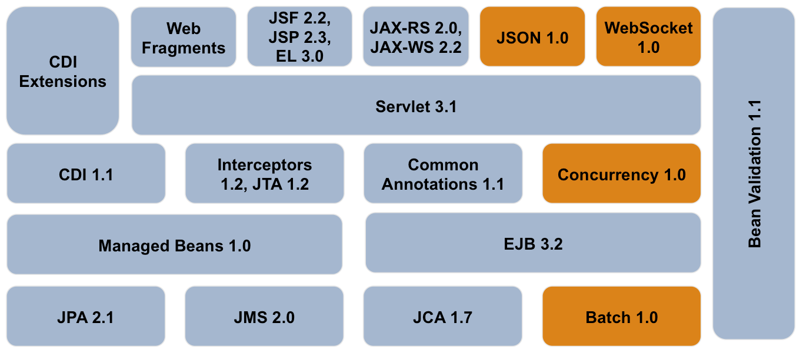
Java EE 7

Slide 8
Model creation strategies
Top - Down:
  No existing system yet
  Starting from conceptual ideas (eg. Class Diagrams)
Bottom - Up:
  Existing systems (existing RDBMS)

Slide 9


Slide 10
DEMO
Talk is cheap, show me the code
– Linus Torvalds

Slide 11
JBoss Forge
WORA for tools
  Write once, run in any IDE
Standard extension model
  Create addons using CDI or plain Java
Built-in support for Java EE 6 and 7
Non-intrusive approach on existing projects

Slide 12
Q&A

Slide 13
Wanna know more about JBoss Forge?
Check out CON-SOMETHING Tools in Action

Slide 14
STAY IN THE LOOP
Website: http://forge.jboss.org
Twitter: http://twitter.com/JBossForge
Forum: http://community.jboss.org/en/forge
Videos: http://vimeo.com/channels/jbossforge
IRC: #forge / irc.freenode.net
Get the Sources: http://github.com/forge/core

