Slide 1
TOKEN MANAGEMENT
Omar Gastelum – Brandy Yang

Slide 2
PLANNING

Slide 3
Problem Statement
The system may serve as a solution to manage tokens that can be used to purchase items at an event.
The goal of the project is to provide flexibility to the number of tickets that will be sold by building a program that will generate tokens that can be loaded to cards based on demand.

Slide 4
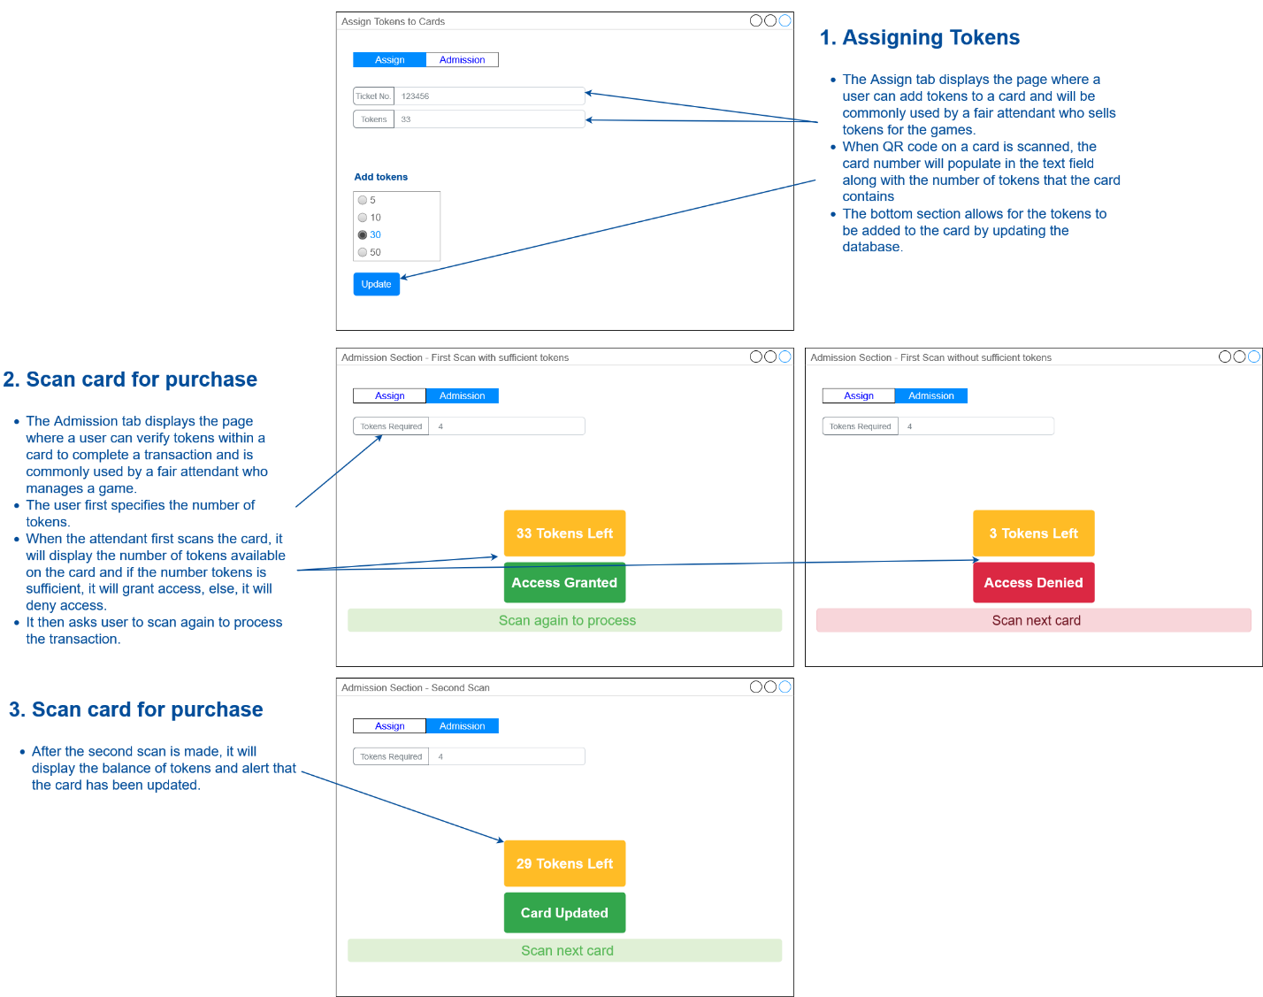
Early Visual Concept
Load tokens to cards
Scan card to purchase items

Slide 5
DESIGN

Slide 6
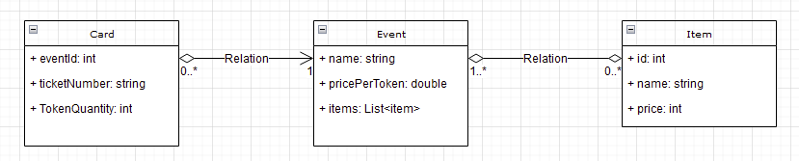
Database
One-to-many and many-to-many relationships
Card table holds the token quantity and the number of the card
MySQL
6

Slide 7
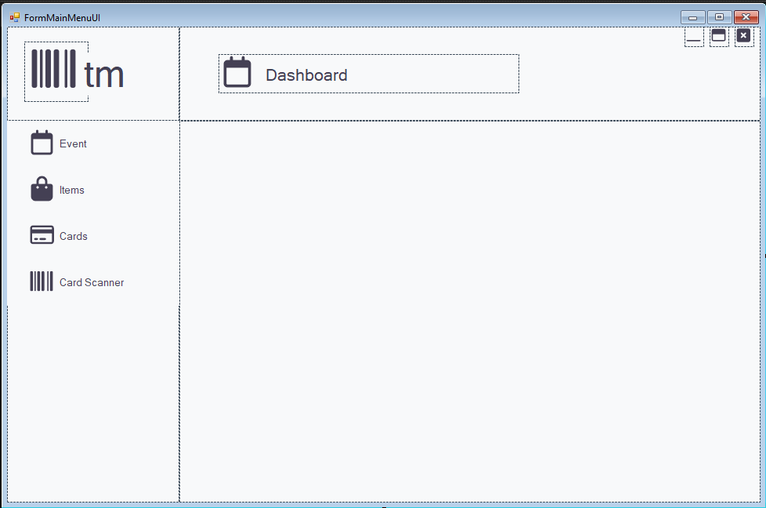
User Interface
Navigation Bar
Logo
Dynamic Header

Slide 8
IMPLEMENTATION

Slide 9
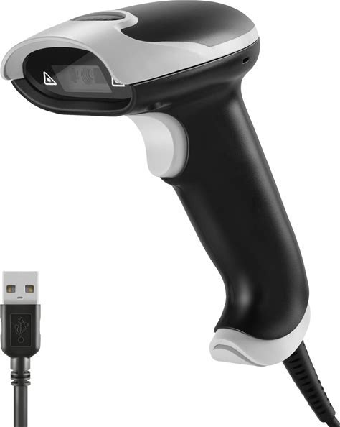
Hardware
JRHC USB Barcode Scanner

Slide 10
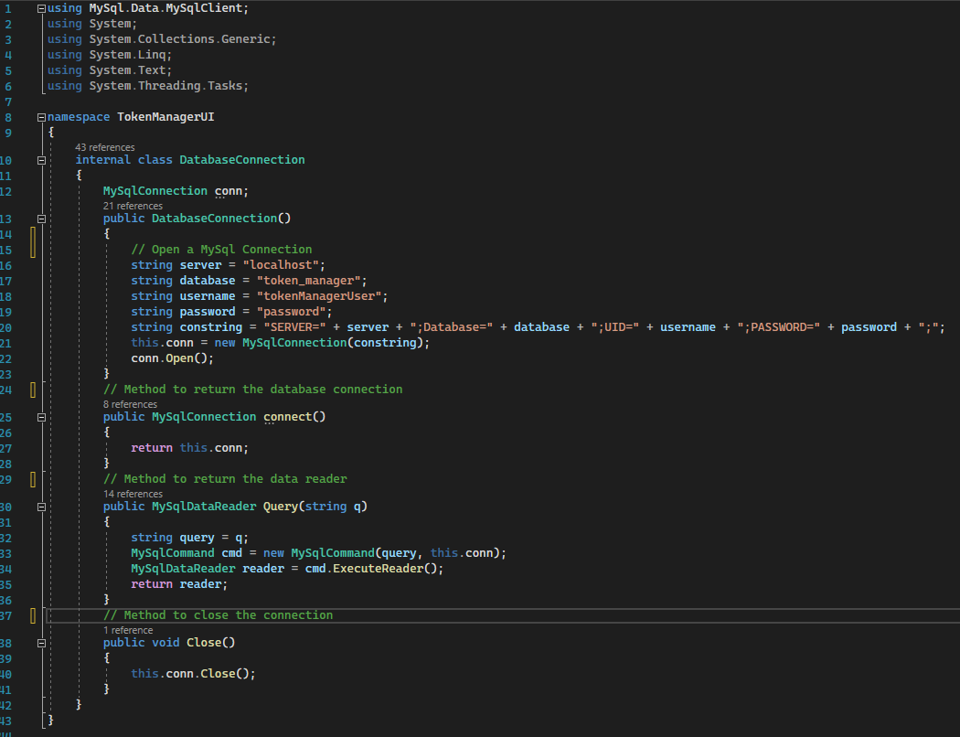
Database
MySQL Client Library

Slide 11
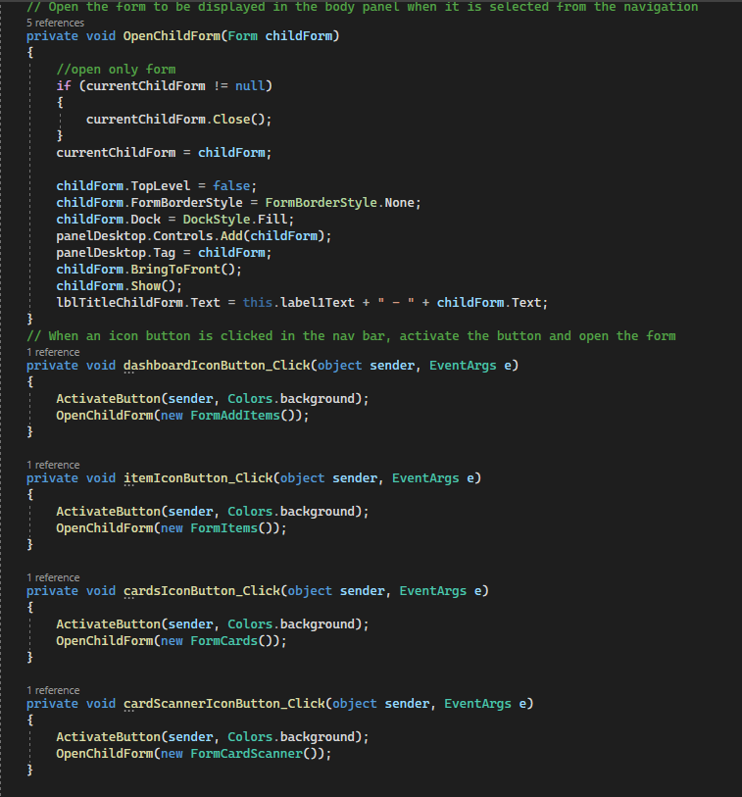
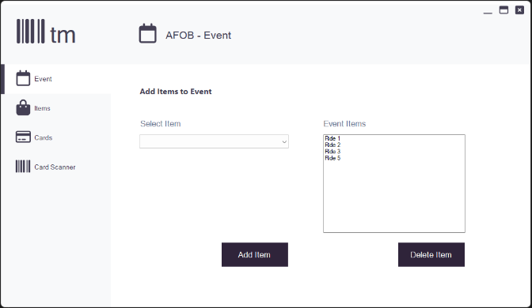
Main UI
Sets the default active button and form.
When a button is clicked, the button becomes active, and the header and form change to the corresponding selection.

Slide 12
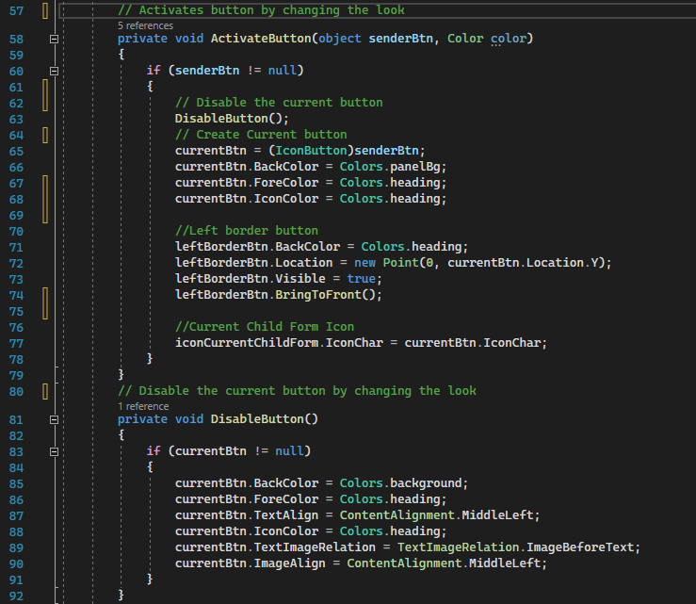
Main UI

Slide 13
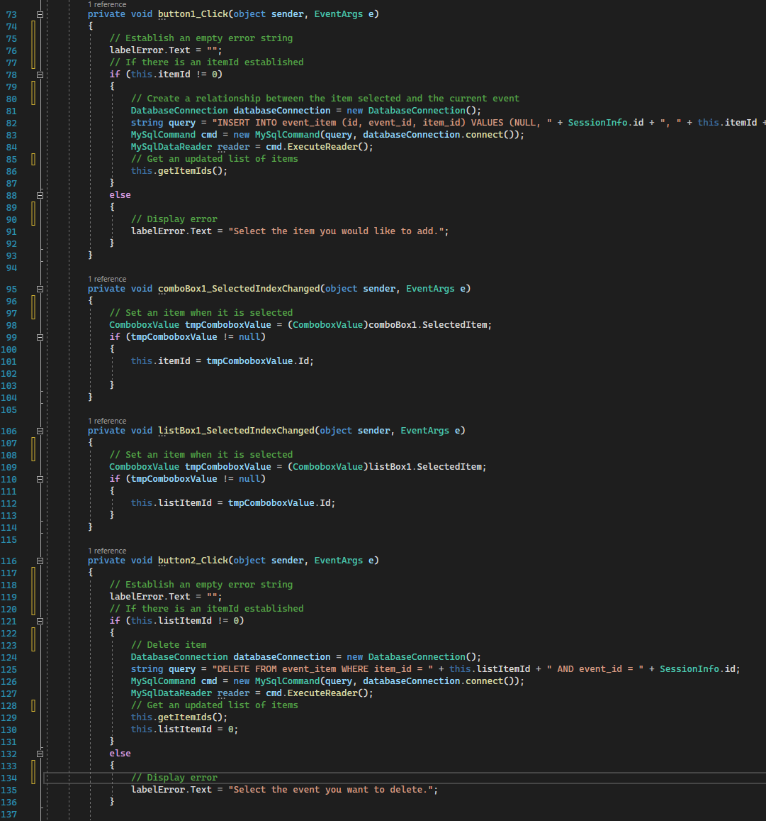

General Functionality of the Forms
Items can be added to the list by filling out the form and clicking the appropriate button.
The same is true for the delete buttons.
Error handling is also included in all the forms.

Slide 14
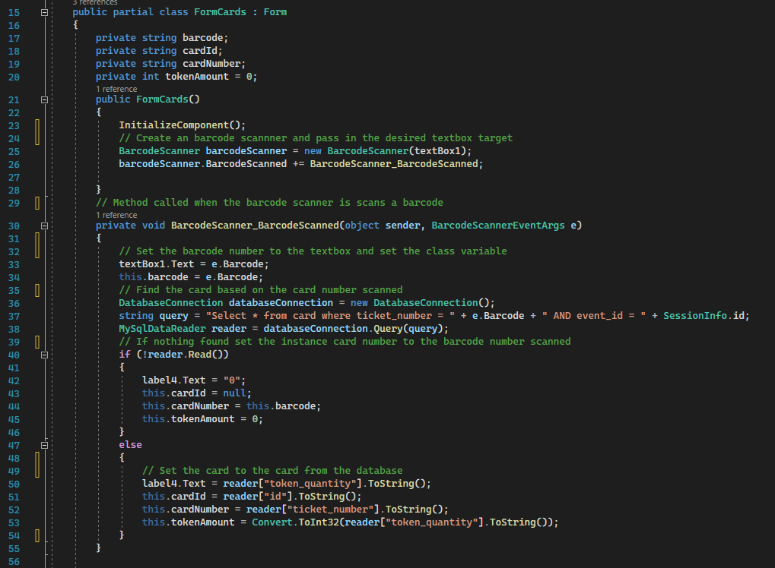
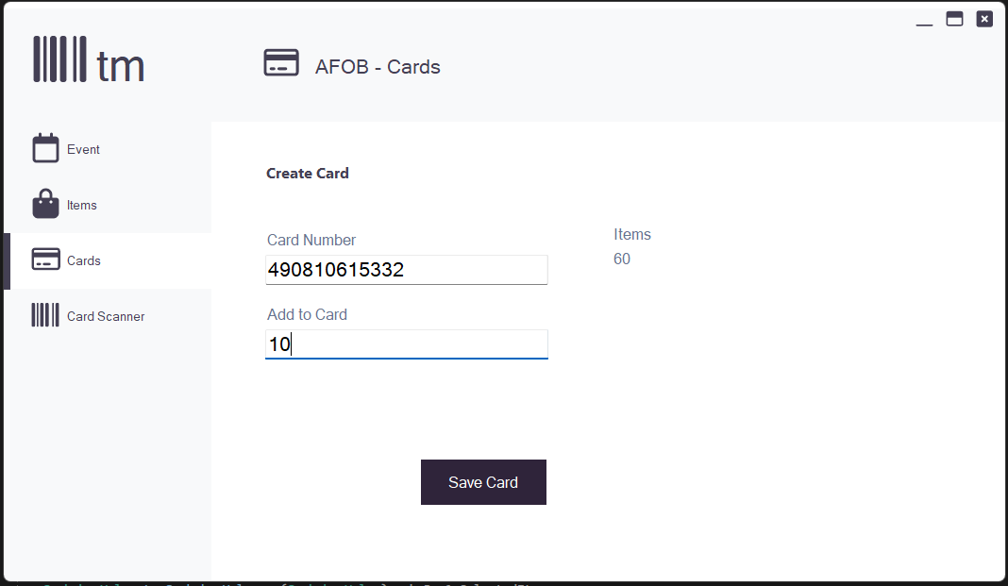
Creating Cards and Adding Tokens
Barcode Scanner populates in the text box
Add tokens to a text box
Click to add

Slide 15
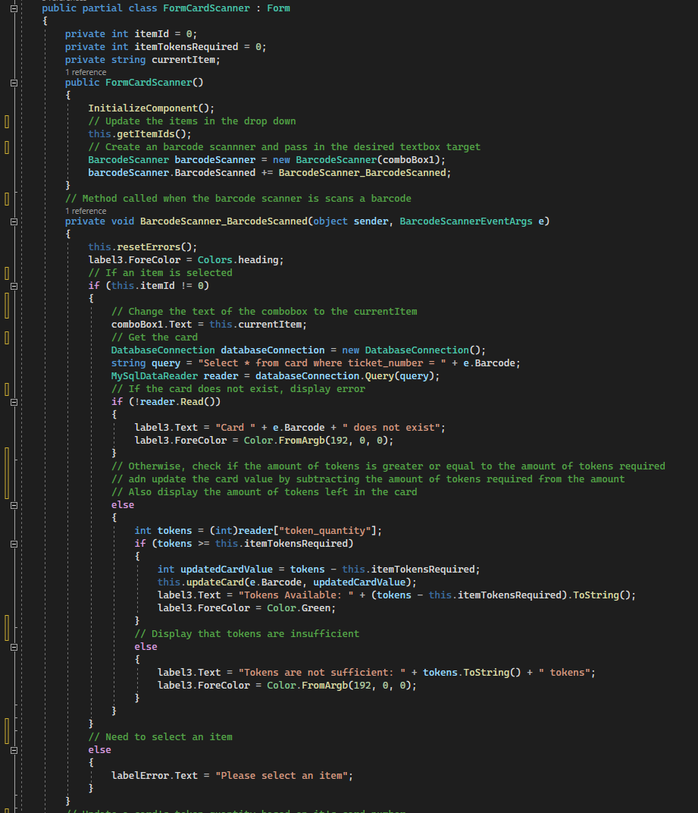
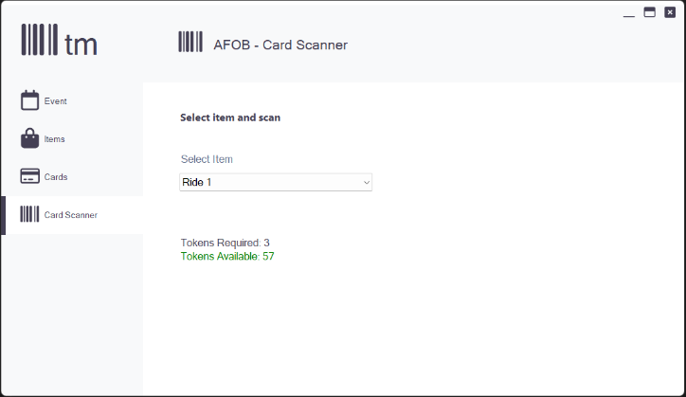
Transactions with Card Scanner
Select an item from the dropdown
Checks if the number of tokens in the card suffices the required tokens
If so, it will subtract the number of tokens required from the number of tokens in the card
If not, it will decline the transaction

Slide 16
DEMO

Slide 17
EVALUATION

Slide 18
User Evaluation
Requires production testing
Tasks that need to be tested
Check all pages to ensure that all CRUD operations work
Perform transactions
Use different barcode scanners

Slide 19
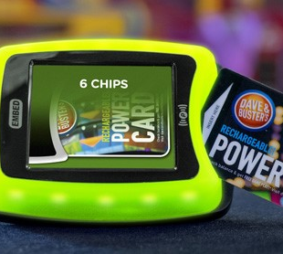
Existing Application Comparison
The system can be compared to Dave & Buster’s card/token management system.
The D&B system additionally
Is managed without attendants scanning cards
Manages tickets earned for prizes

Slide 20
CONCLUSION

Slide 21
Future of the Application
The system can be extended to
Take payments for purchasing tokens
Handle tickets tracking to earn prizes

Slide 22
Q&A

