Slide 1


Orbiting Minds
An RR-10 Data-to-3D Simulation Experience
From spaceflight mouse-brain transcriptomics to interactive visual evidence and creative media.
Presenter: Gaston Dana, Multimodal Technologist • Kaggle Researcher
Gaston Dana • 2026

Slide 2
ORBITING MINDS
How can open space-biology data become more interpretable, inspectable, and memorable?
01 // BRIDGING THE ANALYTICAL GAP
By bridging the gap between raw datasets and interactive media, this project demonstrates how open transcriptomics data can be communicated beyond static plots.
02 // HYBRID EVIDENCE INTERPRETATION
While a benchmark tests how AI systems interpret structured scientific evidence, an interactive visual layer keeps the original evidence visible, creating a more accessible narrative.
PROJECT LIMITATION //Ultimately, visualization extends analysis communication; it does not replace primary analysis.

Slide 3
RR-10: Spaceflight Mouse-Brain Transcriptomics
ORBITING MINDS
Mission Context
NASA Rodent Research-10
The NASA Rodent Research-10 (RR-10) mission provides the baseline scientific context for comparing spaceflight-induced physiological changes against earthbound baselines.
This comparative analysis strictly evaluates Flight (FLT) and Ground Control (GC) mouse samples, mapping region-specific neurological adaptation.
Focus is localized to two distinct functional brain regions: the cerebellum and the hippocampus, tracking transcriptional variations and sequence provenance.
OSDR Source Study / Region
Provenance ID
OSD-563
Cerebellum Transcriptomics
GLDS-568
Dataset Registry
OSD-564
Hippocampus Transcriptomics
GLDS-569
Dataset Registry
Analytical Conditions
FLT (Flight Samples) vs. GC (Ground Control Baseline)
Organism
Mus musculus
RR-10 Cohort

Slide 4
ORBITING MINDS
REGION 01 // CEREBELLAR TISSUE
Cerebellum Comparison
An investigation of cerebellar architecture, evaluating spatial variance and transcriptomic stability between flight conditions and terrestrial baselines.
REGION 02 // HIPPOCAMPAL TISSUE
Hippocampus Comparison
Evaluating hippocampal tissue profiles to analyze how microgravity-induced stresses alter neural synaptic transcript mappings compared to ground groups.
FLT PROFILE
Derived transcriptomic parameters show elevated dispersion in outer cerebellar layers.
GC PROFILE
Ground control baseline shows uniform architectural stability under standard conditions.
FLT PROFILE
Pronounced contrast in synaptic transmission transcripts across hippocampal CA1/CA3.
GC PROFILE
Ground control maintains expected spatial patterns of localized genetic expression.
Visualization extends analysis communication; it does not replace primary analysis.

Slide 5
ORBITING MINDS
From source records to reproducible notebook evidence
The spaceflight transcriptomics pipeline translates raw NASA OSDR source metadata into analytical benchmarks, generating structured datasets and procedural 3D visual environments.
STEP 01
NASA OSDR
Source records (OSD-563, OSD-564)
STEP 02
Kaggle DB
Translated public dataset
STEP 03
Notebook
Cerebellum vs Hippocampus analysis
STEP 04
Benchmark
RR-10 transcriptomics reasoning
STEP 05
JSON Truth
Processed biological data matrix
STEP 06
Blender
Procedural tissue & flight visualization
STEP 07
GLB / WebGL
Interactive model experience

Slide 6

FLT (FLIGHT)
GC (GROUND)
Transcriptomic Space Analysis
Distinct PCA Space Positions
Flight (FLT) and Ground Control (GC) samples occupy distinct positions in PCA space. This Principal Component Analysis provides clear visual evidence of the variance between the sample conditions.
Cerebellum (OSD-563)
PC1 accounts for 25.6% and PC2 for 18.5%.
Hippocampus (OSD-564)
PC1 represents 28.3% and PC2 is 15.7%.
Cerebellum (OSD-563)
30
Hippocampus (OSD-564)
15
PC2 (Variance Explained)
0
-15
-20
-10
0
10
20
PC1 (Variance Explained)

Slide 7
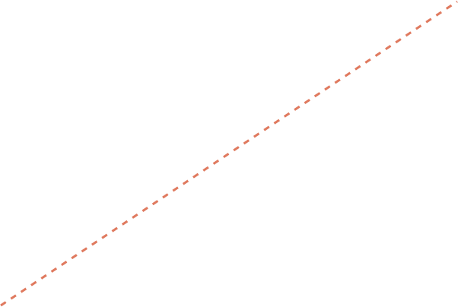
FLT (FLIGHT)
GC (GROUND)
DATA INTEGRITY & BENCHMARKING
Quality-control context before downstream interpretation
The rRNA-removal quality control figure provides essential processing context rather than a biological outcome.
Per-value variance-stabilizing transformation (VST) agreement is displayed as r = 1.000, with the identity line y = x making this agreement clearly visible.
Additionally, the distribution panel documents the rRNA-removal shift, ensuring data integrity before downstream interpretation.
POST-REMOVAL VST
r = 1.000
VST AGREEMENT
PRE-REMOVAL TRANSFORMATION
FIG 01 // VST AGREEMENT PLOT
Identity line y = x makes absolute value-stabilizing transformation agreement visible.

Slide 8
ORBITING MINDS
BENCHMARK GOAL
Turning analysis context into an AI reasoning benchmark
This benchmark tests how AI models interpret dense scientific and transcriptomic context. The evaluation task is strictly grounded in the dataset, the analysis notebook, and an explicit evaluation design.
The project is specifically engineered to surface AI reasoning quality, evidence use, limitations, and uncertainty, rather than just generating a polished answer.
CRITERIA 01 // GROUNDED CONTEXT
Evaluation task is strictly tied to the provided biological dataset, corresponding analysis notebook, and physical constraints.
CRITERIA 02 // REASONING QUALITY
Assesses how models parse dense technical evidence, synthesize complex transcriptomic relationships, and formulate explicit logic.
CRITERIA 03 // UNCERTAINTY & LIMITS
Measures the model's ability to outline transcriptomic dataset limitations, establish boundaries, and cleanly report technical uncertainty.

Slide 9



ORBITING MINDS
The technical scene is driven by defined visualization mappings
Input Evidence Context
3D Visual Encoding
Interpretation Boundary
Derived adaptation & performance-like parameters
Neural-core scale and emission
Visualization control, not physical metric
Volatility-like parameters
Rhythmic pulse and asymmetry
Visualization control, not physical metric
Cluster and complexity parameters
Telemetry ring and probe density
Visualization control, not physical metric
Duration parameters & PCA coordinates
Animation timeline & constellation motif
Visualization control, not physical metric
Interpretation Warning These are derived visualization controls, not direct physiological measurements.

Slide 10

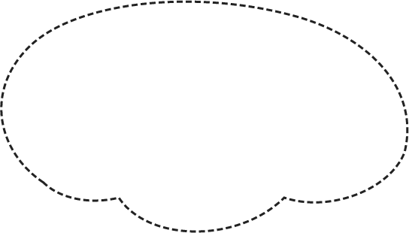





SYSTEM VIEWPORT // NEURAL PROXY
SYS.LOC: OSDR-MP-09 // LATERAL_PROJ
DATA_MATRIX_SYNCHRONIZED
A data-synchronized murine neural proxy
The multi-mode WebGL interactive technical viewer delivers a real-time, data-synchronized visualization of murine brain region transcriptomics.
This neural proxy environment explicitly explains the connection between the interactive visual outputs and the underlying OSDR scientific records.
By maintaining rigorous boundaries, the viewer ensures audiences understand exactly how the source data informs the 3D experience without confusing it for a literal biological model.
VIEWER PARAMS
TARGET: MURINE_V1
DATA SYNC: ACTIVE
OSDR_REF: SEC_402
MODE: MULTI-MODE
FLT_SEC_A
GC_SEC_B
BIO_REF_M
Y
X
Z
■ FLT_CYAN // ■ GC_CORAL // ■ BIO_CLAY
RENDER_ENGINE: WebGL2 // 60 FPS

Slide 11
ORBITING MINDS
Multi-mode interactive inspection of the neural proxy
01 // PRESENTATION
Offers a clean, cinematic scene tailored for high-level technical storytelling and clear overview.
02 // ANNOTATED
Highlights selected anatomical and telemetry hotspots with context to connect structural locations to real-time metrics.
03 // DIAGNOSTIC
Allows for detailed, procedural wireframe and topology inspection of the underlying spatial framework.
EVIDENCE DRAWER
Analytic Verification
Ensures literal PCA and QC graphics remain available for direct verification inside the interactive workspace.
* Note: The PCA constellation is graph-derived and does not represent a spatial anatomy map.

Slide 12
ORBITING MINDS
Technical evidence and creative communication can reinforce each other
01 // ANALYTICAL VIEWPORT
Technical Benchmark
A rigorous, data-linked repository designed for scientific validation and reproducibility.
Reproducible Pipeline: Built on a standardized, open-source workflow.
Evidence Drawer: Interactive, fully structured data tables.
Strict Boundaries: Explicit annotations of analytical limits.
02 // NARRATIVE VIEWPORT
Media Companion
A premium, human-readable editorial layer crafted for multidisciplinary engagement.
Character-Led Journey: Guided onboarding and storytelling.
Premium Visual Identity: High-end editorial layouts and graphics.
Creative Narratives: Clearly labeled, contextual explanations.
“One shared project architecture; two distinct modes of understanding.”
Together, they bridge the gap between rigorous, complex biological data and intuitive, accessible communication.

Slide 13
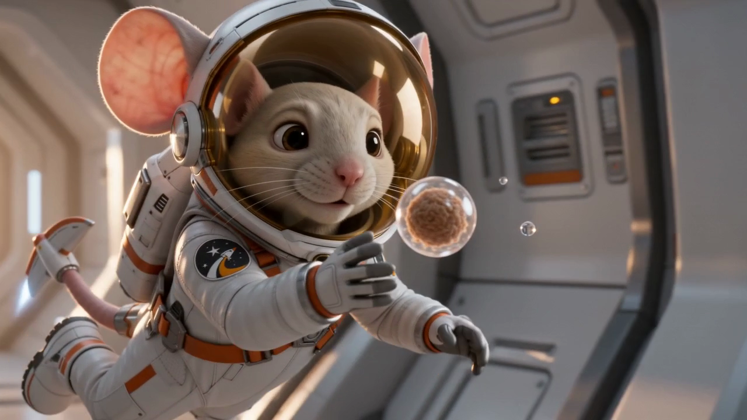
NOT SCIENTIFIC EVIDENCE
Commander Pip: Zero-G Odyssey — Cinematic Media Companion
CHARACTER & HABITAT ARCHITECTURE
A stylized astronaut-mouse narrative inside a zero-G orbital habitat, modeled with real-time PBR shaders and web-optimized geometry in Blender.
• EVA Spacesuit: Matte-white insulated fabric, 4-point orange cross-harness
• Bubble Visor: Ultra-wide optical glass with warm-gold reflective sheen
• Attitude Stabilizer: 5-segment articulated tail with T-wing micro-thruster
• Habitat Staging: Zero-G floating nutrient orbs & Earth-horizon orbital glow
This is a stylized narrative experience inspired by the RR-10 mission context, separate from technical benchmark visualizations to provide public storytelling.

Slide 14
ORBITING MINDS
Citation, Responsible Reuse, & Resources
01 // NASA OSDR / RR-10
NASA OSDR RR-10 Studies (OSD-563 / OSD-564) original repository records.
osdr.nasa.gov
02 // KAGGLE DATASETS
Processed space-flight transcriptomic datasets & analytics notebooks.
kaggle.com/benchmarks/.../rr-10-benchmark
kaggle.com/code/.../rr-10-spaceflight-mice
03 // COMMUNITY & DEV
Interactive benchmark proxy, code repository, and deployment.
orbiting-minds.vercel.app
github.com/.../blender-simulator
PROJECT CITATION
Gaston Dana. "Orbiting Minds" (GitHub, 2026)
Please cite this resource alongside the original NASA OSDR/GeneLab repository records for downstream applications and analytical replication.
Presenter Contact: Gaston Dana via GitHub • Google Scholar
RESPONSIBLE REUSE & LIMITATIONS
• Interactive Proxy: The technical visualization serves as a benchmark-informed interactive proxy, not a validated biomedical simulator.
• Authority: Original NASA OSDR records remain the authoritative source.
• Media Companion: All narrative companion materials represent stylized creative content, not scientific evidence.

