Slide 1
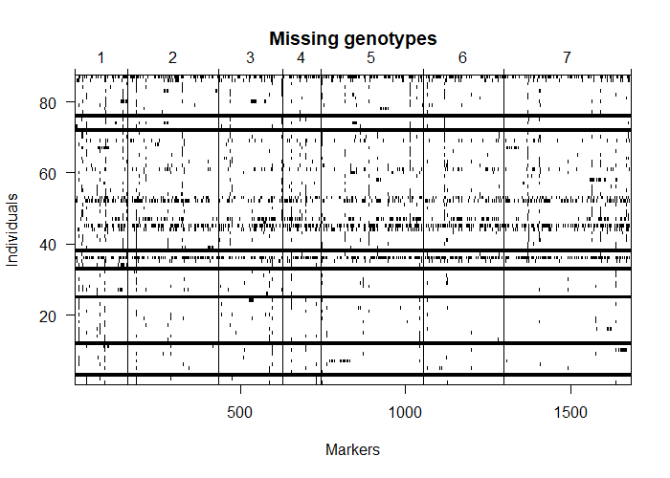
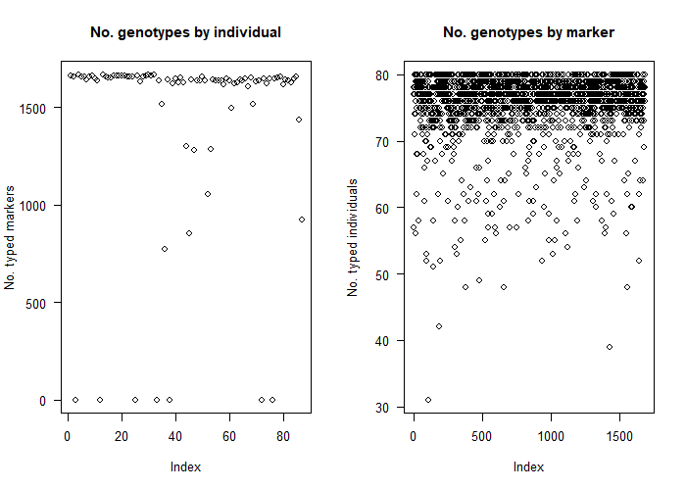
Ill50K Mapeo -original
summary (Ill50K_Mapeo.qtl)
BC(0)F(6) cross
No. individuals: 87
No. phenotypes: 2
Percent phenotyped: 100 100
No. chromosomes: 7
Autosomes: 1 2 3 4 5 6 7
Total markers: 1684
No. markers: 160 274 195 114 312 243 386
Percent genotyped: 86.7
Genotypes (%): AA:51.3 AB:0.0 BB:48.7

Slide 2
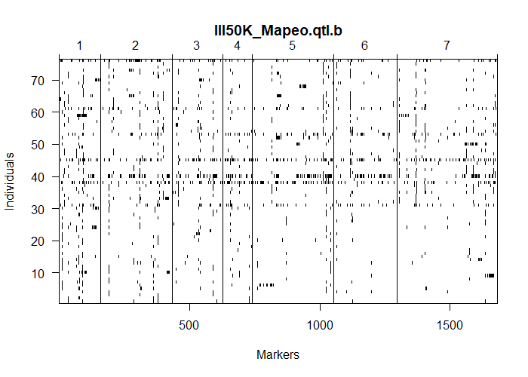
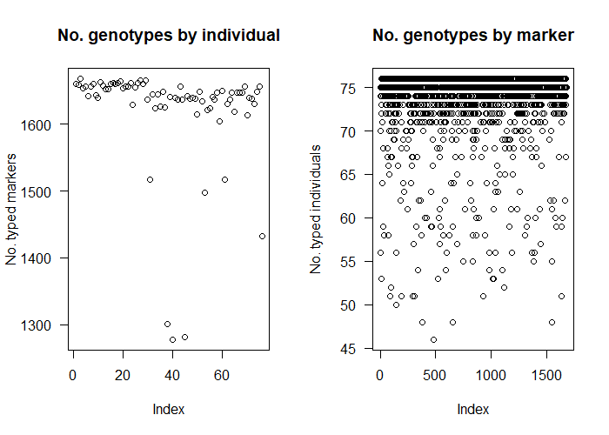
Ill50K Mapeo –control de missing data
BC(0)F(6) cross
No. individuals: 76
No. phenotypes: 2
Percent phenotyped: 100 100
No. chromosomes: 7
Autosomes: 1 2 3 4 5 6 7
Total markers: 1681
No. markers: 159 273 195 114 312 243 385
Percent genotyped: 96.6
Genotypes (%): AA:51.4 AB:0.0 BB:48.6
names.marker
"JHI_Hv50k_2016_47338"
"JHI_Hv50k_2016_67550"
"JHI_Hv50k_2016_473319"
indiv$pheno$id
"IND3" "IND12" "IND25" "IND33" "IND36" "IND38" "IND45" "IND52" "IND72” "IND76" "IND87"

Slide 3
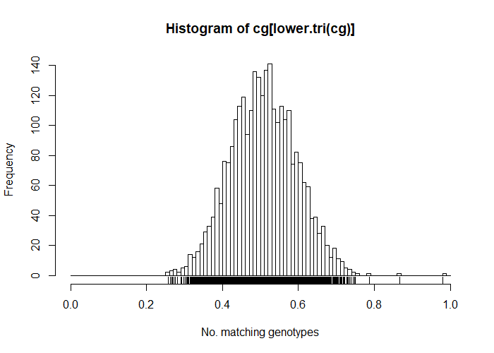
Ill50K Mapeo –compare genotipos identicos
BC(0)F(6) cross
No. individuals: 76
No. phenotypes: 2
Percent phenotyped: 100 100
No. chromosomes: 7
Autosomes: 1 2 3 4 5 6 7
Total markers: 1681
No. markers: 159 273 195 114 312 243 385
Percent genotyped: 96.6
Genotypes (%): AA:51.4 AB:0.0 BB:48.6
names.marker
"JHI_Hv50k_2016_47338"
"JHI_Hv50k_2016_67550"
"JHI_Hv50k_2016_473319"
indiv$pheno$id
"IND3" "IND12" "IND25" "IND33" "IND36" "IND38" "IND45" "IND52" "IND72” "IND76" "IND87"

Slide 4

Ill50K Mapeo –compare genotipos identicos
This is an object of class "cross".
It is too complex to print, so we provide just this summary.
BC(0)F(6) cross
No. individuals: 74
No. phenotypes: 2
Percent phenotyped: 100 100
No. chromosomes: 7
Autosomes: 1 2 3 4 5 6 7
Total markers: 1681
No. markers: 159 273 195 114 312 243 385
Percent genotyped: 96.5
Genotypes (%): AA:51.7 AB:0.0 BB:48.3

Slide 5
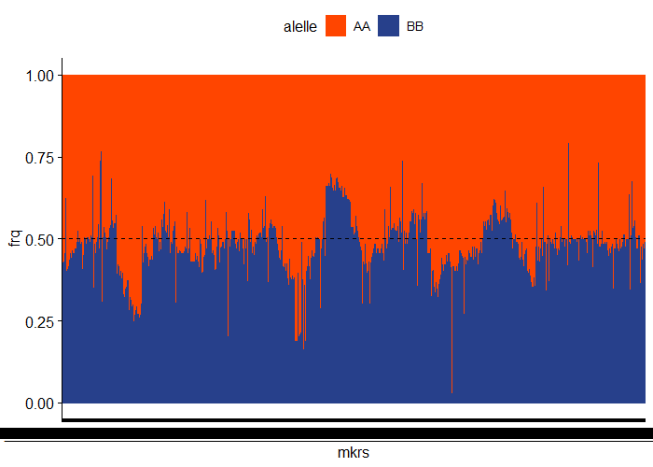
Ill50K Mapeo –Look for markers with distorted segregation patterns
gt[gt$P.value < 0.05/totmar(Ill50K_Mapeo.qtl.c),]
chr missing AA AB BB not.BB not.AA P.value
JHI_Hv50k_2016_48499 1 2 18 0 54 0 0 2.890162e-05
JHI_Hv50k_2016_48693 1 0 17 0 57 0 0 4.316373e-06
JHI_Hv50k_2016_48870 1 3 17 0 54 0 0 1.515771e-05
JHI_Hv50k_2016_49647 1 0 17 0 57 0 0 4.316373e-06
JHI_Hv50k_2016_72497 2 2 54 0 18 0 0 2.890162e-05
JHI_Hv50k_2016_102850 2 25 5 0 44 0 0 4.999269e-08
JHI_Hv50k_2016_160284 3 7 54 0 13 0 0 8.068795e-07
JHI_Hv50k_2016_231810 4 1 59 0 14 0 0 1.865256e-07
JHI_Hv50k_2016_232359 4 0 59 0 15 0 0 4.143313e-07
JHI_Hv50k_2016_232383 4 0 60 0 14 0 0 1.180628e-07
JHI_Hv50k_2016_232393 4 3 57 0 14 0 0 4.626364e-07
JHI_Hv50k_2016_232426 4 1 58 0 15 0 0 6.473806e-07
JHI_Hv50k_2016_232481 4 1 59 0 14 0 0 1.865256e-07
JHI_Hv50k_2016_232482 4 1 59 0 14 0 0 1.865256e-07
JHI_Hv50k_2016_232484 4 1 59 0 14 0 0 1.865256e-07
JHI_Hv50k_2016_232489 4 9 59 0 6 0 0 7.209029e-11
JHI_Hv50k_2016_236614 4 1 58 0 15 0 0 6.473806e-07
JHI_Hv50k_2016_236621 4 7 52 0 15 0 0 8.925261e-06
JHI_Hv50k_2016_236668 4 7 56 0 11 0 0 5.700839e-08
JHI_Hv50k_2016_236727 4 3 56 0 15 0 0 1.569017e-06
JHI_Hv50k_2016_236966 4 0 58 0 16 0 0 1.375149e-06
JHI_Hv50k_2016_238721 4 0 58 0 16 0 0 1.375149e-06
JHI_Hv50k_2016_244599 4 19 46 0 9 0 0 1.084906e-06
JHI_Hv50k_2016_246353 4 1 59 0 14 0 0 1.865256e-07
JHI_Hv50k_2016_246473 4 0 60 0 14 0 0 1.180628e-07
JHI_Hv50k_2016_261020 4 0 60 0 14 0 0 1.180628e-07
JHI_Hv50k_2016_302099 5 14 11 0 49 0 0 1.531524e-06
JHI_Hv50k_2016_374581 6 2 72 0 0 0 0 2.273603e-17
JHI_Hv50k_2016_379986 6 8 64 0 2 0 0 3.037604e-14
JHI_Hv50k_2016_478948 7 6 14 0 54 0 0 1.776285e-06
JHI_Hv50k_2016_498774 7 1 73 0 0 0 0 1.335236e-17
>

Slide 6
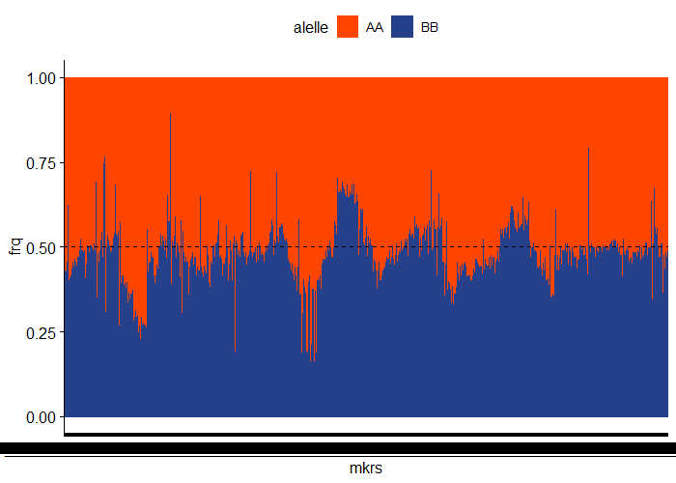
Ill50K Mapeo –Look for markers with distorted segregation patterns
todrop
"JHI_Hv50k_2016_232489" "JHI_Hv50k_2016_374581" "JHI_Hv50k_2016_379986"
"JHI_Hv50k_2016_498774

Slide 7
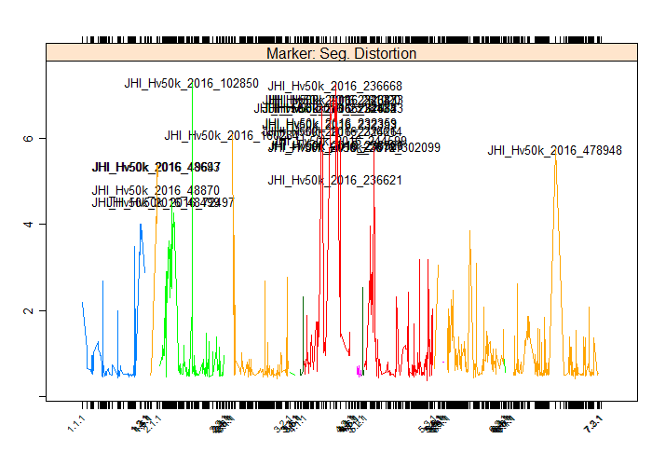
Ill50K Mapeo –Look for markers with distorted segregation patterns
#Profile the -log10 p-value. results from a test of segregation distortion for each marker.

Slide 8
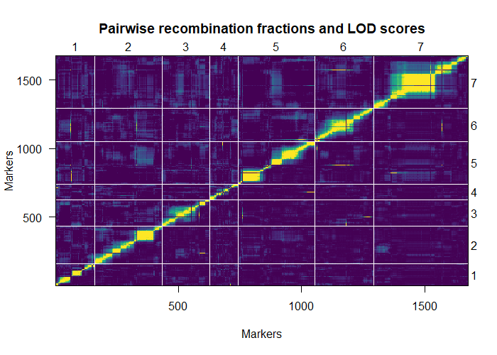
Ill50K Mapeo –Look for markers with distorted segregation patterns

Slide 9
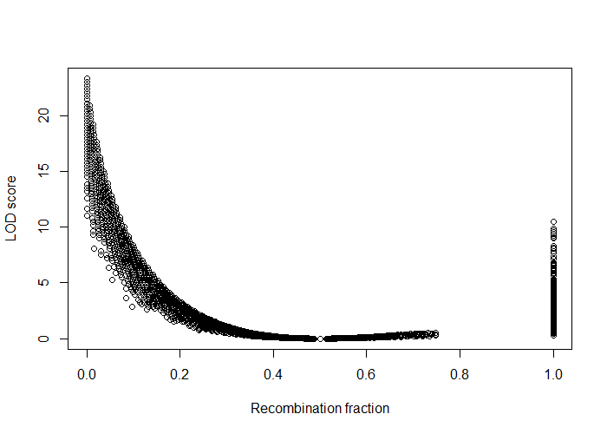
Ill50K Mapeo –Look for markers with distorted segregation patterns

Slide 10

Ill50K Mapeo –Look for markers with distorted segregation patterns

Slide 11
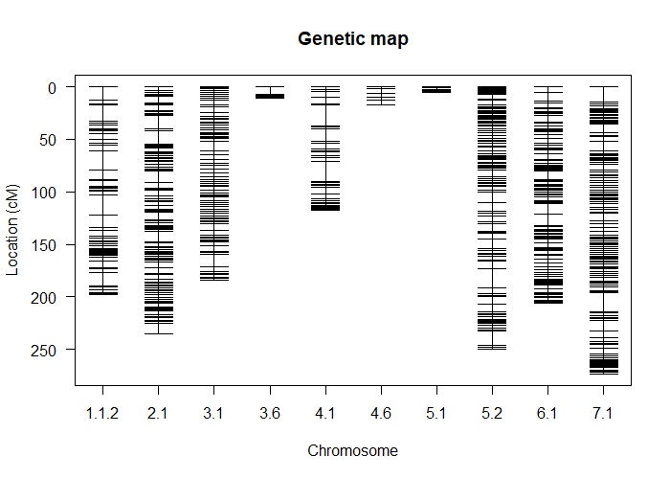
Ill50K Mapeo –Look for markers with distorted segregation patterns
summary(Ill50K_Mapeo.qtl.g)
BC(0)F(6) cross
No. individuals: 74
Total markers: 727
Percent genotyped: 98.4
Genotypes (%): AA:51.8 AB:0.0 BB:48.2

