Slide 1
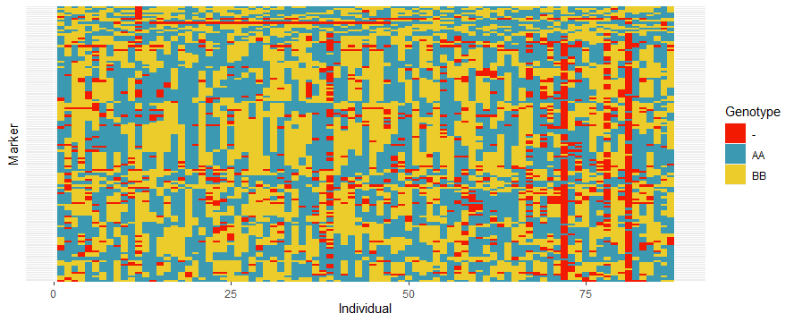
--Read the following data:
Type of cross: riself
Number of individuals: 87
Number of markers: 142
Chromosome information: no
Position information: no
Number of traits: 0

Slide 2
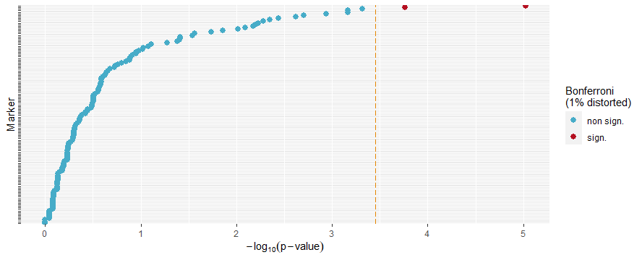
Segregation tests
Now, it should be interesting to see if markers are segregating following what is expected by Mendel’s law.
The graphic is self-explanatory: p-values were transformed by using -log10(p-values) for better visualization. A vertical line shows the threshold for tests if Bonferroni’s correction is applied
"M12_30871" ; "MBmAg0606"

Slide 3
Estimating two-point recombination fractions
This is necessary to allow us to test which markers are linked.
There are two optional arguments in function rf_2pts: LOD and max.rf which indicate the minimum LOD Score and the maximum recombination fraction to declare linkage (they default to 3.0 and 0.5, respectively).
The default for the recombination fraction is easy to understand, because if max.rf < 0.5 we could state that markers are linked.
The LOD Score is the statistic used to evaluate the significance of the test for max.rf = 0.50.
This needs to take into consideration the number of tests performed, which of course depends on the number of markers. Function suggest_lod can help users to find an initial value to use for their linkage test. For this example
(LOD_sug <- suggest_lod (onemap_pia_riself))
4.526316

Slide 4
Estimating two-point recombination fractions
This is necessary to allow us to test which markers are linked.
There are two optional arguments in function rf_2pts: LOD and max.rf which indicate the minimum LOD Score and the maximum recombination fraction to declare linkage (they default to 3.0 and 0.5, respectively).
The default for the recombination fraction is easy to understand, because if max.rf < 0.5 we could state that markers are linked.
The LOD Score is the statistic used to evaluate the significance of the test for max.rf = 0.50.
This needs to take into consideration the number of tests performed, which of course depends on the number of markers. Function suggest_lod can help users to find an initial value to use for their linkage test. For this example
(LOD_sug <- suggest_lod (onemap_pia_riself))
4.526316

Slide 5
It was generated from the object "mark_all_ri.LOD3"
Criteria used to assign markers to groups:
LOD = 3 ,
Maximum recombination fraction = 0.5
No. markers: 142
No. groups: 12
No. linked markers: 132
No. unlinked markers: 10
This is an object of class 'group'
It was generated from the object "mark_no_dist_ri.LOD3"
Criteria used to assign markers to groups:
LOD = 3 ,
Maximum recombination fraction = 0.5
No. markers: 140
No. groups: 12
No. linked markers: 131
No. unlinked markers: 9
LGs_ri.Pia.LOD4.5.no.dist
This is an object of class 'group'
It was generated from the object "mark_no_dist_ri.LOD4.5"
Criteria used to assign markers to groups:
LOD = 4.526316 ,
Maximum recombination fraction = 0.5
No. markers: 140
No. groups: 18
No. linked markers: 123
No. unlinked markers: 17
This is an object of class 'group'
It was generated from the object "mark_all_ri.LOD4.5"
Criteria used to assign markers to groups:
LOD = 4.526316 ,
Maximum recombination fraction = 0.5
No. markers: 142
No. groups: 18
No. linked markers: 124
No. unlinked markers: 18

Slide 6
Ordering markers within linkage groups
After assignin markers to linkage groups, the next step is to order the markers within each group.
First, let us choose the mapping function used to display the genetic map.
We can choose between Kosambi or Haldane mapping functions.

