Slide 1

API Security Common Vulnerabilities
Giulio Astori​

Slide 2
Agenda Common Security Vulnerabilities
Purpose of the presentation: To provide an understanding of APIs common security vulnerabilities
Topics to be covered:
Brief explanation of APIs and their importance in modern web development.
Detailed Explanation of Each Vulnerability
Conclusion

Slide 3
Introduction
API is an essential part of modern web development
Increase in API usage leads to an increase in security threats
Understanding and preventing common API vulnerabilities is crucial to secure data transmission
Ten most common API vulnerabilities:
Broken authentication & authorization
Injection attacks
Broken access control
Insufficient logging & monitoring
Cross-Site Request Forgery (CSRF)
Lack of rate-limiting or throttling
Cross-Site Scripting (XSS)
Server-Side Request Forgery (SSRF)
Insecure Direct Object References

Slide 4
Broken authentication & authorization
Definition Security vulnerabilities that occur during the authentication and authorization process of an API. These vulnerabilities can allow unauthorized access to the API, potentially exposing sensitive data or allowing unauthorized actions to be performed.
Mitigation
Strong authentication mechanisms, such as multi-factor authentication and password hashing with salts
Proper access controls, such as Role-Based Access Control
Regular review and audit of access logs to detect unauthorized access
Importance To prevent unauthorized access and data exposure.

Slide 5
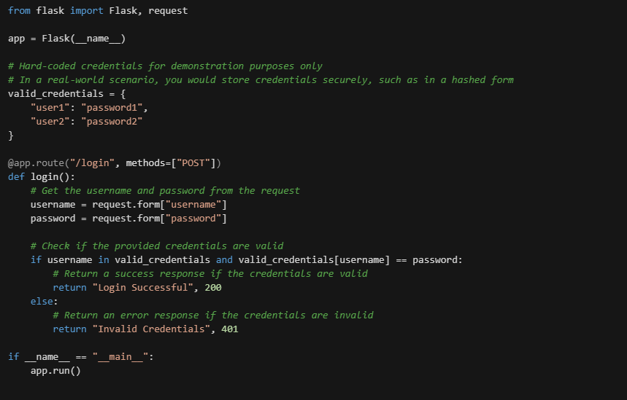
Here's a code example to demonstrate broken authentication in Python using Flask:

Slide 6
Injection Attacks
Definition Injection attacks refer to a class of security vulnerabilities that occur when an attacker can inject malicious code into a system. In the context of APIs, injection attacks can occur when user-supplied data is not properly validated or sanitized before being processed by the API.
Types of injection attacks: SQL, Script, Command.
Mitigation To prevent injection attacks, it's important to validate and sanitize all user-supplied data before processing it in the API. This includes using appropriate input validation techniques, such as using a whitelist of allowed characters, or using prepared statements or parameterized queries to separate user-supplied data from the SQL code being executed.
Importance Injection attacks are a serious security threat, as they can lead to data theft, data corruption, or unauthorized actions. It's crucial to prevent injection attacks by properly validating and sanitizing user-supplied data to ensure the security and integrity of the data being transmitted through the API.

Slide 7
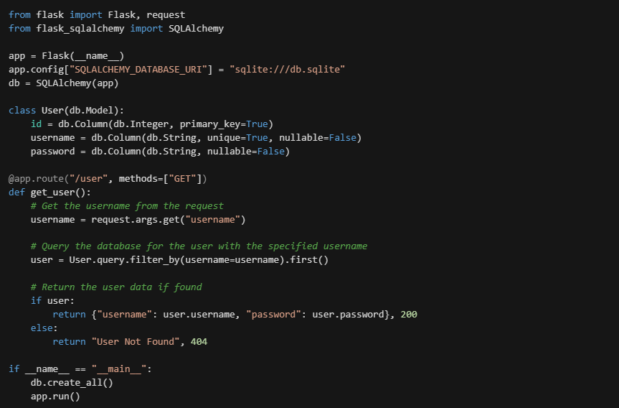
Here's a code example to demonstrate SQL injection in Python using Flask and SQLAlchemy:

Slide 8
Broken access control
Definition Broken access control is a security vulnerability in APIs that occurs when proper controls over access to data and resources are not in place. This can result in excessive data exposure and compromised security.
Mitigation To prevent broken access control, it is important to implement proper access control mechanisms, such as role-based access controls, and regularly review and audit access logs to detect any unauthorized access.
Importance Broken access control is a critical vulnerability in APIs as it can lead to sensitive data exposure and compromise security. Implementing proper access controls and regularly monitoring access logs is essential to prevent unauthorized access and protect sensitive data.

Slide 9
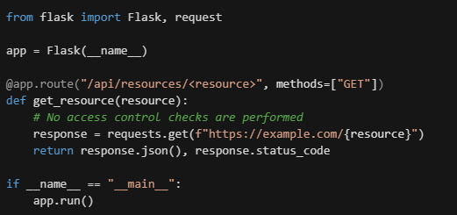
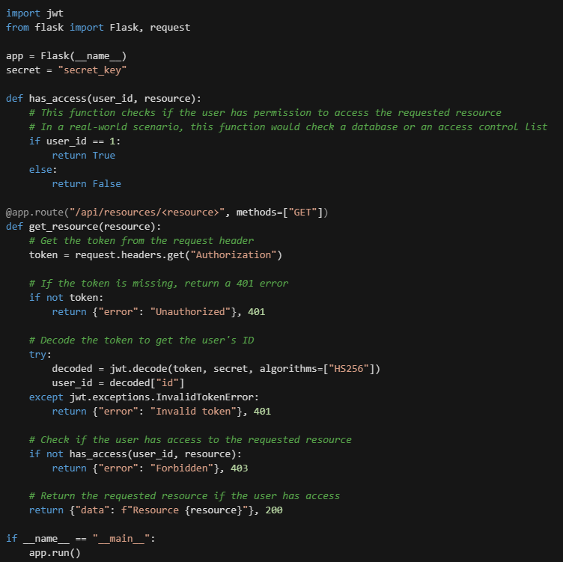
Here's an example code snippet in Python that demonstrates the vulnerability:
Here's a code snippet in Python that demonstrates how to implement a simple access control mechanism in an API:

Slide 10
Insufficient Logging & Monitoring
Definition Insufficient logging and monitoring is a vulnerability in APIs where events during API operation are not recorded (logging) and API's performance and behavior is not observed over time (monitoring).
Mitigation Implement logging of access to sensitive resources to detect unauthorized access and monitor incoming traffic for suspicious behavior to detect potential attacks like DDoS or brute-force.
Importance Helps detect and prevent security incidents, such as unauthorized access and DDoS attacks. Facilitates the diagnosis and resolution of security issues. Enhances overall API security and protects sensitive data.

Slide 11
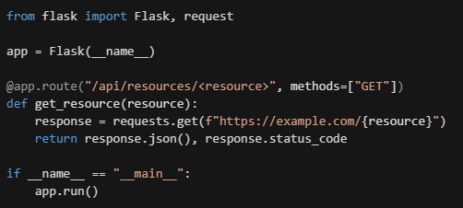
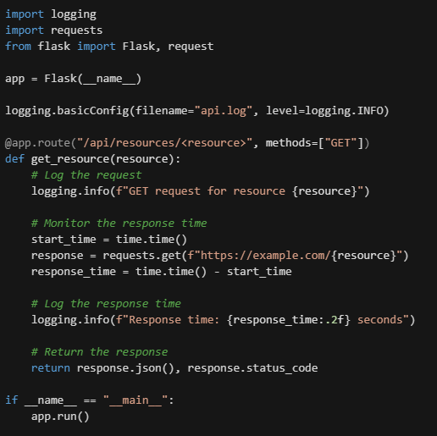
Here's an example code snippet in Python that demonstrates the vulnerability:
Here's a code snippet in Python that demonstrates how logging and monitoring could be implemented in an API:

Slide 12
Cross-Site Request Forgery (CSRF)
Definition Cross-Site Request Forgery (CSRF) is a security vulnerability that affects web-based applications and APIs. Occurs when an attacker tricks a user into making a malicious request to a website or API, without the user's knowledge or consent
Mitigation Implement anti-CSRF measures such as checking for a unique token in each API request (known as a CSRF token). Generate the token on the server and include it in the HTML form sent to the client. Require the client to include the token in all subsequent API requests to verify the authenticity of the request
Importance CSRF attacks can allow an attacker to manipulate API requests to appear as if they are from an authenticated user. Without proper protection, an attacker could potentially craft a malicious request to steal sensitive information or manipulate sensitive data. Implementing anti-CSRF measures can help prevent unauthorized access and maintain the security of API data and functionality.

Slide 13
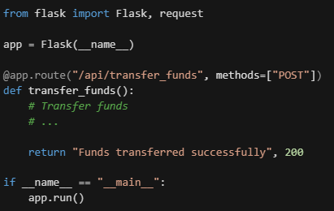
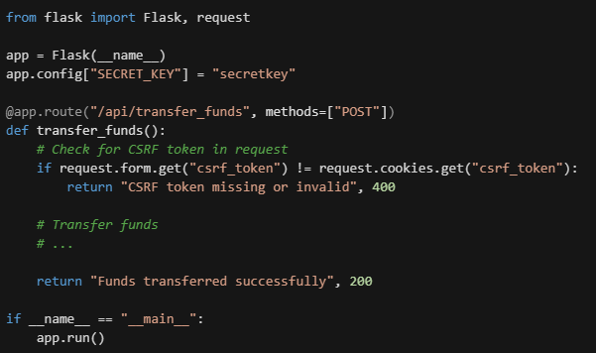
Here's a code snippet in Python that demonstrates a simple example of a Cross-Site Request Forgery (CSRF) vulnerability:
Here's a code snippet in Python that demonstrates the implementation of CSRF protection in an API:

Slide 14
Lack of rate-limiting or throttling
Definition Rate-limiting or throttling is a security measure that restricts the rate of API requests processed, to prevent API abuse or overload.
Mitigation Rate-limiting can be implemented by setting limits on the number of requests made from a single IP address or client within a certain time period. Alternatively, algorithms such as token-bucket or leaky bucket can be used.
Importance Implementing rate-limiting protects against Denial of Service (DoS) attacks and exploitation of API vulnerabilities. It also helps conserve system resources and improve performance by preventing excessive traffic, leading to a better user experience with quick response times and fewer timeouts.

Slide 15
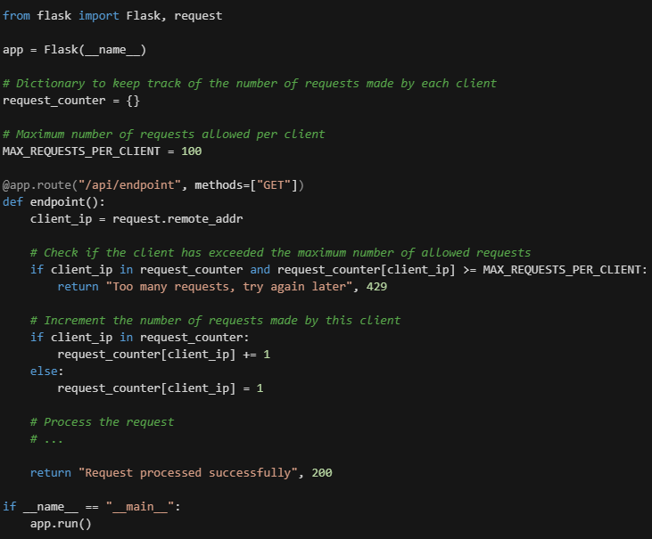
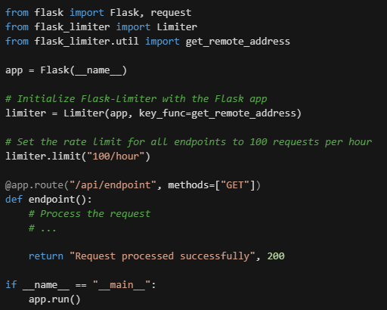
Here's a code snippet in Python that demonstrates how you could implement a simple rate-limiting mechanism using a dictionary to keep track of the number of requests made by each client:
Here's a code snippet in Python that demonstrates how you could implement a more sophisticated rate-limiting mechanism using a rate-limiting library such as Flask-Limiter:

Slide 16
Cross-Site Scripting (XSS)
Definition Cross-Site Scripting (XSS) is a security vulnerability that allows an attacker to inject malicious code into a web page viewed by other users.
Mitigation To mitigate the risk of XSS attacks, validate and sanitize all user-supplied input before displaying it on a web page. Special characters should be escaped or removed to prevent them from being interpreted as HTML tags or entities. Implement a Content Security Policy (CSP) to restrict the types of content that can be loaded into a web page and use the HTTP-only and secure flags on cookies to prevent them from being accessed by malicious scripts.
Importance XSS attacks can steal sensitive information and perform unauthorized actions, such as stealing login credentials or personal information, making unauthorized purchases, or posting spam messages. Protecting against XSS attacks is essential for maintaining the security and integrity of web applications and APIs. Implementing proper mitigation measures can prevent sensitive information from being compromised and help to maintain the trust of users.

Slide 17
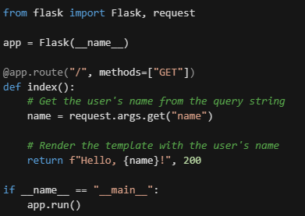
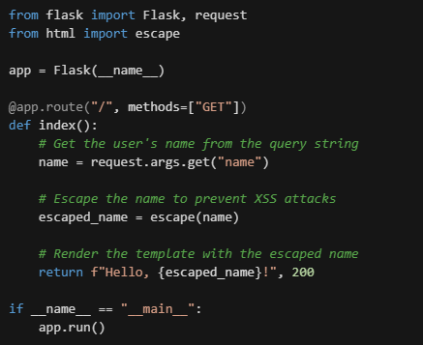
Here's an example of a vulnerable Python Flask application that is susceptible to XSS attacks:
Here's an example of how you could escape user input in a Python Flask application using the built-in escape() function from the html module:

Slide 18
Server-Side Request Forgery (SSRF)
Definition Server-Side Request Forgery (SSRF) occurs when an application makes an unintended request to a server, allowing attackers to execute arbitrary requests on behalf of the vulnerable application. The vulnerability arises when the application relies on user-supplied input to determine the target of an HTTP request.
Mitigation To mitigate the risk of SSRF, validate and sanitize all user-supplied input that is used to make HTTP requests, including implementing proper input validation, such as checking the format of IP addresses or hostnames, and limiting the types of schemes that are allowed in URLs. In addition, you should implement whitelisting and/or blacklist domains and IP addresses that are allowed to be accessed by the application.
Importance SSRF attacks can allow an attacker to access internal resources that are not accessible from the public internet, such as intranet servers, databases, or other sensitive information. This can lead to data exposure, information theft, or even complete system compromise. Additionally, SSRF attacks can be used to carry out other attacks, such as DDoS attacks or port scanning, making them a powerful tool in an attacker's arsenal.

Slide 19
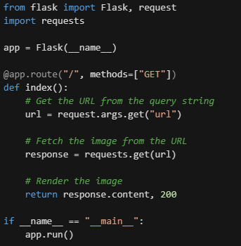
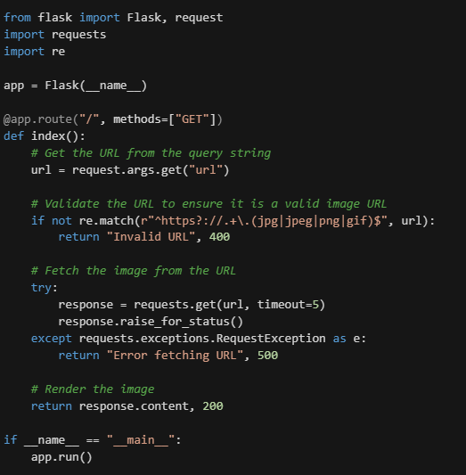
For example, consider a simple Python Flask application that fetches an image from a URL and displays it to the user:
Here is an example of how to mitigate SSRF vulnerabilities in the code sample on the left:

Slide 20
Insecure Direct Object References (IDOR)
Definition A vulnerability that occurs when an application provides direct access to an object, such as a file, database record, or user account, based on user-supplied input, potentially allowing bypass of access controls.
Mitigation Proper validation of user-supplied input to ensure it falls within allowed values, and use of unique identifier that is not easily guessable or enumerable.
Importance Prevents sensitive information exposure and unauthorized actions through direct object references, improving security and confidentiality.

Slide 21
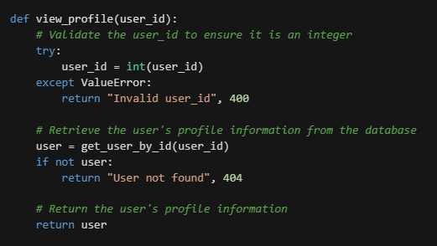
Here is a simple example of a Python function that validates user input to prevent IDOR vulnerabilities:

Slide 22
Insecure Cryptographic Storage
Definition Insecure Cryptographic Storage is a vulnerability where sensitive information like passwords, credit card numbers, or confidential data is not stored in an encrypted format, making it vulnerable to disclosure if an attacker gains access to the database or data storage system.
Mitigation To prevent Insecure Cryptographic Storage, it's crucial to store sensitive information in an encrypted format using a secure encryption algorithm such as AES or RSA. Also, it's a best practice to use a unique random salt for each password to make it difficult for attackers to launch dictionary attacks even if two users have the same password.
Importance The protection of sensitive information is crucial to maintain the confidentiality, integrity, and availability of data. Insecure Cryptographic Storage leaves sensitive information vulnerable to unauthorized access, manipulation, and theft, potentially leading to severe consequences such as identity theft, financial fraud, or reputational damage. Ensuring the secure storage of sensitive information is therefore essential for the overall security of an application and its users.

Slide 23
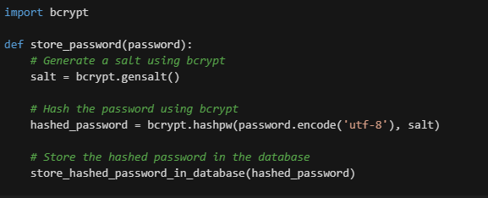
Here is a simple example of a Python function that stores a password securely using the bcrypt library:

Slide 24
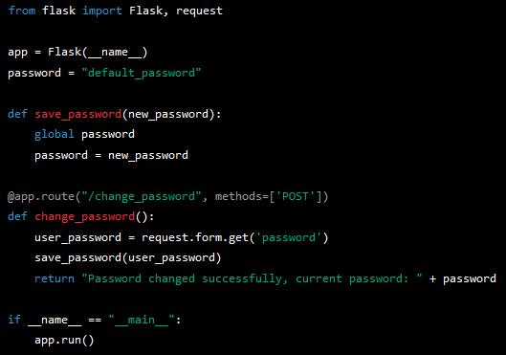
DEMO Cross-Site Request Forgery (CSRF)

Slide 25
Conclusion
API Security is Vital
Common API Vulnerabilities: Broken authentication & authorization, Injection attacks, Broken access control, Insufficient logging & monitoring, Cross-Site Request Forgery, Lack of rate-limiting or throttling, Cross-Site Scripting, Server-Side Request Forgery, Insecure Direct Object References, Insecure Cryptographic Storage, etc.
Proactive Steps to Mitigate Risks: Secure authentication & authorization, Input validation, Encrypted storage of sensitive information, Proper logging & monitoring, Rate-limiting & throttling, etc.
Importance of API Security: Ensures protection of sensitive information, Maintains overall integrity of applications, and Ensures the success & longevity of applications.
Invest in API Security
Stay informed about common API vulnerabilities
Take proactive steps to mitigate risks
Ensure secure and resilient APIs.

Slide 26



Thank you
Giulio Astori
gastori@duck.com
www.linkedin.com/in/giulioastori
https://twitter.com/AstoriGiulio

