Slide 1
The Development of Cologne Digital Lexicons
Dr. Mārcis Gasūns 7th ISCLS, Auroville
16.02.2024

Slide 2
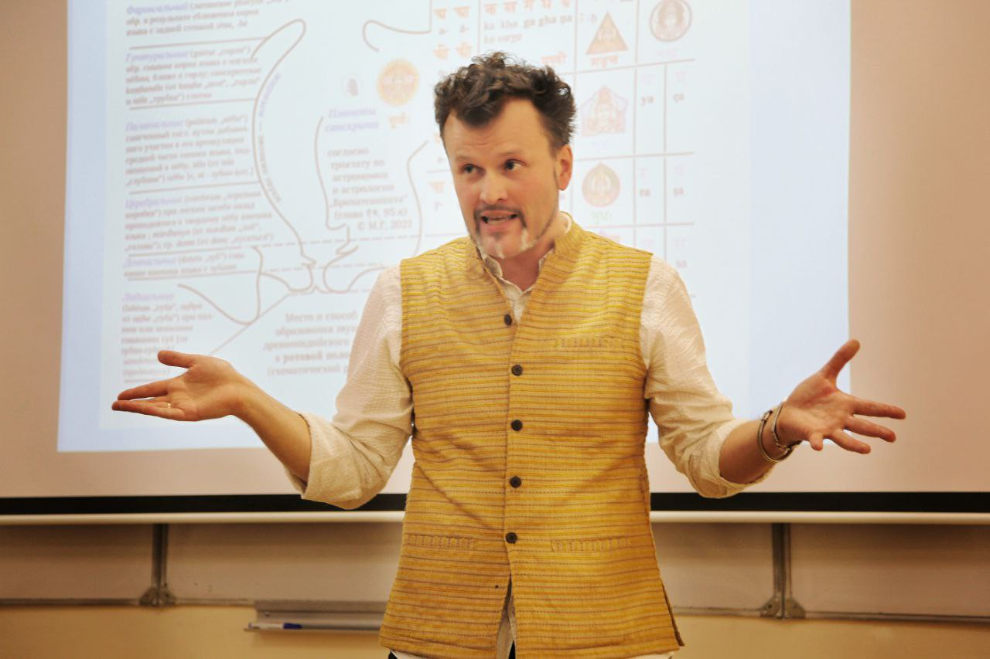
@gasyoun
Who am I?

Slide 3


Origin of Digital Sanskrit Lexicons

Slide 4
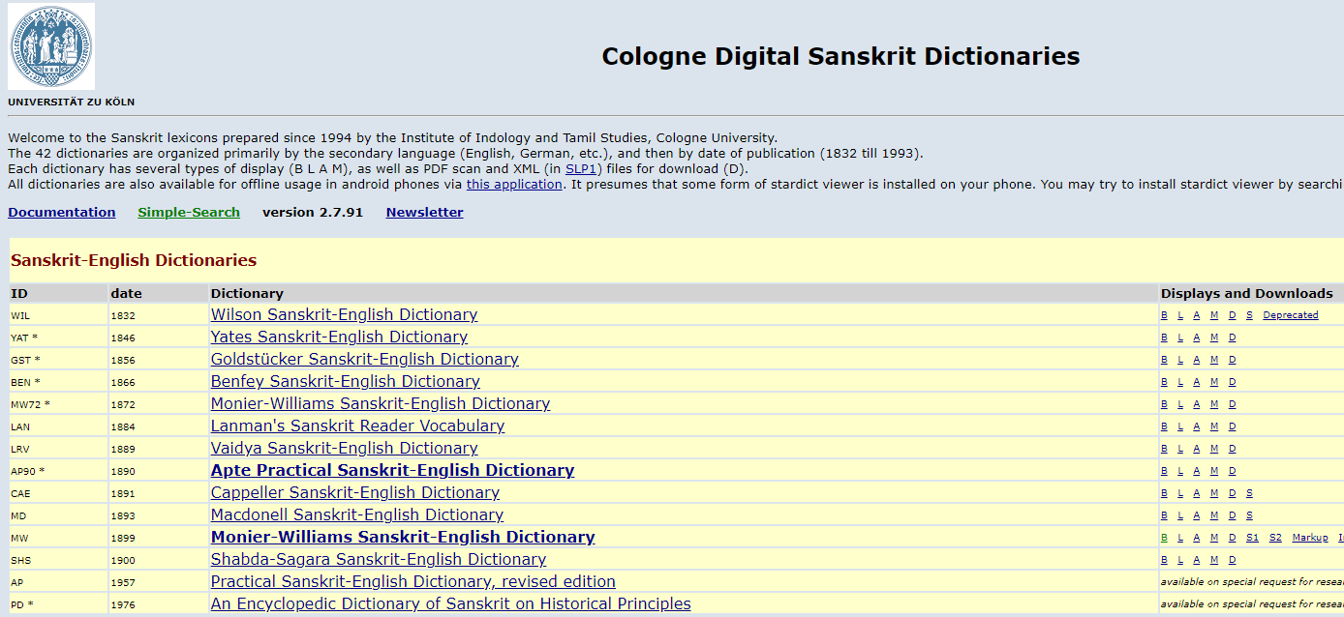
Cologne Dictionaries Homepage sanskrit-lexicon.uni-koeln.de

Slide 5
Brief Cologne Dictionary Timeline
Thomas Malten 1997 mw. PWK, PWG, Schmidt 1998-2006
2. 2004 Scharf, Hyman, Funderburk begin collaboration
with Malten. Other early digitizations : 2005-2008
3. 2008 Begin hosting on Cologne server
4. DFG-NEH Project 2010-2013
Additional dictionaries (see home-page '*')
Sampada Savardekar 2013-2023
5. 2014 Github sanskrit-lexicon organization started by Mārcis Gasūns.
Development of sanskrit-lexicon begins on Github, with major inputs by Dhaval Patel and others.

Slide 6
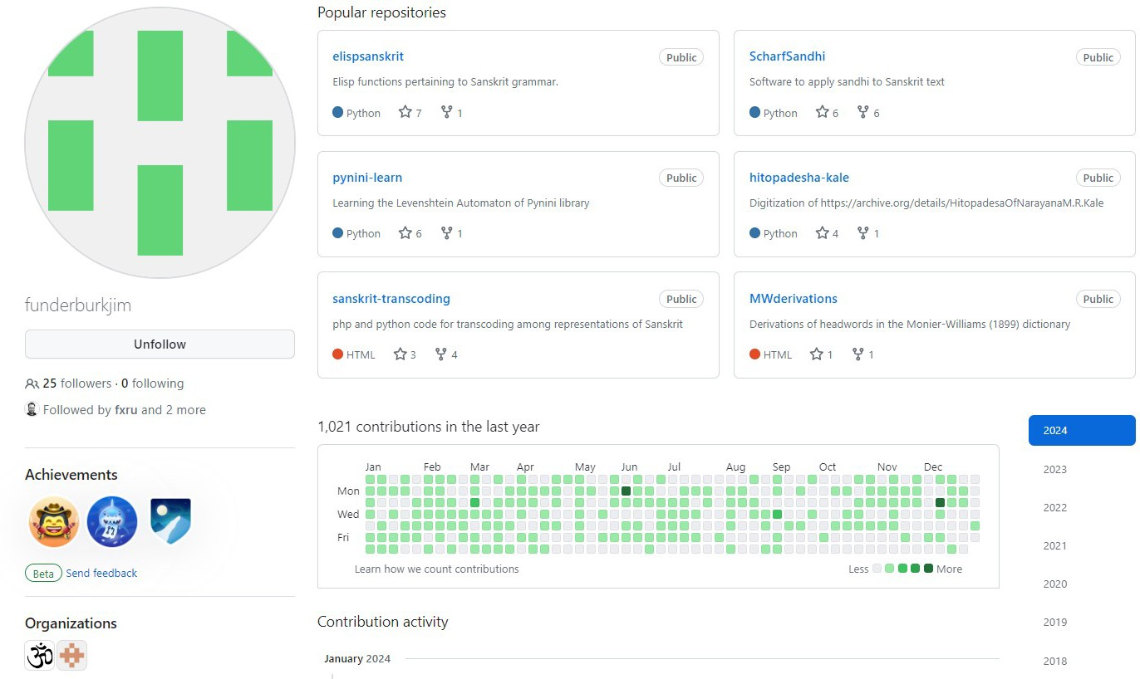
Jim Funderburk @funderburkjim

Slide 7
Funderburk at Cologne 2004-2024
Participated in the initial collaboration between Malten and Scharf/Hyman from about 2004.
Since about 2008 the displays have been hosted at the sanskrit-lexicon.uni-koeln.de web-site, Jim’s primary responsibility for developing and maintaining the site.
In the next couple of years, Jim plans to retire from this responsibility, and Dhaval Patel will assume this role.

Slide 8
Major Indian Contributors to Cologne Sanskrit Dictionaries Dr. Dhaval Patel @drdhaval2785 Nāgabhūṣaṇarāvu Kālepu @Andhrabharati

Slide 9
42 Digital Lexicons 2024 Stats
Sanskrit-English Dictionaries: 14
English-Sanskrit Dictionaries: 3
Sanskrit-French Dictionaries: 2
Sanskrit-German Dictionaries: 5
Sanskrit-Latin Dictionaries: 1
Sanskrit-Sanskrit Dictionaries: 6
Sanskrit-Russian Dictionaries: *5
Specialized Dictionaries: 11
Deprecated Editions & Miscellany

Slide 10
8 Main Priority Digital Lexicons
WIL | 1832 | Wilson Sanskrit-English Dictionary
MW Dictionary | 1899 | Monier-Williams Sanskrit-English
AP | 1957 | Practical Sanskrit-English Dictionary
PWG | 1855 | Böhtlingk and Roth Grosses Petersburger
Wörterbuch
PW 1879
Böhtlingk Sanskrit-Wörterbuch in Kürzerer Fassung
SCH 1928
Schmidt Nachträge zum Sanskrit- Wörterbuch + Nachträge und Verbesserungen
VCP *
SKD *
1873 Vacaspatyam
1886 Sabda-kalpadruma

Slide 11
30 Years After Cologne Started…
Digital copies of dictionaries are still not identical to the original printed books;
We do not know how many entries dictionaries actually contain, as sopasarga and samāsa entries mostly unidentified yet;
Not only we’ve unintentionally added new digital typoes, the original list of corrections available in the printed books are not integrated (done only in GRA and MW).

Slide 12
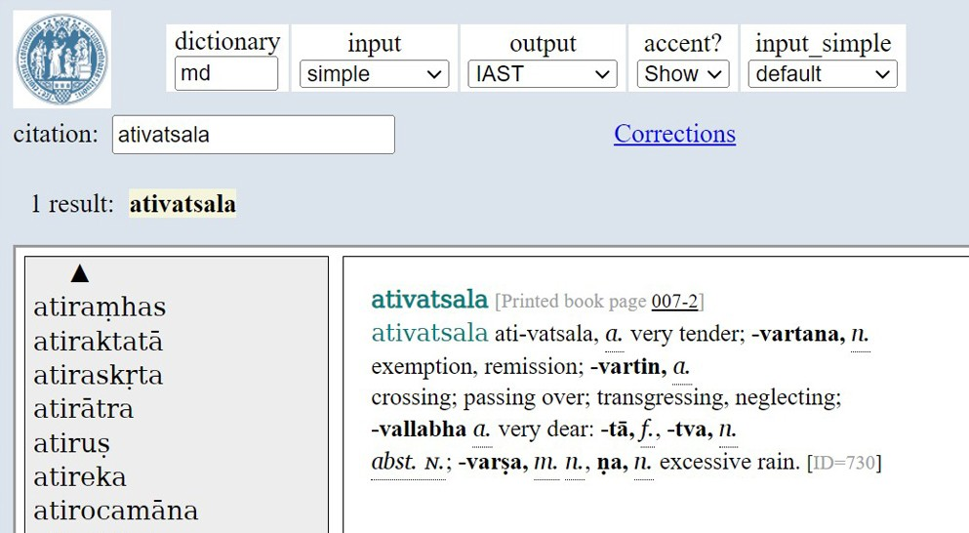
Not All Subheadwords Equal (1/2)

Slide 13
Not All Subheadwords Equal (2/2)
8000 substantives in MD have subheadwords
Previous MW work not of much help, other that the 391300 lemmas at hwnorm1c.txt
“ativatsala” H1
“ativallabha” H2
“ativallabhatva” H3
most obvious is not always true *“ati-tva” (non-alphabetical order of tā and tva as a hint)

Slide 14
5 Sanskrit-Russian Digital Lexicons
К.А. Коссович. Санскрито-русский словарь (1854)
https://samskrtam.ru/sanskrit-lexicon/kossowich/
Д.Н. Кудрявский. Санскрито-русский словарь (1903)
https://samskrtam.ru/sanskrit-lexicon/kudriavskiy/
Ф.И. Кнауэр. Словарь из «Учебника санскритского языка» (1908)
https://samskrtam.ru/sanskrit-lexicon/small/knauer_sm.html
О. Фриш. Санскритская хрестоматия. Т. II. Словарь (1956)
https://samskrtam.ru/sanskrit-lexicon/small/frish_sm.html
В.А. Кочергина. Санскритско-русский словарь (1987)
https://samskrtam.ru/sanskrit-lexicon/small/kochergina_sm.html

Slide 15

How Open is Cologne?

Slide 16
Proprietary vs. Open Source
Apte’s Revised edition 1957 Practical Sanskrit- English Dictionary and the never-to-be finished An Encyclopedic Dictionary of Sanskrit on Historical Principles that started in 1976 are copyright protected from homepage, but still searchable
Manfred Mayrhofer. A Concise Etymological Sanskrit Dictionary, 1953-1980 out of Cologne scope, but with authors’s permission available at Zealots’ website https://samskrtam.ru/sanskrit-lexicon/KEWA/

Slide 17
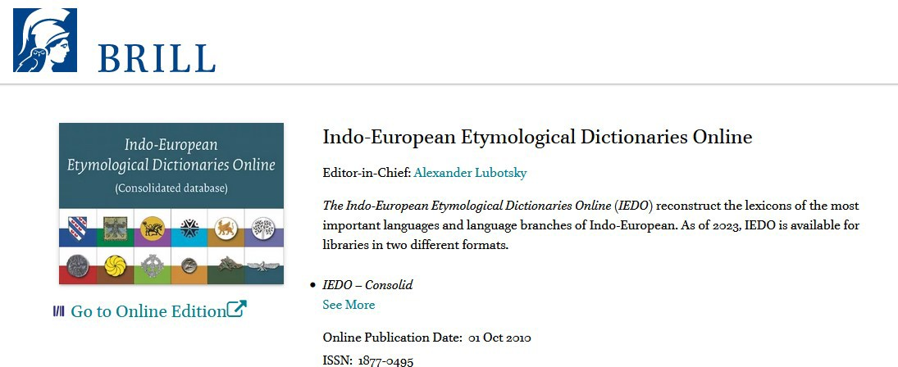
कुपमण्डुकन्याया kūpamaṇḍūkanyāya

Slide 18
Brill vs. Cologne & Zealots 2023
The Indo-European Etymological Dictionaries Online (IEDO) is subscription based and for libraries
Online dictionaries are available
individually for the first time
The R̥gveda: The complete text with
Geldner's and Griffith's translation

Slide 19
Brill vs. Cologne & Zealots 2013
Cologne Digital Sanskrit Dictionaries (CDSD) is free and from home
Online dictionaries are available
individually since the beginning
Geldner's and Griffith's R̥gveda translation since 2013 (10 years ago)

Slide 20
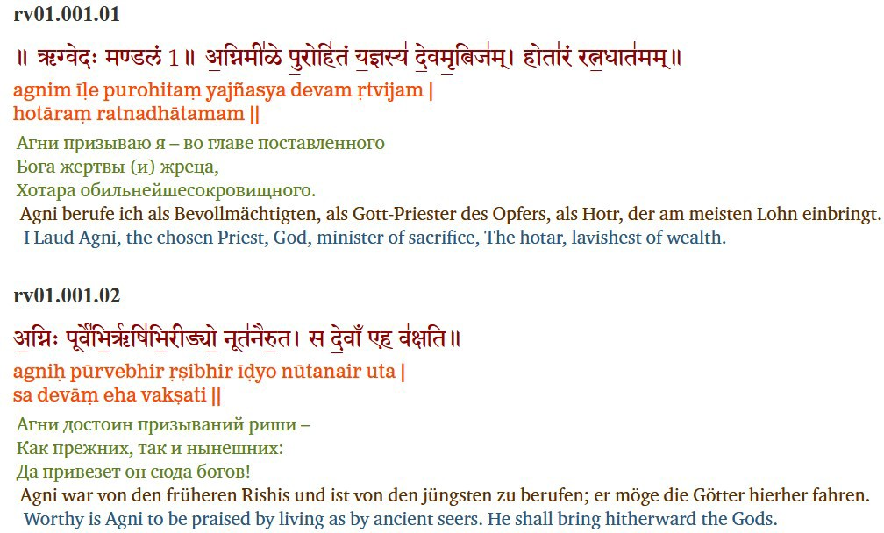
Zealots’ Rigveda Since 2013
https://samskrtam.ru/parallel-corpus
16

Slide 21


Volunteers united with Artificial Intelligence

Slide 22

The Professor and the Madman
18

Slide 23
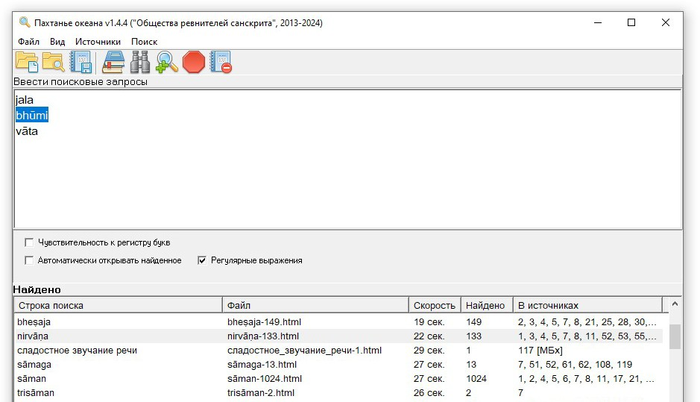
Russia-Born Sanskrit Search Engine
https://samskrtam.ru/parallel-corpus

Slide 24
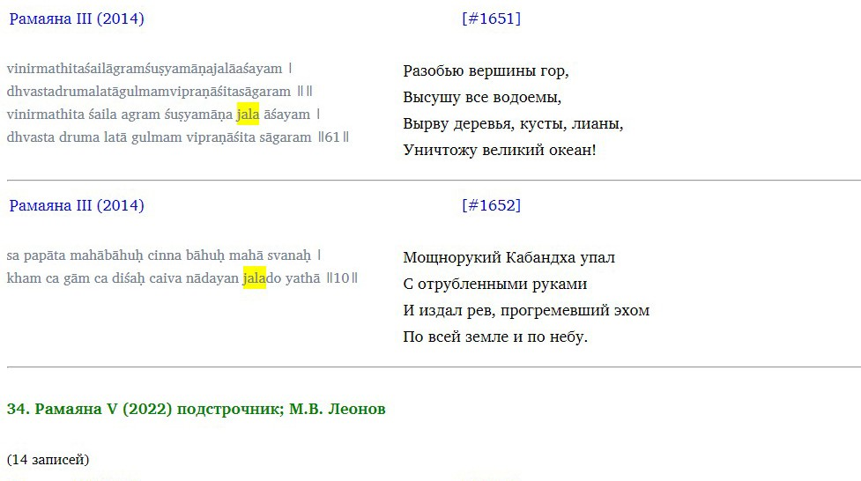
Russia-Born Sanskrit Search Engine
https://samskrtam.ru/parallel-corpus

Slide 25


Data Correction vs. Code & UI

Slide 26
Data Correction Champions
We at Cologne are great at weeding out the dirt. The biggest Sanskrit recycling plant in the Milky Way.
There are no alternatives for continuously corrected Sanskrit dictionary data since 1997
https://sanskrit-lexicon.uni-koeln.de/simple/

Slide 27
NonStop Error Correction
Every other website / offline software, that contains a copy / uses Monier-Williams dictionary data, is taken from Cologne.
Some 30, 20, 10 or 5 years ago. Depending on errors left the date of replication can be calculated
https://sanskrit-lexicon.uni-koeln.de/simple/

Slide 28
Correction of Errors
one-by-one
headwords
entries
Sanksrit
nonSanskrit (English, German, French, Russian, Greek, Latin)
batch mode
https://sanskrit-lexicon.uni-koeln.de/simple/

Slide 29
Older Versions of Monier-Williams
https://sanskrit.inria.fr/MW/1.html 2012
http://buddhism-dict.net/ddb/monier-williams/mw-01.html
https://hu.wiktionary.org/wiki/F%C3%BCggel%C3%A9k:Szanszkrit-English/a
https://www.tuninst.net/SED- MW/download-prem/a.htm 2003
https://sanskrit-lexicon.uni-koeln.de/simple/

Slide 30
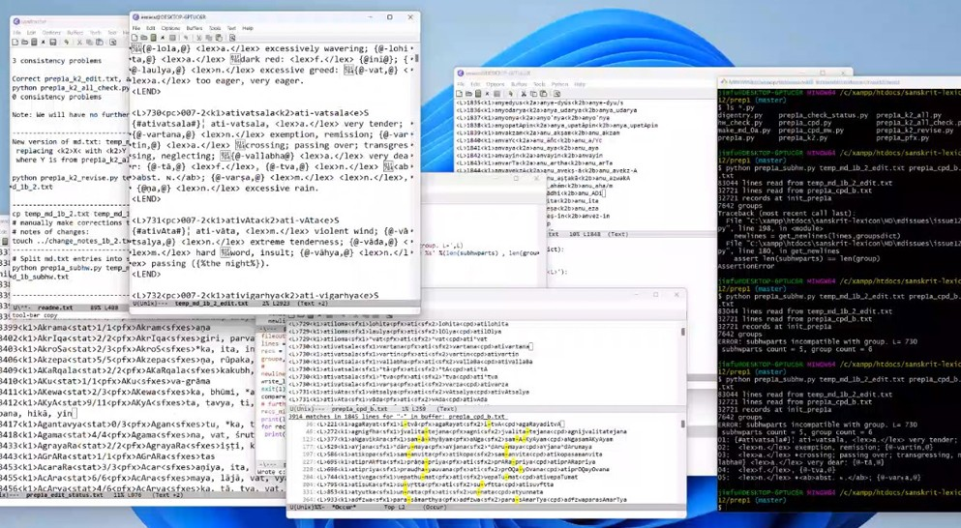
The Original Recipe for Sauces (1/5)
https://sanskrit-lexicon.uni-koeln.de/simple/

Slide 31
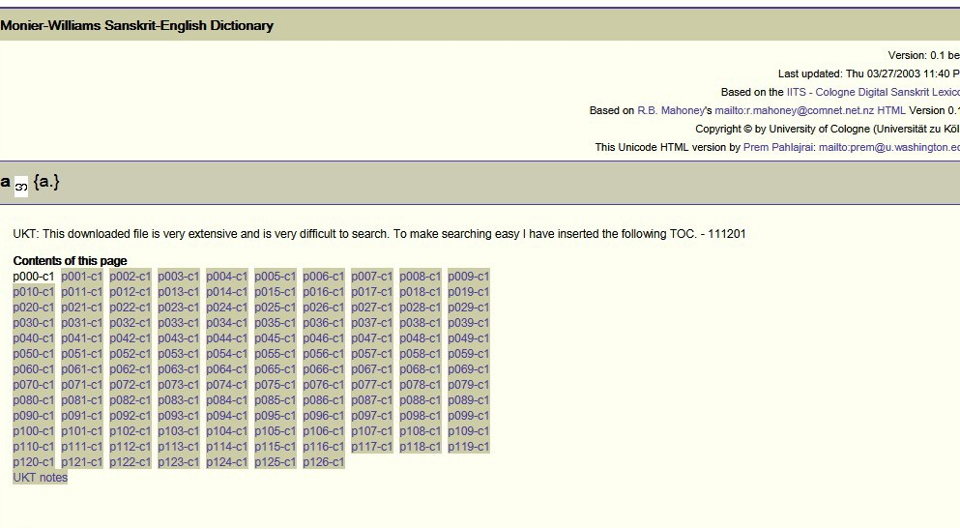
The Original Recipe for Sauces (2/5)
https://www.tuninst.net/SED-MW/download-prem/a.htm

Slide 32
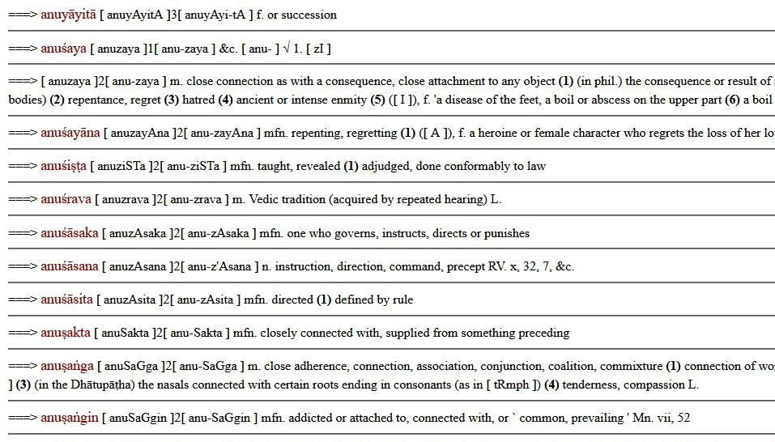
The Original Recipe for Sauces (3/5)
https://buddhism-dict.net/ddb/monier-williams/mw-01.html

Slide 33
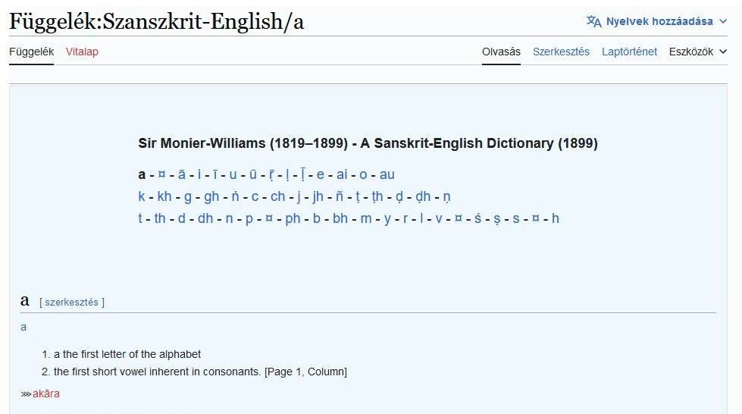
The Original Recipe for Sauces (4/5)
https://hu.wiktionary.org/wiki/F%C3%BCggel%C3%A9k:Szanszkrit-English/a

Slide 34
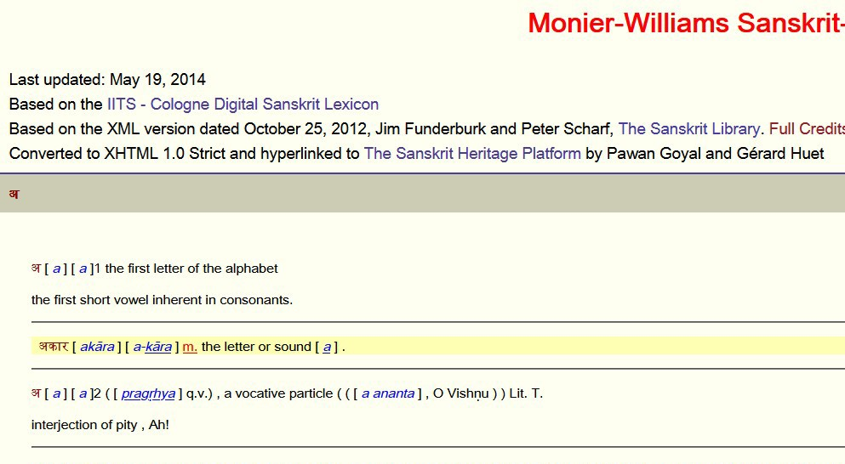
The Original Recipe for Sauces (5/5)
https://sanskrit.inria.fr/MW/1.html

Slide 35



Data Derivation for Learning Aids

Slide 36
Added Value to Derived Data (1/5)
http://sanskrit- linguistics.org/dcs/index.php?contents=lemm a&IDWord=88026
https://vedaweb.uni- koeln.de/rigveda/view/index/0
https://ambuda.org/texts/ramayanam/6.43
https://nws.uzi.uni-halle.de/
https://sanskrit-lexicon.uni-koeln.de/simple/
33

Slide 37
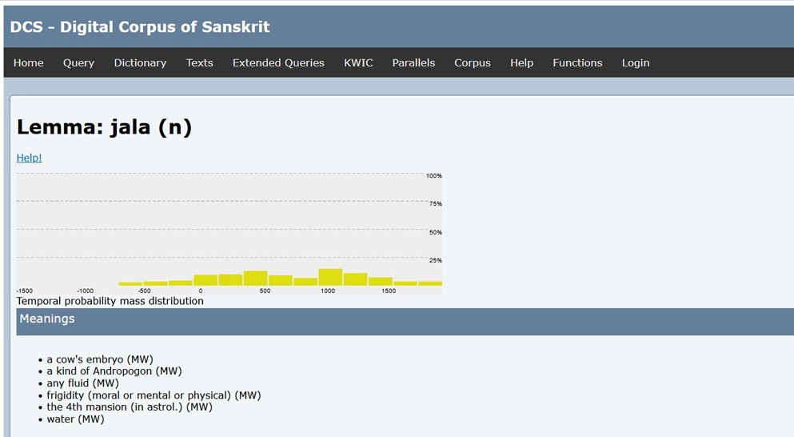
Added Value to Derived Data (2/5)
https://sanskrit-linguistics.org/dcs/index.php?contents=lemma&IDWord=88026
34

Slide 38
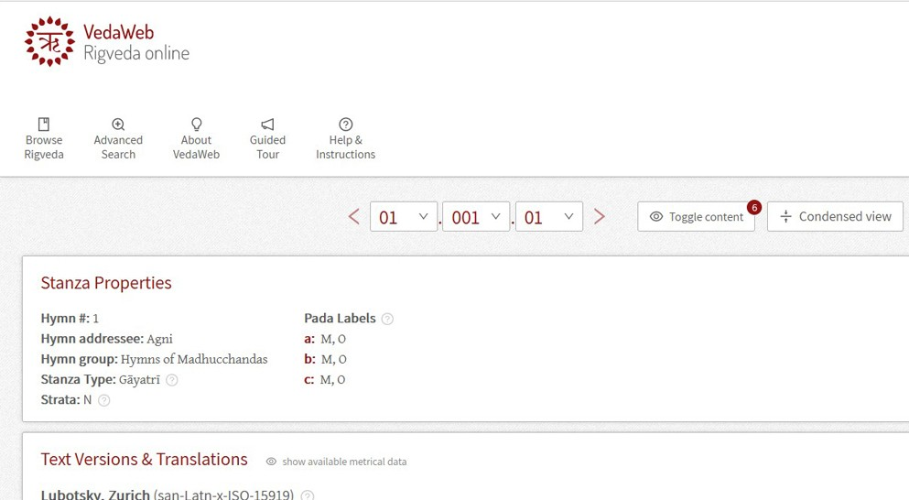
Added Value to Derived Data (3/5)
https://vedaweb.uni-koeln.de/rigveda/view/index/0
35

Slide 39
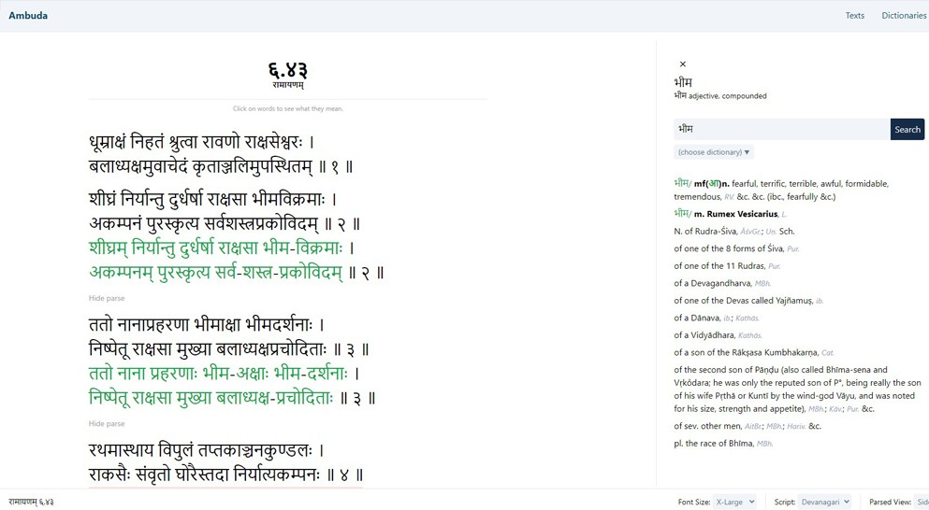
Added Value to Derived Data (4/5)
https://ambuda.org/texts/ramayanam/6.43
36

Slide 40
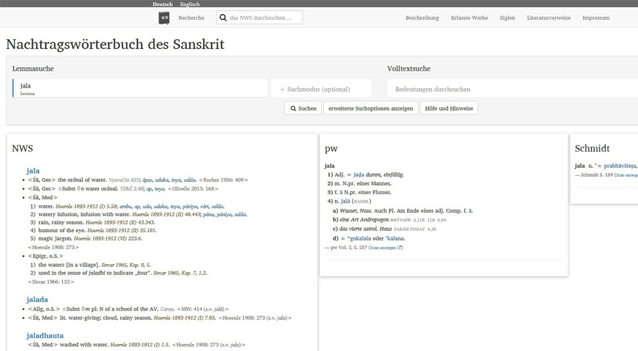
Added Value to Derived Data (5/5)
https://nws.uzi.uni-halle.de/
37

Slide 41


Hiring Volunteers
for Code & Proofreading

Slide 42
Headwords vs. Entries
Data Correction
Normalization of
headwords (2014- 2023)
English errors in dictionary entries
https://github.com/sanskrit-lexicon/COLOGNE/issues/325

Slide 43
Markup Refinement
Markup Refinement
Subheadword to headword in all dictionaries
Verb tagging in all dictionaries
Add missing abbreviations in the dictionaries
https://github.com/sanskrit-lexicon/COLOGNE/issues/325

Slide 44
Code & UI
Code we can handle
highlight searched text
highlight PDF blocks
Every other line of code
hiring volunteers
https://github.com/sanskrit-lexicon/COLOGNE/issues/400

Slide 45
Cologne Code Basic Needs
Critical lacking features
RESTful APIs
JSON as output of APIs
UI based on APIs outputting JSON
Simple search with exact ID
Exportable Simple search algo
https://github.com/sanskrit-lexicon/COLOGNE/issues/400

Slide 46
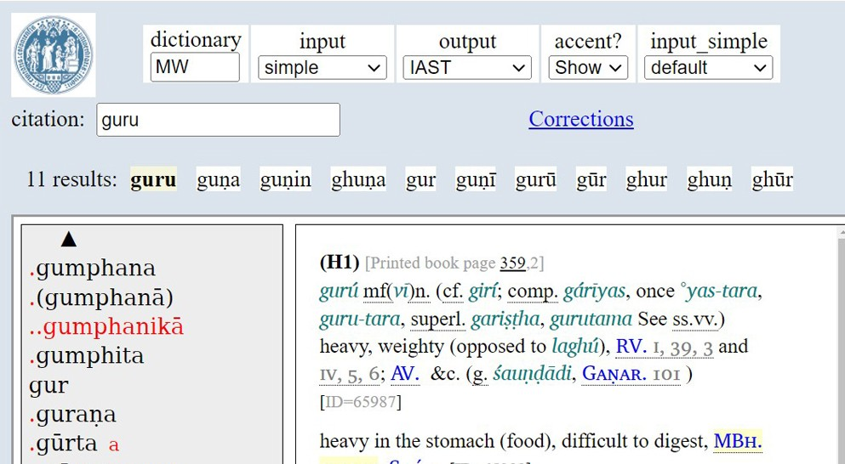
Cologne Dictionaries Simple Search
https://sanskrit-lexicon.uni-koeln.de/simple/
42

Slide 47
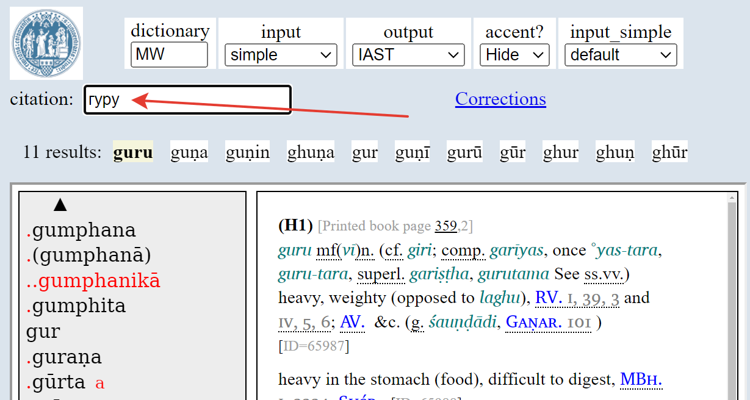
Cologne Dictionaries Simple Search
https://sanskrit-lexicon.uni-koeln.de/simple/
43

Slide 48

Hidden Gems

Slide 49
Unknown Sanskrit Digital Resources
Digitization 2nd ed. of Indische Sprüche, 1870-1873 https://funderburkjim.github.io/boesp- prep/web1/boesp.html?6919
Digitization of Lanman’s Sanskrit Reader, 1884 https://github.com/funderburkjim/lanman
Digitization of Kale’s Hitopadesha of Narayana, 1912 https://github.com/funderburkjim/hitopadesha-kale
https://github.com/funderburkjim/
45

Slide 50
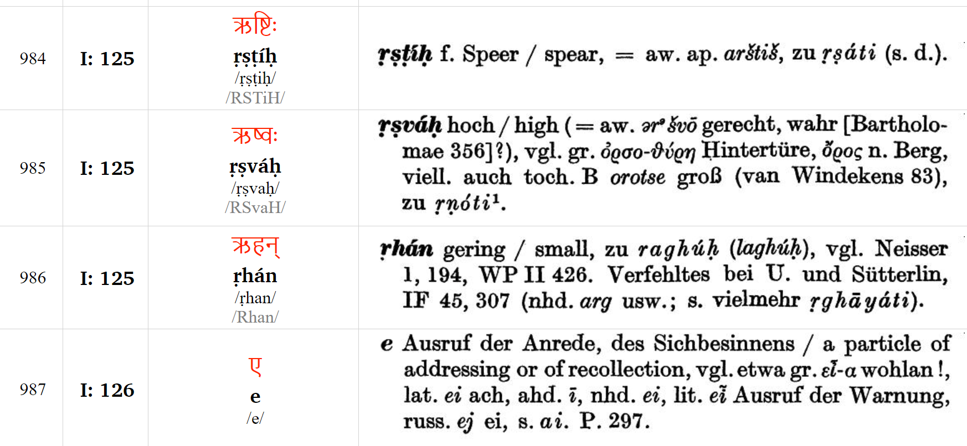
Additional Lexicographical Resources: 9587 entries from Mayrhofer’s KEWA
https:// samskrtam.ru/sanskrit-lexicon/KEWA/
43

Slide 51
What’s Next? 2024-2034
New and refining older markup
abbreviations
literary sources
cross-reference
show corrected print changes
New dictionaries
Sanskrit-Sanskrit Amarakosha still missing
Five Sanskrit-Russian dictionaries started
New website features for easier integration
Detailed history of the dictionary project
https://github.com/sanskrit-lexicon/
46

Slide 52

I give you my thanks!
समा॒ना हृद॑यानि वः
Let a mixed Indian-Russian
Sanskrit team be born now!
Sanskrit Zealots' Society Russian Federation, Obninsk
WhatsApp +79181925084
gasyoun@gmail.com

